Slide 1
Higgs Scan Discussion
A Muon Collider has the unique capability to directly measure the width of a 125 GeV Higgs boson
  Higgs width is 4.2 MeV
  Projected luminosity– 10³² assume 10³¹ (assume 10³¹⁾
  RMS momentum spread ~0.4% - 3.5 MeV beam resolution
Cross sections
  Higgs at 125 GeV ~ 76 pb (delta beam)
  Higgs at 125 folded with beam resolution ~ 46 pb
  μ⁺μ⁻ -> hadrons ~ 100 pb (?)

Slide 2
Branching Ratios
Process Branching rat Uncertainty
H → bb 5.77 x 10-1 +3.2% -3.3%
H → ττ 6.32 x 10-2 +5.7% -5.7%
H → μμ 2.20 x 10-4 +6.0% -5.9%
H → cc 2.91 x 10-2 +12.2% -12.2%
H → gg 8.57 x 10-2 +10.2% -10.0%
H → γγ 2.28 x 10-3 +5.0% -4.9%
H → Zγ 1.54 x 10-3 +9.0% -8.8%
H → WW 2.15 x 10-1 +4.3% -4.2%
H → ZZ 2.64 x 10-2 +4.3% -4.2%
ΓH [GeV] 4.07 x 10-3 +4.0% -3.9%
Process Branching ratio Process Branching ratio Uncertainty
H → 4l (l=e,μ,τ) 2.76 x 10-4 ±4.3% H → 2l2q (l=e,μ,τ, q=udcsb) 3.70 x 10-3 ±4.3%
H → 4l (l=e,μ) 1.25 x 10-4 ±4.3% H → 2l2q (l=e,μ, q=udcsb) 2.47 x 10-3 ±4.3%
H → eeee 3.27 x 10-5 ±4.3% H → lνqq (l=e,μ, q=udcsb) 3.14 x 10-2 ±4.3%
H → eeμμ 5.93 x 10-5 ±4.3% H → ννqq (ν=any, q=udcsb) 7.38 x 10-3 ±4.3%
H → 2l2ν 2.34 x 10-2 ±4.3% H → 4q (q=udcsb) 1.10 x 10-1 ±4.3%
H → 2l2ν 1.06 x 10-2 ±4.3% H → 4f (f=any fefrmion) 2.40 x 10-1 ±4.3%
H → eνeν 2.52 x 10-3 ±4.3%
H → eνμν 2.52 x 10-3 ±4.3%

Slide 3
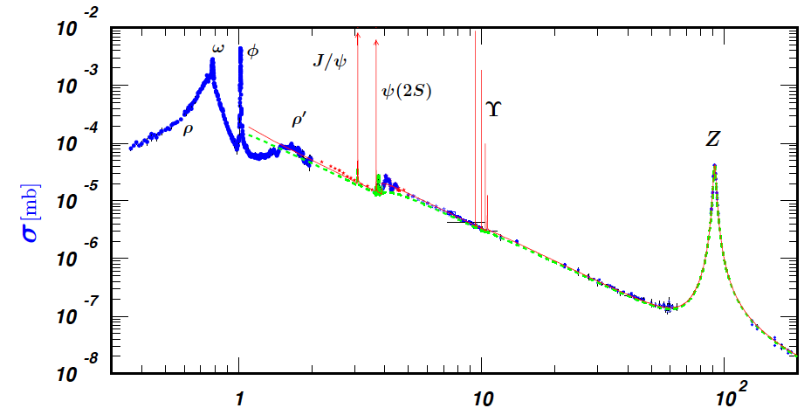
PDG Compilation

Slide 4
Energy Scan
Convolute Higgs
B-W with beam
gaussian

Slide 5
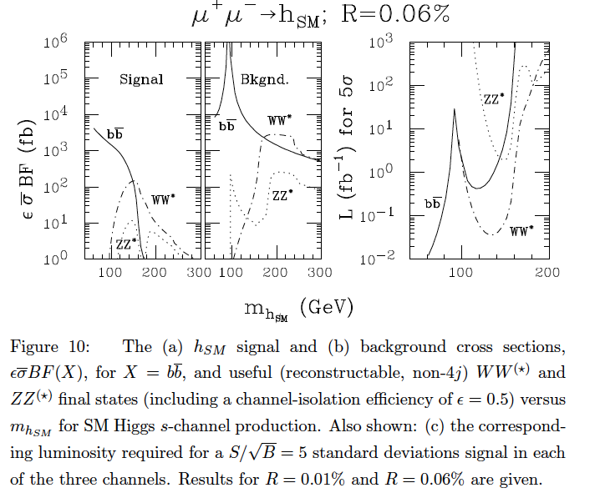
Backgrounds
(Barger Berger Gunion
Han)

Slide 6
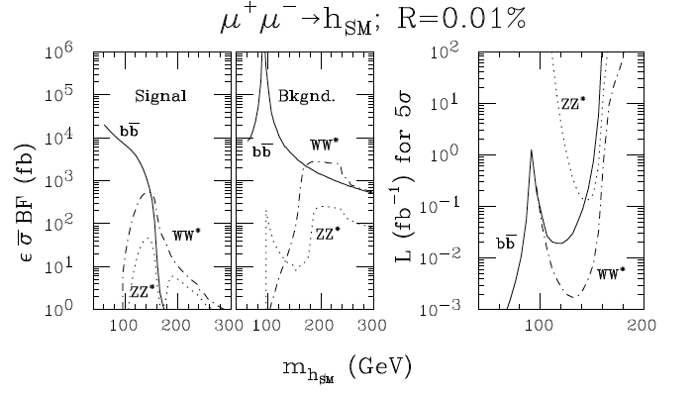

Slide 7
Signal Isolation
B,B, G and H assume:
  WW*-> lν2jet only at 50% efficiency
  No 4jet final state included
    Can we do this with good jet w-mass resolution?
  bb channel at 50% efficiency
    S/B is much worse than WW*
This should be redone with detector simulation, realistic efficiencies and background rejections.

Slide 8
Strategies
H->bbar
  Pure bbar s/b ~ 1.67 (gZ*->bb br~14% ) – different than BBGH
Assume:
  Geom. Eff ~ .8
  Purity ~ 95% (as for LCFI at Z0)
  Also look at purity ~ 70%
H->WW*
  BR ~ .215
  BR W-> lepton nu ~ .325
  BR W->hadrons ~.67
Assume
  Jet-jet mode can be used
  Eff ~ 0.8

Slide 9
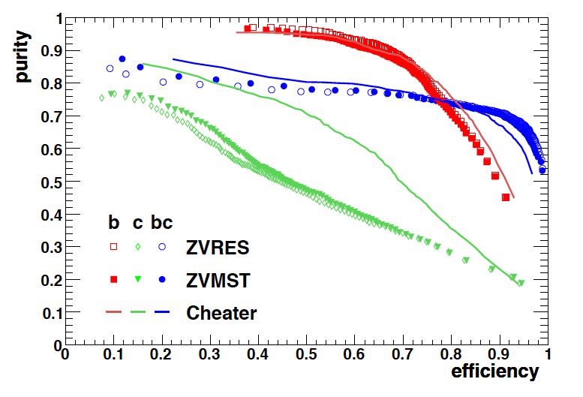
ILC B Tagging (Hillert)
Z Peak
Purity ~ .7
Efficiency ~ .8

Slide 10
Mass Scan
Spreadsheet exercise
to demonstrate
strategy and optimization
Calculate signal and bkd
event rates assuming
various efficiencies and background rejection
H->bbar looks like the best mode if s/b is ~1. Looks worse
in BBHG study.
Just use WW*-> lepton + jets?
Is WW*->4j reasonable?
What background rejection is needed, reasonable (x50 assumed)?
What jet-jet mass resolution is necessary?

Slide 11
With Errors

Slide 12
Detailed Studies
We need to quantify these studies
  Understand cross sections (cross check with BBGH)
  Simulation with LCSIM – jet resolutions
  Signal/background for various beam resolutions
  Efficiencies and background rejection
  Is WW* mode feasible – in what circumstances – does it help to have very high s/b
  Scanning strategy

