Slide 1
ARD Business
Dan Broemmelsiek
ARD Meeting
10 March 2023

Slide 2
ESH Summary
TRAINING/ITNA STATUS
  Course completion rates down due to new training requirements
TRAINING COURSE UPDATES
NEW - WEEKLY EVENT REVIEW SUMMARIES
INJURIES IN FEBRUARY
  One Reportable Case at SD
  Two First Aid cases
ORPS/NTS IN FEBRUARY
  NuMI Stop Work – Access control issues. Operations restarted after corrective actions implemented
  Unauthorized Surveying Work on Booster and MI-8 Berms
EVENT REVIEW STATUS
  Seven reviews underway
FESHM UPDATES/OUT-FOR-COMMENTS
  March 3rd email from MSS on FESHM 7080 Sept 2022 revision
  One chapter out for comment

Slide 3
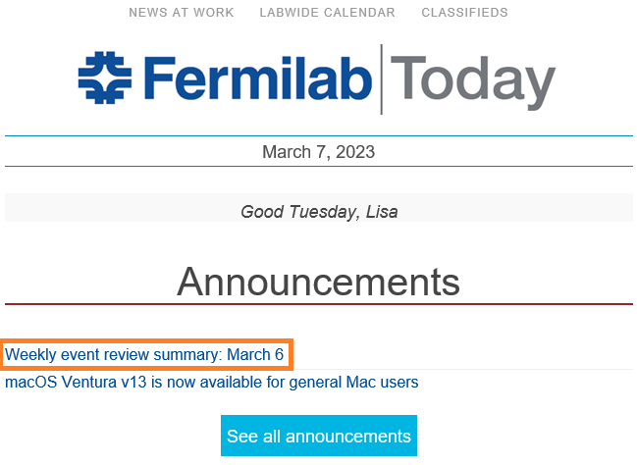
Weekly Event
Posted weekly by the Event Response Team in Fermilab Today
  March 7th
  February 27th
  February 20th
Injuries/illnesses from the previous week
Events under review
Completed event review summaries

Slide 4
Event Review Status
In Progress:
  Access incident at NML (FAST/IOTA) (Level 2 review)
  Personnel experienced symptoms during cleaning process (Level 1 review)​
  Lab 5 Injection Molding Machine Left in Uncontrolled State (ORPS event, Level 2 review)​
  Surveying work in unauthorized area (ORPS event, Level 3 review)​
  Lithium battery off-gassing issue (Level 1 review)​
  Irradiated sample shipment issue (Level 2 review)​
  Linac LCW pump skid trip (Level 1 review)​​

Slide 5
FESHM updates
Memo sent to All Engineers regarding FESHM 7080 on March 3rd (memo on next slide):
  “Recently, FESHM 7080 Concrete Anchor Devices Chapter had been updated from its initial December 2016 version. The Mechanical Safety Subcommittee (MSS) wished to expound on and provide additional clarifications/background on the revised concrete anchor inspection requirements included therein. Refer to the Chapter for definitions and additional provisions not addressed in this Memorandum.”
  The chapter is available here: https://esh-docdb.fnal.gov/cgi-bin/sso/ShowDocument?docid=3353
FESHM Chapter Out for Comment
Chapter 7020 – ES&H Program for Subcontractor Safety Other Than Construction
  Open for lab-wide comments until March 14th, 2023
  Changes are:
    Required ESH review of documents
    Added activities to “Higher Level Hazard” category
    Aligned requirements in Section 4 to new terminology and program expectations
    Removed Service Coordinator, Service Manager and Point of Contact, replaced with Subcontractor Coordinator
  Link to the draft chapter here
  Chapter comments required to be entered here

Slide 6
Goal Setting
  Reminder to ensure that your employees have Individual Goals in WorkDay
    Goals should be in SMART format(SMART (Specific, Measurable, Action Oriented, Realistic/Relevant, Timebound)
    All retained probationary employees must have Individual Goals entered.
    With SMART Goals entered and tracked will allow for a more substantive performance evaluation
  Manager Goal Setting instructions for teams can be found HERE
  Individual Goal Setting instructions can be found HERE

Slide 7
HR Projects
  Succession Planning
    Phase 1 Rollout for senior leaders will occur first; followed by lab wide rollout
  Progressive Discipline Policy
    Is currently under review by Office of General Counsel
    Performance Management (PIPs), Drug/ Alcohol Violations will be separate policies

Slide 8
AD General News
Sasha in Germantown to propose ACE
Recovering from Power Glitch
P5 Town Hall March 21-24
  https://indico.fnal.gov/event/58272/
  Consider attending
  Encourage abstract submission for 3-5 open remarks
FY24 President’s Budget Request to be released today:
  https://www.whitehouse.gov/omb/budget/
  https://www.energy.gov/cfo/listings/budget-justification-supporting-documents

Slide 9
URA Awards
Accepting Nominations:
  https://ura-hq.org/fellowships-awards/
  Deadline April 7
New Engineering Award:
  https://ura-hq.org/fellowships-awards/ura-engineering-award/

