Slide 1
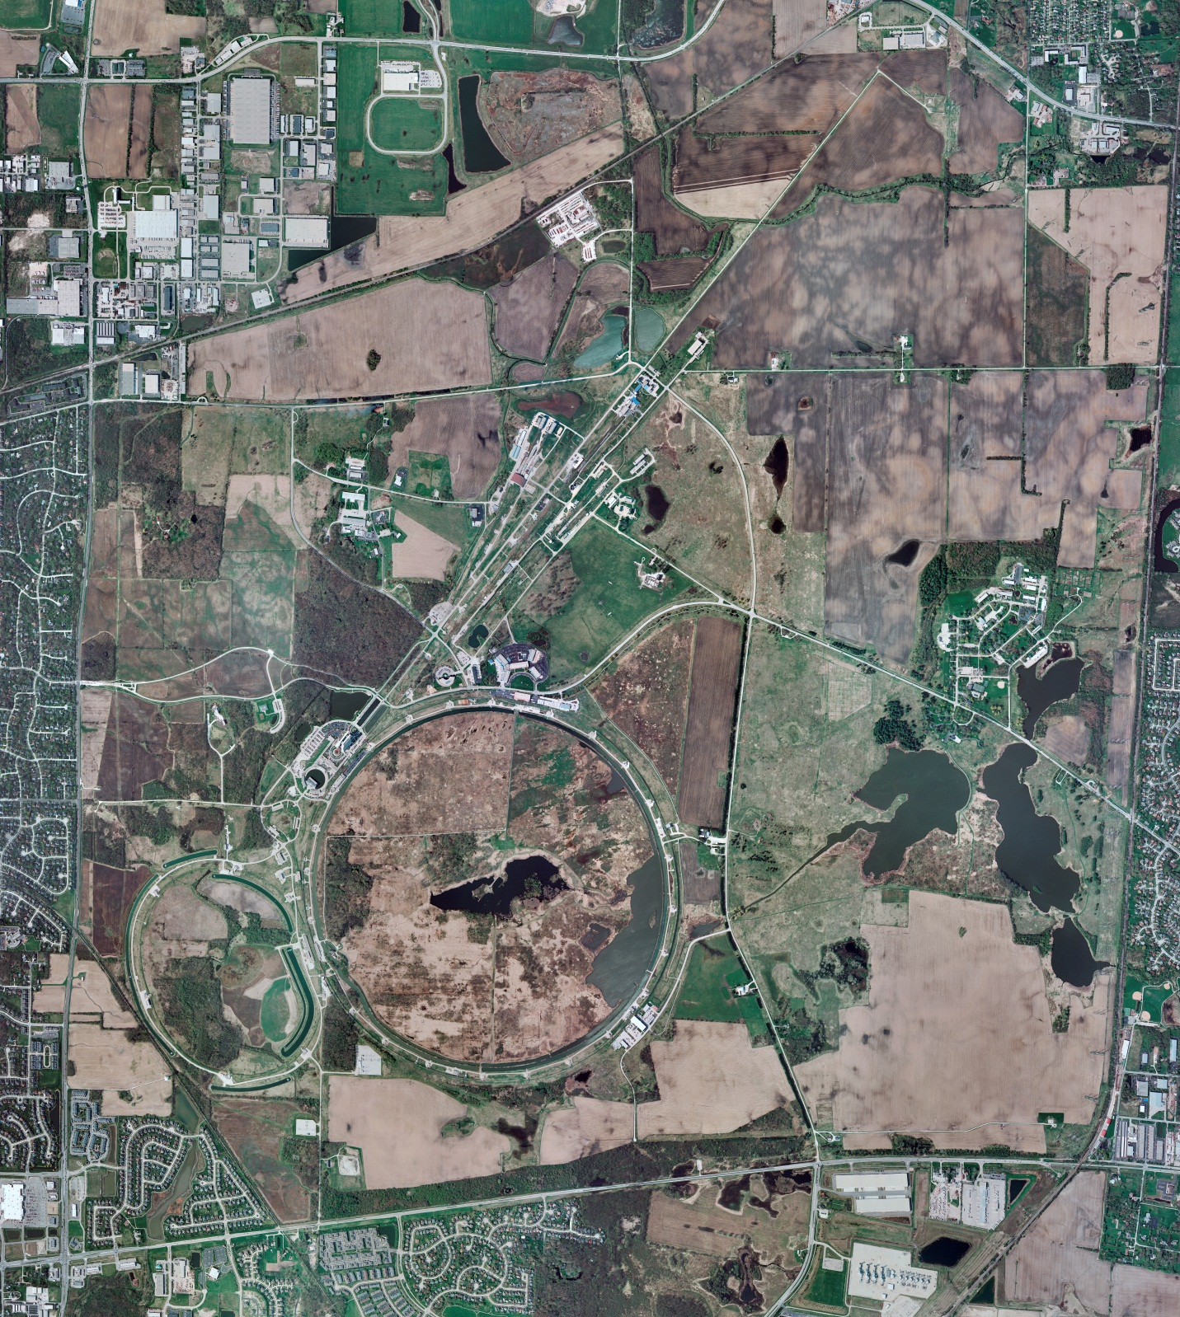
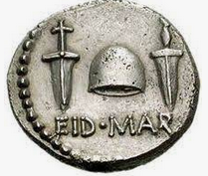
Helium Cryogenics
Status 3/10/2023 J.Makara
CMTF: SCP cold and operating fine
CMTS: HECM24 installation work in progress
PIP2IT: SSR1 at RT
HB650 CM cold at 2 K
MCTF: cryo system is cold and running fine
MDB/HTS: at RT
MDB/STC: SSR2 cavity cold at 2 K
MDB Magnet: at RT
NML/FAST: Cryo system cold and running fine
CC1: cold at 2 K
CC2: cold at 2 K
CM: cold at 2 K
IB1: cryo system recovering from power glitch
Muon Campus: A0 comprs (3) online with MC-1 g-2 cryogenic system running fine at 5 K, recovering from Fd45 power outage that resulted in g-2 magnet trip/quench
Misc:. LN2 subcontracts still under extension; Lhe (500L) under new subcontract

