Slide 1
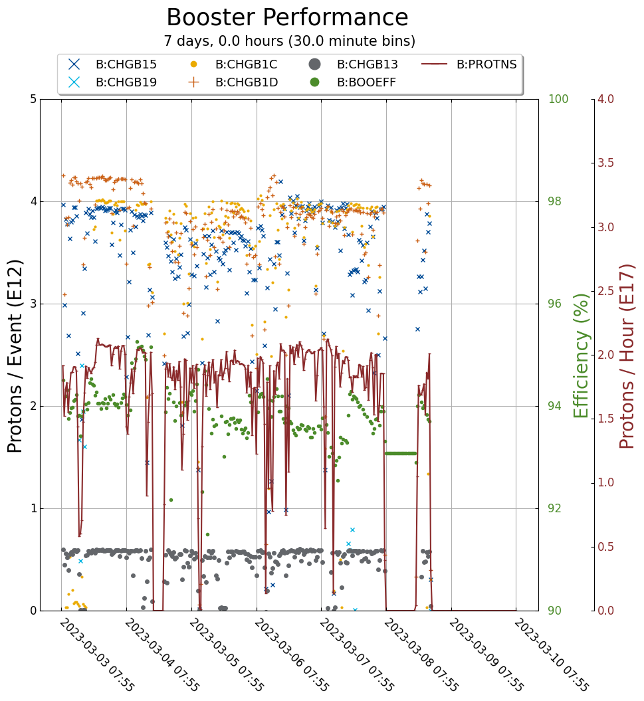
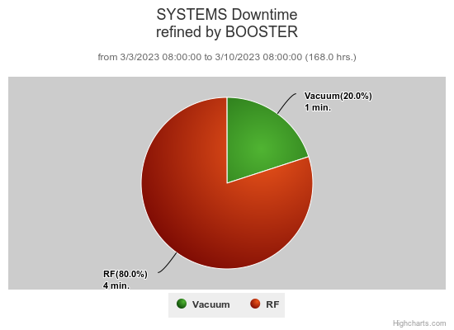
Booster Operations
Downtime - 5 minutes
Orbit tuning to reduce losses in collimation and extraction regions
Transition jump diagnostic work
MKS11 power supply measurements
BRF2 tube socket repair
BRF8 RF measurements
IRM repair period BGE 11
Power glitch recovery

