Slide 1
Muon Campus Report - 03/10/2023
Steve Boi

Slide 2
Overview and Issues
Saturday/Sunday/Monday/Tuesday: beam to g-2.
Wednesday:
Mu2e studies planned – cancelled due to Linac work.
AP0 rad detector changeout.
Timing card in crate 51 replaced, save file 635.
Thursday:
Mu2e studies planned – cancelled due to sitewide power glitch.
AP0 Remnant LCW system had significant leaks on M:Q108A and M:Q108C, several hundred gallons in the tunnel.
Sprayed HEPA system, EF3 blower motor reported ground fault.
Leaks were quickly repaired, water pushed into sumps, and fan put on EF3 to dry it. Special thanks to Fluids and Ops for their effort!
AP0 target blower maintenance was performed.

Slide 3
Overview and Issues
Thursday:
Vacuum was slow to recover in F-17 at the junction between P2 and M1 line.
Pumps have been repeatedly tripping.
Today:
Permission to begin commissioning resonant extraction from the delivery ring was granted!
Started up EF3 motor on HEPA system.
Access AP0 Pre-Vault:
Double check EF3 and remove fan prior to beam delivery.
Await beam delivery.

Slide 4
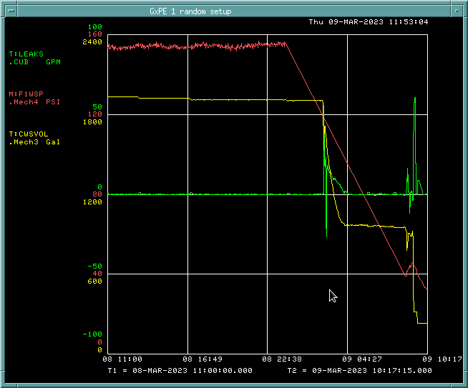
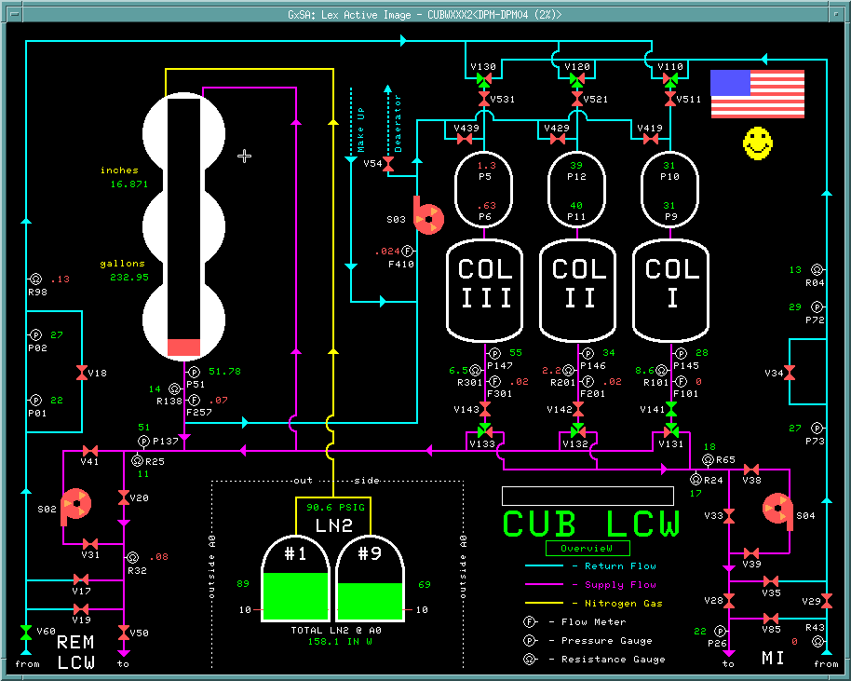
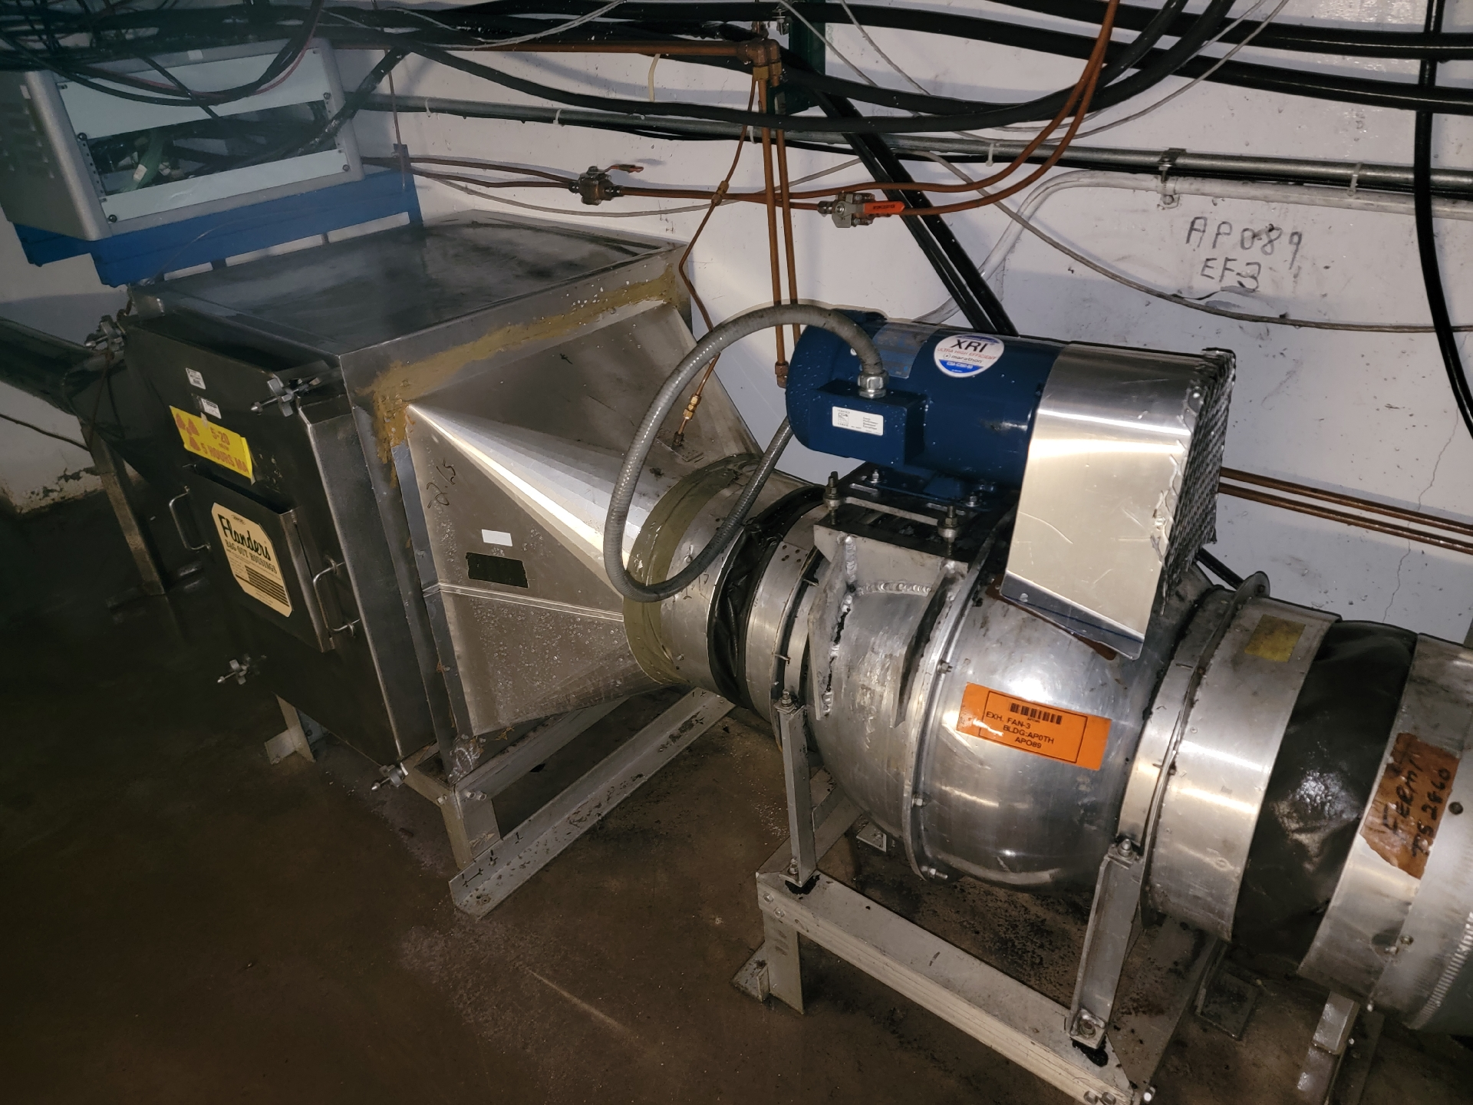
Remnant LCW Leaks

Slide 5
Beam to g-2
Protons to AP0 Target
g-2 Calorimeter-Tagged Muon Decays ($Σ_{24 calos}n_{i}$)
g-2 T0 Detector
Delivery Ring Abort
Linac Work
Power Glitch

Slide 6
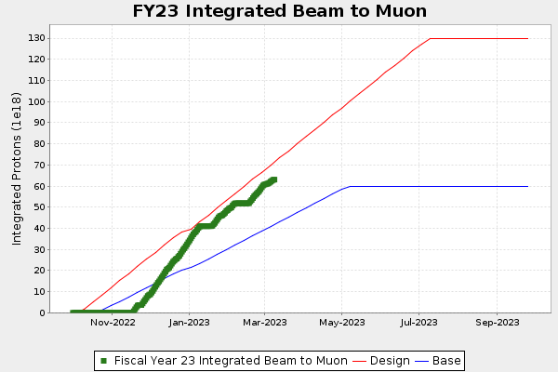
g-2 Protons on Target

Slide 7
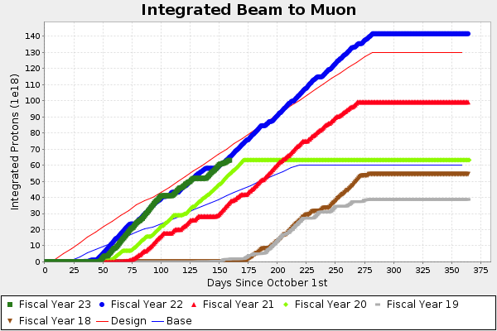
g-2 Protons on Target

Slide 8
g-2 Performance

Slide 9
g-2 Performance
2.18 BNL

Slide 10
Future Prospects
Mu2e studies
Prepare DR for resonant extraction with ESS2 only.
BPM commissioning.
ESS conditioning.
Resonant Extraction.
g-2 running between Mu2e study time.

