Slide 1
48 Hour Summary
Patrick Dowdle
MCR Crew Chief
March 10, 2023

Slide 2
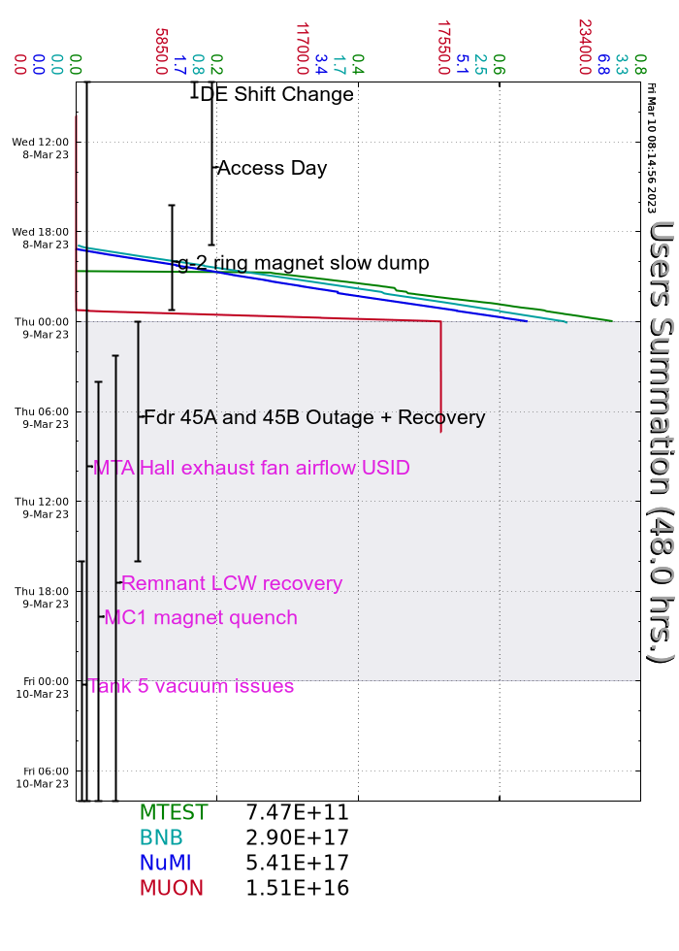
Summary
Wednesday:
Access to MI, M03, MI-65
Secured MC1
Resumed beam ~1900 to BNB/NuMI/SWYD, ~2330 to g-2
Power glitch just before midnight, feeder 45A and 45B
Thursday:
Power glitch recovery all day
LRF5 Vacuum issue
Leaks in Pre-Vault, Ops prepared for access and assisted in the cleanup, MSD repaired leaks on M:Q108A and M:Q108C, remnant system still of while spheres are filled
Prepared F1 for access to reset vacuum pump
Vacuum in P2/P3/M1 line degraded during glitch, resetting ion pumps every ~30 mins

