Slide 1
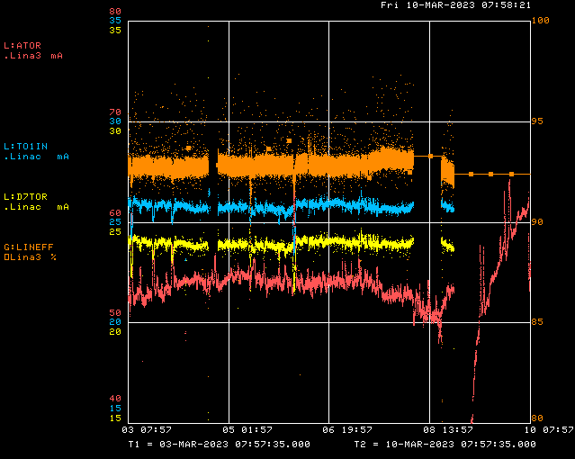
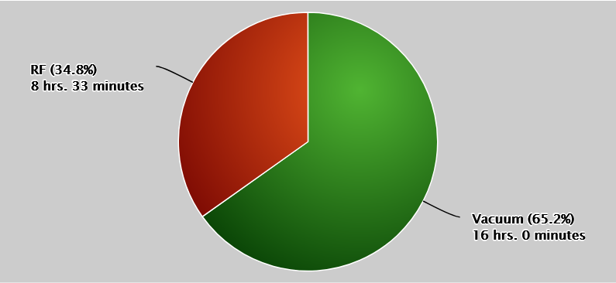
Linac/Preacc Operation (Mar 3 – Mar 10)
PREACC: (5 min)
KRF2 Phase
Access Day
Tank 5 Vac
LINAC: (24 hr 33 min)
Issues:
Sa/Sun: KRF2 VXI module swap
Mon: L:GR5MID instability inhibiting beam
W: Access day (Tank 5 Vac, KRF2/5 diagnostics, LRF2 PA change)
Th: Power glitch, spoiled vacuum at Tank 5
F: QPS212, Tank 5 vacuum not recovering
All Week: LRF2 OV Trips (corrected by PA change), KRF2 phase instability, CS Faults at KRF2/5

Slide 2
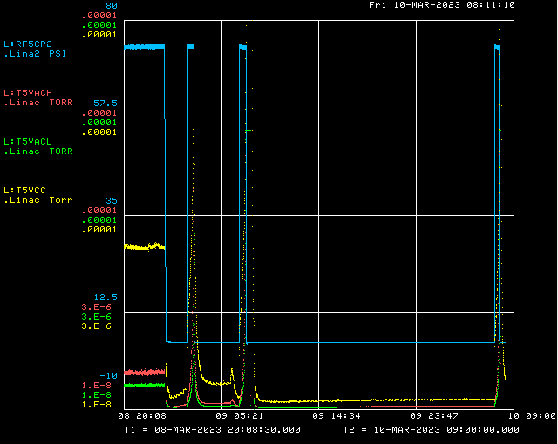
Tank 5 Vacuum
Power Glitch

