Slide 1
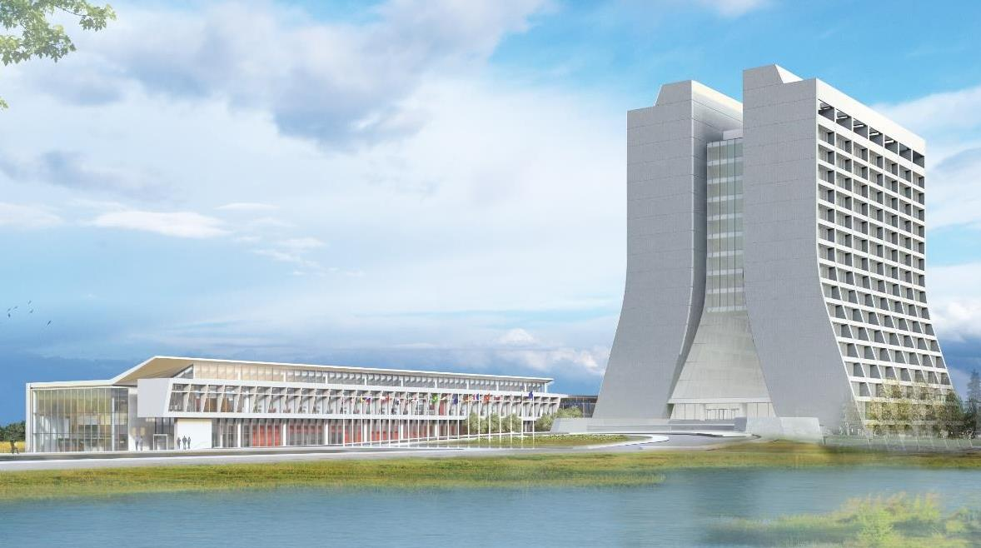
Infrastructure Services Division Updates
Pressing Issues / Special Topic:
SEWS Test
FDR45 Trip
Items of Note: F0, MS-3, XG Roof
Contractors Onsite (verbal update)
Utility Outages – None Upcoming
Road Closures – None scheduled
Prairie burns – Sparrow Hedge Area

Slide 2
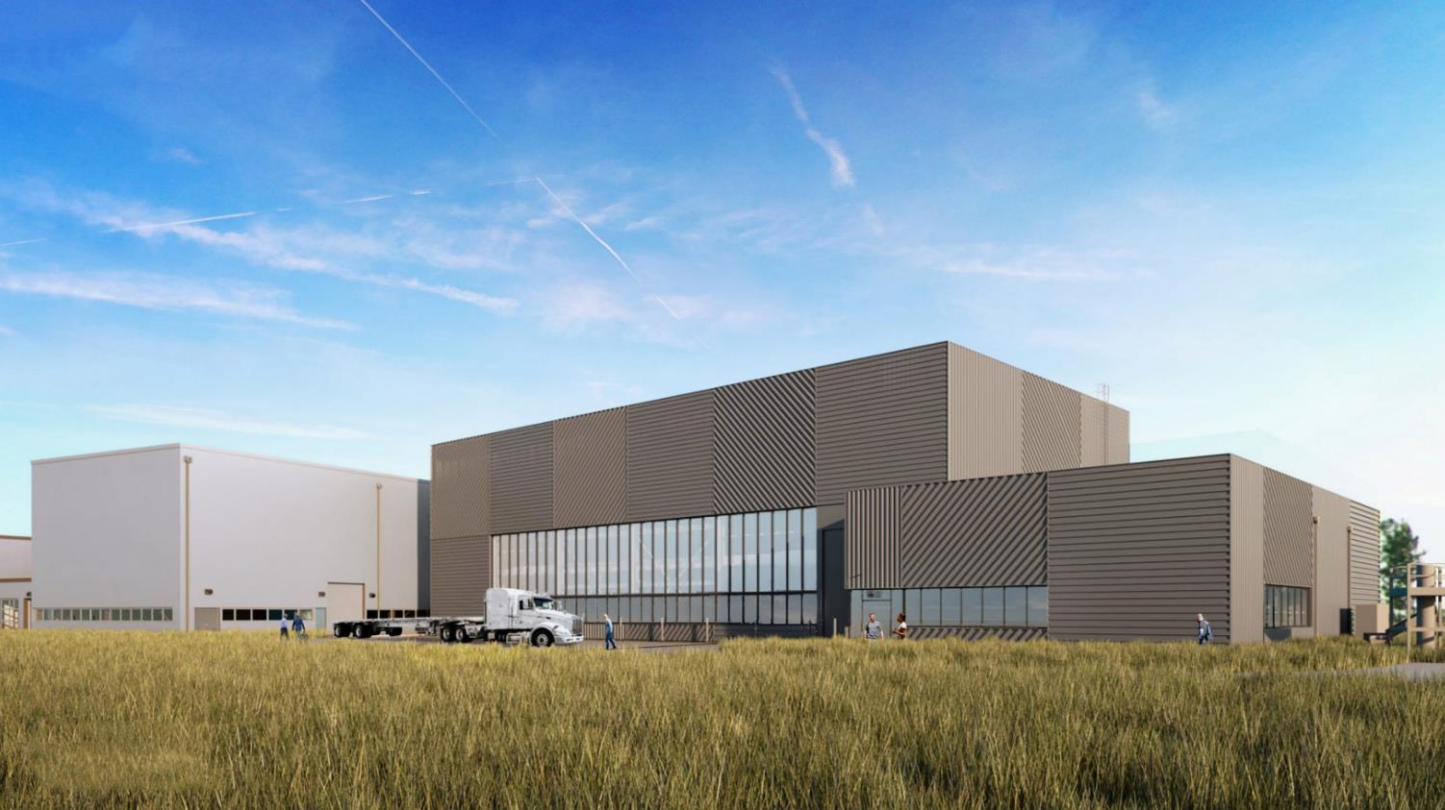
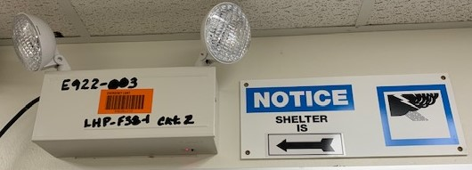
Special Topic:
FDR45 Trip
Culprit: Musculus (Little Mouse)
Building mechanical/electrical shake down – no issues noted
Sitewide Emergency Warning System(SEWS) Test
Tasked to survey results.
Posted in TG North
Surveyed occupants in Linac/X/TG, Boosters, A0
Reported results

Slide 3
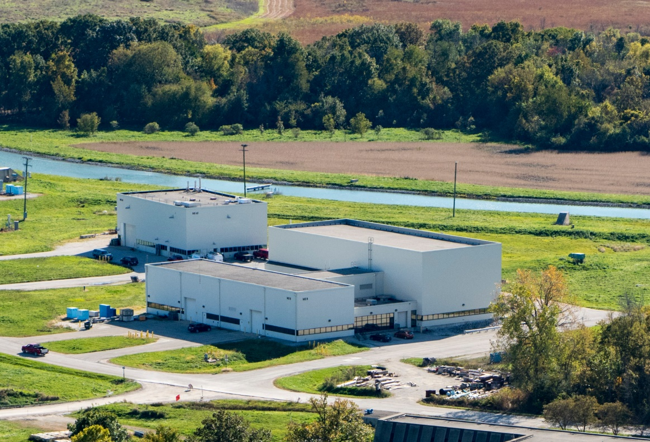
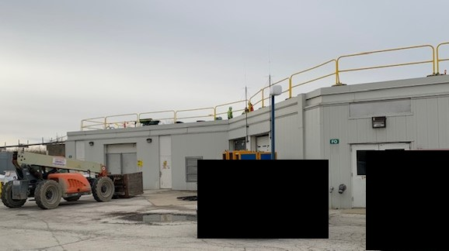
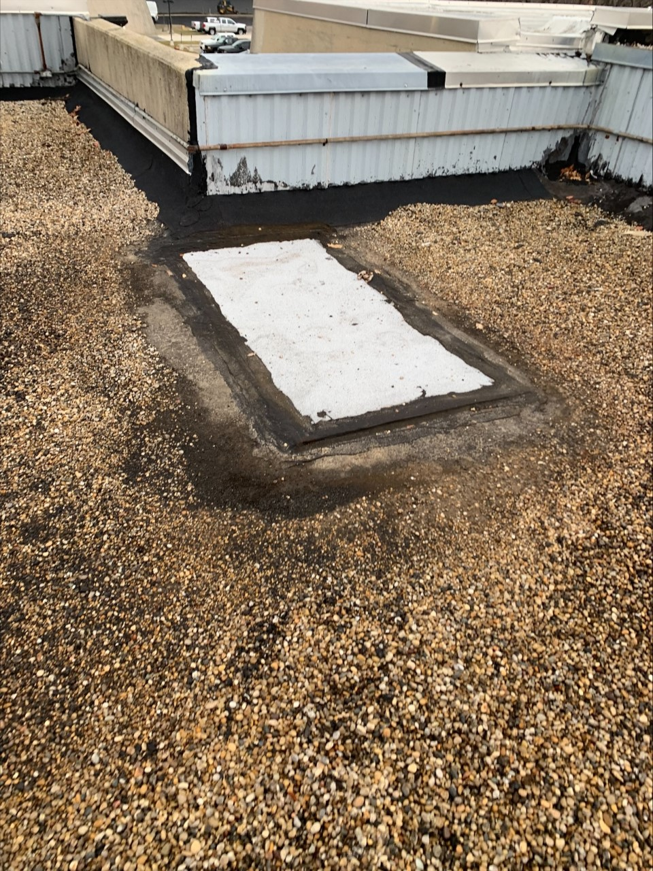
Items of Note
F-0 Roof work underway
MCR Roof leak repairs – Raptor relocated from BT to XG.
Generator work ongoing at MI-65

Slide 4
Contractors on Site
Midwest Mechanical: 2 people: BGW, BGE, MI10-MI14.
ECS: OTE Door installation.
Rachke: Site 38 HVAC.
Seivert Electric: Crane Inspections: SBNND Crane upgrade
INTERSTATE: Generator inspections - Master Substation.
Leyden Electric: D0,MDB (lighting)
MidAmerican Elevator: Elevators

Slide 5
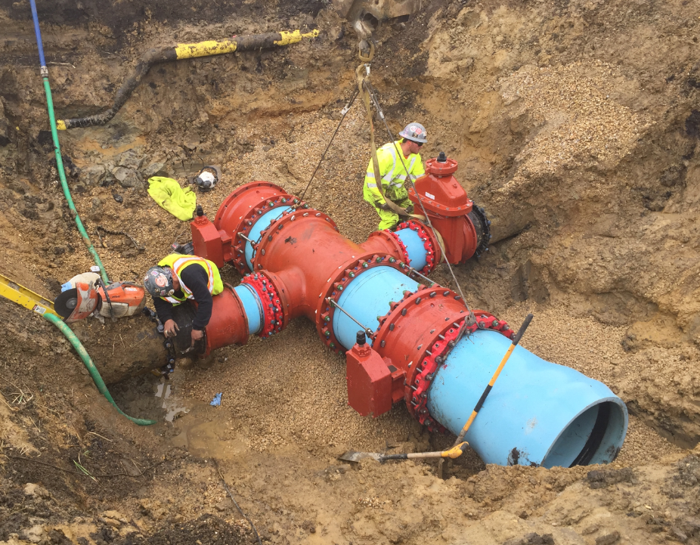
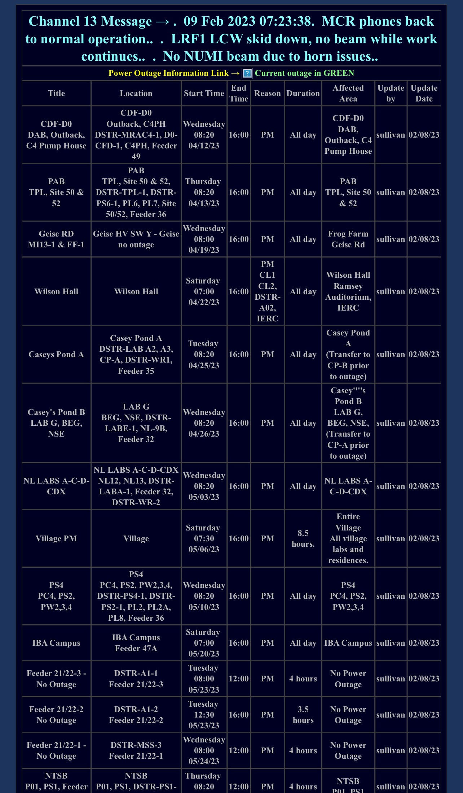
Utility Outages

Slide 6
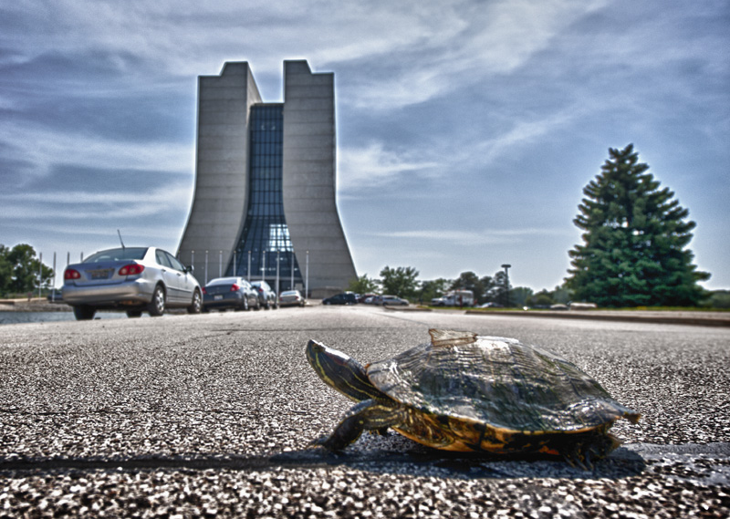
Road Closures
None Scheduled

Slide 7
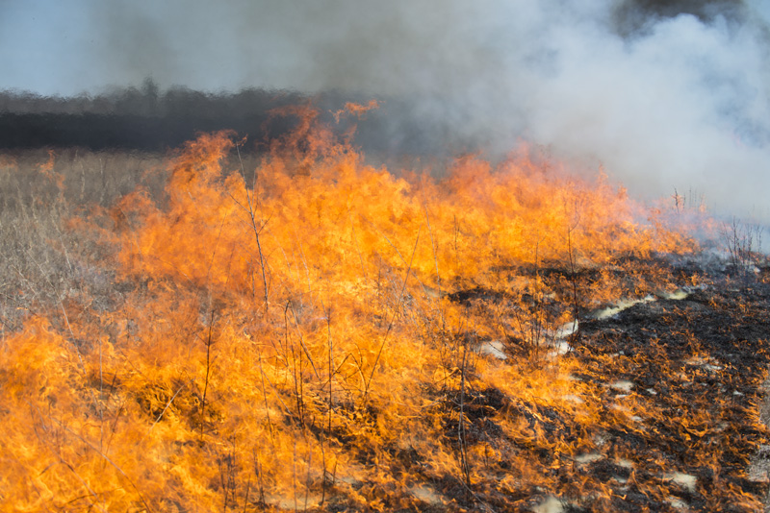
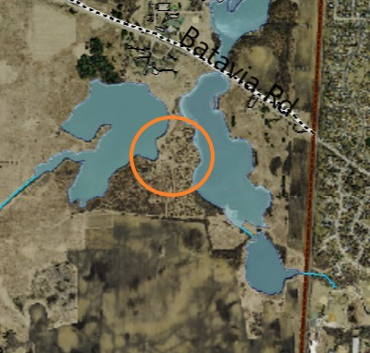
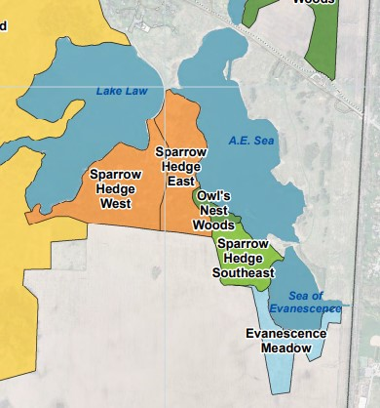
Prairie Burns
Sparrow Hedge Area – 8Mar23

