Slide 1
Memory Profiling
B. Chowdhury on bahalf of Memory Task Force
Mar. 12, 2023

Slide 2
Overview
Start with Simulation
Run Beam MC fhicl files from ProtoDUNE-SP Production IV
Run DUNE-FD2-VD simulation (1x8x14_3view_30deg production)
Run with “dunesw v09_66_02d00”
PRocess MONitor is used to monitor the resource consumption of a process
The PRocess MONitor is a small stand alone program.
Github Link: https://github.com/HSF/prmon

Slide 3
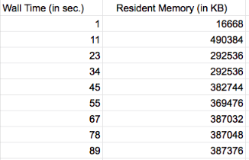
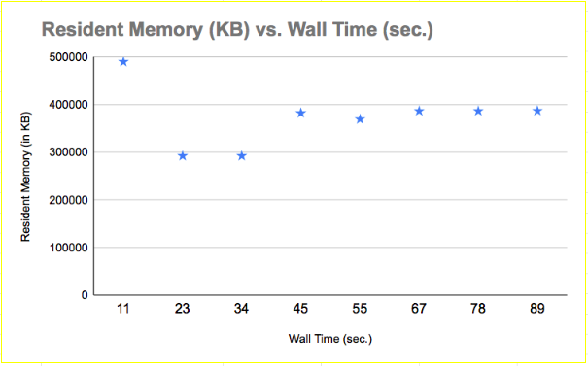
ProtoDUNE Gen Stage (1GeV)
/dune/app/users/barnali/prmon/prmon_3.0.2_x86_64-static-gnu94-opt/bin/prmon --interval 10 --disable netmon -- lar -n 10 -c prod4_gen_protoDUNE_beam_cosmics_1GeV.fcl -o gen.root
Total time 1.48 minute
10 events are processed

Slide 4
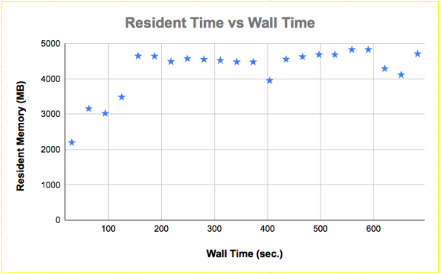
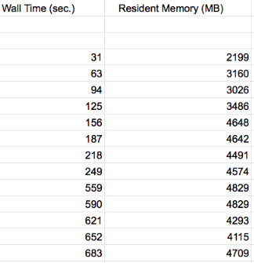
ProtoDUNE G4 Stage
/dune/app/users/barnali/prmon/prmon_3.0.2_x86_64-static-gnu94-opt/bin/prmon --interval 30 --disable netmon -- lar -c protoDUNE_refactored_g4.fcl -o g4.root gen.root
Processing 10 events takes 11.38 minutes
This includes
G4 stage 1: Geant 4 simulation
G4 stage 2: Light simulation without space charge effect

Slide 5
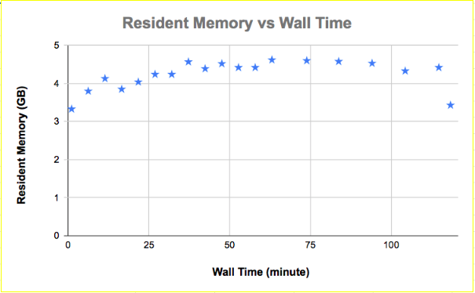
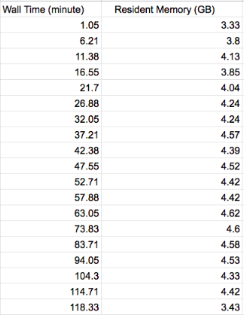
ProtoDUNE Detsim Stage
/dune/app/users/barnali/prmon/prmon_3.0.2_x86_64-static-gnu94-opt/bin/prmon --interval 30 --disable netmon -- lar -c protoDUNE_refactored_detsim.fcl -o detsim.root g4.root
Processing 10 events take 118.33 minute
This includes
Detsim Stage 1
Detsim Stage 2

Slide 6
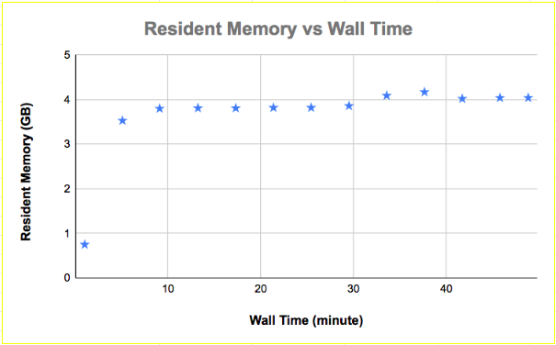
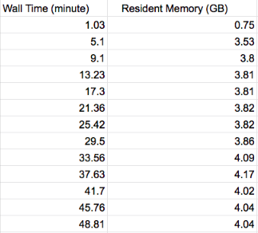
ProtoDUNE Reco Stage 1
/dune/app/users/barnali/prmon/prmon_3.0.2_x86_64-static-gnu94-opt/bin/prmon --interval 60 --disable netmon -- lar -c protoDUNE_refactored_reco_stage1.fcl -o reco.root detsim.root
Processing 10 events take 48.81 minute

Slide 7
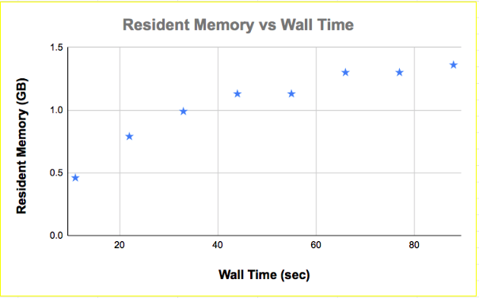
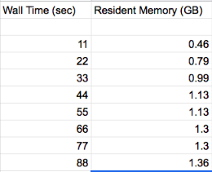
FD (1x8x14 geo) Gen Stage
/dune/app/users/barnali/prmon/prmon_3.0.2_x86_64-static-gnu94-opt/bin/prmon --interval 10 --disable netmon -- lar -n 30 -c prodgenie_nu_dunevd10kt_1x8x14_3view_30deg.fcl -o gen.root
Processing 30 events take ~88 second

Slide 8
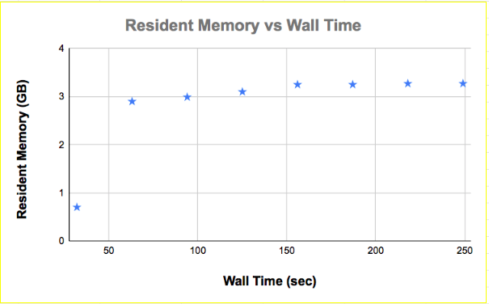
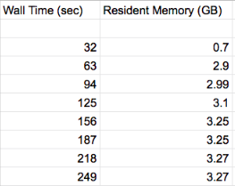
FD (1x8x14 geo) G4 Stage
/dune/app/users/barnali/prmon/prmon_3.0.2_x86_64-static-gnu94-opt/bin/prmon --interval 30 --disable netmon -- lar -n 30 -c standard_g4_dunevd10kt_1x8x14_3view_30deg.fcl -o g4.root gen.root
Processing 30 events take ~4.20 min

Slide 9
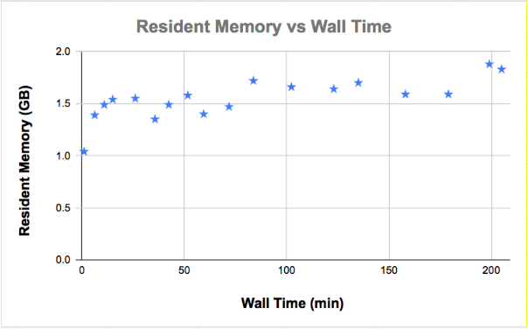
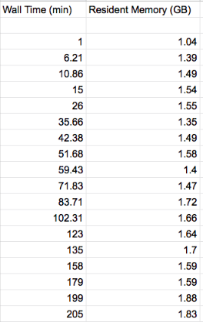
FD (1x8x14 geo) Detsim Stage
/dune/app/users/barnali/prmon/prmon_3.0.2_x86_64-static-gnu94-opt/bin/prmon --interval 30 --disable netmon -- lar -n 30 -c standard_detsim_dunevd10kt_1x8x14_3view_30deg.fcl -o g4.root gen.root
Processing 30 events take ~205 min.

Slide 10
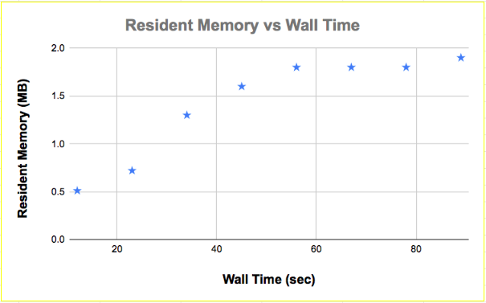
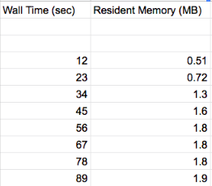
FD (1x8x14 geo) Reco Stage
/dune/app/users/barnali/prmon/prmon_3.0.2_x86_64-static-gnu94-opt/bin/prmon --interval 10 --disable netmon -- lar -n 30 -c standard_reco_dunevd10kt_1x8x14_3view_30deg.fcl -o reco.root detsim.root
Processing 30 events take ~90 second
Resident memory is in GB (mislabelled in diagram)

Slide 11
To do…
Check memory usage for
Raw Data reconstruction
Data recalibration
Tuple creation
Thank You !

