Slide 1
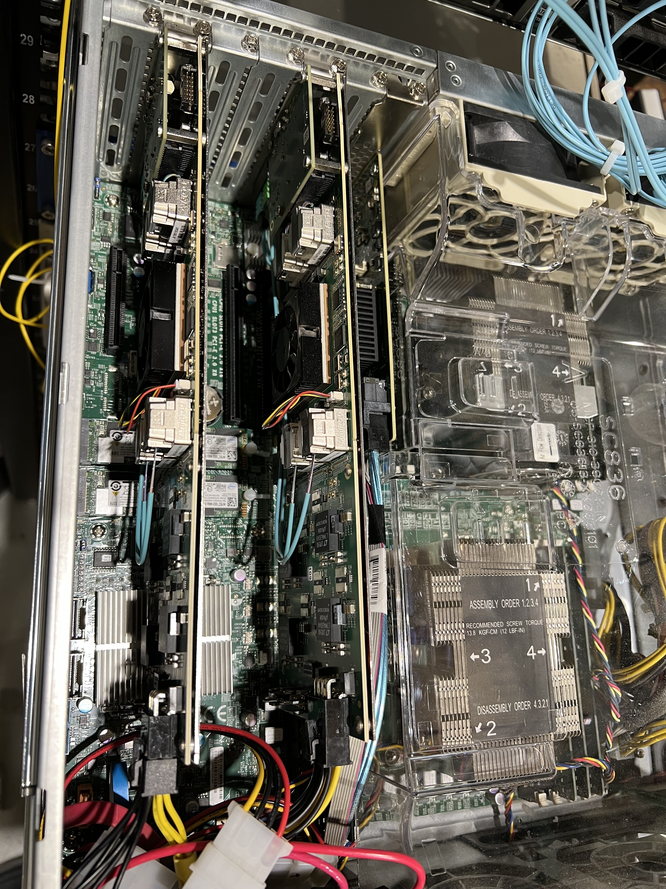
ICEBERG DAQ
Iceberg01.fnal.gov now has 2 FELIX
FELIX 01 is connected to WIB Fiber Combiner
FELIX 02 will be connected to DAPHNE Fiber
No change is planned to this setup.
Iceberg01.fnal.gov has been tested with DUNE-DAQ V3.3.2
One software HDF5 has been written for WIB configuration
Iceberg01.fnal.gov TLU has been updated and tested to the latest firmware which runs with DAQ V3.2.2
This clock has been tested with DAPHNE
WIB 2 at ICEBERG does not have the firmware to test with this version of TLU
DAPHNE DAQ Fiber will directly go to FELIX 2 from a fiber combiner box.

Slide 2
WIB Data Flow to WIB2 → FELIX Readout

Slide 3
What is needed from DUNE CE Consortium
3+1 DUNE WIB,
10+2 DUNE FEMB,
1 DUNE PTC,
1 DUNE WEIC with modified back plane,
1 Tee Back Plane,
12 Data cables,
12 power cables
1 WIB to FEMB interface card for CTS test
Specifications for new SFP and fibers

Slide 4
Minimal Request to DUNE CE Consotrium
1 DUNE-WIB
2 DUNE-FEMB
1 Extender Card to attach WIB to FEMB on bench
2 Data Cables
2 Power Cables
2 1 Gbits SFP
3 10 Gbits SFP
1 Clock SFP
Dave Christian to coordinate this with CE

Slide 5
What is needed from the DUNE PD Consortium
2 DUNE-HD Photon Detector that will in the ICEBERG Slot
Associate fiber/power cables
Integration to DAPHNE
Dave Christian to coordinate this with PD Consortium

Slide 6
WIB3 Fiber Layout at ProtoDUNE-II-HD

Slide 7
WIB3 Fiber to FELIX and Ethernet Readout
We need to make a schematic of this layout.
Need part number for SFP
Need Fiber specification
Need specification for combiner boxes
Fiber Combiner
Box
WIB1
FELIX
WIB2
Ethernet DAQ
WIB3
This ICEBERG could work.
Bonnie to get information from CERN on switch

Slide 8
Ethernet DUNE DAQ
DUNE WIB Ethernet Integration has “Finalized” the 100 Gbits Ethernet card.
https://www.intel.com/content/www/us/en/products/sku/218110/intel-ethernet-network-adapter-e810cqda2t/specifications.html
CERN is testing
AMD Server
2x AMD EPYC 7313 @ 3GHz Core: 32 Disk: 2 TB
Cache: 1MB, 8MB, 128MB
Memory: 512GiB (32x16GiB)
NIC: 2xGiB, 2x100GiB QSFP, 2x10GiB SFP+
Intel Server
2x Intel(R) Xeon(R) Gold 6346 CPU @ 3.10GHz Core: 32 Disk: 2 TB
Cache: 80KiB, 1280KiB, 36864KiB
Memory: 512GiB (32x16GiB)
NIC: 2x10GiB SFP+, 2x100GiB Intel E810

Slide 9
Ethernet DAQ Server
Neutrino Division in principle has agreed to purchase a new server for Ethernet DAQ and AI/ML development.
DUNE needs to finalize the specification
This server will run Alama Linux 9.1 and DUNE DAQ V3.2.2

Slide 10
ProtoDUNE-DAQ02.fnal.gov
Will be used for TLU server
Will be used for database server
Need DQM

Slide 11
WIB Internet Connection for DUNEDAQ
NetGear 1 & 2
Cisco 2960G
NetGear 2 (Top DAQ Rack)
NetGear 1
ProtoDUNE-DAQ02
Iceberg01
Iceberg01
8. Bench
WIB003 (Fiber)
Cisco 2960(Fiber)
NetGear 1 (Bottom DAQ Rack)
NetGear 2
DUNE-Room-1a
DUNE-Room-1b
XXX
8. TLU
WIB001 (Fiber)
WIB002 (Fiber)
CISCO 2960G (CE Power Rack)
1,2,3 not connected at the WEIC
5. Purity Monitor PC
6. Test Bench WIB
7. PL506
15. MPOD
1. NetGear 2 (Fiber)

Slide 12
ICEBERG Intranet and Internet Connection
Fermi Network
ProtoDUNE-DAQ02
Apps
EPICS & Ignition
CAT6
Switch 1
Bench Test PC
Iceberg01
Fiber
Fiber SFP
Clock to PTC
TLU
Fiber SFP
FELIX
CAT6
NetGear 2
Cisco 2960G
Fiber SFP
Fiber
Fiber SFP
NetGear 1
Fiber SFP
Fiber SFP
Fiber SFP
Fiber
Fiber SFP
PL506
Fiber SFP
WIB003
WIB002
MPOD
Fiber SFP
Fiber
WIB001
Fiber SFP
Fiber SFP
Fiber SFP
Purity Monitor PC
Fiber Combiner Boxes

