Slide 1
48 Hour Summary
Kevin McDonough
March 15, 2023

Slide 2
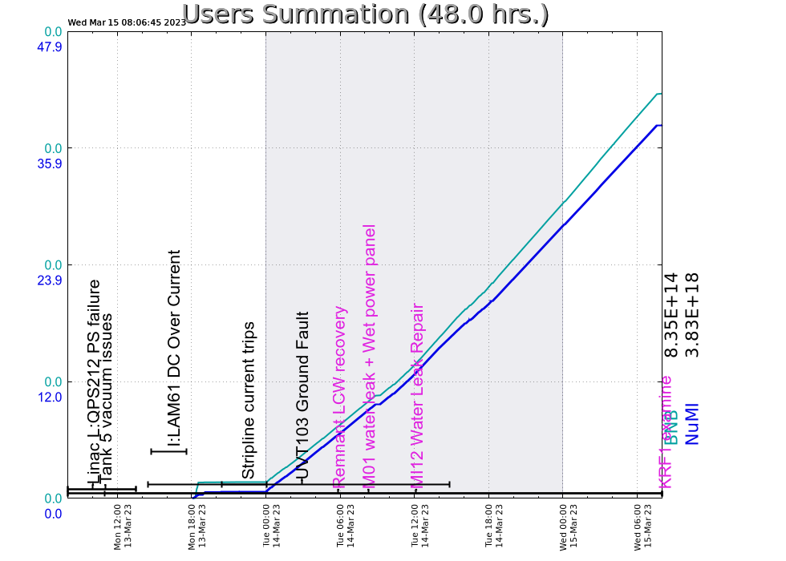
Summary
MONDAY
MI12 prepared for access
MI12 prepared for access
MS1 disconnect work will continue tomorrow, will be config control locked off. Do not turn on disconnect or supplies.
Once LAM61 was repaired and the MI/RR people fixed the BPM issues they were having, we started running beam to NUMI.
Dealt with F-Sector vacuum all shift.
NUMI horn stripline current started pulling the permit by going low.
TUESDAY
Problem with NuMI Horn PS Control card issue resolved
MS1 wet breaker maintenance continues today
EE Support swapped out R:QT604.
MS1 disconnect inspected and back in operation now.
Beam to MTA for commissioning
Remnant system air vented, system currently polishing.
MIRF05 was brought back online.
F17 vacuum issues continue.
WEDNESDAY
RR LLRF VXI DDS RF phase out issue ongoing – rebooting
Current Conditions
Beam to NUMI,
Remnant system polishing
BNB leak check in progress.

