Slide 1
Magnet Fabrication Travelers, Non-Conformities and Resolution
Katherine Ray, Mike Solis, Jennifer Doyle
March 28, 2023 – MQXFA15 Structure and Loading Review

Slide 2
Overview
State of the Magnet Fabrication Travelers
Non-Conformances on MQXFA15
Structural Components
Shell
Yoke laminations and stacks
Master keys
Load pad laminations and stacks
Collar laminations
Assembly

Slide 3
Magnet Fabrication Travelers Overview
# | Title | Revision | ID
1 | Coil Acceptance WI | C | SU-1011-5294
2 | Coil CMM WI | A | SU-1012-3958
3 | Yoke Pre-Stack WI | C | SU-1008-8072
4 | Yoke Half Stack WI | G | SU-1009-7829
5 | Shell Instrumentation WI | H | SU-1009-3745
6 | Shell-Yoke Assy WI | F | SU-1008-2169
7 | Loadpad Pre-Stack WI | B | SU-1008-8075
8 | Dressed Coil WI | M | SU-1008-8073
9 | Pad-Collar Assy WI | G | SU-1010-1610
10 | Coil Pack Subassy WI | H | SU-1008-8074
11 | Magnet Electrical QA at LBNL | K | SU-1010-1903
12 | Magnetic Measurements | B | SU-1010-2018
13 | Integration and Loading WI | J | SU-1011-5637
14 | Axial Rods Instrumented WI | F | SU-1008-8069
15 | Connectors and Finishing WI | D | SU-1012-5517
16 | Splice Box WI | G | SU-1008-8067
17 | Magnet Shipping WI | E | SU-1011-3284
18 | Disassembly WI | A | SU-1013-8309

Slide 4
Magnet Fabrication Travelers Overview
# | Title | Revision | ID
1 | Coil Acceptance WI | C | SU-1011-5294
2 | Coil CMM WI | A | SU-1012-3958
3 | Yoke Pre-Stack WI | C | SU-1008-8072
4 | Yoke Half Stack WI | G | SU-1009-7829
5 | Shell Instrumentation WI | H | SU-1009-3745
6 | Shell-Yoke Assy WI | F | SU-1008-2169
7 | Loadpad Pre-Stack WI | B | SU-1008-8075
8 | Dressed Coil WI | M | SU-1008-8073
9 | Pad-Collar Assy WI | G | SU-1010-1610
10 | Coil Pack Subassy WI | H | SU-1008-8074
11 | Magnet Electrical QA at LBNL | K | SU-1010-1903
12 | Magnetic Measurements | B | SU-1010-2018
13 | Integration and Loading WI | J | SU-1011-5637
14 | Axial Rods Instrumented WI | F | SU-1008-8069
15 | Connectors and Finishing WI | D | SU-1012-5517
16 | Splice Box WI | G | SU-1008-8067
17 | Magnet Shipping WI | E | SU-1011-3284
18 | Disassembly WI | A | SU-1013-8309
We continue to update the travelers based on lessons learned.

Slide 5
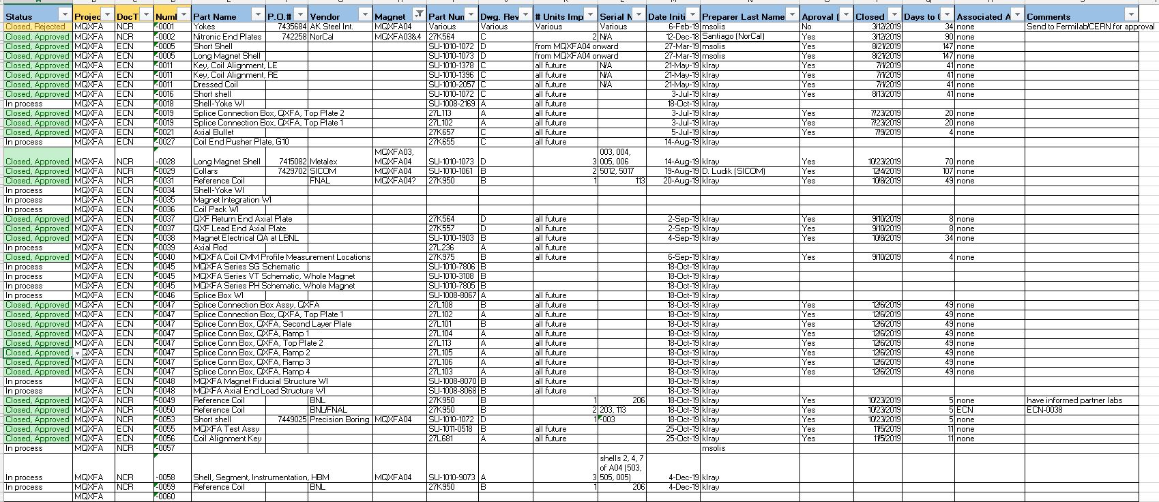
Change Records
We are tracking Non-Conformances, Deviations and Engineering Changes in one spreadsheet
These are currently communicated to Fermilab L2 on a monthly basis

Slide 6
Parts to be used on MQXFA15
The following parts will be used:
Coils:
127, 220, 226, 233
 | PO #
Shells | 7532740
Yokes | 7532497
Master Keys | 7580674
Load Pads | 7532636
Collars | 7532707

Slide 7
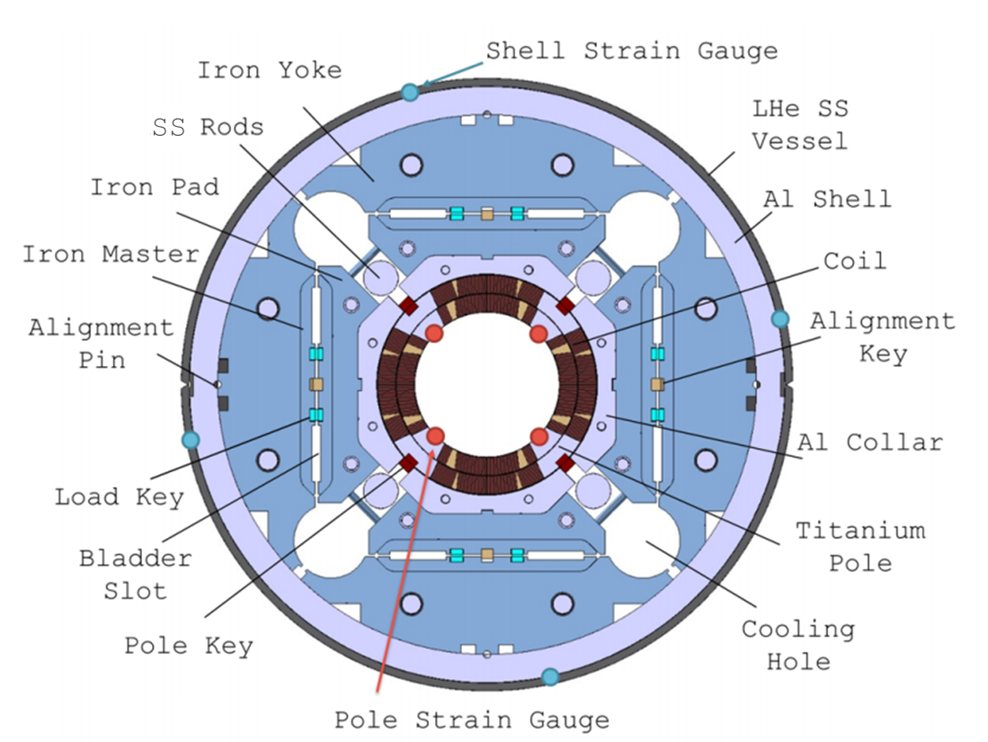
Introduction

Slide 8
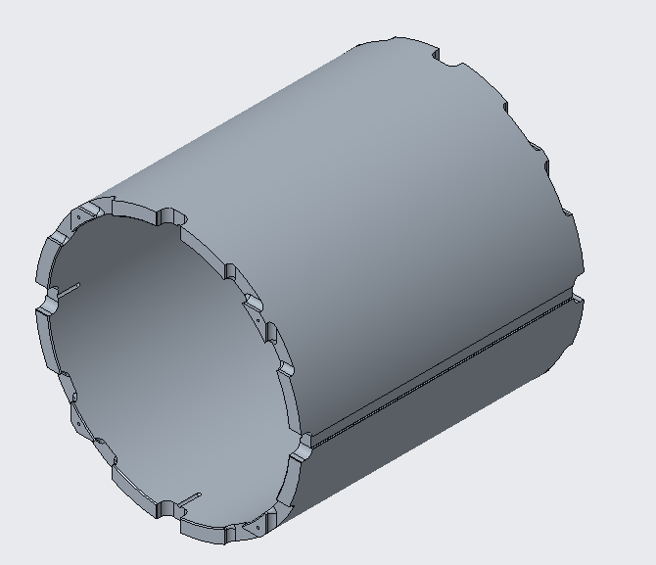
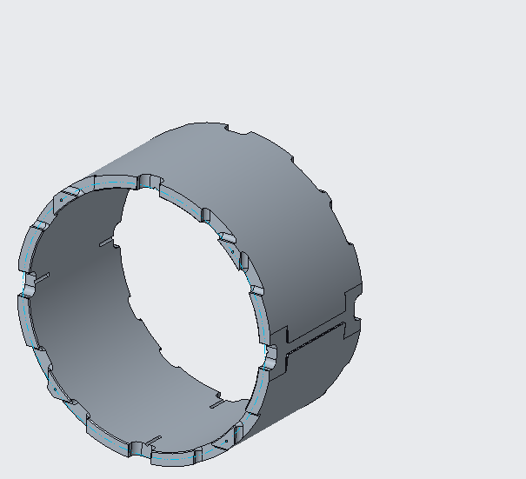
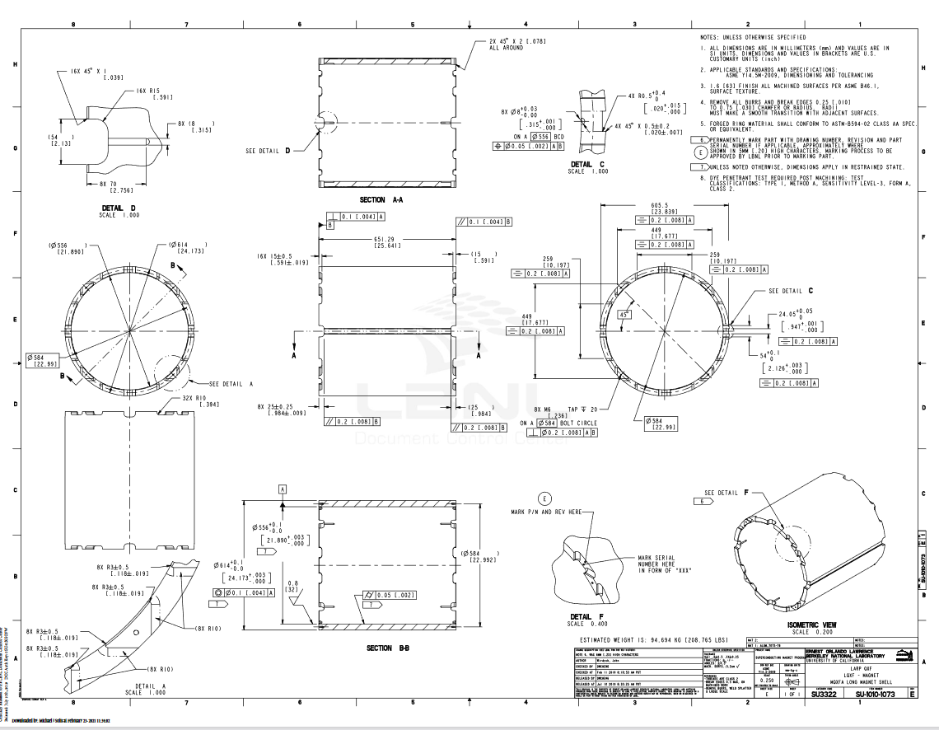
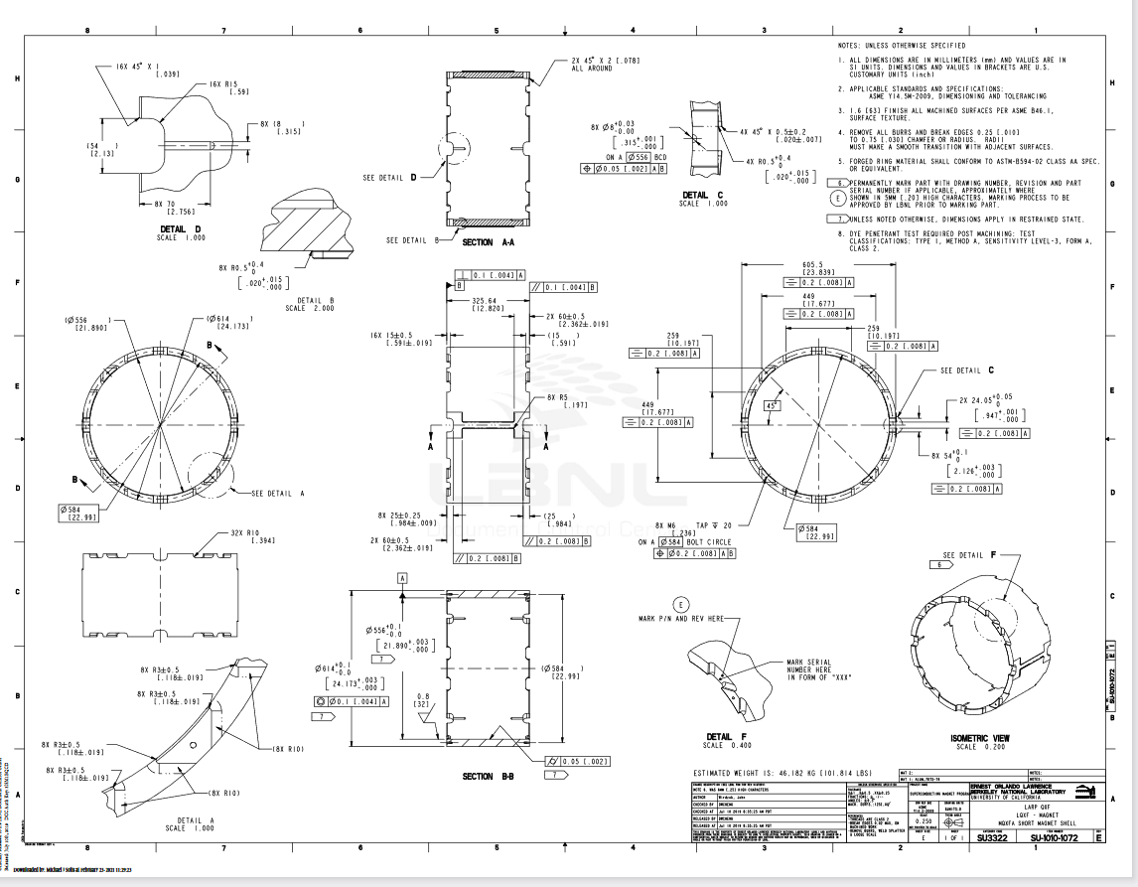
Shell
Long Shell: SU-1010-1073
Short Shell: SU-1010-1072

Slide 9
Shell
For the shell ID and OD, the following specifications are set:
The shell ID at 5 evenly spaced rings shall have an average diameter of 556 mm +0.1/-0.0
The shell OD at 5 evenly spaced rings shall have an average diameter of 614 mm +0.1/-0.0
PO 7532740 approved
NCR -0272

Slide 10
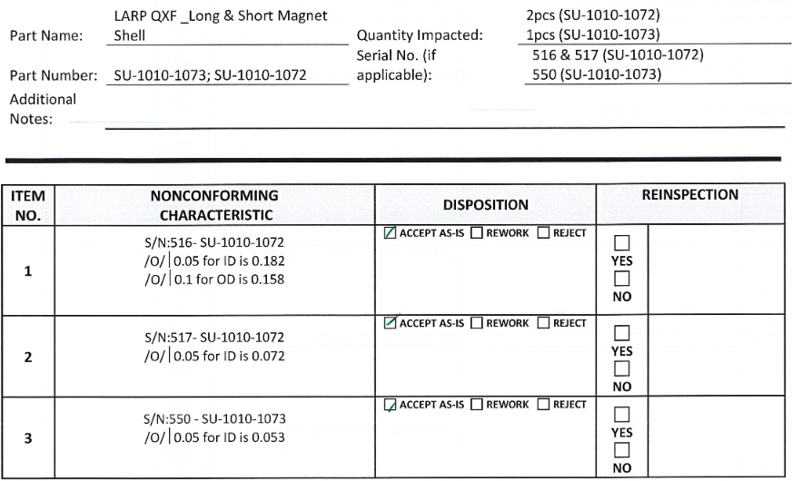
NCR-0272

Slide 11
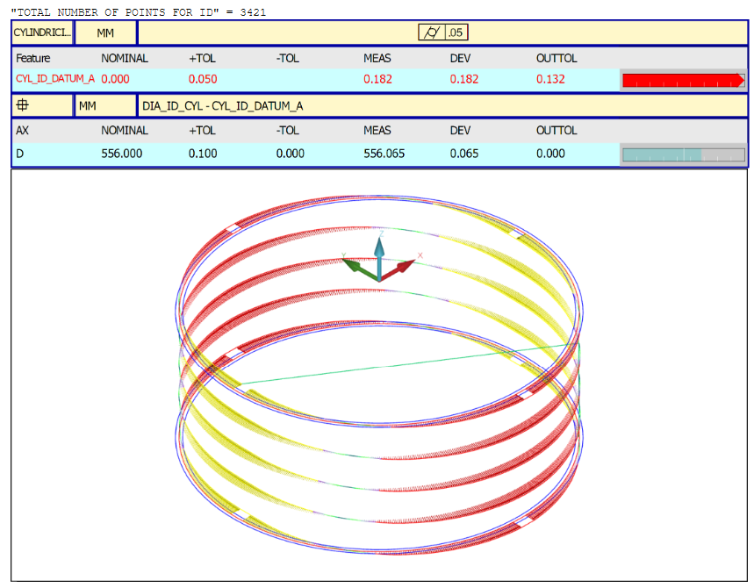
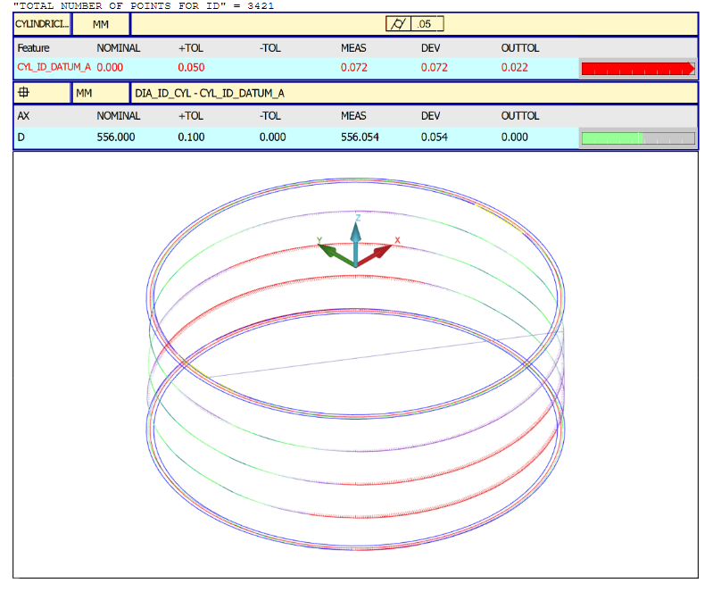
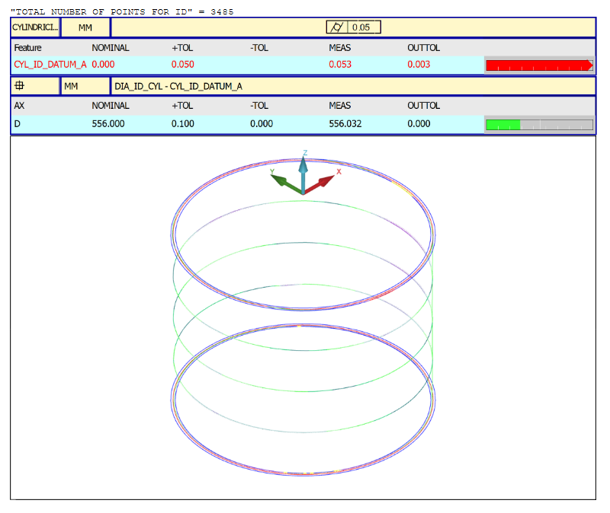
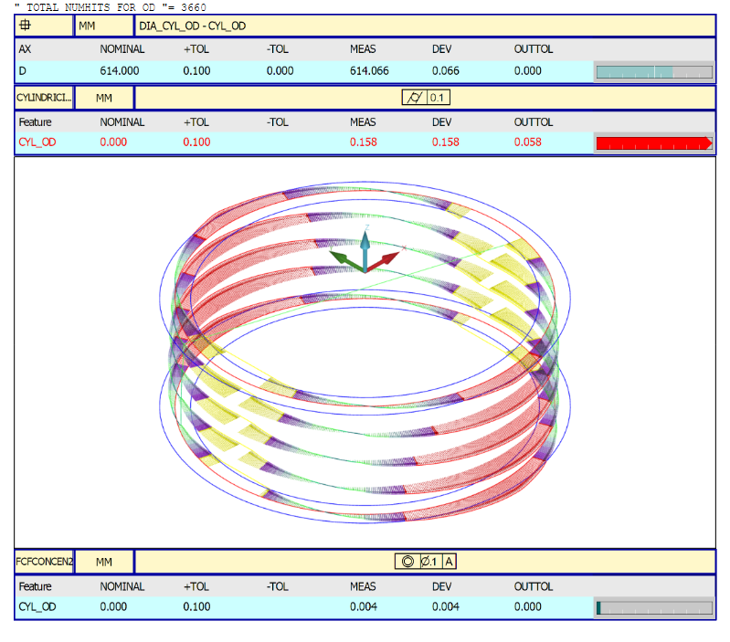
NCR-0272 (cont)
 | Short # -0516 | Short # -0517 | Long # -550
ID
OD
Notes:
The roundness of these shells are out of tolerance. We were able to accept them because the average diameter is still in spec with the understanding the pre-load will correct the roundness

Slide 12
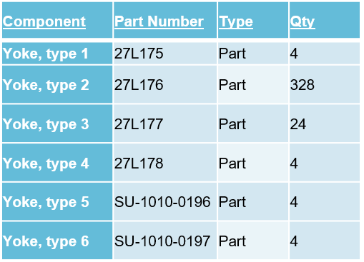
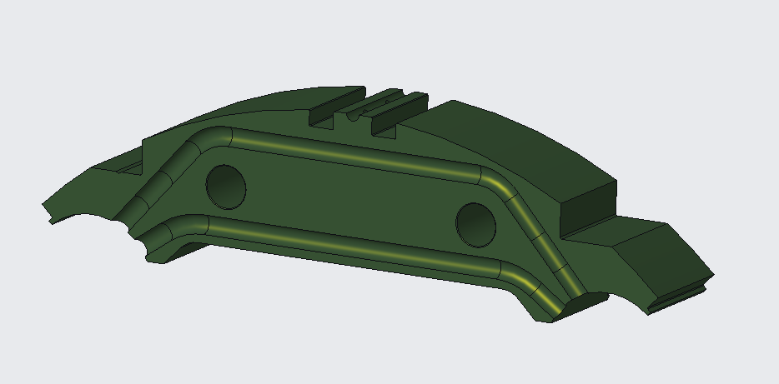
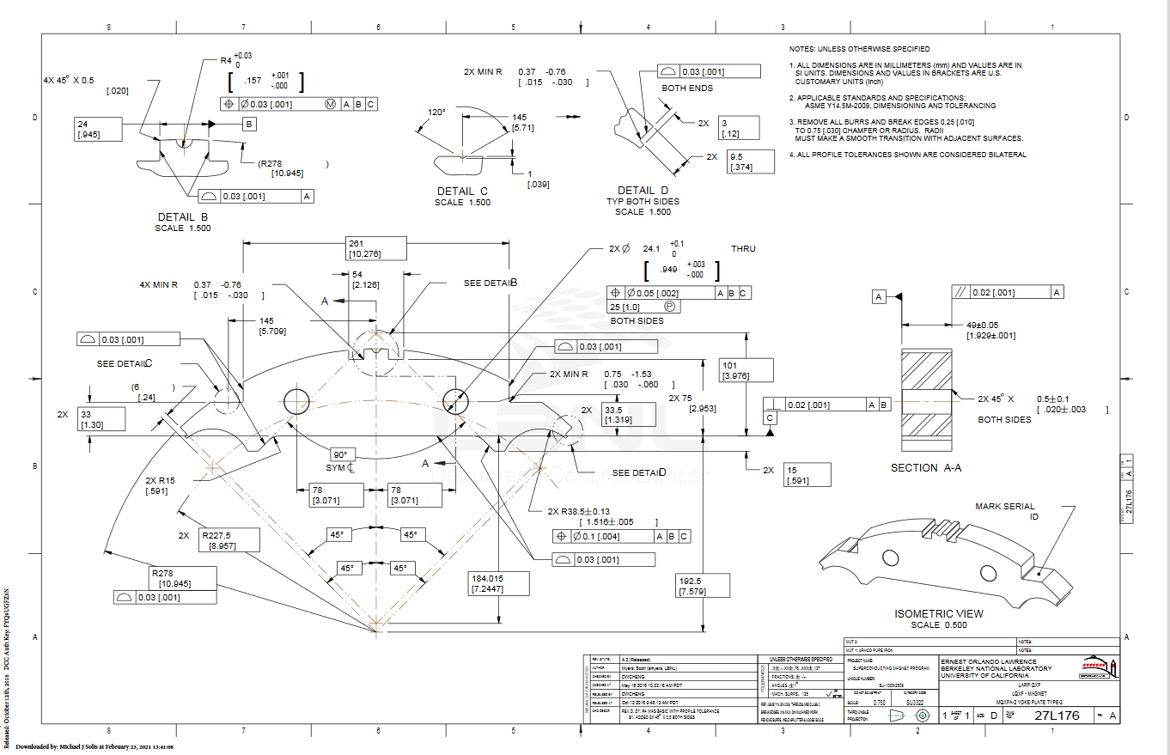
Yoke laminations and stacks

Slide 13
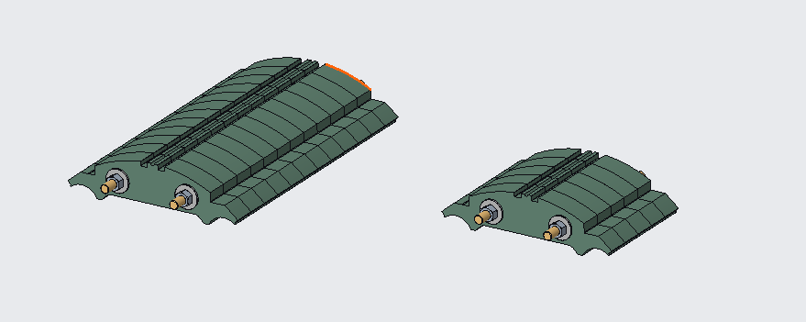
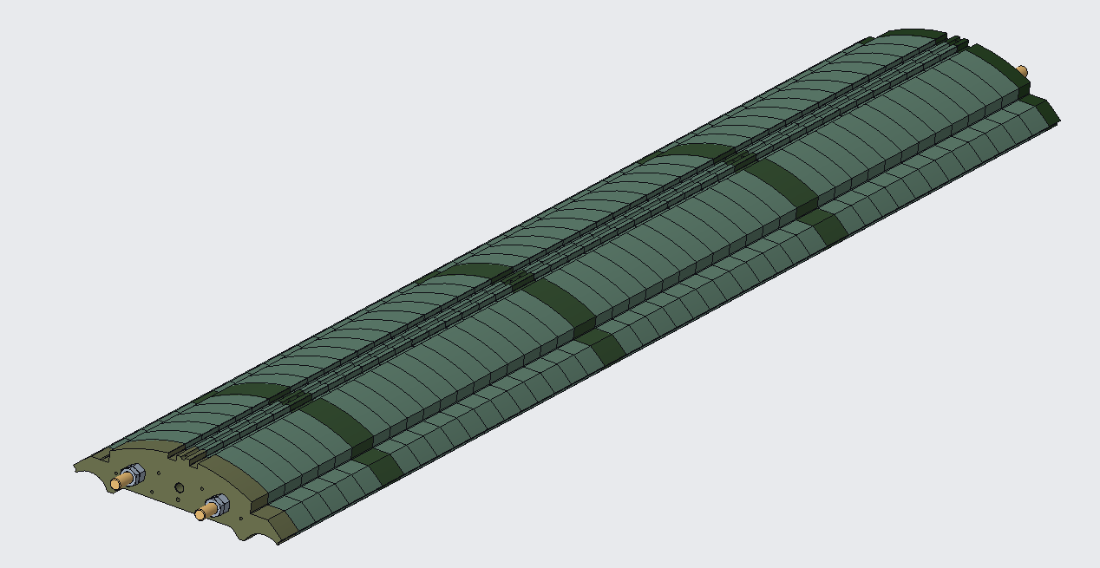
Yoke laminations and stacks

Slide 14
Yoke laminations and stacks
For the yoke outer radius, the following specifications are set:
The yoke radial profile shall maintain a 0.03 [.001”] tolerance.
For the yoke master key interface, the following specifications are set:
The yoke master key interface profile shall maintain a 0.03 [.001”] tolerance.
For the yoke pre-stacks, the following specifications are set:
588 mm Pre-stacks width shall be 588 mm +/- 0.13 with a Parallelism of 0.03 [.001”]
245 mm Pre-stacks width shall be 245 mm +/- 0.13 with a Parallelism of 0.03 [.001”]
For the yoke half-stacks, the following specifications are set:
Yoke half-stacks width shall be 2281.5 mm +/- 0.25 with a Parallelism of 0.05
PO 7532497 approved
NCR -0226

Slide 15
NCR-0226
Notes:
The yoke laminations had a profile spec that was out of tolerance in a various places. The maximum profile deviation was .013mm. The small deviance allowed us to accept as-is. The pre and half stacks were in tolerance.

Slide 16
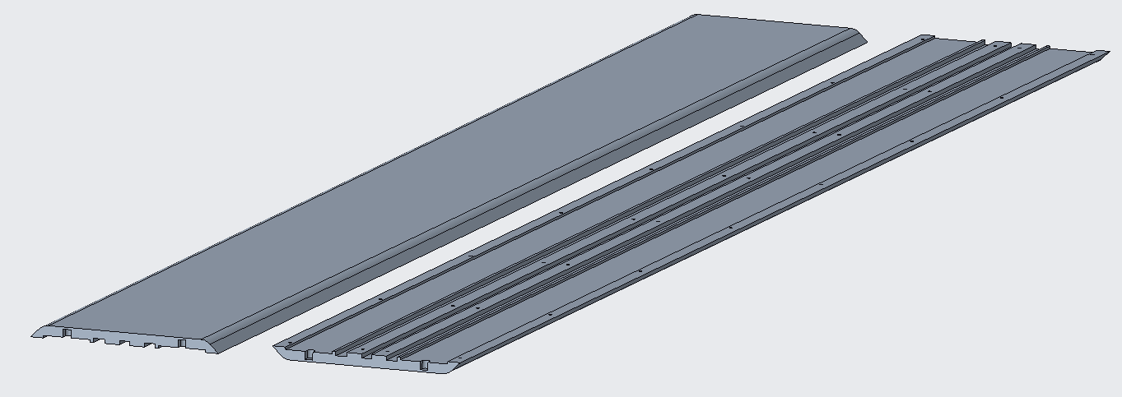
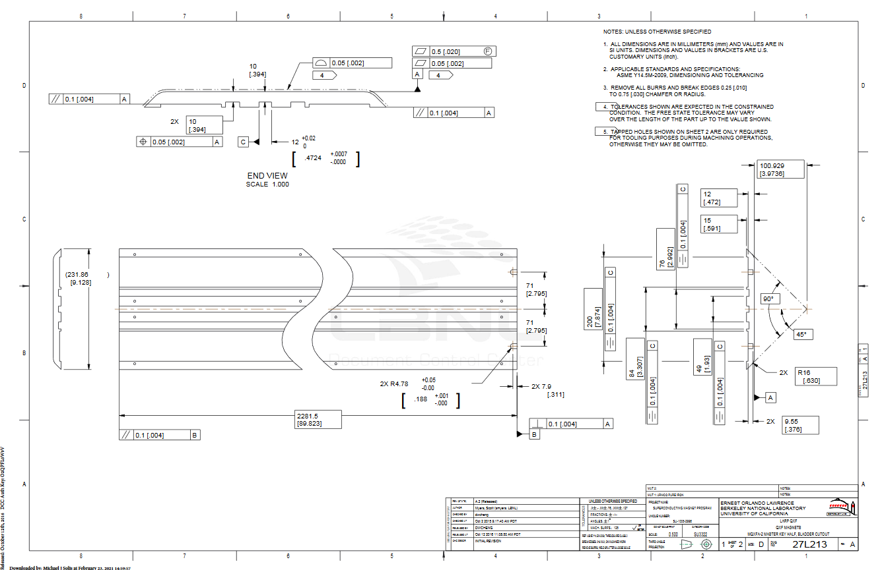
Master key

Slide 17
Master key
For the master key outer profile, the following specifications are set:
The master key outer profile scan shall maintain a .05 [.002”] tolerance.
PO 7580674 approved
No NCR

Slide 18
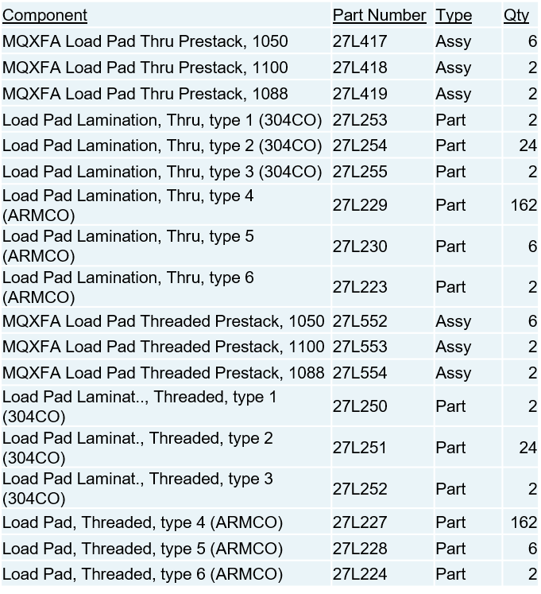
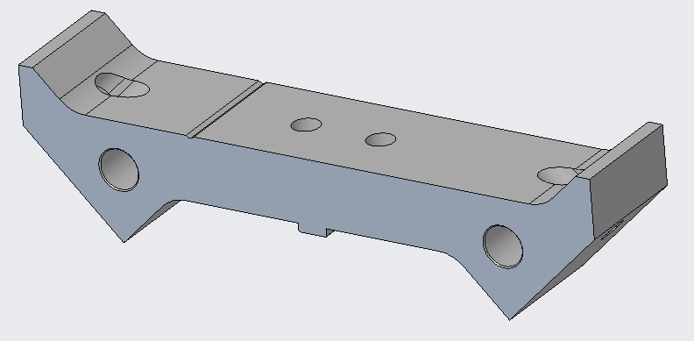
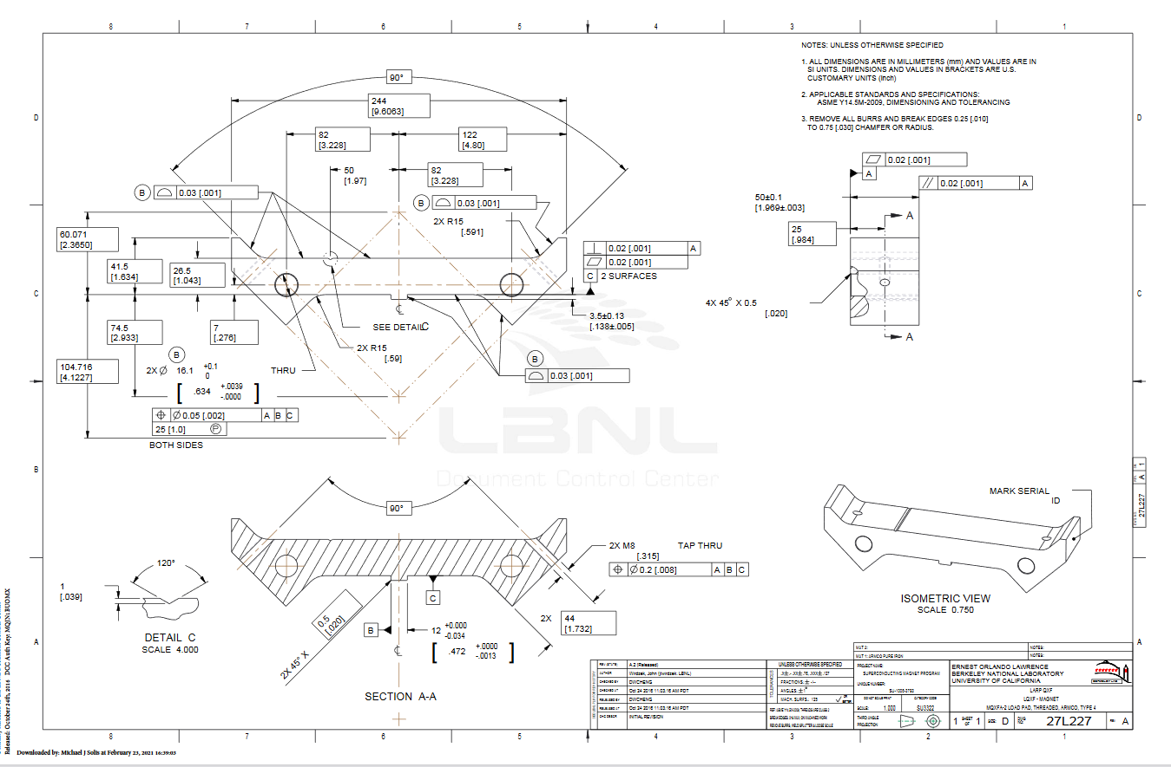
Load pads laminations

Slide 19
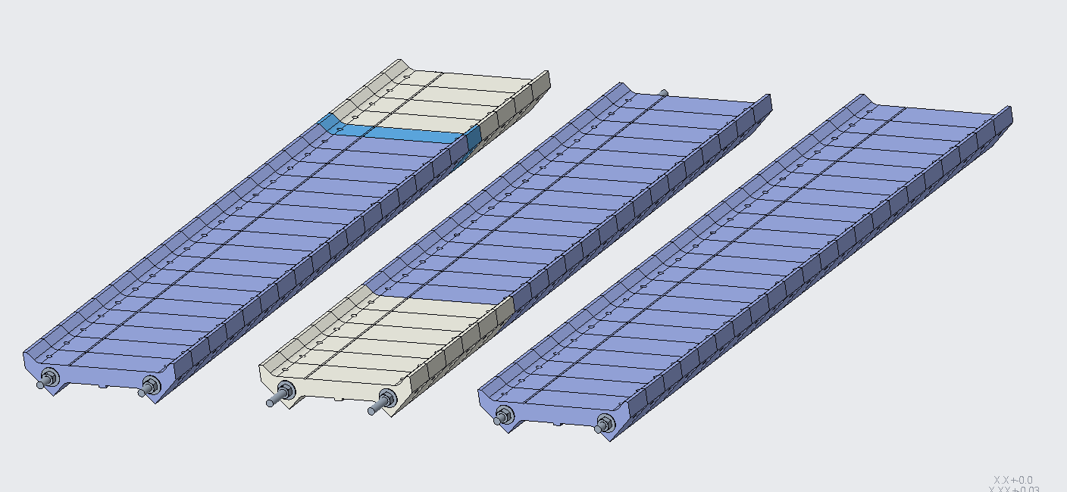
Load pad pre-stacks

Slide 20
Load pads laminations and stacks
For the load pad master key interface profile, the following specifications are set:
The Load Pad master key interface profile shall maintain a 0.03 [.001”] tolerance.
For the load pad collar key interface profile, the following specifications are set:
The Load Pad collar interface profile shall maintain a 0.03 [.001”] tolerance.
For the stainless-steel section of the pad pre-stack, the following specifications are set:
On the LE pre-stack, the LE pads shall have a stainless-steel section of 300 ± 0.6 mm and an overall pre-stack length of 1050 ±0.13 mm
On the RE pre-stack, the RE pads shall have a stainless-steel section of 200 ± 0.4 mm and an overall pre-stack length of 1088 ±0.13 mm
The 1100 pre-stack shall have an overall length of 1100 ±0.13
mm
PO 7532636 approved
NCR -0153

Slide 21
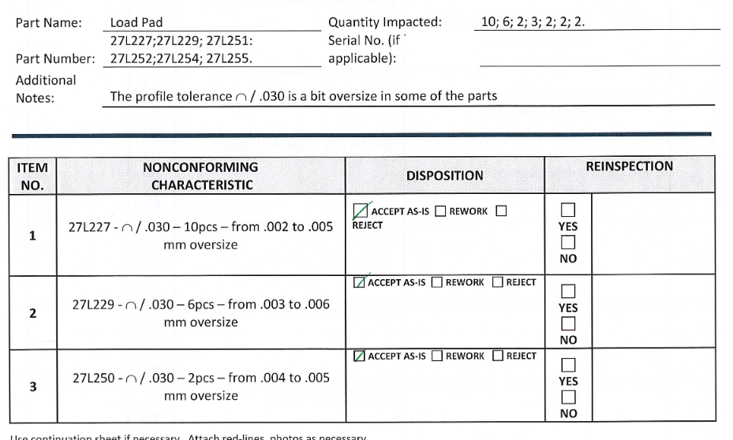
NCR-0453
Notes:
The Load pad laminations had a profile spec that was out of tolerance in a various places. The maximum profile deviation was .006mm. The small deviance allowed us to accept as-is. The pre-stacks were in tolerance.

Slide 22
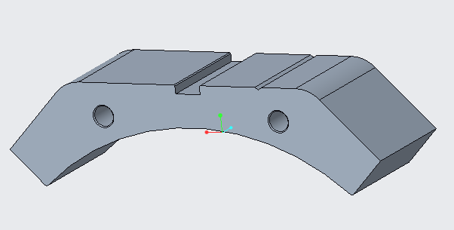
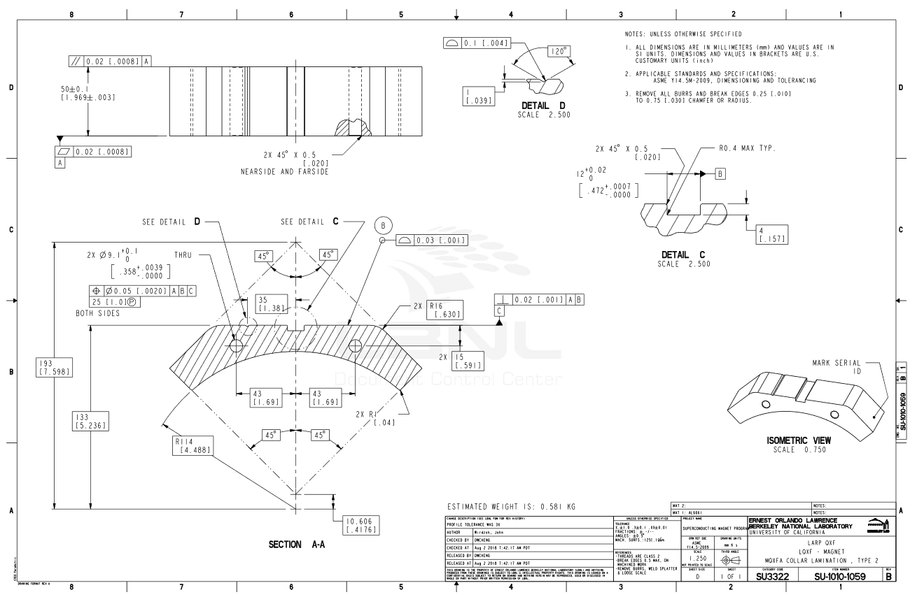
Collar laminations

Slide 23
Collar laminations
For the collar to load pad interface profile, the following specifications are set:
The entire collar to load pad interface profile shall maintain a 0.03 [.001”] tolerance all around.
For the collar to coil interface profile, the following specifications are set:
The collar to coil interface profile shall maintain a 0.03 [.001”] tolerance all around.
PO 7532707 approved
No NCR

Slide 24
MQXFA15 Change Records
NCRs on A15 thus far include:
#153 – minor load pad non-conformances
#226 – minor yoke non-conformances
#268 – coil 220 PHB01b label missing
#272 – minor shell non-conformances
#276 – coil 220 tall pin
#359 – coil 220 GPI replaced after long storage
#468 – coil 233 broken strands on lead 31” from LE
#470 – coil 127 crate, 1 shockwatch tripped
#472 – coil 127 rubbed NbTi leads due to unprotected leads discovered during in-crate inspection
#490 – coil 127 some surface anomalies on RE OD, proud spacer in the cable turn region
#491 – (DEV) make the SG overlap the solder tabs pad in SG prep process
#494 – (DEV) test out wrapping leads with 0.002” thick 2/3 overlap instead of 0.002” thick 50% overlap
#495 – coil 226 has proud pin and several proud epoxy plugs
#497 – three load pad stacks initially placed with RE and LE reversed
#498 – load pad bushings not fitting, need to be replaced
#505 – G11 radial layers shifted during glue drying; redone

Slide 25
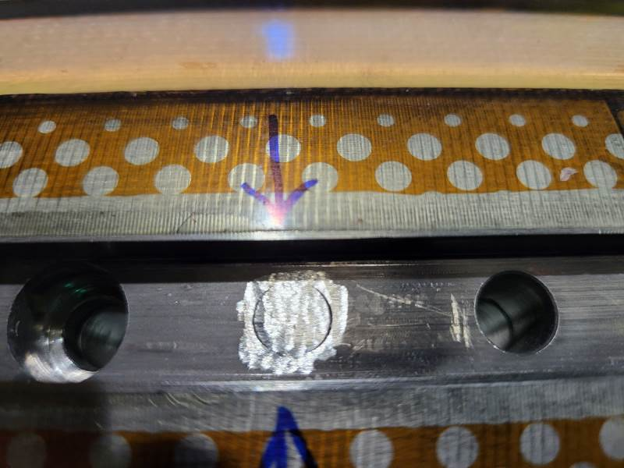
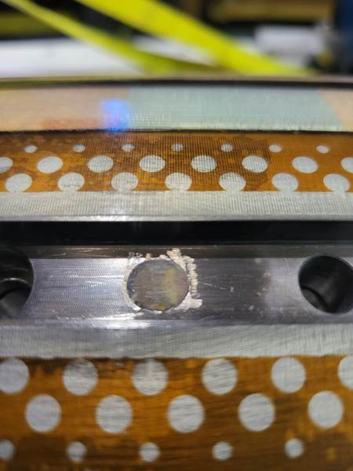
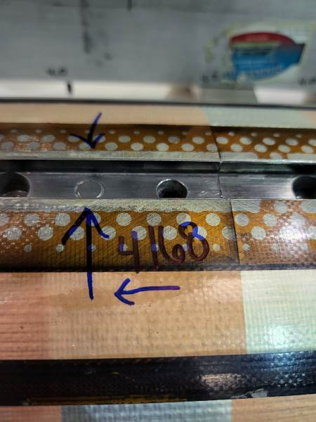
NCR #276 Detail
Tall pins trimmed on coil 220
(Done in Oct. 2021, current instructions are to leave the pins)

Slide 26
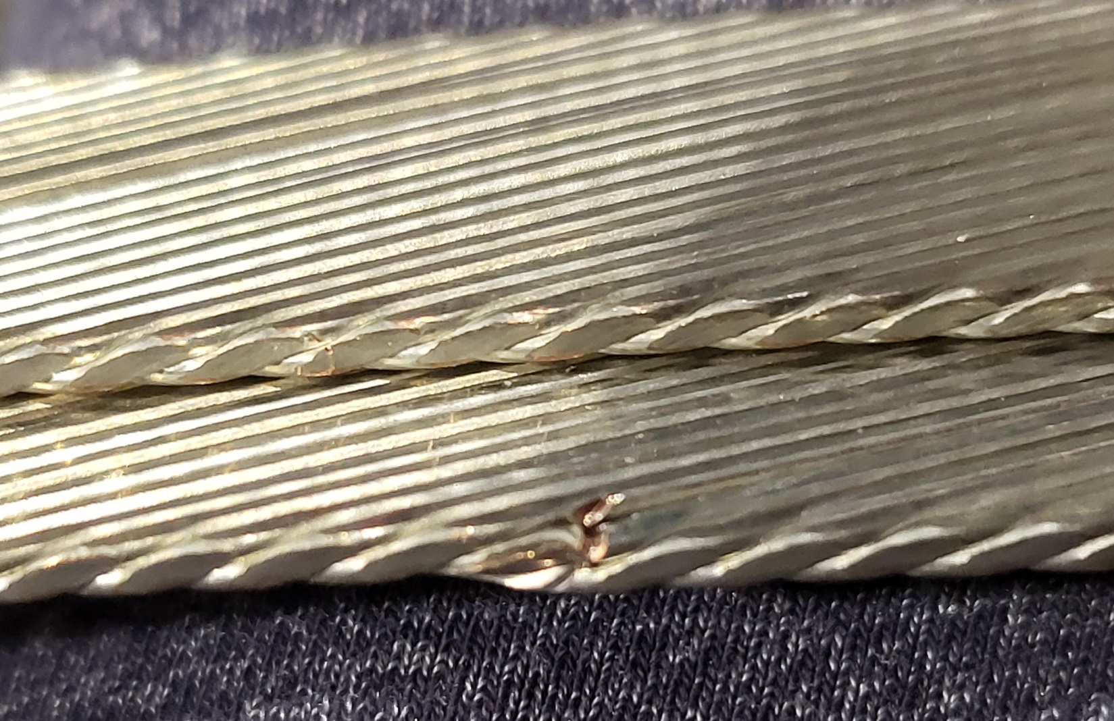
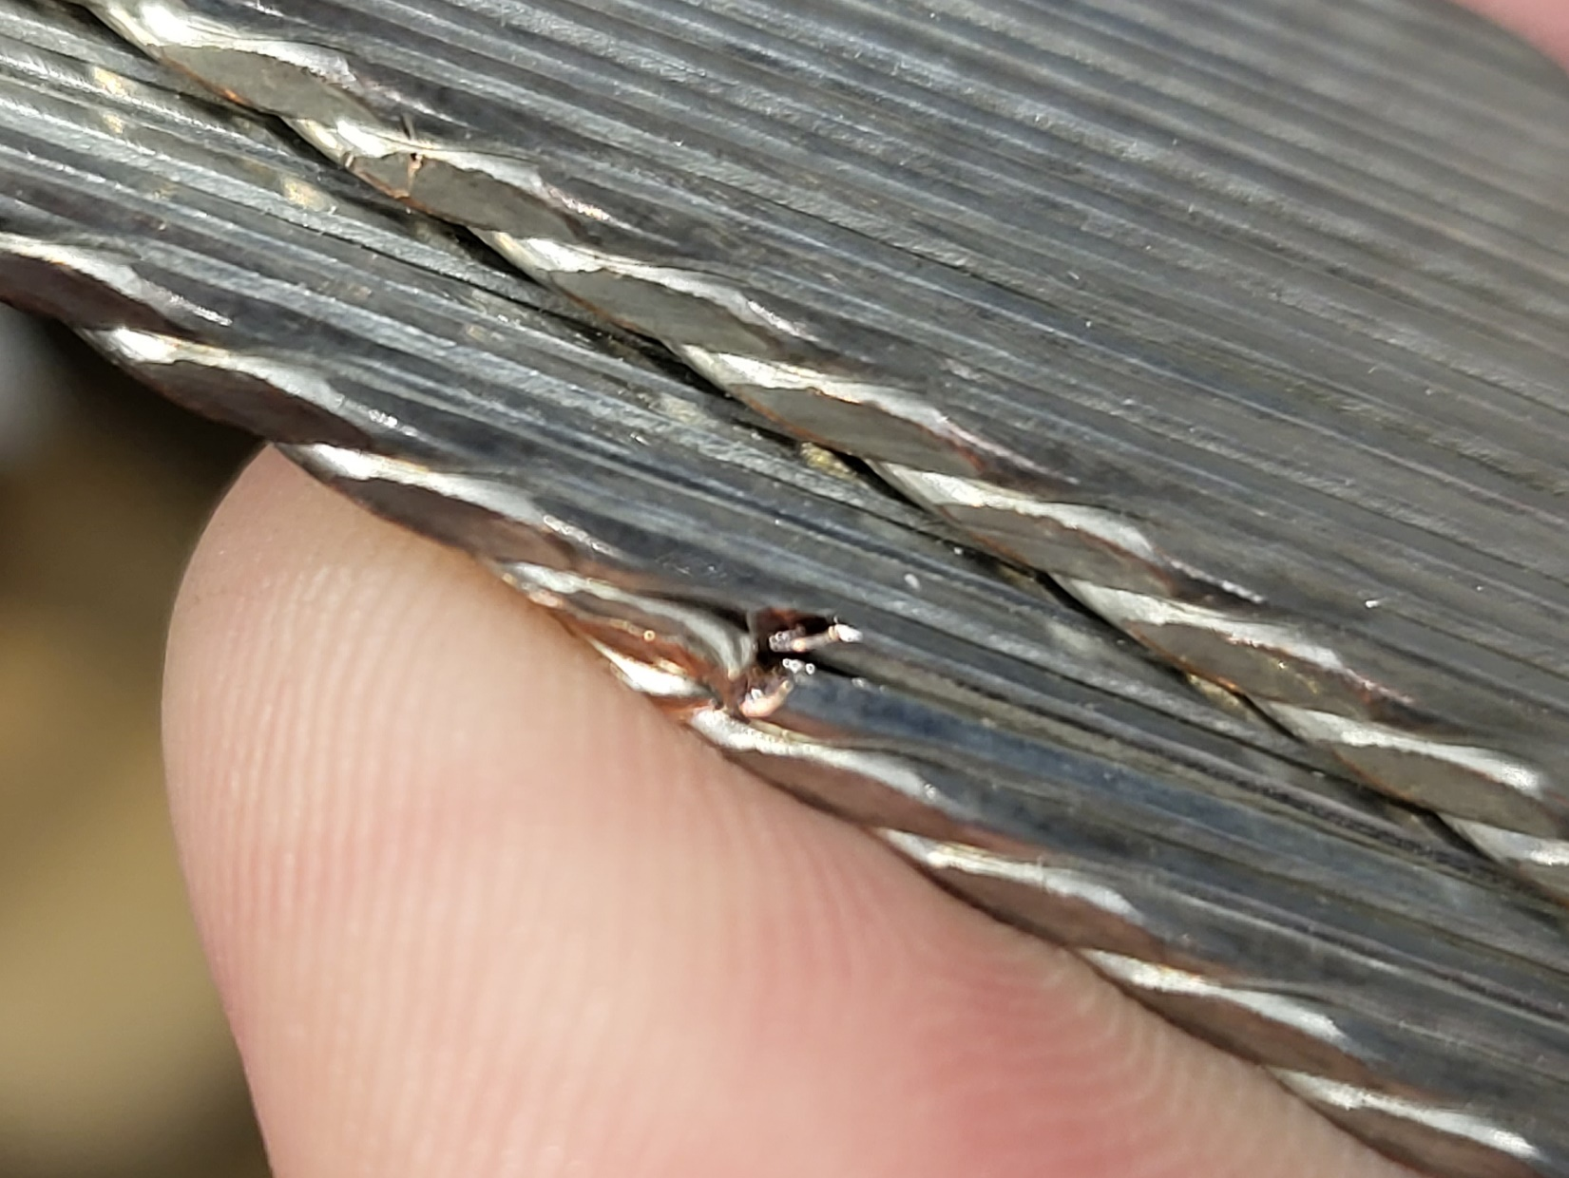
NCR #468 Detail
Coil 233, 31” from LE

Slide 27
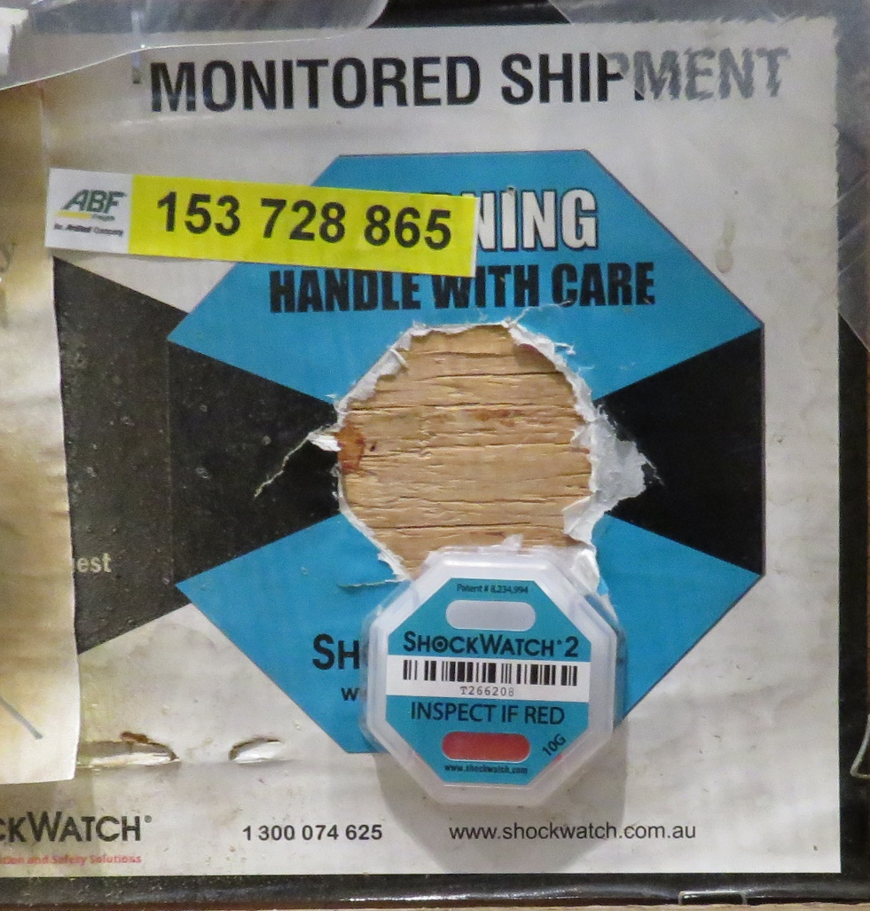
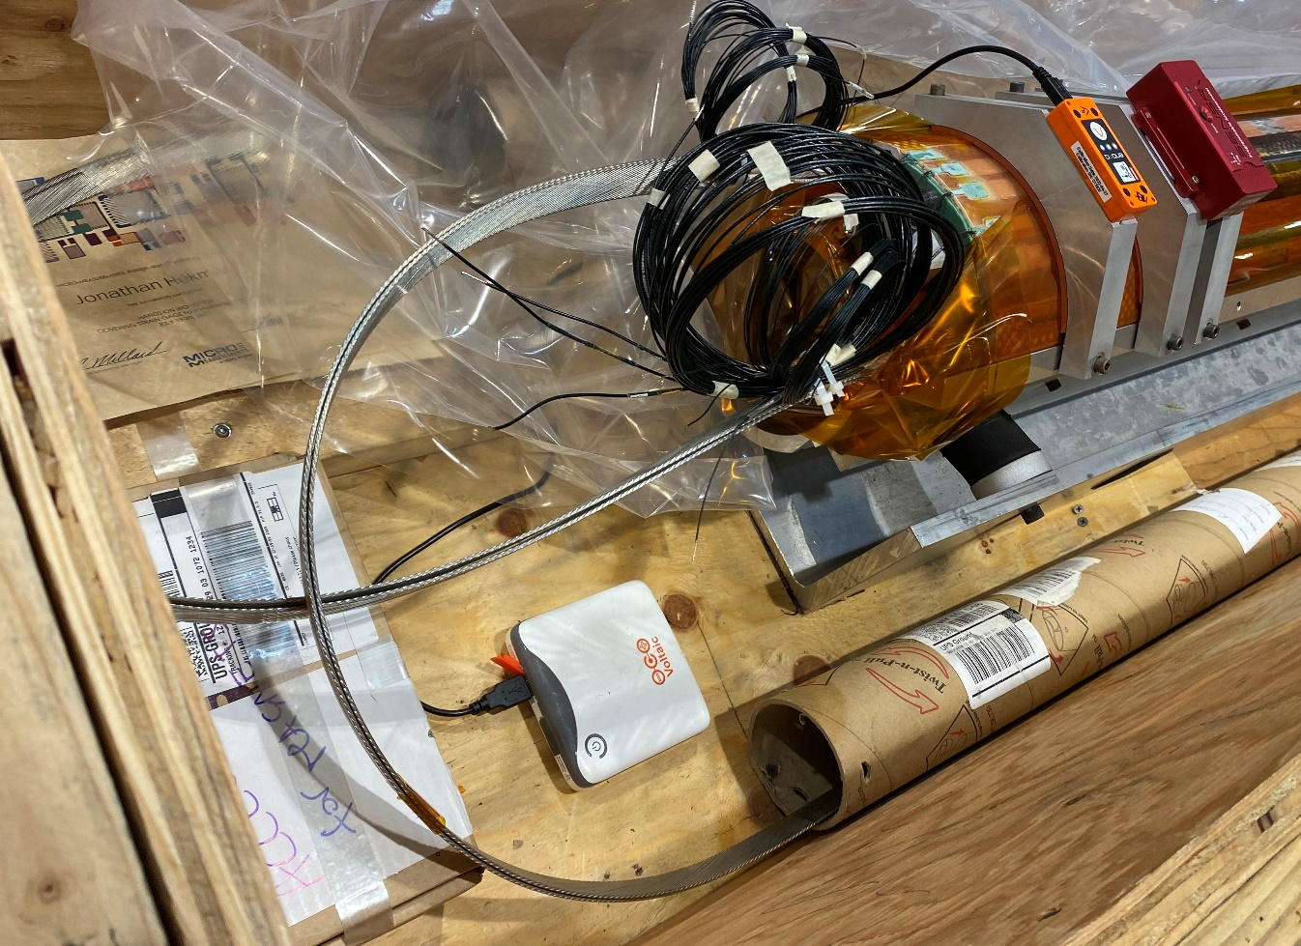
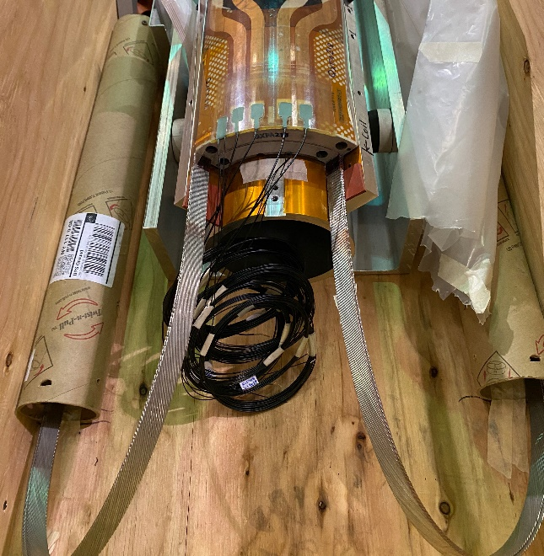
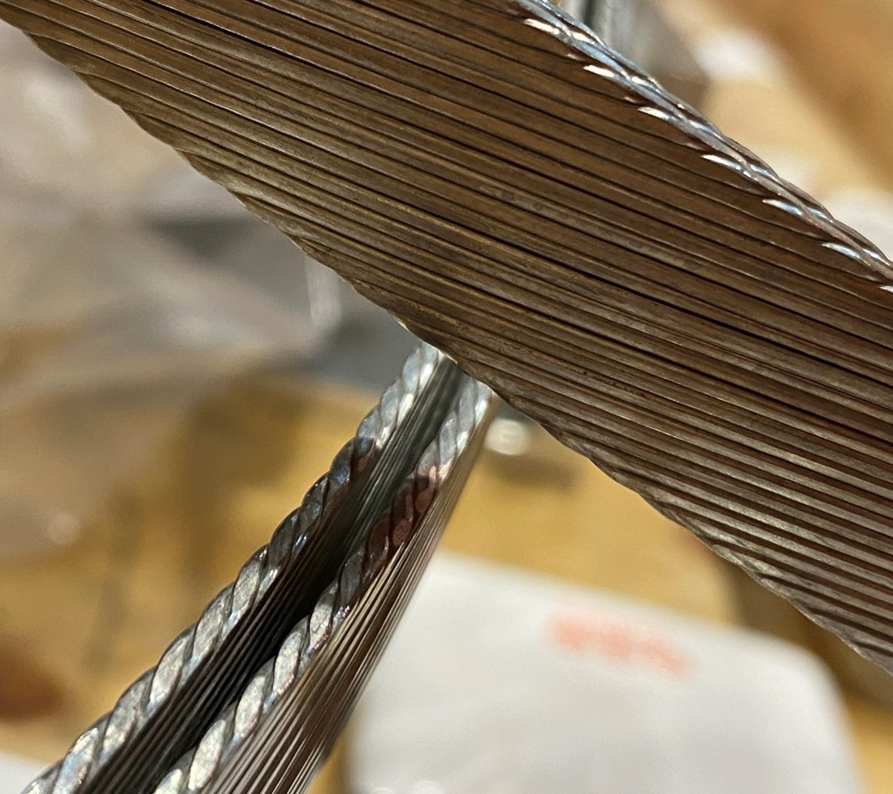
NCR #470, 472 Detail
Previous coil for comparison
Coil 127, 1 shockwatch tripped, others okay
Coil 127, leads crossed in crate, some discoloration noted

Slide 28
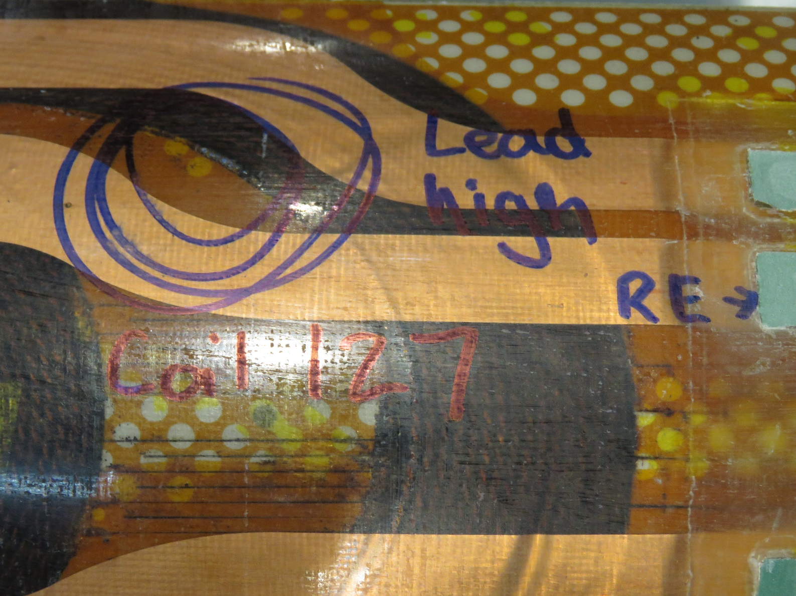
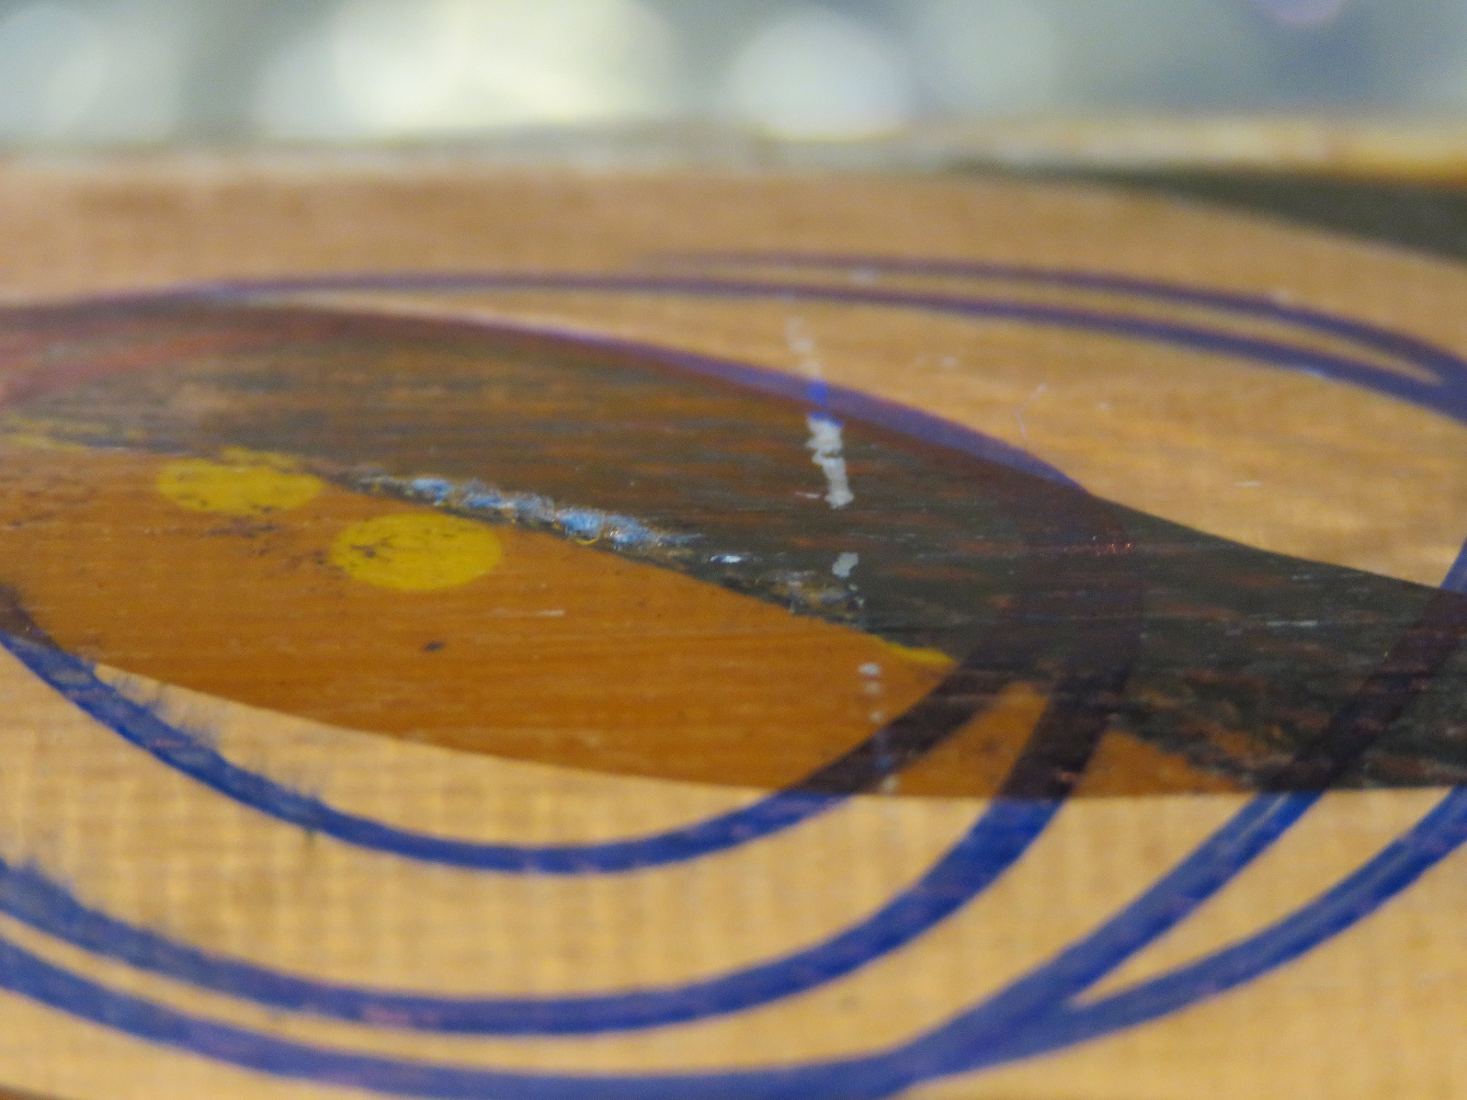
NCR #490 Detail
Coil 127, spacer high
To be filed down

Slide 29
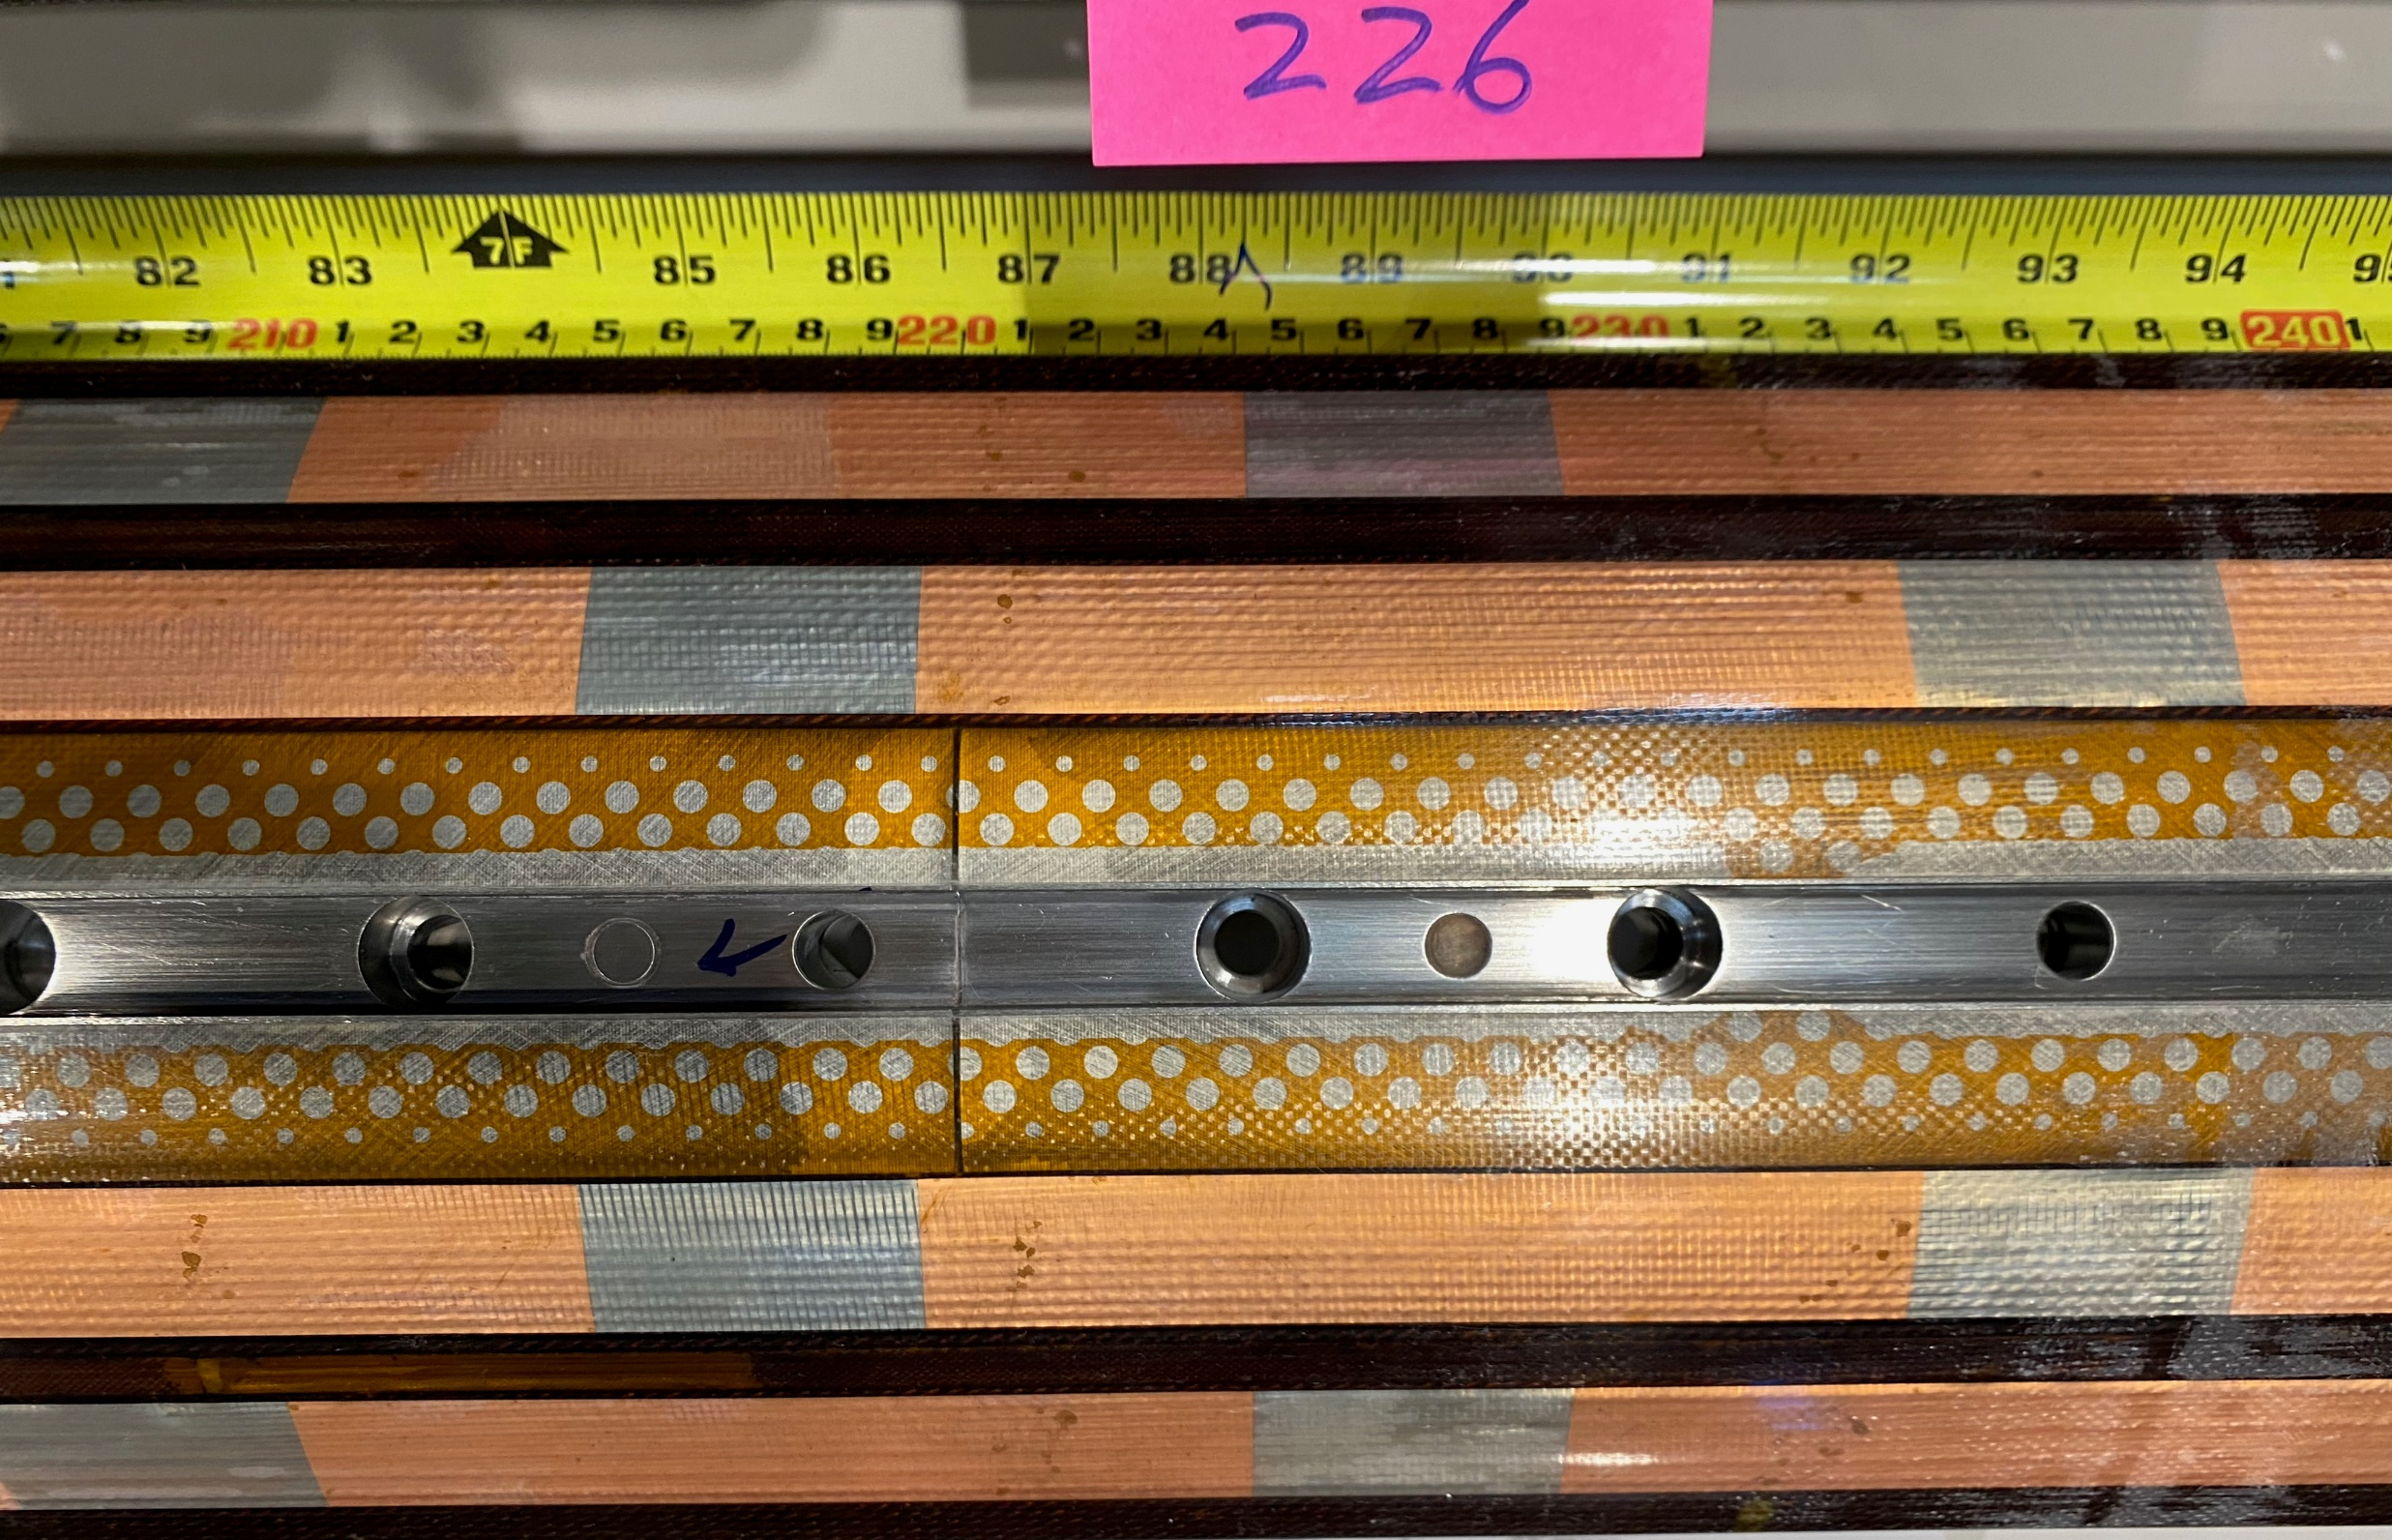
NCR #495 Detail
Coil 226, proud pin at 2167 mm from LE

