Slide 1
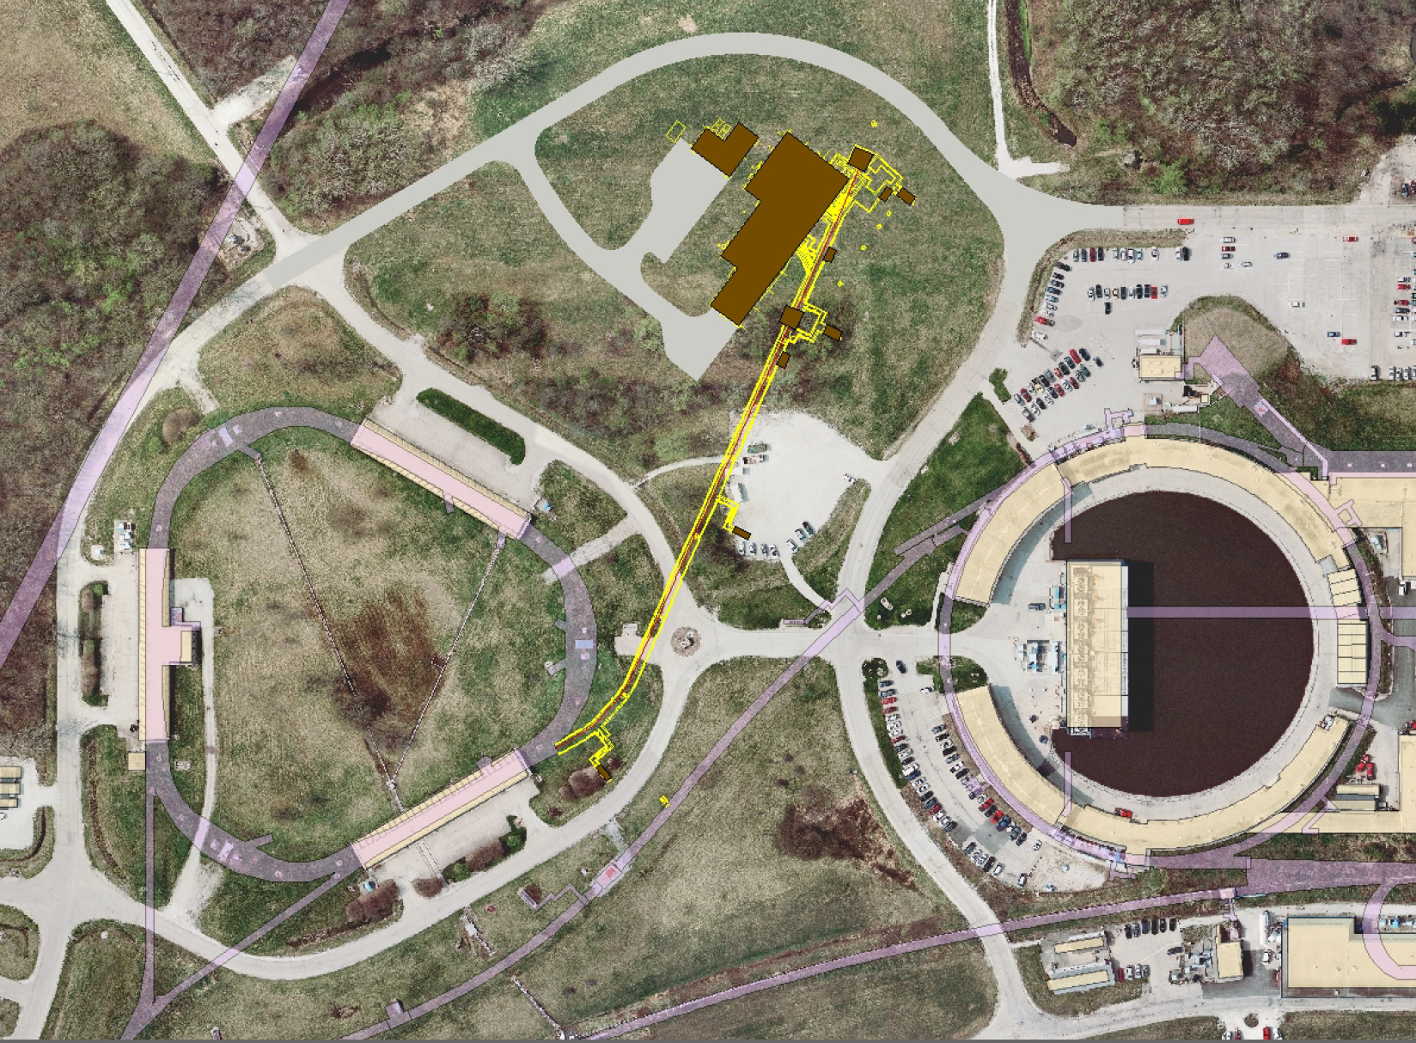
Accelerator Controls plans for g-2
Brian Drendel September 11, 2012

Slide 2
Controls needs for g-2
Funding and Deadlines
Muon Campus Controls
Controls plan for existing buildings
Controls plan for new buildings
Potential Problems
Communication duct bank interruption.
Need for Multimode fiber
Controls cables in accelerator tunnels.
Legacy shared 10Mbps controls Ethernet in AP0, F23 and F27.

Slide 3
How Instrumentation gets funded
Mu2e
Controls for extraction and Mu2e.
Mu2e Document Database (http://mu2e-docdb.fnal.gov/)
AIPs (Beam Transport and Delivery Ring; Recycler, etc…)
Repair communications duct
Beams Document Database (http://beamdocs.fnal.gov/)
g-2
Controls to MC-1
g-2 Documents Database (http://gm2-docdb.fnal.gov/)

Slide 4
FTL Codes
 | FTL Description | M&S Code | Description
g-2 | ///AD-G-2 PRECD0 FWP 40G-40G.01/// |  | All pre-conceptual design work for the g-2 experiment. This includes controls and instrumentation work specific to g-2. This is the M2 and g-2 lines, as well as portions of the M3, Delivery Ring and M4 lines.
AIP | ///AD-DELIVERY RING AIP CD 20-20.12.16.19/// |  | All design work for items on the Beam Lines and Delivery Ring AIP. Presently this includes Delivery Ring abort, beam line instrumentation (except M2, M4, g-2, or g-2 specific instrumentation), and Delivery Ring instrumentation (except DCCT and Tune measurement).
Mu2e | ///AD-Mu2e-Acc BL-Conc Des 475-1.02.01.01.02/// |  | Conceptual Design work for Mu2e. Do NOT use this code for new technical design work.
Mu2e | ///AD-Mu2e-Accelerator PED 475-475.011/// | 475.011 | Technical Design work for 475.02.03.01.01 Transport Controls. Mu2e controls work for P1, P2, M1, M3 and abort lines.
Mu2e | ///AD-Mu2e-Accelerator PED 475-475.014/// | 475.014 | Technical Design work for 475.02.03.01.02 Delivery Ring Controls. Mu2e controls work for the Delivery Ring.
Mu2e | ///AD-Mu2e-Accelerator PED 475-475.016/// | 475.016 | Technical Design work for 475.02.03.02.01 Delivery Ring DC Beam Measurement. This is for work on the Delivery Ring DCCT. AVAILABLE SOON.
Mu2e | ///AD-Mu2e-Accelerator PED 475-475.020/// | 475.020 | Technical Design work for 475.02.03.02.02 Delivery Ring Tune Measurement. This is for work on the Delivery Ring Tune Measurement system. AVAILABLE SOON.
Mu2e | ///AD-Mu2e-Accelerator PED 475-475.099/// | 475.099 | Technical Design work for 475.02.07.04 External Beam Line: Instrumentation. This is for work on the M4 line instrumentation. AVAILABLE SOON.
Mu2e | ///AD-Mu2e-Accelerator PED 475-475.102/// | 475.102 | Technical Design work for 475.02.07.05 External Beam Line: Controls. This is for work on controls to the Mu2e service building. AVAILABLE SOON.
Mu2e | ///AD-Mu2e-Accelerator PED 475-475.152/// | 475.152 | Technical Design work for 475.02.10.01 Operations Preparation: Machine Protection. This is for work on the Delivery Ring beam permit system.

Slide 5
Important g-2 Dates
October 1, 2012: Conceptual Design Report (CDR) Complete
Controls section draft (G2M-doc-449)
November 1, 2012: BoEs Complete
December 1, 2012: Internal Director’s Review
January 15, 2013: Lehman Review for CD-1.

Slide 6
Also in FY’13
Transport and Delivery Ring Accelerator Improvement Plan (AIP) scheduling.
Technical Design Report (TDR) for Mu2e
Plans for g-2 beam studies

Slide 7
Controls Plan
The existing controls infrastructure will be used in existing buildings.
Care will need to be taken not to disrupt the signal paths and restore any signal paths that are interrupted!
CAMAC and serial links over Heliax cable
Controls Ethernet over fiber optic cable
Long range plans have us phasing out CAMAC in favor of Hot-Link Rack Monitor systems.
New Service Buildings (Mu2e and MC1)
New fiber optic cable will be pulled to the MC1 service building to provide all controls.
There will be no CAMAC in the MC1 service building
Controls Ethernet run over fiber optic cable.
Hot-Link Rack Monitors that run over Ethernet will replace CAMAC.
Timing and abort links will be back fed from the cross gallery via the fiber optic cables.

Slide 10
Manholes

Slide 12
Open Questions, issues?
Communications Ducts:
Is there room in the communications ducts for the required cable pulls and Heliax splices?
Access manholes?
Fiber Pulls
MC-1 and Mu2e fiber pulls will have to include multimode fiber. Costing was only done for singlemode.
Should we also pull multimode to AP30?
FIRUS?
Heliax Splicing
How serious of an option should pulling new multimode fiber instead of splicing?
Pulling new Heliax was the backup to splicing. Should it be fiber?
FIRUS?

Slide 13
Open Questions, issues?
Tunnel Cable Trays
Delivery Ring abort dump installed in the AP2 line. Do we need to shield the cables?
M2/M3 lines (Transport Enclosure) magnet moves. There will be a lot of work in this enclosure.
Delivery Ring Injection and Extraction at D30. This will become a very crowded area of the tunnel. Cable tray moves will be required!
Replacing Legacy Networks at AP0, F23 and F27
Still trying to find someway to pay for it!

Slide 14
References
FESS Site Maps, http://fessesri.fnal.gov:8080/Planning/index.html
B Drendel, Controls and Instrumentation Plan, GM2-doc-449, August 2012.
B Drendel, et al., “Pbar Controls Reference Material,” Mu2e-doc-1161, May 2012.
B Drendel, et al., “Muon Campus Controls Costing,” G2M-doc-429, July 2012
A. R. Franck, et. al., “HOTLink Rack Monitor,” FERMILIAB-Conf-01/342/E.
B Drendel, et. al., “Muon Campus Controls Costing,” Mu2e-doc-1611, July 2012
B Drendel, et. al., “BoE 475.02.03.01.02: Delivery Ring Controls,” Mu2e-doc-1468, May 2012.
B Drendel, et. al., “BoE 475.02.03.01.01: Transport Controls,” Mu2e-doc-1572, May 2012.
C. Johnstone, et. al., “BoE 475.02.08.06: External Beamline Controls,” Mu2e-d0c-2136, January 2012.
B Drendel, et. al., “BoE 475.02.11: Machine Protection,” Mu2e-doc-1639, May 2012.
P Kasley, “HRM,” Project X Document 672, September 2010.

Slide 15
Supplemental Slides

Slide 16
Potential Issues
Controls Duct bank interruption.
Tunnel cable tray moves
Controls signal cables in beam tunnel
Legacy shared Ethernet at F23, F27 and AP0

Slide 17
CAMAC Serial Link

Slide 18
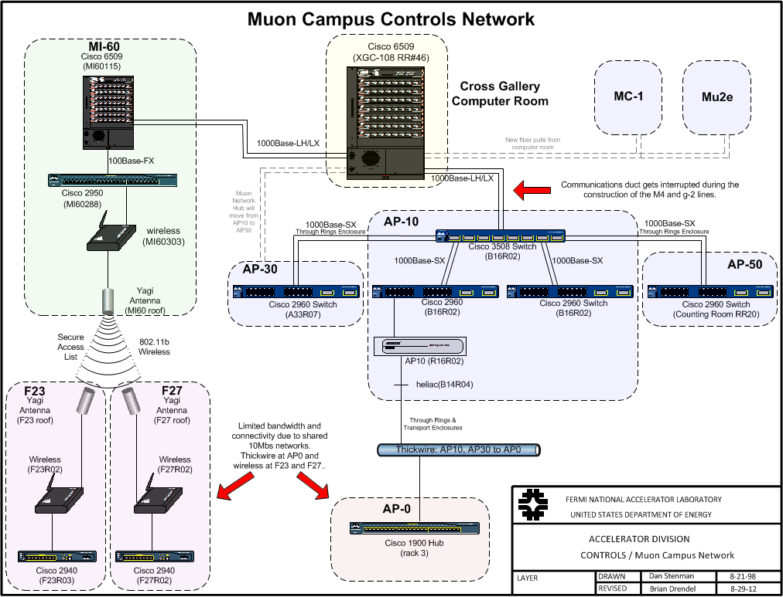

Slide 19
Serial Links
There are other links used by the accelerator that connect from building to building the accelerator enclosures.
Abort Loop
Used for beam permit for the Muon Rings
Existing Buildings: MCR → AP10 → AP30 → F27 → AP0 S → F23 → AP0 N → AP50 → Ap10 → MCR
New buildings: Fiber pulled from cross gallery.
Tevatron Clock
Transfers accelerator timing information throughout the accelerator complex.
Existing buildings use existing infrastructure.
New buildings: Fiber pulled from cross gallery.
Beam Synch Clock
Beam synchronization (Instrumentation and transfer devices)
Main Injector (MIBS) – 53 MHz
Recycler (RRBS) – 2.5 MHz
F0, F1, F2:
Need both MIBS (SY120) and RRBS (g-2 and Mu2e)
TVBS replaced by RRBS at MI60.
Existing Muon buildings
Replace MIBS feed at F0 with RRBS.
New Buildings
Fiber pulled from cross gallery.

Slide 20
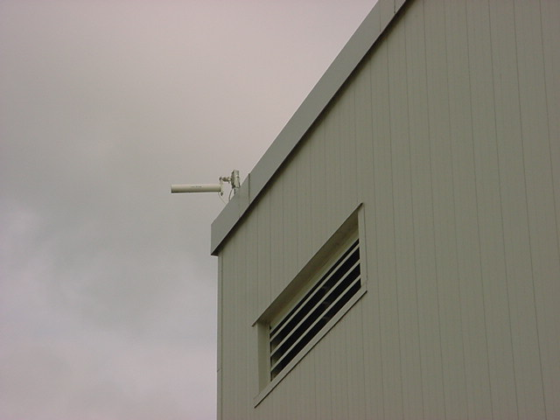
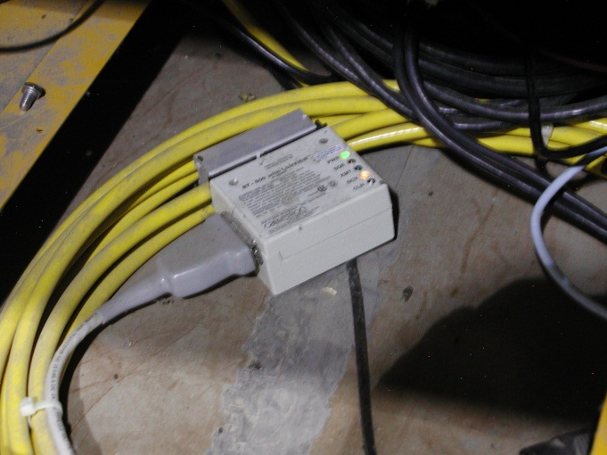
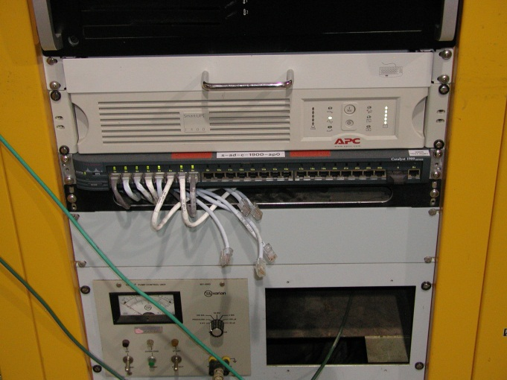
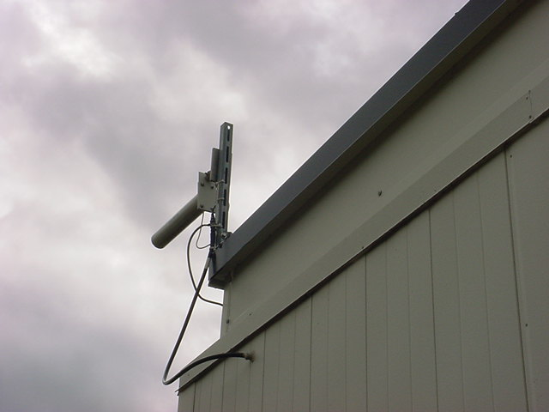
Limited Networks
MI-60 Wireless
AP0 Thicknet
AP0 Ethernet Hub
Wireless network at F23/F27 and Thicknet at AP0
Limited bandwidth
Limited connections
More difficult troubleshooting
Least costly upgrade is fiber run through tunnel enclosures (rad hardened?).
F23 Wireless
Notes:
Shared 10Mbps networks at F23, F27 and AP0 limit bandwidth and connectivity.

Slide 21
Service Buildings

Slide 22
Muon Campus Service Buildings
Notes:
M1 line – F23, AP0
M2/M3 lines – F27, AP0, AP30
Delivery Ring – AP10, AP30, AP50
G-2/M4 lines – AP30, MC1

Slide 23
CAMAC Crates

Slide 24
Hot-Link Rack Monitors
Flexible data acquisition and control system composed of a remote unit (RU) and a PCI Mezzanine Card (PCI).
Each HRM provides sixty four 16 bit analog input channels, 8 analog output channels, 8 TCLK timer channels and 8 bytes of digital I/O.
Each RU can accept up to three I/O Modules (IOM).
New modules are being designed to slowly replace all of the functionality of CAMAC.
Notes:
HRM
-Flexible data acquisition and control system composed of a remote unit (RU) and a PCI Mezzanine Card (PCI).
-Remote Data Acquistion chassis
-Companion PMC, resides in host VME crate
-4-wire, 320 Mbps bidirectional serial link. Cable can be 20m
-Data collected at the remote chassis streams directly into PCI memory at the host with no host processor intervention.
HRM Advantages
-Platform independent
-Operating system independent
-Copact
-Easy expansion
-Potential to do preprocessing

Slide 25
Conclusions
Existing Muon Service Buildings
Communication duct band connection restored by a new fiber optic cable pull and splicing the Heliax.
Communications star out from AP30 instead of AP10
Continue to use legacy CAMAC systems and links using existing infrastructure.
Beam synch switched from MI 53MHz to RR 2.5MHz.
Care taken not to interrupt tunnel cabling in areas of work.
AP0 stays on legacy Thickwire Ethernet.
F23 and F27 stay on wireless Ethernet.
Rad resistant fiber optic cable upgrades in tunnel not necessary until Mu2e.
New buildings (MC-1, Mu2e)
New single mode fiber optic cable pulled to the MC1 service building.
Fiber optic cable provides all Ethernet and controls connectivity.
HRMs will be used in place of CAMAC.
Abort and timing links back fed via fiber optic cable to the cross gallery.

