Slide 1

Chimneys Status
Steel tanks
V24 steel tank under production (4 months)
Delivery expected at the end of the month
Vacuum tests and cryogenic test in April
Validation of steel tank in May in order to launch V48 production before summer in order to receive it during automn
Fabien Cavalier, 20/03/23

Slide 2
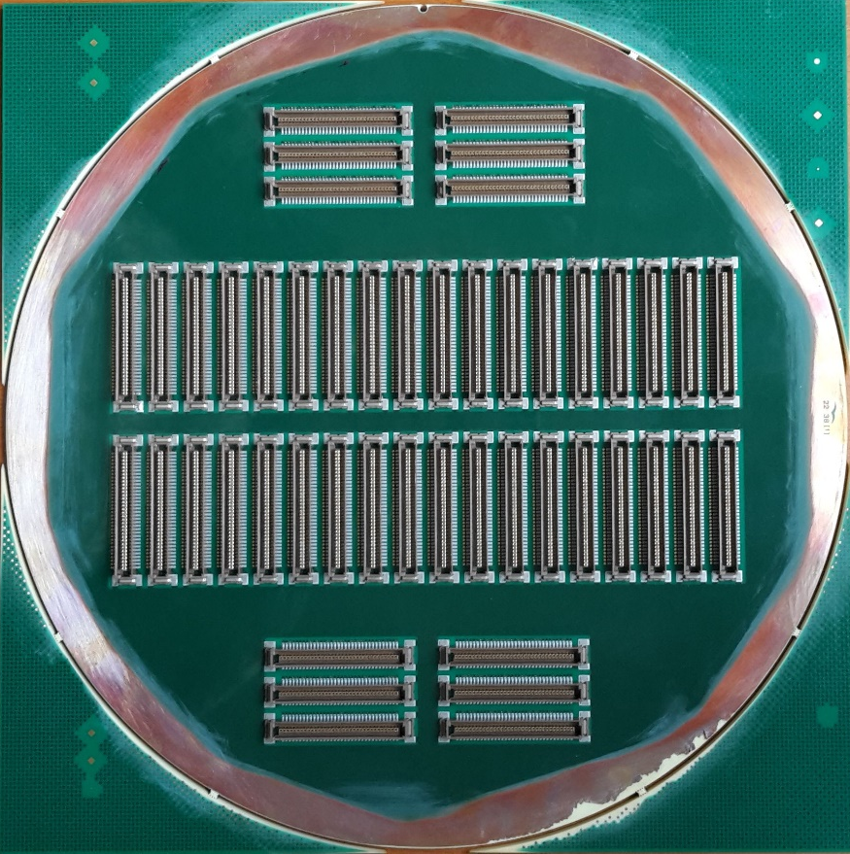
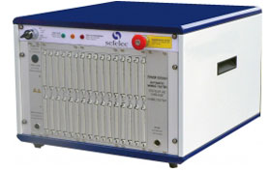
PCB
Cold V24 produced and connectors mounted on both sides
Offers received for mass production Cold V24 and Cold V48 including connector mounting and tests (continuity, short-cuts and isolation)
~20 weeks, ~100 k€ (connectors excluded)
Cold V48: purchase in progress for 1 prototype => Available end of April
Warm (identical for both chimneys):
  Layout in progress.
  Discussion on Friday 24th with Lyon (Thibaut and Jeremy at Lyon on Friday)

Slide 3
Guiding System
Design for V24 with improved airflow or cooling plates
=> to be ordered before the end of the month, available in April

Slide 4
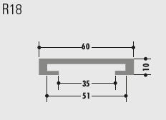
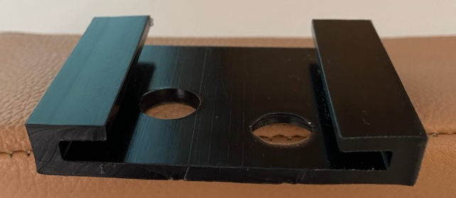
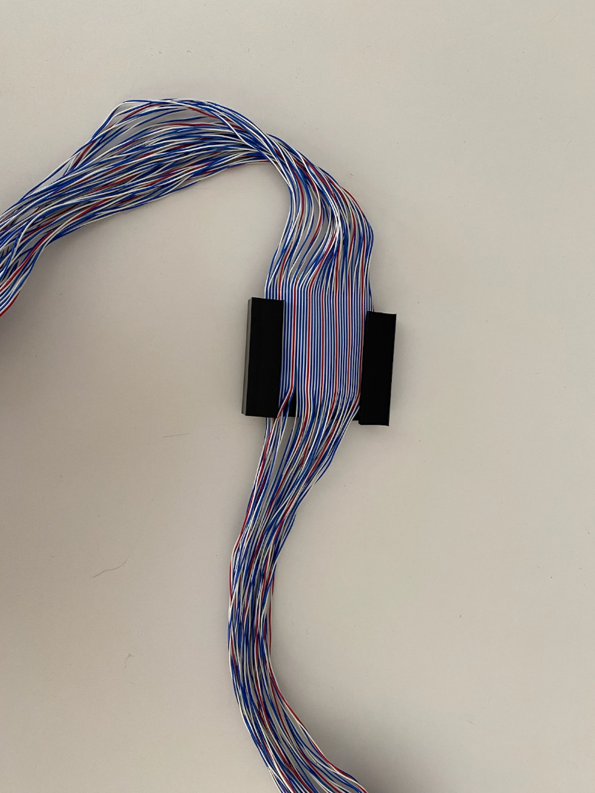
Blades
Interesting discussion last week with Rochling (provider of cathode frame)
Possibility to use a C-shape on-the-shelf profile
Cables directly inserted in the C-shape and covered with a Mylar foil
No cable holder
=> Cost reduction about ~100 k€
Waiting for long samples for rigidity checks
To be tested on V10 prototype for board insertion and cryogenic behavior (April-May)

Slide 5
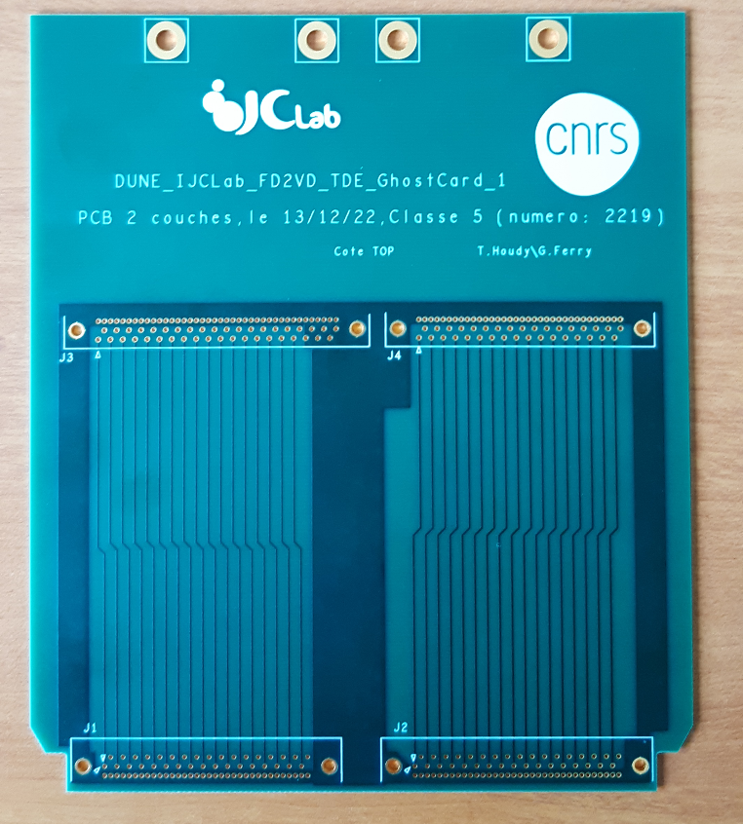
Tests and Validation
Test bench under design (will be used for production)
Continuity tests @IJCLab
  Pass-thru boards designed (extended version with respect to FE for easier and cheaper blade connection (to be validated)) and 1 prototype produced
  Need for cables and connectors
Board with thermal dissipation under design
Thermal tests @ IJCLab in May-June for V24
Full Functional tests @ CERN (to be discussed and defined):
  V24 + Blades + FE boards if possible during Autumn
  V48 + Blades + FE boards if possible at the end of the year
  Cryogenic conditions
  In Faraday cage ?
  Noise measurements ?
  Electronic response ?
  Interaction with Module-0

Slide 6
Conclusion
FDR with « standard » design of guiding system and blades
Probably first leak tests results available for V24 steel tank
Planning OK for PRR
Exact validation program to be defined for CERN tests

