Slide 1
Meson Report
Michael K. Olander
AD 9:00 Meeting
17 March 2023

Slide 2
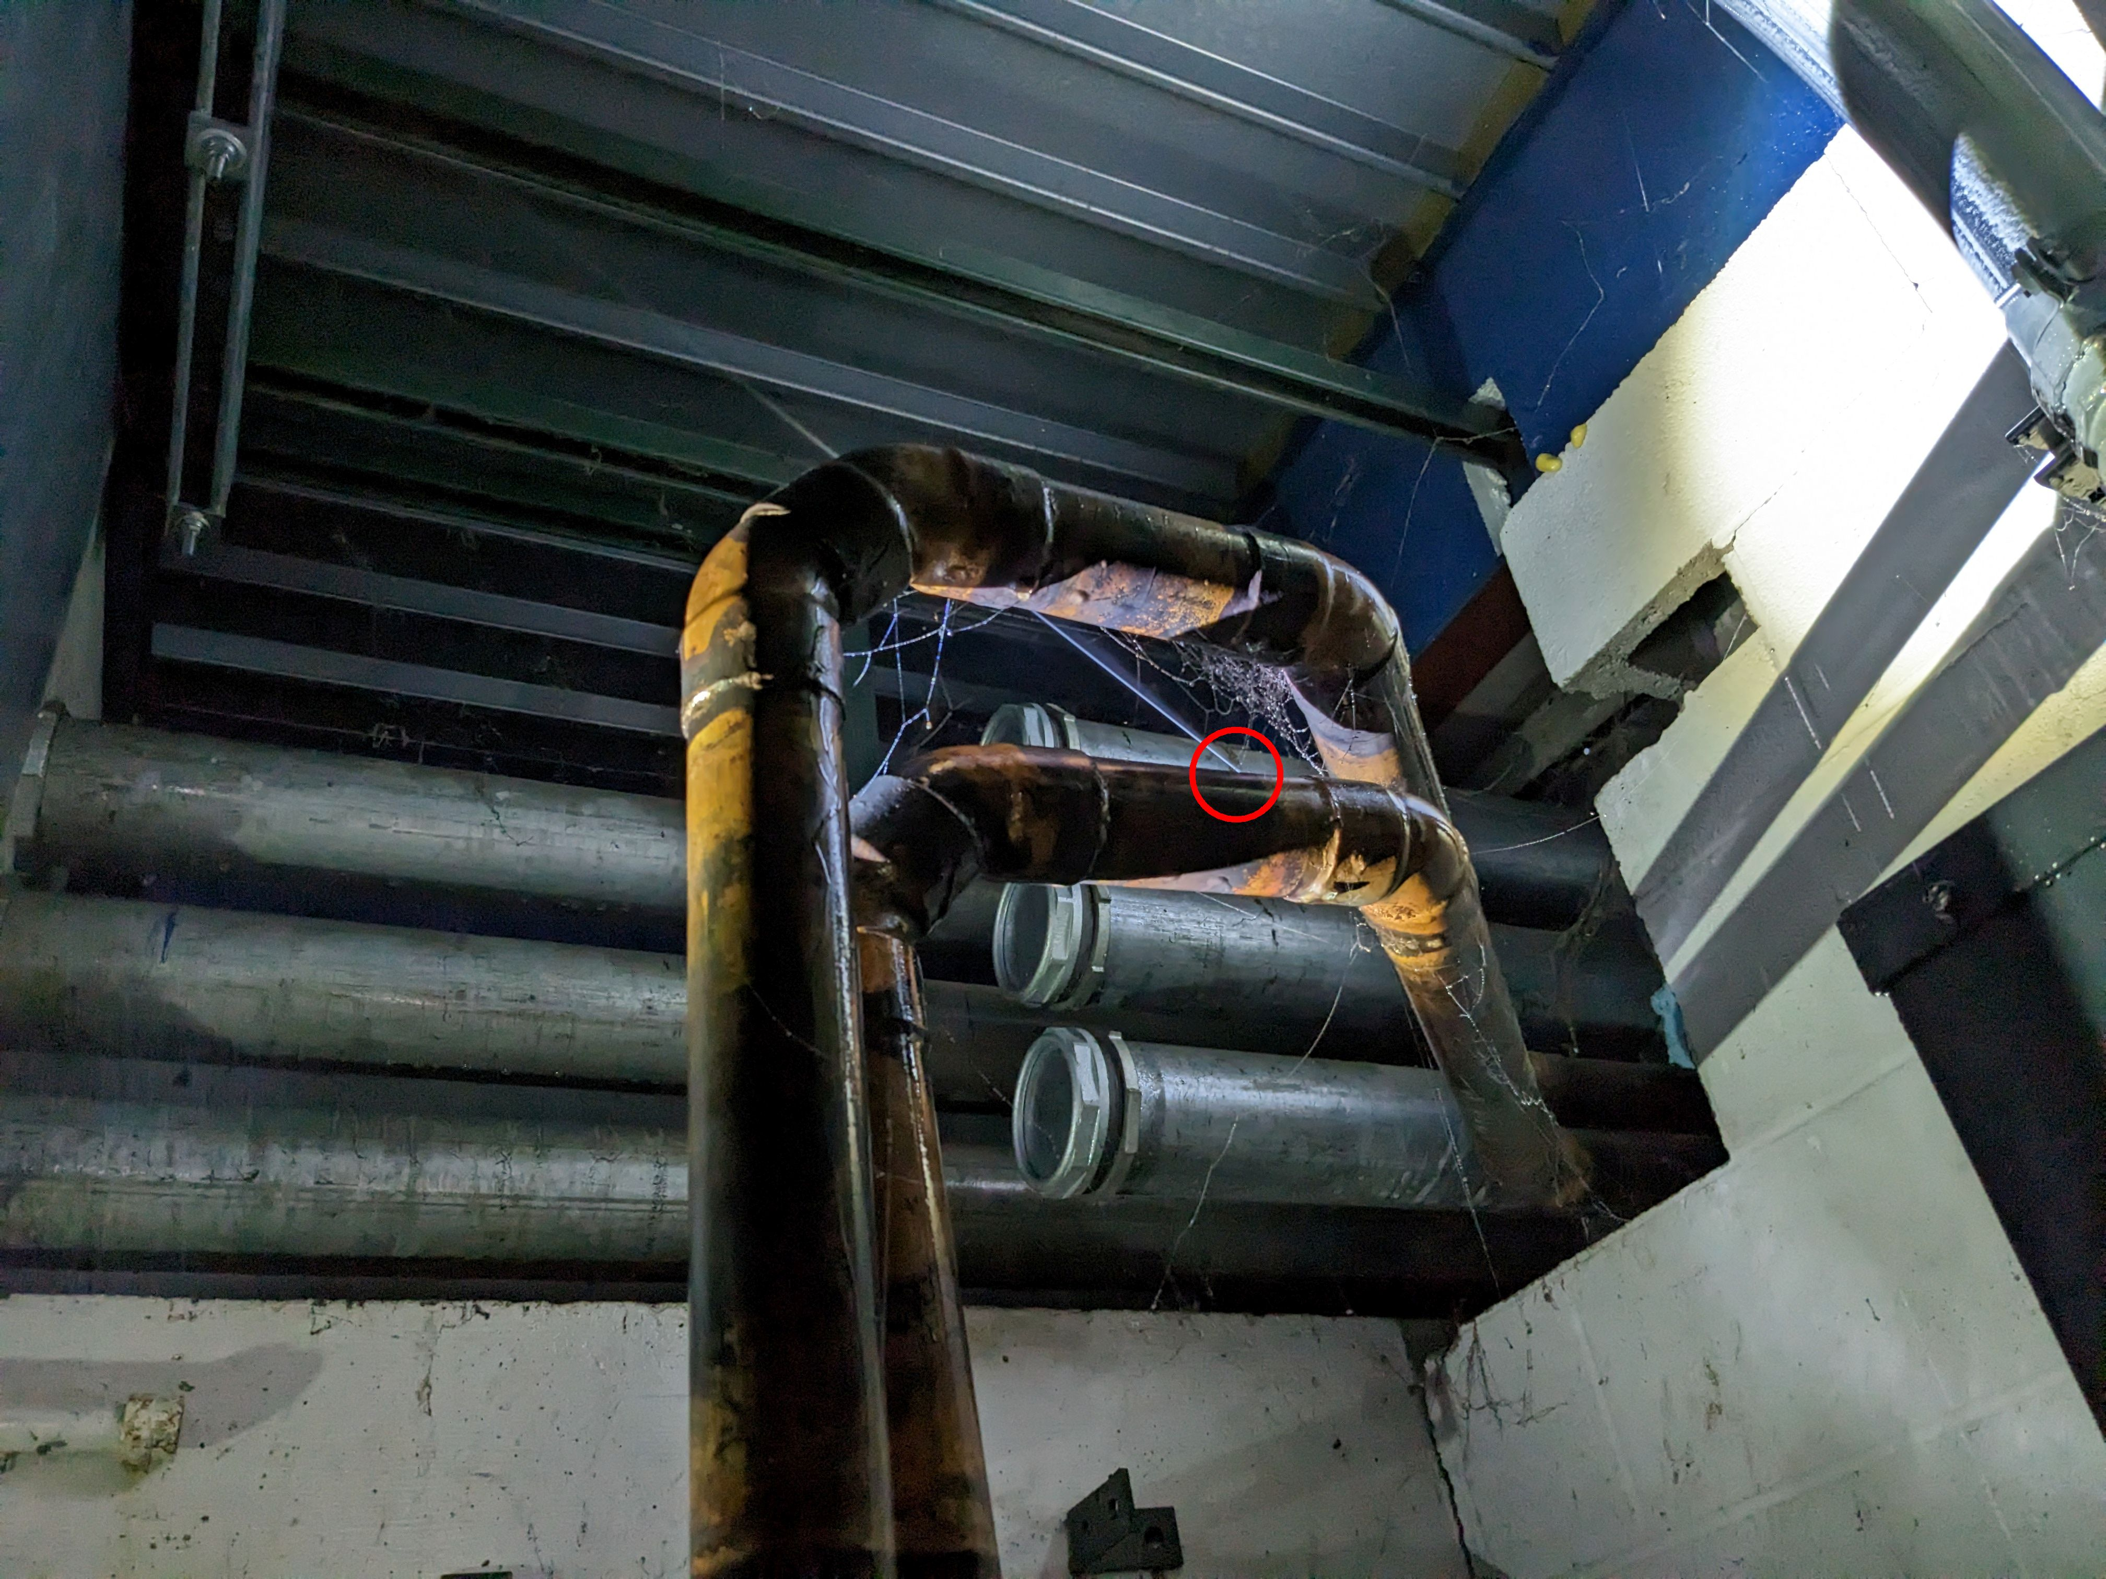
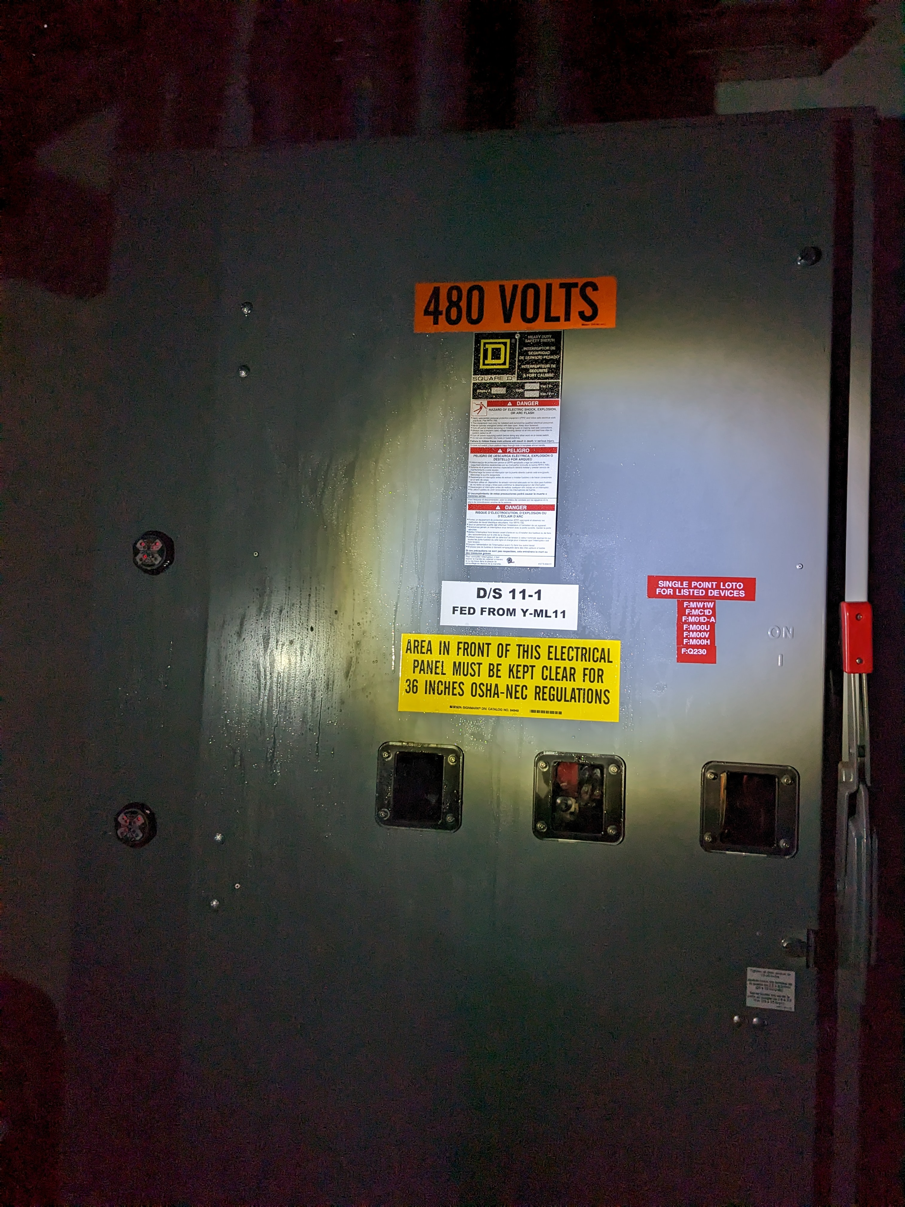
MS1 LCW Leak
Leak on the LCW header in the MS1 Service Building next to the MS1 Single Point LOTO disconnect.
Thanks to MSD for getting a clamp on the leak.
MS1 Single Point LOTO disconnect had LCW/Glycol in the cabinet upon inspection.
Thanks to Paul Neville and Engineering Support for handing the clean up and repair of the disconnect.

Slide 3
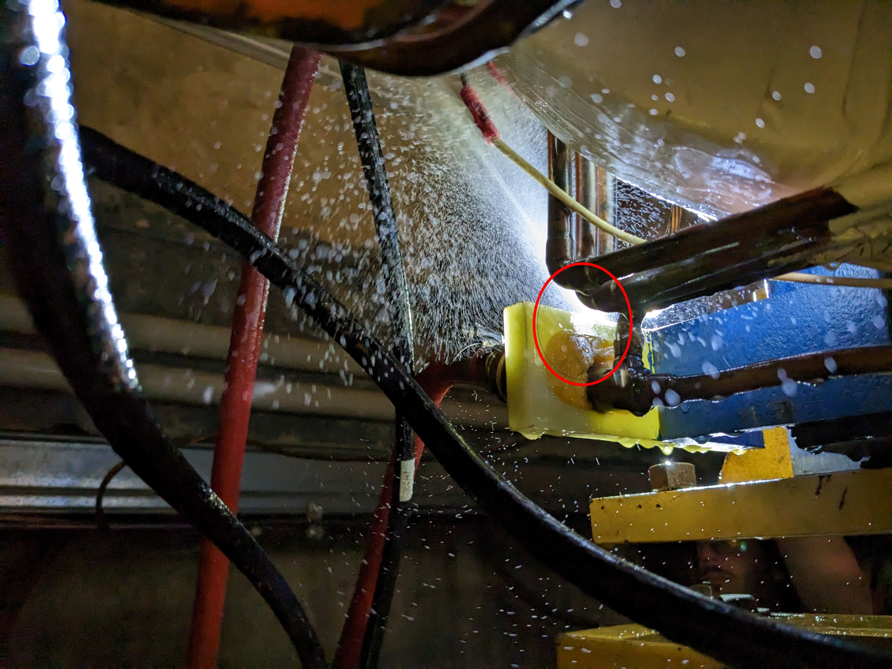
MC6V1 Leak
Significant leak on MC6V1 on the copper line near the G10 & foam spacer.
Leak is patched and holding.
Thanks to MSD & TD for coordinating repair efforts, and EE Support for handling LOTO.

Slide 4
In Other News…
Meson is ready for beam.
Turn power supplies back on today.
MS2 LCW Pump #3 is waiting for seals to come in for ISD to complete repairs.
Thanks to MSD for keeping up with the leaks!

