Slide 1
Muon Campus Report - 03/17/2023
Steve Boi

Slide 2
Overview and Issues
Beam down for Linac repair and Remnant LCW system recovery.
F17 Vacuum problems worsened
Wednesday:
Remnant LCW conductivity reached acceptable level, powered up M1 and P2 lines without issue.
Swapped out a rad detector in downstream M4 line.
Mu2e studies.
Beam to g-2 overnight (special off momentum run).
Thursday:
Mu2e studies planned – cancelled for Linac repair.
Today:
Beam to g-2 when available.

Slide 3
Beam to g-2
Protons to AP0 Target
g-2 Calorimeter-Tagged Muon Decays ($Σ_{24 calos}n_{i}$)
g-2 T0 Detector
Delivery Ring Abort
Linac Work
+
Remnant LCW System Recovery
Linac Work

Slide 4
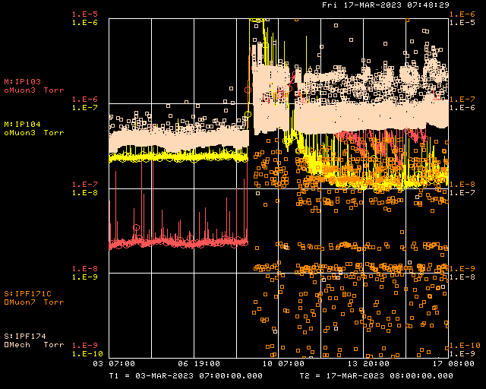
F17 Vacuum (2 weeks)

Slide 5
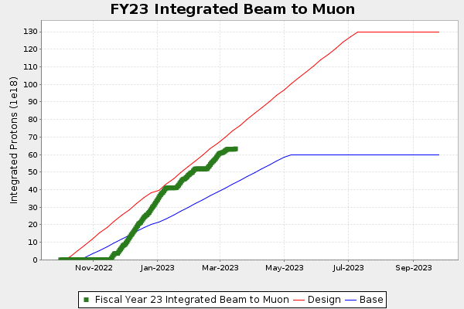
g-2 Protons on Target

Slide 6
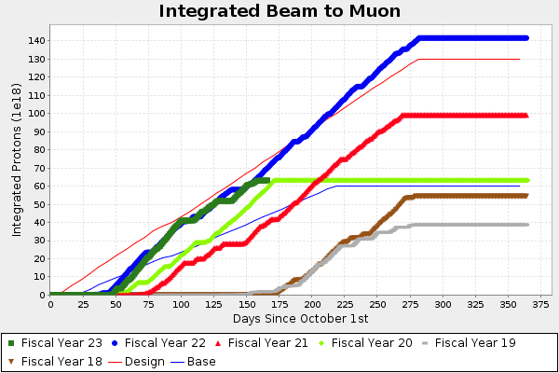
g-2 Protons on Target

Slide 7
g-2 Performance

Slide 8
g-2 Performance
2.19 BNL

Slide 9
Future Prospects
Mu2e studies
Prepare DR for resonant extraction with ESS2 only.
BPM commissioning.
ESS conditioning.
Resonant Extraction.
Shared g-2 running and Mu2e commissioning.
Repair vacuum at F17 when time appropriate

