Slide 1
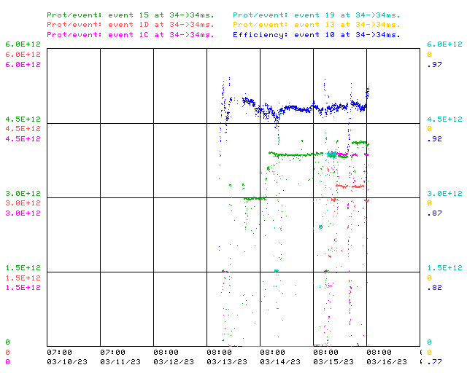
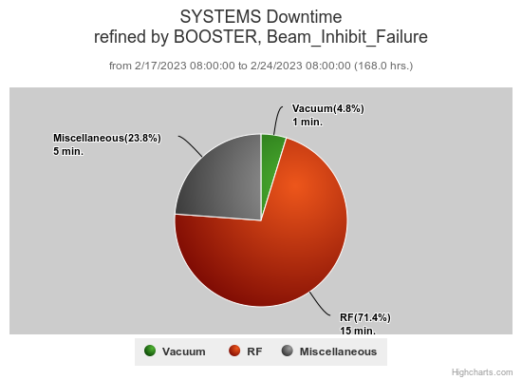
Booster Operations 03/10/23 – 03/17/23
F
Sa
Su
M
F
Tu
W
Th
F
Downtime this week: ~ 7 minutes
A few minor RF related trips
Also:
Laser Notcher RF Interlock Module required reset early Thursday, better cooling appears to be helping. Spare being checked out.
20Hz upgrade effort at E4R continues.
Thanks to Ops for diligence & tuning on the off shifts
This week:
Linac vacuum recovery and resume beam to users. Lots of tuning required as we came up to higher intensities again.
Beam to NuMI Monday, ~3.9E12 – 4.2E12 per pulse (730KW -768KW)
Beam to BNB Wednesday ~3.3E12 per pulse to start
Beam to Muon Wednesday, ~ 3.9E12 per pulse, 13T >1E12 pot
Beam for studies on $19’s & $15’s

