Slide 1
Current Energy Resolution Studies, and Future Plans
Matthew Szydagis
09/12/2012

Slide 2
Status Now
Began a study of the “combined” energy resolution as a function of the light collection, starting with 0.1 and 1.0 phe/MeV tests
Initial results are very bad: the light collection is too poor even at the high end to have any effect on the energy resolution at 500 V/cm
Not giving up: since detector not being built tomorrow, still not too late to enhance the light collection, with more reflective surfaces, more TPB, and greater PMT coverage
Have determined we need to improve the light collection by at least one order of mag.

Slide 3
Simulation Parameters
Used a home-grown simulation geometry with “infinite” volume of liquid argon, and NEST
Shot 500 e-’s of 500 or 50 MeV energy, to study energy resolution enhancement at what could roughly be our threshold possibly, where energy resolution would be the worst
Finding optimal a and b such that a*LY + b*CY peak has best possible resolution
Best intrinsic resolution ~0.02% @ 0.5 GeV
Found problem with how NEST currently does things as opposed to LArSoft: generating actual particles for the drift electrons takes up too much RAM (another reason to start testing at small energies!) even though they are geantino-like

Slide 4
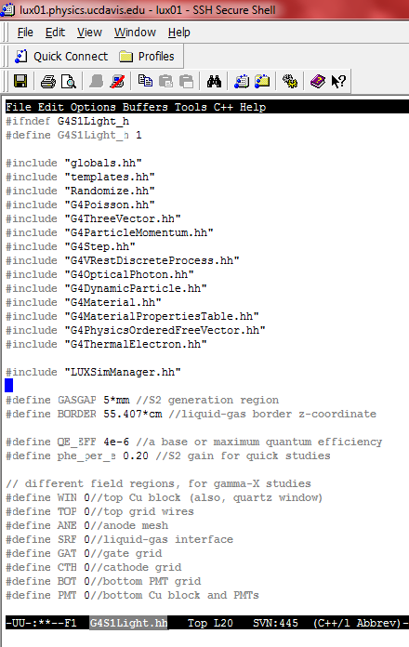
Simulation Parameters
Using the handy built-in feature in the latest NEST version that allows inputting of mean efficiencies coupled with killing of quanta at birth
Estimating 10% charge collection in the worst-case scenario, at a far corner of the far detector
Light collection of 1e-6-1e-5 correspond with our best estimates for the detector

Slide 5
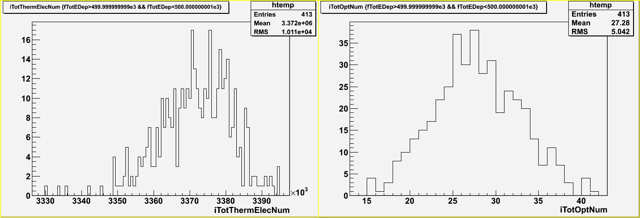
Charge and Light Yields
Statistics clearly favor the charge yield peak (left), so the light yield peak (right) is a joke
The σ/μ resolution of the charge peak is ~0.3% @500 MeV
Little difference when turning on non-binomial recombination fluctuations in NEST

Slide 6
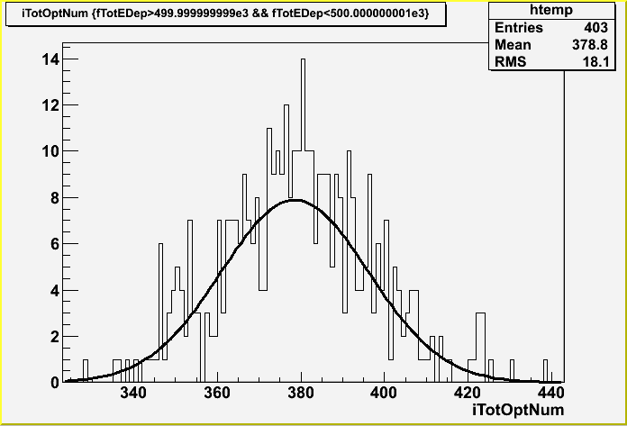
Charge and Light Yields
No salvation in testing the overly optimistic case of 1 phe/MeV (1e-5): light peak has ~5% resolution

Slide 7
More Comprehensive Study
Two energies
Two charge collections (10 and 100%, which made no difference)
We have a long ways to go before seeing an effect, and the question is what is realistic?

Slide 8
More Comprehensive Study
Full table of results at right
Despite order of magnitude difference in energy, results are consistent
“Improv” is the CY resolution divided by the optimum resolution (opt)
CY and LY are the percent resolutions of the charge and light yield peaks by themselves; “comb” is a raw, calorimetric combination, while “opt” is the optimal combination, weighting charge more heavily (the “with” column gives the weight given to the light yield)

Slide 9
NEST Implementation
Deciding to wait because NEST not yet ready
NEST has argon yield, resolution, and scintillation decay times implemented, but not the proper diffusion constants, or drift speed
Still getting mixed suggestions for implementation (Brian’s suggestion versus discussion with Eric in Lead…)
May have an even better plan: just replace (or offer user choice of) the Birks’ law light and charge yield parameters in LArSoft
Only (?) drawback: will not benefit from NEST interaction site model in that case

Slide 10
NEST Implementation
Here Birks’ law applied “site-by-site,” where an interaction site is defined by a free-parameter spherical radius, and not just any new G4Track energy deposition
Goal is to have its value be no more than ~10-100x the electron-ion thermalization distance (~1 um in liquid argon)
To answer Andrzej and Tom’s questions regarding electrons and positrons separating after pair production, I will undertake a comprehensive study of the effect of applying Birks’ law separately, for differing distant interaction site definitions

Slide 11
Pair Production Study
Shot 500 gammas of 100 MeV in energy (1% charge and 0% photon collection, for speed), to get lots of pair production occurring
Changing min-allowed electron track length (which effectively sets the energy threshold for production of secondary electrons by Geant4) can affect the final charge yield by ~20% Ouch! Sharp change in behavior is observed…
Negligible effect when changing the ionization scale, which determines the sizes of the steps taken by any ionizing particles
No effect when tweaking dE/dx variation size
To-do: Different NEST length scales; different physics models? (G4EmLivermore tried)

Slide 12
Pair Production Study
Questions for the experts:
What are the LArSoft default values, for the default electromagnetic physics list?
Which is the default model?
(Mozumder 1995)

