Slide 1
72 Hour Summary
Patrick Dowdle
MCR Crew Chief
March 20, 2023

Slide 2
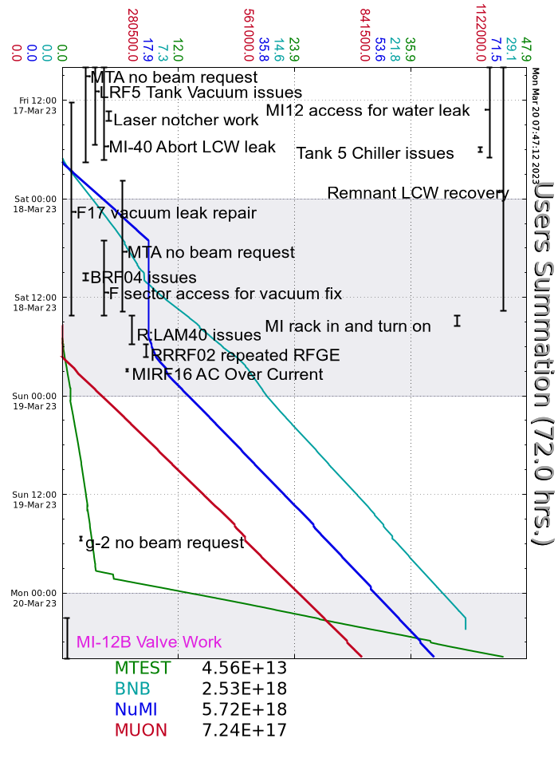
Summary
In general
Tuning
MTA has been taking studies beam
LRF5 vacuum looks good
MIRF05 repeated incomplete gaps
Friday:
After Linac vacuum/MI40 abort pump work established beam to NuMI/BNB
Saturday:
LRF5 O/I, increased filament current
Prepared F-Sector for access for vacuum work
Lost BRF04 due to filament power supply, swapped to BRF19
After vacuum work, remnant resistivity looked good
R:LAM40 needed a phase balance relay replaced Recycler RF02 needed to be brought up locally
Ran MI only mode to SWYD and NuMI
Source B had an issue with the Arc Modulator
Lost MIRF16 due to bias supply

Slide 3
Summary
Sunday:
Continued tuning up the complex
E:CPSMB issue, is being looked at today
F:MC5Q1 trip showing SCR overtemp/DC O/I
Lost MIRF06 due to repeated incomplete RFGE
Monday:
Turned BNB beam off at 0300, prepared MI-12 for access

