Slide 1
Physical sciences & Engineering (PSE)
March 20, 2023
Kawtar Hafidi
Associate Laboratory Director
Physical Sciences & Engineering
Argonne National Laboratory

Slide 2
Physical Sciences & Engineering
By the numbers
FY22 PROGRAM SPENDING: $194.1M
PEOPLE
340+
employees
Basic Energy Sciences – $83.3M
Nuclear Physics – $35.7M
270+
visiting scientists
Energy Efficiency/Renewables – $25M
Strategic Partnership Projects– $16.9M
190+
High Energy Physics – $16M
postdoctoral scholars
Other Science Programs – $2.1M
170+
graduate & undergraduate students
Adv. Scientific Computing Res. – $1.7M
Other DOE Programs – $0.8M
Defense-related Activities – $0.6M
35+
joint faculty

Slide 3
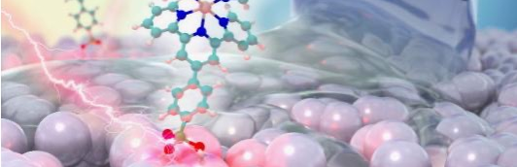
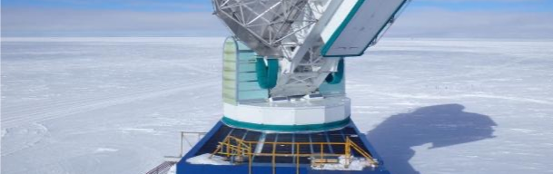
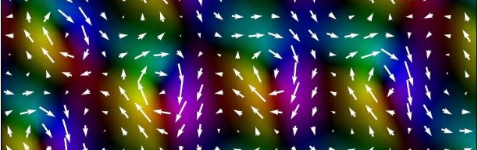
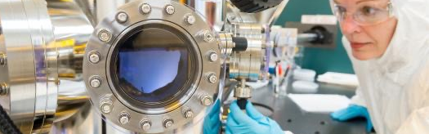
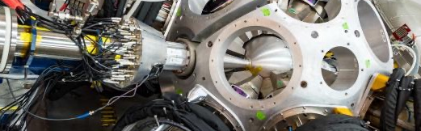
Physical Sciences & Engineering (PSE)
Directorate
ARGONNE COLLABORATIVE CENTER FOR ENERGY STORAGE SCIENCE (ACCESS)
CHEMICAL SCIENCES & ENGINEERING (CSE)
HIGH ENERGY PHYSICS (HEP)
Translate scientific discoveries in energy storage into technologies
Energy storage
Solar photochemistry and photosynthesis
Fuel cells and catalysis
Gas-phase chemical physics
Ultrafast X-ray science
Heavy elements and separation sciences
Large Hadron Collider
Cosmic Microwave Background (CMB) and cosmology theory
Neutrinos and muons
Particle theory
Advanced accelerator development
Detector R&D
Focus on batteries (e.g., Li ion, Li metal, flow batteries, multivalent systems)
MATERIALS SCIENCE (MSD)
NANOSCIENCE & TECHNOLOGY (NST)
PHYSICS (PHY)
Materials discovery
Quantum materials
Electrochemical systems
Soft materials
Imaging/scattering with coherent X-rays and electrons
Center for Nanoscale Materials (CNM) user facility
Electron microscopy
Autonomous discovery (AI + robotics)
Cleanroom (fabrication, metrology)
Argonne Tandem Linac Accelerator System (ATLAS) user facility
Nuclear physics
Production of medical isotopes
Notes:
PSE overview
PSE is organized into 5 divisions and contains Argonne’s Collaborative Center for Energy Storage Sciences (ACCESS)
ACCESS
While not a division, I wanted to call out ACCESS - Argonne’s Collaborative Center on Energy Storage Science, which translates scientific discoveries in energy storage into technologies, bridging PSE and Argonne’s Applied Energy Technology (AET) directorate.
The focus is primarily on batteries, including Li ion, Li metal, flow batteries and multivalent systems.
CSE
The largest division within PSE is the Chemical Sciences and Engineering Division (CSE).
CSE integrates both basic and applied science. It is a diverse division that spans a wide range of disciplines in chemistry and chemical engineering.
It is divided into four themes focused on Electrochemical Energy Storage; Actinide, Geochemical and Separation Sciences; Catalysis and Energy Conversion; and Fundamental Interactions.
CSE has strong programmatic efforts in Energy Storage, Gas-Phase Chemical Physics, Solar Photochemistry and Photosynthesis, Ultrafast X-Ray Science, Heavy Element Chemistry and Separation Science, Solar Photochemistry, Fuel Cells and Catalysis.
HEP
Argonne’s High Energy Physics (HEP) division has participation in the Large Hadron Collider. Research also covers:
Cosmology theory and the Cosmic Microwave Background (CMB)
Neutrino and muon science
Particle theory
Particle physics detector R&D
MSD
Argonne’s core institutional capabilities in condensed matter physics with noted research programs in superconductivity, magnetism and quantum materials sits within our Materials Science Division.
NST
The Nanoscience and Technology division operates one of the five DOE-BES national user facilities in nanoscience research – the Center for Nanoscale Materials.
CNM maintains a large collection of microscopy tools, including both X-ray and electron microscopes.
CNM has led the directorate’s autonomous discovery work through the establishment of a platform for AI-guided polymer characterization called the Polybot.
CNM also operates a cleanroom that contains a large collection of fabrication and metrology tools and instruments.
PHY
The Physics Division operates the Argonne Tandem Linac Accelerator System (ATLAS), another national user facility.
ATLAS was the world’s first superconducting LINAC for heavy ions used to study the properties of the nucleus.
Within the Physics Division, the central focus is on nuclear physics, and this is where the production of medical isotopes through photonuclear reactions sits.

Slide 4
Argonne’s one-of-a-kind national user facilities
Enabling science from the nanoscale to the cosmos
ARGONNE TANDEM LINAC ACCELERATOR SYSTEM (ATLAS)
CENTER FOR NANOSCALE MATERIALS (CNM)
The Argonne Tandem Linac Accelerator System (ATLAS) is a U.S. Department of Energy national user facility for nuclear physics at low energy. ATLAS is used for both basic nuclear physics and astrophysics research, and in R&D of nuclear physics applications in nuclear forensics, nuclear reactor safety and medical isotope production.
ATLAS produces unique neutron-rich beams for studies aimed at understanding the formation of heavy elements and for the development of nuclear safeguards.
ATLAS is used to study the effects of radiation on materials in next-generation nuclear reactors.
ATLAS is used to develop production methods for new medical isotopes for diagnostics and targeted therapy.
The Center for Nanoscale Materials (CNM) provides expertise, instrumentation and infrastructure for interdisciplinary nanoscience and nanotechnology.
Academic, industrial and international researchers can access the center for both nonproprietary and proprietary research.
CNM offers more than 150 tools and capabilities.
From X-ray microscopy to cleanroom-based nanofabrication techniques, the CNM provides researchers with a powerful combination of scientific resources found nowhere else.
350
USERS
EACH YEAR
700 USERS
EACH YEAR
+
Notes:
Argonne maintains and operates 6 national user facilities for DOE.
Argonne’s unique combination of user facilities enables cutting-edge research that can’t be done anywhere else.
These user facilities are big scientific installations used by thousands of researchers from around the world.
PSE hosts and operates two of these user facilities, the Argonne Tandem Linac Accelerator System (ATLAS) and the Center for Nanoscale Materials (CNM).
The unparalleled expertise of the scientific staff at these facilities, combined with their state-of-the-art capabilities, has produced a wide variety of game-changing discoveries and inventions in fields ranging from energy conversion, to quantum information science, to cosmology.
ATLAS was the world's first superconducting LINAC for heavy ions and is used to study the properties of the nucleus.
CNM is one of five Nanoscale Science Research Centers funded through DOE’s Basic Energy Sciences.

Slide 5
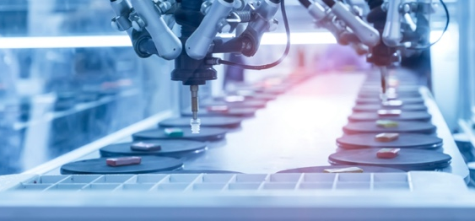
Our strategic initiatives drive discovery & innovation
AI FOR SCIENCE
AUTONOMOUS DISCOVERY
CLEAN ENERGY & SUSTAINABILITY
IMAGING & DETECTION OF SIGNATURES
Creating an AI framework to dramatically expand the classes of computational problems researchers can pursue
Build a world-leading AI capability to dramatically expand the classes of problems that researchers can pursue and accelerate solutions
Create a framework to integrate data-driven models with theory, experiment and traditional modeling and simulation
Revolutionize the practice of experimental science through the combined power of AI and robotics
Demonstrate a generalized, AI-driven, closed-loop autonomous discovery platform that can be used across biology, chemistry and materials science
Frame a disruptive concept for a user facility that would democratize researchers’ access to automated discovery
Discover materials and chemical processes to enable technologies to limit use of fossil fuels and manage waste and CO₂ in the environment
Decarbonization
Electrification of transport
Industrial emissions
Stationary storage
Circular economy
Sustainable polymers/ recycling of plastics
Waste recovery and reuse
Carbon capture of CO₂ and conversion into value-added products
Advancing observations of phenomena important to discovery science and national security
Develop novel photosensors to drive discovery in large-scale physics experiments
Generate transformational solutions to national security challenges in chemical, biological, radiological and nuclear signatures
Notes:
Throughout Argonne’s history, our research capabilities have grown to enhance our service to science and society. Our strategic initiatives chart critical new directions in that service.
PSE leads or co-leads several of Argonne’s strategic initiatives, which are made up of interdisciplinary teams across all of Argonne’s directorates. The initiatives leverage and build upon Argonne’s expertise and capabilities in the materials, chemical, environmental, biological and computational sciences, coupled with the characterization and computing capabilities of our world-class user facilities.

Slide 6
Our strategic initiatives drive discovery & innovation
MICROELECTRONICS
QUANTUM INFORMATION SCIENCE
RADIOISOTOPE DISCOVERY
Accelerate development of energy-efficient and environmentally benign microelectronics
Discover innovative architectures and materials to enable energy-efficient, AI-based computing
Create new approaches to environmentally sustainable microelectronics manufacturing
Driving progress in distributed quantum computing simulation, sensing and networking
Conduct foundational research:
Quantum-accelerated hybrid computing nodes
Transduction, sensing and network design for distributed quantum information science (QIS) applications
Develop algorithms and benchmarks for near-term quantum/classical hybrid computing
Facilitate cross-laboratory QIS collaboration
Developing novel methods to produce advanced radionuclides for nuclear medicine
Produce high-quality copper-67
Develop emerging radioisotopes and experimentally verify their nuclear decay properties
Establish novel radioisotope production methods
Train the next generation of radioisotope scientists

Slide 7
Individual division and center slides

Slide 8
Argonne Collaborative Center for Energy Storage Science (ACCeSS)
A catalyst for innovation, solving complex energy storage problems
ACCESS coordinates the energy storage activities at Argonne across fundamental science, applied R&D and scaling
Focus is on identifying future needs and developing the strategy to ensure continued leadership
An important aspect of ACCESS is outreach to stakeholders in government, academia and industry
Notes:
ACCESS is a catalyst for innovation comprised of scientists and engineers from across Argonne who solve complex energy storage problems through multidisciplinary research.

Slide 9
Chemical Sciences & engineering (CSE)
Providing breakthroughs in chemical transformations, energy storage and energy conversion by leveraging unique capabilities
CSE research covers a broad range of fundamental and applied topics in chemistry and chemical engineering:
Electrochemistry, batteries and fuel cells
Solar energy conversion
Heavy-element chemistry and separations science
Gas-phase chemical physics
Ultrafast X-ray science
Catalysis
Notes:
Argonne’s Chemical Sciences and Engineering division (CSE) provides the nation with breakthroughs in understanding of chemical transformations, energy storage and energy conversion by leveraging unique and world-leading capabilities.
In disciplines ranging from electrical energy storage and fuel cells to solar fuel and separations science, CSE works to revolutionize how we will produce, store and use energy while protecting the environment in the 21st century.
The close coupling of experiment, theory and computational studies with detailed modeling provides a feedback loop to continuously improve understanding as well as translation of knowledge to real world applications.
We are providing the foundational understanding necessary for predictive modeling and control of the complex, interacting chemical processes relevant to the sustainable production and use of our energy resources.

Slide 10
High energy physics (HEP)
Understanding the fundamental constituents of matter and energy, and illuminating the ultimate nature of space and time
The HEP division carries out cutting-edge research at the energy, intensity and cosmic frontiers of scientific knowledge
The division is a hub of innovation in the utilization of new developments in computing, detector and accelerator technologies of HEP science
Notes:
Scientists in Argonne’s High Energy Physics (HEP) division investigate the elementary constituents of matter and energy and the nature of space and time through experiment and theoretical investigations. They also develop accelerator, detector and computing tools to enable tomorrow’s science.
The division leverages Argonne’s suite of multidisciplinary facilities and equipment to support some of the largest HEP projects in the world, including the Large Hadron Collider’s ATLAS detector, Cosmic Microwave Background experiments at the South Pole Telescope and CMB-S4 and the Legacy Survey of Space and Time (LSST), among others.
The division maintains two state-of-the-art facilities for high energy physics:
The Argonne Wakefield Accelerator Facility enables breakthroughs in the development of next-generation particle accelerators.
The 4 Tesla Magnet Facility reuses a magnetic resonance imaging magnet for detector testing and calibration under high magnetic fields. It provides benchmarking for experiments all over the world that are exploring potential physics beyond the Standard Model.

Slide 11
Physics (PHY)
Understanding the origin, evolution and structure of the matter in the universe that makes up the stars, planets and human life itself
The Physics division is a leader in basic nuclear physics and its applications with major programs in low- and medium-energy physics, theoretical physics and accelerator R&D
The division operates the Argonne Tandem Linac Accelerator System (ATLAS), a DOE Office of Science national user facility
Research is focused around five primary themes
Accelerator R&D
Atom trapping and fundamental symmetries
Nuclear astrophysics
Nuclear structure
Quantum chromodynamics and hadron physics
Notes:
Argonne’s Physics (PHY) division focuses on accelerator R&D, low and medium energy physics and theoretical physics to understand the origin, evolution and structure of matter in the universe.
PHY operates the Argonne Tandem Linac Accelerator System, a DOE Office of Science user facility.
The division’s research focuses on innovative approaches to:
Design and fabricate high-intensity ion and electron accelerator systems for cutting-edge physics experiments
Determine the structure of nuclei, both stable and radioactive, found here on Earth and produced in the cosmos
Probe the atomic nucleus in terms of its fundamental constituents and new physics beyond the Standard Model

Slide 12
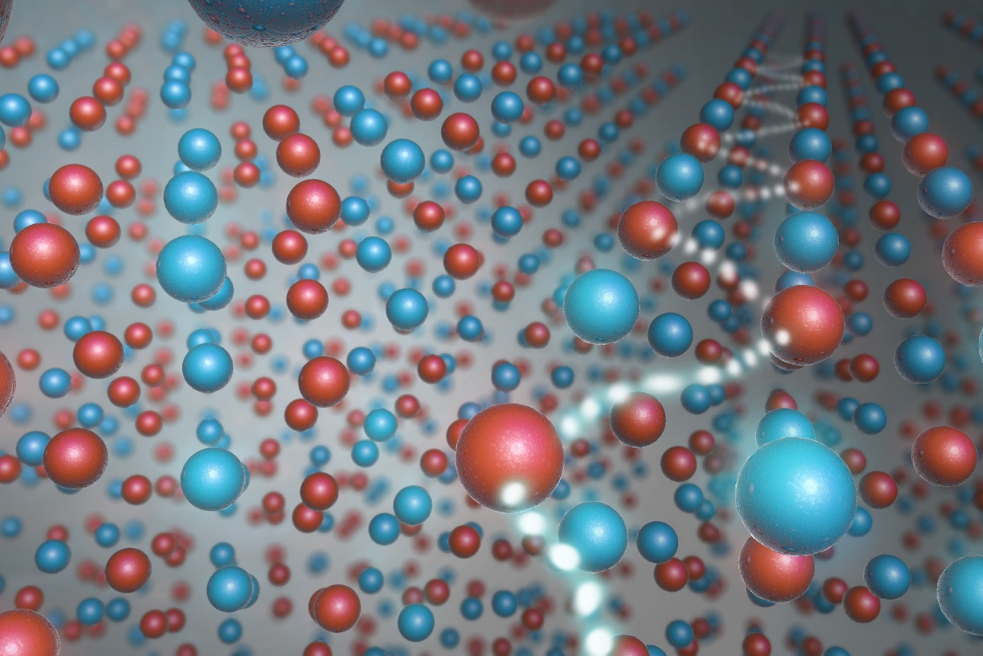
Materials Science Division (MSD)
Understanding the structure and function of novel materials to solve America’s energy challenges
Exploring emergent behavior that arises from defects and interfaces
Using AI/ML for efficient approaches to materials discovery
Exploring common themes in soft and hard materials
Ion and electron dynamics
Fundamental materials science for microelectronics and quantum information science
Notes:
Scientists in Argonne’s Materials Science Division (MSD) pursue a deep fundamental understanding of new materials and systems that will have a lasting impact on science and form strong foundations for the technologies of tomorrow.
The MSD research portfolio emphasizes defects and interfaces as a unifying theme for exploring condensed matter physics and materials science.
MSD researchers also investigate materials at the quantum level, where individual electrons cooperate to make new energy and information science technologies possible.
The unique combination of facilities at Argonne contributes to the integration of theoretical, computational and experimental approaches in MSD to yield new insights into material properties and function.

Slide 13
Nanoscience & technology (NST)
Bringing together researchers from around the globe for world-class nanoscience, from fundamental science to use-inspired technologies
The Center for Nanoscale Materials (CNM), housed within the NST division, is a diverse DOE Office of Science user facility in the areas of nanoscale synthesis, fabrication, characterization and theory and modeling
The CNM performs research in areas of national priority such as clean energy, quantum information science, artificial intelligence and machine learning and robotics for autonomous discovery
Notes:
Researchers in Argonne’s Nanoscience and Technology (NST) division perform world-class nanoscience ranging from fundamental to use-inspired science with connections to industry.
NST operates the Center for Nanoscale Materials (CNM), a DOE Office of Science user facility. From X-ray microscopy to cleanroom-based nanofabrication techniques, NST and CNM capabilities provide researchers with a powerful combination of scientific resources found nowhere else.
NST researchers are:
Developing capabilities that go beyond off-the-shelf technology to identify, define and develop electron and X-ray microscopy needs
Fabricating, integrating and manipulating nanostructures to produce working nanofabricated structures
Using ultra-fast spectroscopy and advanced microscopy to investigate nanoscale properties
Creating nature-inspired assemblies for energy conversion, transport and sensing
Using theory, modeling, machine learning and data science to understand and predict nanoscale behavior
Designing and studying atomic- to meso-scale materials with implications for energy, the environment and quantum information science

Slide 14
ADDITIONAL RESOURCE SLIDES

Slide 15
Large multi-lab programs led by Physical Sciences & Engineering
 | FUNDING | SCOPE | PSE DIVISION
Joint Center for Energy Storage Research | DOE-BES | Energy storage hub developing next generation beyond Li-ion batteries | CSE, MSD, NST
Earth-abundant cathode active materials | DOE-EERE | Develop Li-ion cathodes with low/no cobalt and nickel | CSE
Silicon anodes for next generation Li-ion batteries | DOE-EERE | Develop approaches to extend the life of silicon anodes | CSE
Enabling extreme fast charging of Li-ion batteries | DOE-EERE | Develop approaches to charge batteries in <10 mins | CSE
Next-generation lead acid batteries | Industry and DOE | Understand and solve cycle life limitations of lead-acid batteries | CSE, MSD

