Slide 1
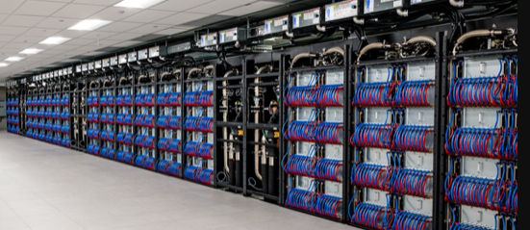
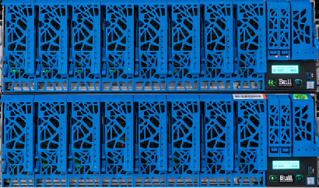
Argonne Computing
&
High Energy Physics
Salman Habib,
CPS/HEP Divisions
Division Director, CPS
March 20, 2023
KEK Visit
1

Slide 2
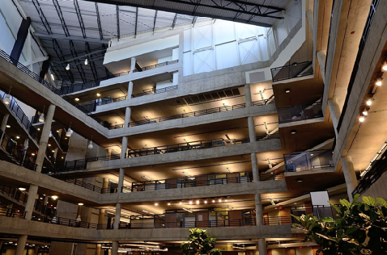
Overview
Argonne Computing and HEP
Argonne hosts extreme-scale and large-scale computational resources, as well as high-performance computing (HPC) and AI testbeds
Major role in DOE’s Exascale Computing Project (ECP) with the exascale system Aurora turning on in 2023 at the Argonne Leadership Computing Facility (ALCF)
Argonne is the lead Lab for DOE’s HEP Center for Computational Excellence (HEP-CCE)
Joint staff and postdoc positions across the computing divisions and HEP division at Argonne
TCS Building at Argonne
HEP-CCE
2

Slide 3
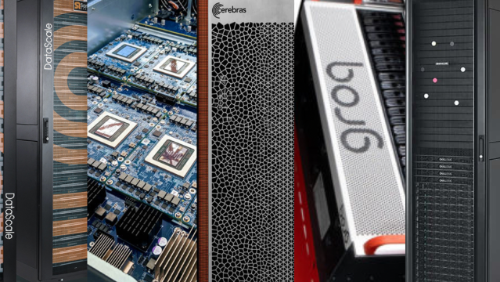
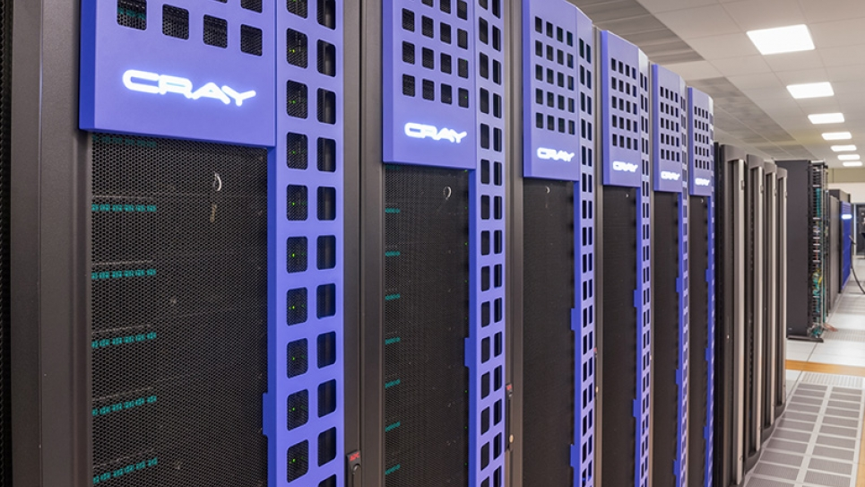
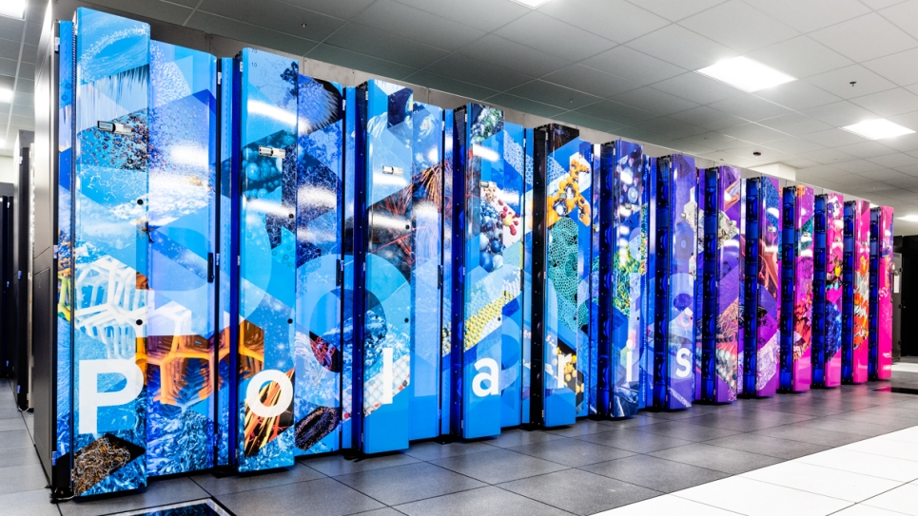
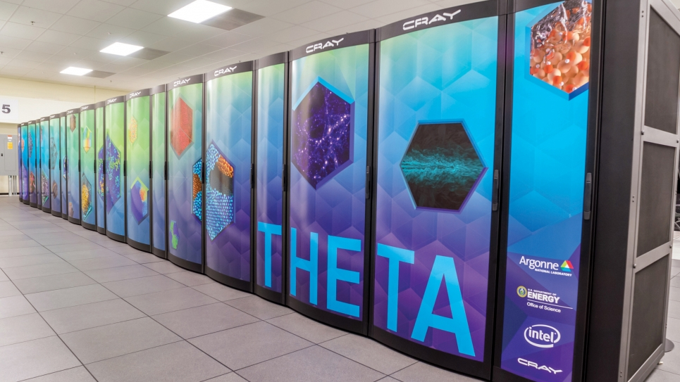
Argonne Computing
Organization/R&D/Systems
Computing divisions:
Argonne Leadership Computing Facility (ALCF)
Computational Science division (CPS)
Mathematics and Computer Science division (MCS)
Data Science and Learning division (DSL)
ALCF Systems:
AI Testbed (various AI/ML-focused systems)
Aurora (2 EFlops +, >10 PB memory, >230 PB high-performance storage)
Cooley (analysis/visualization cluster)
Polaris (44 PFlops, 0.38 PB)
Theta/ThetaGPU (>15 PFlops aggregate, 0.87 PB)
Computing Focus Areas:
Extreme-scale HPC (Modeling/Simulation)
Data-Intensive Applications (Large-scale data analytics, real-time applications)
Large-scale AI/ML for scientific applications
2

Slide 4
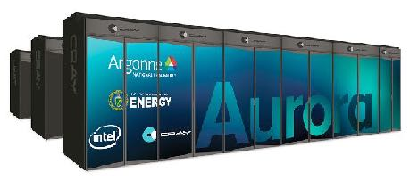
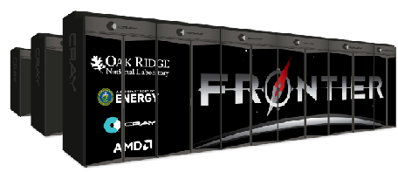
HEP Aurora Early Science Projects (ESP) + ECP
Aurora ESP
ECP: ExaSky
Extreme-Scale Cosmological Hydrodynamics
HACC optimization for Aurora
Simulating & Learning in the ATLAS Detector at the Exascale
Use of Kokkos* on Intel platforms as a portable performance paradigm
Dark Sky Mining
AI/ML application for cosmological predictions/analysis
ECP AD Project
Argonne (lead), LANL, LBNL
Targeting Aurora and Frontier for next-generation high-resolution, large-volume, multi-physics cosmological simulations
*C++ performance portability ecosystem, ECP supported
6

Slide 5
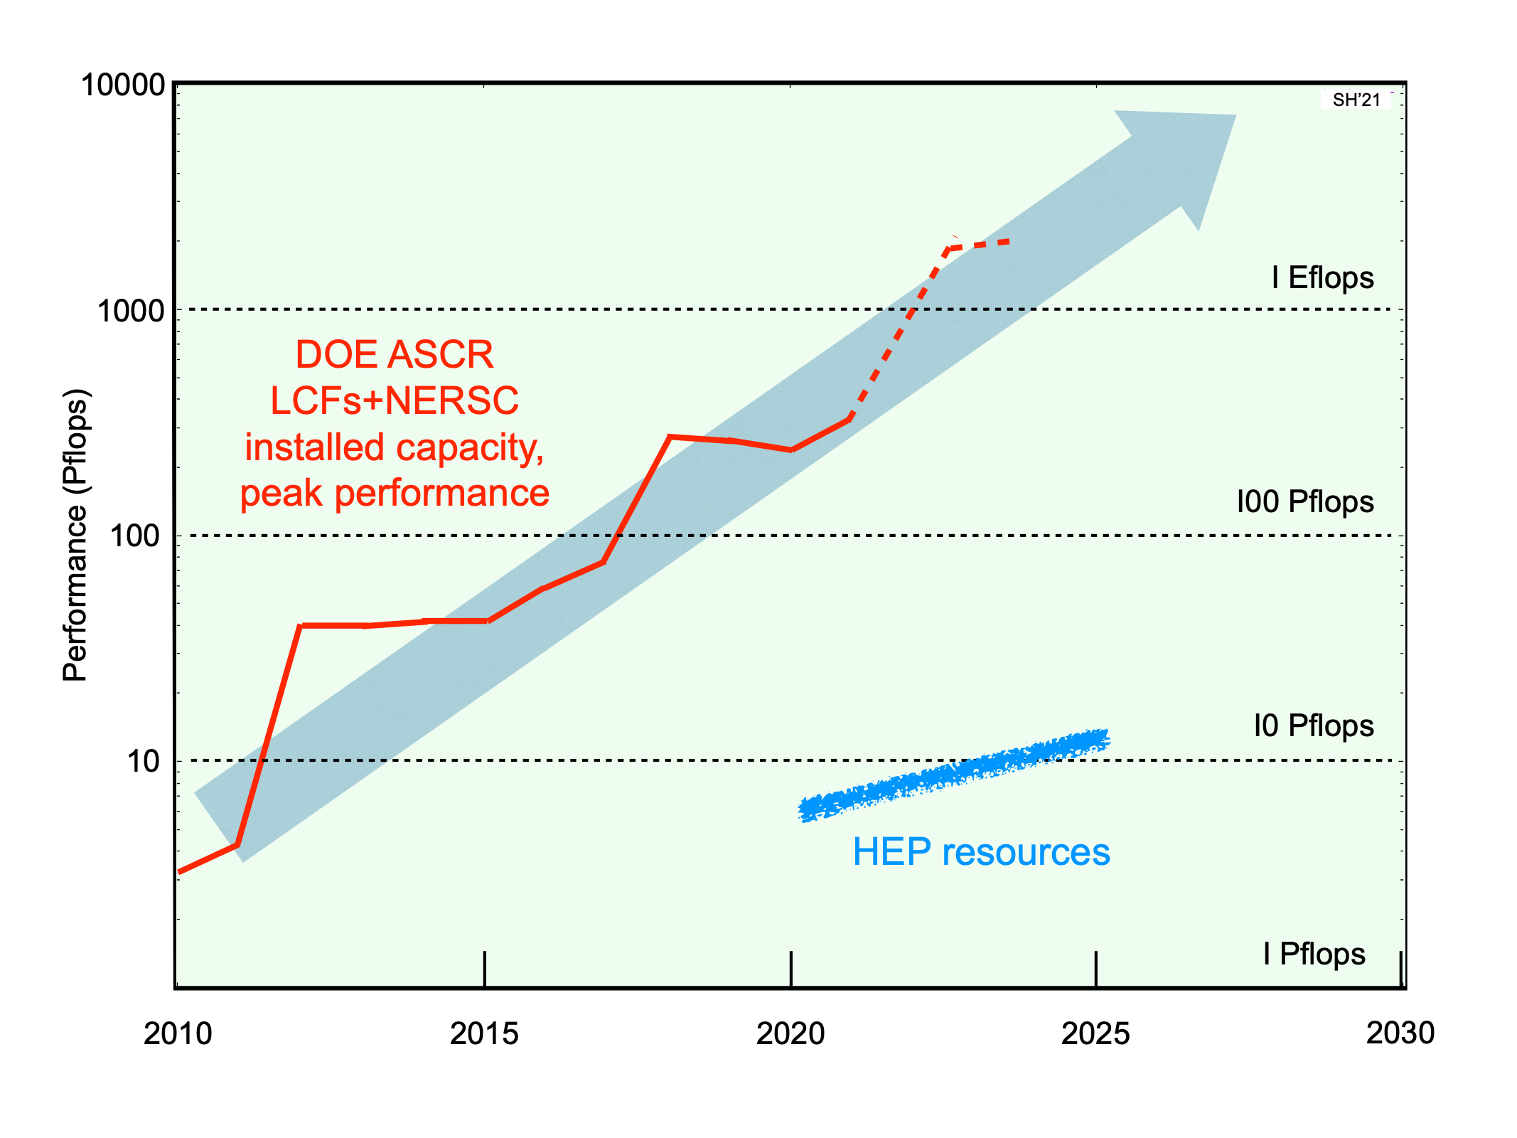
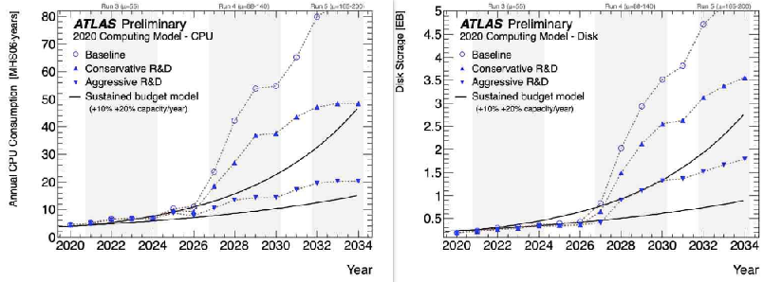
HPC and HEP
HPC Meets Data
The computational power of HPC systems continues to rise steeply
HPC-specialized architectures are a challenge for general use cases, especially data-intensive ones
Computing needs for HEP theory, modeling, and data analysis are very large — need for new approaches
Two areas of improvement:
HPC systems need to be better at data-crunching
HEP community needs to evolve its software
DOE computing centers vs. HEP computing resources
ATLAS computing and storage projections
4

Slide 6
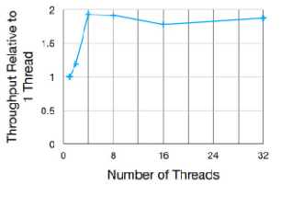
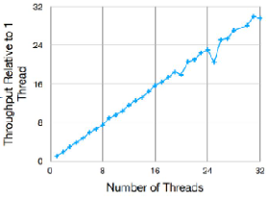
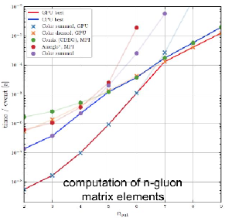
HEP-CCE
Adam Lyon (Fermilab)
Peter Nugent (LBNL)
Kerstin Kleese van Dam (BNL)
HEP-CCE
Salman Habib (Argonne)
Paolo Calafiura (LBNL)
Exascale Computing for HEP Experiments
Advanced Scientific
Computing Research (ASCR)
High Energy Physics (HEP)
3-year pilot project (FY20-23)
Develop practical solutions to port hundreds of kernels to multiple platforms
Collaborate with HPC communities on data-intensive use cases
HEP-CCE focus areas
PPS (Portable Parallelization Strategies)
IOS (IO and Storage)
EG (Optimizing Event Generators)
CW (Complex Workflows on HPC systems)
Research and Facilities
Research and Facilities
HEP-CCE
ASCR Programs
Computational HEP Program
Cross-Cuts
Top: ROOT IO improvements
Left: Ported kernels from MadGraph using Kokkos to CPUs and GPUs, demonstrated GPU speedups
https://www.anl.gov/hep-cce
5

Slide 7
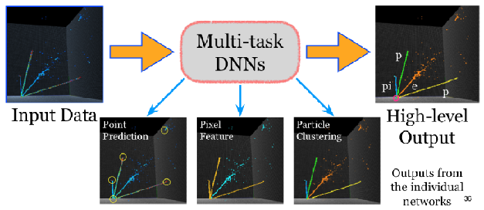
AI/ML: The Big Picture
AI for Science: HEP Context
HEP data flows are increasing rapidly in throughput and complexity metrics, a feature shared with many other areas
AI for Science Challenges
Data is expensive, ‘digital twins’ are complex
Subtle inferences vs. brute force classification
Rigorous UQ (no ‘black boxes’)
Causal structure, extrapolation — need for models
Context-dependence (limits of transferability)
Credit: K. Terao and L. Domine, ACAT 2019
Intensity Frontier: Almost all neutrino experiments are investigating AI technologies; ongoing research in dealing with sparse nature of the data and use of cluster finding algorithms
Credit: S. Madireddy, et al, 2019
Cosmic Frontier: Automated, modular AI-based pipeline for strong lens classification and regression analysis; many ML-based techniques are being investigated for next-generation sky surveys [Argonne-led ASCR/HEP SciDAC project]
13

Slide 8
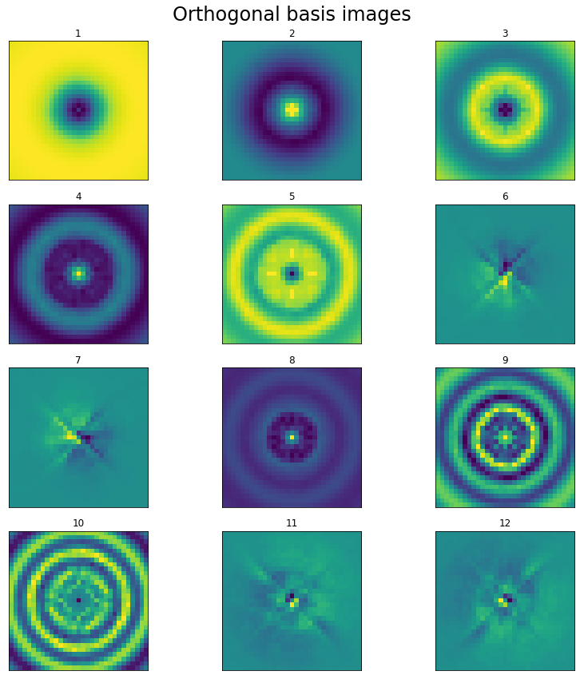
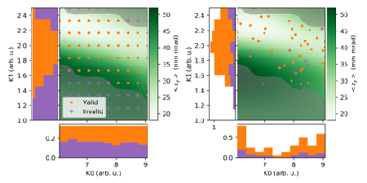
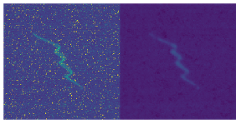
AI/ML and HEP Example
predicted
true
AWA
Surrogate modeling of the AWA Linac
PCA + AI for recreating beam distributions
Diagnostics
Denoising and artifact removal from beam images
Automated Accelerator Controls
Multi-objective optimization with Bayesian techniques
Adaptive sampling methods for beam control (minimizing radioactivation)
A multilayer perceptron is trained to produce linear combinations of 15 PCA basis functions (left), recreating beam distributions (right) as determined by 9 control parameters.
Bayesian techniques to enable efficient multi-objective optimization for experiments outperforming evolutionary algorithms (top) and automatic, adaptive (vs. grid) exploration of constrained experimental measurements for magnet settings (bottom)
CNN-based filter for background/artifact removal in YAG phosphor images
17

Slide 9
Summary: Future Outlook
Drivers for work at Argonne
The trend towards heterogeneity and specialization in computational hardware is irreversible, as CPU performance gains will remain modest
Over the next decade, no radically new computing technology is likely to get us back to the Moore’s Law era of the recent past
For HEP computing to succeed in the “new world”, we should
Actively consider new algorithmic approaches to solving our problems, if possible (e.g., AI/ML approaches, data restructuring)
Actively consider coordinating mechanisms to form a big enough market (this will require a combination of co-design and perhaps a more limited version of specialization) — national facilities and commercial or public clouds could also aid in providing this function
17

