Slide 1

MATERIALS & DETECTORS
drhgfdjhngngfmhgmghmghjmghfmf
(アルゴンヌへようこそ !)
Valentine NOVOSAD
Argonne National Laboratory
Materials Science Division
Physics Division
High Energy Physics Division
March 20, 2023
novosad@anl.gov

Slide 2


MATERIALS SCIENCE DIVISION
MATERIALS DESIGN LABORATORY ENERGY SCIENCE BUILDING
SUPERCONDUCTIVITY & MAGNETISM GROUP
SUPERCONDUCTING SENSORS, DETECTORS & DEVICES R&D:
INTERNAL COLLABORATIONS
MSD
SC - Magnonic
Hybrids
(BES Office)
HEP
Experimental
Cosmology
(HEP Office)
PHYSICS
Particles
& Light
Detectors
(NP Office)
CNM
On-chip SSNPDs
for QIS
(BES Office)

Slide 3
Talk Outline
INTRO (about thin films synthesis & devices)
1. “LOW Tc” SCs (Tc tuning - key to detectors improvement)
2. DIELECTRIC FILMS (low-loss & tunable optical properties)
3. ”HIGH-Tc” SCs (emerging opportunities for detectors development)
4. NANOFAB & CHARACTERIZATION TOOLS (thin films & novel detectors)
SUMMARY

Slide 4
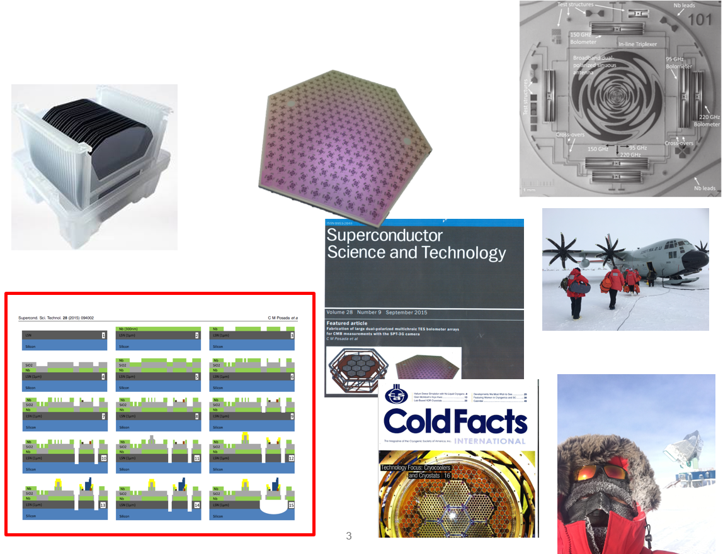
hep journey of Silicon wafer
Credit: HEP detectors microfab team

Slide 5
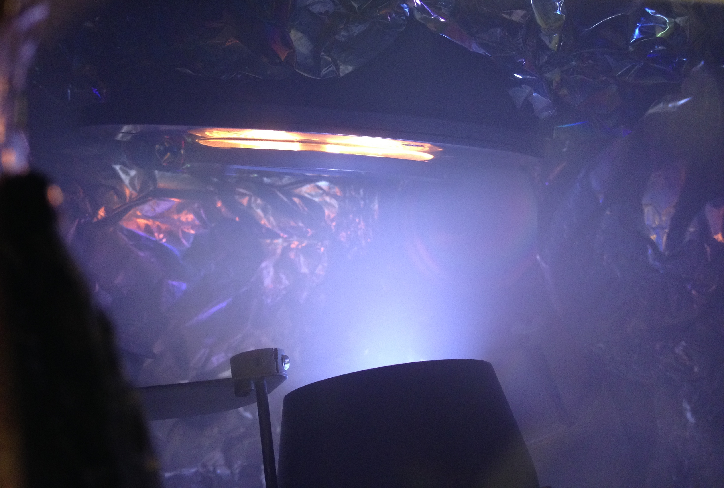
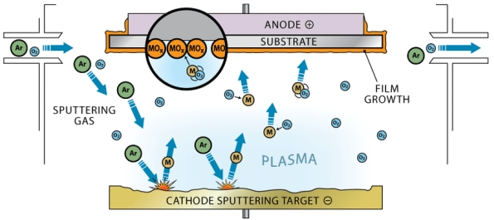
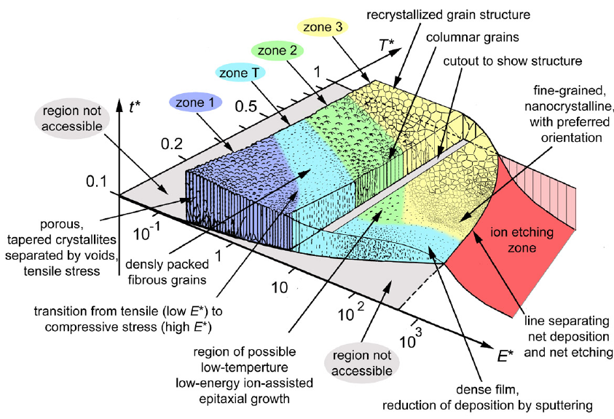
MAGNETRON SPUTTERING
Why it matters:
- Uniquely suited process for detector R&D and device fabrication
Reproducible process:
  Widely employed in industry.
Versatile:
  Allows for the synthesis of elemental materials, alloys, and layered structures.
Controllable growth of thin films:
  By adjustment the plasma parameters, substrate temperature and bias.
Metals & insulators can be grown:
  Reactive sputtering processes.

Slide 6
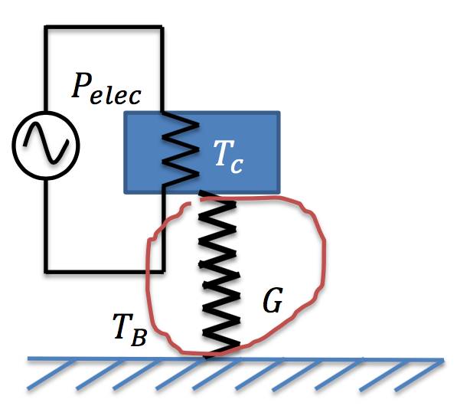
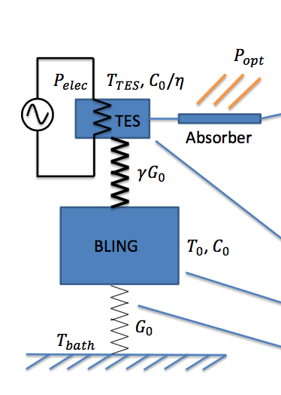
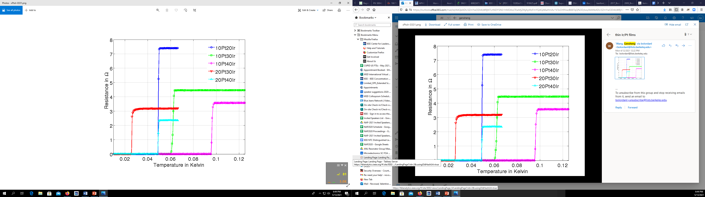
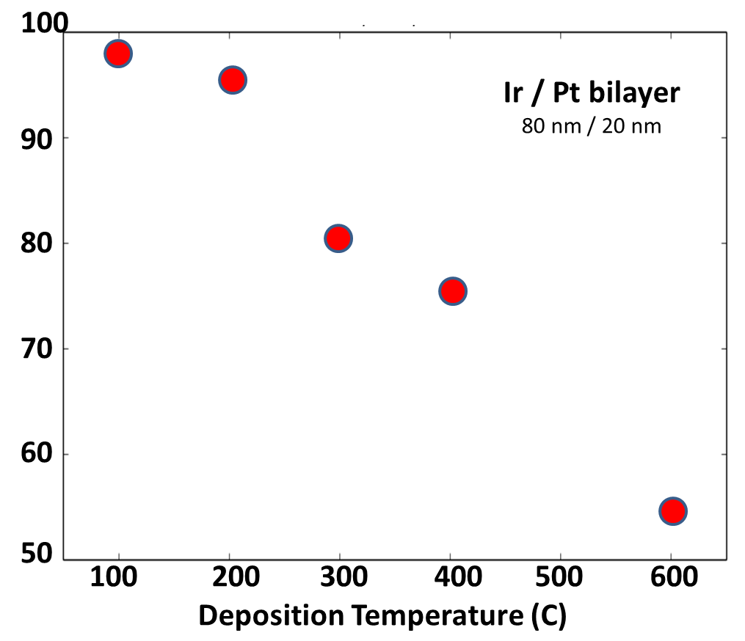
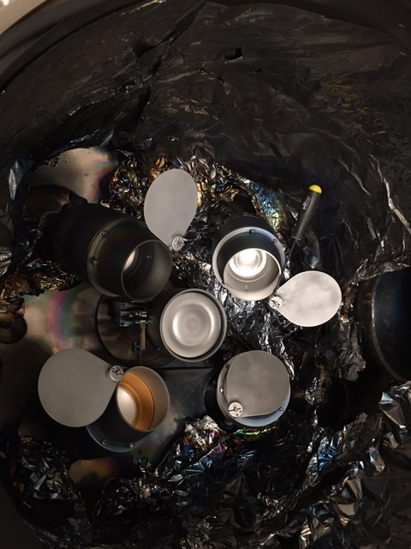
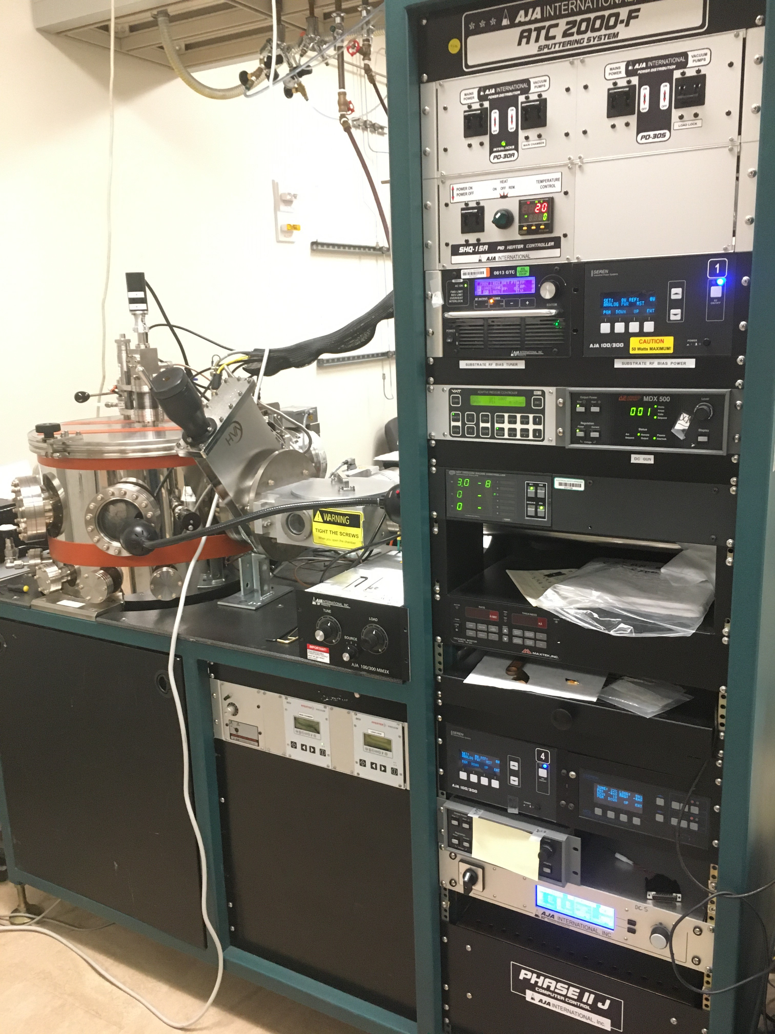
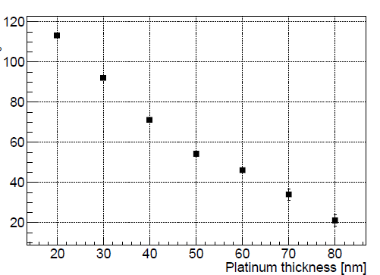

LOW Transition temp. SUPERCONDUCTORS
Why it matters:
- New low Tc superconductors for ultra-low noise TES devices
$$P_{tot}=K∗(T_{C}^{n}−T_{B}^{n})$$
P_{tot}
Ir/Pt bilayers:
- Proximity effect - Dep. temp. effect
G
T_{B}
Ir/Pt
80nm/20nm
CMB-3G design
Resistivity, ohms
Transition temp. Tc (mK)
Stage Temperature, K
Deposition temp., C
Tc
Al: 1.2 K
Mo: 0.9 K
Ti: 0.5K
Ru: 0.5 K
Zr: 0.5 K
Ir: 0.15K
Ir: 100nm
Transition temp. Tc (mK)
UHV grade
5 sputtering guns
DC/RF/Impulse + RF bias
800C sample stage
(MSD lab # ESB/A013)
Pt thickness, nm
Credit: Vlad Yefremenko, HEP

Slide 7
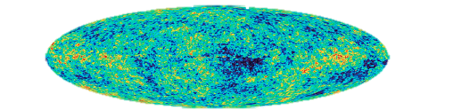
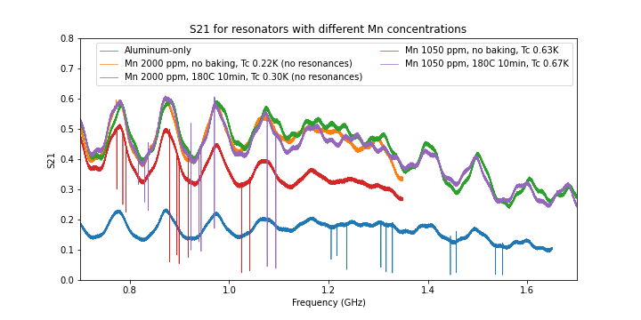
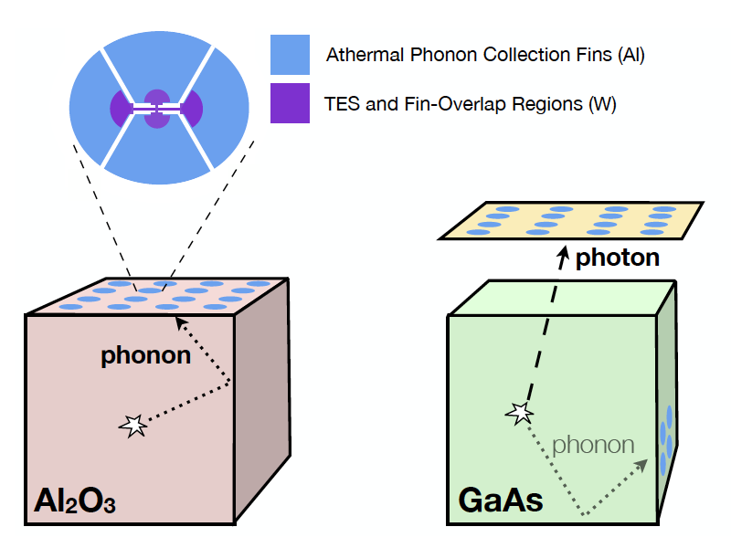
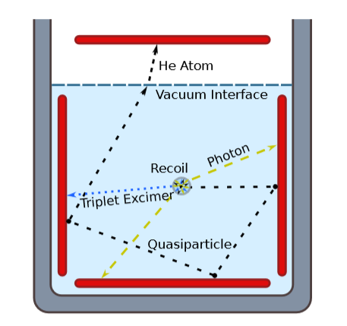
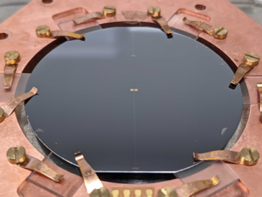
Connections
Materials enables lowering detector threshold
For superconducting detectors, noise and threshold scale with Tc.
Low Tc MKIDs
Credit: Zhaodi Pan, HEP
TES detector
Low Tc detectors for NLDB searches
Low Tc Dark Matter detectors
(Credit: Gensheng Wang, HEP)

Slide 8
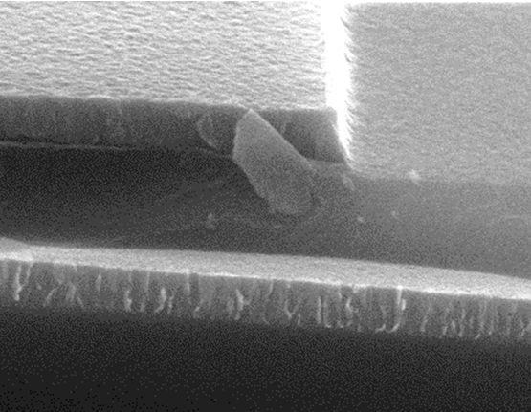
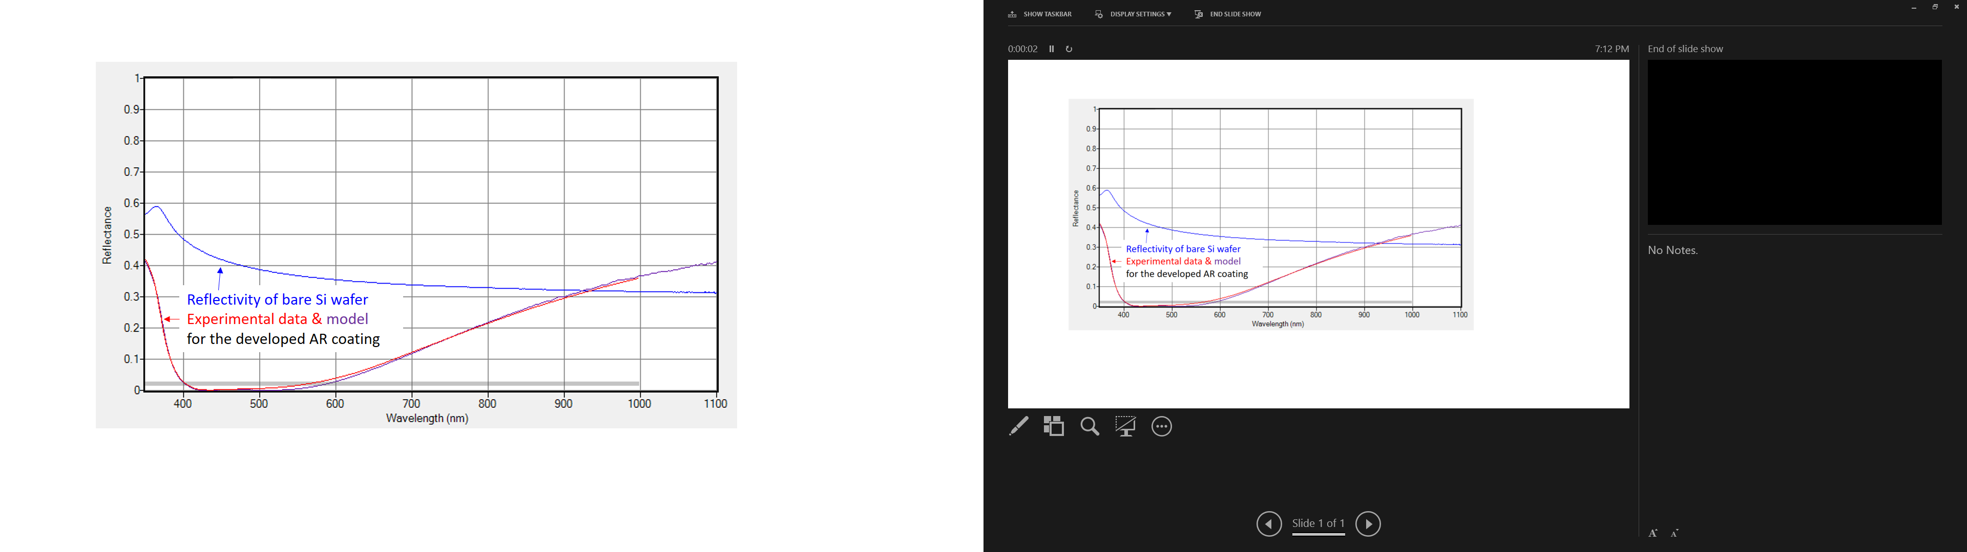
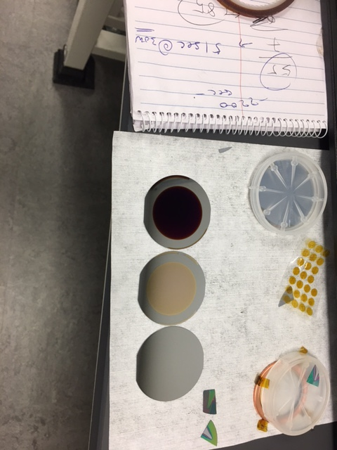
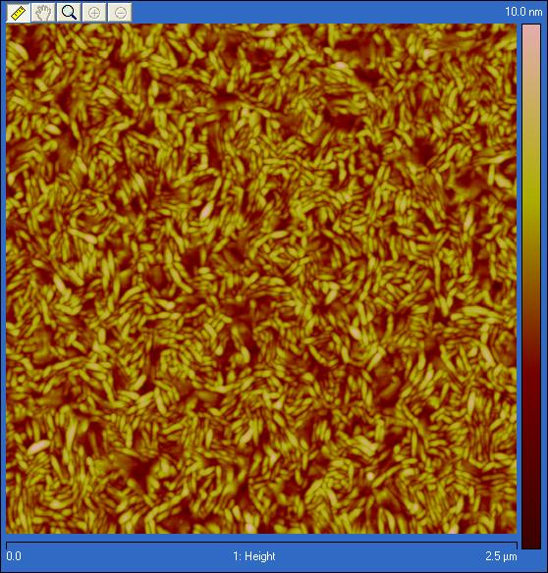
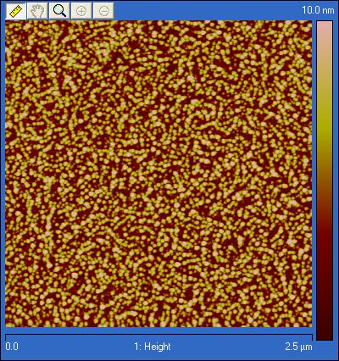
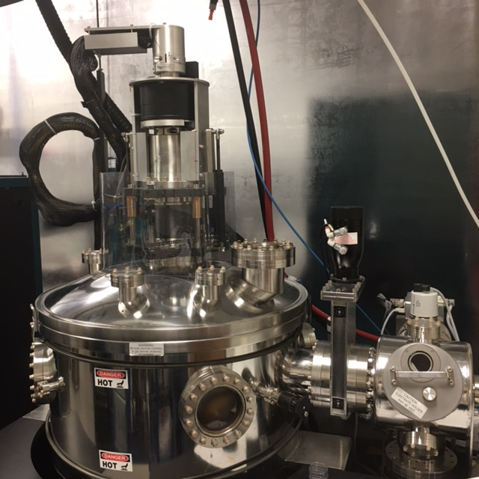
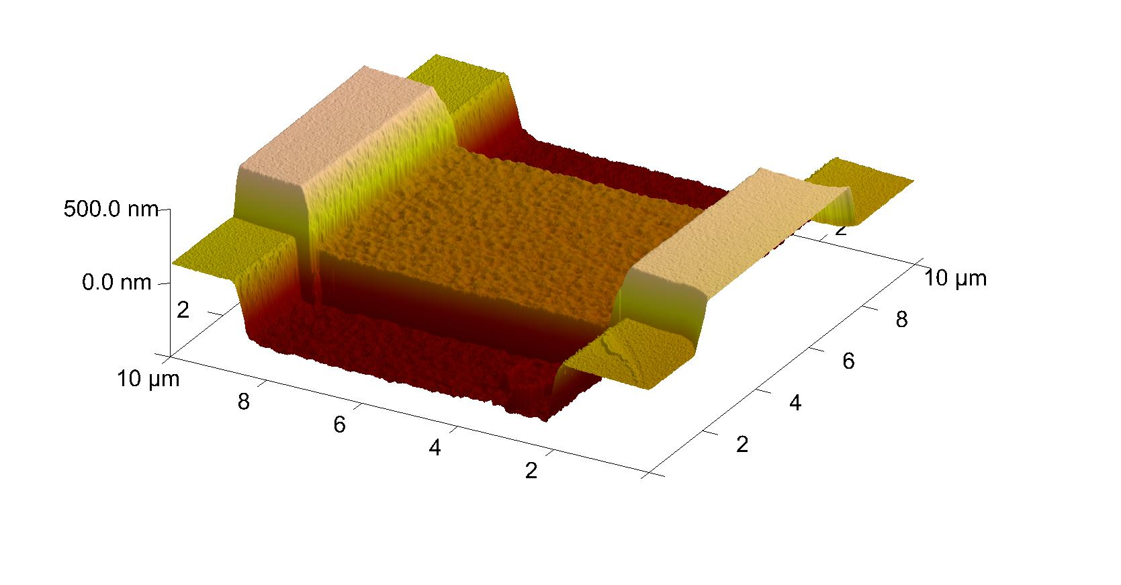
THIN FILM DIELECTRICS
Why it matters:
low-loss dielectrics for RF circuits
tunable optical properties
tunneling barriers
Sputtering of Si₃N₄ (Si target, RT)
Stochiometric
Si and Si3N4
Sputtering of SiO₂ (SiO₂ target)
200C + RF-bias
Optical constant, n
Nb
1.0
0.9
0.8
0.7
0.6
0.5
0.4
0.3
0.2
0.1
0.0
bare Si wafer AR-coated Si
Ar flow, sccm
SiO₂
Nb
Reflectivity
400 500 600 700 800 900 1000
Wavelength, nm
UHV grade
DC/RF + RF bias
Cryo pumping
700C sample stage
Direct sputtering
5 sputtering guns
(MSD lab # MDL/H109)

Slide 9
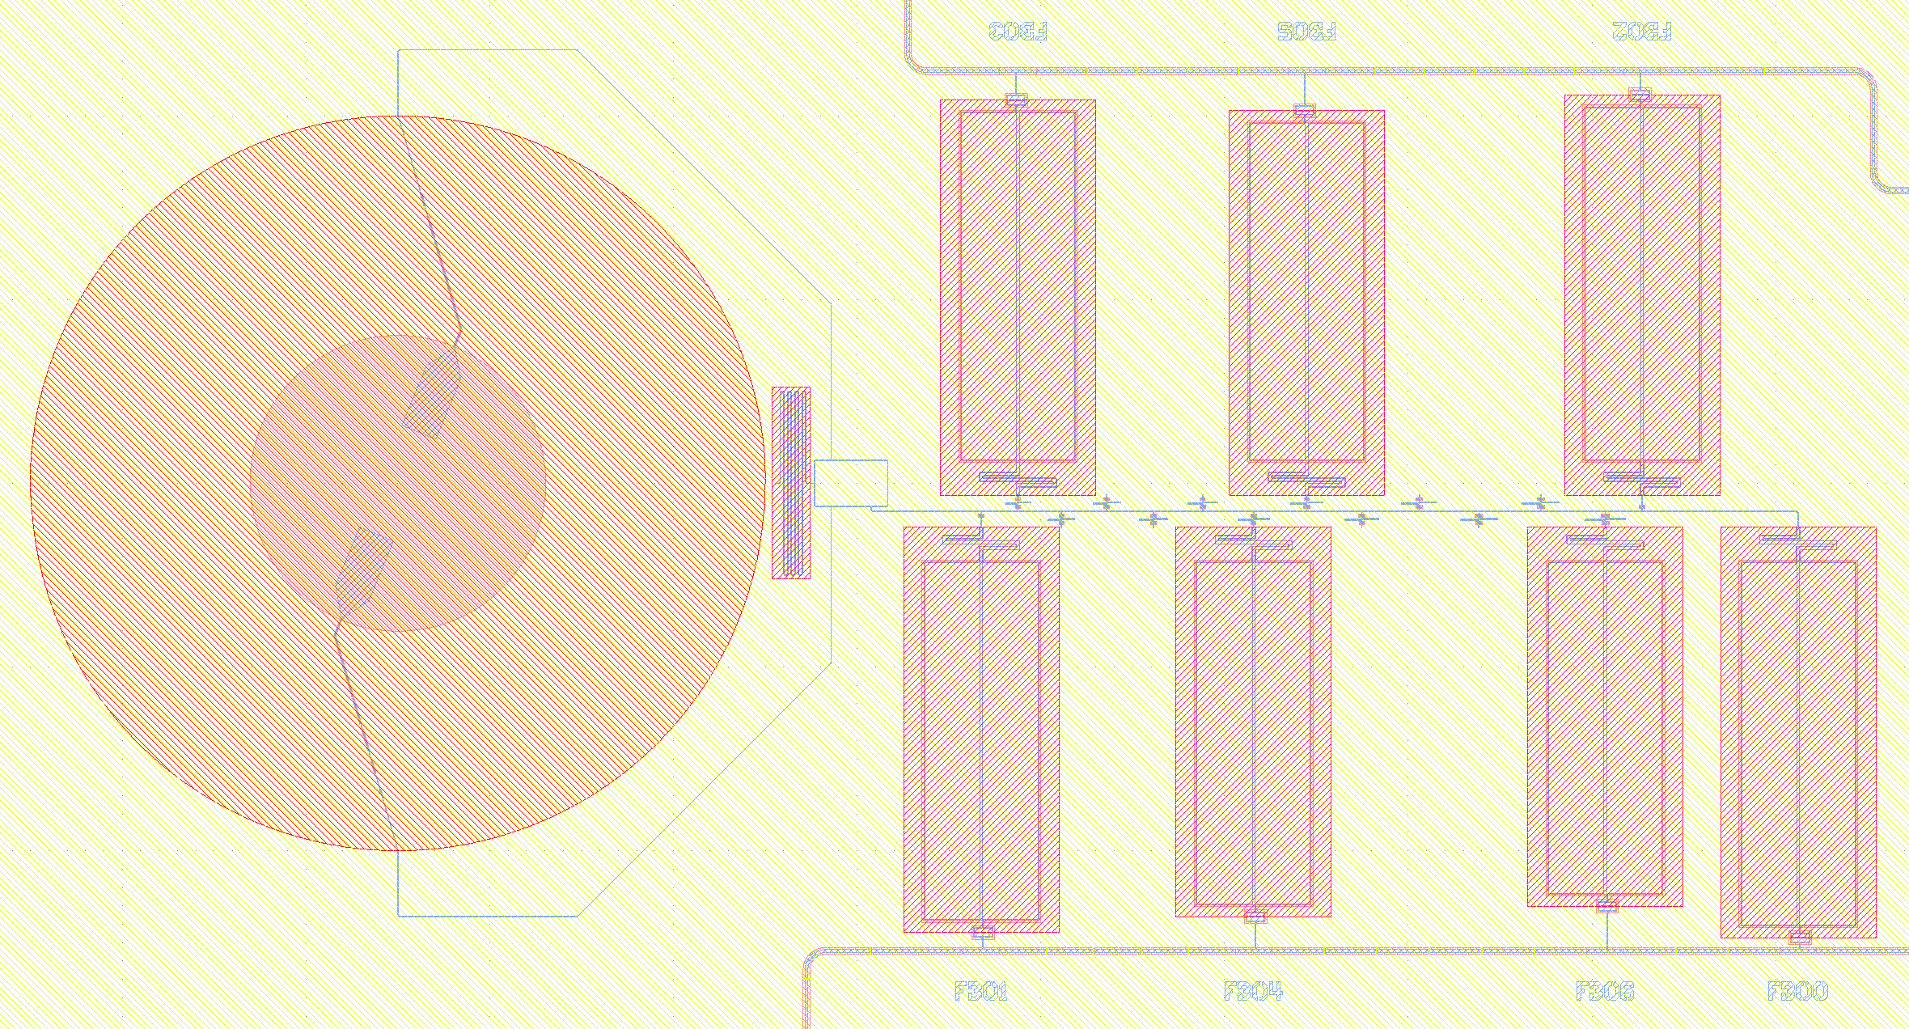
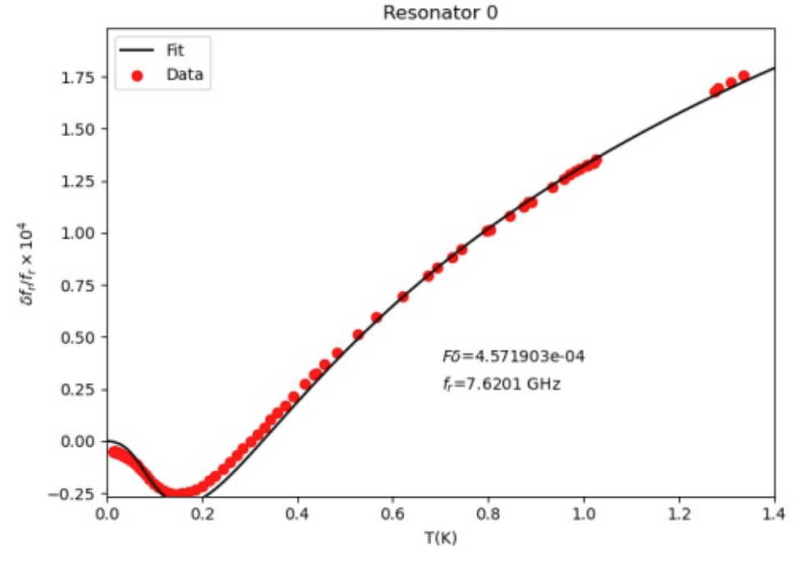
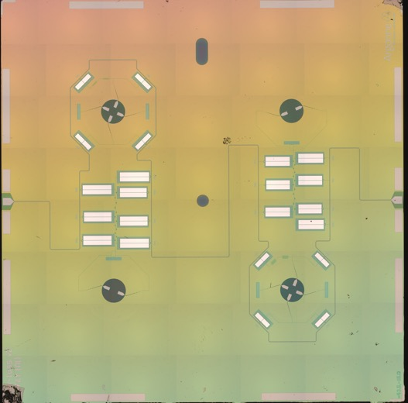
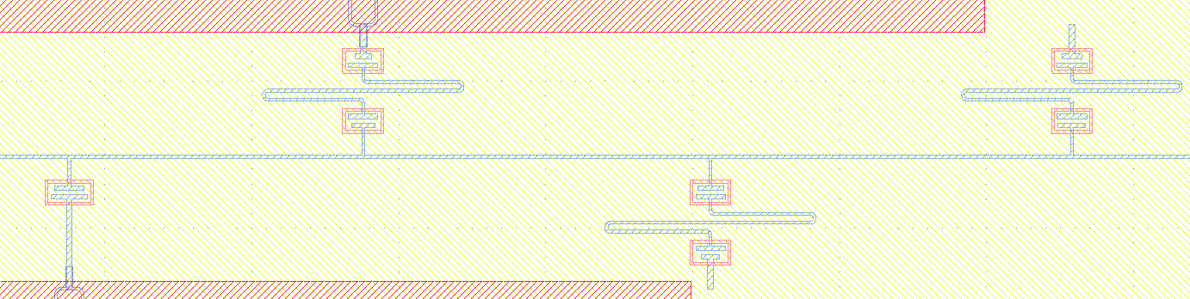
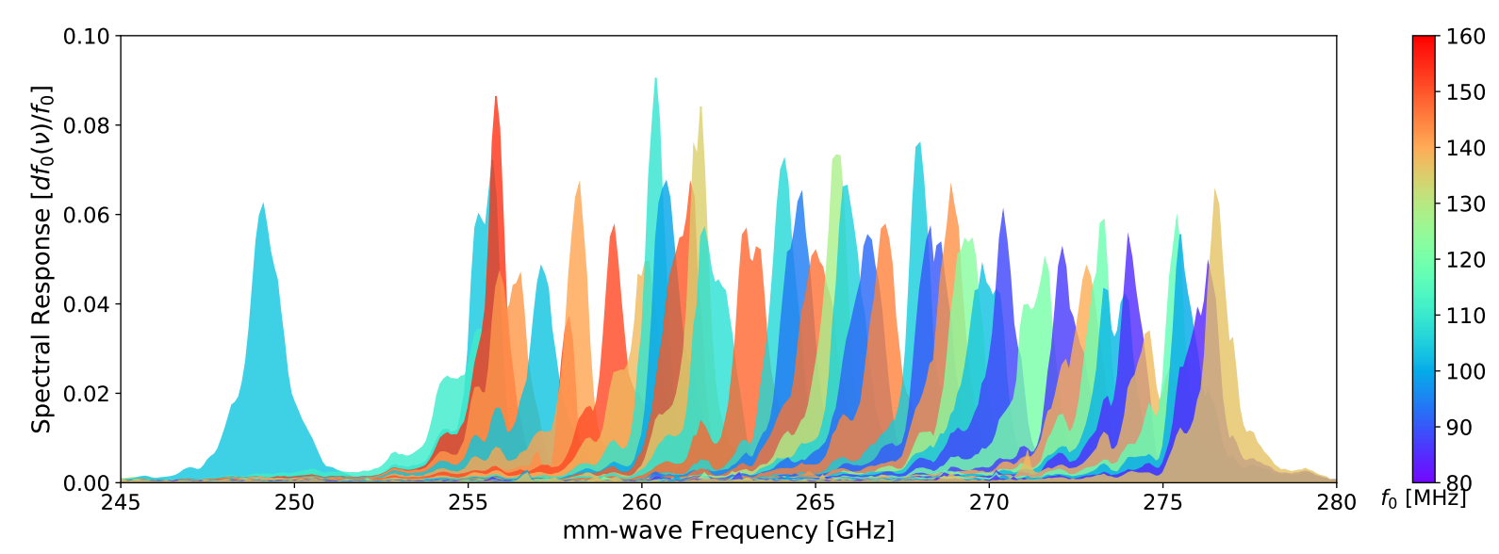
Connections
Future mm-wave detectors require low loss microstrip
Resolving power of mm-wave on-chip spectrometers limited by microstrip materials loss
OMT probe
Filter banks
Feedline
On-chip mm-wave spectrometers
Credit: Zhaodi Pan, HEP

Slide 10
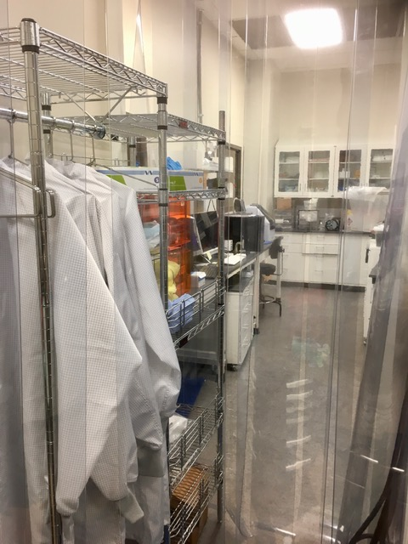
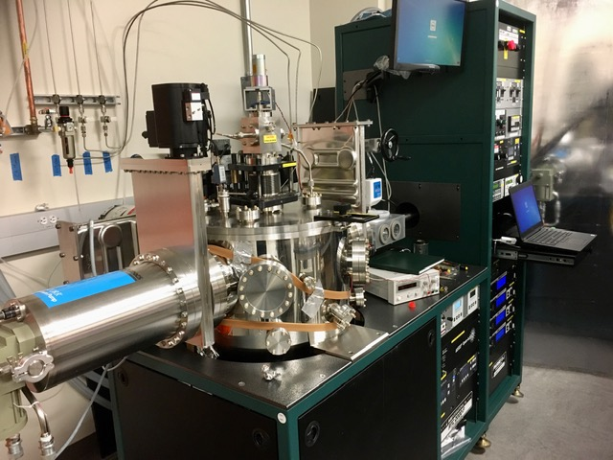
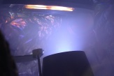
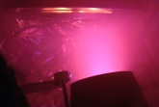
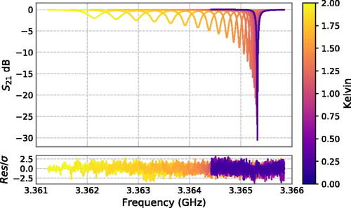
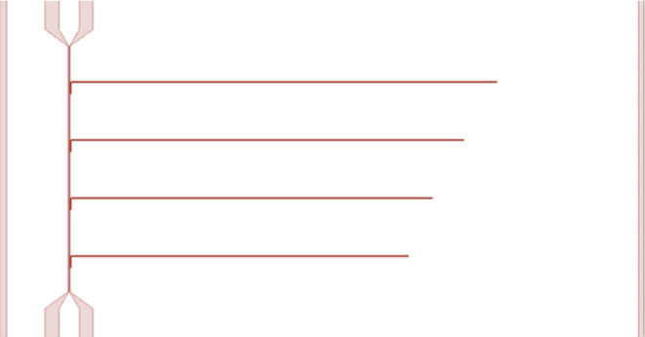
“HIGH-Tc” SUPERCONDUCTORS:
NITRIDES via REACTIVE SPUTTERING
Why it matters:
Superconductivity fine-tuning
via nitrogen content adjustment
Synthesis of new superconductors
Passivation & diffusion barrier layers
Example of NbN
“Bulk” Tc:~16K
@ 250C + RF-bias
UHV grade
6” wafer process
Class 1000 CR
5 sputtering guns
DC/RF + RF bias
700C sample stage
Turbo + Cryo pumping
(MSD lab # MDL/H109)
F. Carter, et al.,
Appl. Phys. Lett. 115, 092602 (2019)

Slide 11
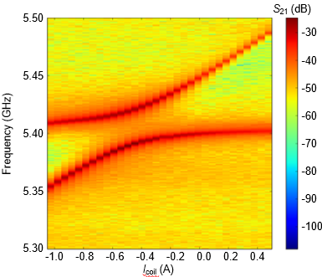
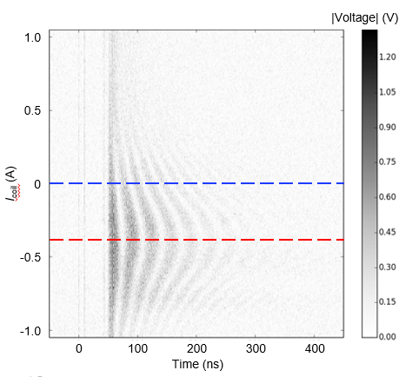
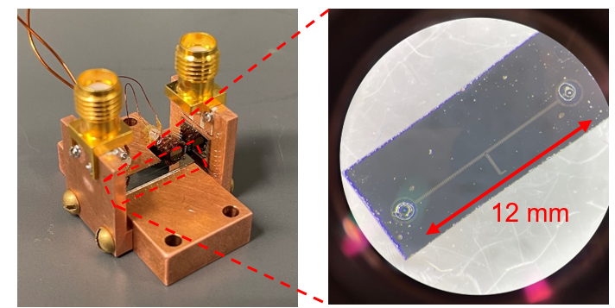
Connections
Hybrid Superconducting – Magnonic Devices
Why it matters:
On-chip coherent information trunsduction
From RF to Microwave frequency (microwave-to-optical is a possibility to)
Low-temperature operation
Magnetic field tenability
An emerging opportunity for novel dark matter particle candidates?
YIG sphere1
YIG sphere2
magnon2
Time-domain
Rabi-like oscillation
magnon1
Low-loss SC circuit (NbN)
Remote coupling of distant magnetic resonator
Credit: Yi Li, MSD
(YIG: Y₃Fe₅O₁₂)

Slide 12
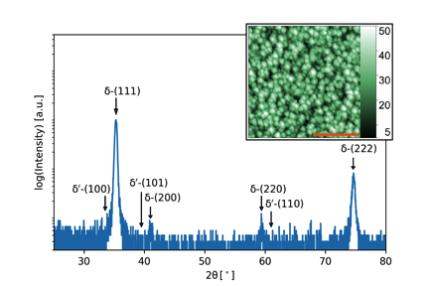
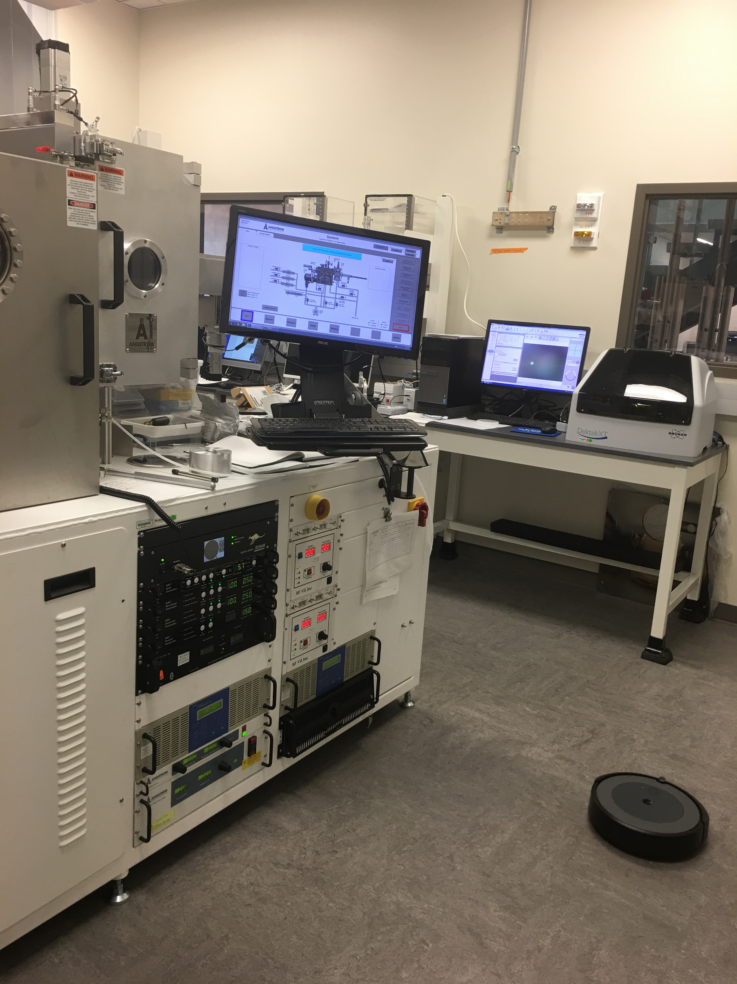
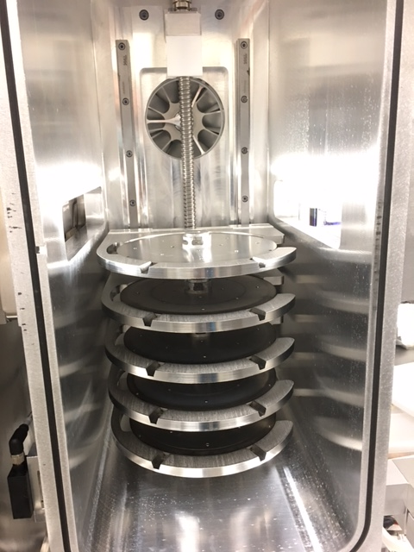
“HIGH-Tc” SUPERCONDUCTORS: NITRIDES
ION-BEAM ASSITED SPUTTERING
Why it matters:
Synthesis of nitrides/oxides @ RT
Surface preparation + in-situ interfaces control
Example of NbN
Conventional process
N2
Si
+ heating
Nb
IBAS process
Si
UHV grade
Auto-loader / five wafers
Class 1000 CR
5 sputtering guns
Low voltage ion gun
700C sample stage
E-beam evaporator
Tiltable stage
Oversized Cryo pump
(MSD lab # MDL/H109)
heating
e⁻
Nb
N⁺
T Polakovic, et al.,
Appl. Phys. Lett, - Materials, 6(7) 076107 (2018)

Slide 13
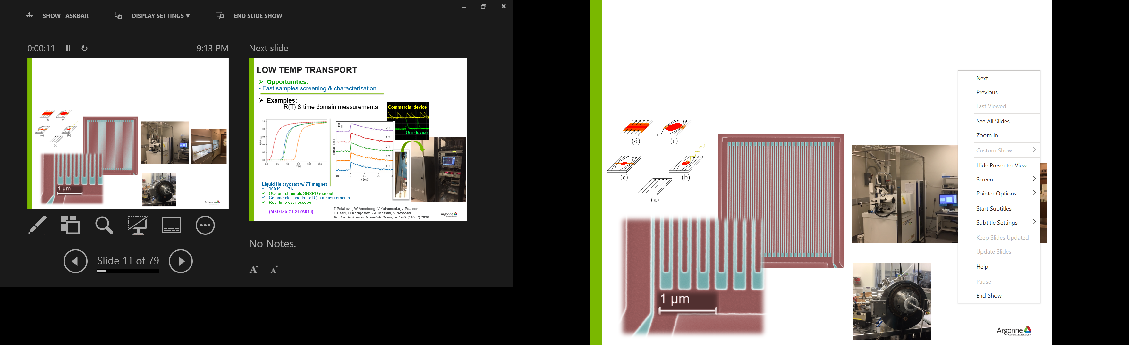
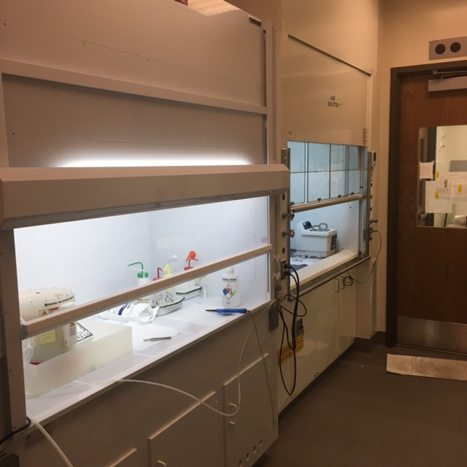
NANO-FABRICATION FACILITIES: from SUB-MICRON TO wafer-scale
Why it matters:
- Fast turn-around devices prototyping
High-resolution e-beam writer
Class 1000 Clean Room
Resist processing CR lab nearby
Closed-loop x-y-z stage
30 kV, sub-10nm e-beam
Earth magnetic field compensator
Vibration isolation
Multi-apertures for pattering & SEM
(MSD lab # MDL/A051)
Example: superconducting nanowire single photon detector
Ion-milling tool
Titled stage
Liquid N2-cooled
From ~0.1-1kV (Ar+)
(MSD lab # ESB/H109)
Credit:
Tomas Polakovic, PHY

Slide 14
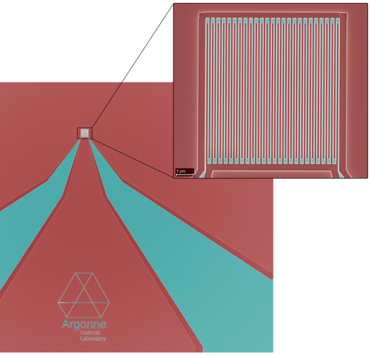
Connections
Single Photon / Single Particles Detection
SNSPDs are an emerging high-impact superconducting technology
  Fast timing, no dark count, high efficiency at IR
  QIS science enabling technology
Growing program at Argonne
  for DOE-BES QIS
  for DOE-NP
  for DOE-HP
The inter-divisional partnership the key to enable the success of future SNSPD-related programs

Slide 15
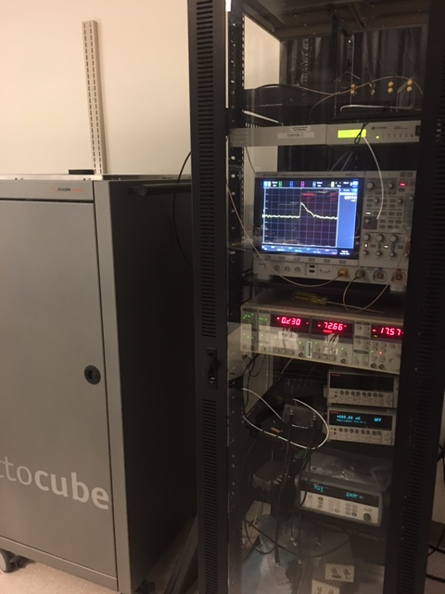
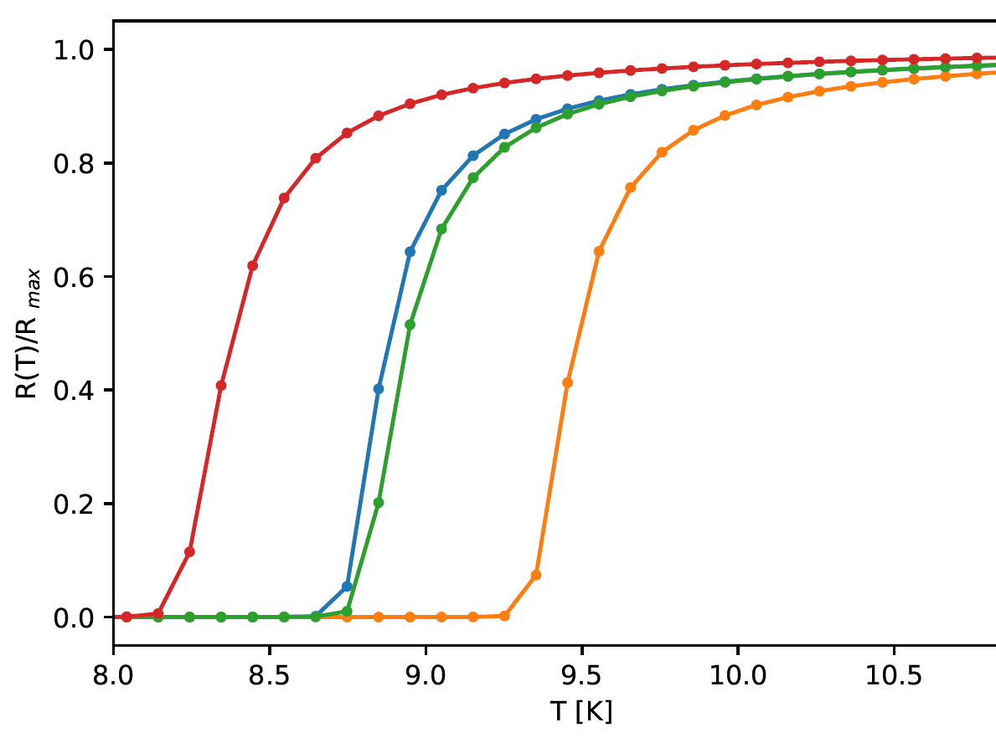
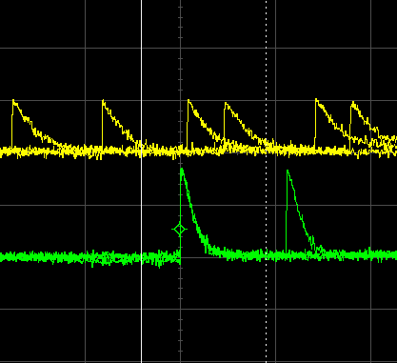
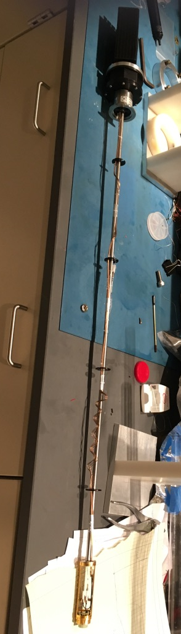
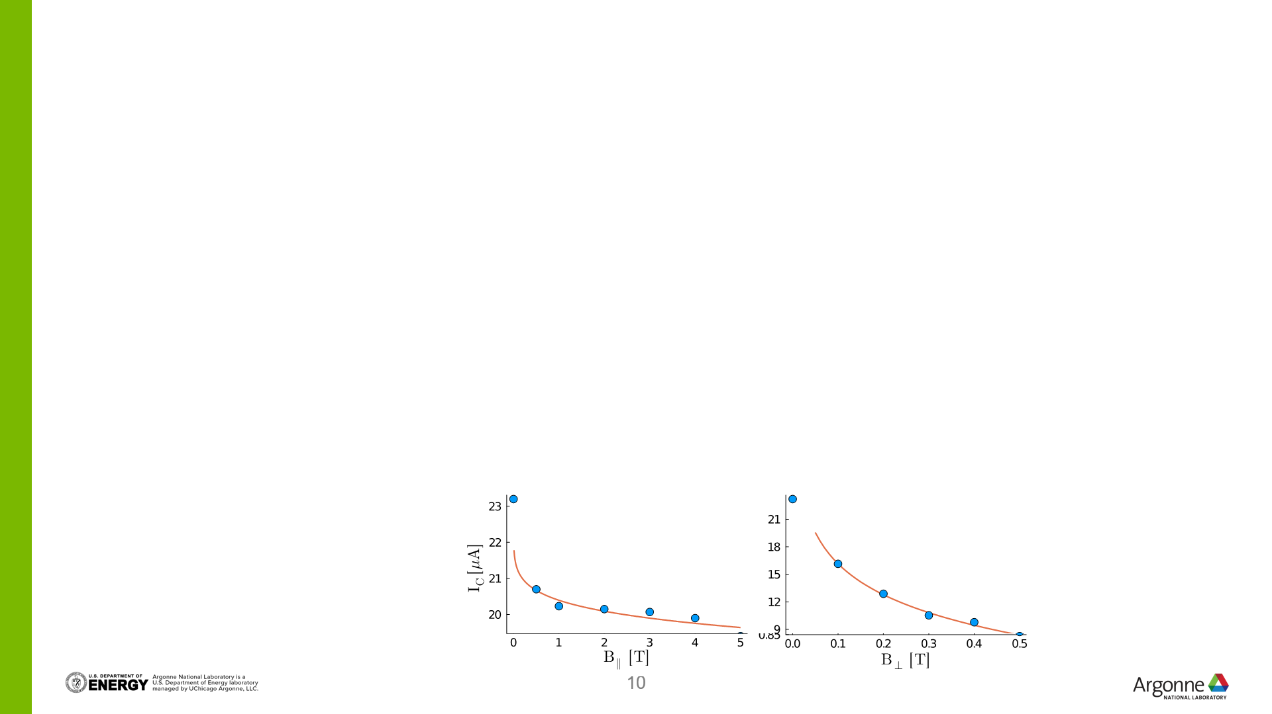
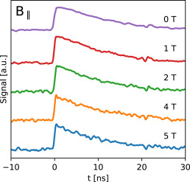
LOW Temperature TRANSPORT
Why it matters:
- Fast samples screening & characterization
Examples:
Measurements of R(T), Jc & in time domain
Commercial device
Our device
Liquid He cryostat w/ 7T magnet
300 K – 1.7K
QO four channels SNSPD readout
Commercial inserts for R(T) measurements
Ultra-fast real-time oscilloscope
(MSD lab # ESB/A013)
Credit:
Tomas Polakovic, PHY

Slide 16
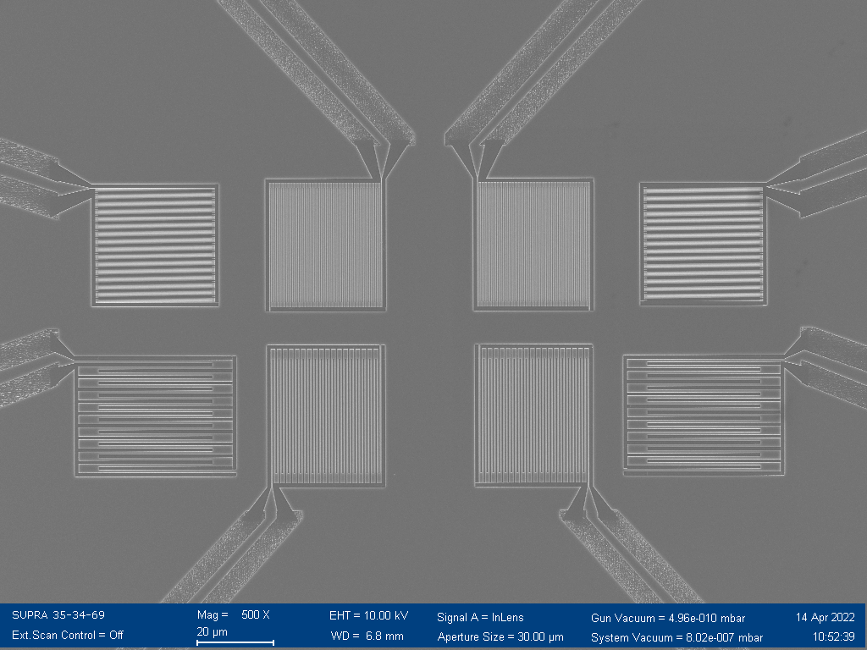




Particles detection
Novel application of SNSPDs:
- α particles detection
Source activity: 10 μCi
Limited by noise/interference at low bias currents → working to improve the SNR in this region
Should be able to detect ɑ particles down low I_{b}/I_{c} < 0.2
Credit:
Whit Armstrong, PHY

Slide 17


Particles detection
Novel application of SNSPDs:
- 120 GeV protons at Fermilab
Preliminary results show 120 GeV proton detection with superconducting nanowires.
This is a key demonstration for applications at the EIC.
Particle | Energy | Approximate Energy loss in |  | Detected
 |  | 100 μm silicon | 15 nm NbN
photon | 0.1 - 2 eV | all | all | ✔
alpha | 5 MeV | 5 MeV | 9.1 keV | ✔
beta | 1 MeV | 15 keV | 15.8 eV | ✔
electron | 100 MeV | 100 keV | ~100 eV | ?
proton | 120 GeV | 40 keV | 24 eV | ✔
pion /muon | 10 GeV | 30-45 keV | ~20 eV | ?
nanowire signal (red)
scintillation counters (blue)
Need to scale up detector area with larger pixel arrays
Cryogenic readout electronics also needed for high channel counts
Credit:
Whit Armstrong, PHY

Slide 18

MATERIALS R&D is foundational for Complex devices
IN SUMMARY:
Materials & Devices
Low Tc materials
High Tc materials
Dielectrics
Nano-patterning
Mm-wave imagers and spectrometers:
  CMB, LIM, early universe cosmology
Low threshold detectors:
  dark matter, neutrinos, NLDBD
Nano-strip devices:
  Particle detection, Quantum sensing
どうも ありがとう ございます !

