Slide 1
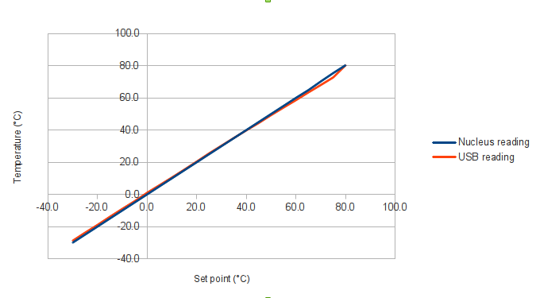
From Al Ito
Ceramic Temperature
Stability is reached in 5 minutes
Conclusion: Trust the Thermo-Resistor
read out and set the chuck temperature to
~75 Cº to achieve 60 Cº at the sensor
From Elena

