Slide 1
Checks of 2x2 MINERvA with Beam
Howard Budd, University of Rochester
Mar 27 2023

Slide 2
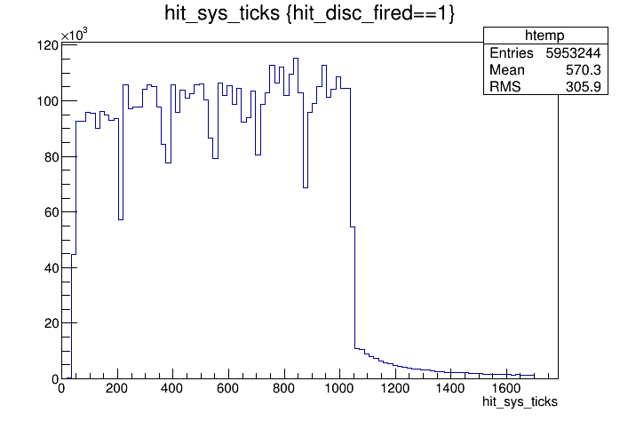
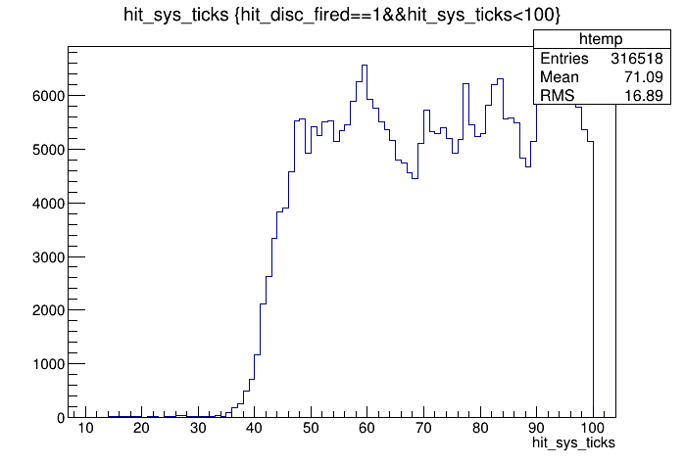
Triggers & Gate
MTM triggers on beam signal.
Time of disc hits in clock counts
1 clock count = 9.42ns
16 μs gate which starts ~ 400 ns before beam arrives. Tail is Michel electrons
Plot same as MINERvA
6 Booster batches

Slide 3
DAQ
The FEB PEDs are from MINERvA, Jul 2019, when MINERvA was stopped
To understand the plots
DAQ reads out 5 -10 FEBs in a daisy chain, MINERvA had 59 chains
“The Sequencer”, the FGPA in the CROCE & the name given by Boris Baldin & Cristian Gingu, reads out a chain.
Event Builder & et puts the data on disk.
A module set (MS) is a unit of production consisting of 4 steel modules. The scintillator planes are read out by 2 chains, one east and one the west.
2x2 MINERvA consists of 3 HCAL MS (4 scintillator planes), 2 ½ ECAL and 5 ½ tracker MS (8 scintillator planes)
The plots show this.
qhi is the most sensitive measure of pulse height.

Slide 4
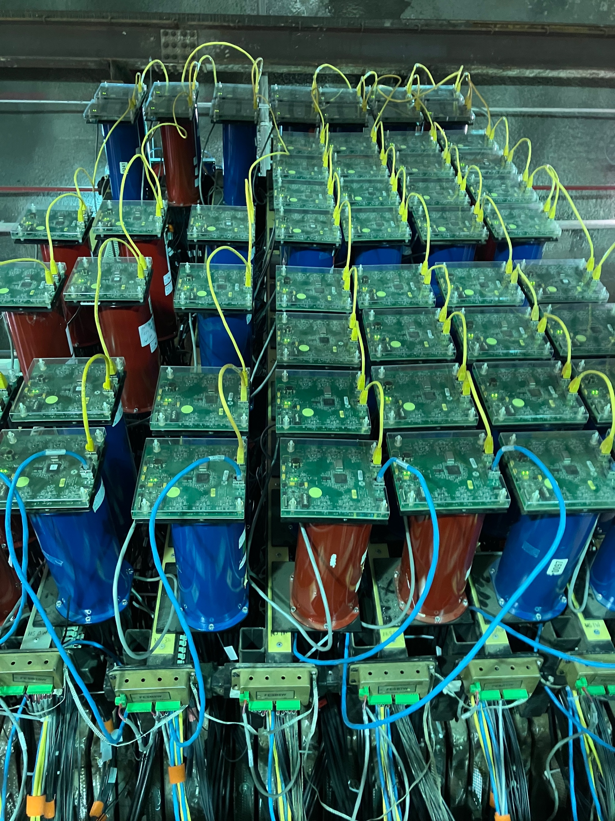
Module Sets
MINERvA From above
West side
Left 3 are HCAL & the 4 on the right side are 2 ½ ECAL and 1 ½ tracker.
FEB
PMT
Daisy Chain
Module Set, going up

Slide 5
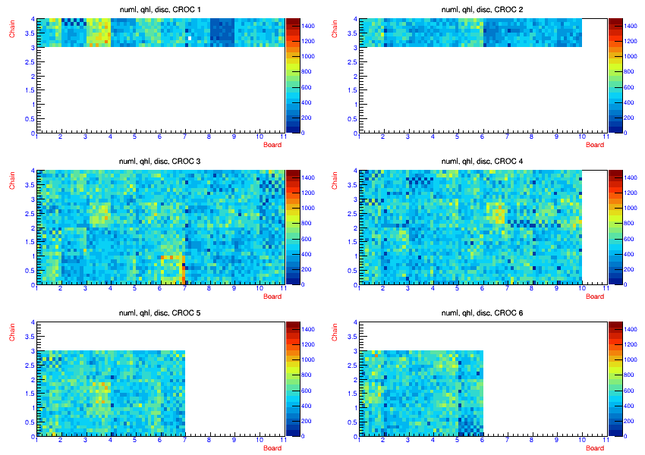
Ave Qhi for Pixel Older plot, but shows geometry
West
East
qhi for pixels, vs CROC, board & chain
Plotted in MINERvA nearline
Checker board pattern, cable not seeded
O outer calorimer
X x plane
U u plane
V v plane
MS4
MS3
O X X U X X U U U O
O V V V X X V X X
MS2
Tracker
Tracker
To be completed
To be completed
MS1
MS8
MS7
MS6
MS5
O X X U X X U U U O
O V V V X X V X X
HCAL
MS11
HCAL
MS10
MS9
O X UX XU U. O
O V VX XV X

Slide 6
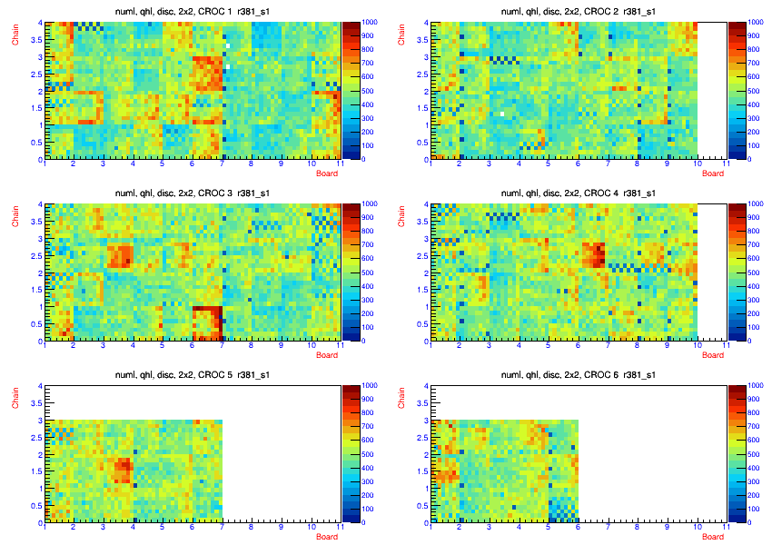
Ave Qhi For Pixels
After finishing assembly
Cable not properly plugged in to a connect
We see this in a variety of places

Slide 7
Ave Qhi for Pixel Addressing the problem
Light Green, pushed on
Red, not great connection
Orange, nothing found
Yellow, no cable
Blue 7,loose @ PMT
Dark Blue, maybe plugged into PMT
Grey, unplugged at PMT
Violet, unplugged at detector

Slide 8
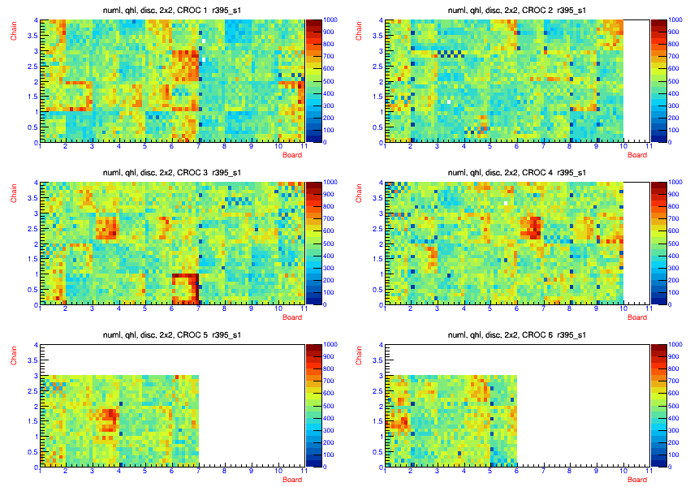
Ave Qhi After Fixing
Light Green, pushed on
Red, not great connection
Orange, nothing found
Yellow, no cable
Blue 7,loose @ PMT
Dark Blue, maybe plugged into PMT
Grey, unplugged at PMT
Violet, unplugged at detector

Slide 9
Non fixed cables
MS WE Croc Chain BD cable action
1 W 1 0 5 1 nothing found
3 W 1 2 10 1 nothing found
3 W 1 2 5 5 one not looked at
3 E 2 2 3 1 Broken connector at detector
6 W 3 1 1 2 unplugged at PMT
5 W 3 0 2 1 nothing found
8 W 3 3 8 5 nothing found
8 E 4 3 1 1 nothing found
7 E 4 2 7 7 pushed on at detector - pushed at detector
7 E 4 2 1 2 nothing found
11 W 5 2 1 4 nothing found
11 E 6 0 5 7 pushed on at detector
Could this be due to either the PMT box or the modules?

Slide 10
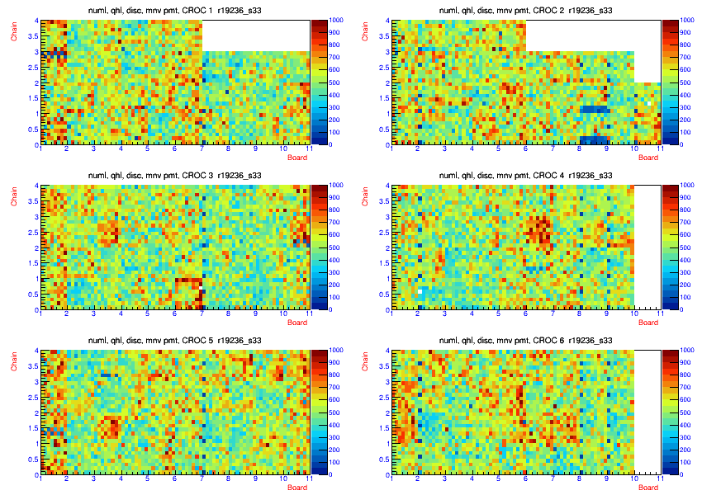
MINERvA r19236 Same CROCs, Match PMTs
Same scale
Matching PMTs
We had to replace some PMTs, but none on the previous page
Looks like cable problem is not a PMT problem
Problem cables circled with box
They do not match with problem cables in r395

Slide 11
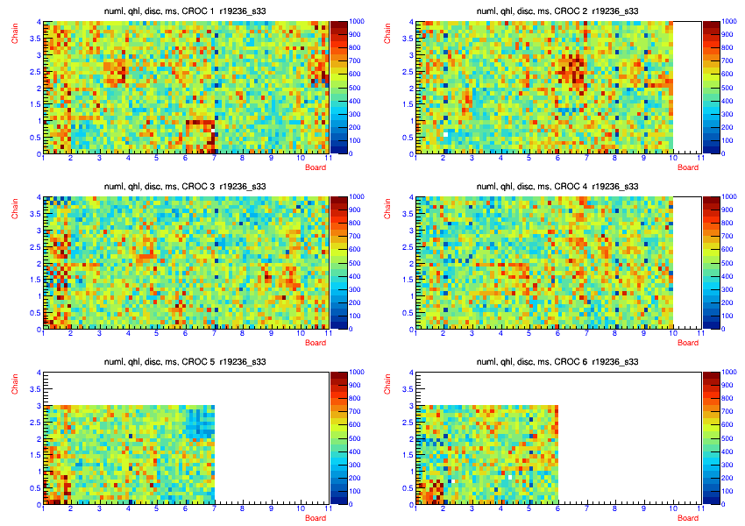
MINERvA r29236 Match Module Sets
Check if detector is the problem.
Contruct plot to put MINERvA module sets at same place for MINERvA 2x2
Again, cable problem is not a module problem
Our problem cables that we see in r395 are due to our assembly, not the PMT boxes or the detector

Slide 12
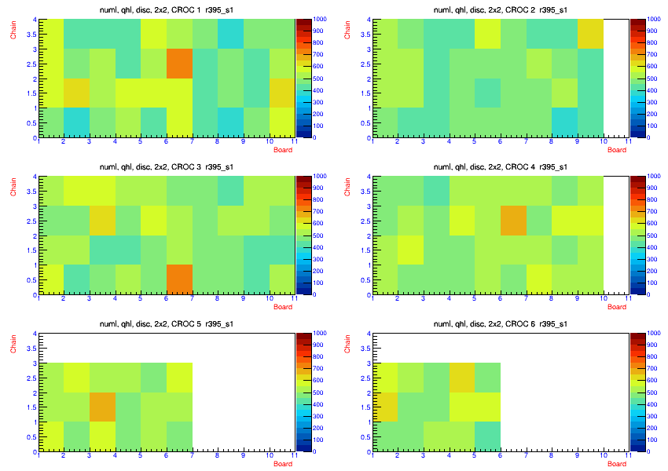
Ave Qhi/PMT, 2x2
Shows ave qhi/pmt
Shows variation in gain of PMTs
Boards 1, 10 & 6 for Chain 5. are outer calorimeter. The have square scintillator instead of triangles

Slide 13
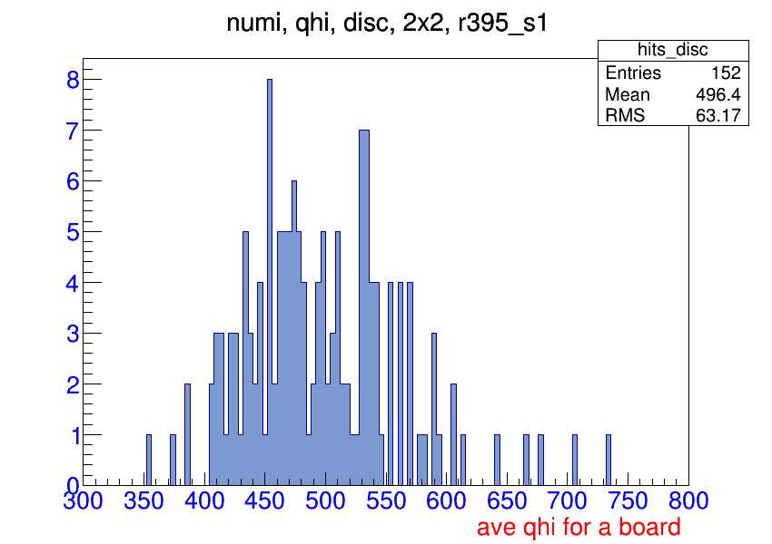
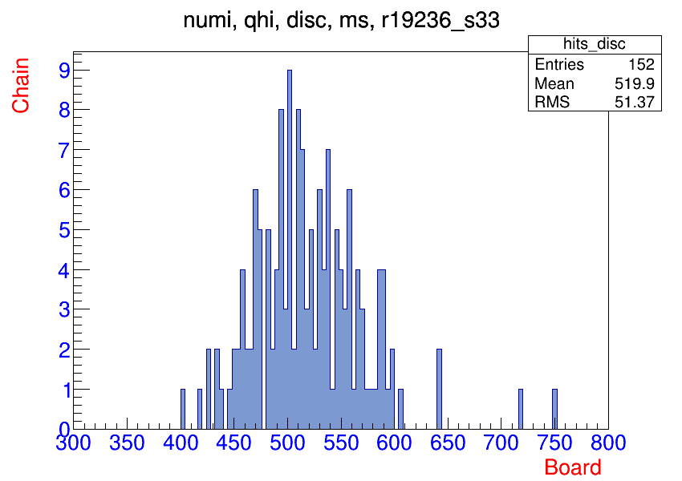
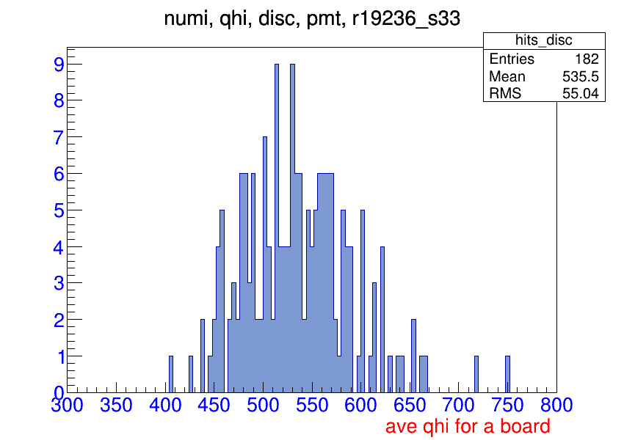
Qhi board ave 2x2, same PMT, same MS
2x2
MINERvA
Same MS
Does not include outer HCAL calorimeter
2x2 = 496 av, 63 rms
Ave of MINERvA plot = 528 av, 53 rms
MINERvA HV determined by using RMS of LI pulse.
The MINEvA ~ 4.5 years ago, maybe light ~ 1%/year.
The beam is not centered at this same place on the detector so this could also be part of the difference.
2x2 has larger gain tubes or detector RMS, looks like tails
The 2x2 looks similar to MINERvA with small change in the amount of light & slightly higher RMS
MINERvA
Same PMT

Slide 14
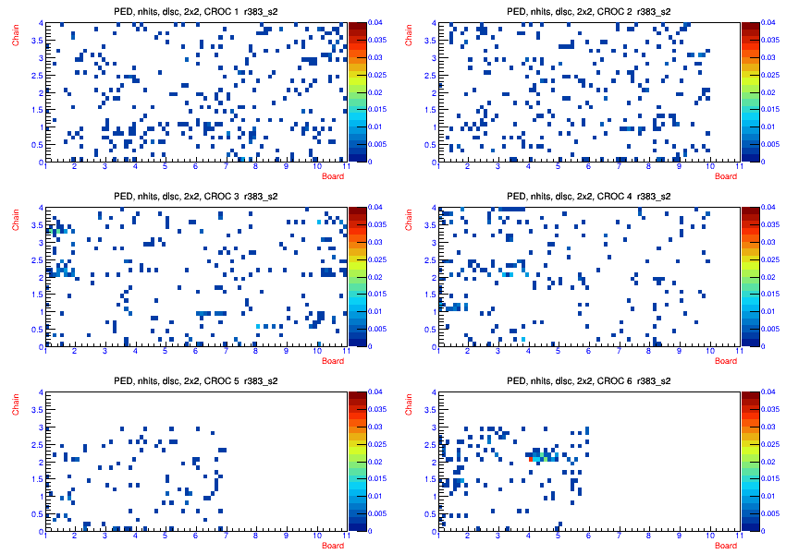
PEDs, nhits
PED during light leak checking.
Z axis changed from 0.25 to 0.04
500 events

Slide 15
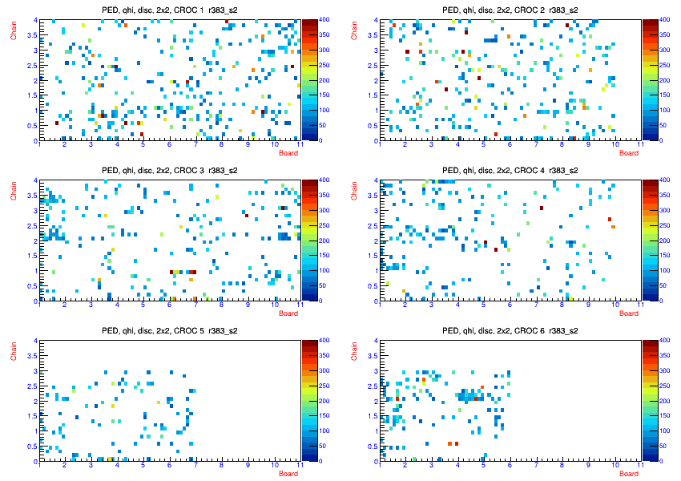
Ped, qhi
Changed z axis to 400 instead of 1500
500 events

Slide 16
HV
As stated before Cockcroft-Walton (CW) generator, designed by Sten Hanson for Quark Net, sets the HV of the PMTs. HV in configuration file.
HV can become unstable. This was the major reason for replacing a PMT in MINERvA
HV break down on or in the PMT or on PMT board? Some indications is it’s in PMT
But CW can’t generate much current, so a small breakdown causes a problem.
I can look at this by going through all the DSTs and look at the all the PMT HVs
The nearline program was stopping after every run. We were running the DAQ, but w was not making DSTs since it was such a pain.
On Friday, I resubmitted the DST program and it is still running, the problem seems to have gone away.
Nearline program is now using data files on local disk instead of using files on Blue Arc over the network. Looks like nearline over the network has problems.
Looks like it will finish late this week, maybe beyond.
So the HV issues will have to be presented next week.
With the DAQ problem, making DSTs should be able to catch up.
Numi, PED, or LI data work for this test.
This is also a couple more tests I want to do, so I can try to show it at the same time

