Slide 1
COLDATA PLL Locking
David Christian
March 21, 2023

Slide 2
COLDATA (Final Version) Phase Locked Loop
Voltage Controlled Oscillator
Phase and Frequency Detector
Low Pass Filter
62.5 MHz
2.500 GHz
The PLL output clock is divided by 2 to yield 1.25 GHz. A much larger inductor would be required to produce 1.25 GHz directly.
Notes:
The LC oscillator consists of a fixed large inductor and a capacitor whose value is determined by CONFIG_PLL_BAND. The range of frequencies that can be produced by the VCO depends on the practical range of L and C available in the process. The inductor is physically large (~500um x 500um).

Slide 3
Problem observed in VD Coldbox tests (CRP5 & CRP4)
Some of the COLDATA 1.25 Gbps links were unreliable.
A checksum (sum mod 256) is calculated for each group of 16 ADC values (corresponding to one ColdADC).
Some links had a large number of checksum errors detected at the WIB.
Some also were corrupted badly enough that output frames (to FELIX) were dropped.
When CONFIG_PLL_BAND was changed from the default value of 0x20 to the value recommended in the data sheet (0x25) for all COLDATA chips, the errors stopped.

Slide 4
Output Link Bit Rate vs. CONFIG_PLL_BAND
COLDATA configured to output PRBS7 (80K)
Line rate measured using Tek DSA72004C
Reasonably stable output is observed for almost all values of CONFIG_PLL_BAND
When the PLL is locked, the LOCK output is always HIGH (TRUE).
When the PLL is not locked, the LOCK output is either always LOW (when PLL_BAND is far from the locking range) or sometimes TRUE and sometimes FALSE (when PLL_BAND is closer to the locking range).
When PLL_BAND is just outside the locking range, the bit rate is unstable.

Slide 5
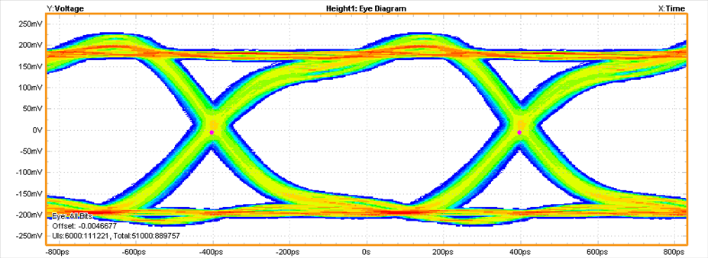
PLL_BAND = 0x24 (near center of locking range for this chip)
Source | Data Rate | Pattern Type | Pattern Length
MATH1 | 1.2500Gb/s | Repeating | 20UI

Slide 6
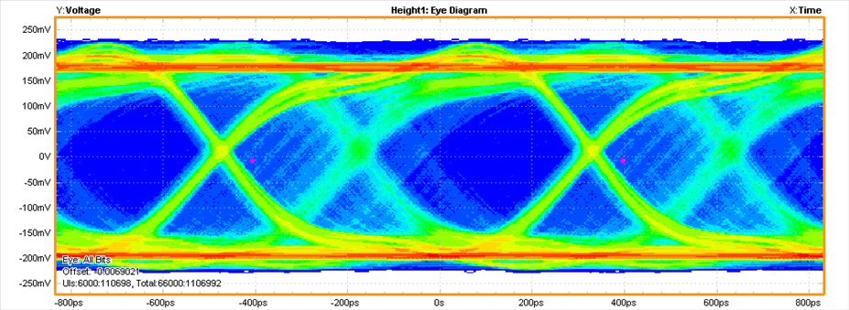
PLL_BAND = 0x1A (just outside of the locking range; 0x1B is locked)
Source | Data Rate | Pattern Type | Pattern Length
MATH1 | 1.2446Gb/s | Arbitary | NA

Slide 7
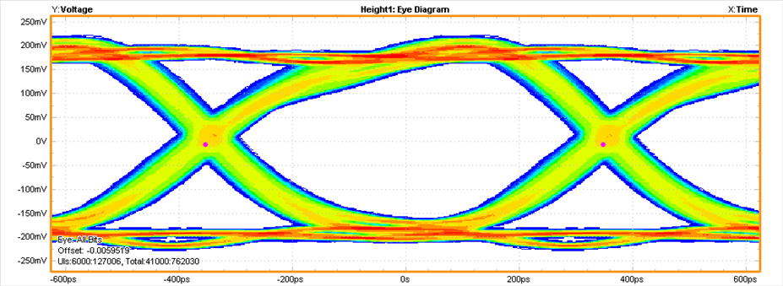
PLL_BAND = 0x3F (well outside of the locking range; 0x2C is locked)
Source | Data Rate | Pattern Type | Pattern Length
MATH1 | 1.4275Gb/s | Repeating | 20UI

Slide 8
COLDATA QC
The default value of CONFIG_PLL_BAND is 0x20 (and this is the nominal center of the locking range).
Tests of a few COLDATA indicated the center of the locking band for chips produced in the COLDATA_P3 MPW was 0x25.
The parts I made these measurements on is from the engineering run; the center of its locking range is between 0x23 and 0x24.
We will want to measure the locking range (warm and cold, although the difference is expected to be small) as part of COLDATA QC.
Studies with the FEMBs in NP04 (warm) and on CRP5 in the next cold box tests would be interesting too.

