Slide 1
SSR Status Update at Fermilab
SSRs team at Fermilab
March 23, 2023
ALL Partners Coordination Meeting

Slide 2
EPDM for PIP-II/SSRs scope
Engineering Process Documentation Management (EPDM) | Teamcenter No.
Prototype SSR1 | ED0001256
Production SSR1 | ED0011856
Pre-production SSR2 | ED0001257
Production SSR2 | ED0011912
The EPDMs listed contain all the references for the Design, Procurement, Fabrication, Assembly and Testing for all components and subassemblies for the cryomodule.

Slide 3
Flow-down of Requirement and Interface Specifications

Slide 4
Overall status and upcoming activities
Prototype SSR1 CM
Completed. Currently used to get residual magnetic field within the coldmass.
Pre-production SSR2 CM
Design completed. All POs awarded.
Planning incoming inspections and finalizing assembly phases.
A series of meeting is going to start this month between the design and assembly teams.
Production SSR1 CMs (Total 2)
Cavities fabrication is ongoing.
Finalizing design of CM and preparing procurement of major sub-assemblies. FDR in April.
Production SSR2 CM (Total 7)
Nb procurement is ongoing.

Slide 5
SSRs Niobium and Cavities
SPM: P. Berrutti
Presenter: M. Parise

Slide 6
Niobium
SSR1
Awarded second PO for CM2 to Ningxia
SSR2
RFP for Production Niobium will be out in March.
Cavities
SSR1
PO 690591 with Zanon for the fabrication of 9 Production Cavities.
MRR will be scheduled for March 24th
SSR2
Fabrication and processing
Cavities 001 and 003 were tested and limited by FE.
Trim tuning of 004, 005 and 006.
Cavity 001 is at Fermilab. Limited by Multipacting at 3.1 MV/m
Spent >20 hours trying to condition the cavity. Warmed up to try to mitigate multipactor. We arrived around at 80K at cavity and started cooled down right away. It seems this process didn’t work.
RI is working on the fabrication of 3 cavities. MRR was performed. First cavity (manufactured and processed) ready in late June 2023.

Slide 7
SSRs Solenoids
SPM: Miao Yu
Presenter: Miao Yu

Slide 8
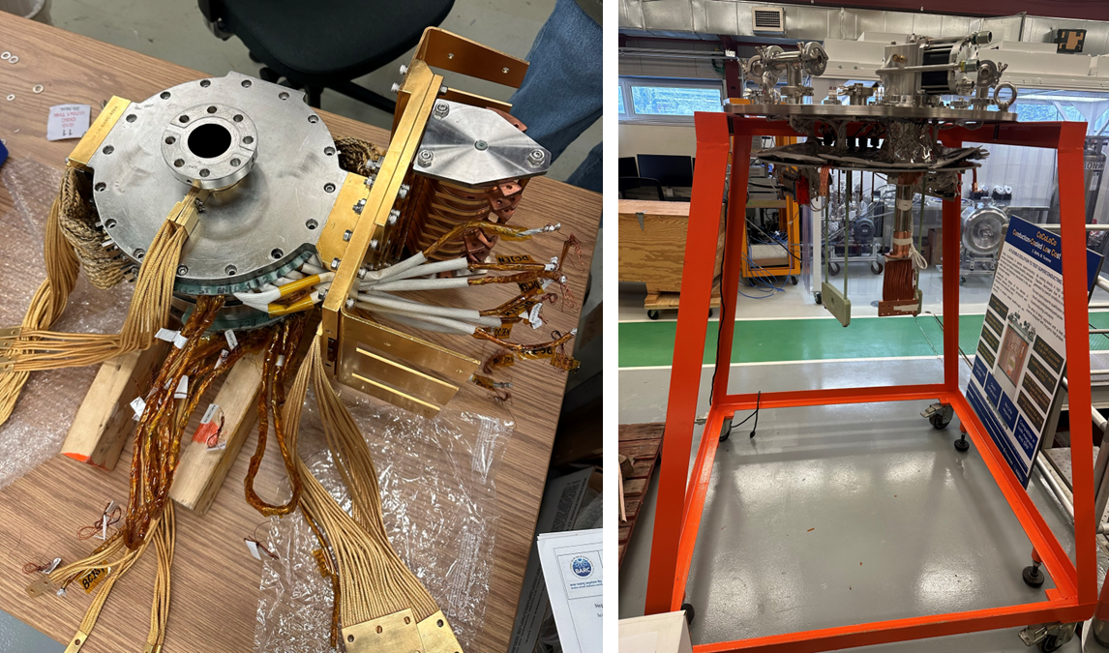
SSR solenoid status update – FNAL activities
The prototype magnet was assembled mechanically and is in the process of lead soldering.
The assembly procedure for pre-series and production magnets is being developed https://vector-onsite.fnal.gov/Tools/TravelerWriter/TravelerWriterPreviewDocument.asp?qsSpecificationID=2091&qsRevisionID=2
Plan to start the prototype test by the end of March.

Slide 9
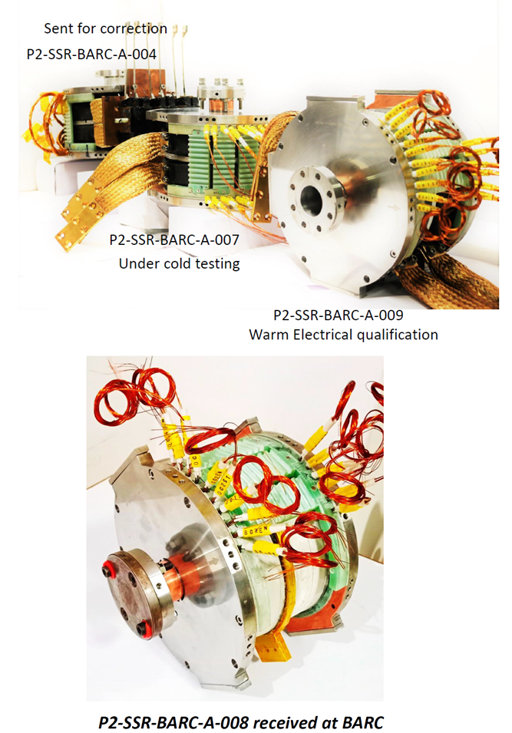
SSR solenoid status update – BARC activities
The four (4) pre-series magnets are in the queue for cold testing at BARC.
P2-SSR-BARC-A-007 was successful tested
P2-SSR-BARC-A-008 and P2-SSR-BARC-A-003 are being tested parallel.
P2-SSR-BARC-A-009 need repair.
BARC plan to ship P2-SSR-BARC-A-007 with another pre-series magnet together to FNAL by the end of March.
Prepare the documents for FDR while testing the magnets.

Slide 10
SSRs Couplers
SPM: N. Solyak
Presenter: N. Solyak

Slide 11
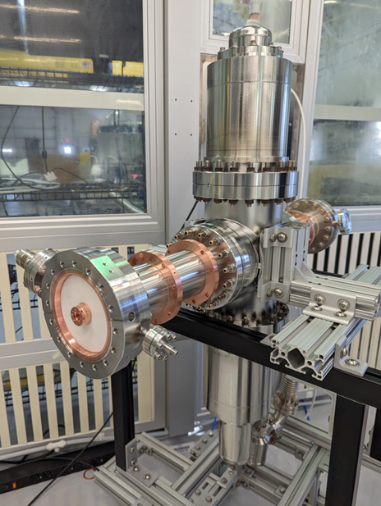
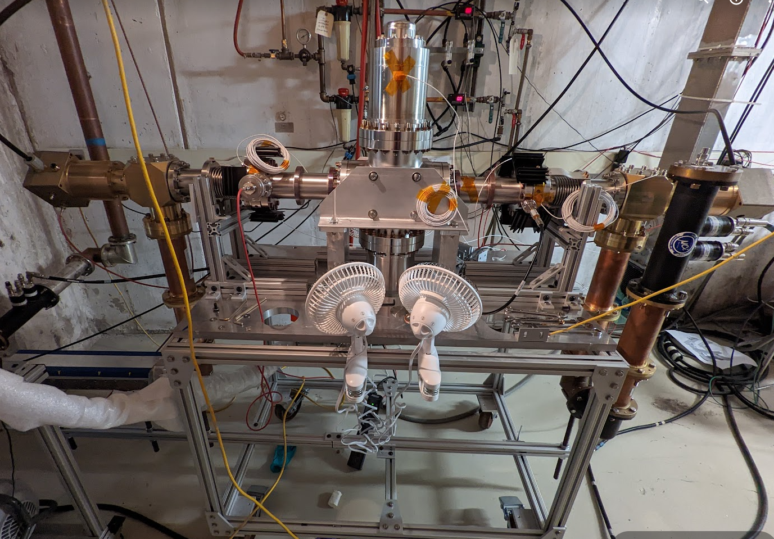
Couplers
Planning procurement of all (50+) production SSR couplers
Continue testing ppSSR2 couplers
First test of Ti-N vs no coating showed little difference in performance. To be tested again, including 1x IJCLab coupler.

Slide 12
Future Warm Test

Slide 13
SSRs CM design
SPM: M. Parise Presenter: M. Parise

Slide 14
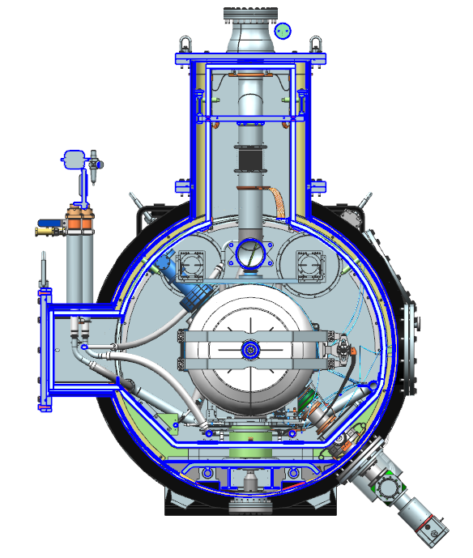
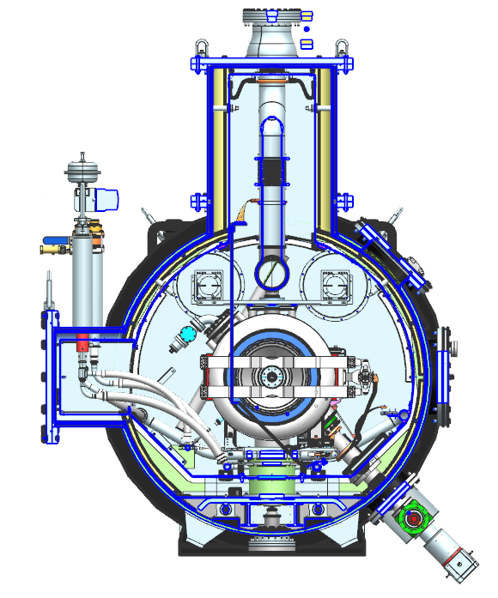
SSRs Cryomodule Cross-section
Pre-production SSR2 (F10138829)
Production SSR1 (F10142933)

Slide 15
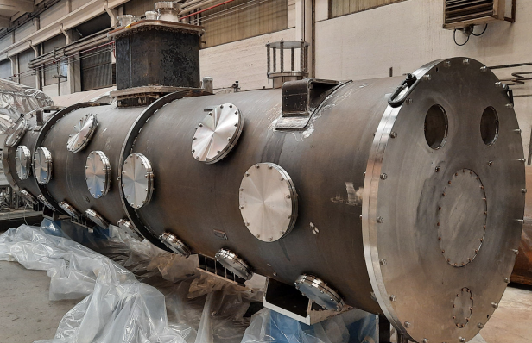
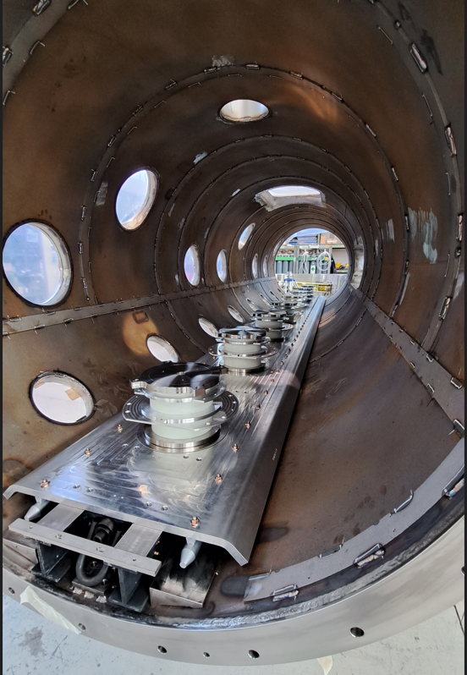
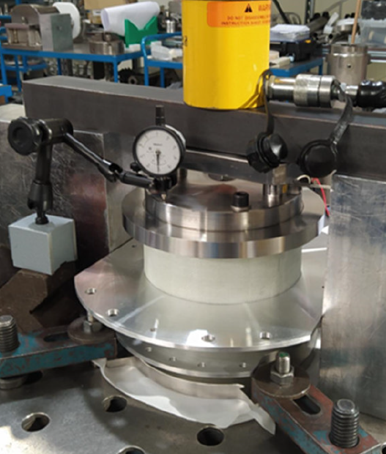
SSR2 Cryomodule Procurement
The vacuum vessel with strongback and support posts is in the final fabrication phase.
Vacuum vessel assembled and leak checked.
Strongback and support posts assembled and inserted into vessel.
F10163988
PO # 687044
Manufacturer: Simic
Promised date: 03-27-23
Support posts assembled and traction tested.

Slide 16
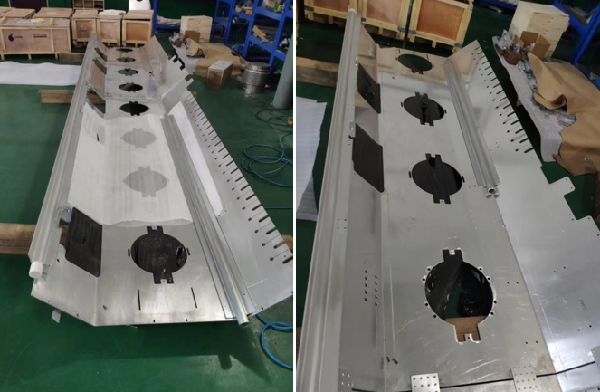
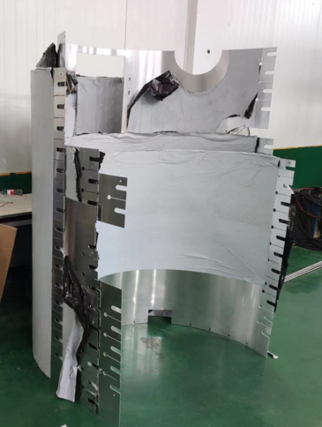
SSR2 Cryomodule Procurement
Global magnetic shield manufacturing ongoing – 1st parts delivered and QC completed
Thermal shield machining is ongoing – design changes are being implemented
F10177118
PO # 691991
Manufacturer: Wuxi
Promised date: 03-20-23
All components were manufactured and are being welded together. Final assembly will be completed at Fermilab during CM assembly.

Slide 17
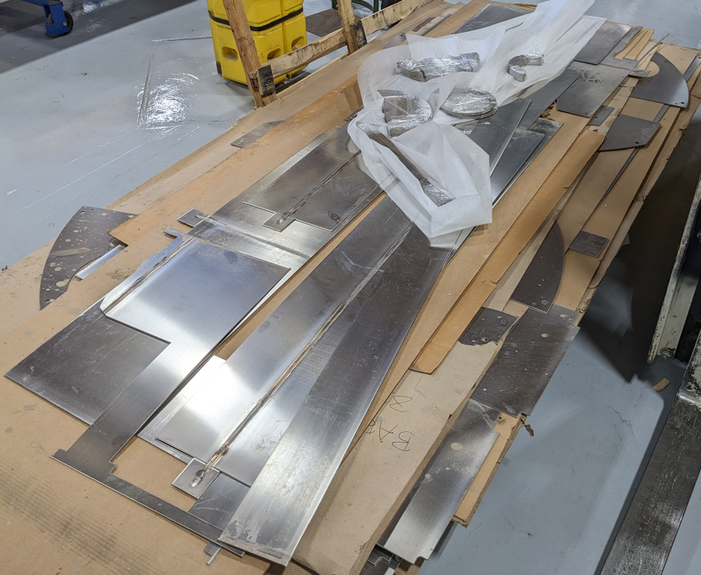
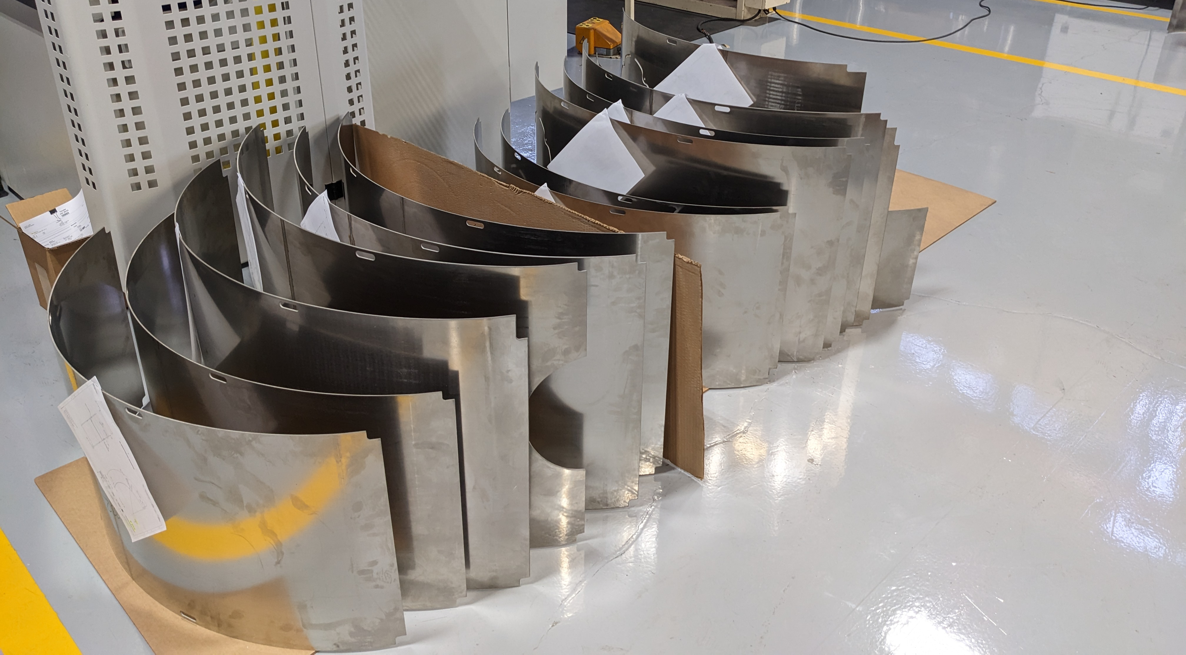
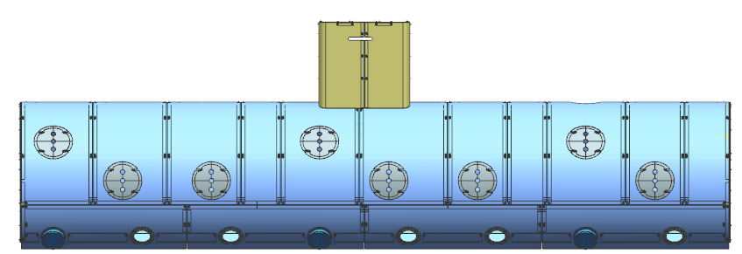
SSR2 Cryomodule Procurement
Global magnetic shield manufacturing ongoing – 1st parts delivered and QC completed
Thermal shield machining is ongoing – design changes are being implemented
F10156591
PO # 690358
Manufacturer: Magnetic Shield Corp.
Promised date: 05-01-23

Slide 18
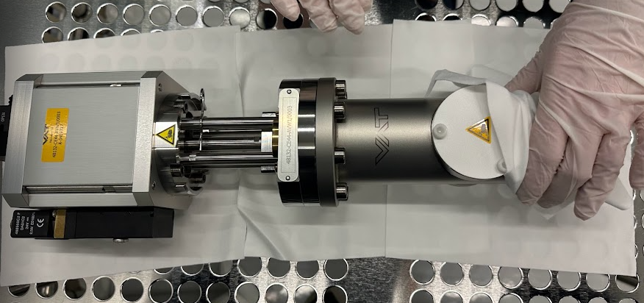
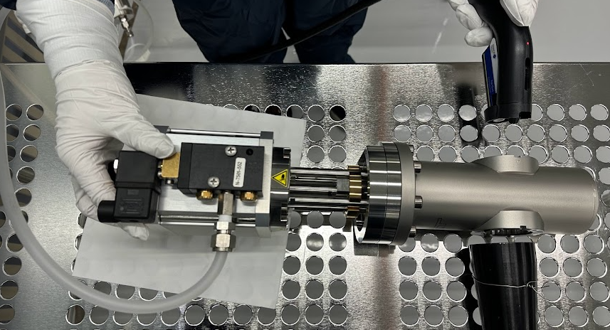
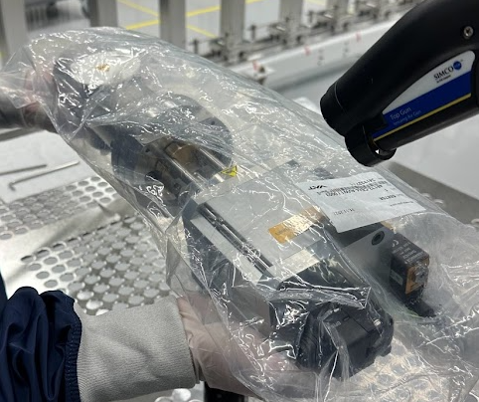
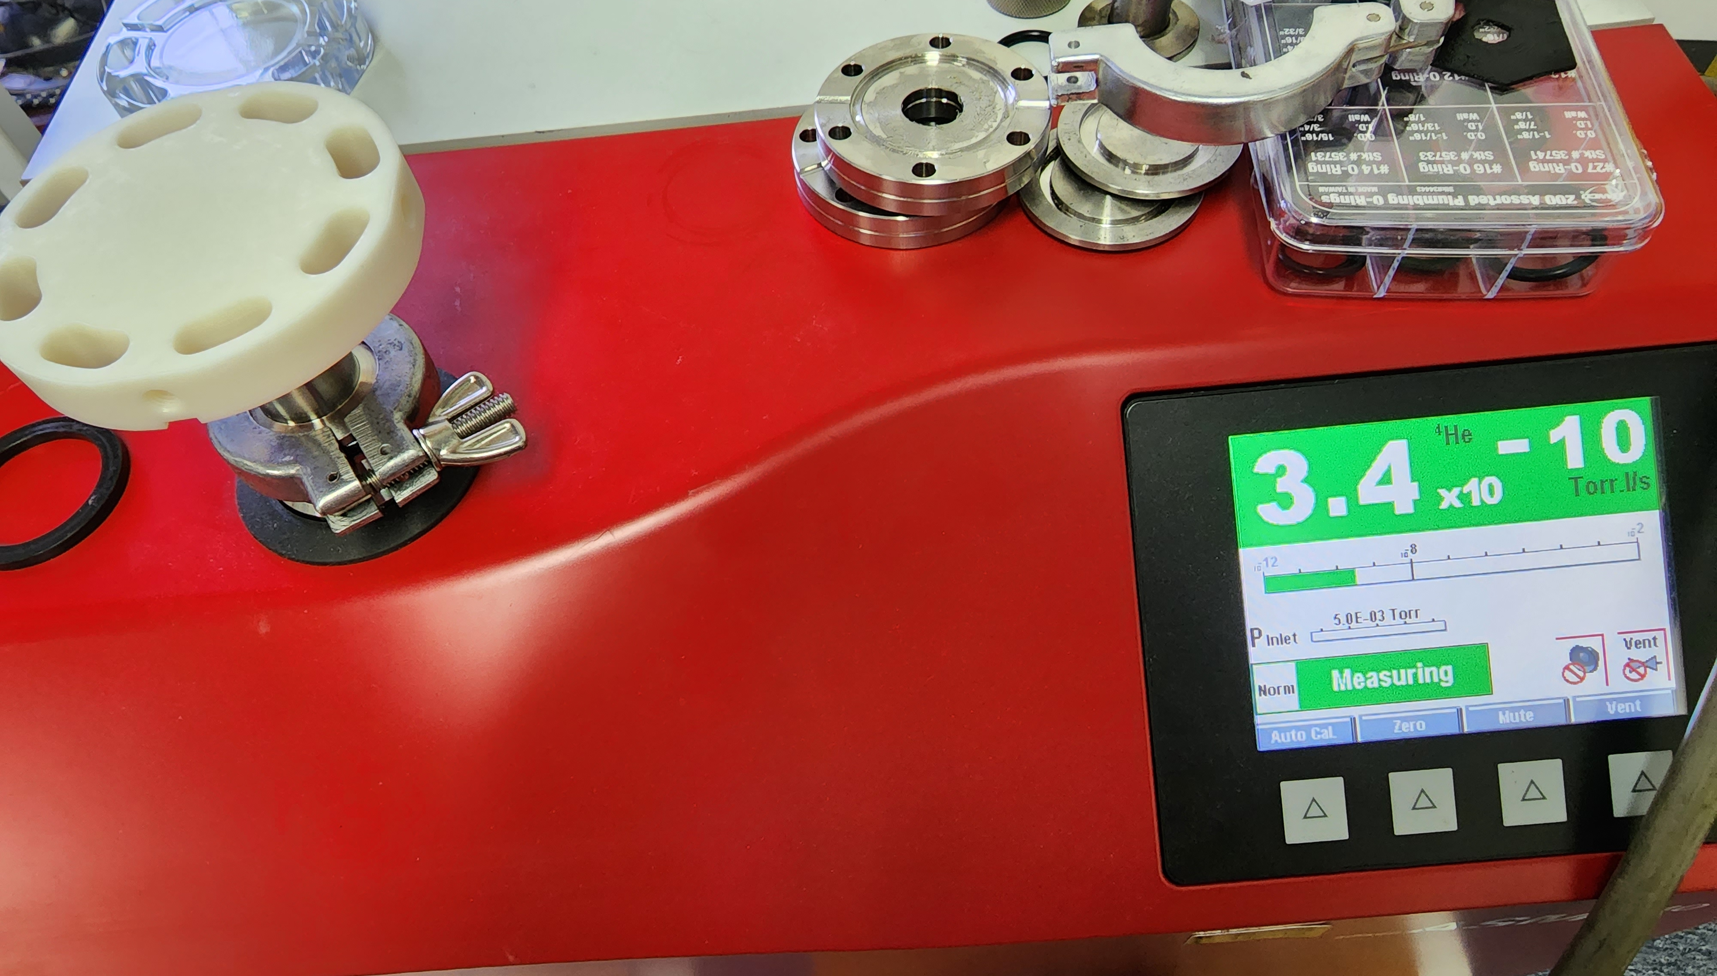
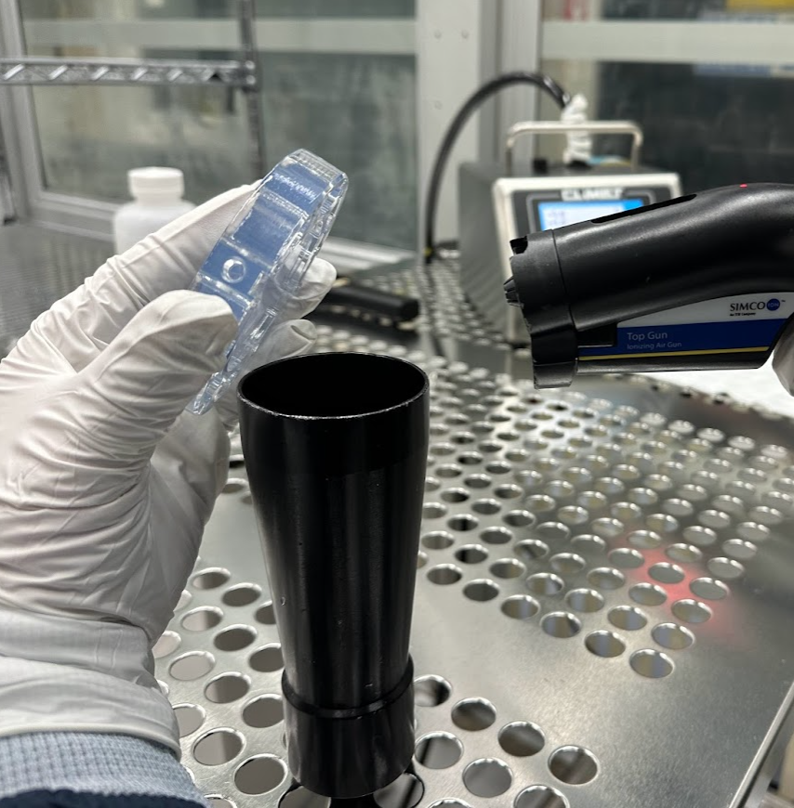
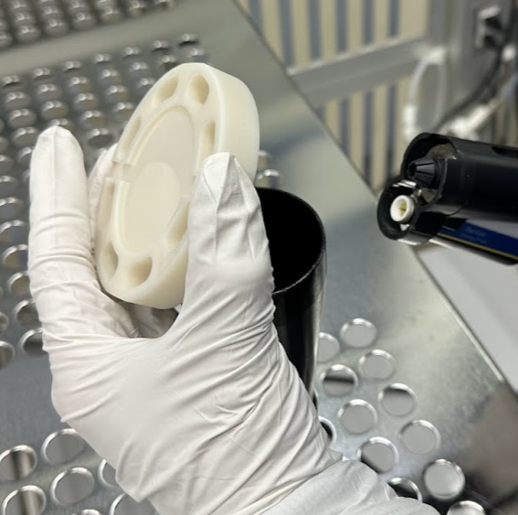
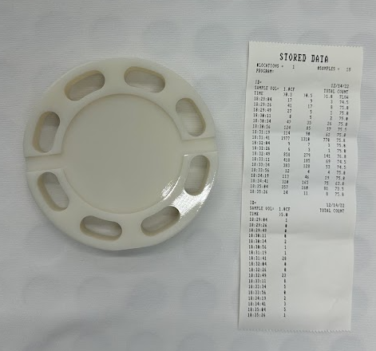
SSR2 Cryomodule Procurement
The beamline gate valve was tested in cleanroom to assess the cleanliness of the product as received from the manufacturer.
Cleanroom string assembly tooling is 3D printed. Tests to characterize materials for additive manufacturing and to assess their cleanroom compatibility were performed.
Gate valve cleaning and nitrogen blowing in cleanroom.
Leak check of 3D printed flanges in Accura 25 and Somos Watershed with clear coating.
Nitrogen blowing of 3D printed flanges in Accura 25 and Somos Watershed with clear coating

Slide 19
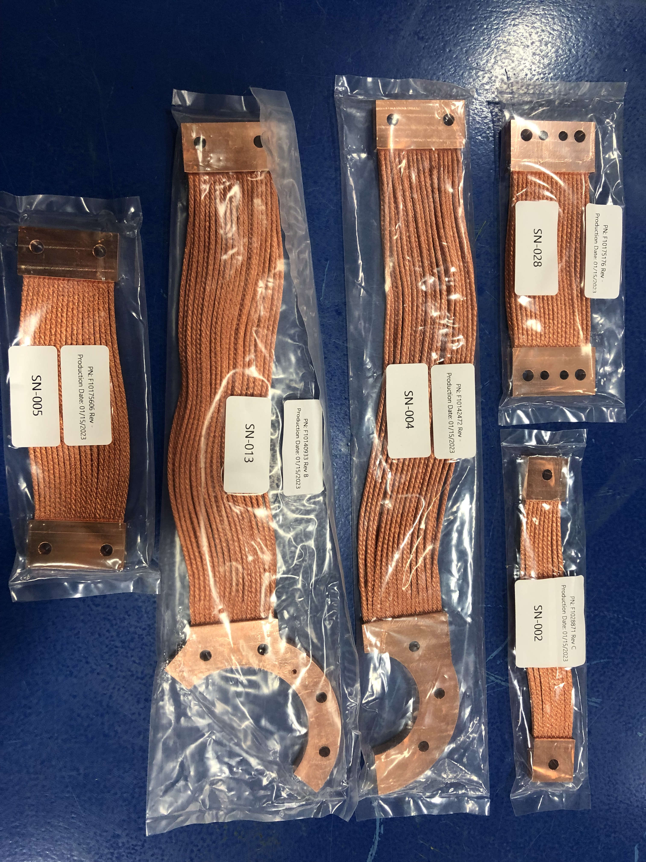
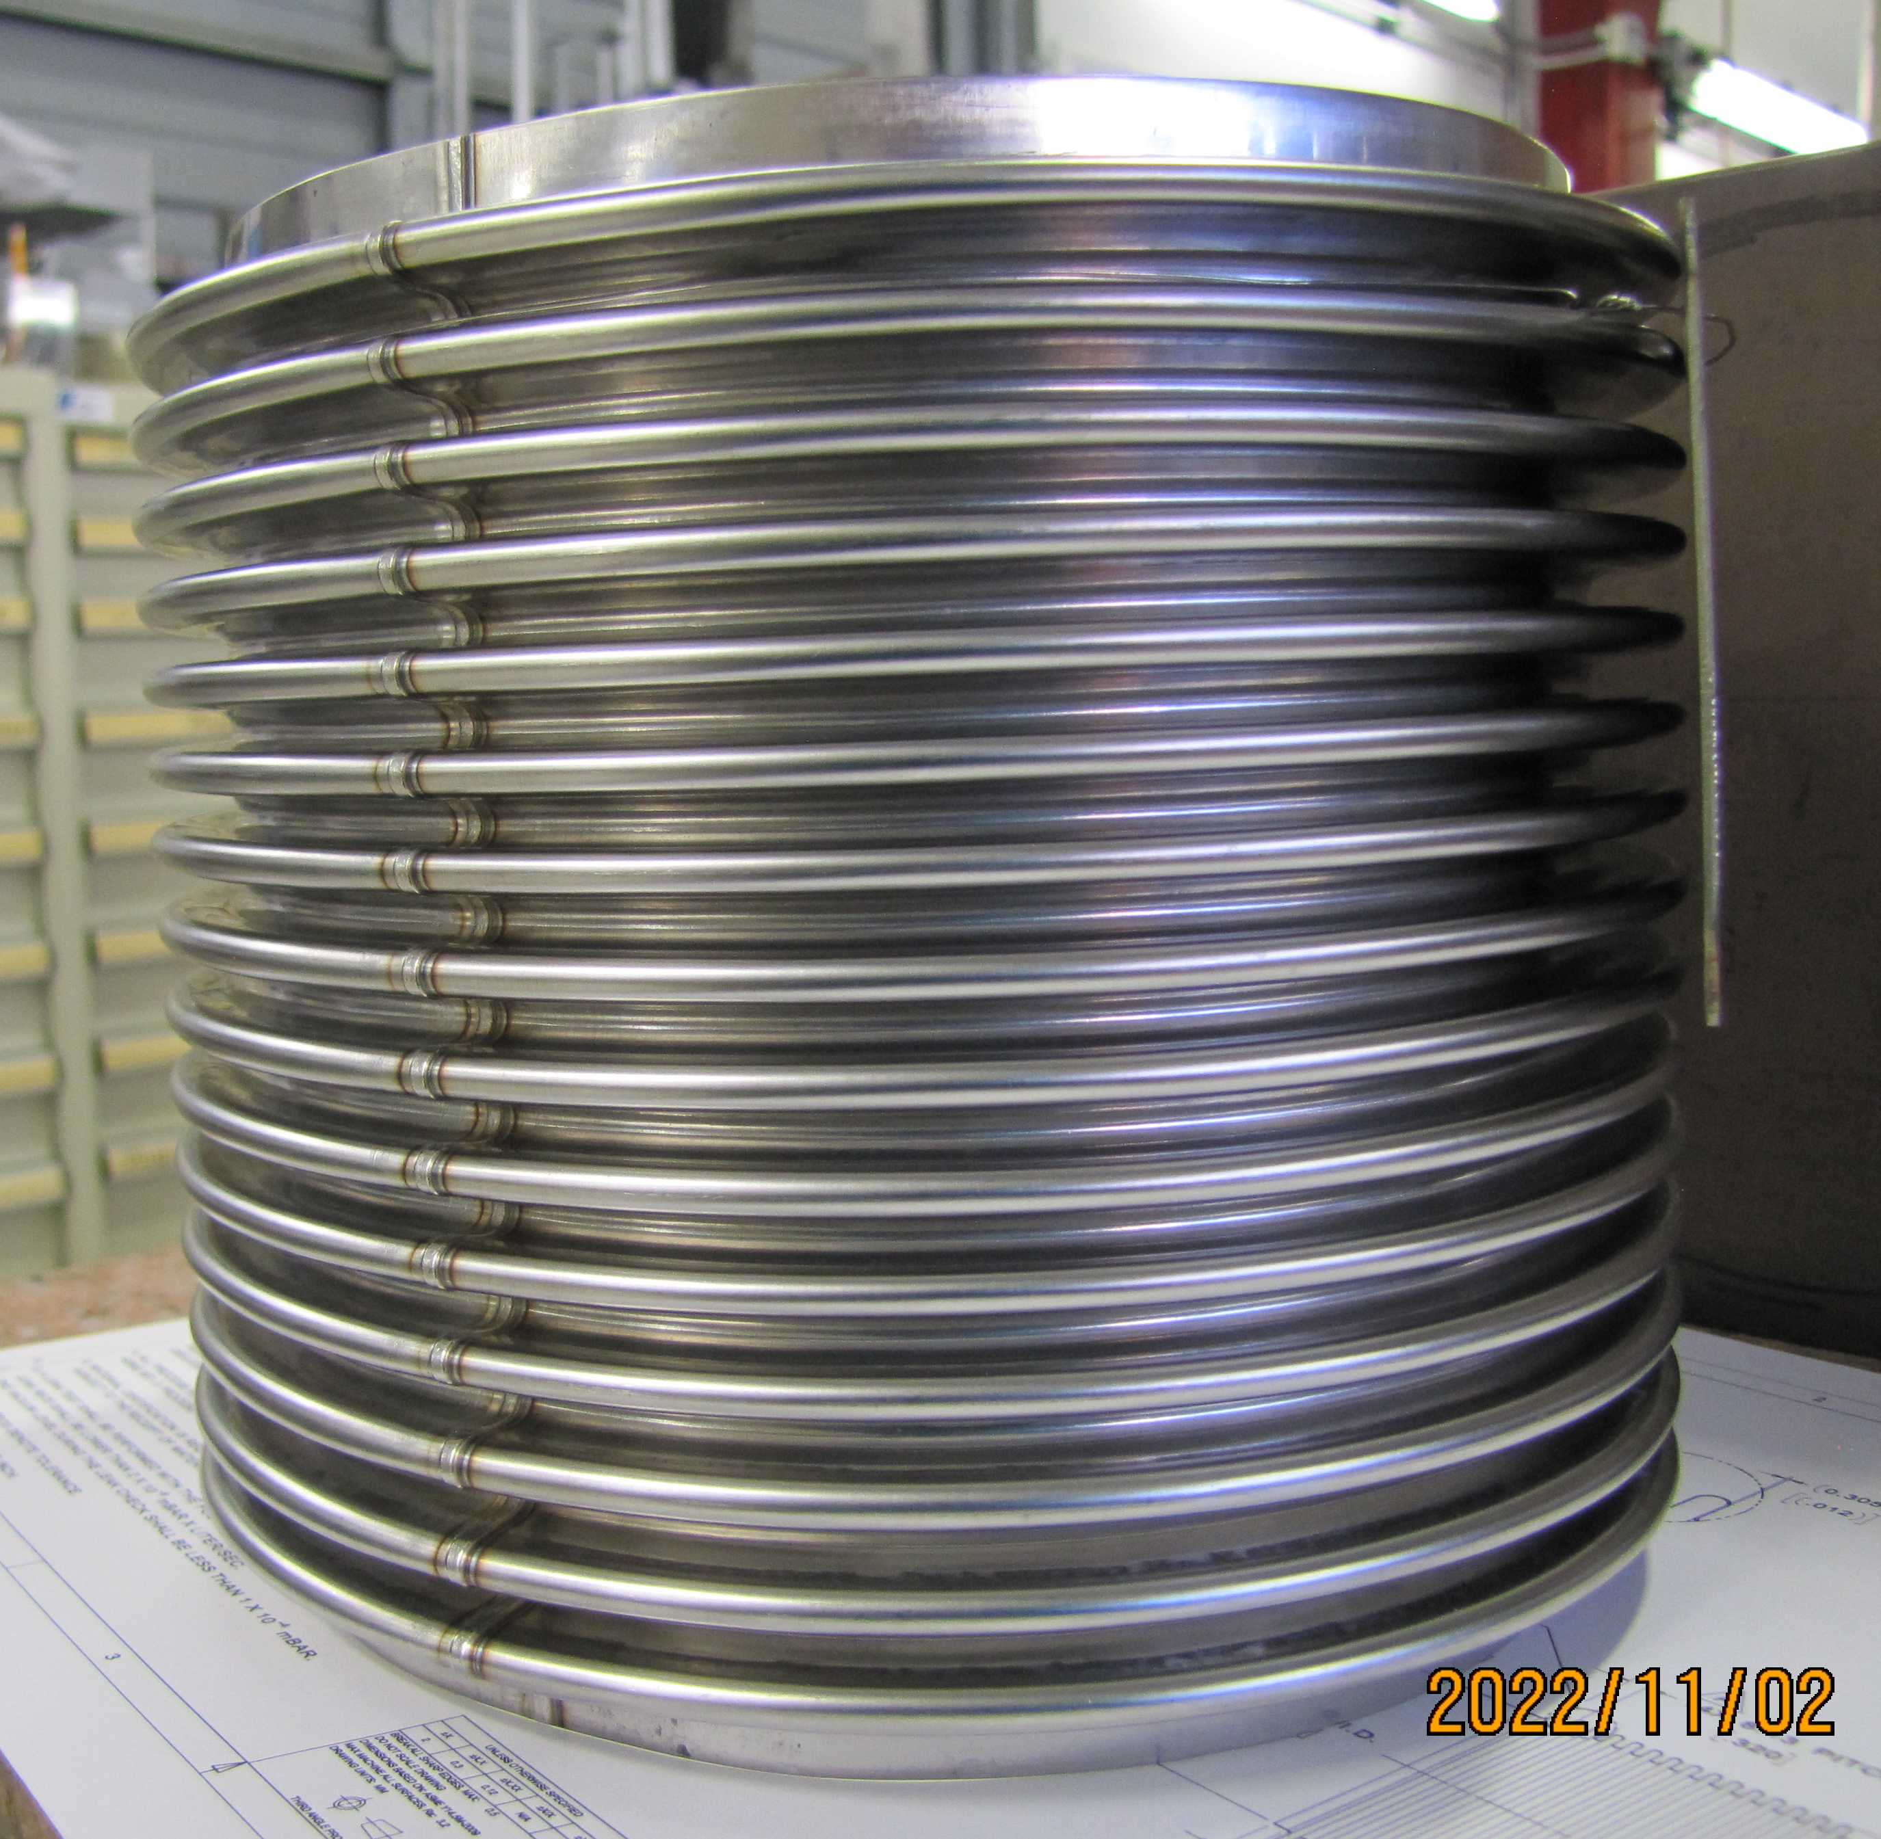
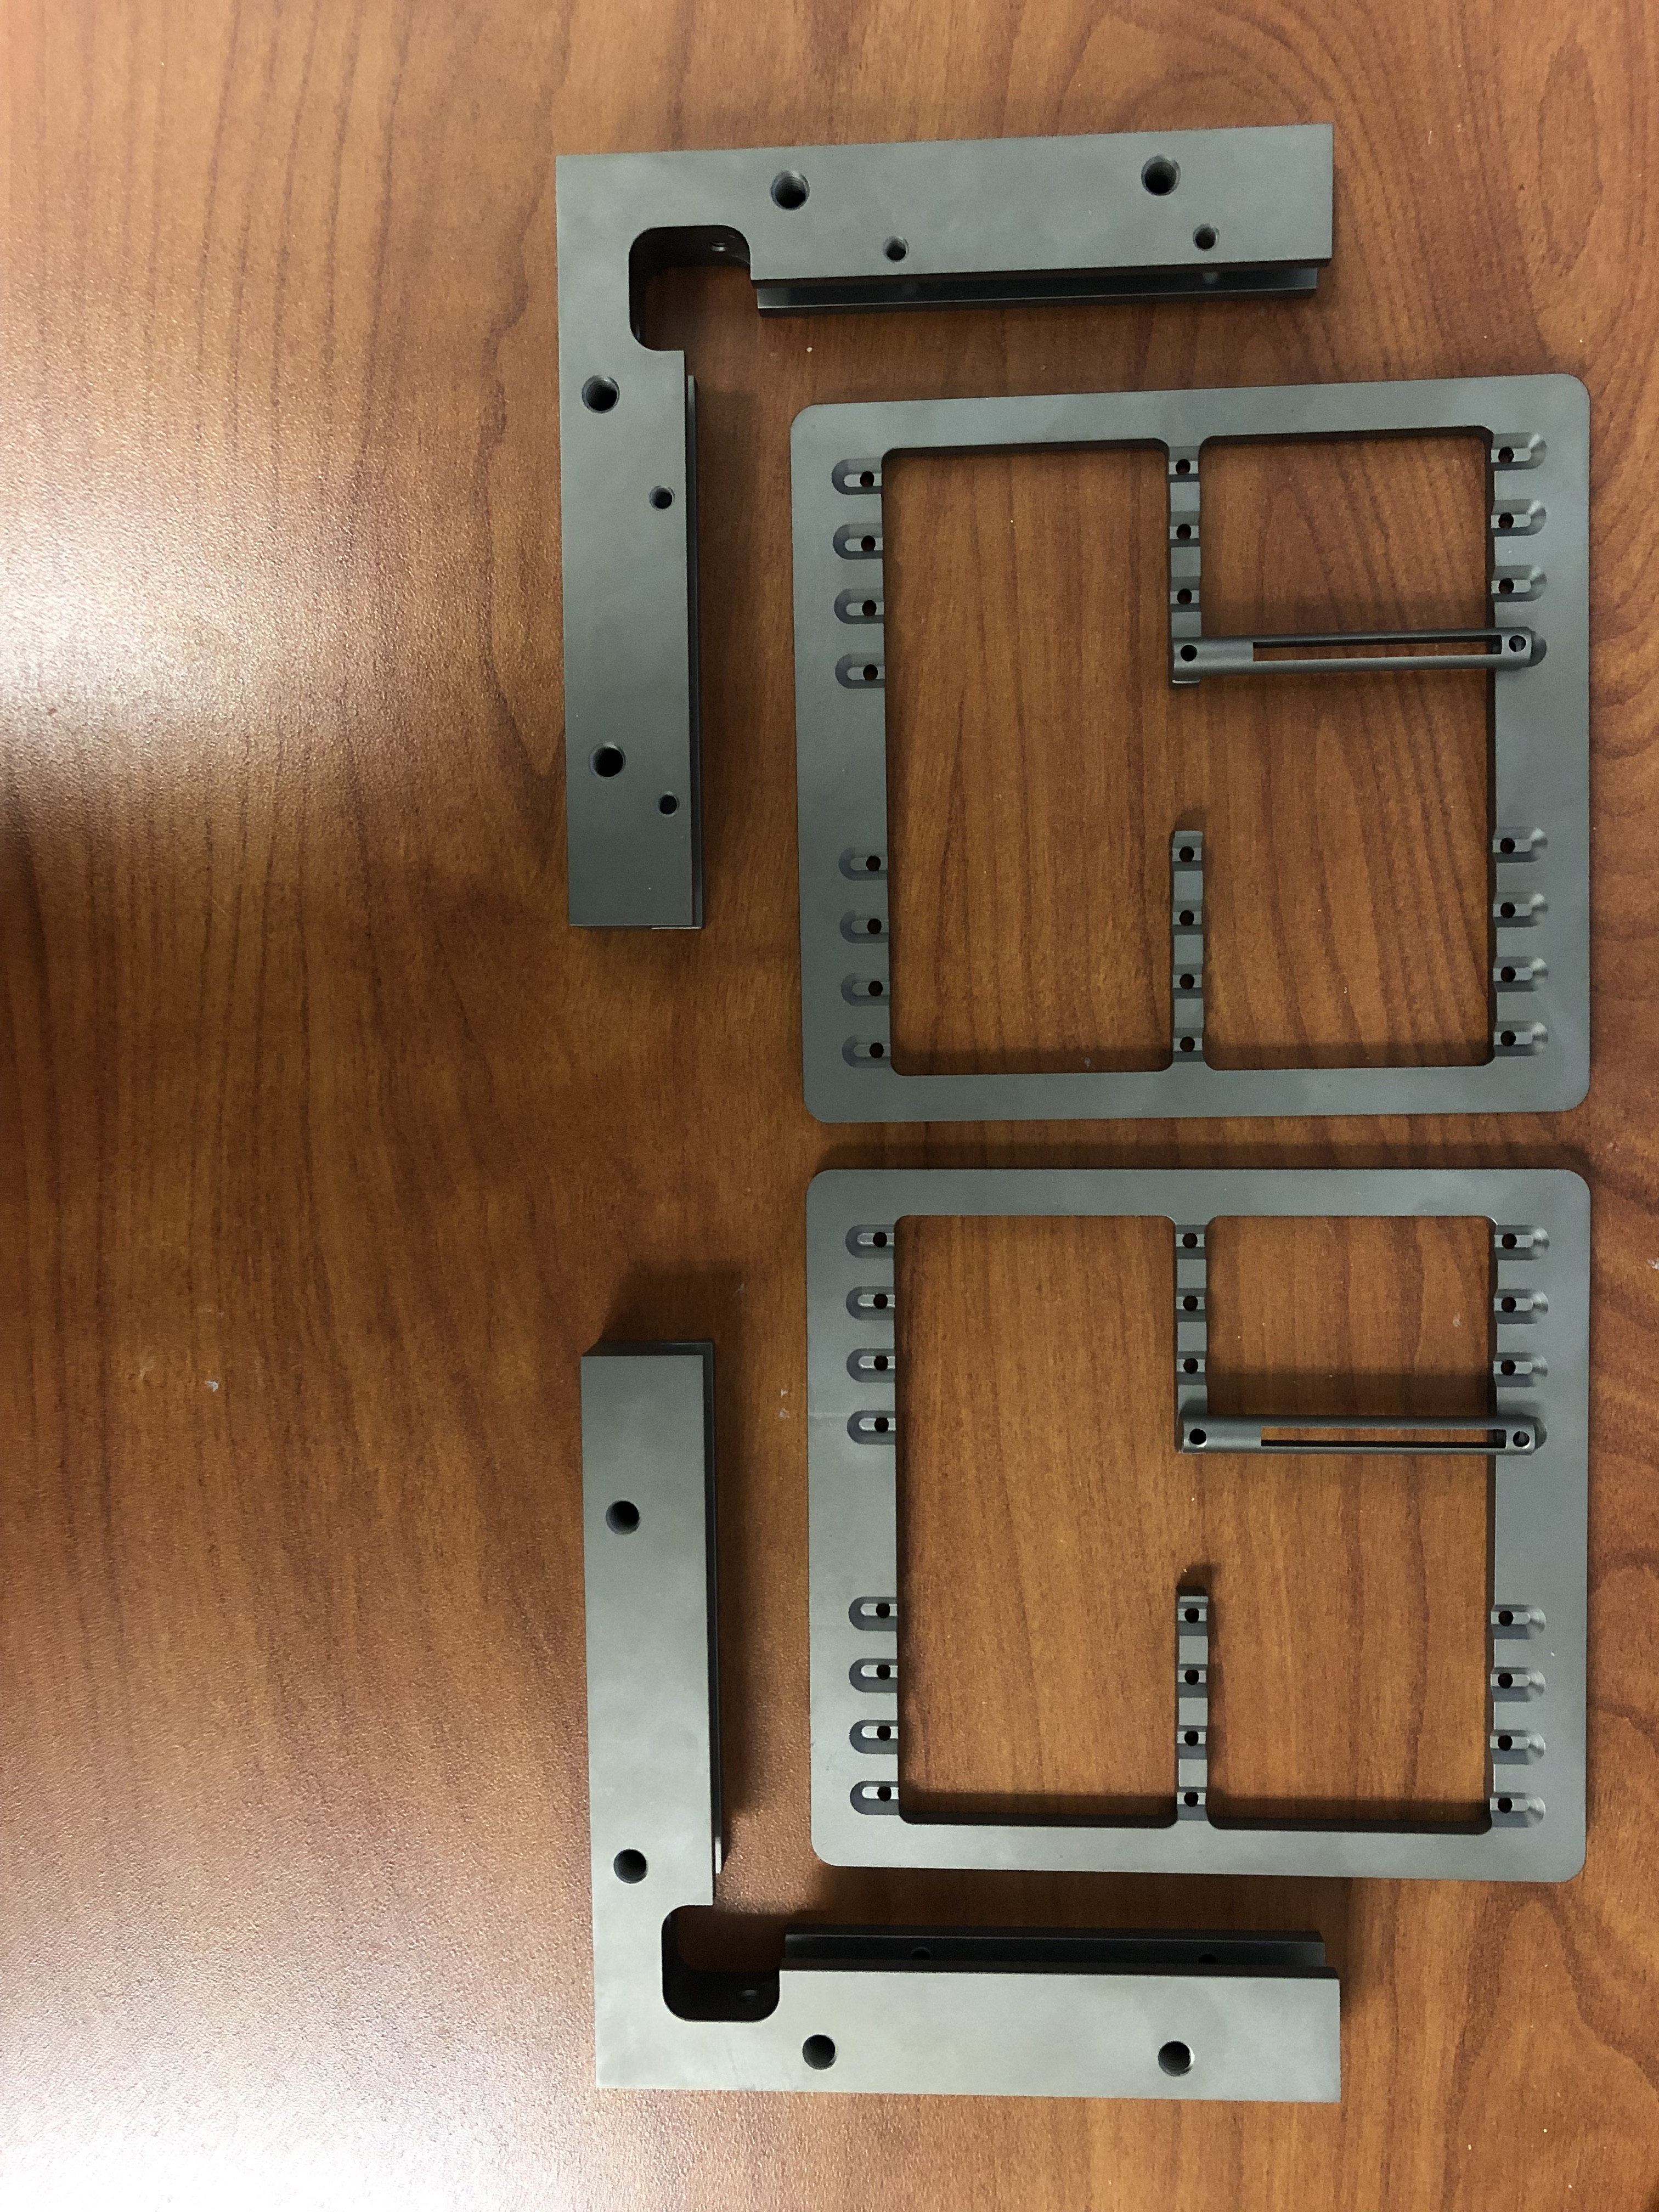
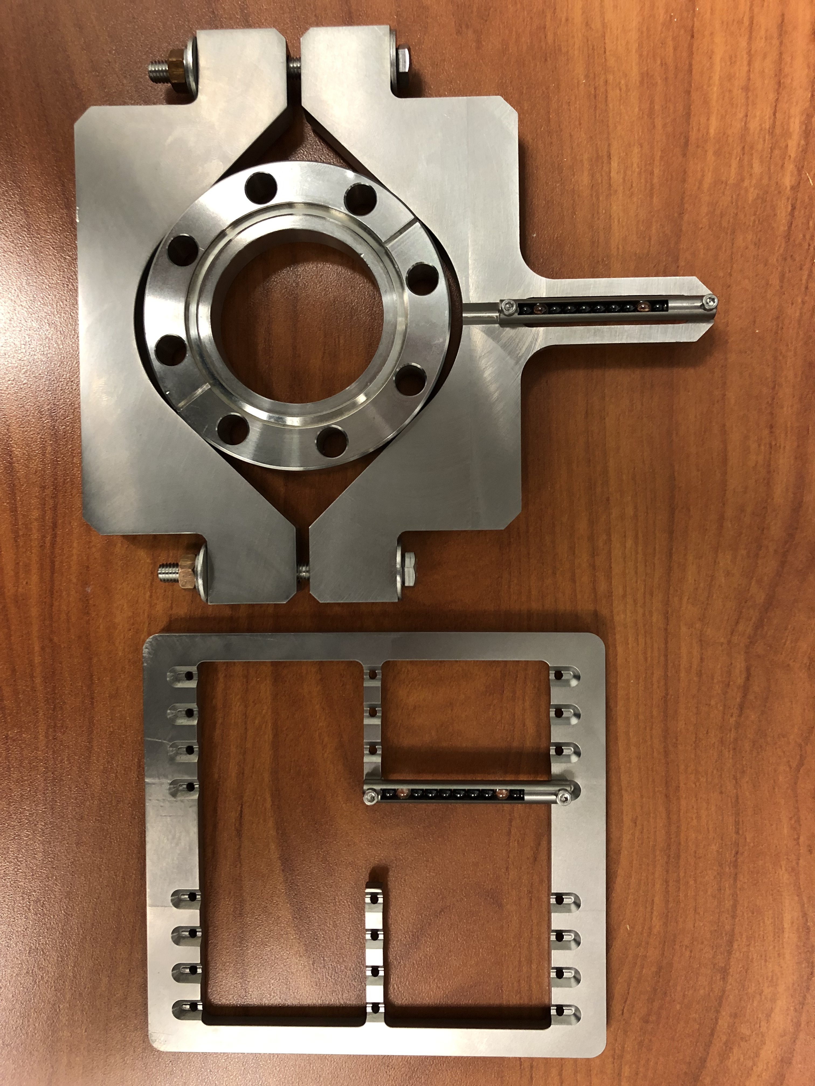
SSR2 Cryomodule Procurement
Smaller components and hardware for coldmass assembly have arrived at Fermilab.
Thermal Straps
PO # 690490
Manufacturer: TAI
Received on 02-13-23
Transition Joints
PO # 687894
Manufacturer: High Energy Metals
Received on 08-26-22
H-BCAMs Targets
PO # 693360
Manufacturer: WPA
Received on 03-07-23
Expansion formed bellows
PO # 690406
Manufacturer: Hyspan
Received on 10-14-22

Slide 20
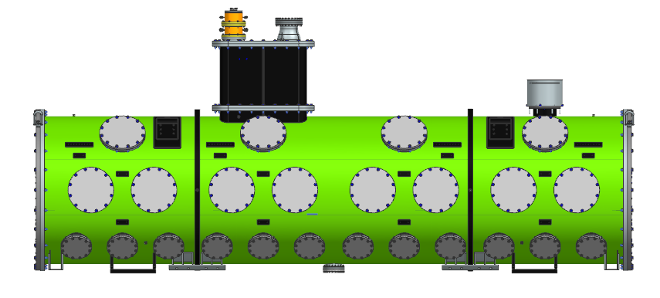
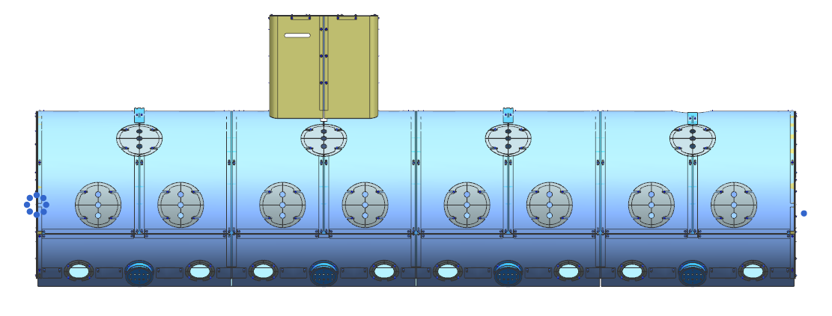
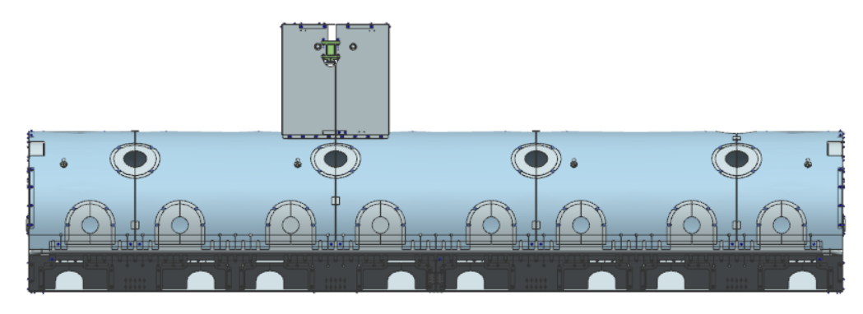
SSR1 Cryomodule
Vacuum Vessel and Strongback Tray: 3D model completed – Analyses completed – Drawings finalized
Global Magnetic Shield: 3D model completed – Analyses completed – Drawings finalized
HTTS: 3D model 100% completed – Drawings finalized – Analyses ongoing
CD line: 3D model completed – Drawings to be finalized
LTTS: 3D model completed – Drawings to be finalized
2-Phase He pipe: 3D model 50% completed – Analyses ongoing
Pumping line: 3D model 90% completed – Ready for drawing
F10187714 – Vacuum Vessel and Strongback Tray procurement package.
F10193985 – Global Magnetic Shield procurement package.
F10191721 – High Temperature Thermal Shield procurement package..

Slide 21
Action items from previous meetings
BARC: cavities tooling Technical discussion ongoing
BARC: Plan tuner Manufacturing Readiness Review Completed!
Release TRS/ISD for the SSR2 cryomodule Released!!!

Slide 22
Action Items

