Slide 1
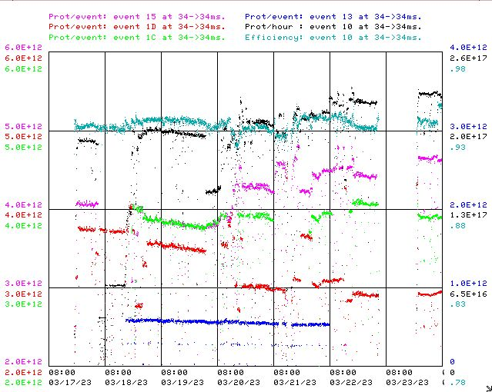
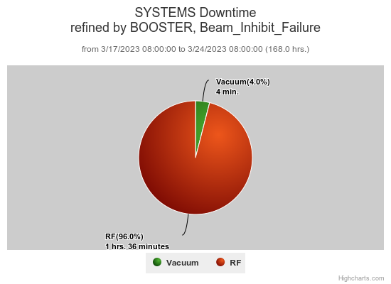
Booster Operations 03/17/23 – 03/24/23
LRF5 Bulk Tuner water skid build
Linac Klystron Buncher replacement
Downtime this week: ~1.6 hrs
BRF4 issues
BRF5 issues causing EAPS trip also
WAPS/EAPS trips due to BRF19/22
Also this week:
This week:
Beam to NuMI currently ~4.5 E12 per pulse ~850kW.
This week to BNB ~3.0-4.6 E12 per pulse, up to 5Hz , ~ 3-7E16 pph
Beam to Muon this week, ~ 4E12 per pulse, ~ 1E12 pot
Beam to SY as requested 2T, ~ 5E11 per pulse
High intensity push on $15 to NuMI this week.
Trouble shooting occasional transition jump glitch.
General tuning to reduce losses and improve efficiency.
Thanks to Ops for maintaining good Booster performance over week.
Scheduled PS studies next Wednesday.
20Hz upgrade effort at E4R progressing.
Thanks to Linac for switching collimation aperture and tuning to reduce losses in Booster.
Thanks to Ops for maintaining good Booster performance over week.

