Slide 1
Modeling Needs
HEP High Power Targetry Roadmap
04/11/2023

Slide 2
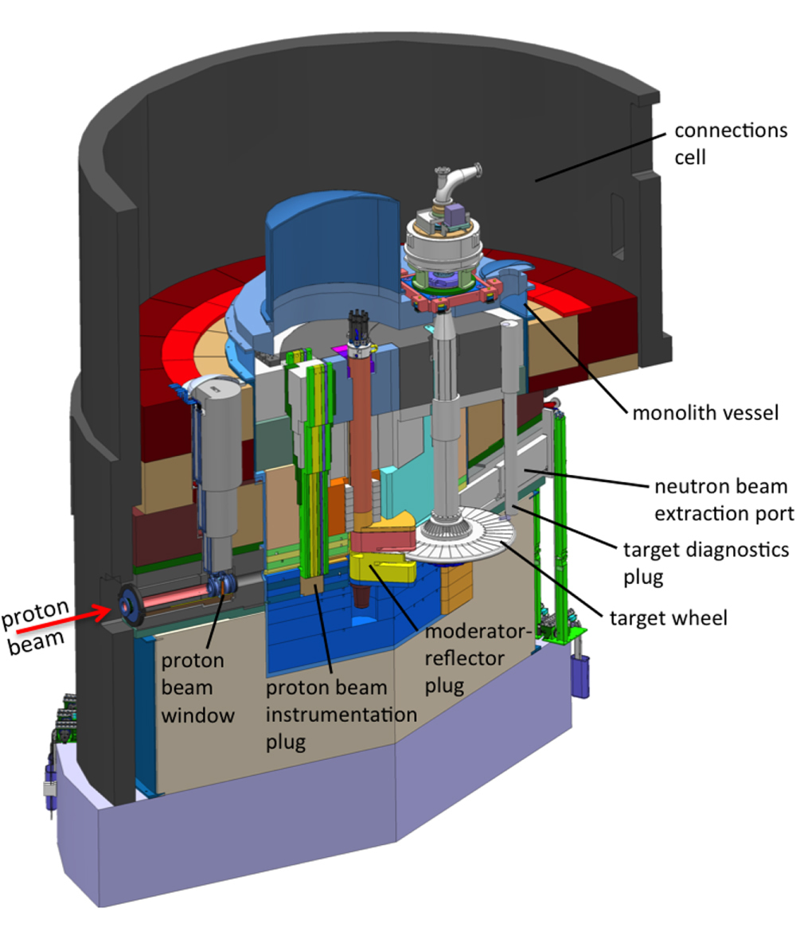
Higher Intensity, Bigger Challenges for Targets
Larger thermal shock
Higher radiation activity
Shorter lifetime due to radiation damage
Operational safety (remote handling, radiation protection)
Storage/disposal
Higher heat flux
Fabrication more challenging:
More complex or/and tighter quality control ➔ higher cost
Low availability on the market for some material
Develop new material ➔ long process before reaching “commercial” grade
ESS rotating target

Slide 3
Better Codes interfaces
Target simulations are complex:
Complex CAD model
Particle simulations
Conjugate Heat transfer
Structural analyses
Thermal stresses
Explicit
Fatigue analysis
Handshakes between experts are often manual
Limited optimization/ Design of exploration
Limited Machine Learning
Different experts

Slide 4
Better accuracy
Capture more physics
Multiphase
Better material model
Limited data for some material
Simple model used
Impact of radiation damage on material properties (transient)
Leverage HPC/exascale simulations

Slide 5
Numerical tools to predict radiation damage
Today, we are using particle simulation to estimate radiation damage (DPA)
At higher power, there will be a push to run targets longer and accept “some” radiation damage.
Need numerical tool that can predict impact of radiation on material properties
Need to explore novel materials numerically

Slide 6
Better Verification and Validation
Code validation is generally limited
Few testing facilities
Few instrumentation on the targets
Irradiated material data need to be expanded
Explore novel materials

