Slide 1
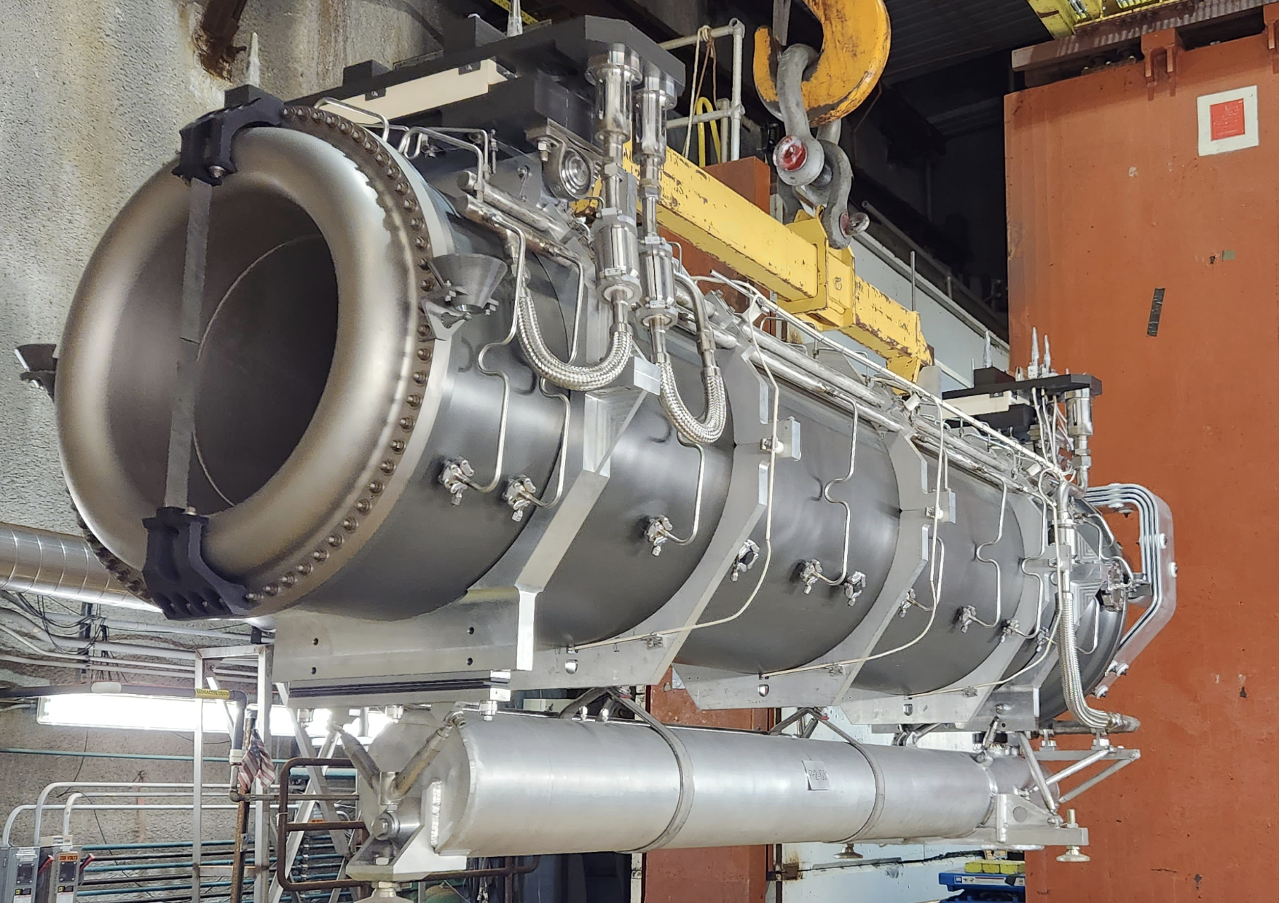
HEP Roadmap, HPT
Beam Instrumentations
Katsuya Yonehara
4/11/2023

Slide 2
Object of HEP Radiation Hardened Beam Instrumentation for High Power Target facilities
Proton facility
Multi-Mega Watt beam operation for future beam facilities
Neutrino facility
Multi-MW target health sensor and secondary beam monitor
Muon facility
1-MW target health sensor and secondary beam monitor
Maintain 4-MW target system and secondary beam monitor for muon collider
Electron facility (slightly off topic)
Monitor intense and ultra fast electron beam in plasma and dielectric wakefield accelerators and FEL beam facilities

Slide 3
Existing facility and radiation
https://arxiv.org/abs/2203.06024
Institution | Beam energy | Beam intensity | Beam power | Radiation dose at beam instrumentations
CERN CNGS | 400 GeV | 2.4e13 protons per pulse | 500 kW
CERN LHC | 7 TeV | 1.2e11 protons per bunch, 2808 bunches per beam | 362 MJ per beam
Fermilab NuMI | 120 GeV | 5.5e13 (6.5e13) per 1.2 sec | 870 kW (1 MW) | 10¹⁰ mSv/hr at target 10⁴ mSv/hr at muon monitor
Fermilab LBNF | 60-120 GeV |  | 1.2-2.4 MW
J-PARC neutrino | 30 GeV | 3.2e14 protons per 2.48 sec (1.32 sec) | Present 515 kW (700 kW-1.3 MW)
ESS | 2 GeV |  | 4 MW
J-PARC MLF | 3 GeV | (4.5e8 pulses, 25 Hz) | 730 kW (1 MW) | 30 MGy/6 y
SNS | 1 GeV (1.3 GeV) | 1.5e14 per beam | 1.4 MW (2 MW)
FRIB | 200 MeV/nucleon |  | 400 kW | 10⁹ mrem/hr
Blue font: Not operational
Orange font: Nuclear beam facility

Slide 4
Identified Beam Instrumentations (I)
https://arxiv.org/abs/2203.06024
Item | Reported radiation hardness in the workshop | Possible R&D institutions
Light optics | SNS single-mode fiber sensors: >4×10⁸ Gy SNS epoxy (Stycast 2850FT with Catalyst 11): > 10⁸ Gy FRIB viewport: Zinc selenide, no detectable RIA @430 Gy FRIB metal mirror: typically 10⁸ Gy MLF Ni: 1MWh and found corrosion MLF Au: More accumulate than Ni but found no corrosion CERN rad hard fiber: FIGR-10, tested RIA @694 kGy by using ⁶⁰Co (activity is currently stopped) | Various institutions
ASIC | FNAL CMS ECON-T: demonstrated up to 500 Mrad CERN luminosity monitor FBCM: design goal 250 Mrad & 3.5e15 1 MeV neq. Fluence; tested 10 Mrad | CERN, Fermilab
Camera | CERN camera: SYRA camera tested @10 Mrad (100 kGy) CERN Micro-Cameras & Space Exploration SA: tested @11.7 krad & 36 krad J-PARC neutrino: OTR CID camera operated 1 kGy/year for 750 kW beam power | Various institutions

Slide 5
Identified Beam Instrumentations (II)
https://arxiv.org/abs/2203.06024
Item | Reported radiation hardness in the workshop | Possible R&D institutions
Strain detector | Described in light optics | ESS, J-PARC, SNS
Acoustic sensor | MLF dynamic mic: tested > 4000 MWh | ESS, J-PARC, SNS
Laser Doppler Vibrometer | MLF tested total 5000 MWh, total dose 5000 Gy | Fermilab, J-PARC
Luminescence beam profile | SNS Cr:Al2O3: 100 MW, ~0.1 DPA | SNS
IR monitor | Described in light optics | Various institutions
Thermocouple sensor | Extremely radiation robust, no specific dose reported | Various institutions
Optical Transition Radiation | Described in light optics | Various institutions
Beam Induced Fluorescence | Described in light optics | J-PARC, Fermilab
Secondary Electron emission Monitor | ESS APTM: design goal 4 kGy/h, lifetime > 2 years ESS GRID: design goal 4 kGy/h, 5 DPA/year | Various institutions
Beam Loss Monitor | CERN BLMASIC: > 100 kGy (10 Mrad) | CERN, Fermilab
Electron Multiplier Tube | J-PARC 100 days at 1.3 MW | J-PARC, Fermilab
Gas-filled RF | FNAL 3 yrs test at MI abort line, no signal degradation found | Fermilab
Current Transformer | No specific report in the workshop | J-PARC, Fermilab

Slide 6
Timeline for major HEP facility beam upgrade plan
USA
Fermilab: LBNF (2030-), AMF (2045-)
Europe
CERN: HL-LHC (2026-2041), Muon collider (2045-)
ESS (2023-): ESSnuSB
Asia
J-PARC: Hyper-K (2027-), g-2/EDM, COMET
CSNS: MELODY
R&D of rad hard beam instrumentations should start asap to follow the future HEP roadmap

Slide 7
Strategic plan (I)
We need to represent our demand to the global communities of beam detectors and beam instrumentation across various beam facilities and companies in the world
Collider community
CERN, Fermilab
Beam instrumentation community
All beam facilities
Nuclear physics community
SNS, ESS, MLF, FRIB, etc

Slide 8
Strategic plan (II)
Challenge common issue
Rad hard light optics and visualization device can be a breakthrough technology for directly monitor the target health
Nuclear physics and collider communities have developed a rad tolerant glass, fiber, and camera
Rad hard ASIC will improve S/N and fast signal manipulation
Collider community has developed a rad tolerant beam loss monitor and luminosity detector
Find new beam detector technology
Neutrino community has developed a new type of secondary particle detectors
Develop existing beam detector technology

Slide 9
Strategic plan (III)
Object of the project
What is the object?
Only for the HPT project (e.g. Neutrino and Muon facilities)?
Or involve more items (e.g. Collider and Nuclear physics facilities)?
Organization
Budget?
Where can we get support?
When?
How much?
Size of the project?
National facility
University

