Slide 1

The Muon Spectrometer Magnet Review
Tom LeCompte
SLAC

Slide 2
Introduction
Big Thanks to the reviewers!
Our goals:
  Tell us what we have forgotten
  Tell is what we can do better
  Think “big picture” – don’t sweat the small stuff
This talk: overview and mechanics
  I have some cost information to give you context, but this is not a cost & schedule review
Next talk: numerical simulations

Slide 3
Outline
Overview
Steel Plates
Magnetization
Installation

Slide 4
Overview

Slide 5
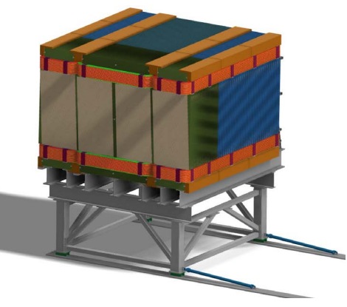
The Muon Spectrometer
7x7x3 m active (middle) region
100 plates in z, with 40 mm gaps for detectors
  40 thin (15mm) and 60 thick (40mm plates)
Field is ~1 T in the active region, with an up-down-up dipole configuration (see later slides)
  Magnetization measures sign, not momentum (we do that with range)
30 kA turns
  6 coils in a Helmoltz-y configuration
The whole thing sits on a movable cart (the Iron Throne) and it is expected to move weekly or so
A 100 layer magnetized range stack, behind ND-LAr to measure muons that escape. There are 19200 channels of MINOS-like scintillator.
It is essentially a reshaped MINOS near detector.

Slide 6
Constraints
TMS needs to match the area of the upstream detector, 7x3 m.
  Bigger is better, but that runs into all sorts of problems (cost, space, weight, etc.)
TMS can be at most 7m long
  So that’s how long it is.
The card can support at most ~1000 tons of steel
  So that’s how much is there
  This is a fairly soft constraint – 1199 can be made to work, 2000 probably not
TMS needs ~100 planes of detectors in the gaps between steel
The field East and West of TMS needs to be “as small as possible”:
  It’s 12 gauss, so this probably overdoes it. A few hundred is likely OK but nobody will give us a spec

Slide 7
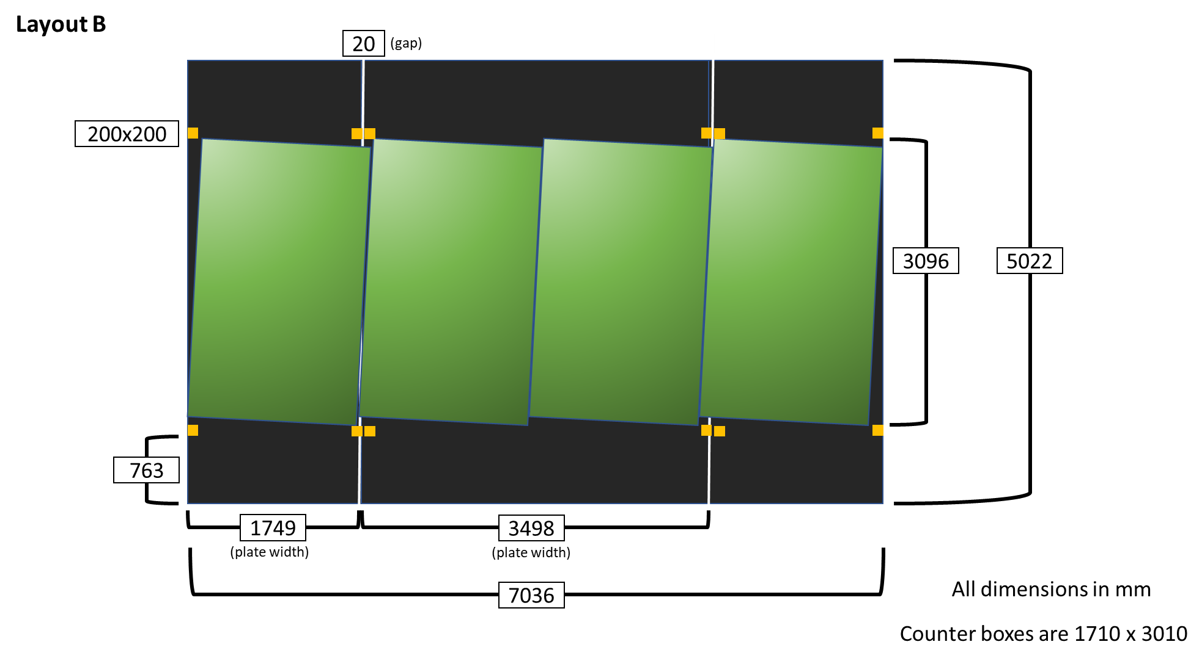
Detector Plane + Detector Panel Geometry
There is a 40 mm gap between plates. The panels occupy 20 mm of this space. The remaining “stay clear” accommodates steel flatness tolerances.

Slide 8
Steel Plates

Slide 9
Detector Steel
Number | Dimensions (mm) | Weight per plate (pounds)
40 | 15 x 3498 x 5022 | 4638
80 | 15 x 1749 x 5022 | 2319
60 | 40 x 3498 x 5022 | 12367
120 | 40 x 1749 x 5022 | 6183
Total |  | 1855020
Base cost: $1,364,797
Contingency: 23.5%
Date of last estimate: 19 April
Getting 15 mm steel may be difficult
  USA vendors will do 5/8 inch (16 mm)
  We can adapt by adjusting the number of think/thick plates
Issues Beyond The Scope of his Review
  Steel prices have been crazy since Covid, and we follow the DUNE rubric for risk and escalation. We could spend the entire day just discussing this,

Slide 10
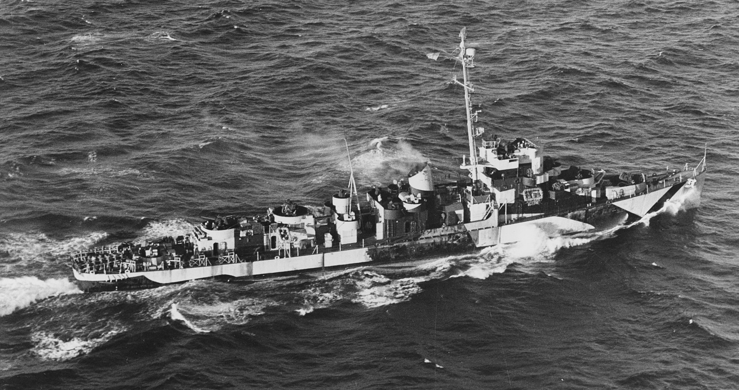
Steel Materials
The plates will be made out of AISI 1006 steel
  “MINOS Steel”
  Low-carbon, with some manganese, silicon and just a pinch of sulfur.
  Chosen for its magnetic properties – permeability is around 700
    150 is more typical of carbon steels.
What does 1000 tons of steel look like? This:

Slide 11
Steel Dimensions
We need 3x100 plates, nominally 40 thin (15 mm) and 60 thick (40 mm).
Plates 1 and 100 are different. The notches need to be slightly larger to accommodate the magnetic coil bend.
Plate 100 can also be as thick as we want, since there is no detector after it.
In x and y (the view shown) tolerances will be quite good: it’s just cutting.
  Likely we can get 1mm or better (do we even need that?)
It’s z (thickness) where we need to put in some work (next slide)

Slide 12
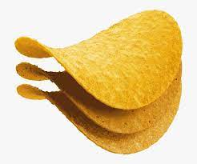
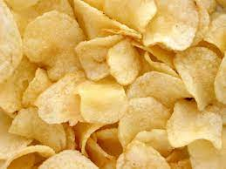
Steel Flatness
When a cold-roll steel sheet flat is not flat, what does that mean?
Does it look like this?
Or more like this?
The “flatness” spec is not the same as the “thickness” spec. Both will need to be carefully specified in the contract.
Thickness is likely very consistent (set by the steel rollers) and as such errors accumulate through the stack.
Flatness requirements are more stringent in the middle of the plates (where the detectors are) than the ends.
Is every sheet the same?
Or different?

Slide 13
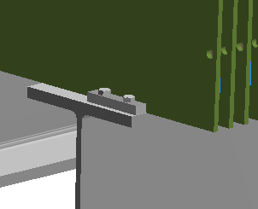
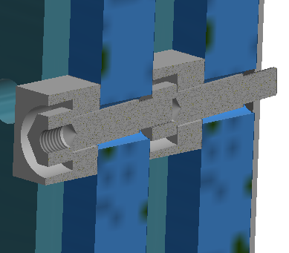
Spacer Bars and Bolts
Design is at the conceptual stage
Spacer Block
  Rests on support structure & sets the space between steel plates
  Physicist estimate $11.70 each (600 needed)
  May “grow” in y to improve the magnetic field (see later slides)
Spacer Bolt
  Holds the distance between plates
  Physicist estimate $25 each (600 needed)
  May increase in number (see later slides) to improve plane flatness.
Spacer Block
Spacer Bolt

Slide 14
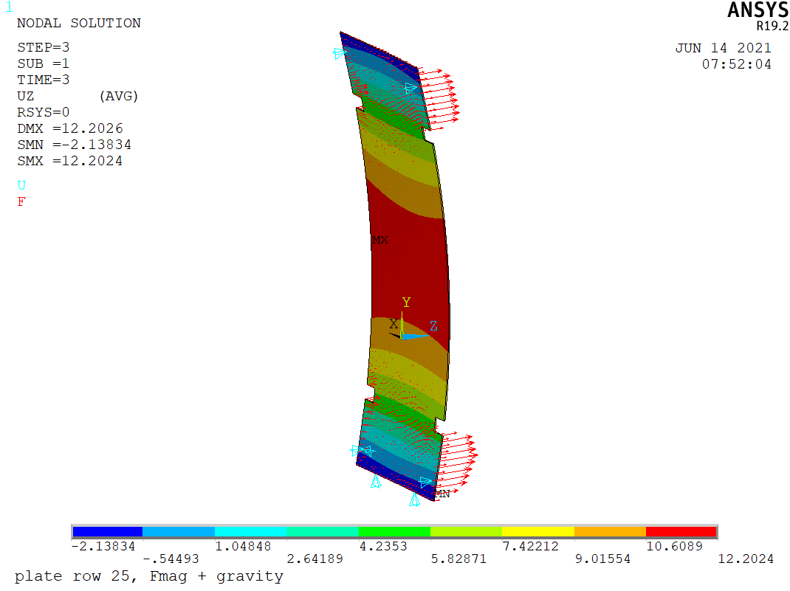
Outer Plates Under Gravity + Magnetic Forces
Worst case out of plane deflection is 12.2 mm
  By itself exceeds our tolerance budget of 10 mm per side
This is an advertisement for the next talk – we have lots of studies on magnetic and deflection behavior..

Slide 15
magnetization

Slide 16
Magnet Requirements
We need (KPP) 98% charge identification – pushes us to high field
  We don’t know what field this implies. My guess is a little lower than the canonical 1.0 T.
We want the field in the liquid argon to be “as small as possible”
  This is not a spec.
  Deflect tracks by less than half a pixel → less than a few 100 G
  Ionized electron orbit larger than an atom → less than a few 100 G
    I didn’t find anything in the literature to suggest anything measurable happens
  This magnet overdoes it – field in the liquid argon < 15 G. (Earth’s field is 0.6 G)
We want the magnet to be inexpensive as possible
Overarching Design Philosophy: keep the field lines in the steel
One of Tom’s rules for muon detection: “Air is your enemy, steel is your friend”. Applies here too.

Slide 17
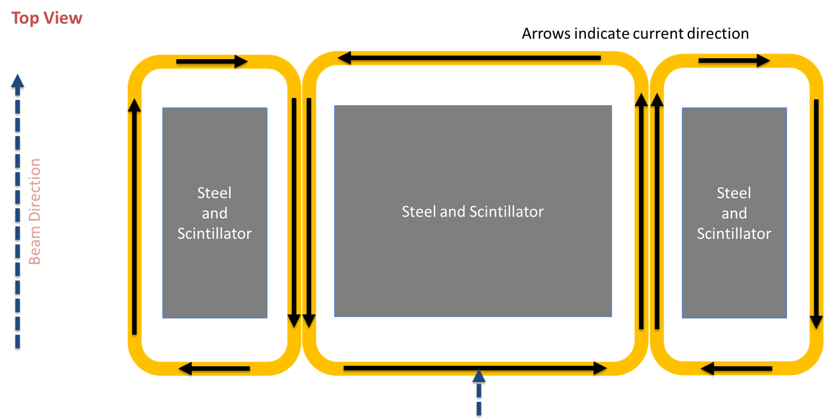
Magnet Coils and Power Supplies
Base cost: $1,256,734
Contingency: 43.9%
Date of last estimate: 7 April
Upcoming changes
  I am unhappy with the copper quote. We are going out for more quotes. No estimate on time.
  We likely need 6 smaller power supplies. (See later slides)
Coil Design:
Insulated bus bars:
    300 units 40mm x 40mm x 7000mm
    200 units 40mm x 40 mm x 1749 mm
    100 units 40mm x 40 mm x 3498 mm.
Corner pieces:
  600 corner pieces
Power supplies
  Two Lakeshore 648’s (one doesn’t quite cut it)
Control computer
Scope

Slide 18
Magnet Coils
We need 30 kA-turns to get the field we need
  How do we distribute this between kiloamps and turns?
Current per area is a constant for a given material (set by electrical code)
  If I halve the area, I halve the current
  I double the resistance per length and double the length/number of turns
    Power needed is constant
    Voltage goes up by a factor of 2
  Power supplies cost goes up with power, but also voltage – above a few kA, they get hard to find → 25 turns
Each bar needs to be isolated from the others.
Property | Value
Length/turn | 21 m (central coil)
Resistance (total) | 5.5 mΩ
Voltage | 6.6 V⁽¹⁾
Power | 8 kW (43 kW total) ⁽²⁾
Inductance | 1.8 H
Time constant | 6 minutes⁽³⁾
(1) 6V is sort of a threshold on power supply costs. Value engineering might have us add some more copper to get cheaper supplies.
(2) This is my calculation; the engineers’ was 16 kW. We need to hunt this down. We have the needed power capacity to do 43 kW.
(3) Time to power up and down is driven by reactance, not stored energy.

Slide 19
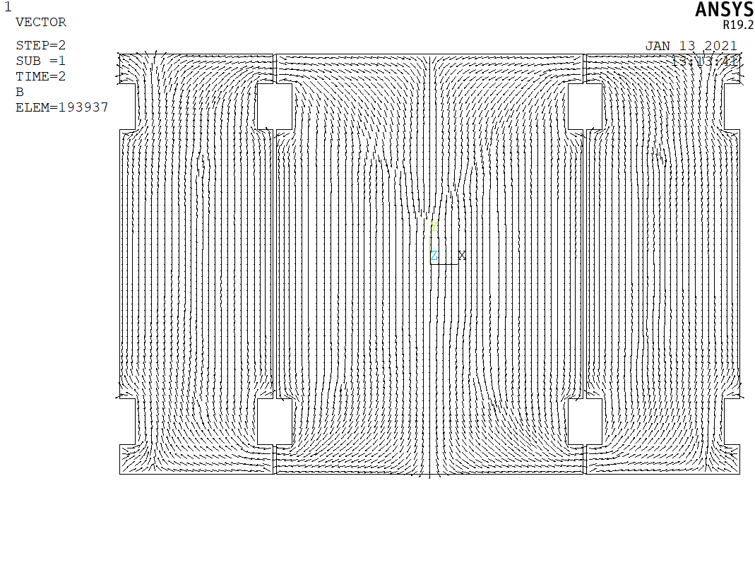
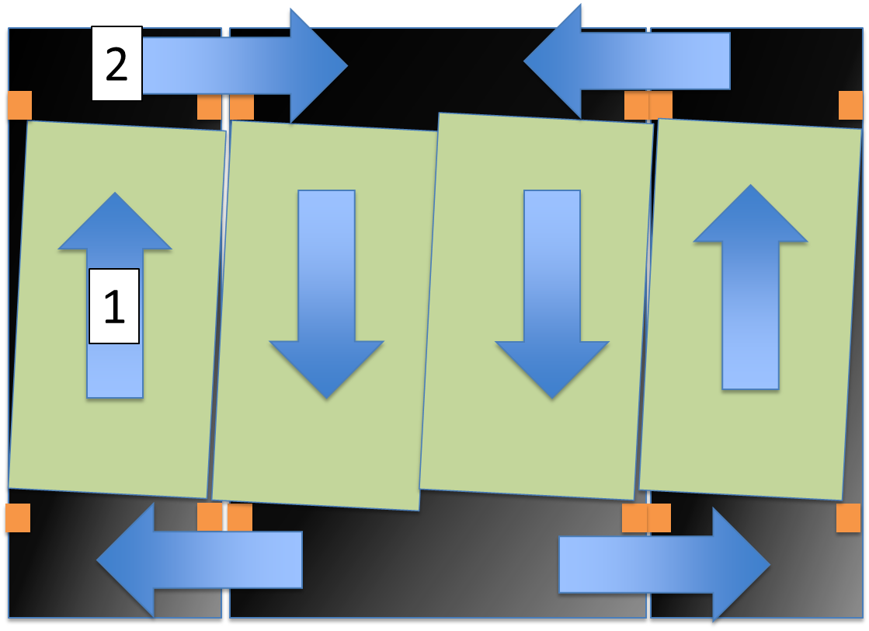
Magnetic Field
These are not exactly field lines (right), but close.
The fringe field is largest above and below the stack. (By design – see next slide)

Slide 20
Magnetic Field Design
Inside the detector active region, the field is dipole-like
Outside the magnet, the field is a sextupole
  If you like, half an octupole
Fringe field is largely above and below the stack, plus the corners
  Field in z is low because
    it is contained in the steel
    the dipole cancelation and quadrupole partial cancellation

Slide 21
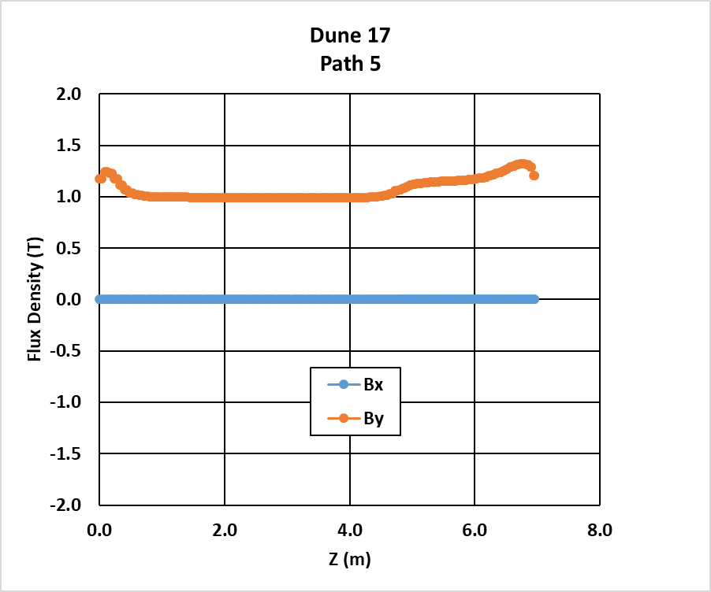
Magnetic Field Quality
Average B_{y} through the stack
This steel geometry produces a fairly uniform field where the detectors are.
  Standard deviation of By in the x-y direction is 6%
B vs. z from ANSYS at a single (x,y).
We have 40 paths + symmetry.
x-y (front) view
Black dashed line indicates active area
Field in ND-LAr is negligible (15 gauss)

Slide 22
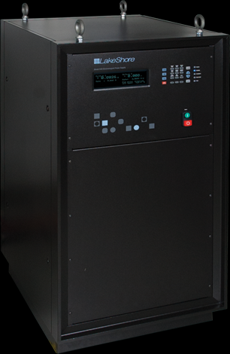
Magnet Power Supplies
There are many makers of power supplies, but only one has given us a quote for something that will work
  The magnet is big, so the coils are long, so the resistance is high, so the needed voltages are atypically large
  These supplies are $210,000 each and we need 2.
    We need 2 because we really need 1.1, but they are quantized
    We would power the top coils with one and the bottom coils with the other
  We would prefer six smaller supplies, one per coil
    Lets us better tune the field
    Cost expected to be between $210K and $420K.

Slide 23
Why Do You Want Six Power Supplies?
The issue: the gaps between panels plays an important role in the magnetic circuit.
  Flux path lengths are between 6200 and 17,000 mm.
  There is 40mm of air gap (20 mm above and below)
  For μ=700, 60-80% of the reluctance comes from the gaps.
  The 20 mm gaps are surely not 20.00000 mm.
  Tolerances in the gap width imply different currents needed to supply a uniform field. → need multiple supplies
How do we measure the field to tune it? It’s in the iron.
  Place a small Hall probe or NMR in these gaps
  Use the RL time constant & power supplies

Slide 24
More on Reluctance
The gaps between plates top and bottom dominate the reluctance of the magnetic circuit – bad
But the same gaps in the middle keep the field lines from swirling – good
We have a balancing act ahead of us

Slide 25
Coil Installation
Sixteen coil assemblies are easy to install – they come in from the side (4) or front (8)
Eight are difficult – they come in from the front.
We have a plan (not ready for review) that improves this and reduces cost
Easy
Hard

Slide 26
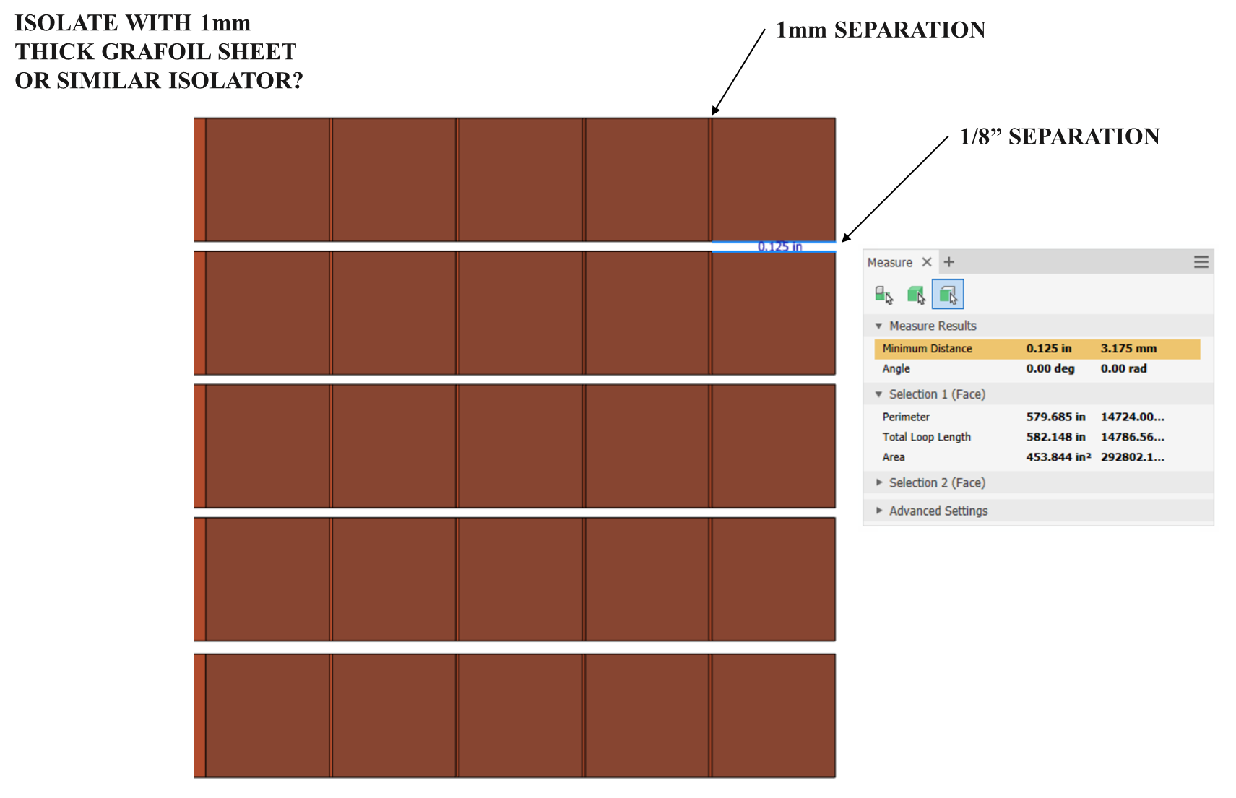
Bus Bars
Luvata is quasi-willing to wrap them
  For ¼M$ and “we don’t know with what” – this is business-speak for “go away kid, you bother me”. But that’s what is in the BOE.
We should investigate alternatives
  Find another vendor? Find a dedicated wrapping vendor? Wrap ourselves?
  I don’t understand why this drawing assumes Grafoil (e.g. graphite) sheets, as graphite is conductive.
I don’t think we want aluminum bars, but they are an option:
  Less conductive, so larger. And larger so stiffer.
  Lighter, less expensive (factor of 3) but requires bigger power supplies: financially, it’s a wash
  Take more power and generate more heat

Slide 27
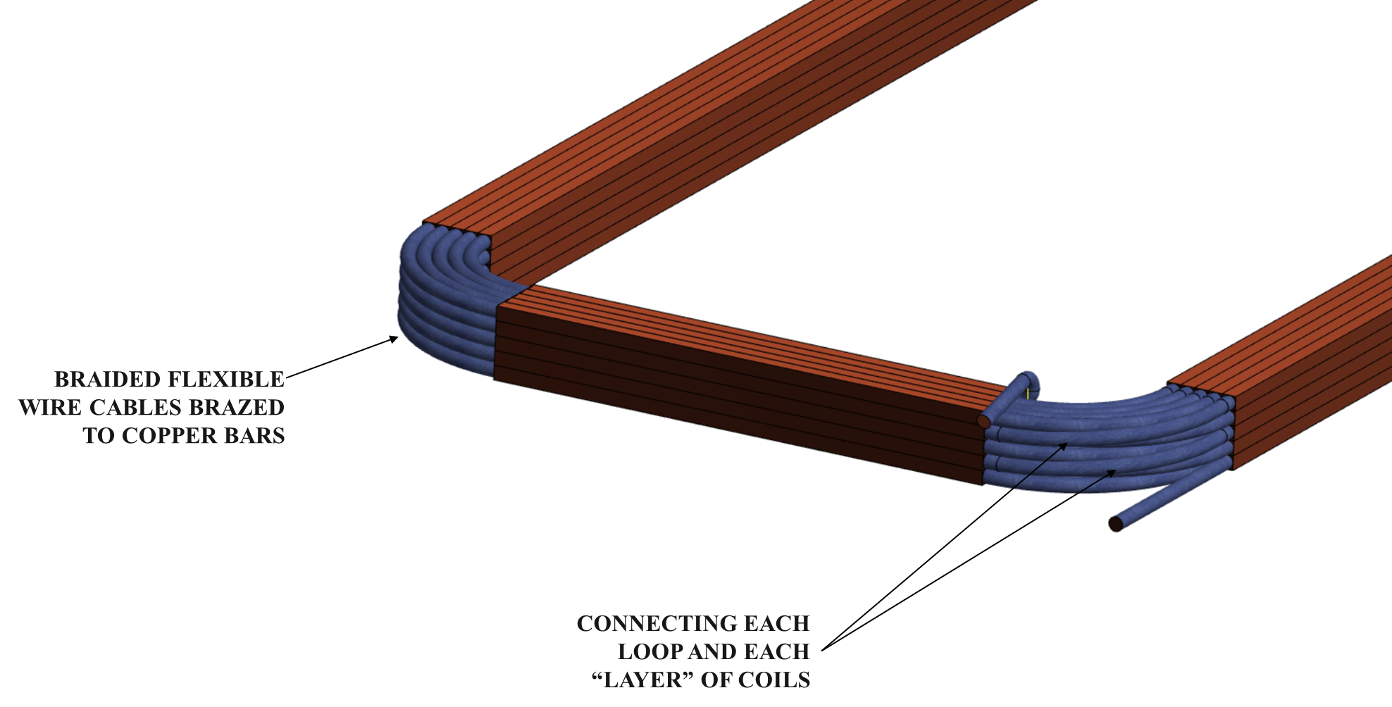
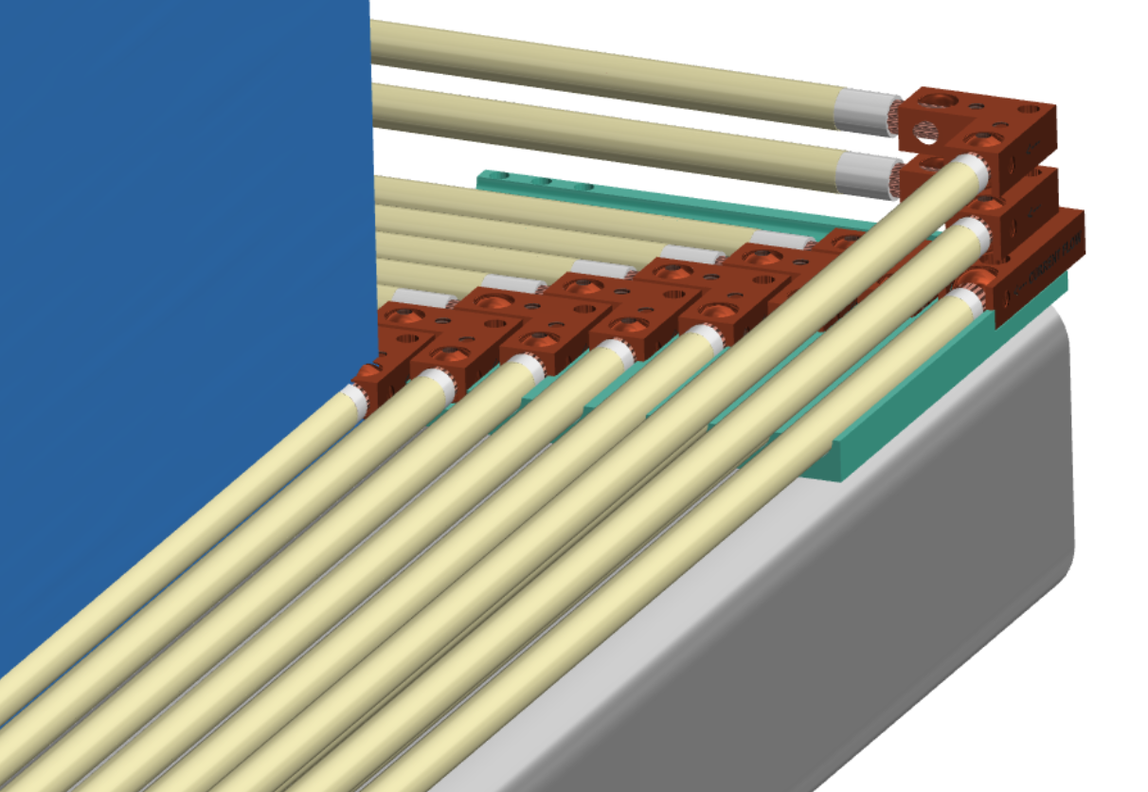
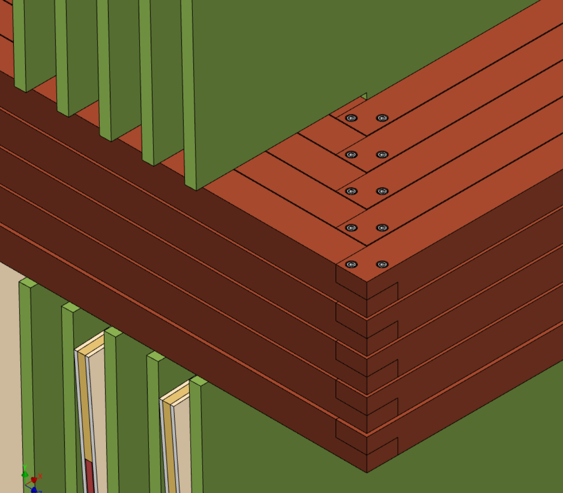
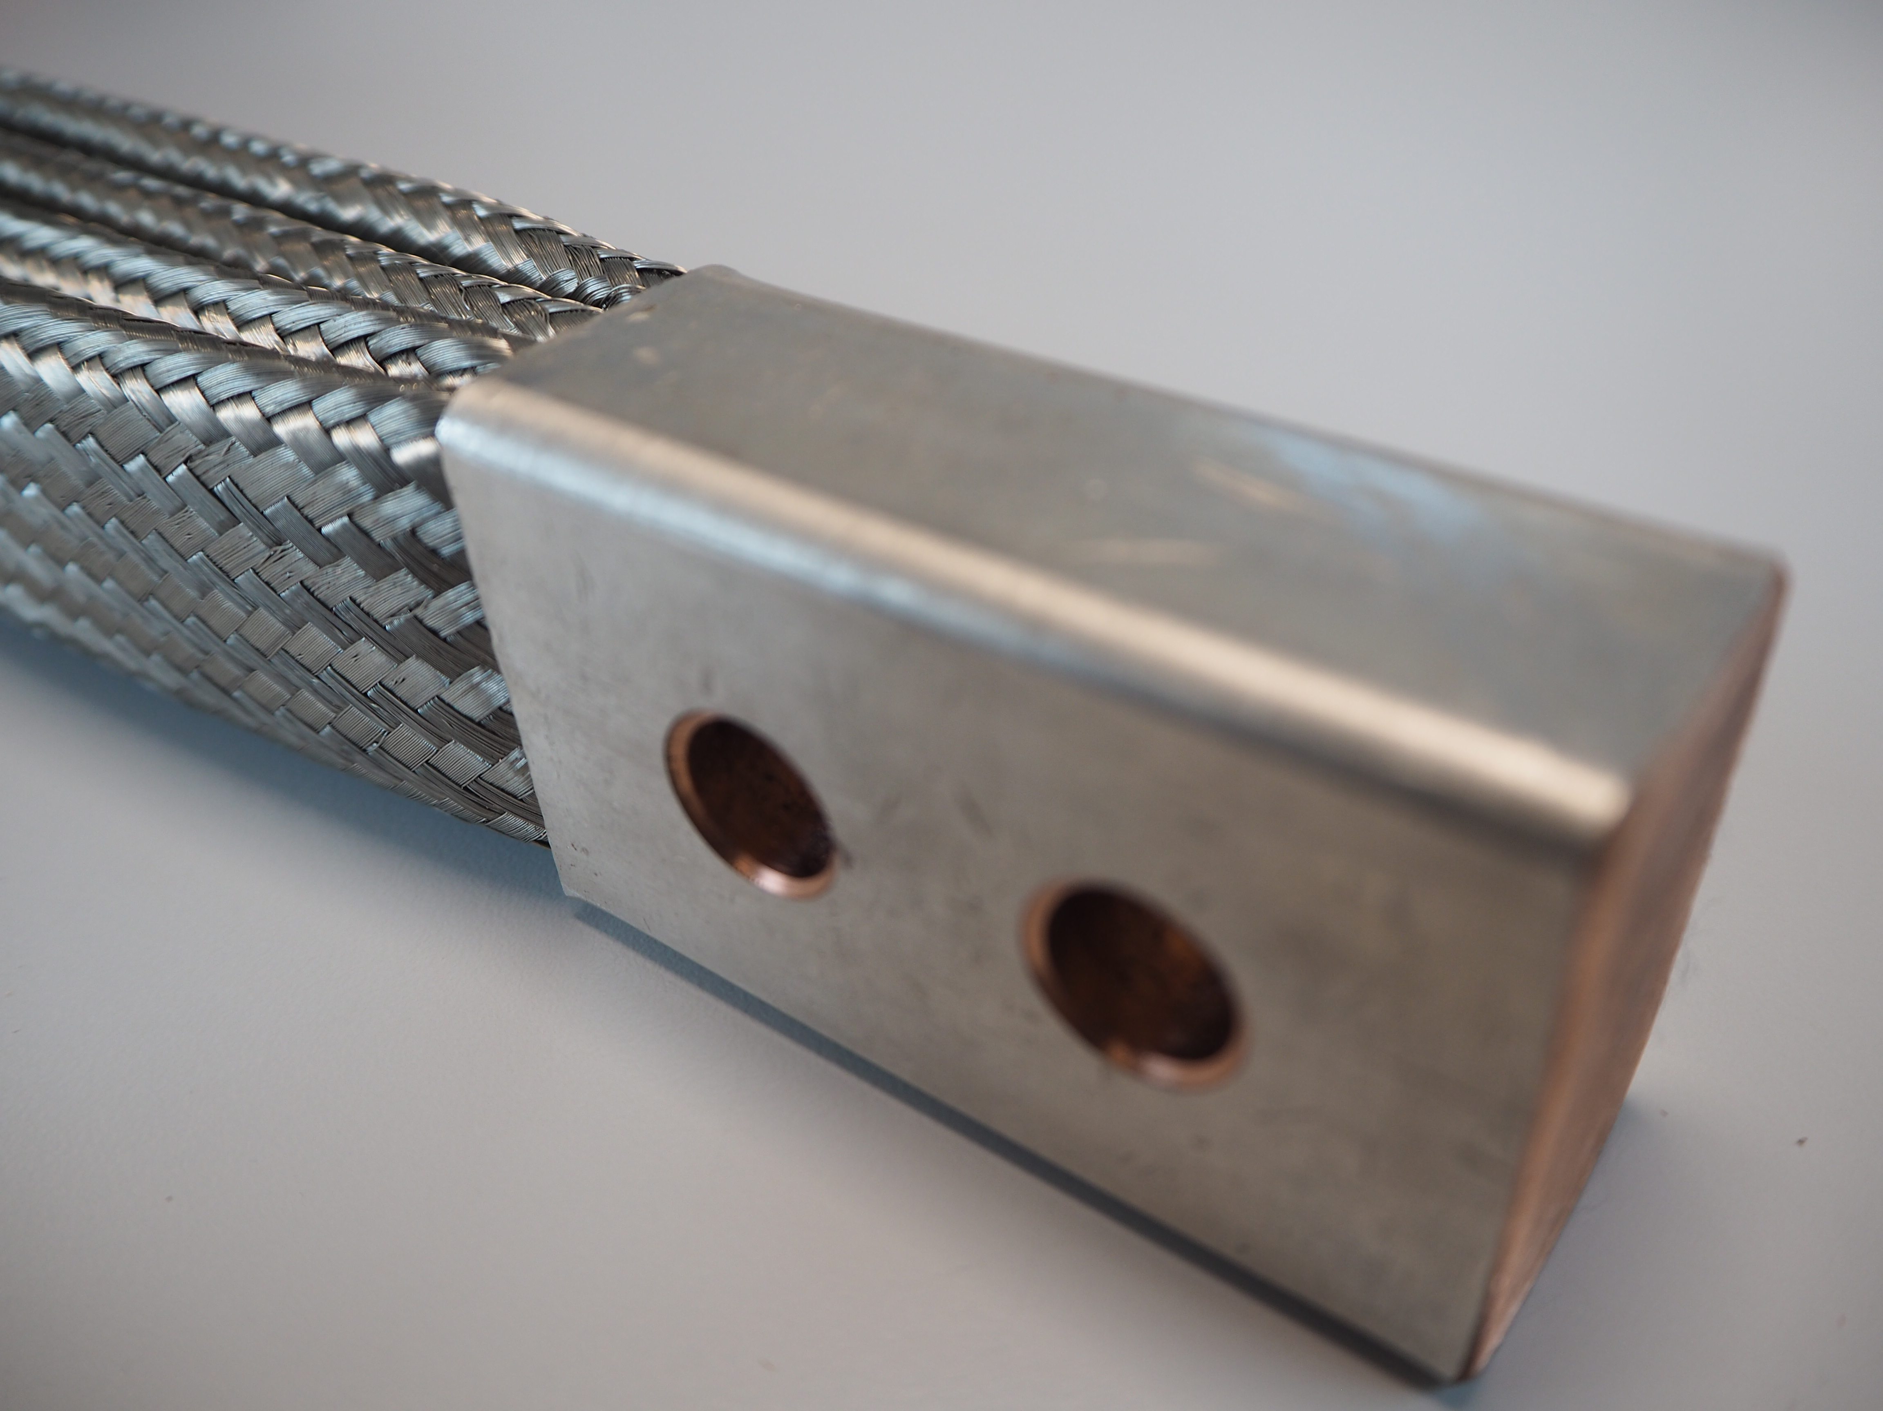
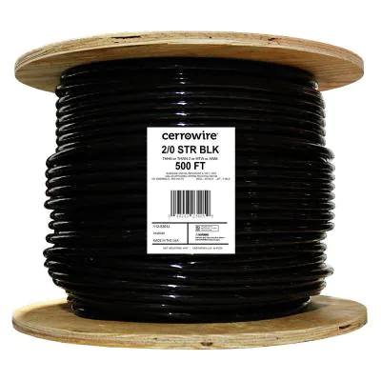
Magnet Coil Corners
Plan C
Plan A
Plan E
Plan A
Plan D
Plan B

Slide 28
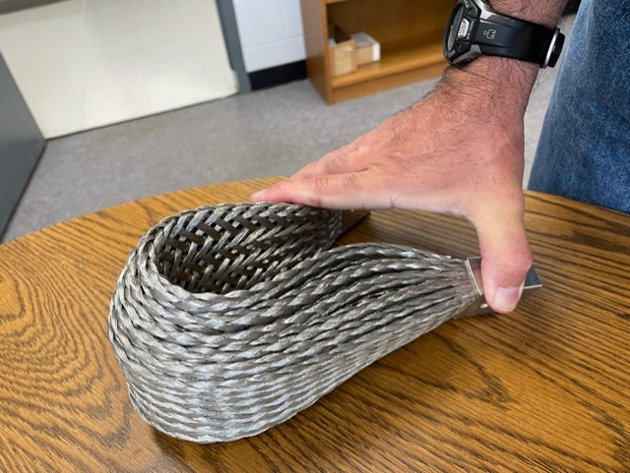
Plan D: Flexible Bus Bars
One solution is to get Mettex to make us bus bars with a “natural bend” of 90º.
  They seem uninterested, but I don’t know how hard we pushed.
We could buy these and modify them ourselves
  I would insist on substantial testing to ensure they can still handle 1200 amps
We could try and make these ourselves.
We could go to Plan E
Out of plane motion when flexed: This is because the inner radius needs to be simultaneously the same length and shorter than the outer radius.

Slide 29
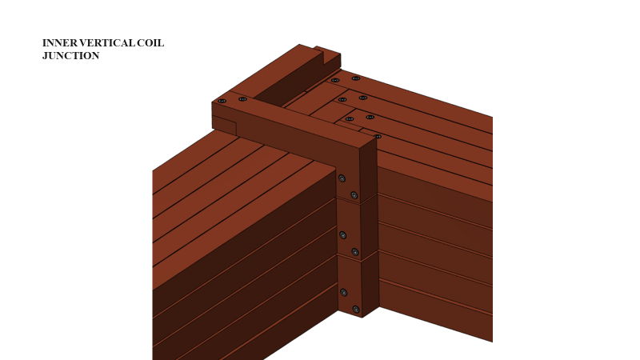
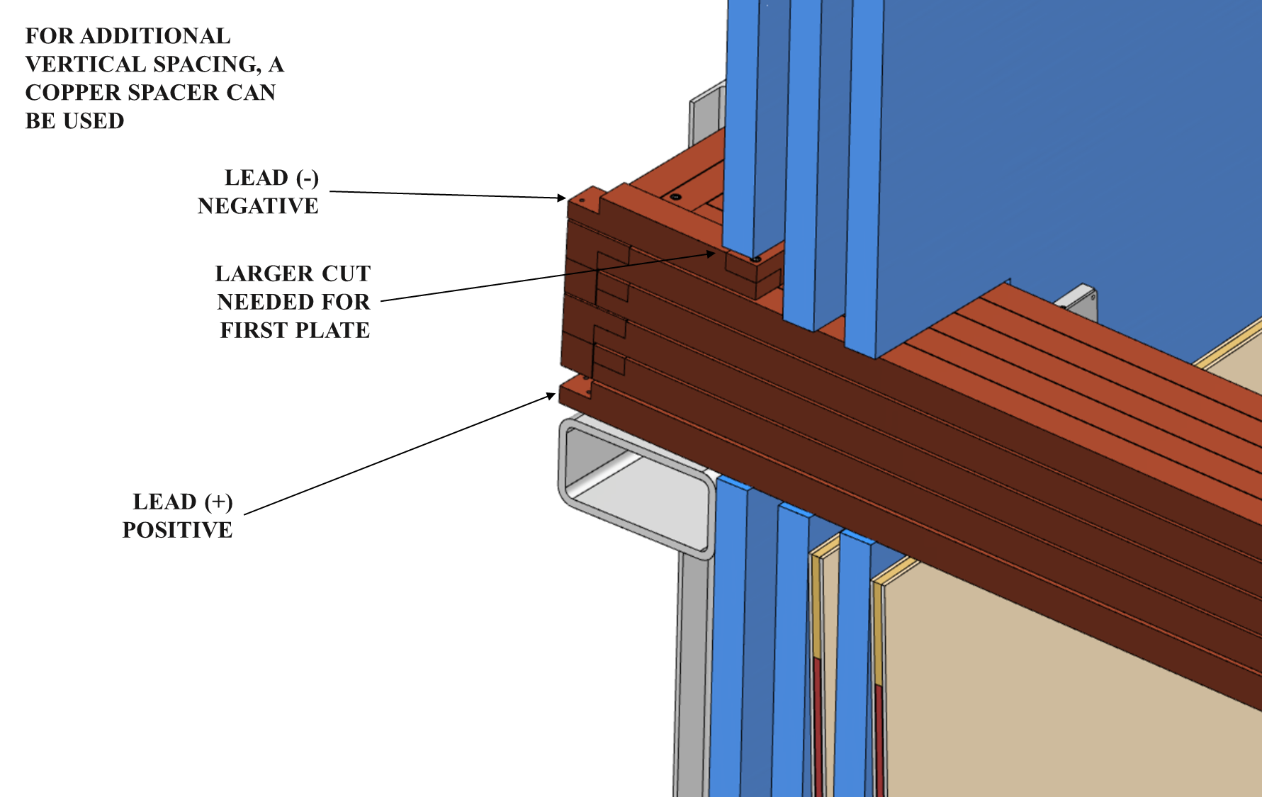
Plan E: Individual Right-Angle Attachment
Construction looks hard – maybe harder than we want:
  Instead of 8 difficult insertions, there are now 200. Granted, most are easier, but the last ones will be tough.
  A single bar is 25 times as floppy as the full pack – it flops almost the size of a pack

Slide 30
The Ultimate Backup Plan
Plan D
Plan B
Build our own “flexible bus bars” using ordinary insulated wire as the conductor.
Advantages
  Guaranteed to work
  Can be built on a bench. No brazing or other “messy” operations in the ND Hall
Disadvantages
  Takes time (=money) to build each one. Probably 4x what it takes to buy one from Mettex
Design issues
  Higher gauge (thinner) wire allows for more efficient packing (HCP) and has better (smaller) bend radius.
  Lower gauge (thicker) wire has fewer connections
  We have about a factor of 3.3 margin in area for insulators, air gaps, etc.
  Silver? No. Its margin is 3.5 but costs $100K more.
Plan A

Slide 31
Power Supply Selection
The power supplies we need depend on the current (and ability to adjust current) that we need, which depends on the magnetic circuit, which depends critically on gaps and steel trim pieces.
We also need to consider safety from the perspective of the individual supplies and the magnetic system as a whole
  If one supply crowbars, we need to take the other 5 down in a controlled manner.
  At its heart, the TMS magnet is an iron-core transformer. Where does the energy go?
  The assumption is there will be some kind of computer (also interfacing with slow controls) but no details and certainly no programming.

Slide 32
Installation

Slide 33
Installation Sequence
Build the support structure
Install four bus bars
Install planes 100 to 1 in order (see next slide)
Install remaining bus bars and corner pieces
Unfortunate fact: the first time we can energize the magnet is after the detector is built.
  One layer of steel blocks all previous layers of detectors
  The coils block everything

Slide 34
Steel Plate Installation
The installation plan is to install one layer at a time, starting from the back/west and working eastward
The schedule assumes
  We install one plate per hour
  We install one detector panel per hour
  That works out to 7 hours= 1 day. Evening shift checks out the new panel plus the existing stack.
Going faster would be good – this is a five month job
Understanding the relationship between time and precision would be good too
The detector panel sits on a small bracket
  How – and maybe more importantly – when is this installed?
  And is there any other work that needs to be done?

Slide 35
Backup

Slide 36
TMS Cost Breakdown
I deliberately included only fractions here (dollars come later) – the point of this slide is the relative costs
Overall costs
Detector-only costs

Slide 37
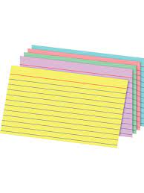
The Front Plates Are Really, Really Thin
I often say that the front plates have the same aspect ratio as a
3x5 index card. This is a lie.
  A (cheap) 3x5 index card scaled up would be 20 mm thick.
  Our plates are only 15 mm thick.
The only steel vendor that responded to our call (Ryerson) will not make 15 mm thick plates for us.
  They will make 40 mm plates, so it is not an aversion to metric
  They will make 5/8” plates (~16 mm)
  Conclusion: they have never made a plate this thin and don’t want to

Slide 38
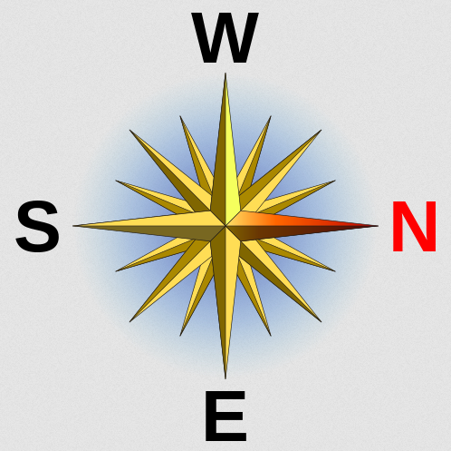
How Do You Get TMS Out?
When ND-GAr is ready the swap with
TMS takes 3-6 weeks when no muon detector is available
  Dominated by magnet removal time
  Cabling and uncabling might be done in parallel
PRISM is used for N-S motion of both detectors
  TMS moves to the East PRISM rails on temporary E-W rails. The SAND rails are too close together to use for this purpose
During ND-GAr construction and TMS disassembly PRISM motion is limited to ¾ of maximum.

Slide 39
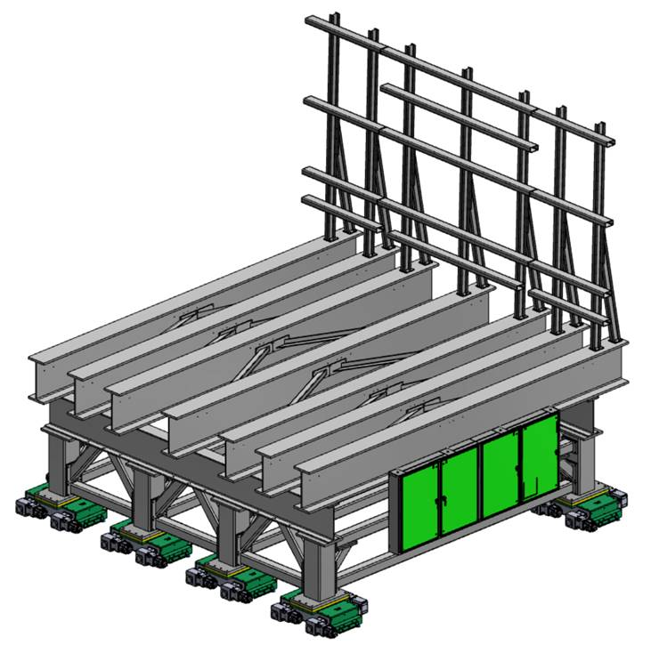
Support Structure Status
The design is quite advanced.
  The last design change was a shortening of the lower structure by 534 mm
    Two errors in the ND Hall geometry caused by incorrect calculation of the effect of the 6º beam downward direction
  I have asked for a BOM (Bill-of-Materials) cost estimate
    The present cost estimate is set by total weight, not part by part
It sits on 8 Hilman rollers
  Too much weight for four
  Six doesn’t help (see cartoon (idealized) at right)
w/2
w/2
w/4
w/2
w/4
w/4
w/4
w/4
w/4

