Slide 1
TMS Magnet:
Flux Density and Magnetic Force Analysis
Lei Xia
ANL - HEP
Work Performed By: VIC GUARINO, RICK FISCHER, SCOTT POREMBA, JEFF WHITE, GUOSHENG YE, ALEENA RAFIQUE, ZELIMIR DJURCIC, LEI XIA

Slide 2
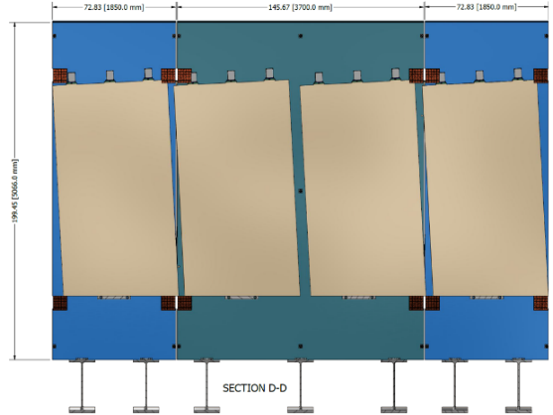
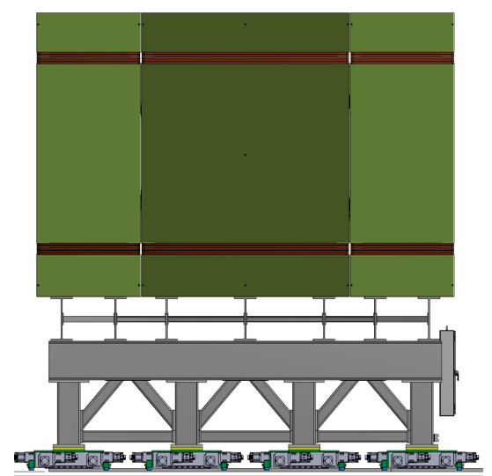
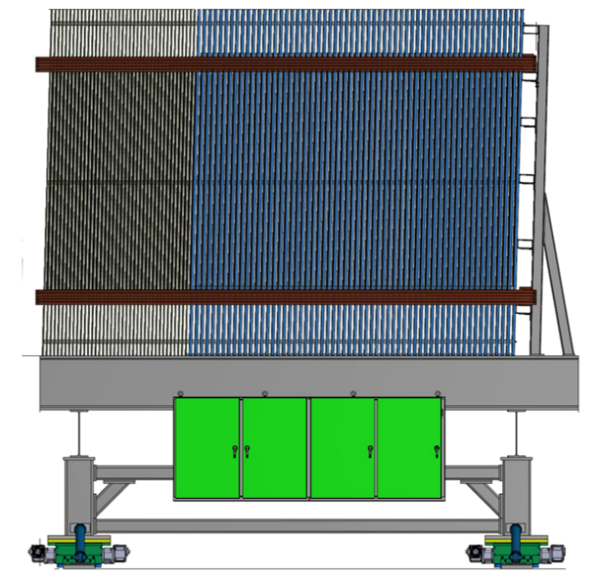
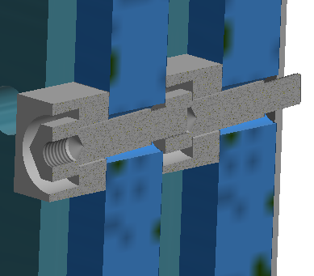
TMS introduction
Front view
Side view
TMS is a magnetized range stack that has 100 layers
  40 thin (15mm) steel layers in the front, 40mm air gap between plates
  60 thick (40mm) steel layers in the back, 40mm air gap between plates
  Each layer consists of three plates: middle + 2 sides
  All layers are inter-connected by spacer bolts and lean on the support tubes at the back end
  Active area is between the top and bottom coils

Slide 3
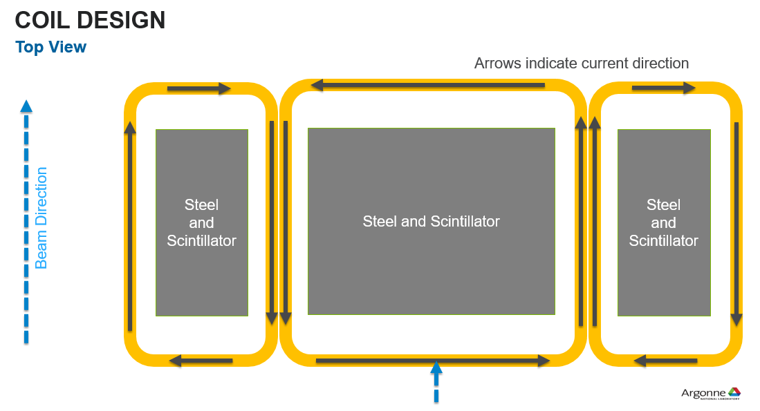
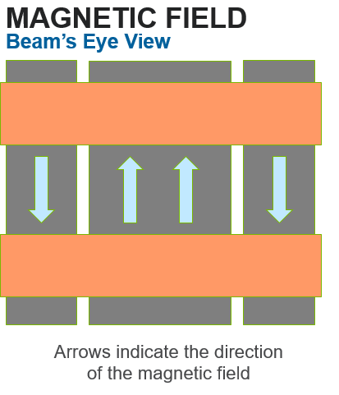
Conceptual Coil Design
Two ‘belts’ of coils in a ‘Helmholtz’ configuration for each role of plates + scintillators
  Reasonably uniform field between coils (active area)
Field inside as large as possible, field outside as small as possible
  The magnetic field configuration is a dipole inside the coils
  Sextupole outside the coils: Its dipole cancelled out and quadruple partially cancelled

Slide 4
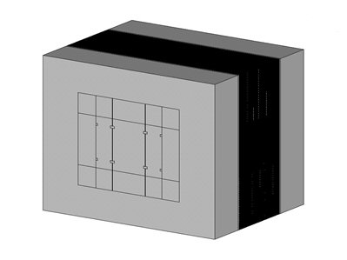
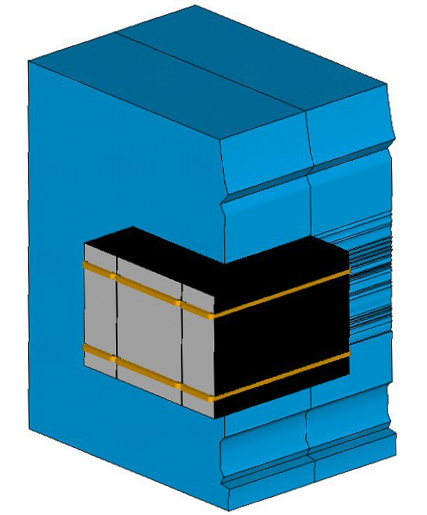
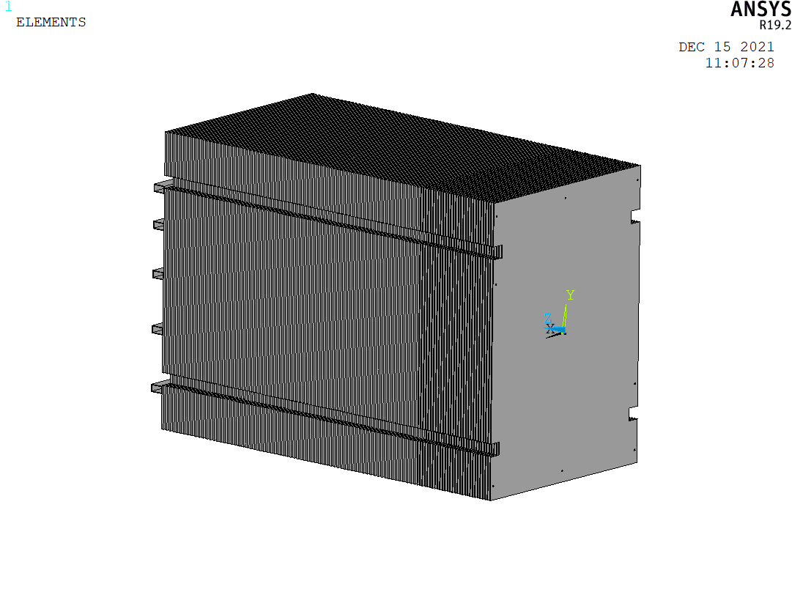
Overview of analysis I
Solid Geometry for the Magnetic Simulation
Electromagnetic Finite Element Model
Structural Finite Element Model
Finite element method, as implemented by ANSYS R19.2, was used throughout this analysis
  Full feature structural analysis program with modest low frequency electromagnet (EMAG) capabilities
Analysis steps
  An EMAG model was constructed with APDL script: steel plates/stack, coils, air gap, exterior air volume (large enough to approximate open boundary)
  EMAG model was converted to a structure model: allow direct application of the magnetic forces from the EMAG solutions to the structure model
  A linear static structural analysis was then performed to determine plate deflections
  Lastly, a pre-stressed eigenvalue buckling analysis was performed

Slide 5
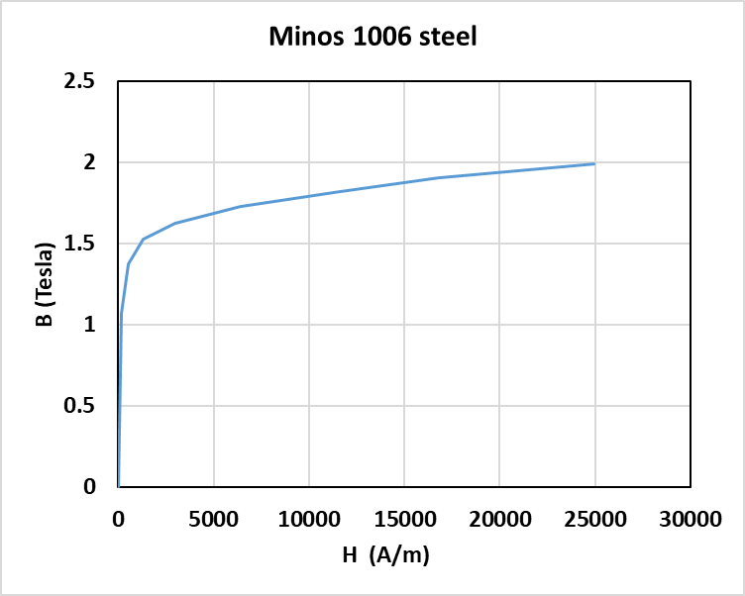
Overview of analysis II
Steel plate material: hot rolled AISI 1006 steel (‘MINOS’ steel)
Over 20 design versions were looked at: this report is mostly from the latest configuration
Several design optimizations were performed, based on structural analysis
Saturation Curve
Mechanical Properties

Slide 6
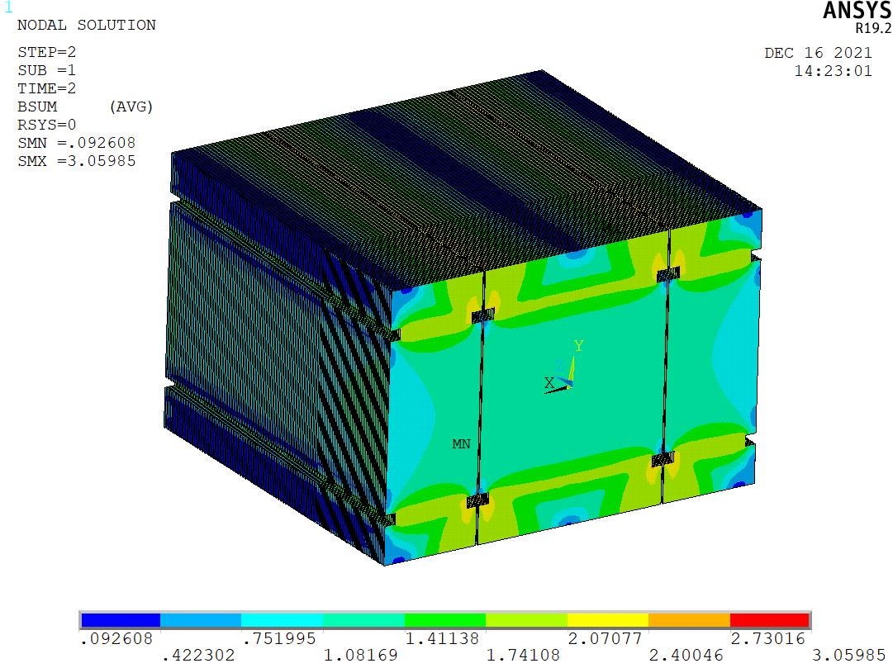
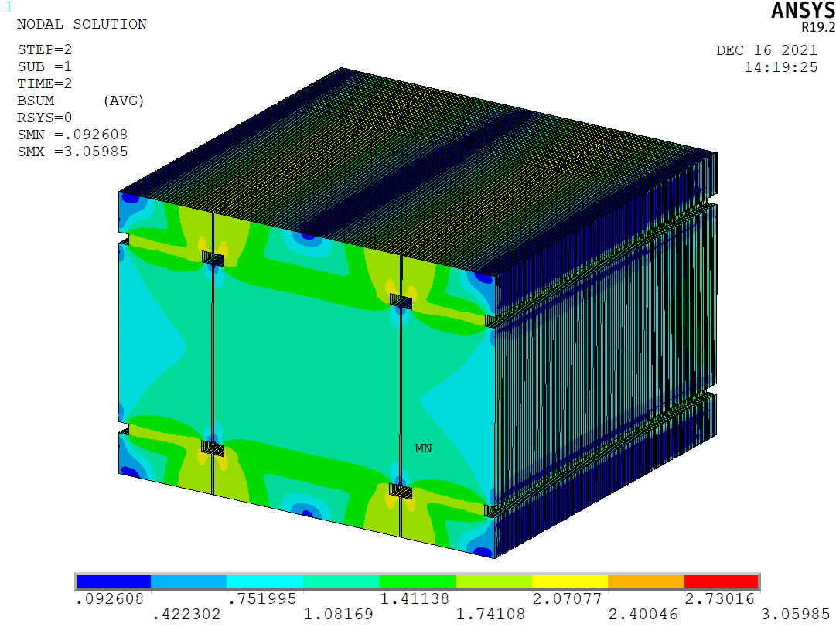
Electromagnetic Analysis: Total Field B
Front View
Back View
Summed Magnetic Flux Density in the stack

Slide 7
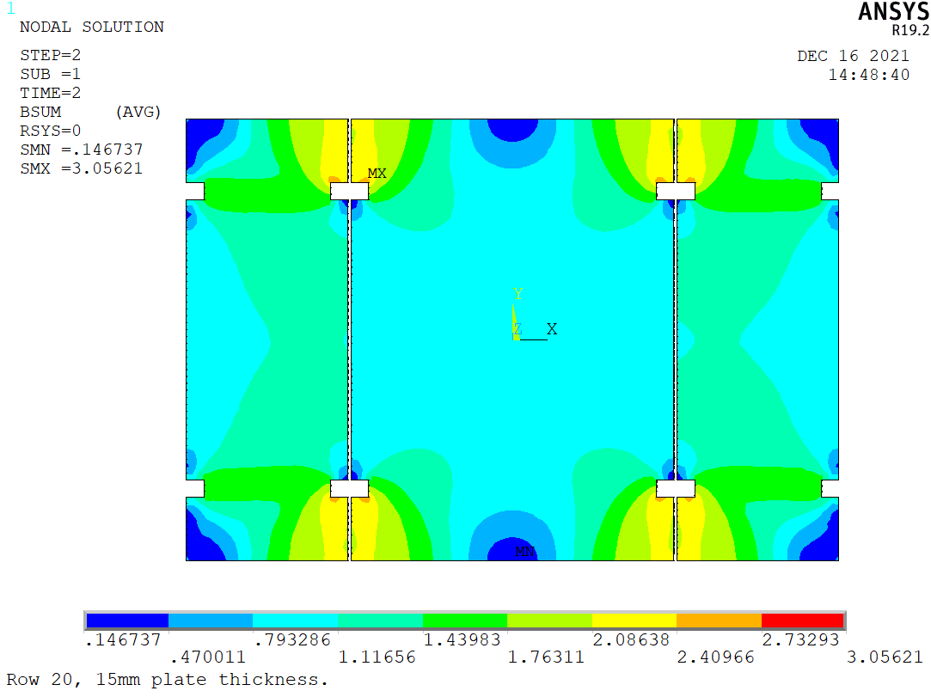
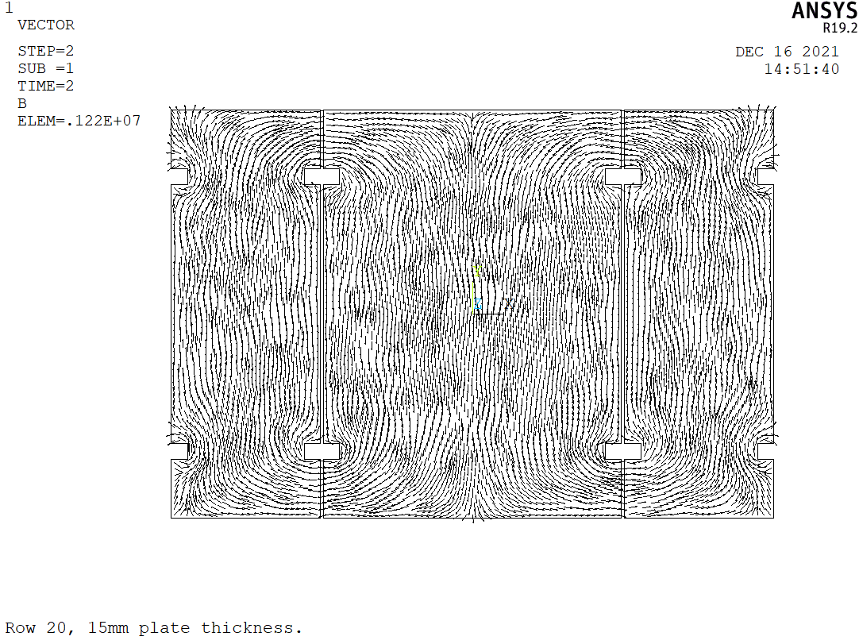
Electromagnetic Analysis: Total Field B, Row 20
Bsum(T)
Vector field
Summed Magnetic Flux Density in Row 20 (middle of thin/15mm plates)

Slide 8
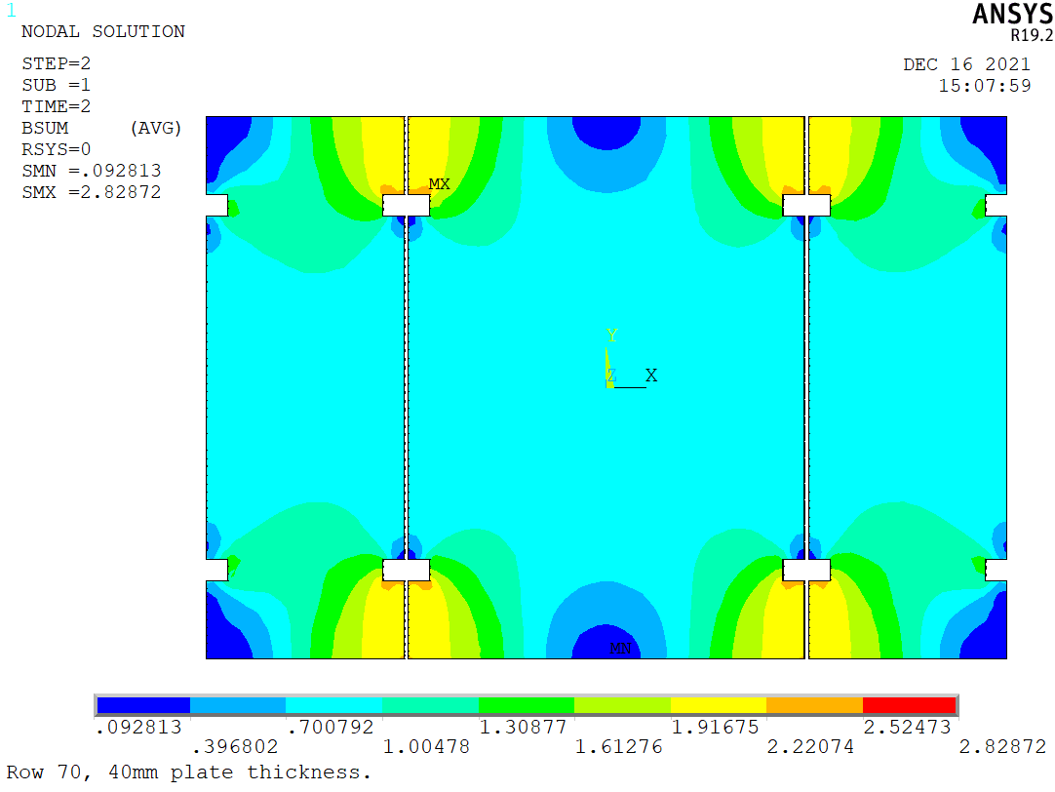
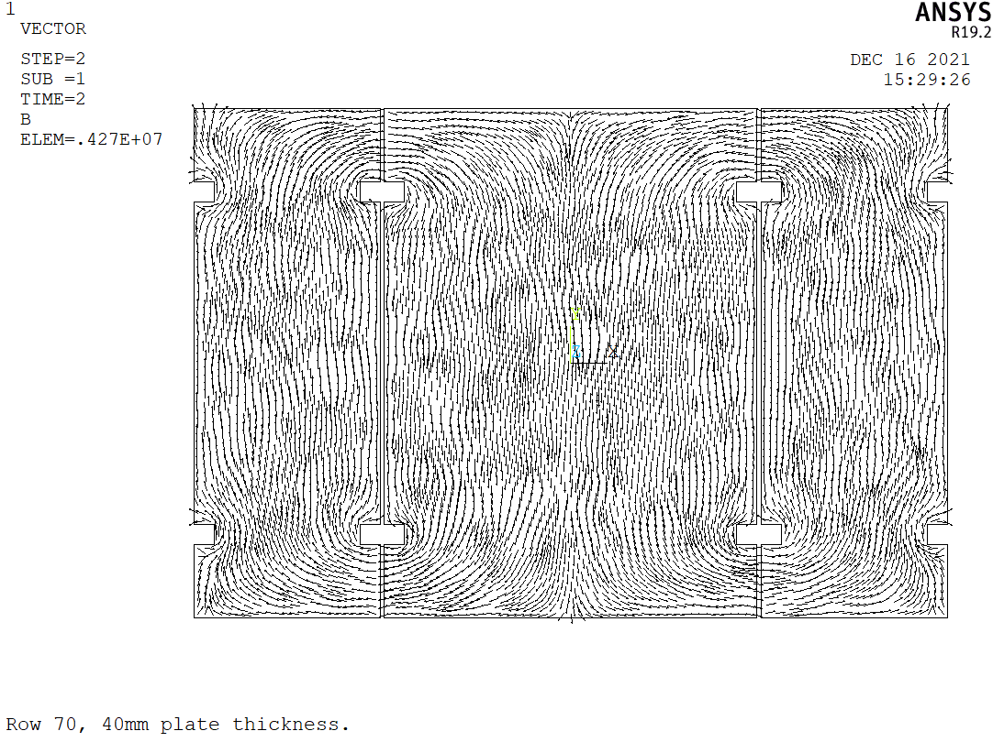
Electromagnetic Analysis: Total Field B, Row 70
Bsum(T)
Vector field
Summed Magnetic Flux Density in Row 70 (middle of thick/40mm plates)

Slide 9
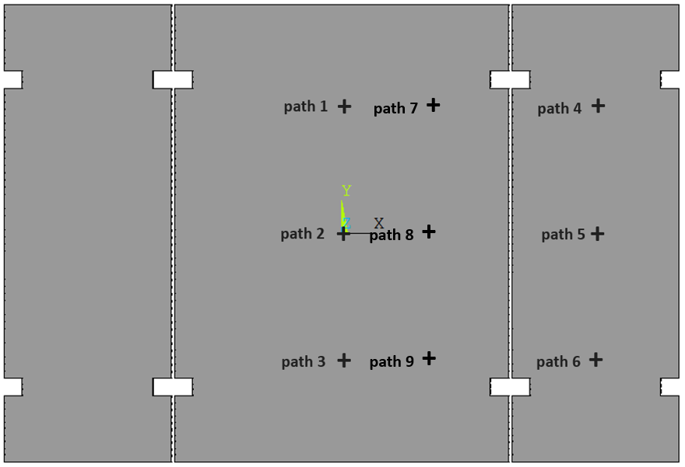
Electromagnetic Analysis: Field Components Bx,y,z(z)
Path locations
Bx,y,z(z) are plotted for the entire stack (100 layers) at 9 (x, y) locations
  1,2,3: along vertical center line of middle plates
  4,5,6: along vertical center line of side plates
  7,8,9: along vertical quarter line of middle plates

Slide 10
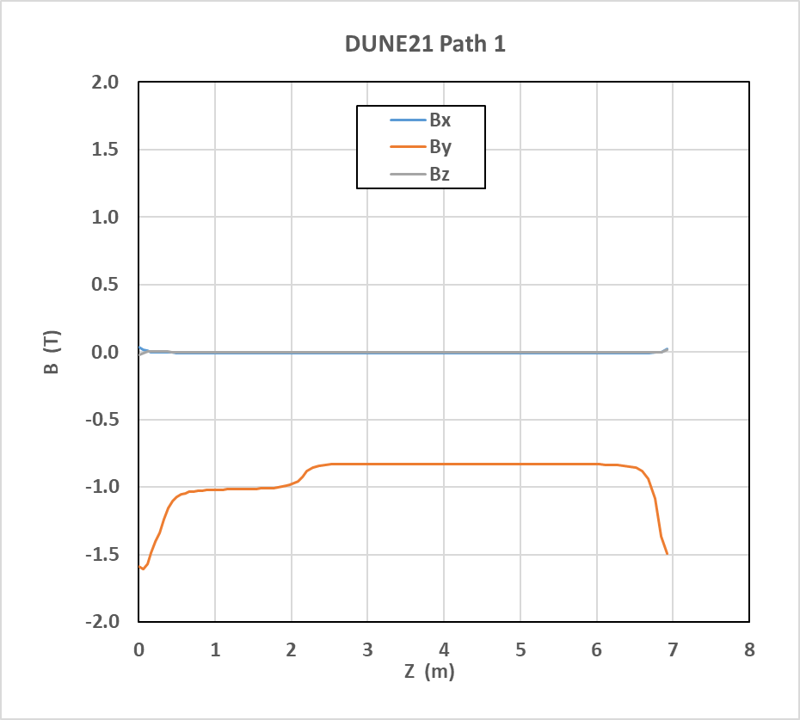
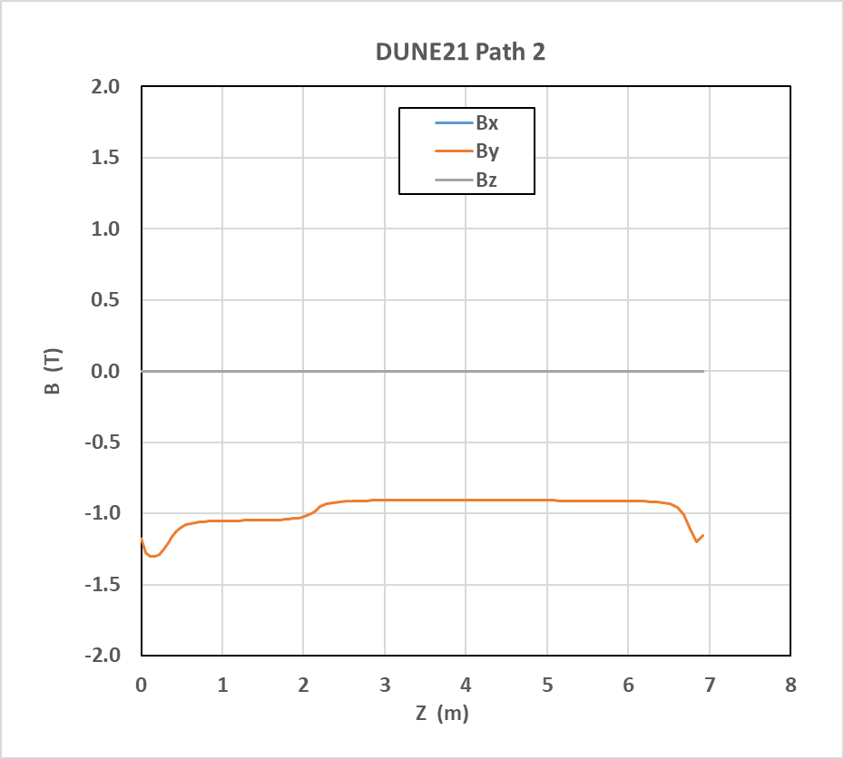
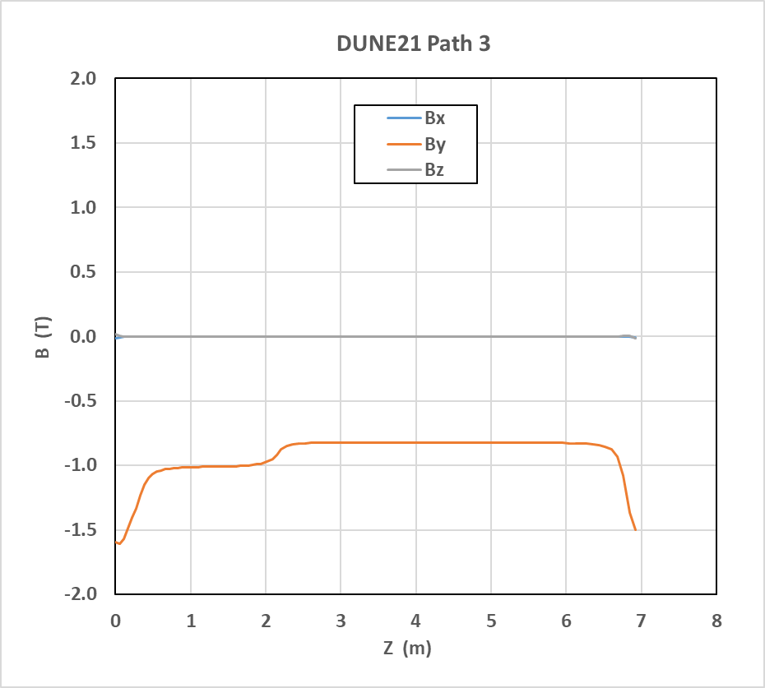
Electromagnetic Analysis: Field Components Bx,y,z(z)
Bx,y,z(z)
Bx,y,z(z) along path 1,2,3: on vertical center line of middle plates

Slide 11
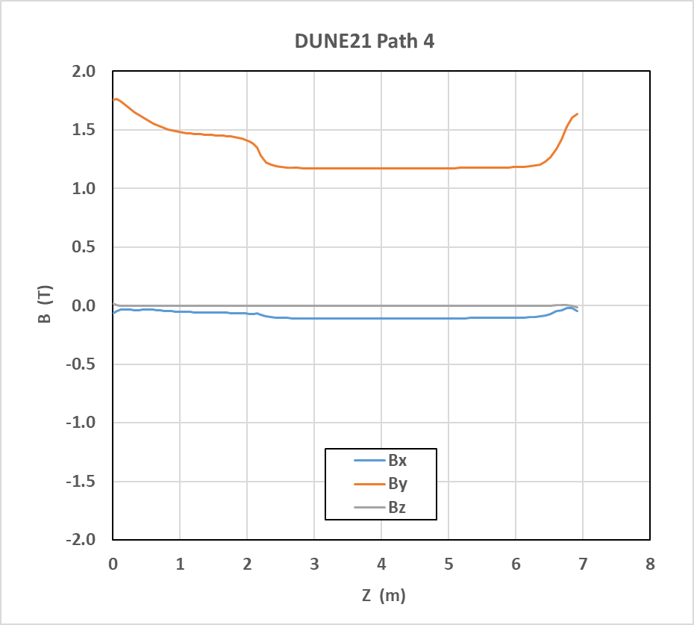
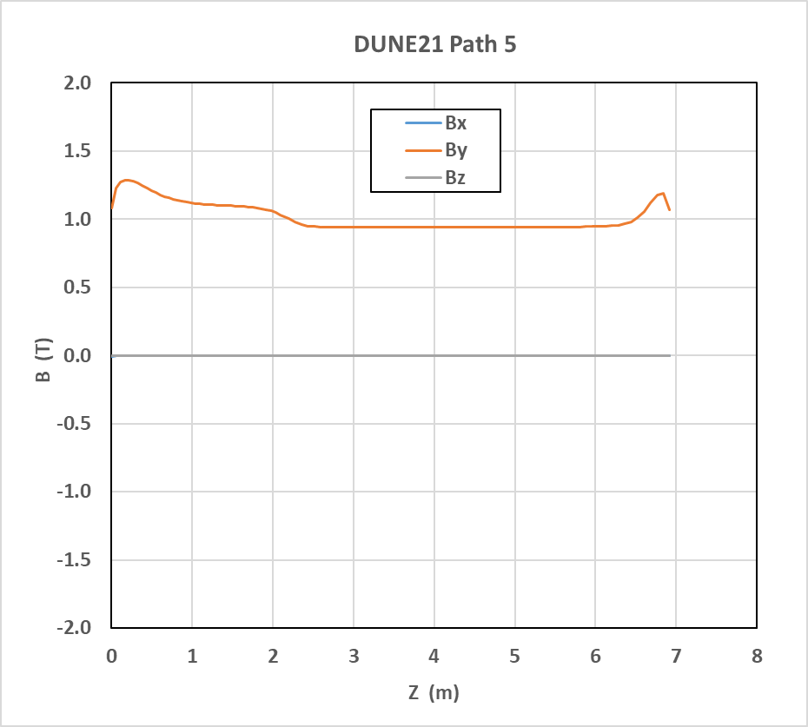
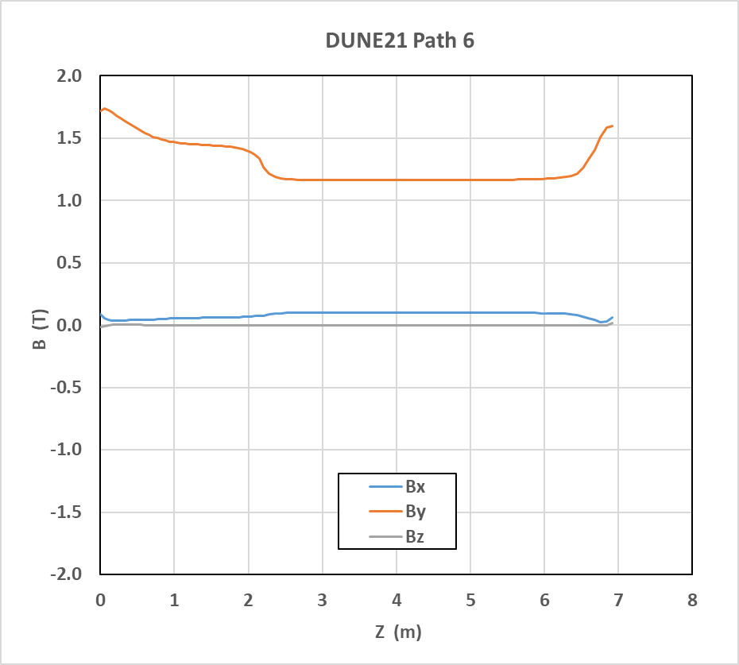
Electromagnetic Analysis: Field Components Bx,y,z(z)
Bx,y,z(z)
Bx,y,z(z) along path 4,5,6: on vertical center line of side plates

Slide 12
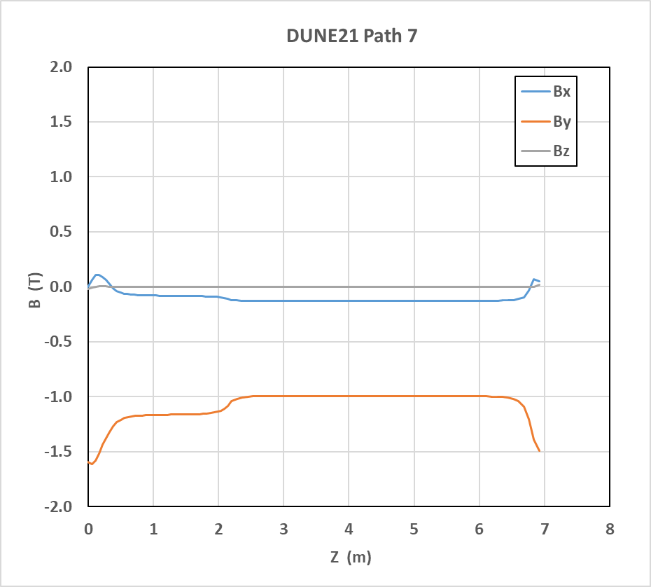
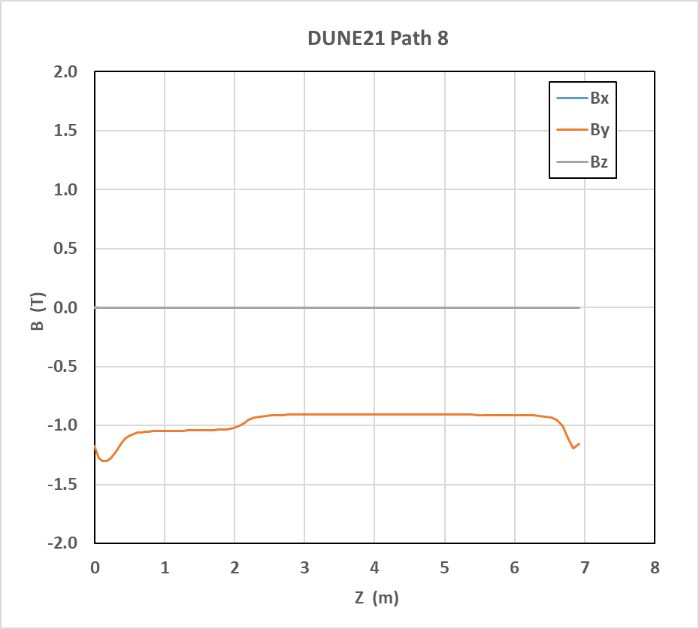
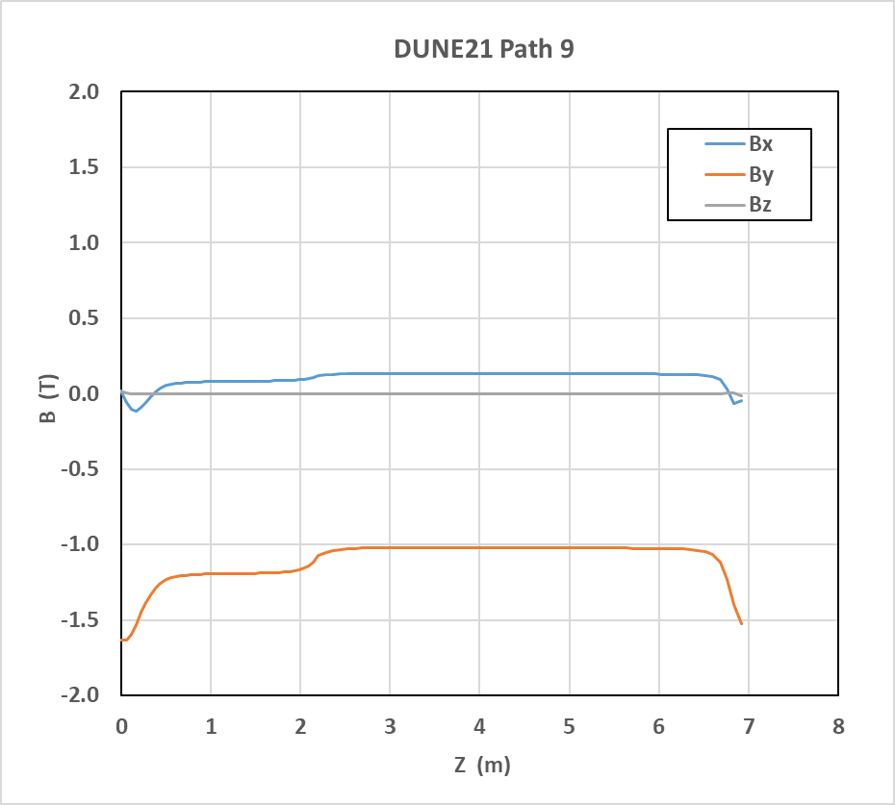
Electromagnetic Analysis: Field Components Bx,y,z(z)
Bx,y,z(z)
Bx,y,z(z) along path 7,8,9: on vertical quarter line of middle plates

Slide 13
Second Analysis: ANSYS Maxwell
A second analysis was performed using ANSYS Maxwell, to validate the ANSYS EMAG/APDL analysis
  The two analysis are consistent with each other
  The two shows ~10% Bvertical differences → indicate the level of analysis uncertainty
  Some of the comparisons are shown in the next few slides

Slide 14
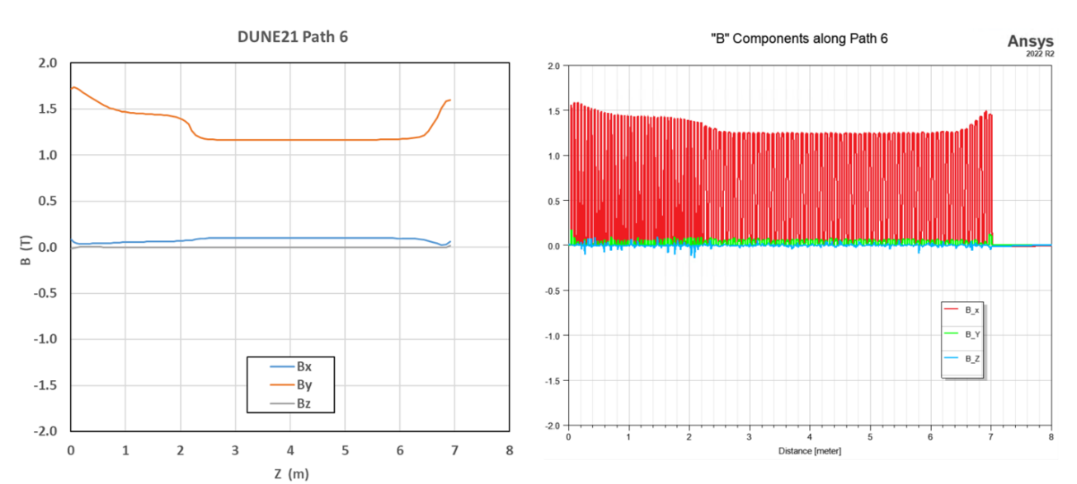
EMAG/APDL vs. Maxwell: Path 6

Slide 15
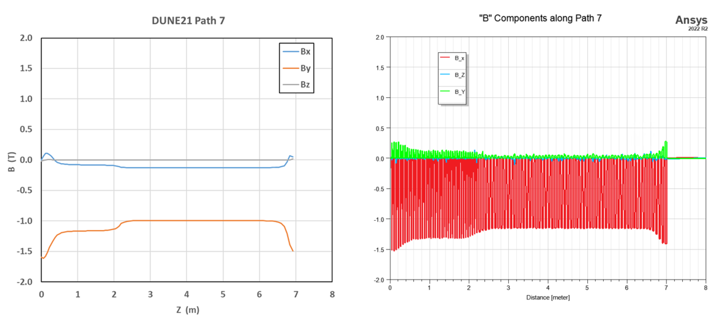
EMAG/APDL vs. Maxwell: Path 7

Slide 16
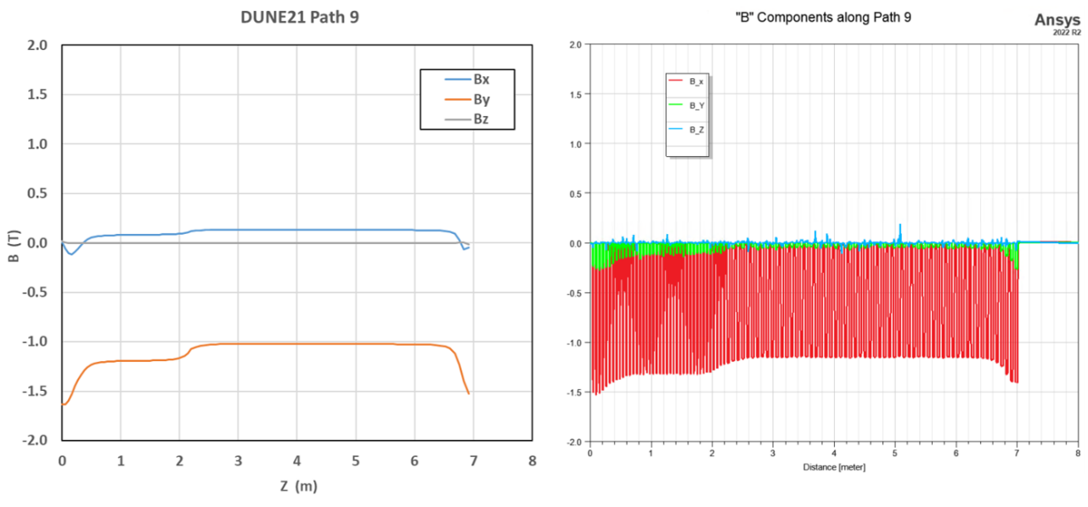
EMAG/APDL vs. Maxwell: Path 9
Line shape looks very similar, absolute value has a small shift

Slide 17
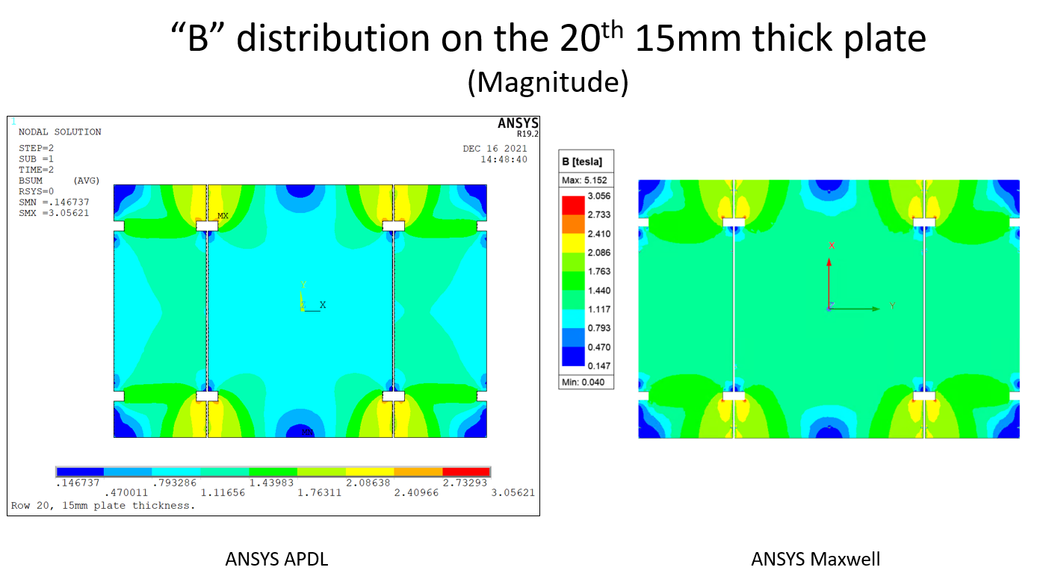
EMAG/APDL vs. Maxwell: Bsum, row 20

Slide 18
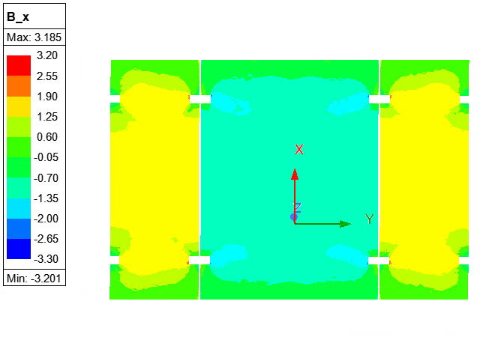
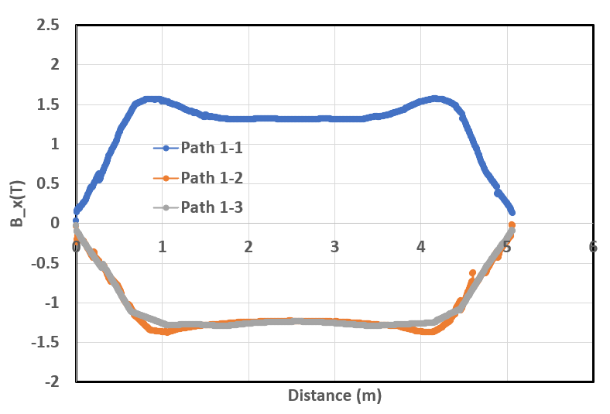
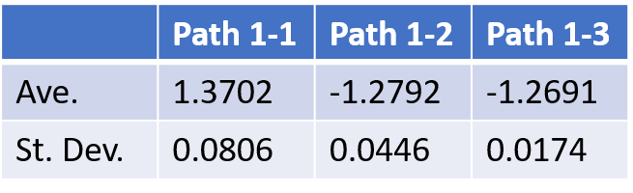
Recent Maxwell Analysis: Field Component By(y), Row 20
Path 1-1 Path 1-2 Path 1-3
x=0.911m x=4.135m
By(y)
By Row 20
By(Y) along path 1-1,2,3
Average and S.D. are calculated in the region between the coils

Slide 19
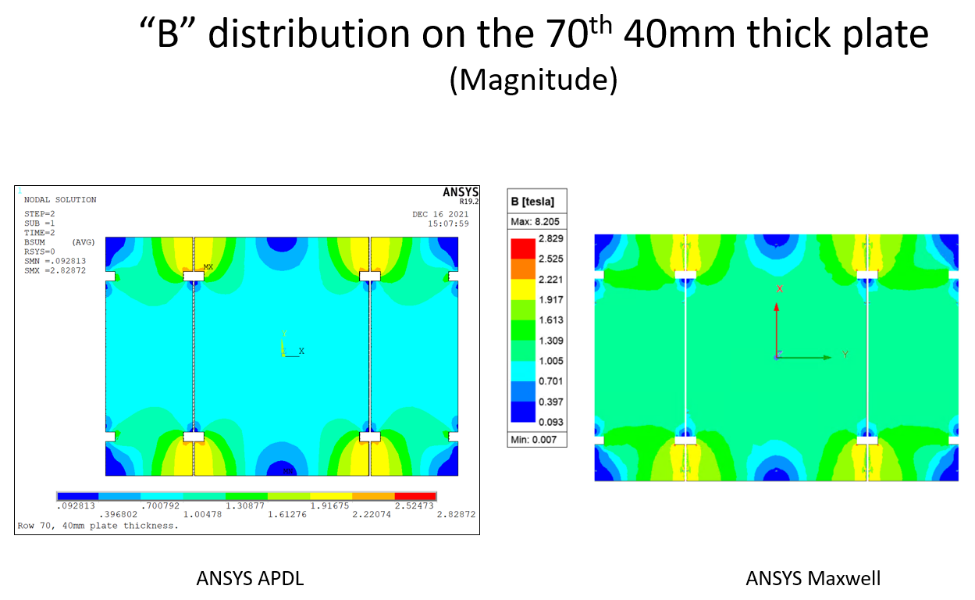
EMAG/APDL vs. Maxwell: Bsum, row 70

Slide 20
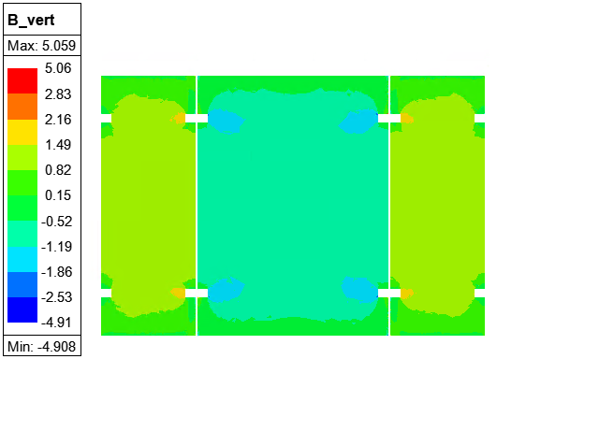
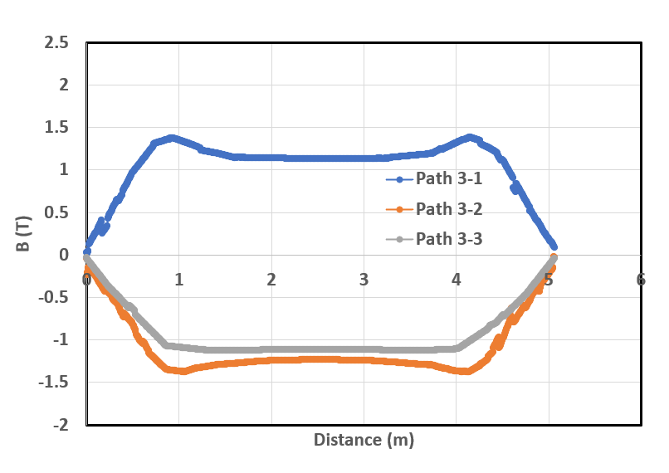
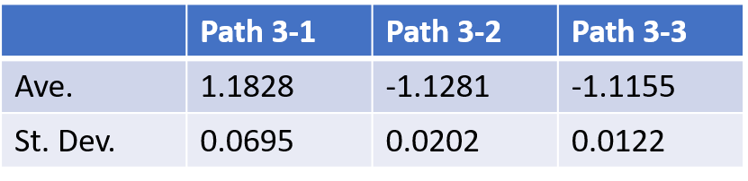
Recent Maxwell Analysis: Field Component By(y), Row 70
Path 3-1 Path 3-2 Path 3-3
x=0.911m x=4.135m
By(y)
By Row 70
By(Y) along path 3-1,2,3
Average and S.D. are calculated in the region between the coils

Slide 21
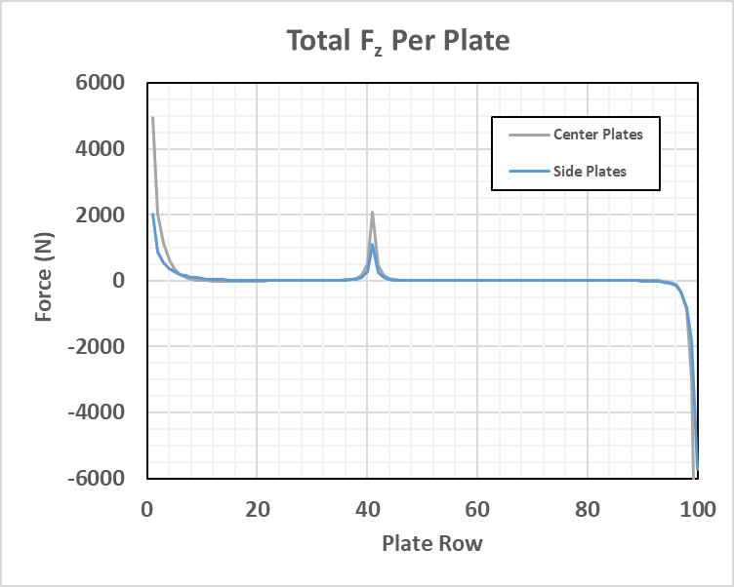
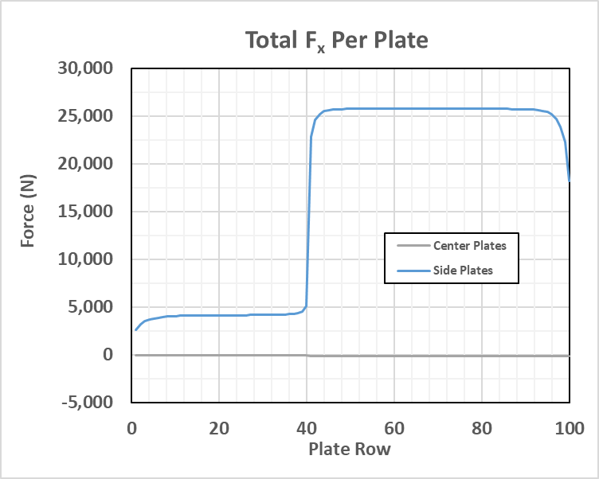
Structural Analysis: magnetic force on steel plates
Magnetic forces are summed on each of the steel plates

Slide 22
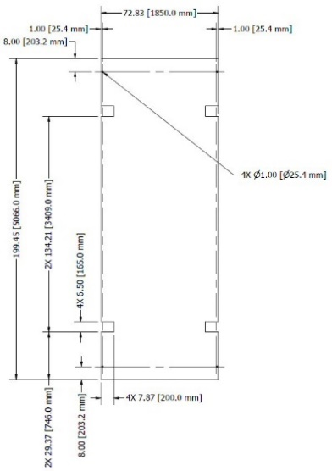
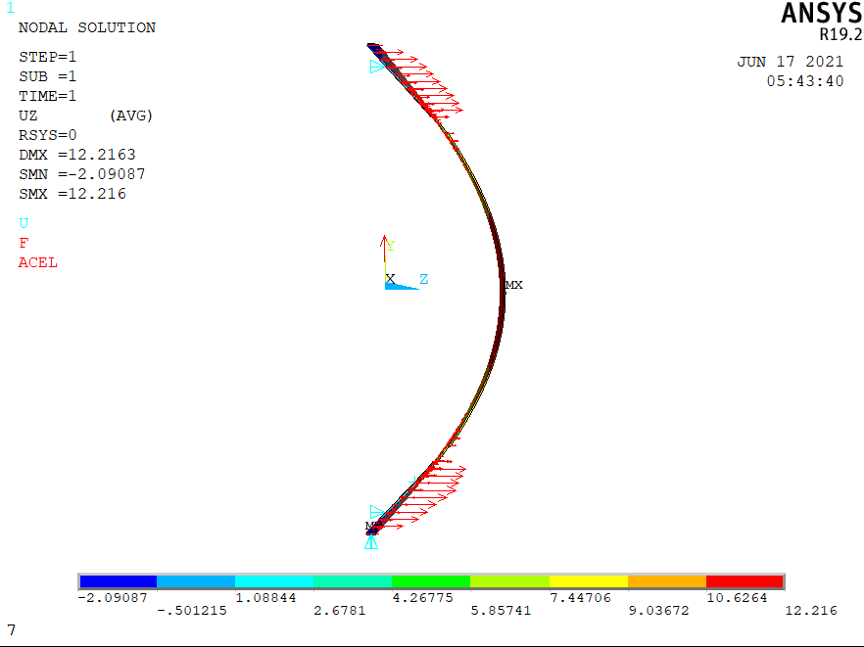
Structural Analysis: optimizing spacer bolt positions for side plates (I)
First look at plate deflection using a 25 plate model with spacer bolt on row 25 fixed in the Z direction
Deflection of ‘original design’ (spacer bolts at ~203mm from edge od coil notch)
  Largest deflection >= 12mm (way too much)

Slide 23
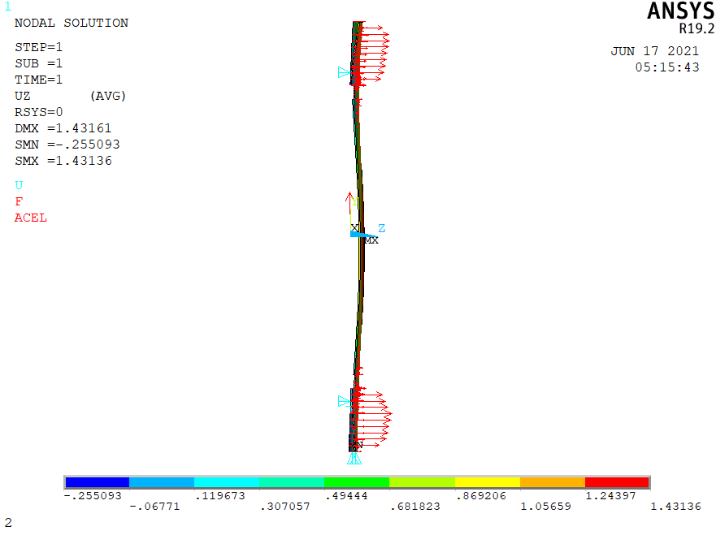
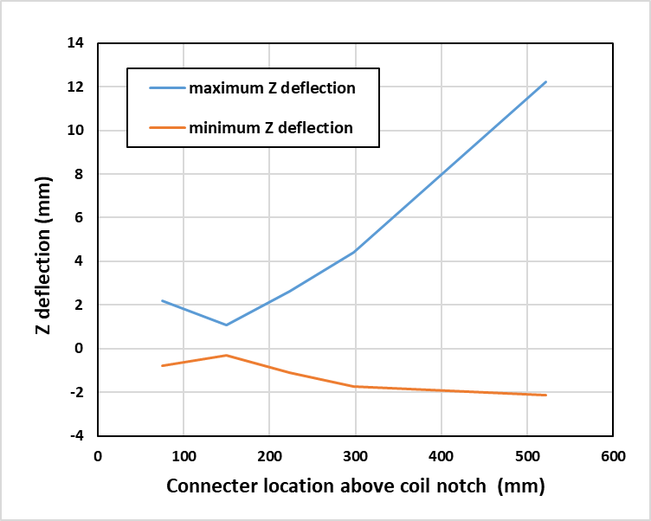
Structural Analysis: optimizing spacer bolt positions for side plates (II)
Optimization study on spacer bolt position performed
Spacer bolts were moved to 150mm from the coil notch edge: ~1mm deflection

Slide 24
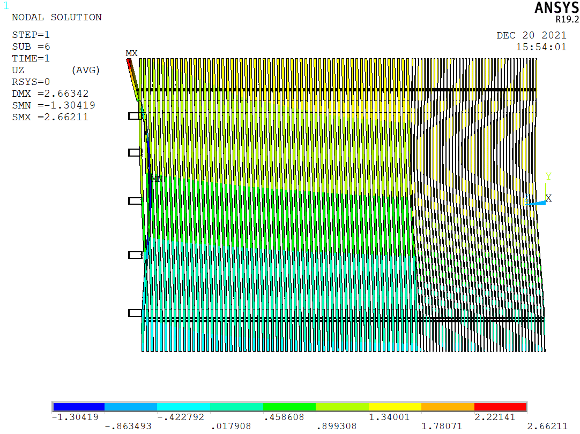
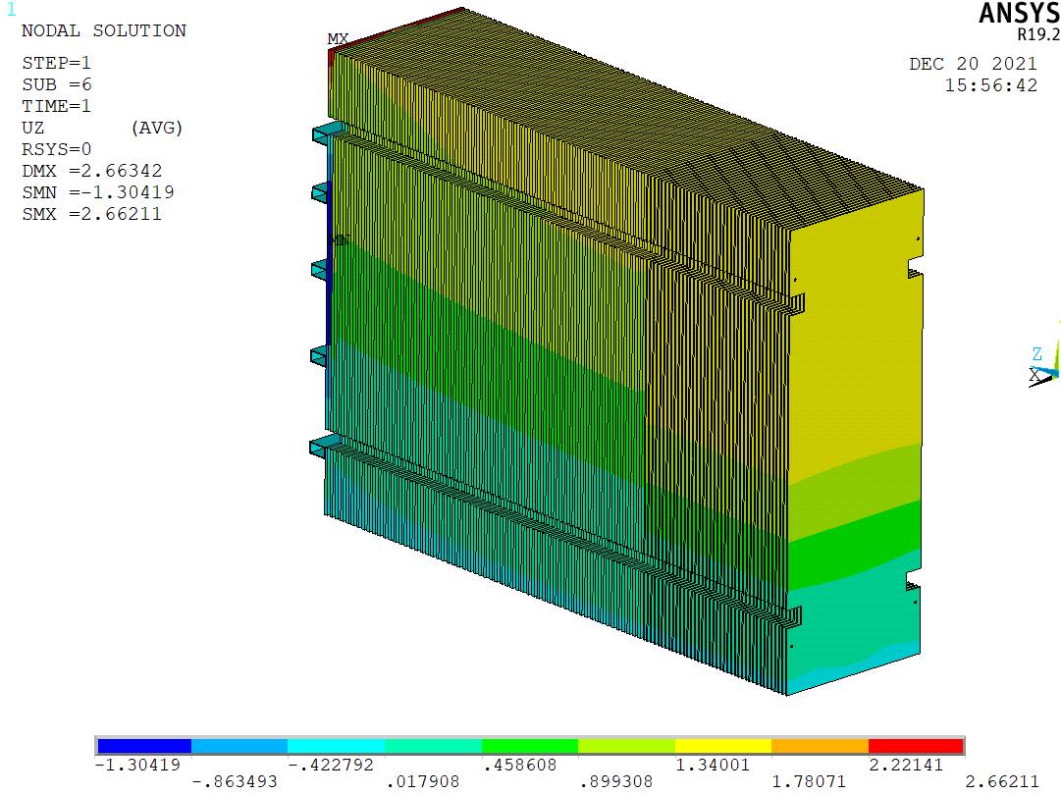
Structural Analysis: optimizing support tube positions for side plates (I)
Optimization study on support tube positions performed to minimize side plate deflection in the 100-layer stack
‘Original’ positions result in large deflection in the last plate: > 2mm

Slide 25
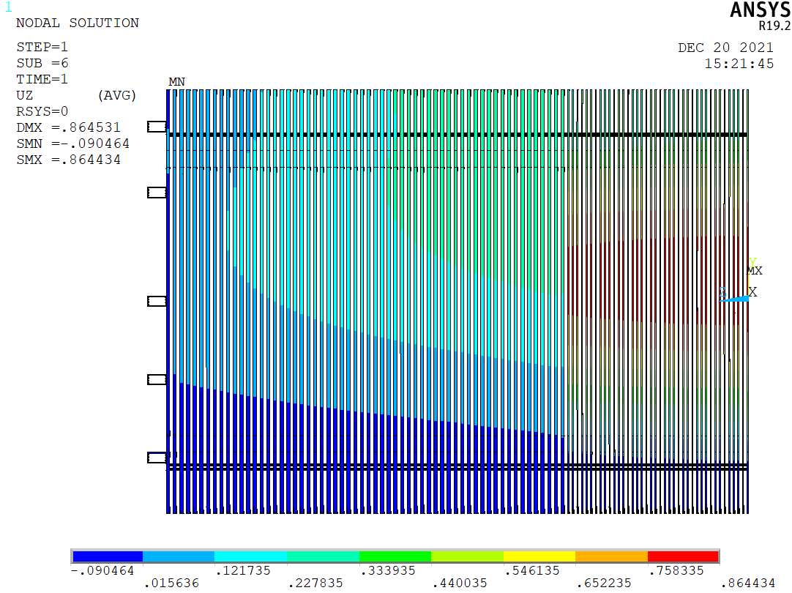
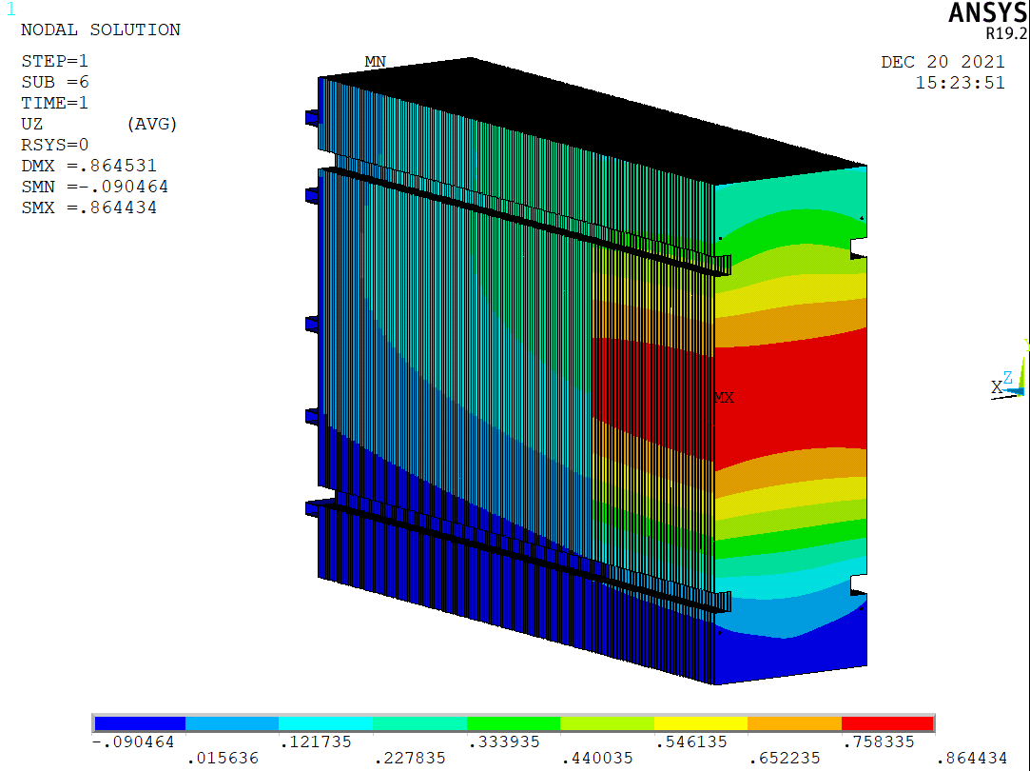
Structural Analysis: optimizing support tube positions for side plates (II)
‘New’ positions gives smaller deflection everywhere in the stack: < 1mm

Slide 26
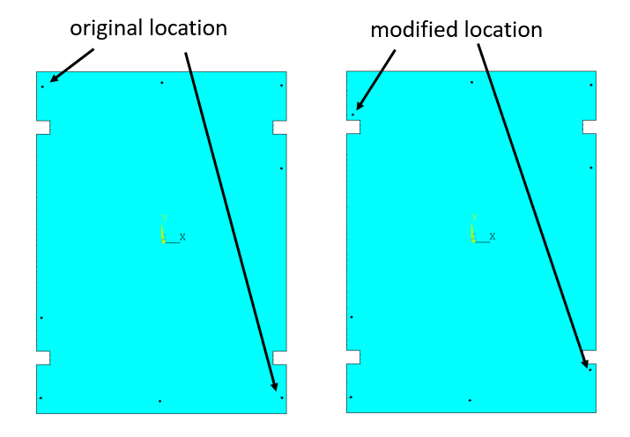
Structural Analysis: optimizing spacer bolt positions for middle plates (I)
Optimization study on spacer bolt positions for middle plates were performed too
Two spacer bolts were moved to reduce overall deflection in the 100-layer stack

Slide 27
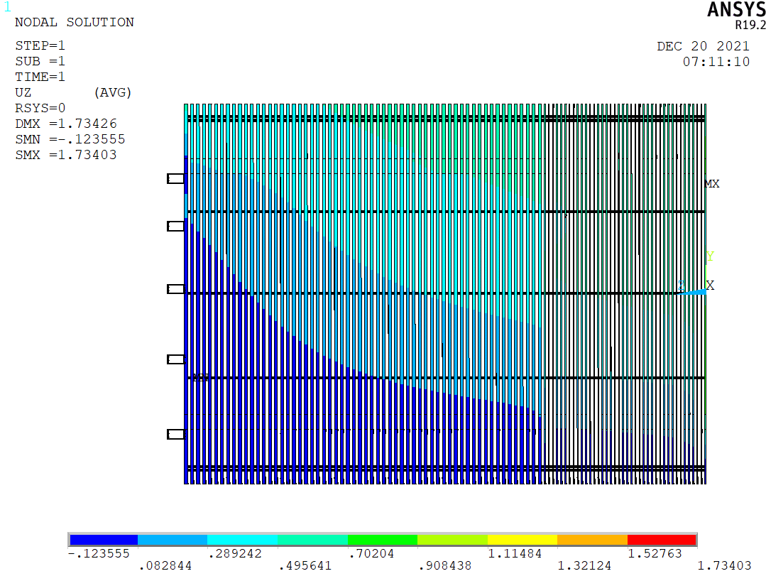
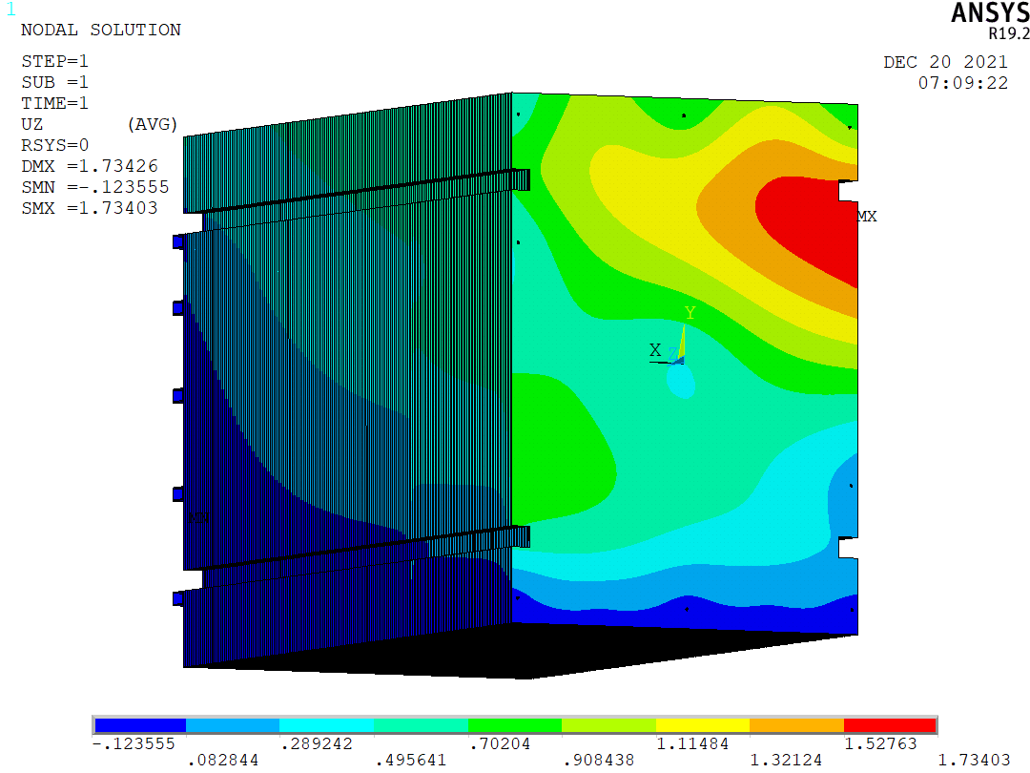
Structural Analysis: optimizing spacer bolt positions for middle plates (II)
Original locations: max deflection ~1.7mm

Slide 28


Structural Analysis: optimizing spacer bolt positions for middle plates (III)
Modified locations: max deflection ~0.6mm

Slide 29


Buckling Analysis: Side Plates (I)
The solutions from the magnetic analysis was used as a pre-stress for the bucking analysis for the side plates, which extracted the first 3 bucking loads
First buckling mode is shown here: load factor = 27.7

Slide 30


Buckling Analysis: Side Plates (II)
Second buckling mode is shown here: load factor = 30.1

Slide 31


Buckling Analysis: Side Plates (III)
Third buckling mode is shown here: load factor = 31.3

Slide 32


Buckling Analysis: Middle Plates (I)
Similar bucking analysis was performed for the middle plates
First buckling mode is shown here: load factor = 44.7

Slide 33


Buckling Analysis: Middle Plates (II)
Second buckling mode is shown here: load factor = 49.1

Slide 34


Buckling Analysis: Middle Plates (III)
Second buckling mode is shown here: load factor = 49.6

Slide 35
Conclusions
Magnetic analysis of the TMS coil/stack design is performed with ANSYS EMAG/APDL, verified with ANSYS Maxwell
The magnetic flux density magnitude at the center of the plates is at least ~0.9 Tesla in EMAG/APDL (~1.0 Tesla in Maxwell), uncertainty is at the level of 10%
The magnetic flux density in the area of the plates between the coils acts in a vertical direction
Out of plane plate deflections are sufficiently small so as not interfere with the fit or function of the scintillator modules
The range stack is structurally stable

