Slide 1
SBND Installation Status
Anne Schukraft
SBN Oversight Board Meeting
June 9, 2023

Slide 2
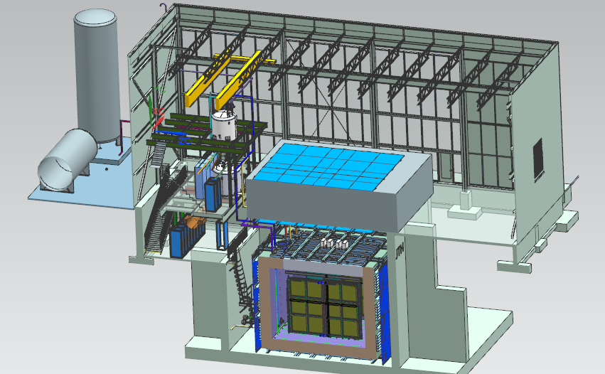
Near Detector - SBND
Top CRT
23 ton crane
Cryogenic Dewars
Proximity Cryogenics
Readout racks
Top CRT
TPC
Cryostat
Side CRT

Slide 3
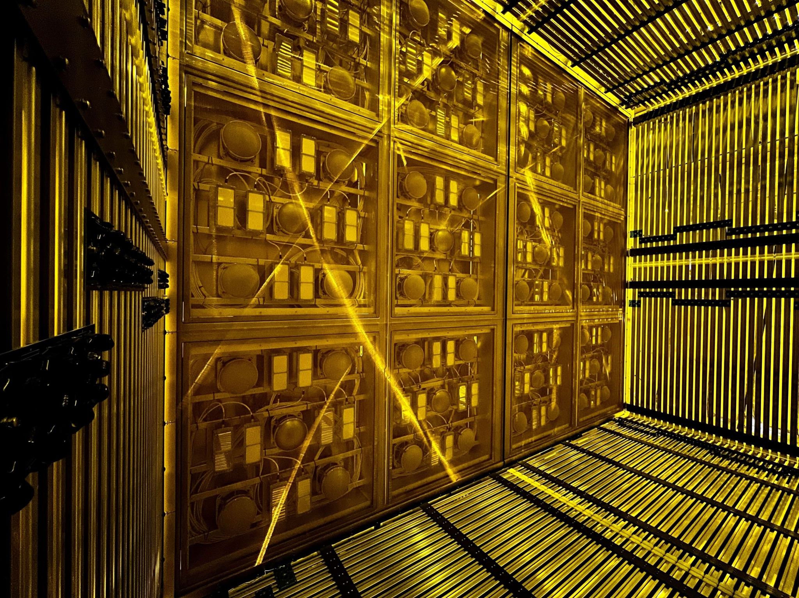
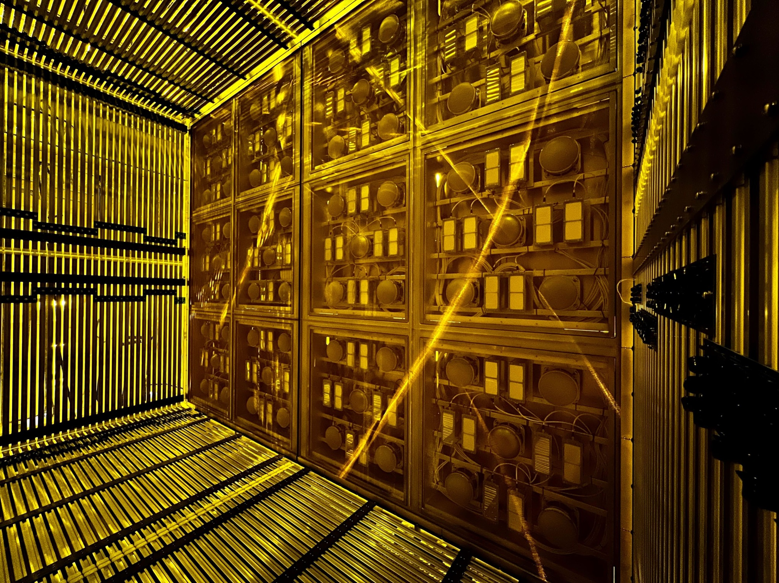
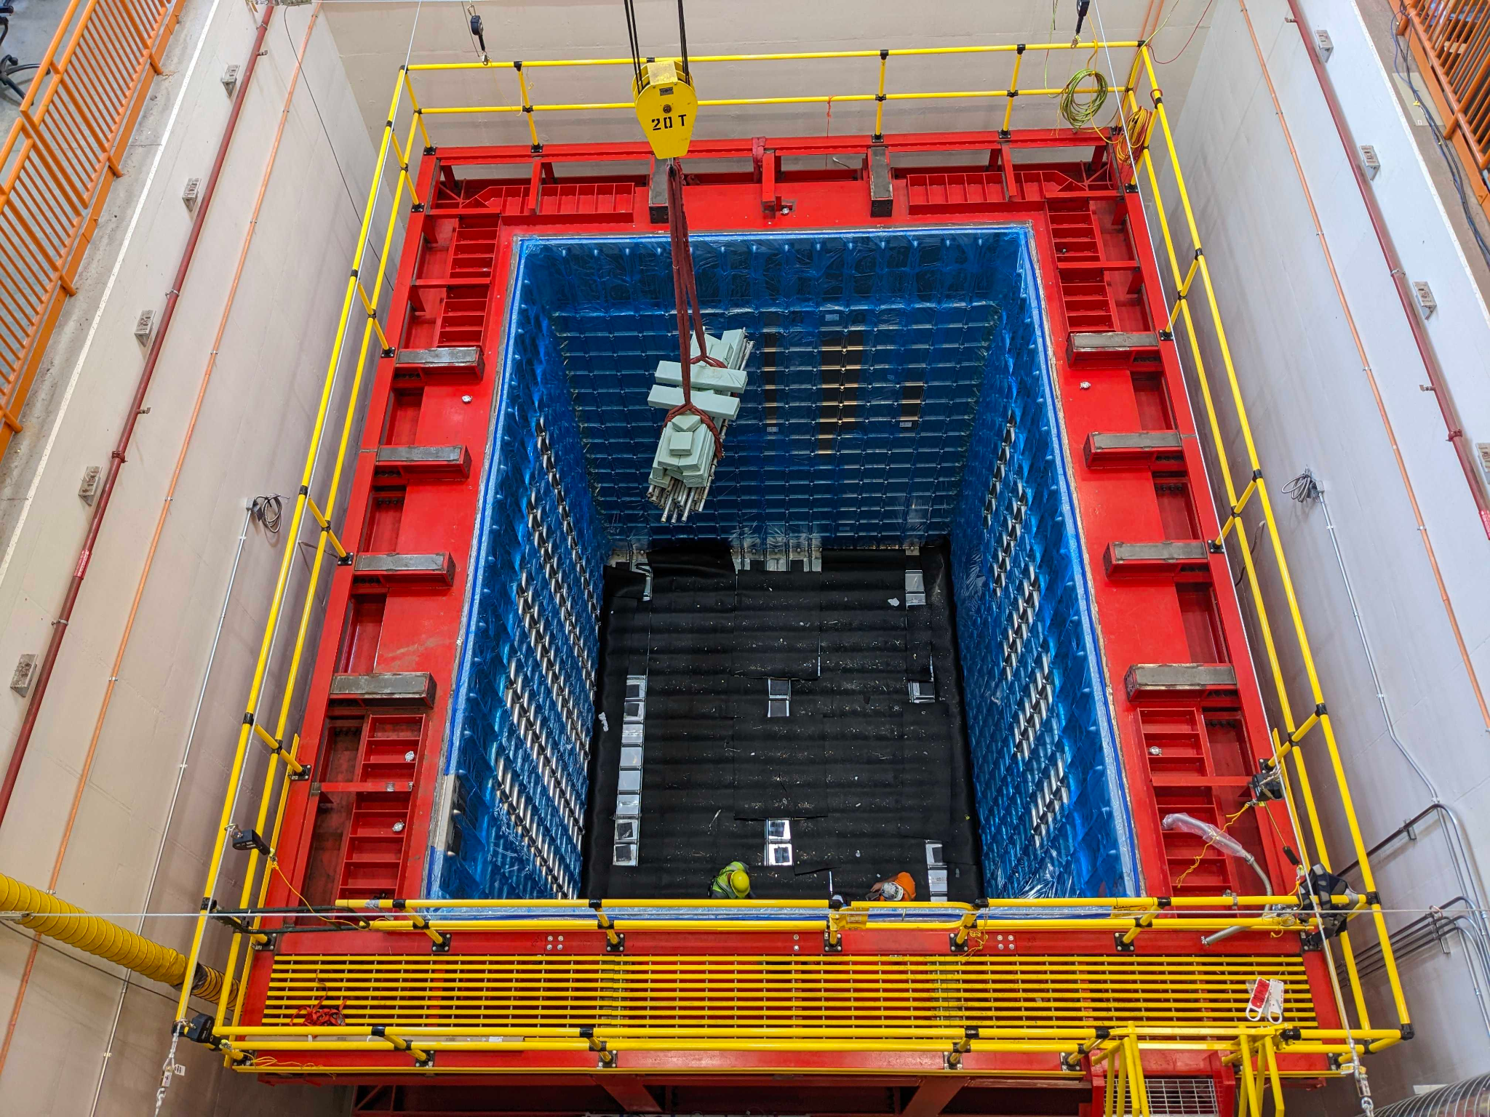
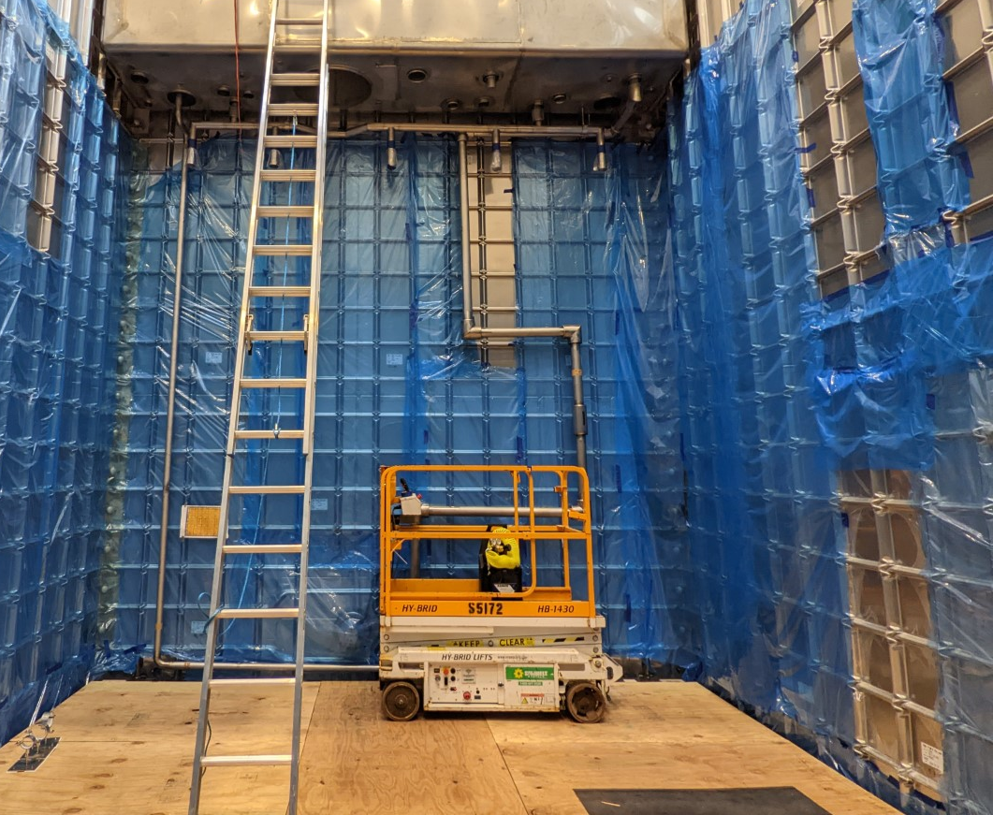
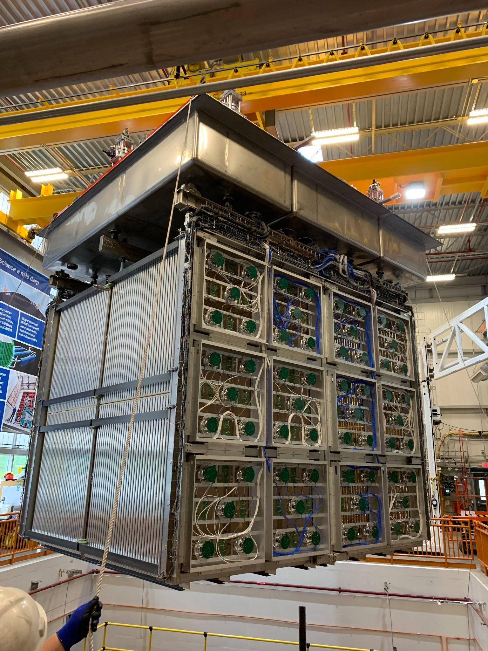
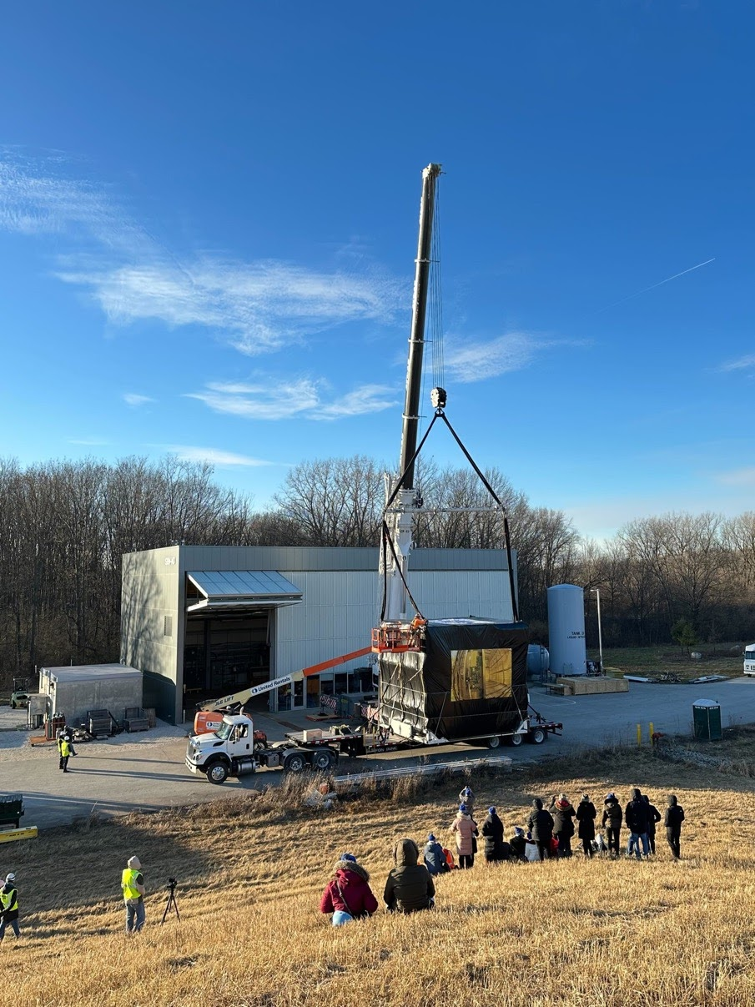
High-level Status
TPC Assembly Complete
PDS System Installation Complete
Cryostat installation Complete
Internal Cryogenics Installation Complete
Top Cap Assembly Complete
Detector Move Complete
Post-Move Detector QC Complete
Detector & Top Cap Coupling Complete
Detector insertion into Cryostat Complete
CRT North Wall Installation Complete

Slide 4
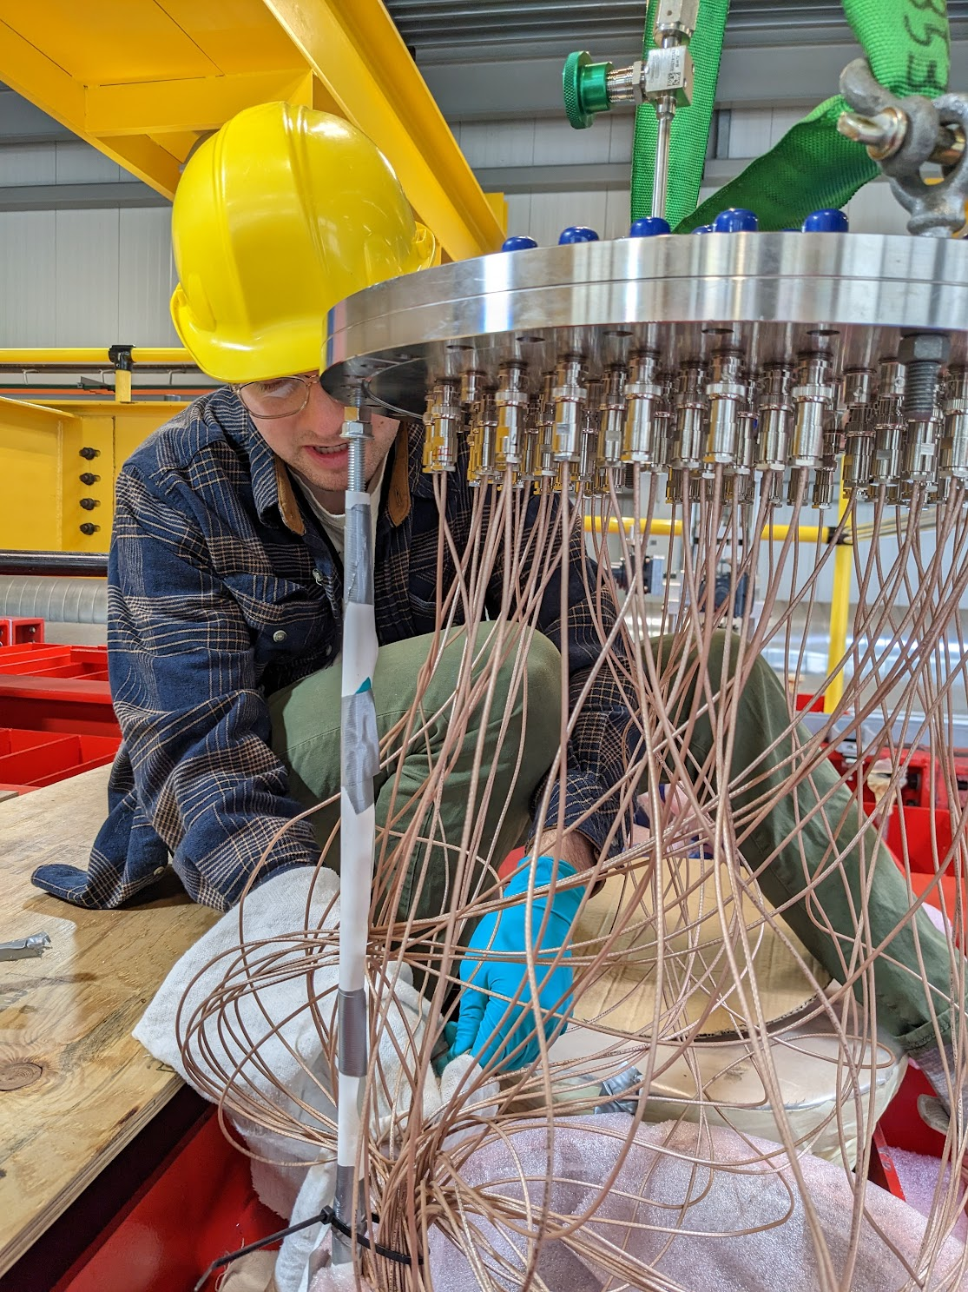
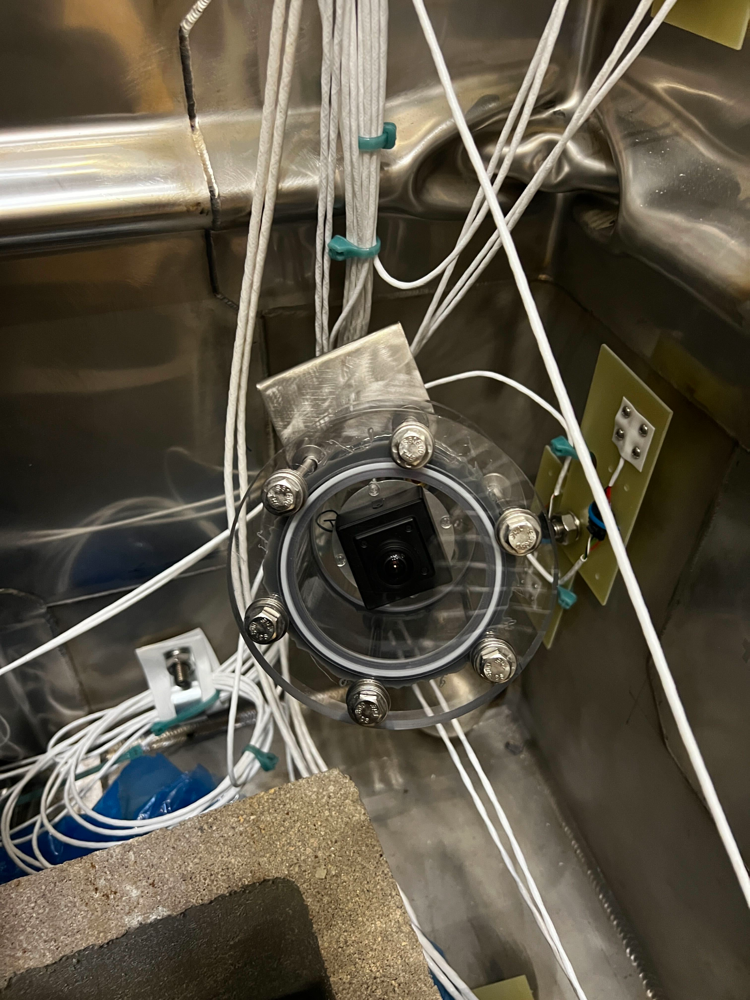
Detector Rigging Preparations
Prior to rigging the detector into the cryostat, all subsystems completed another QC check
Installed last part of optical fibers for the PDS calibration system
Installed PMT flanges & PMT repeated QC
X-ARAPUCA system pulled cables through the top cap and QC
All CE FEMBs were re-tested after pulling CE cables through the top cap
Wire bias system was checked out again, after solving problems with bad connectors between wire bias filter boards;
Installation of PMT feedthroughs
Camera and temperature probes inside the cryostat.
Performed another test fit of the HV donut & installation practice
Installation of Instrumentation
12 RTDs on the detector, 42 RTDs on the cryostat walls + underside of top caps
5 cameras (4 on the cryostat walls, 1 on the detector) & several LED strips for lighting
2 liquid level probes on the cryogenics top cap
CERN team installed strain gauges

Slide 5
Detector Rigging
The detector was successfully lowered into the cryostat on Tuesday, Apr 25
Thanks to planning by our Installation Coordinator Roberto Acciarri & Project Engineer Dave Pushka, the operation went very smoothly and completed within the morning
thanks to FNAL technicians John Najdzion & team, and Tom Wicks & team
thanks to our DSO, as well as fire department, & ISD for providing an emergency generator for the crane
Very useful in the preparation process was an internally organized technical review, which was held March 15th

Slide 6
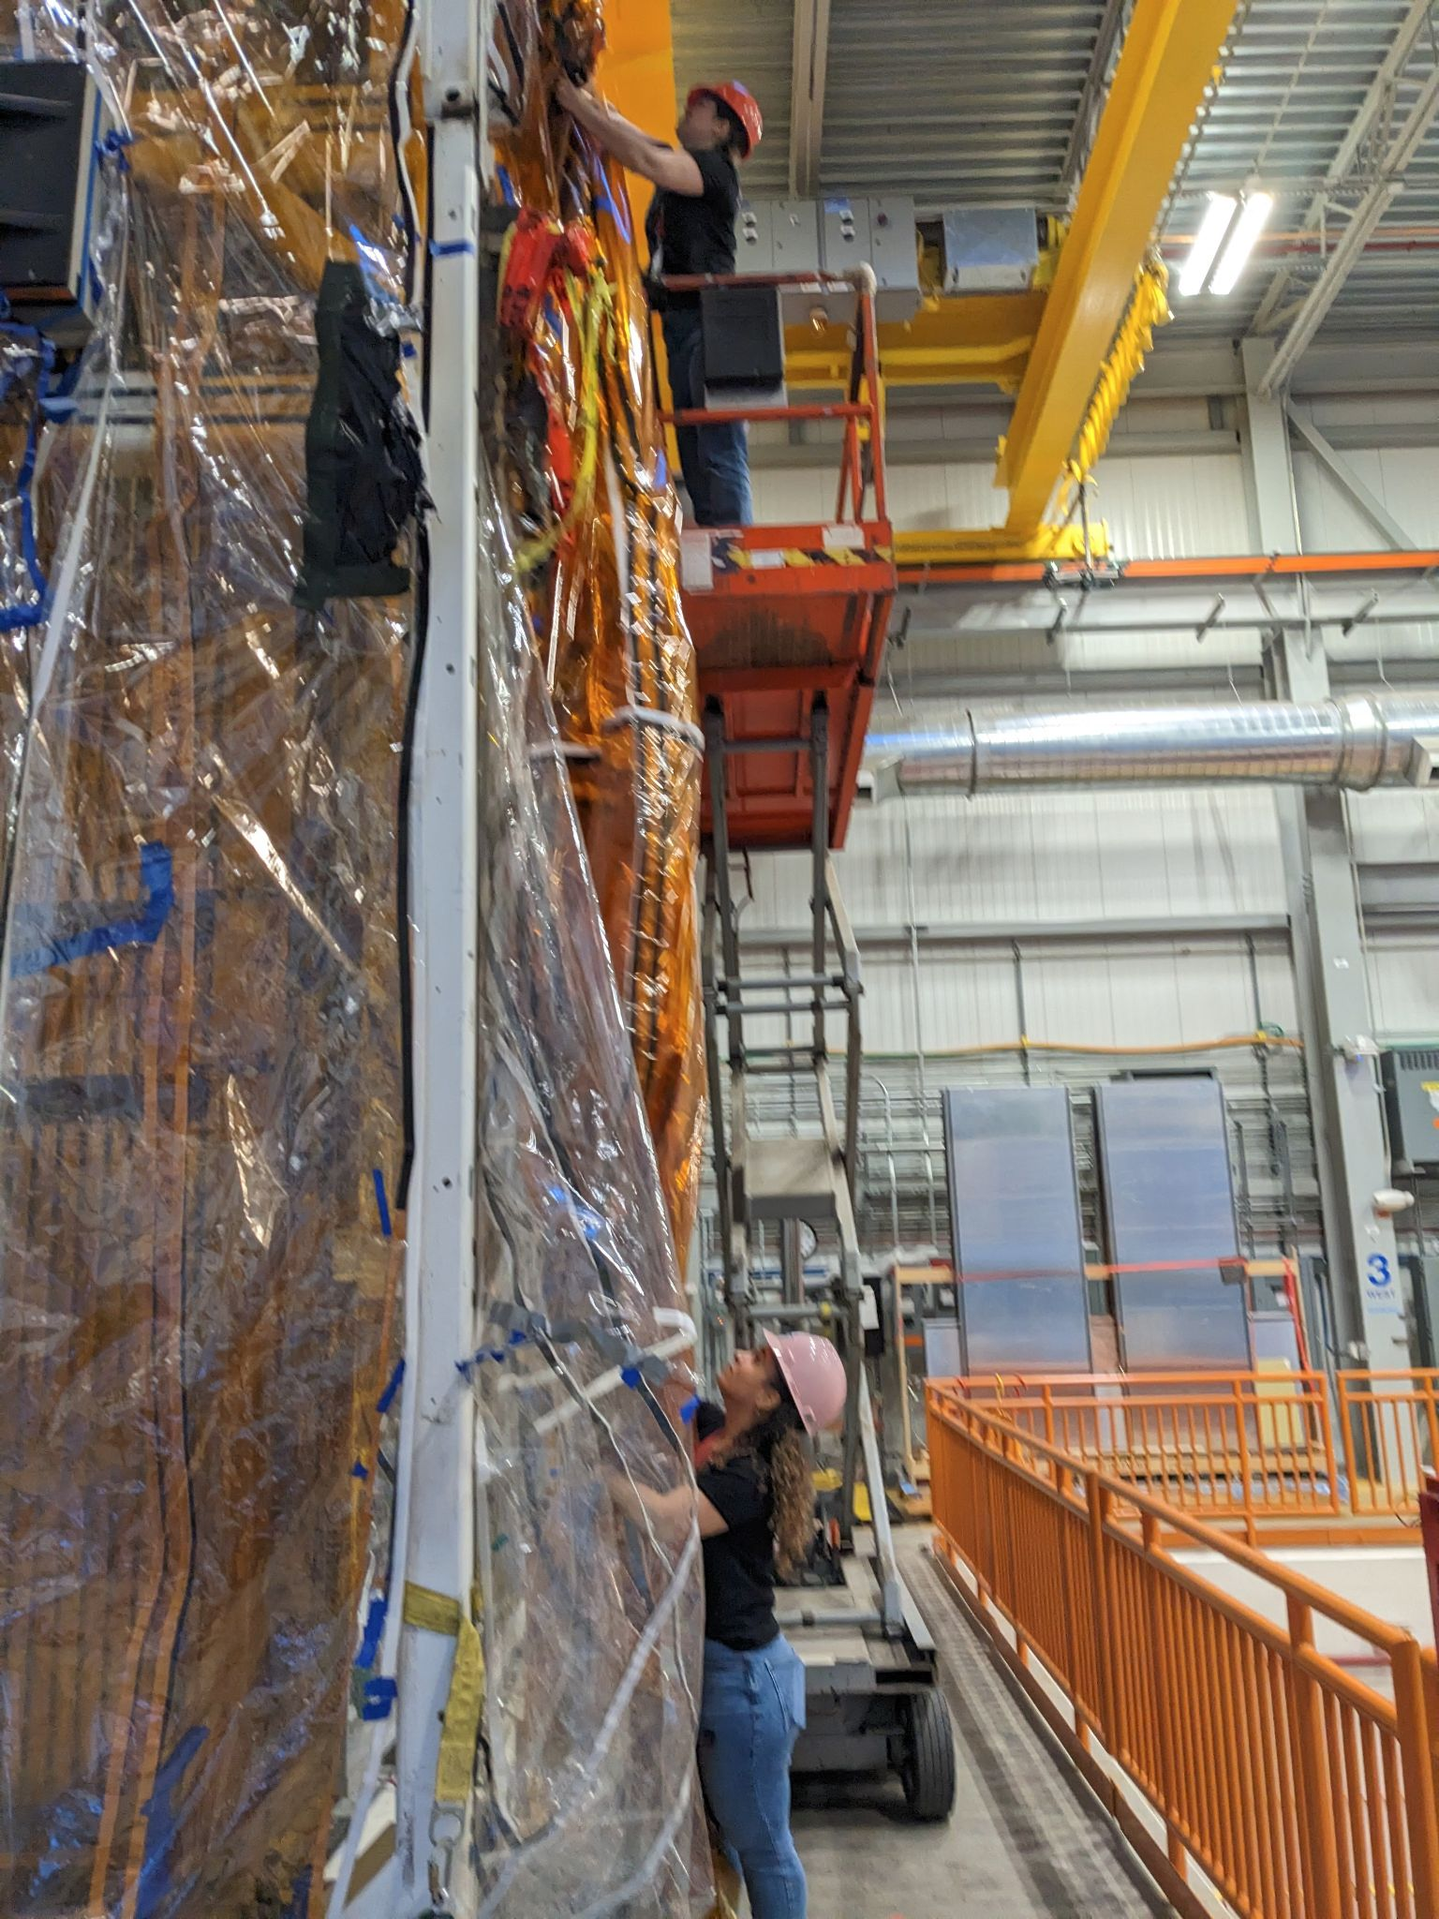
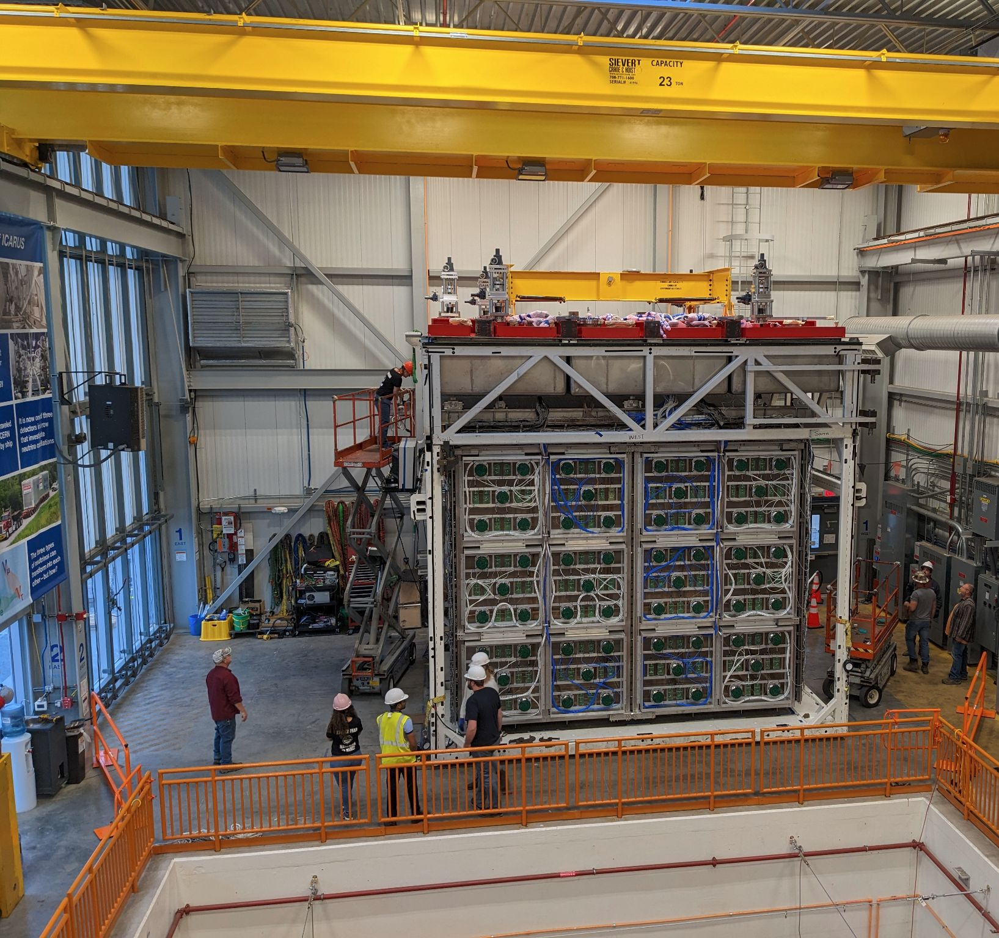
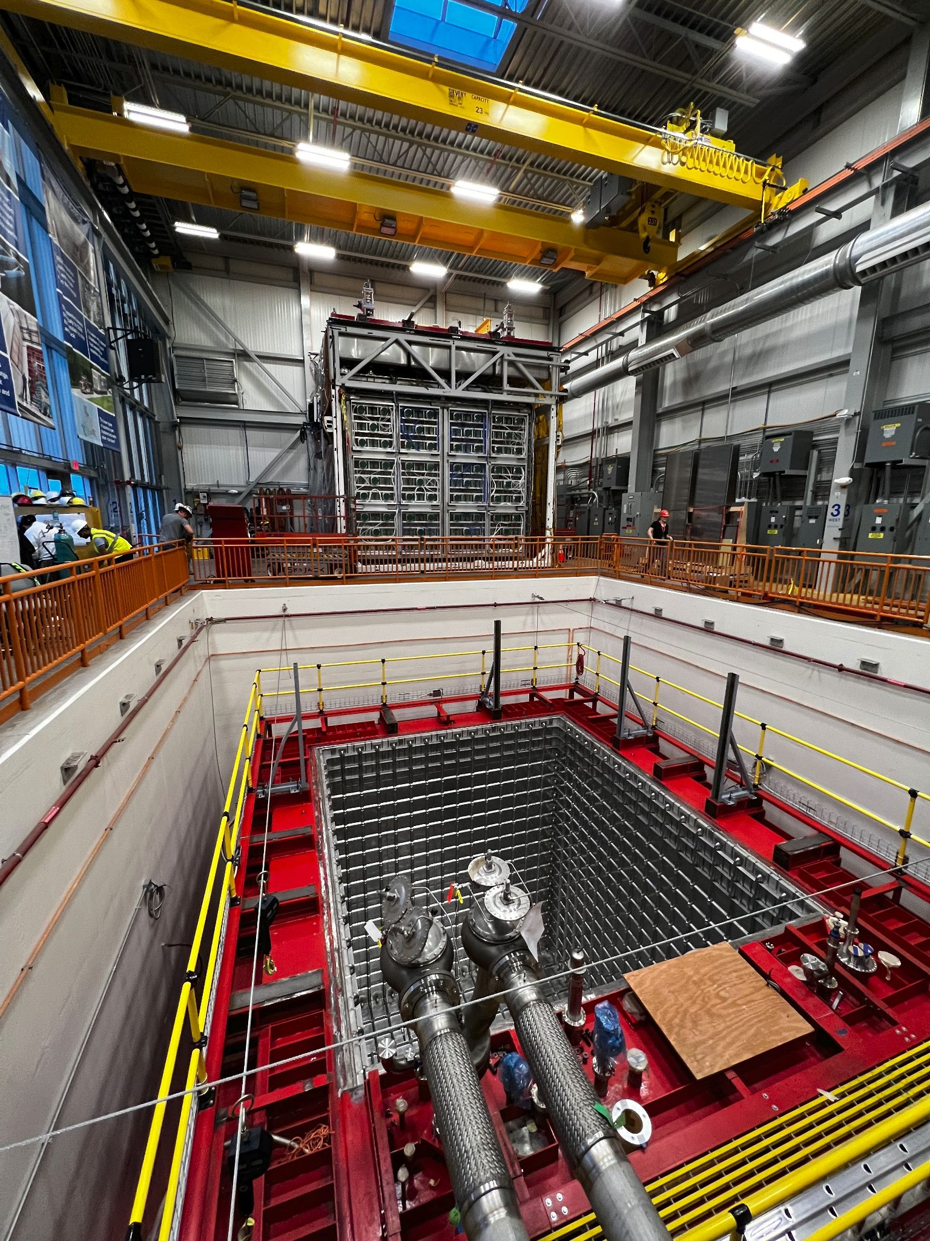
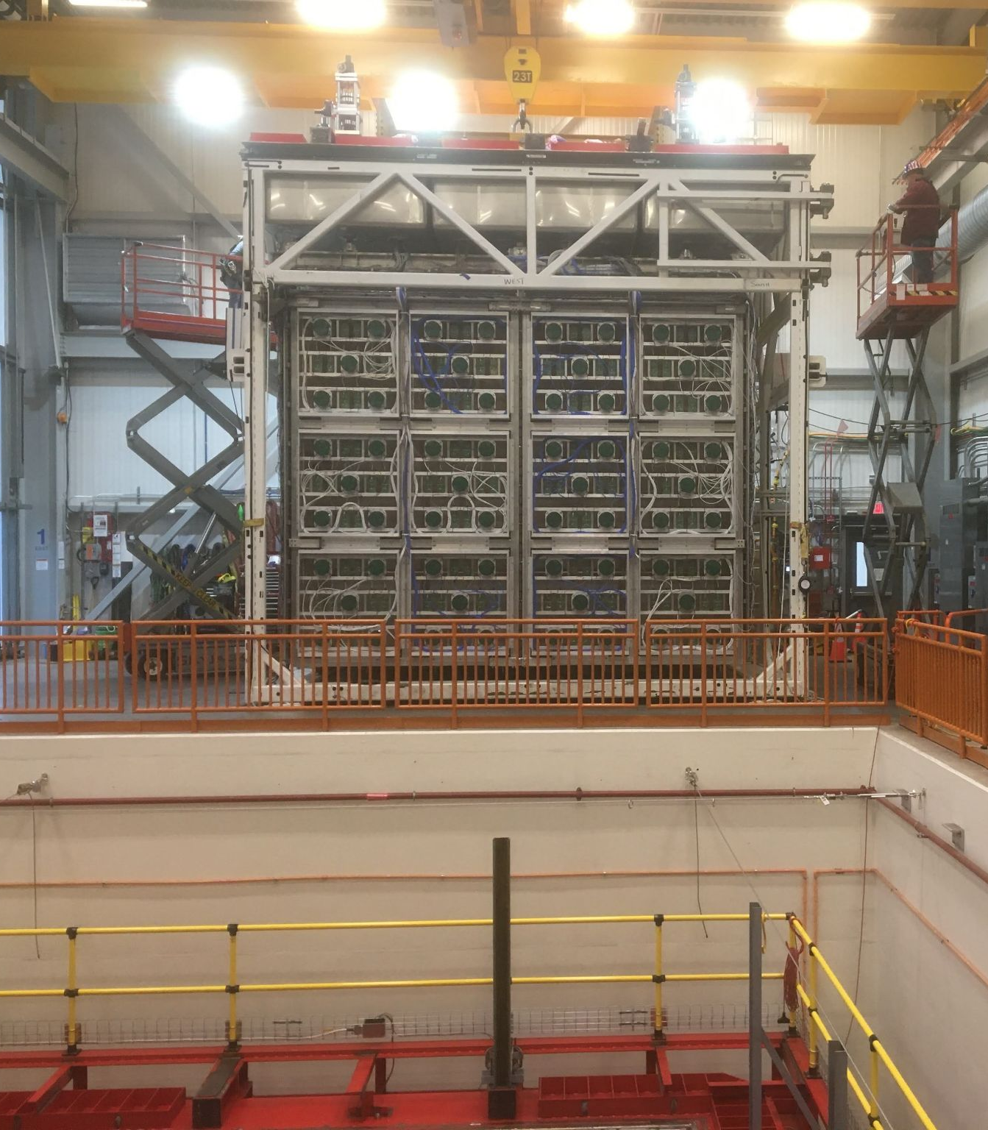
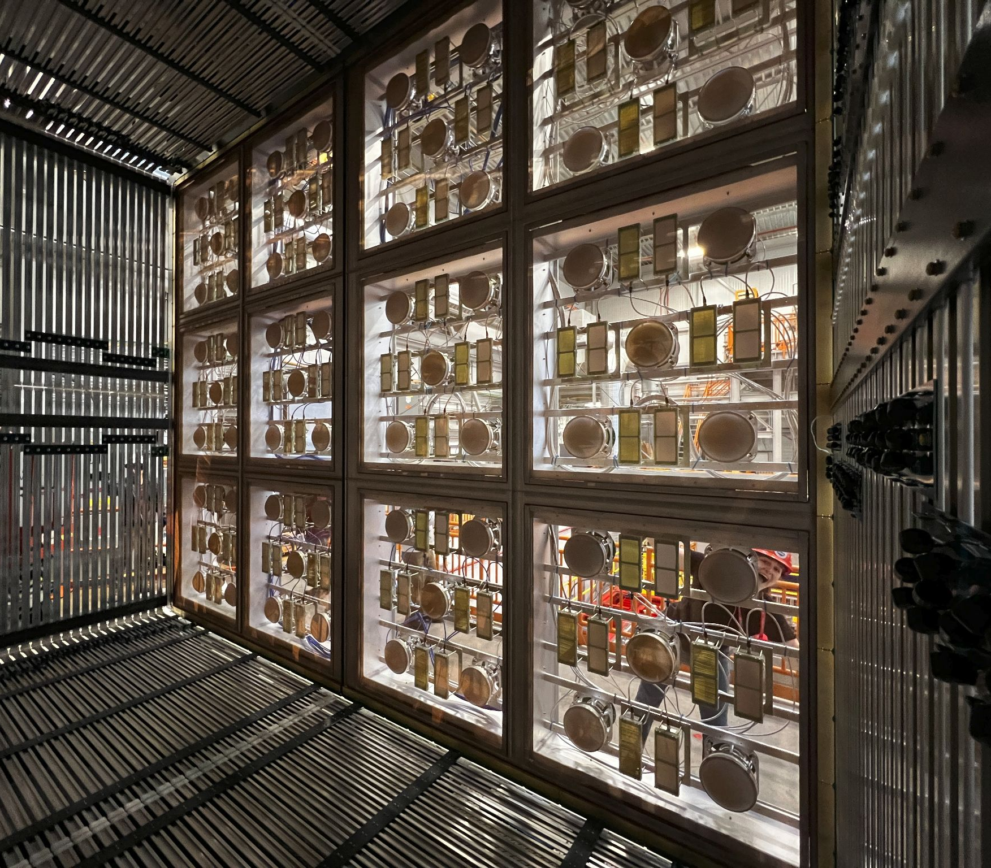
Detector Rigging
This goes here… will it fit?
~6:20 am - Unwrapping
6:45 am - Removing last ground connections
~7:30 am - Crane connected, removing shims between Top Cap and ATF
Last peek inside
photo series courtesy of Roberto Acciarri

Slide 7
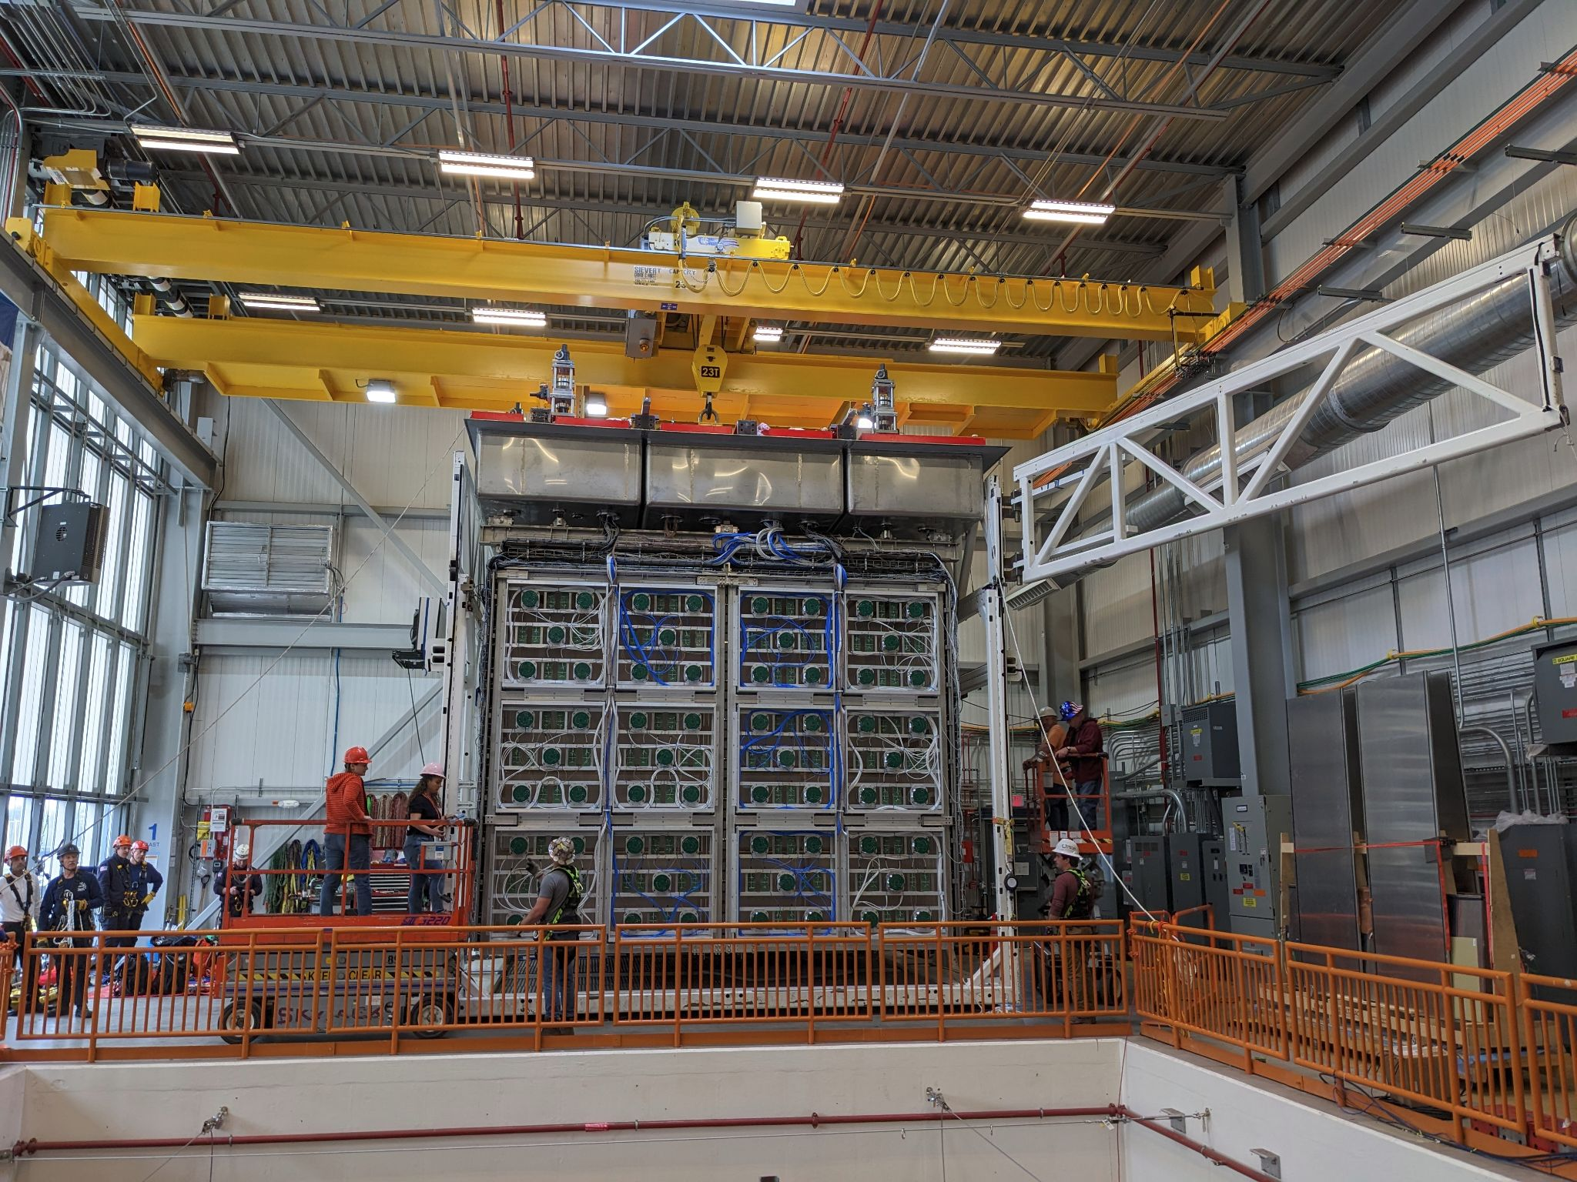
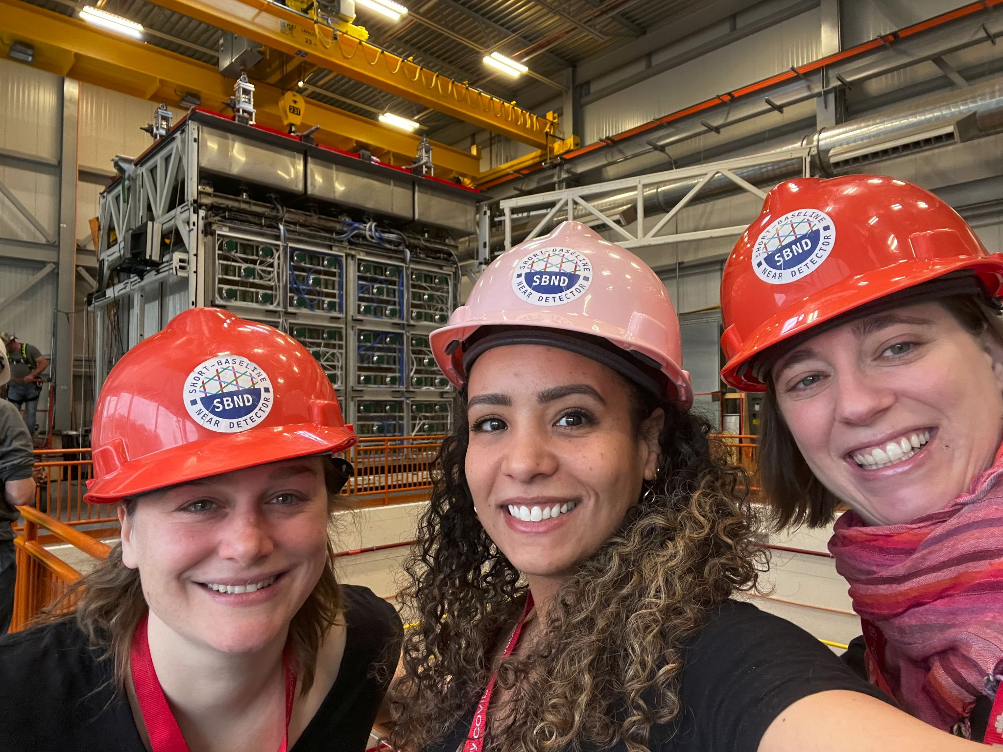
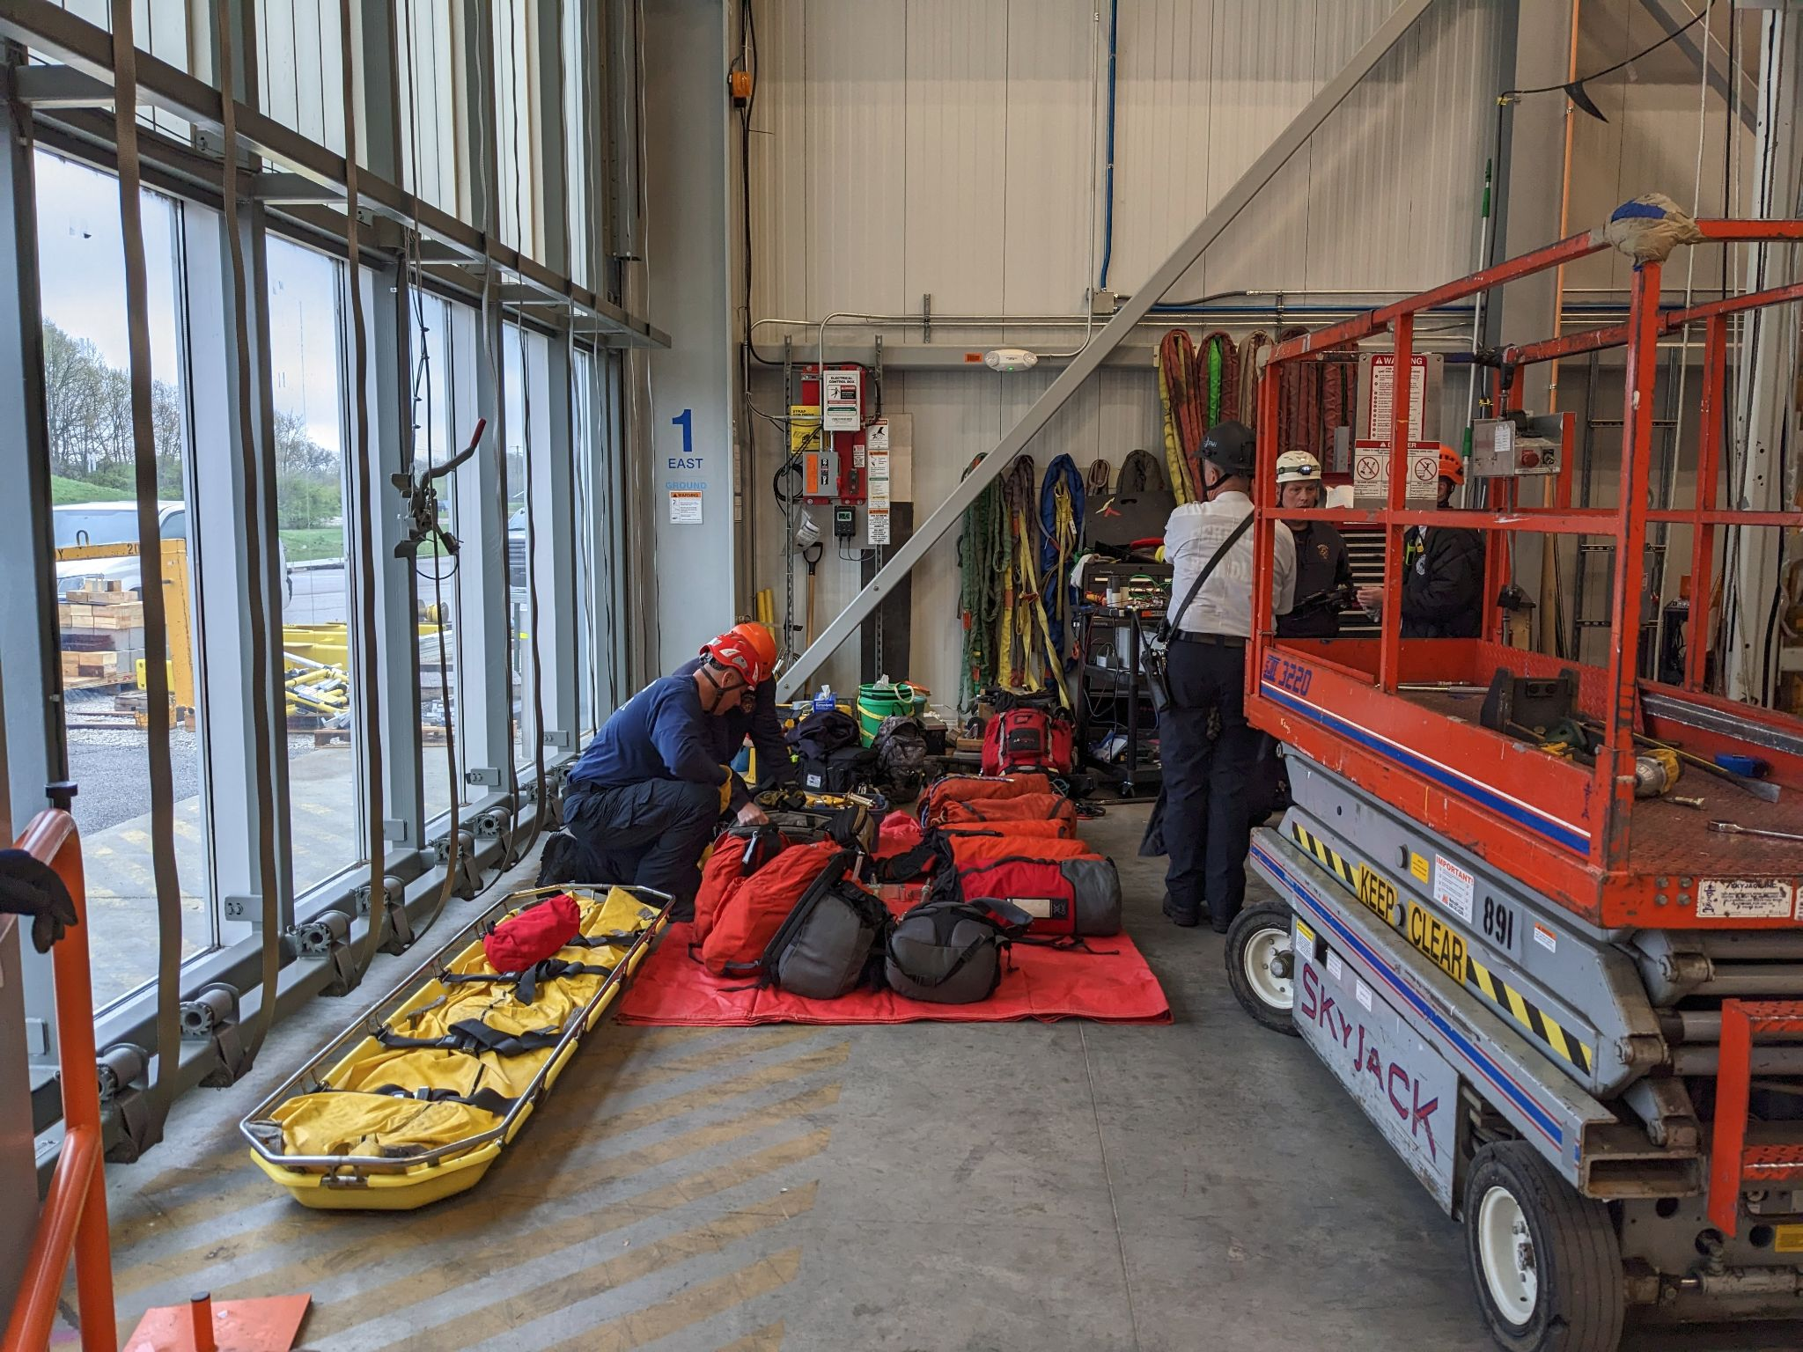
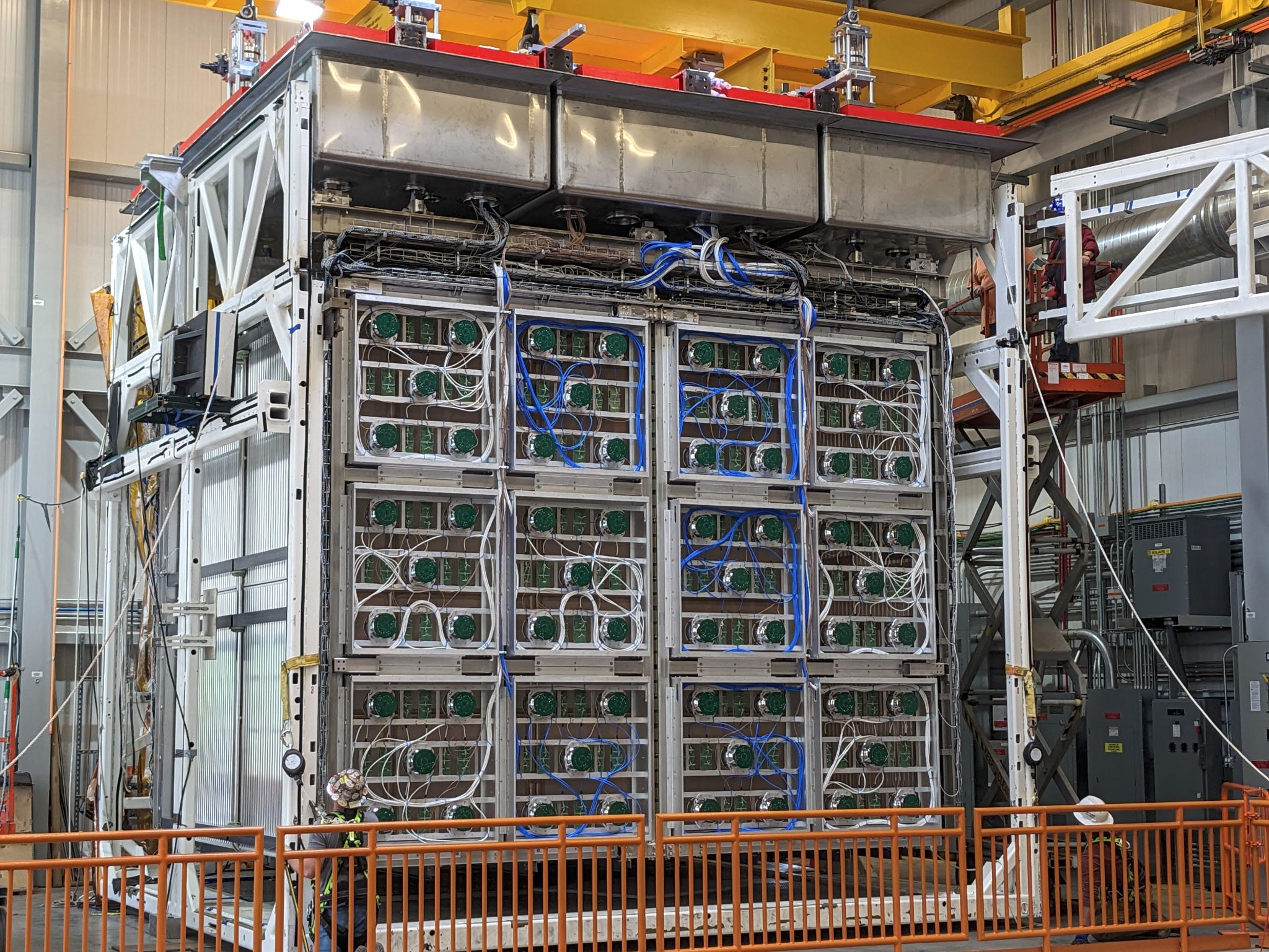
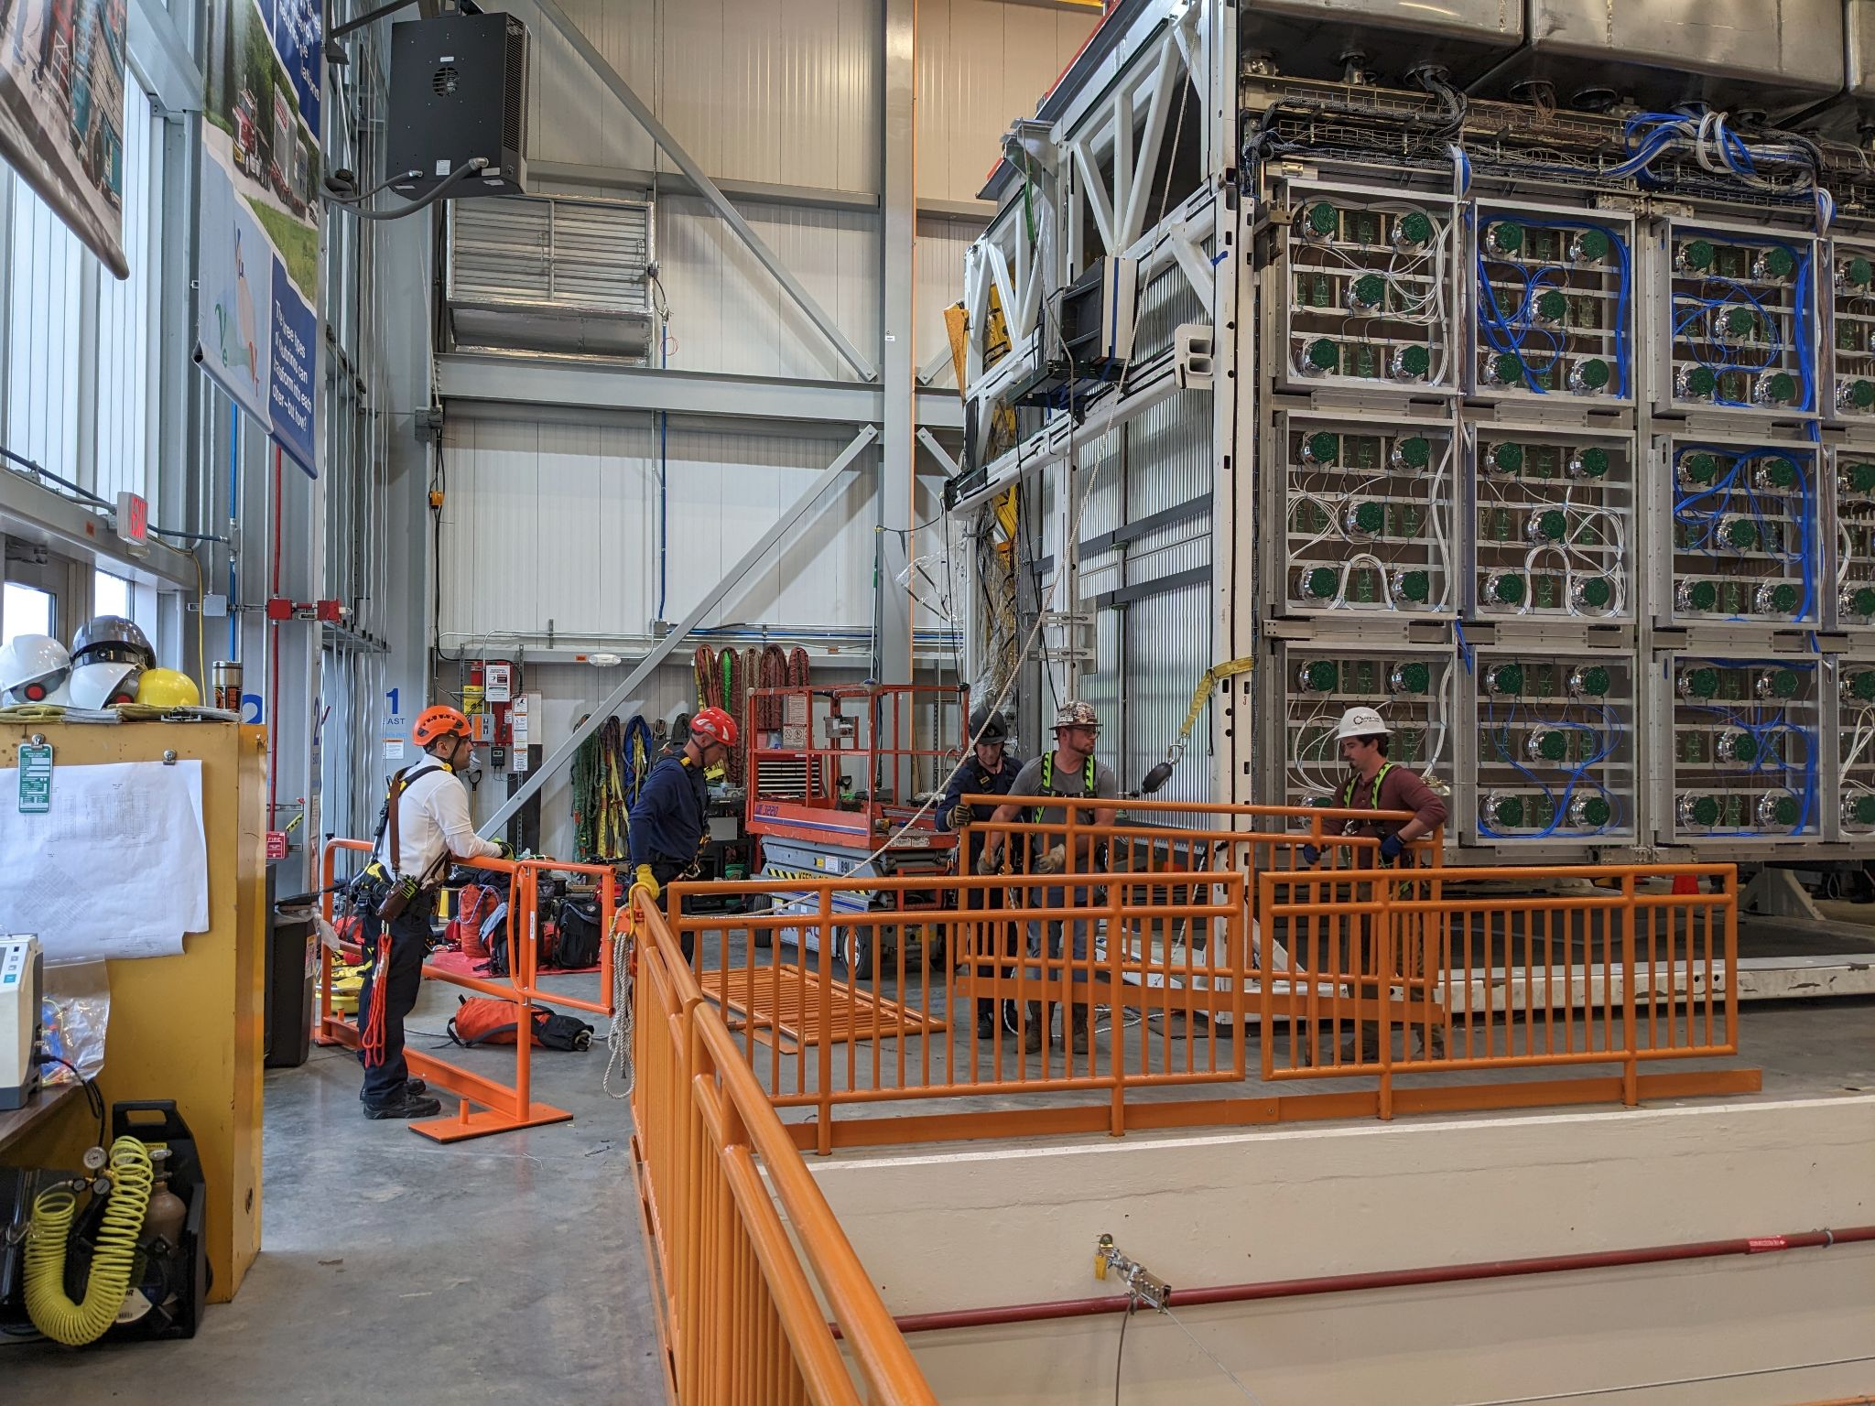
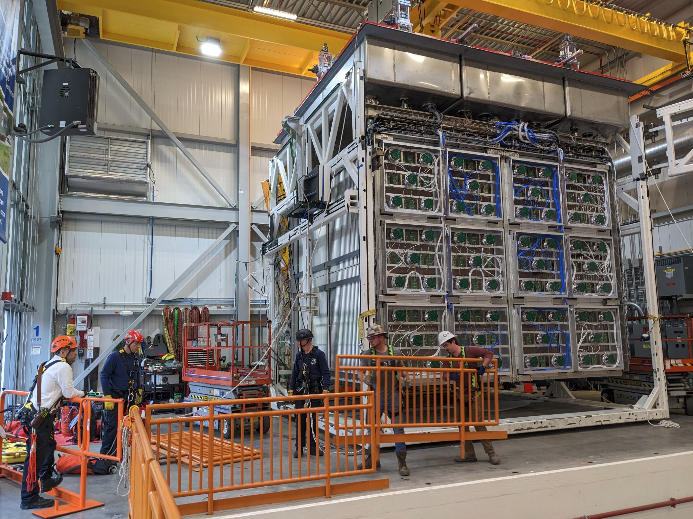
Detector Rigging
~ 8:04 am - Door open. Time for a break!
Dream Team Selfie Time
Meanwhile, Fire Department gets ready for anything may happen…
Last guardrail coming out
~ 8:30 am - Adjusting TPC for extraction
~ 9:00 am - Removing guardrails

Slide 8
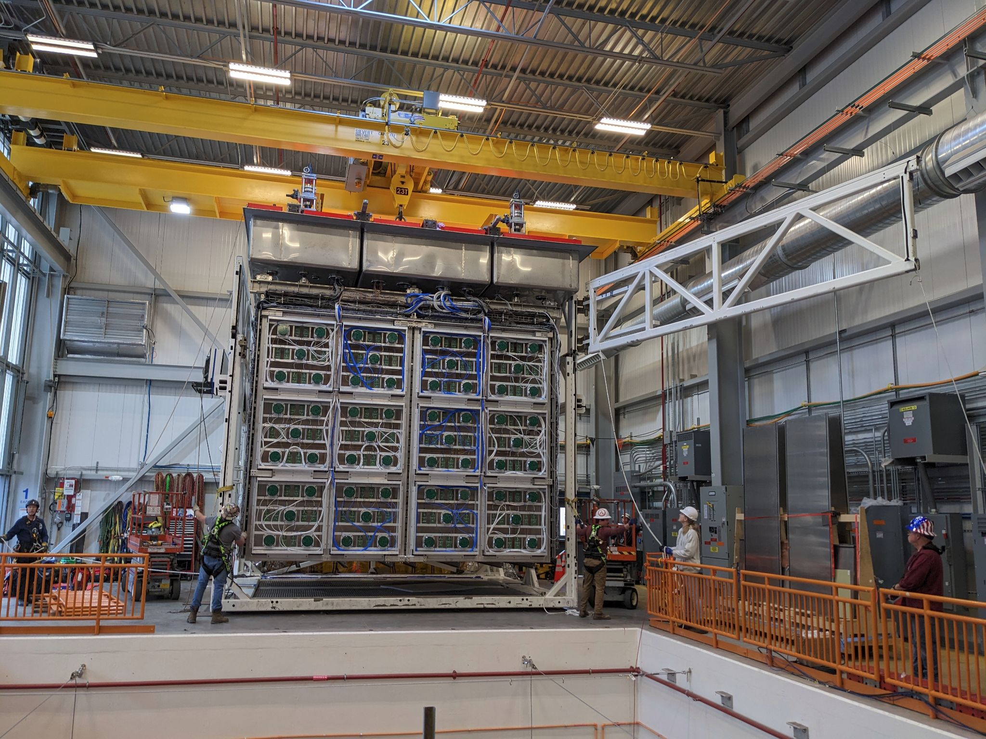
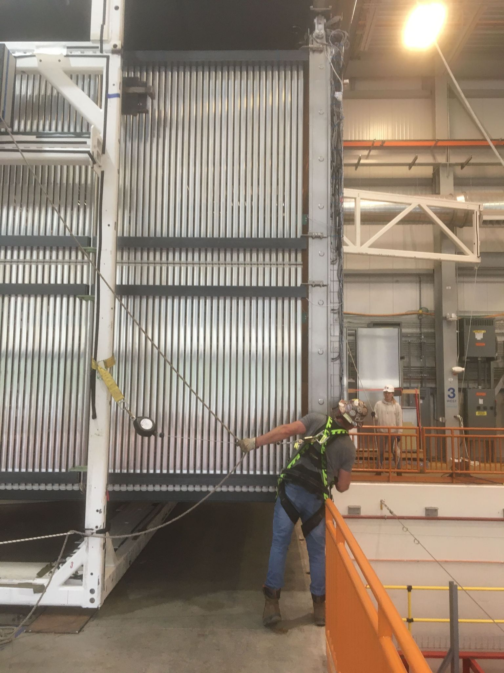
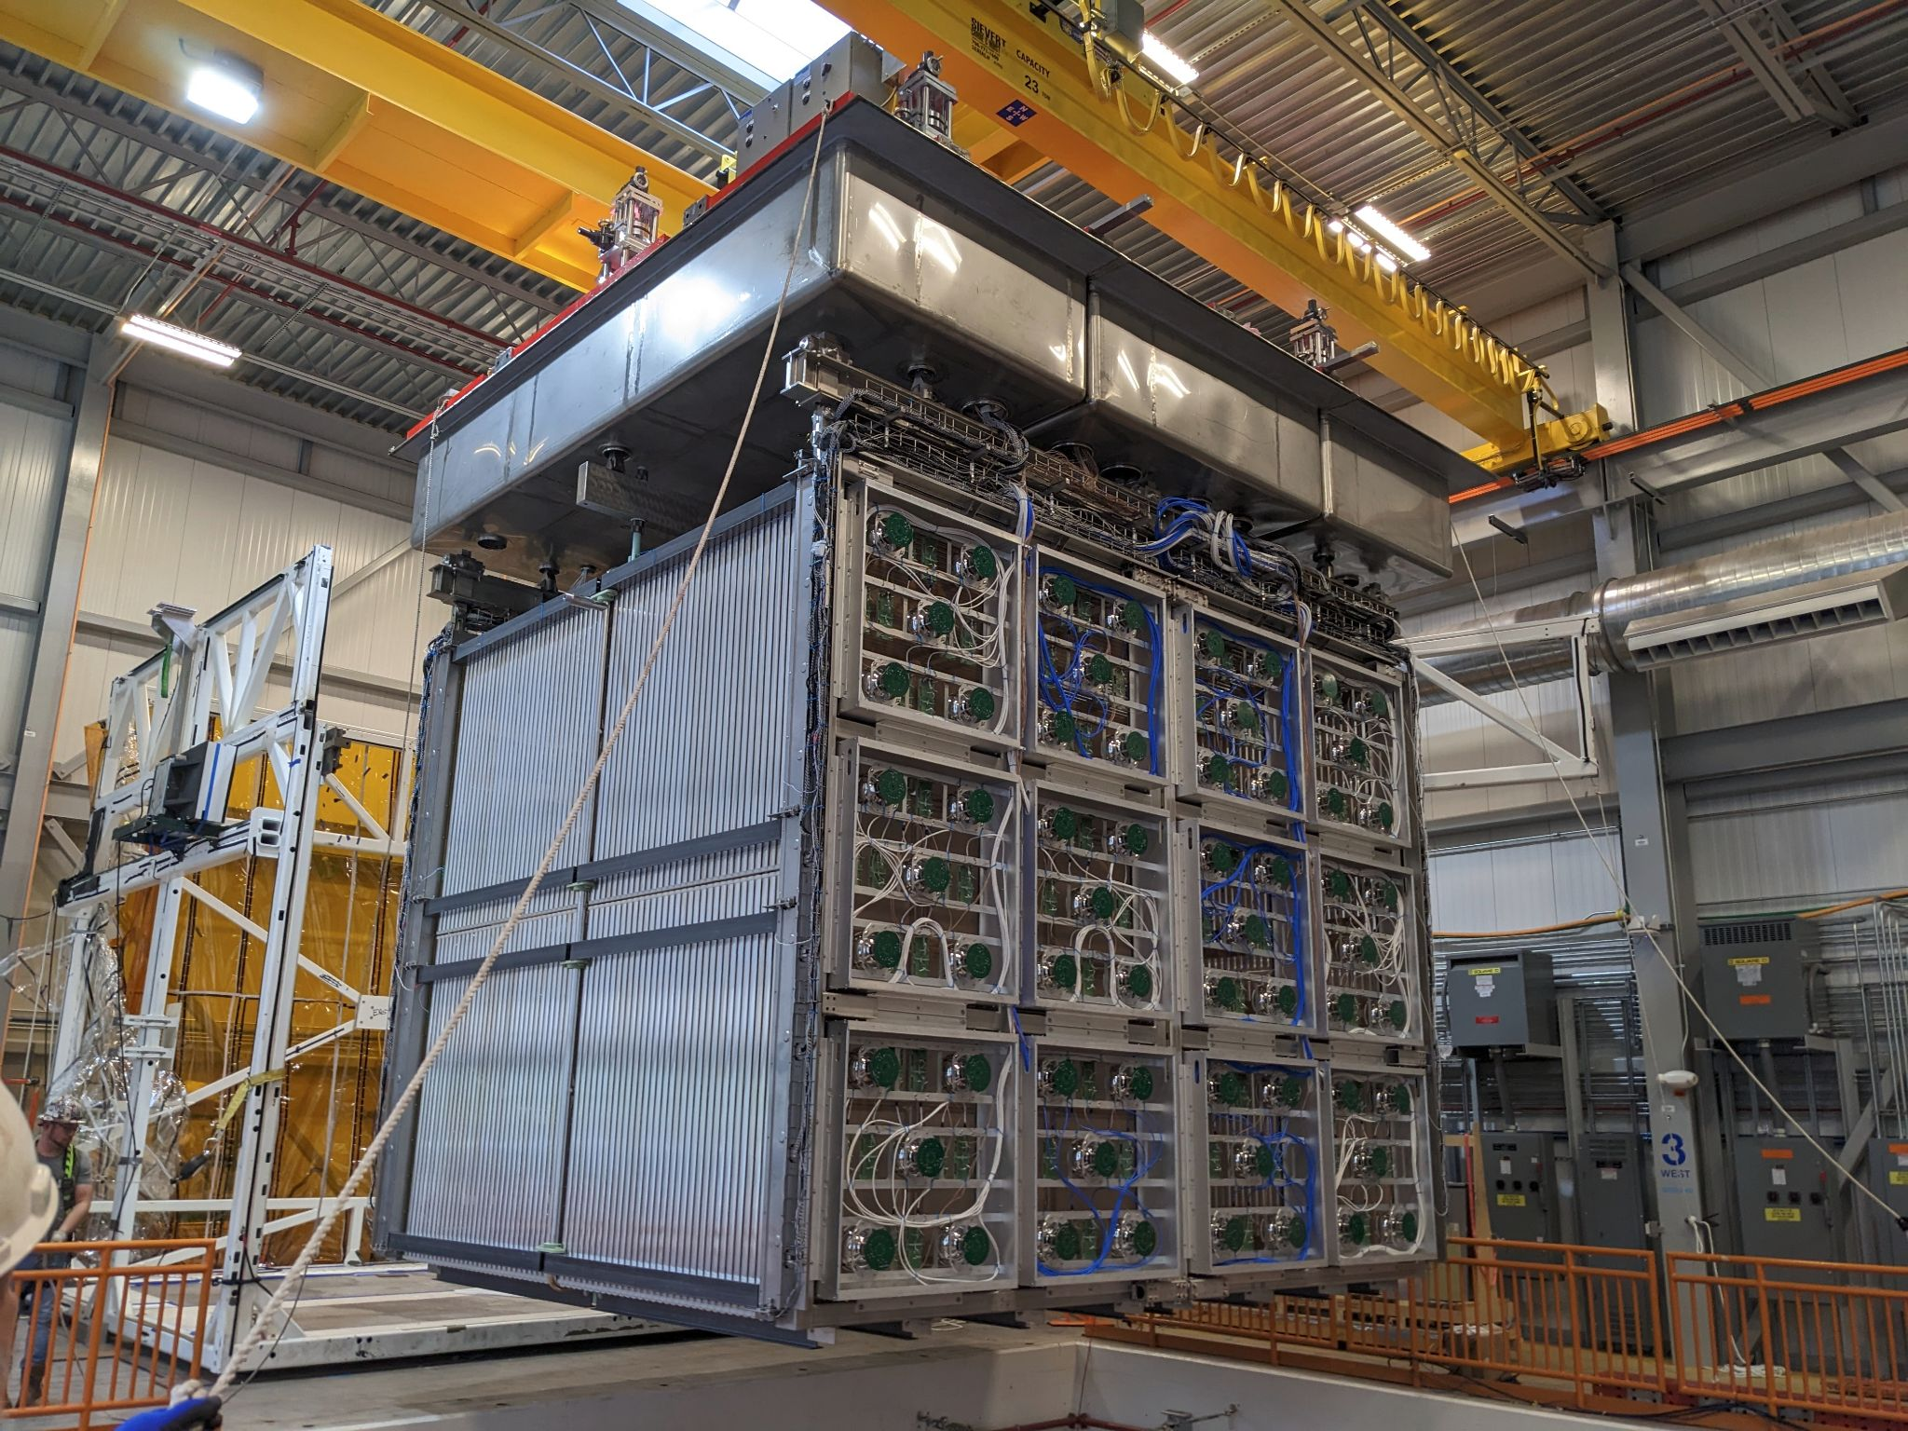
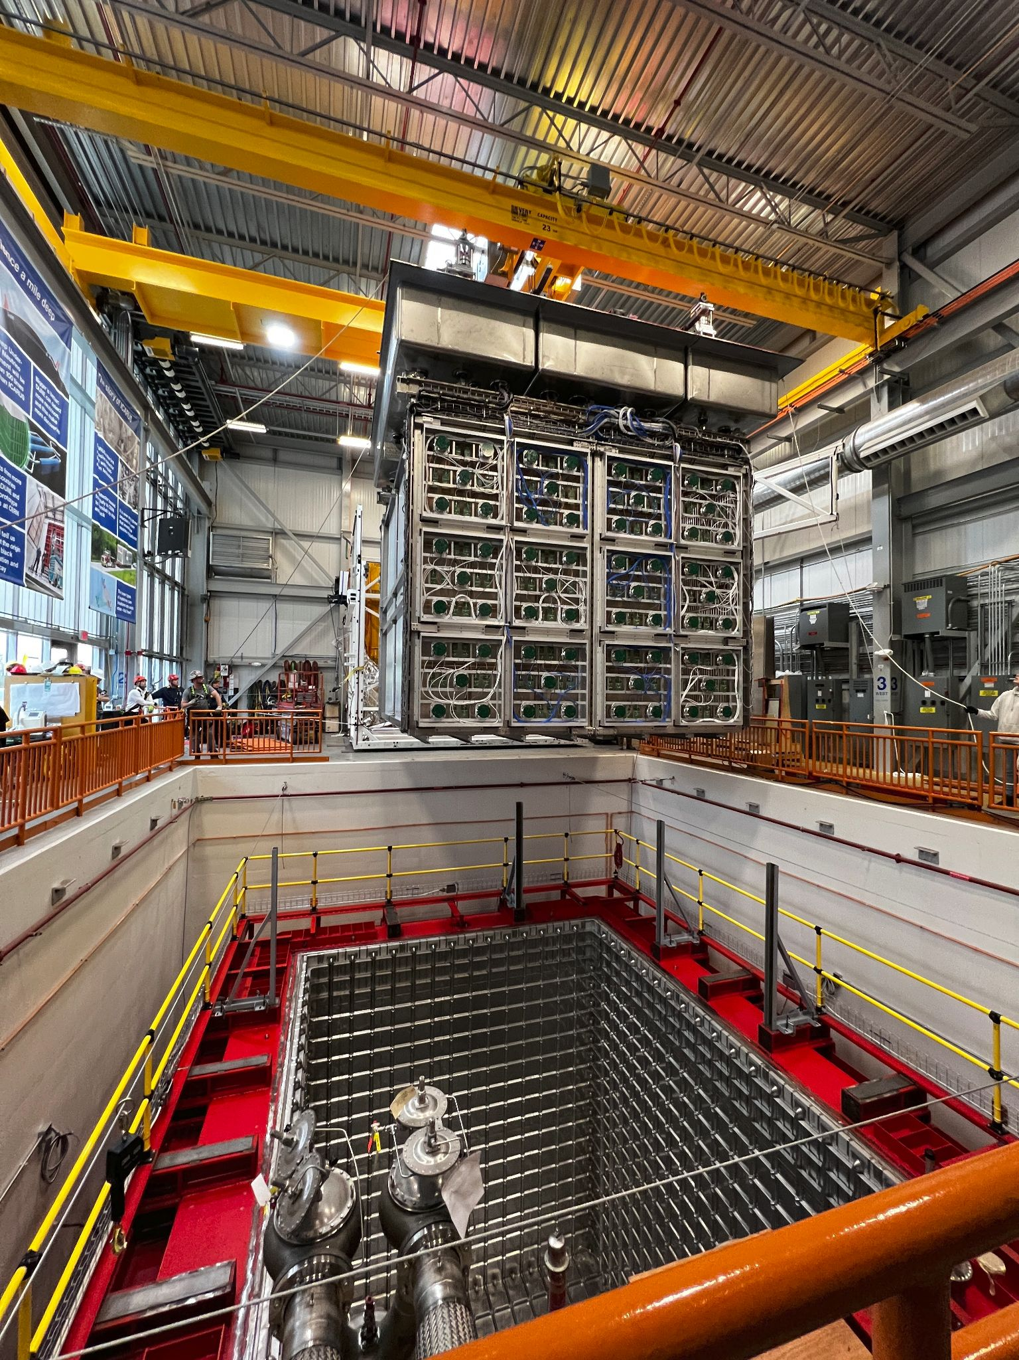
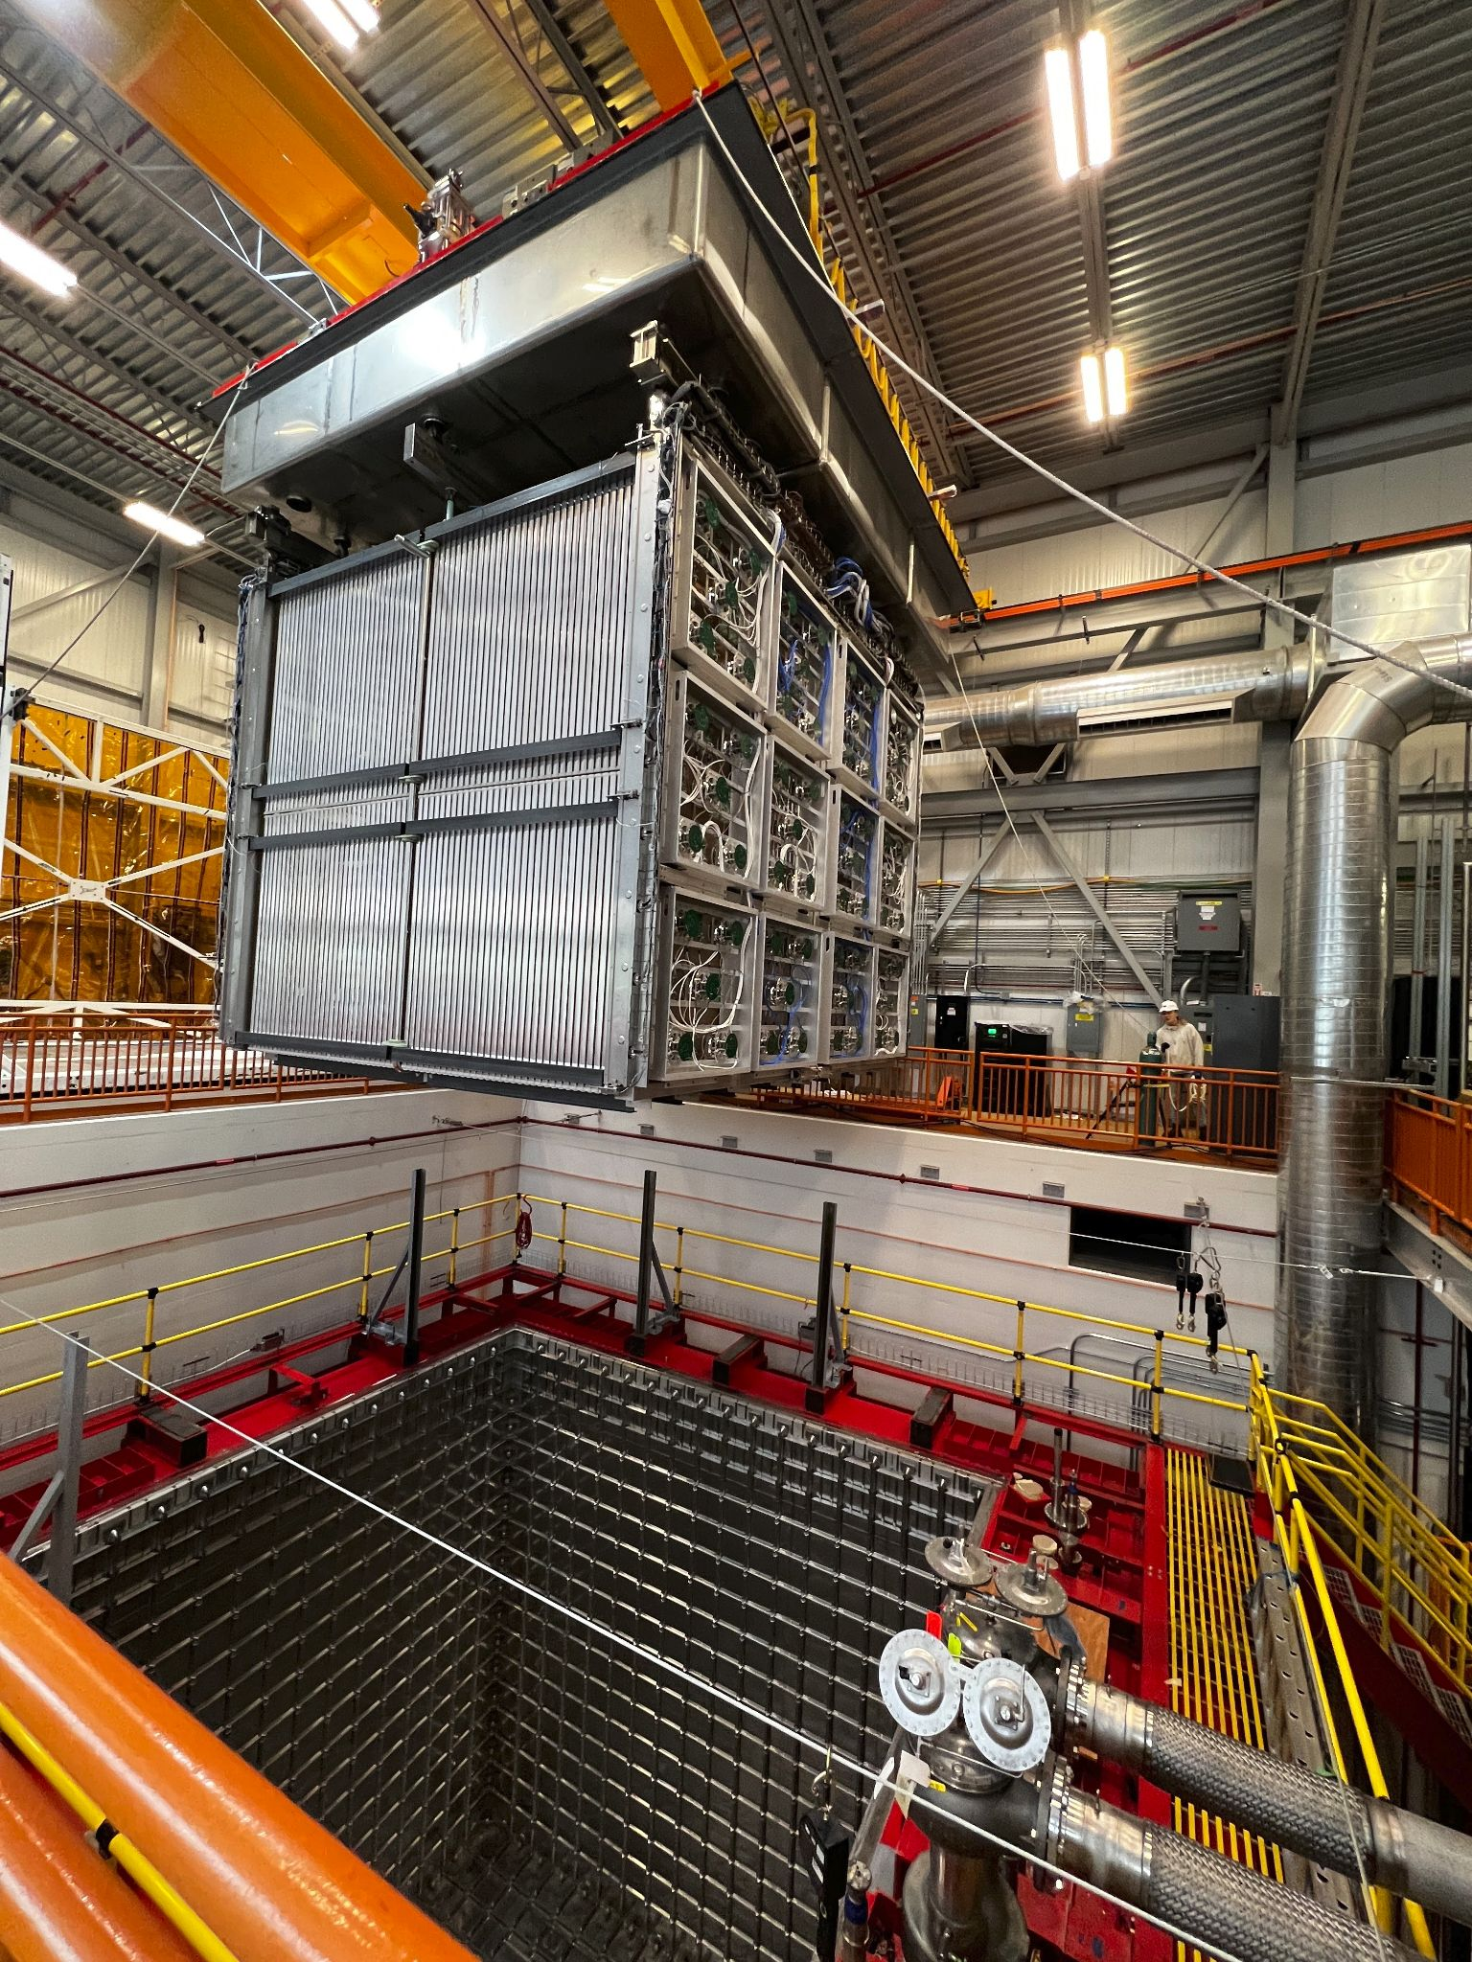
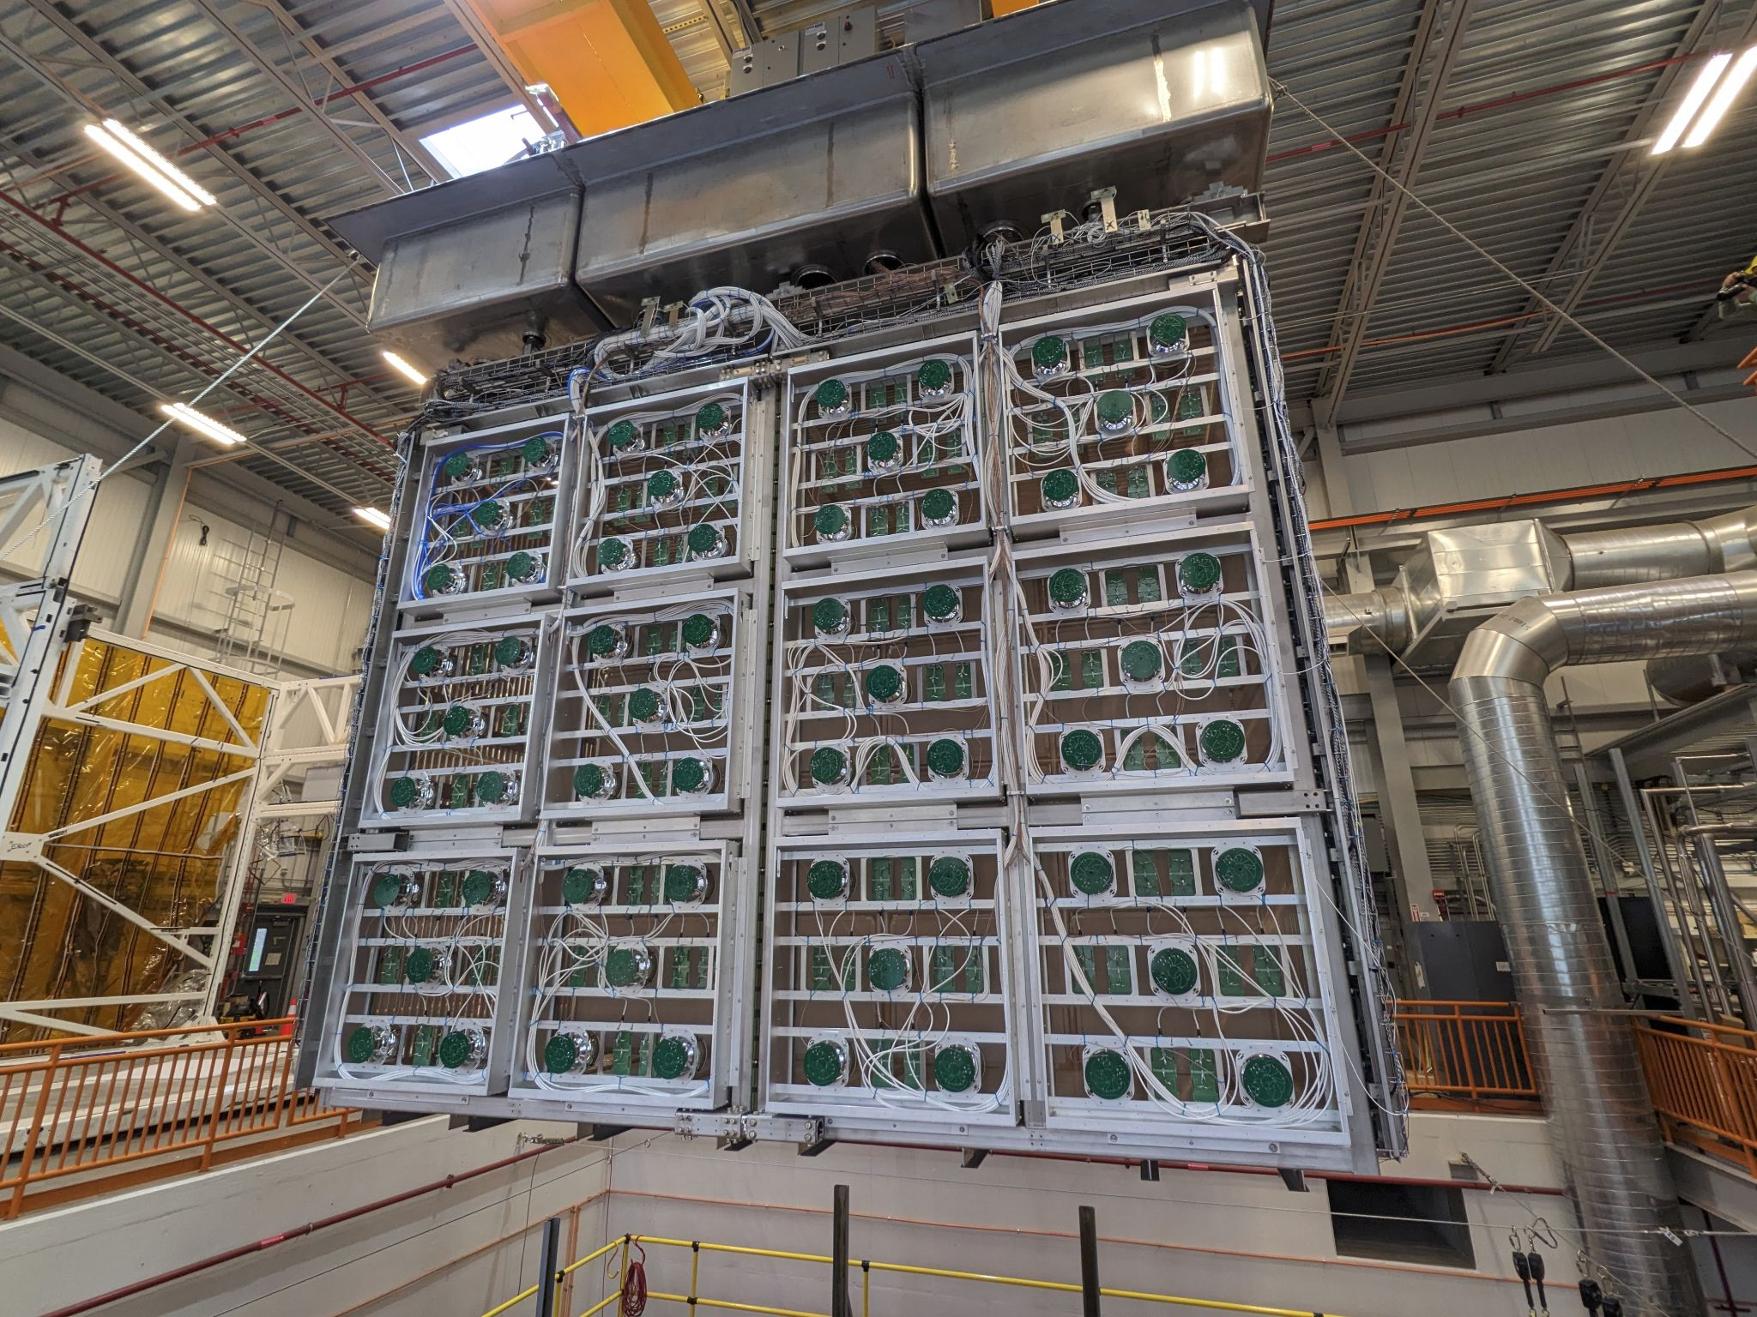
Detector Rigging
~ 9:05 am - Start TPC extraction
Working at the PIT cutting edge…
Almost out…
It’s out! Time to rotate!
90° rotation
~9:17 am - TPC rotate, time to lower!

Slide 9
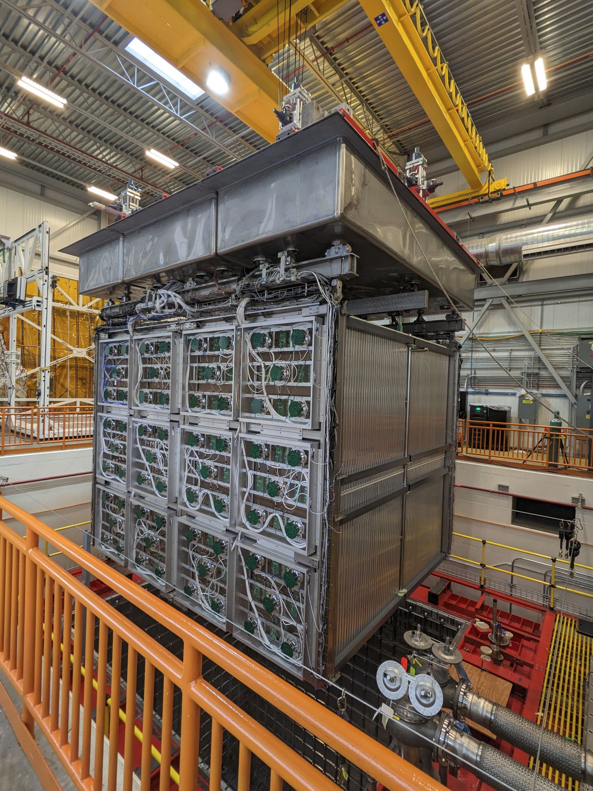
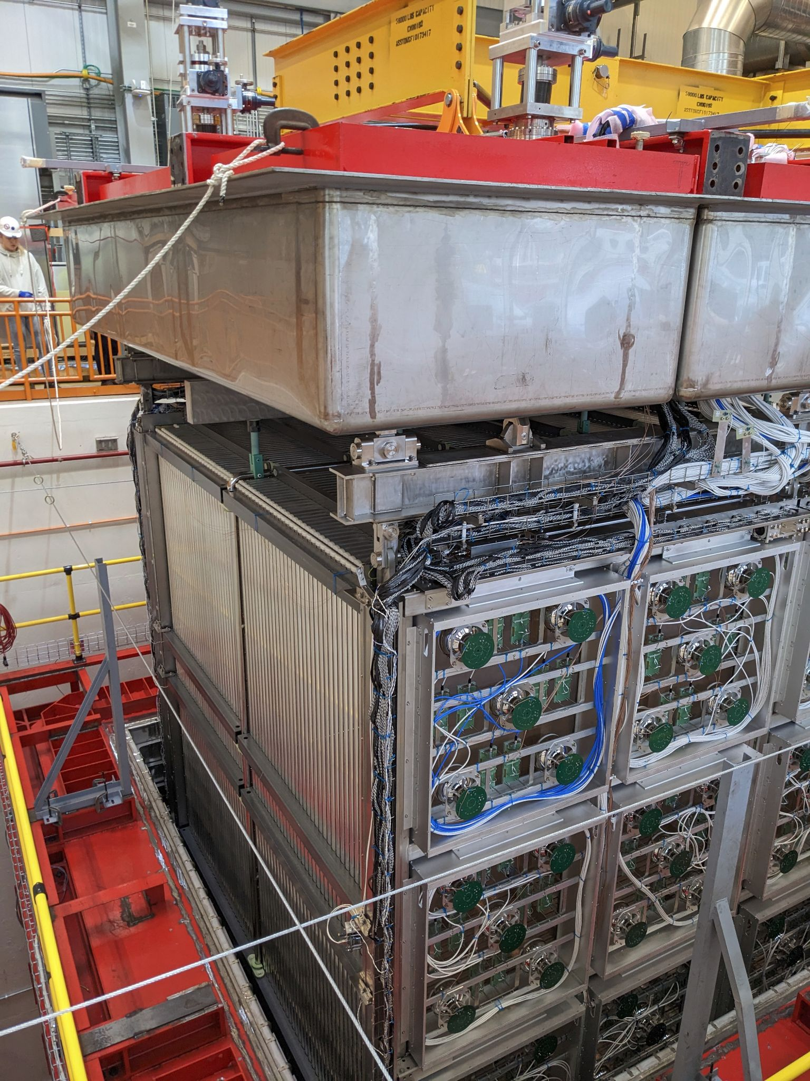
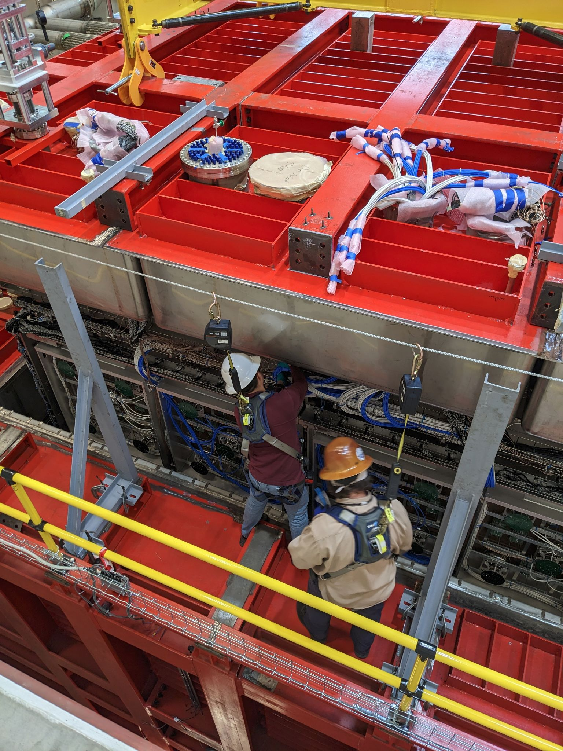
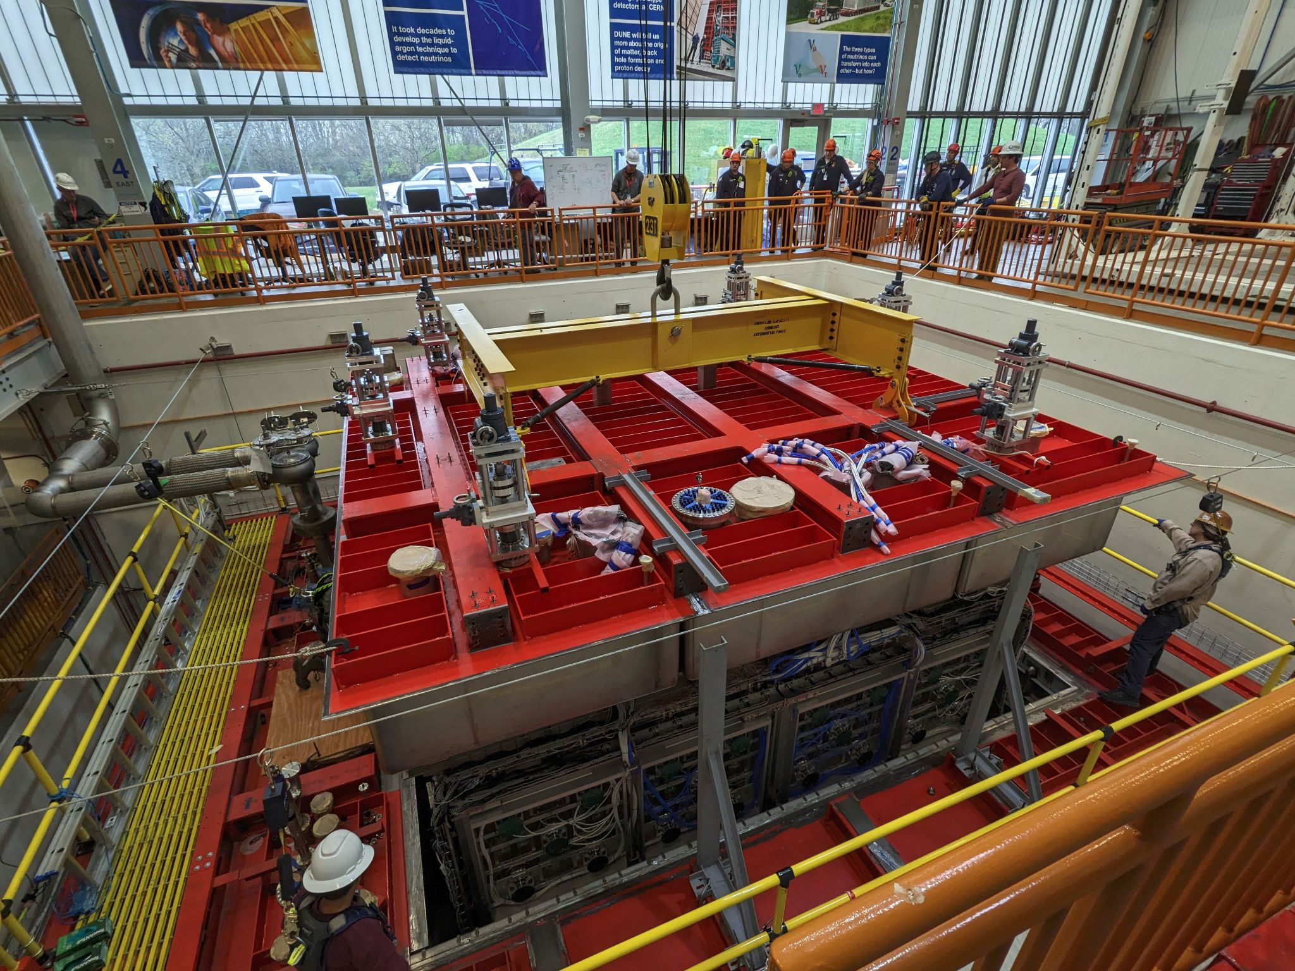
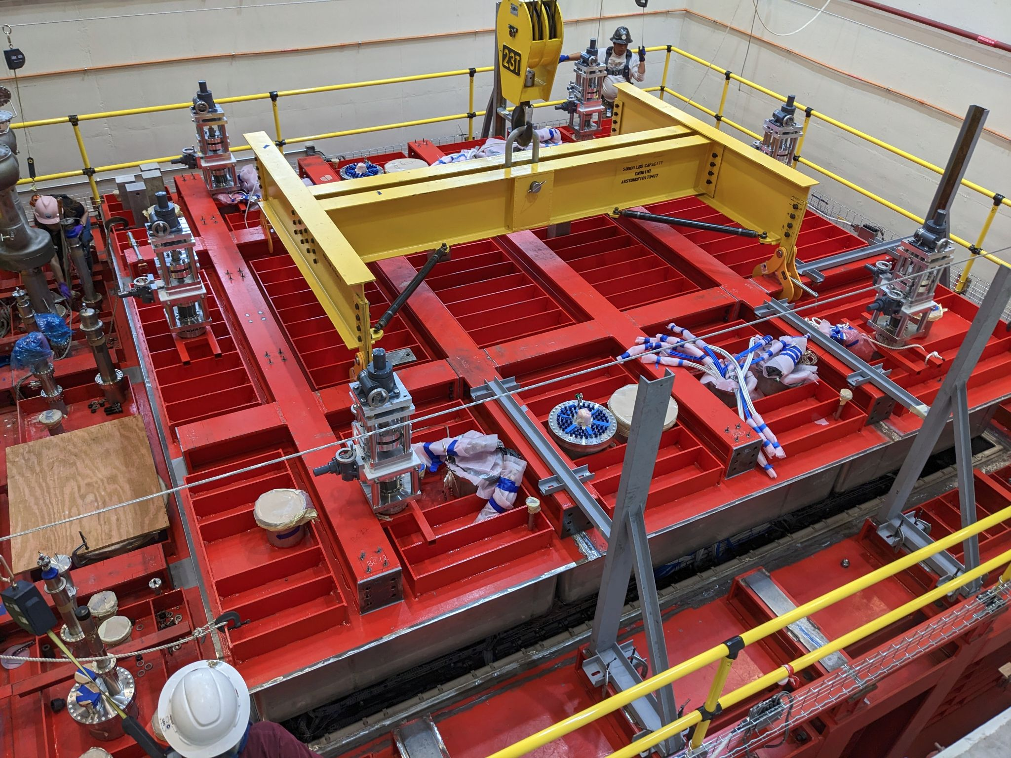
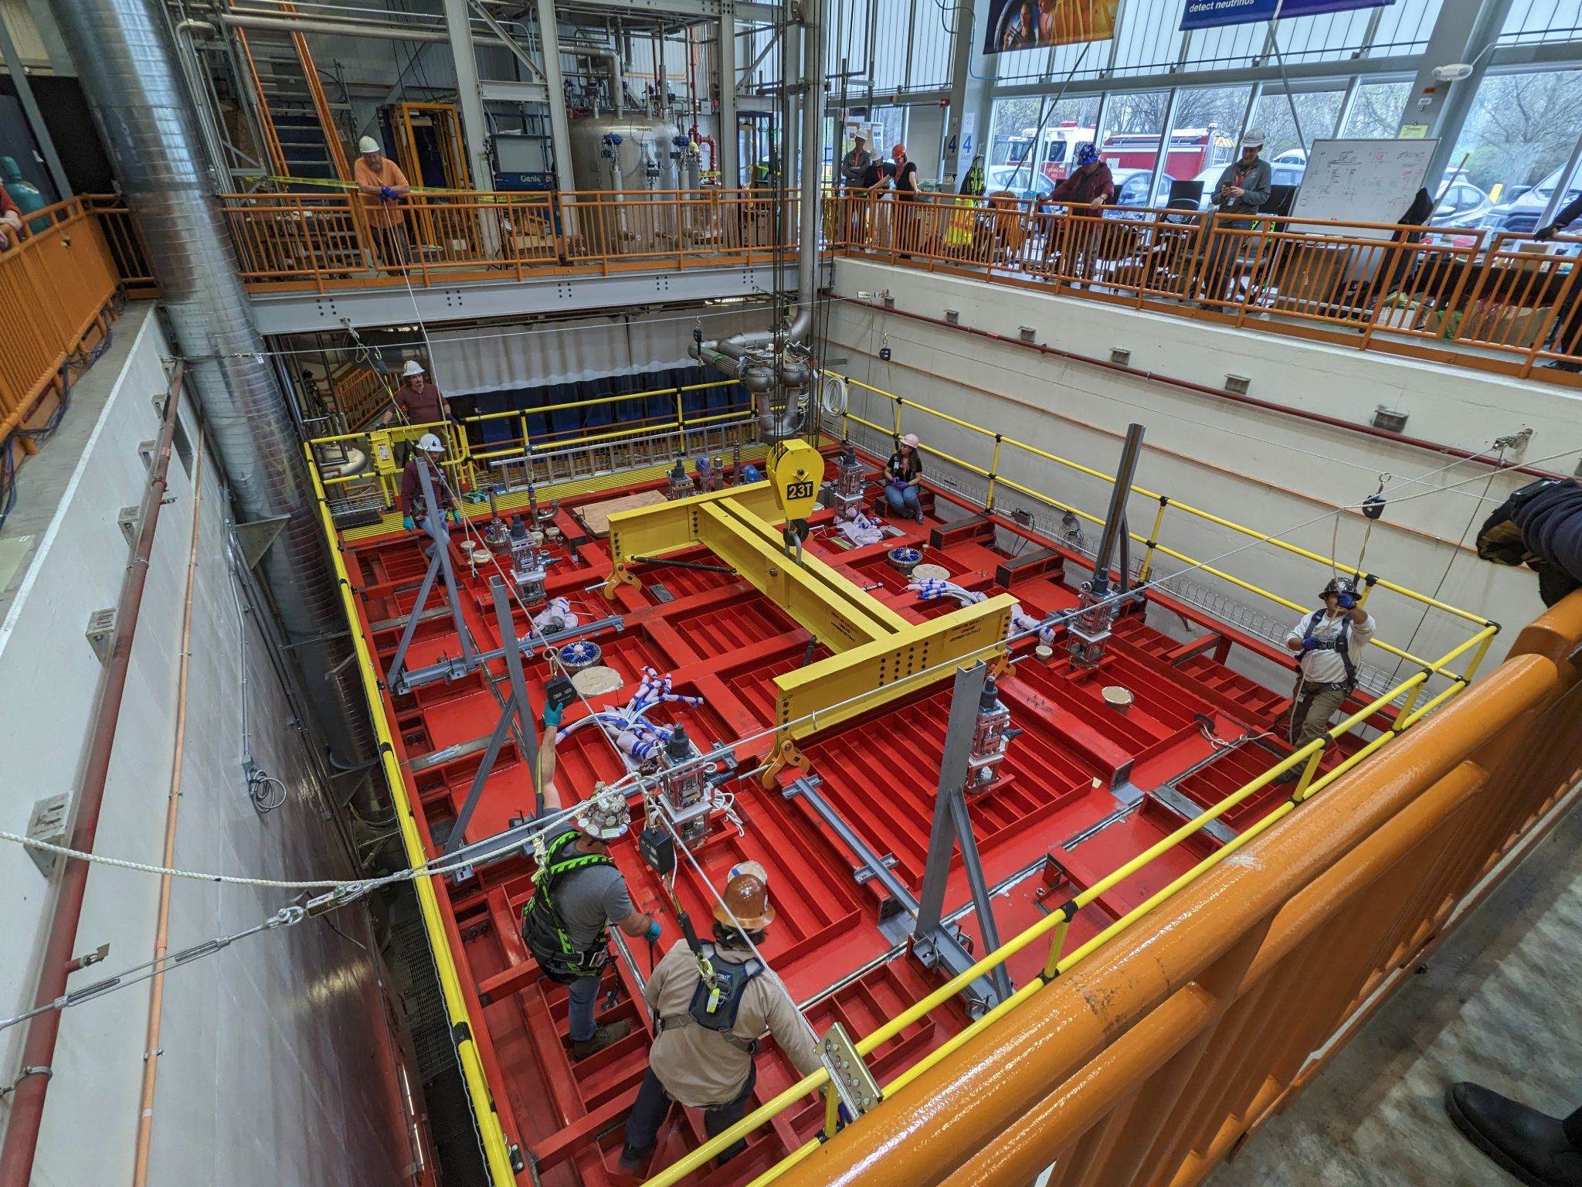
Detector Rigging
9:20 am
9:27 am
Taking care of last details
9:44 am
9:55 am
10:13 am - It’s in!

Slide 10
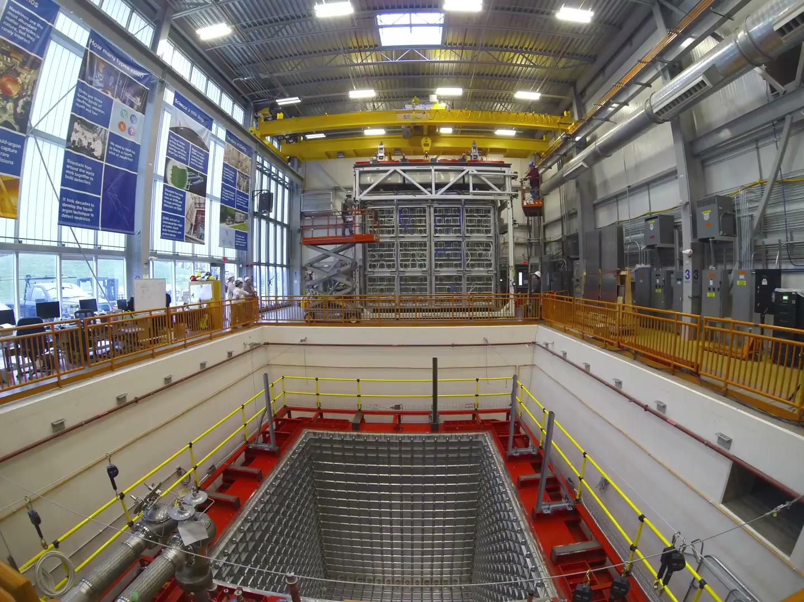
Detector Rigging
video credit: FNAL Visual Media Services
Download from SBN DocDB 31466

Slide 11
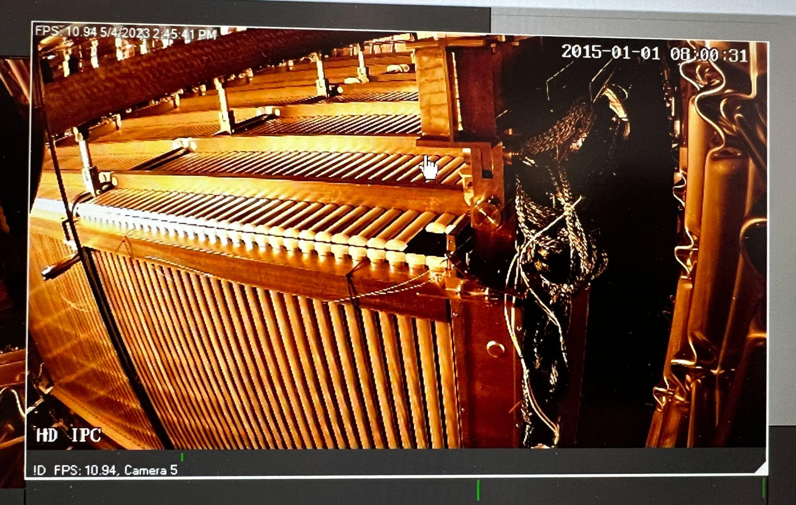
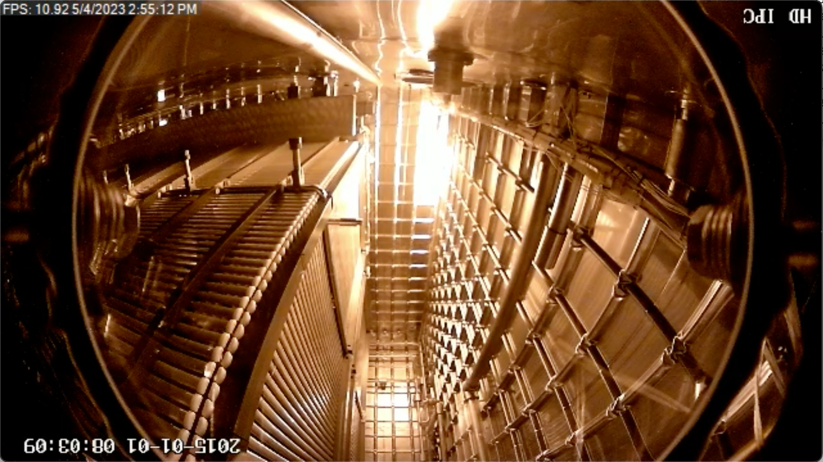
Preparing for top cap welding
Flange installation
X-ARAPUCA & PMT flanges installed (2 each)
TPC laser flanges to be installed next week (4)
TPC flanges to be installed June 20 (4)
Repeating QC tests
PMT Checked out
X-ARAPUCA, Cold Electronics and Wire Bias QC ongoing
Field Cage QC test to be repeated after first cryostat access
Preparing for cryostat access through access port on top cap
install cathode probe to repeat FC test
confirm positioning of the TPC inside the cryostat
install HV donut arm
First images from inside the cryostat.

Slide 12
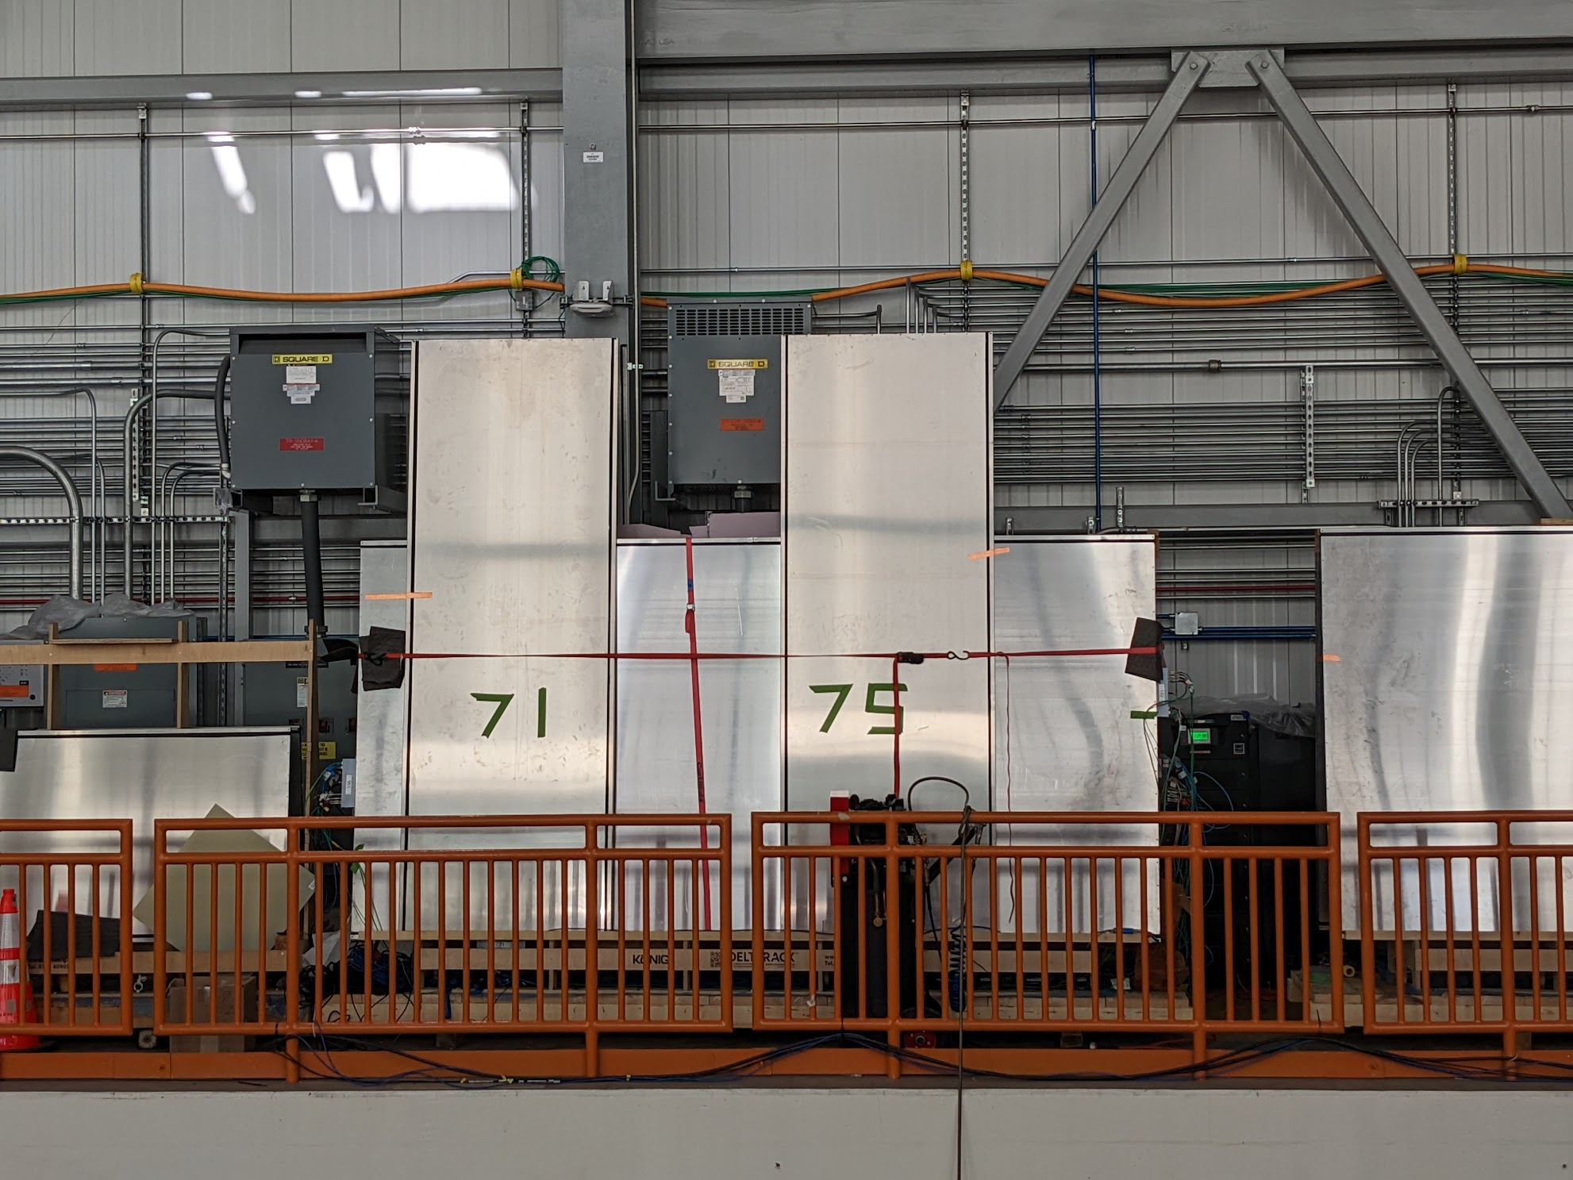
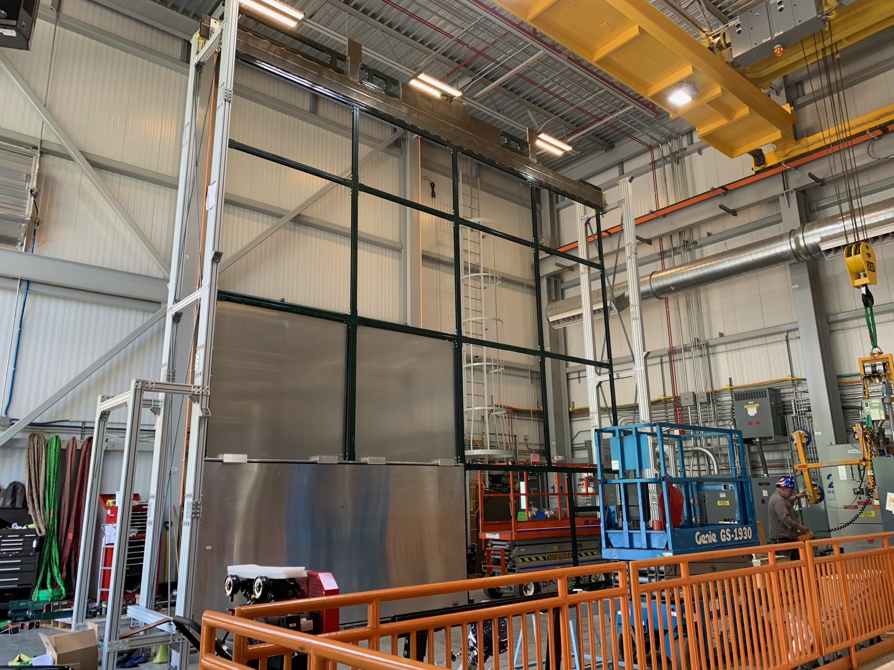
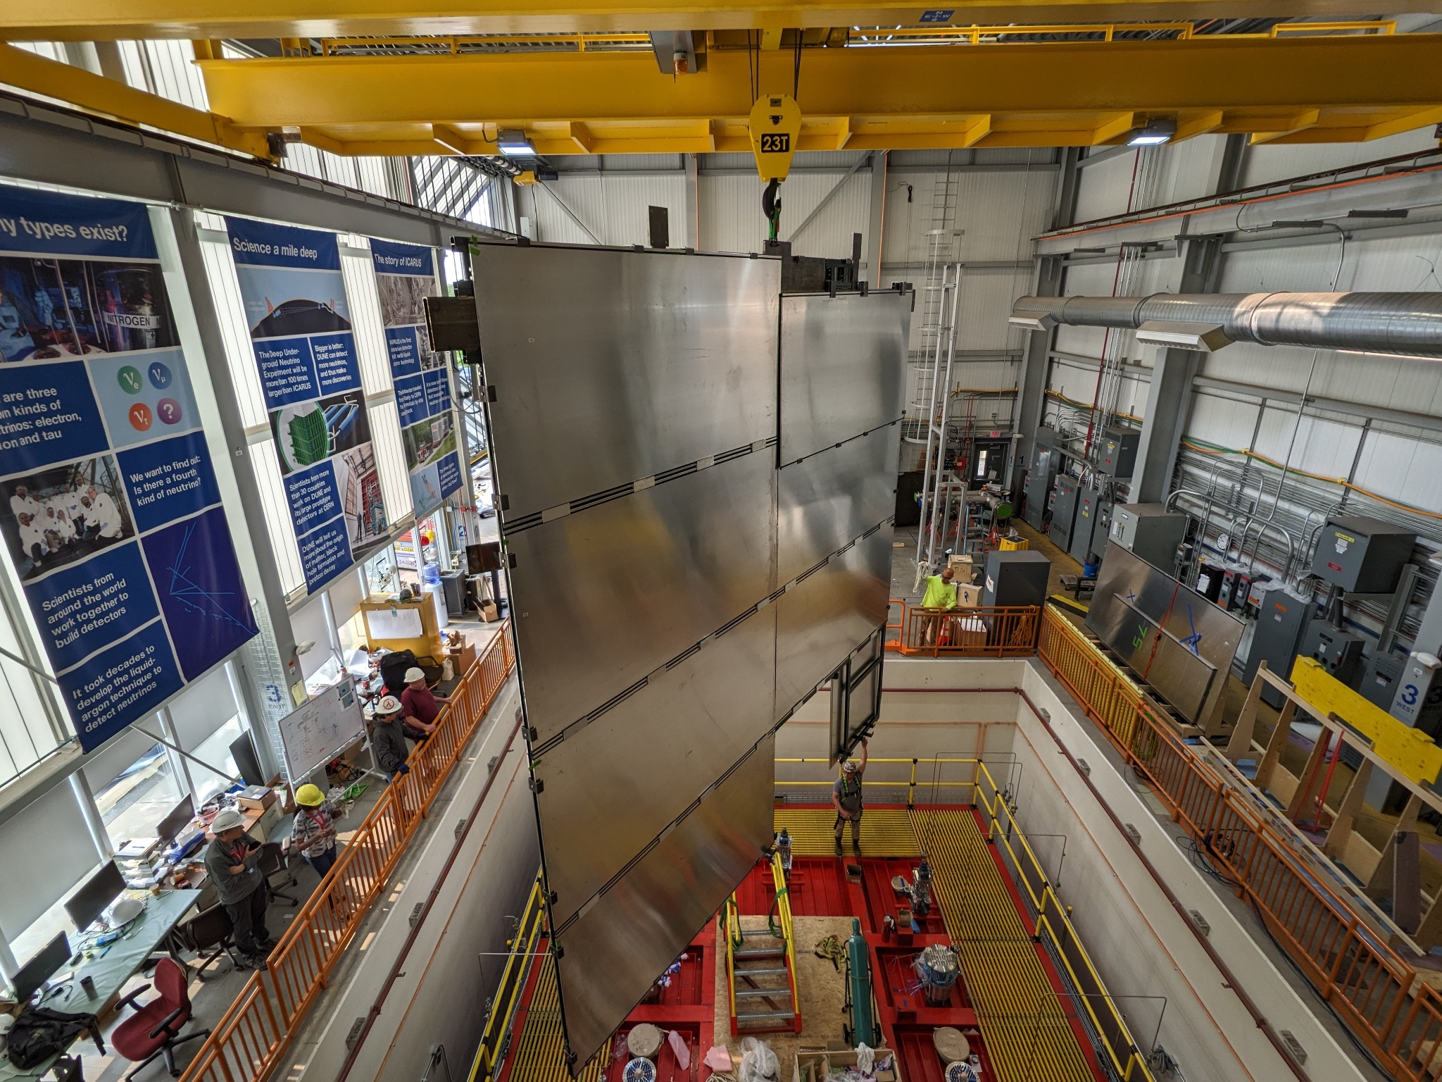
CRT North Wall Installation
Installation of the CRT North Wall is complete
The North Wall has to be installed prior to finalizing cryogenics piping connecting to the cryostat; East, West and South Wall will be installed only after successful cryo operation is established, using same method
18 CRT modules have been tested & characterized on an A-frame setup to be installed on the North Wall
The North wall was assembled as a whole on the loading deck prior to installation
The entire wall was rigged into place and hung from the North Wall steel support posts
Modules being tested on A-frame & CRT wall module installation
CRT Wall Rigging

Slide 13
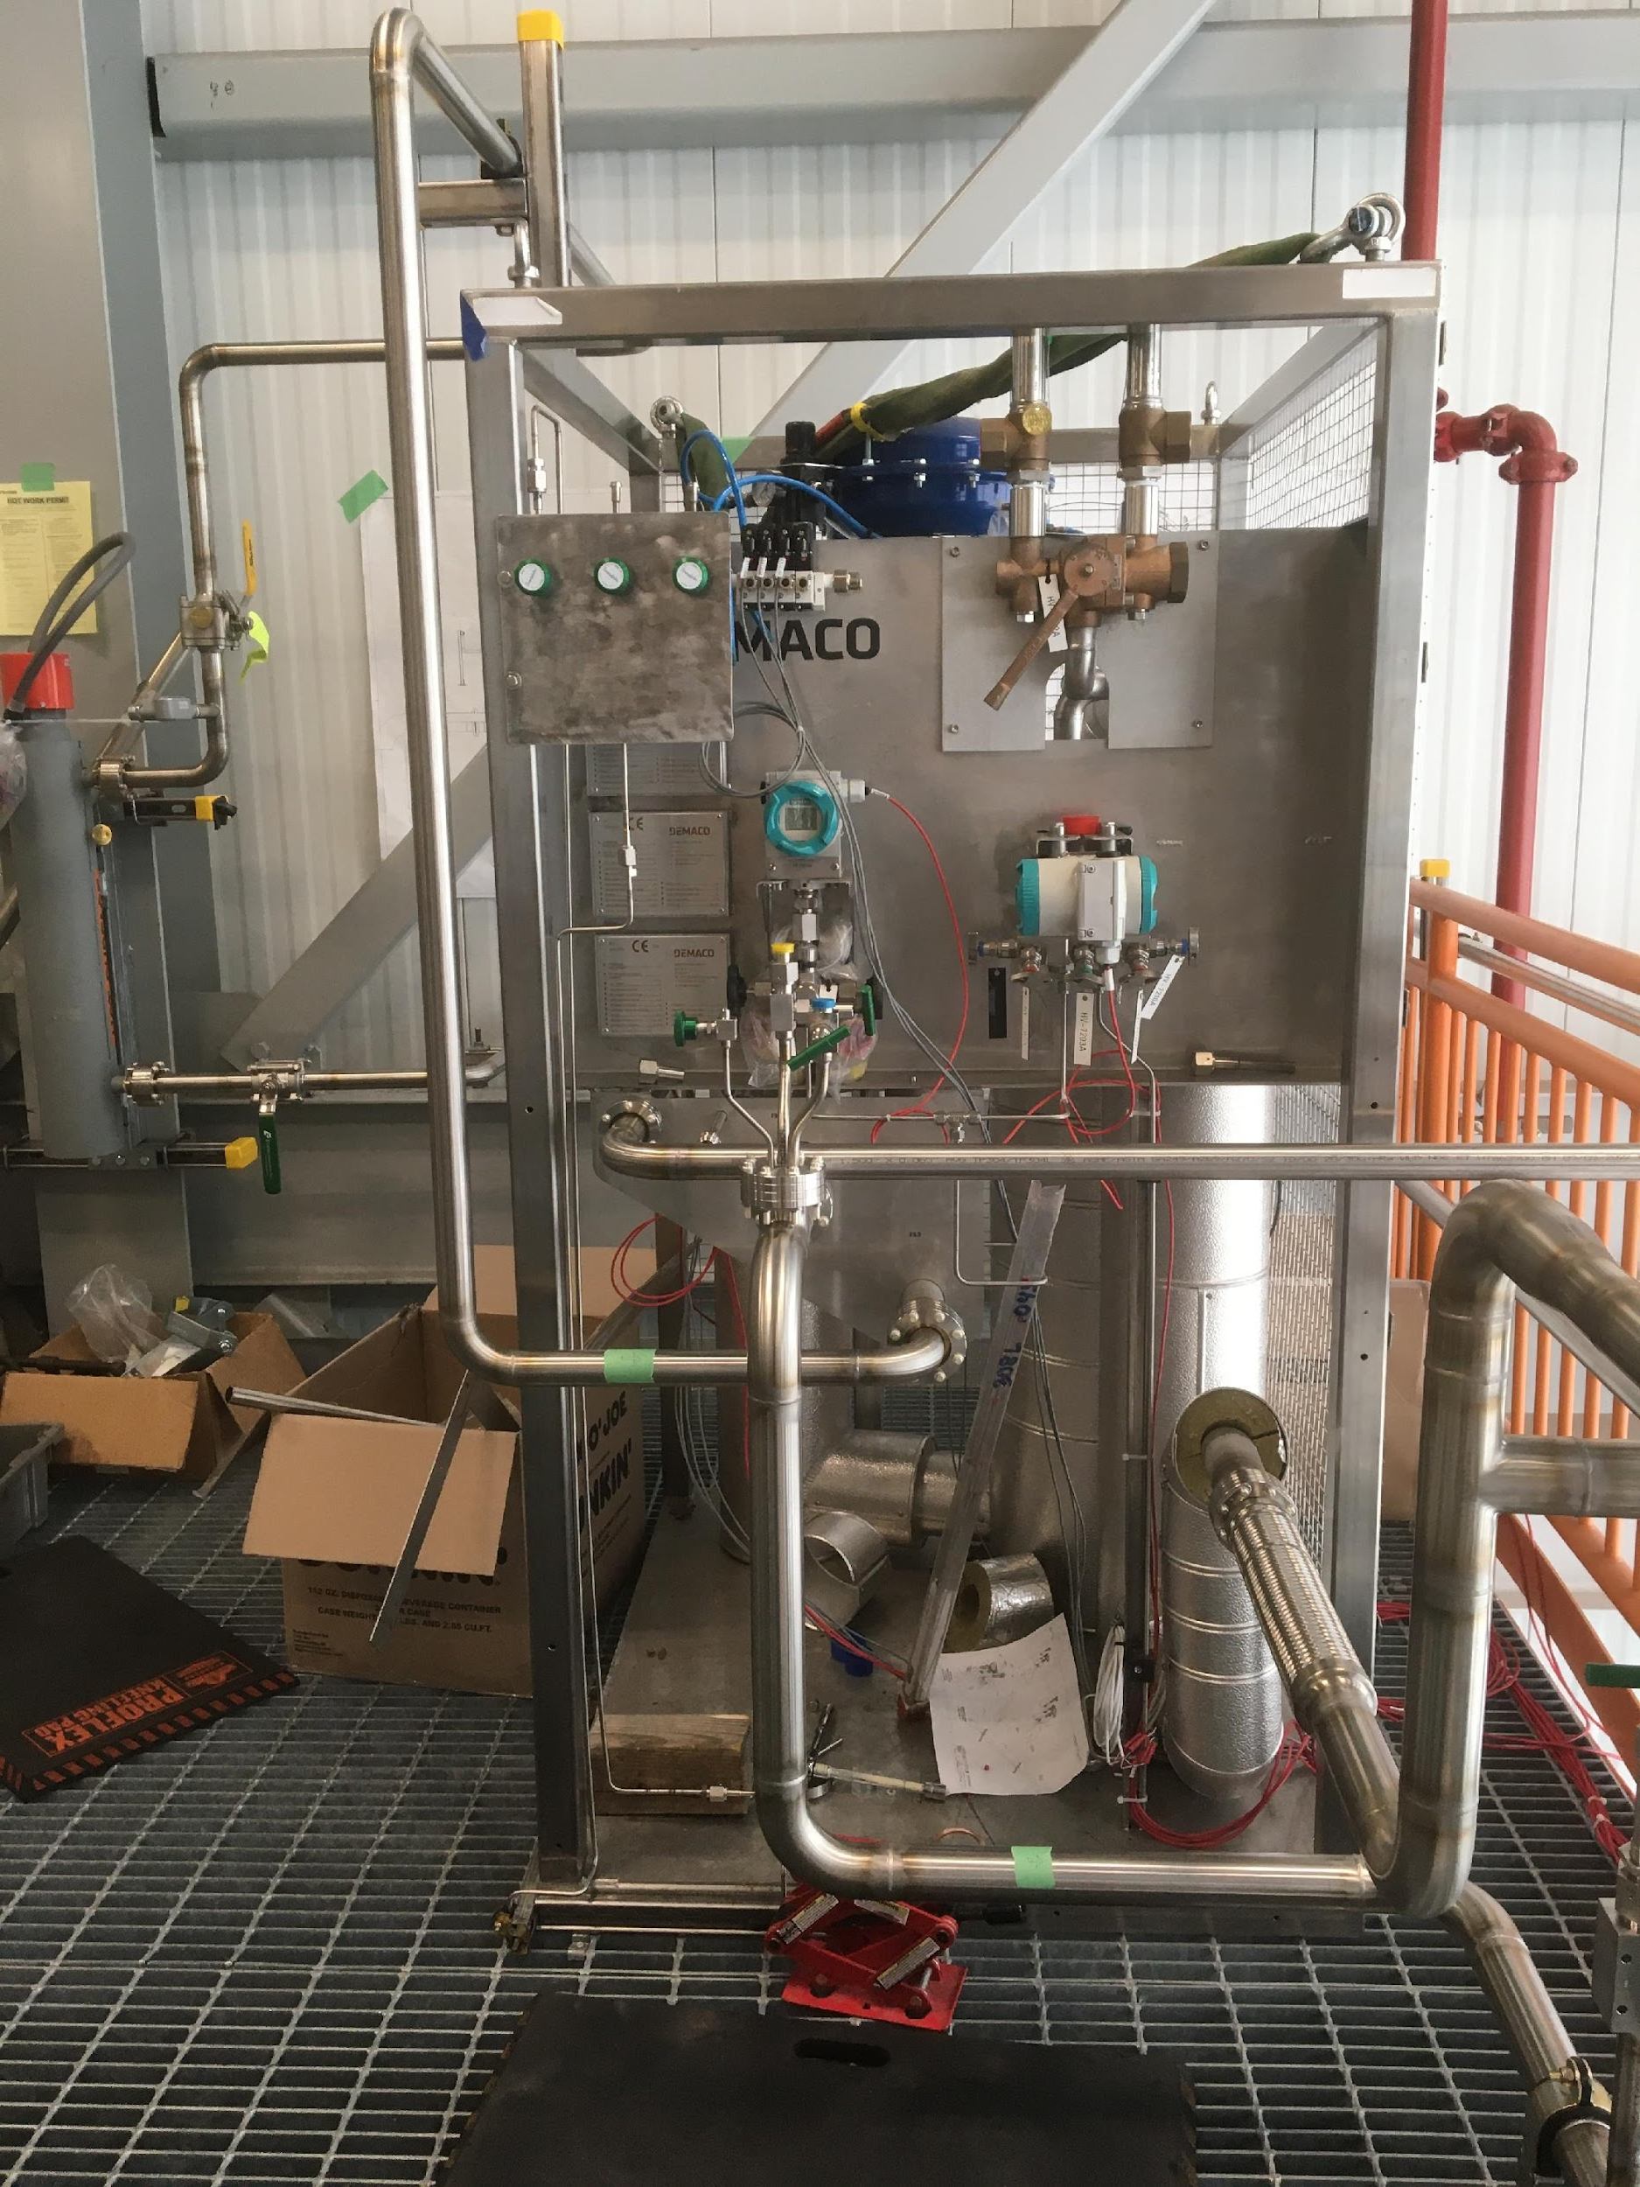
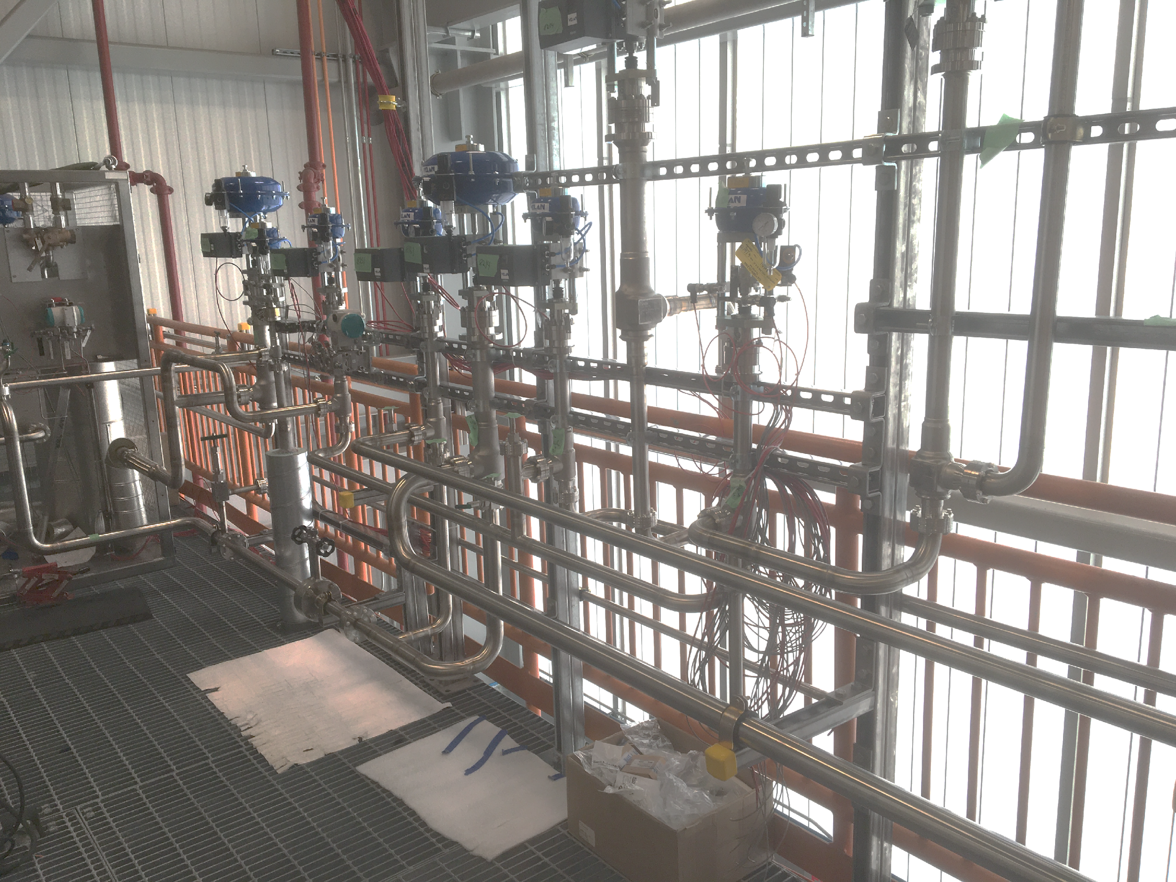
Cryogenics Installation Progress
Cryogenics Installation Progress
Gas analyzer system installation in progress
Warm GAr collection system installation complete
Only part remaining is connection to top of cryostat
Insulation Nitrogen purge system almost complete
In-line PrM line completed and vacuum jacket leak-checked
Vacuum jacketed transfer lines that connect the cryogenics system to cryostat are on critical path
delay in the delivery of bellows and ceramic isolators to TechniFab from supplier
Received a partial delivery of 21 of 36 parts in May; installation of these starting now
expected final delivery in August/early September
Pressure test for Ar Dewar and connecting piping ongoing
LAr delivery contract placed with Air Products
on schedule and under budget
same vendor as MicroBooNE and ICARUS fills
Warm GAr system

Slide 14
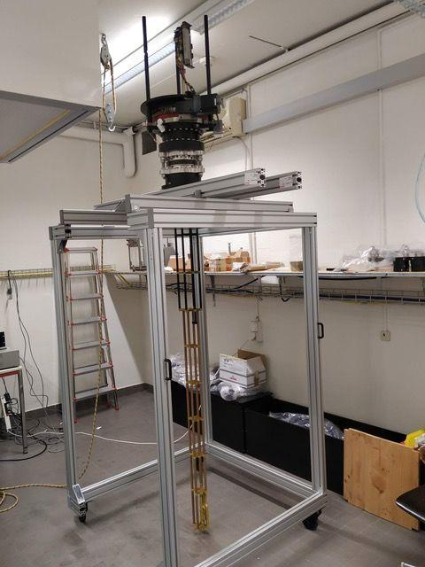
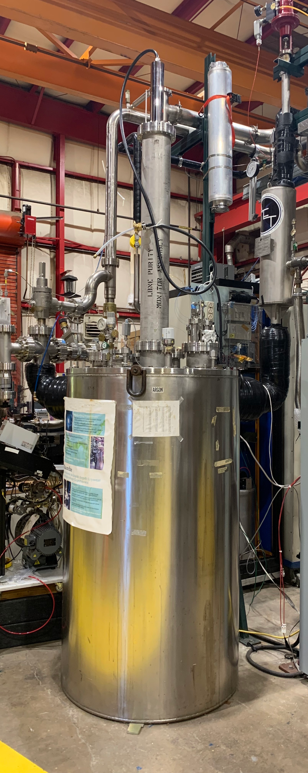
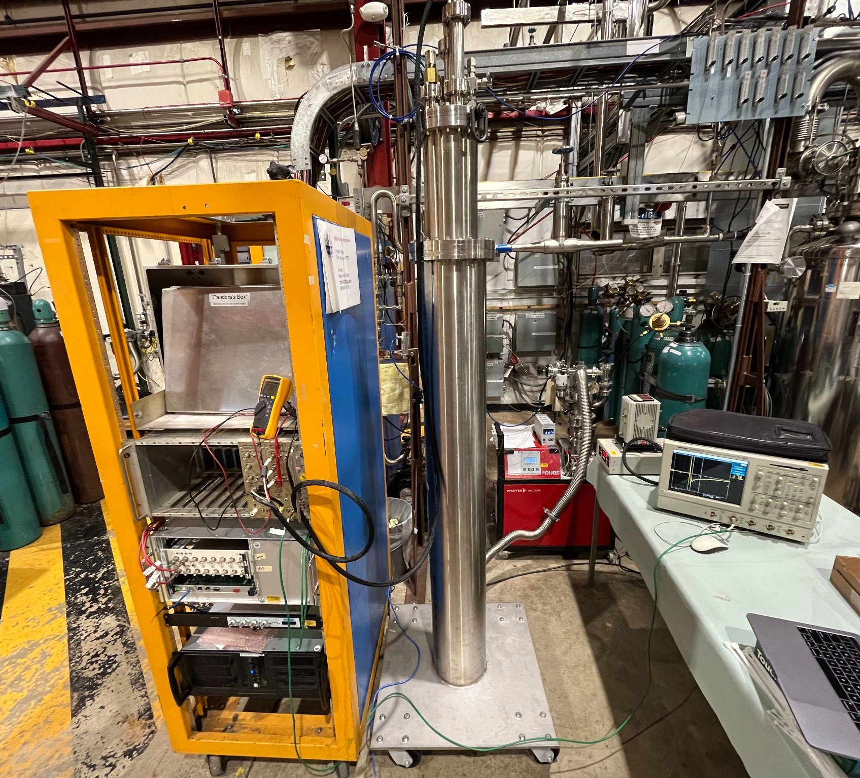
Remaining Subsystem Installation
All parts for the TPC Calibration laser system have been received from Bern
installation of feedthroughs scheduled for next week
Laser testing (Class IV), rotation motor testing & electronics installation to happen in July/August
HV Production Feedthrough testing ongoing at NLTF
Laser Feedthrough Test Assembly @Bern
Purity Monitors
inline and cryostat-internal purity monitors being tested at NLTF (fka PAB)
HV FT Test Setup in BLANCHE @NLTF
Purity Monitor Test Setup at NLTF

Slide 15
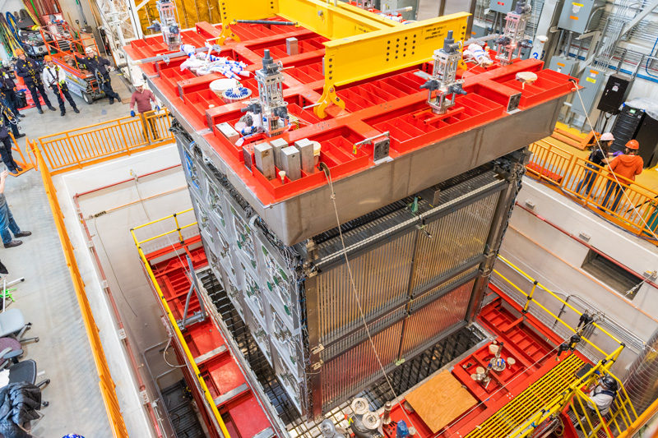
Summary
SBND recently accomplished the insertion of the detector into the cryostat & installation of the CRT North Wall
The LAr delivery contract has been placed
Next upcoming milestone is the welding of the cryostat top cap planned for early July
Cryogenics commissioning is forecast to start around September

Slide 16
Backups

