Slide 1
Shipping Post Final Design Review - Introduction
Roger Rabehl – Fermilab
Shipping Post Final Design Review – April 6, 2023

Slide 2
Charge for the Final Design Review

Slide 3
Outline
Scope
Requirements
Design
Drawings
Procurement
Testing & Validation
Release to Operations
Risk
Summary

Slide 4
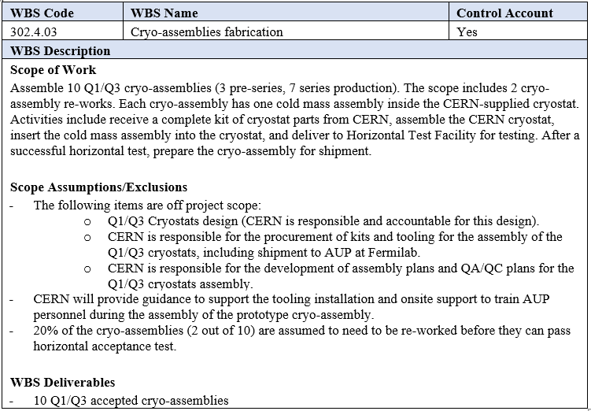
Scope and WBS Deliverables
(WBS Dictionary: US-HiLumi-doc-39)

Slide 5
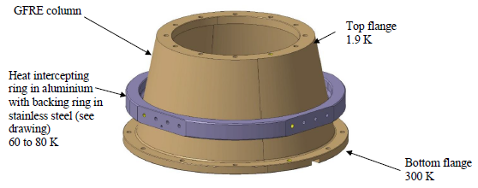
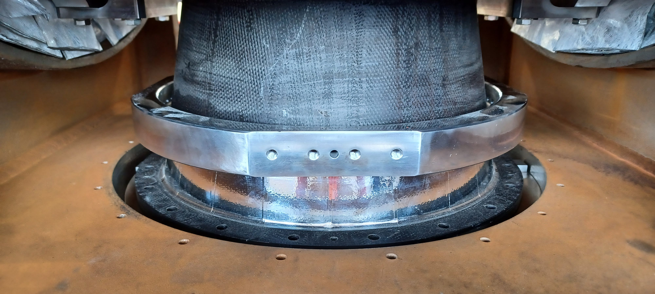
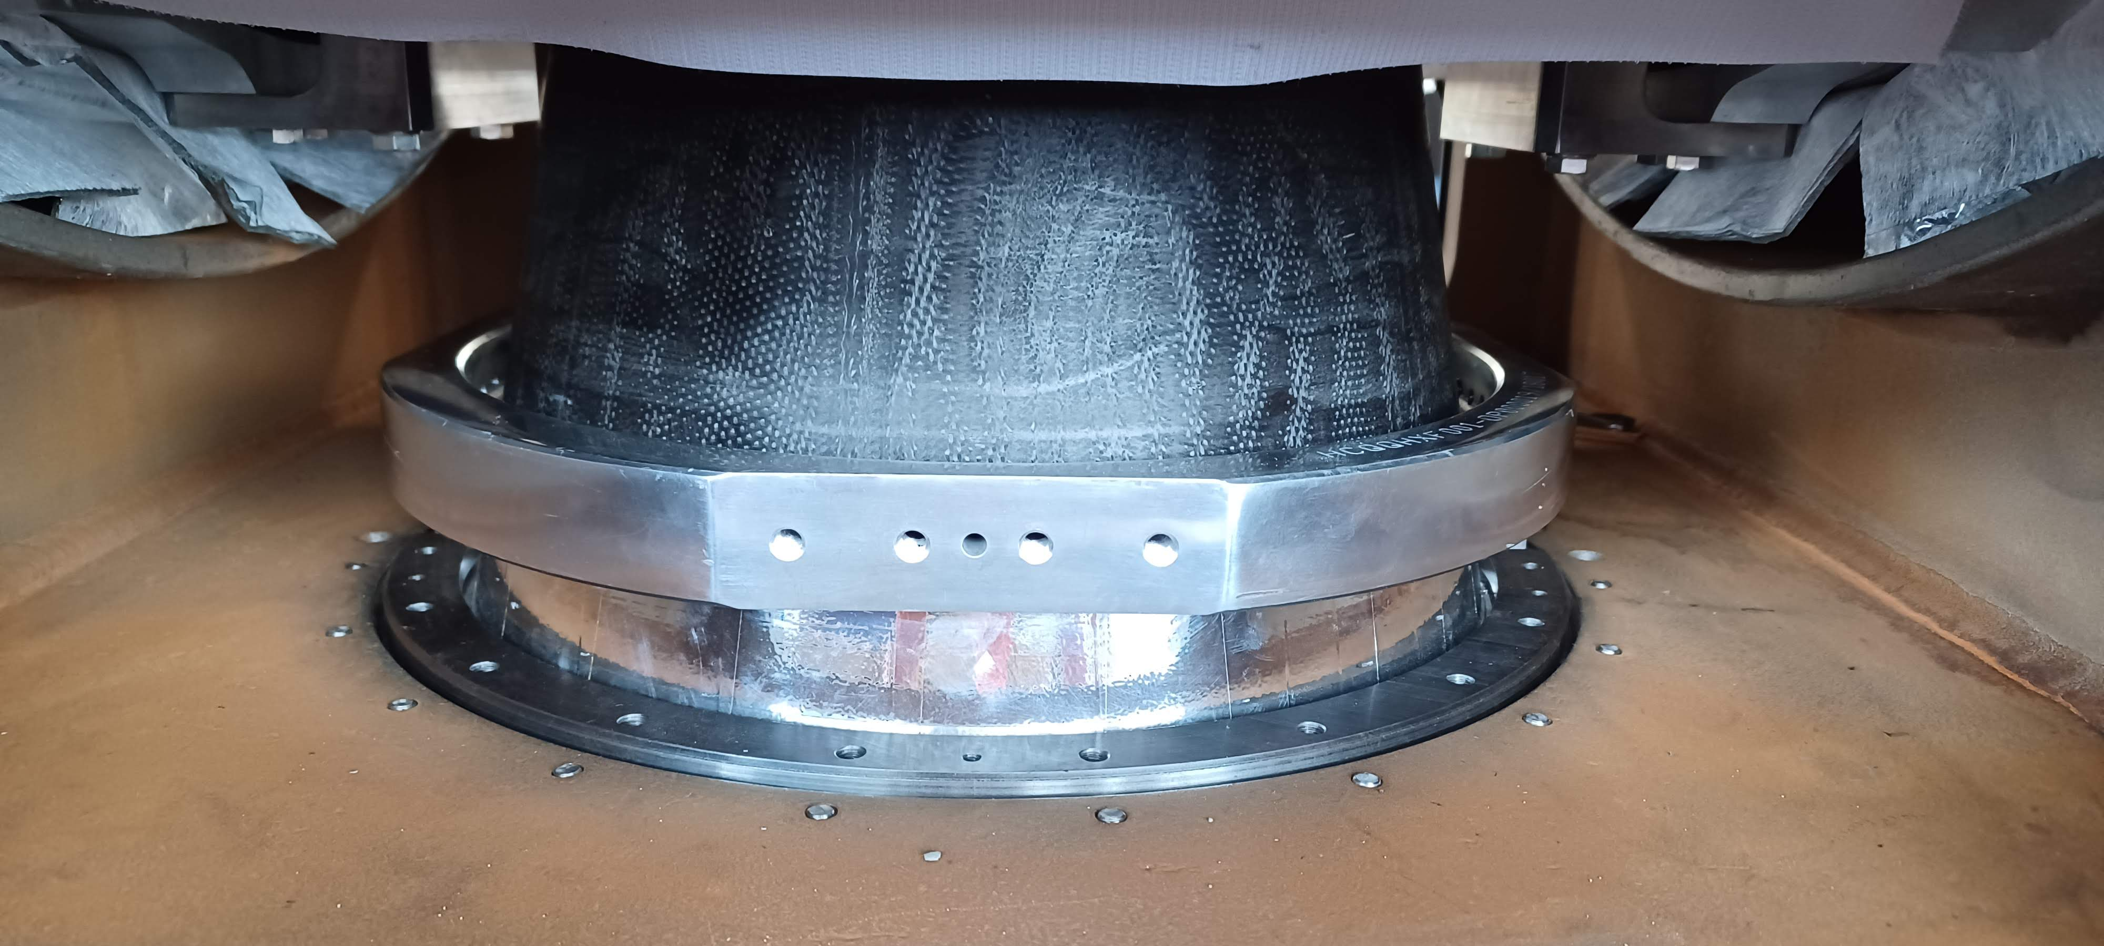
Scope
Cold Mass support posts are supplied as part of the cryostat kit.
The support posts are made from glass fiber reinforced epoxy.
They are relatively fragile and could be damaged during transport of a Cryo-Assembly from Fermilab to CERN.
Sliding positions
Fixed position

Slide 6
Scope
A shipping post assembly is required to:
Unload the GFRE support post
Rigidly attach the Cold Mass to the Cryo-Assembly vacuum vessel
Support the Cold Mass against shipping loads

Slide 7
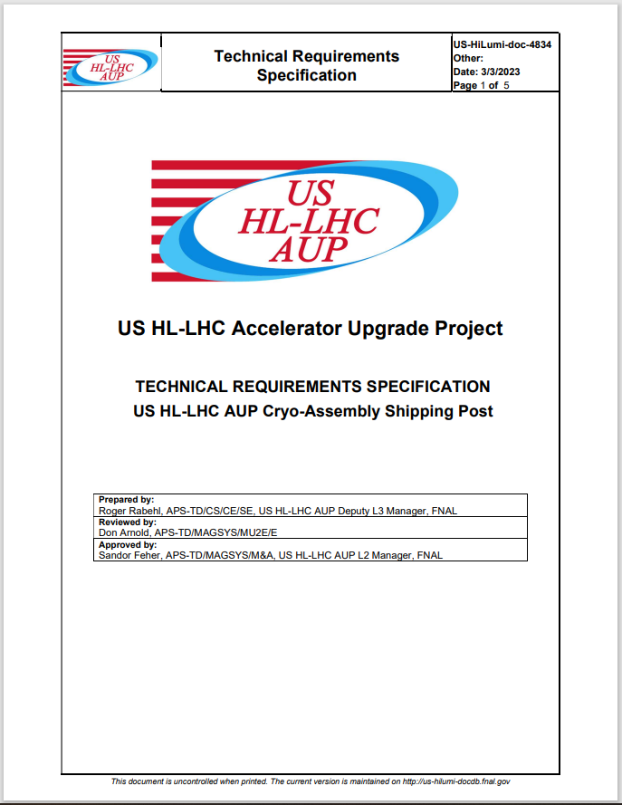
Technical Requirements Specification
(US-HiLumi-doc-4834)
Specifies/references
Loading requirements
Static
Dynamic
Interfaces requirements
Features of the Cold Mass, support post, and Cryo-Assembly vacuum vessel
Cryostat tooling

Slide 8
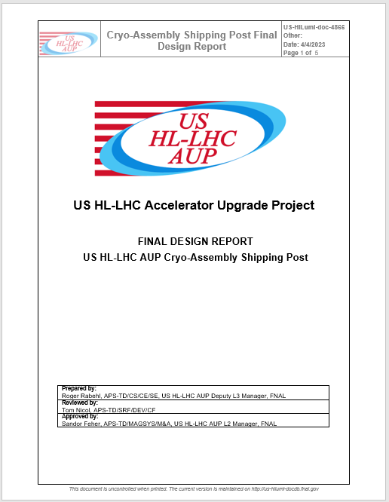
Final Design Report
(US-HiLumi-doc-4866)
Specifies/references
Technical Requirements Specification (docdb 4834) for interfaces
Teamcenter Engineering Document (ED0010721) for shipping post analyses
Vacuum vessel analysis (docdb 4835)
Shipping post installation procedure for Fermilab and removal procedure for CERN (to be written)

Slide 9
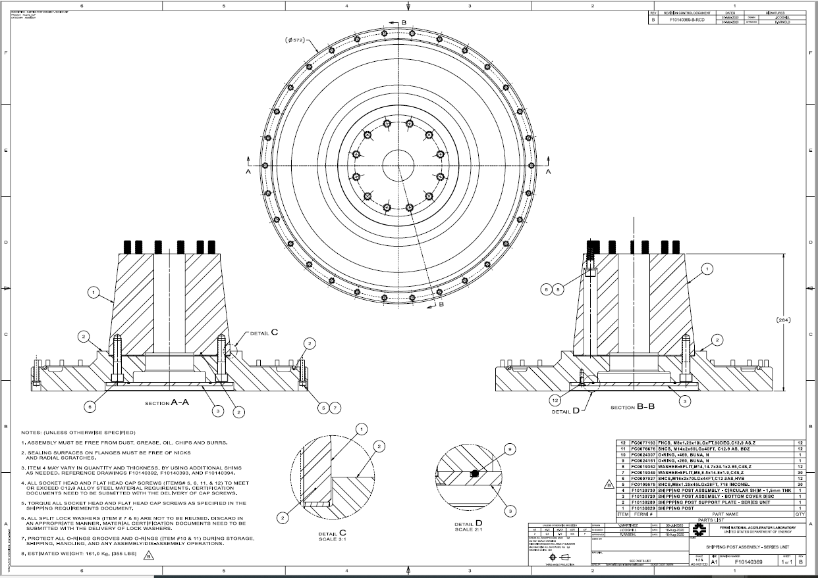
Drawings
Based on analysis results, drawings have been updated and released
Additional material added to support plate F10139289
Specified bolt material changed on assembly F10140369 (shown) for the M8 bolts connecting the support plate to the vacuum vessel

Slide 10
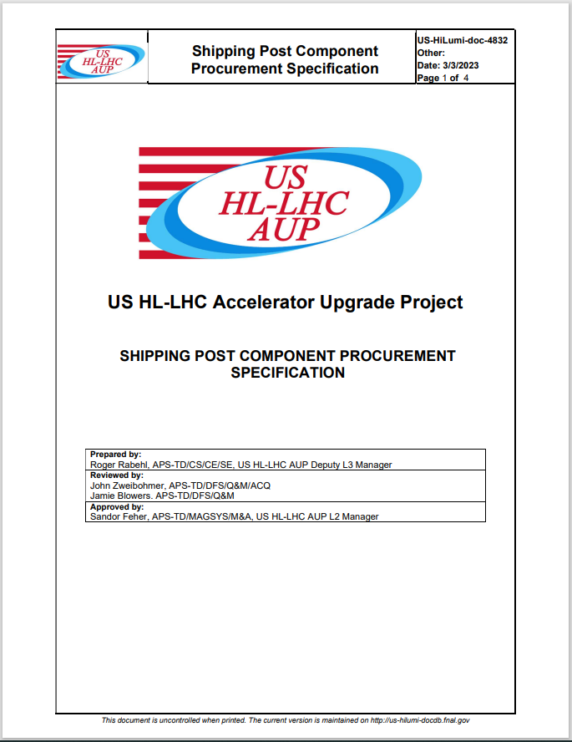
Procurement Specification
(US-HiLumi-doc-4832)
Specifies/references
Materials and certifications
Inspection and acceptance criteria

Slide 11
Testing & Validation
(US-HiLumi-doc-4855)
Specifies/references
Components to be tested
Required test equipment
Test method

Slide 12
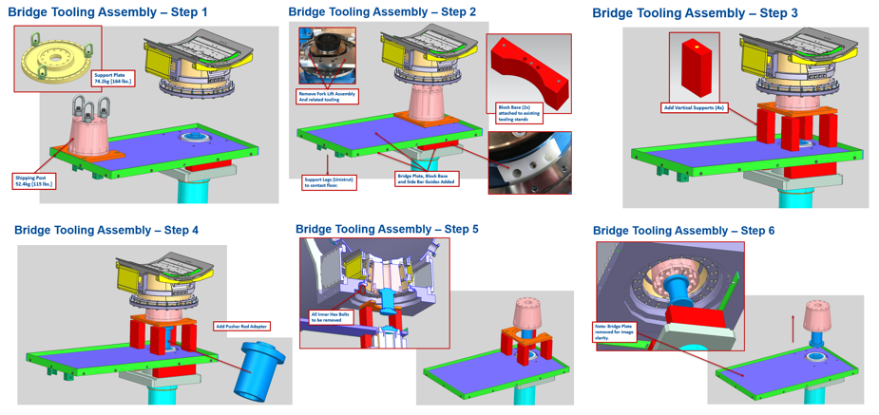
Release to Operations
Shipping posts will be released to operations after:
Receipt, inspection/acceptance, and testing of the first shipping post
Receipt and inspection/acceptance of the first set of 3 shipping posts
Review and approval of shipping post installation and removal procedures.

Slide 13
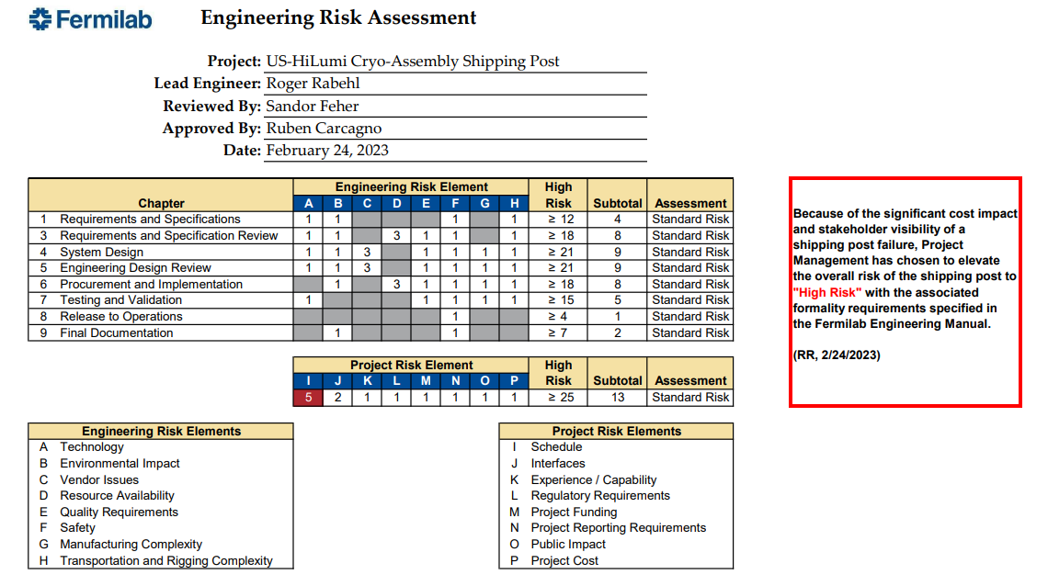
Engineering Risk Assessment
(US-HiLumi-doc-4798)
Specifies/references
Overall risk elevated to “High Risk” by project management

Slide 14
Summary
Shipping post design has been thoroughly analyzed.
Results of the analysis are reflected in revised & released drawings.
Testing & validation plan will ensure that the shipping posts will function as expected.
Documentation required by the Fermilab Engineering Manual has been written.

