Slide 1
Insertion Depth between FEMB and CR adapter board
Shanshan Gao on behalf of BNL CE Team
04/04/2023

Slide 2
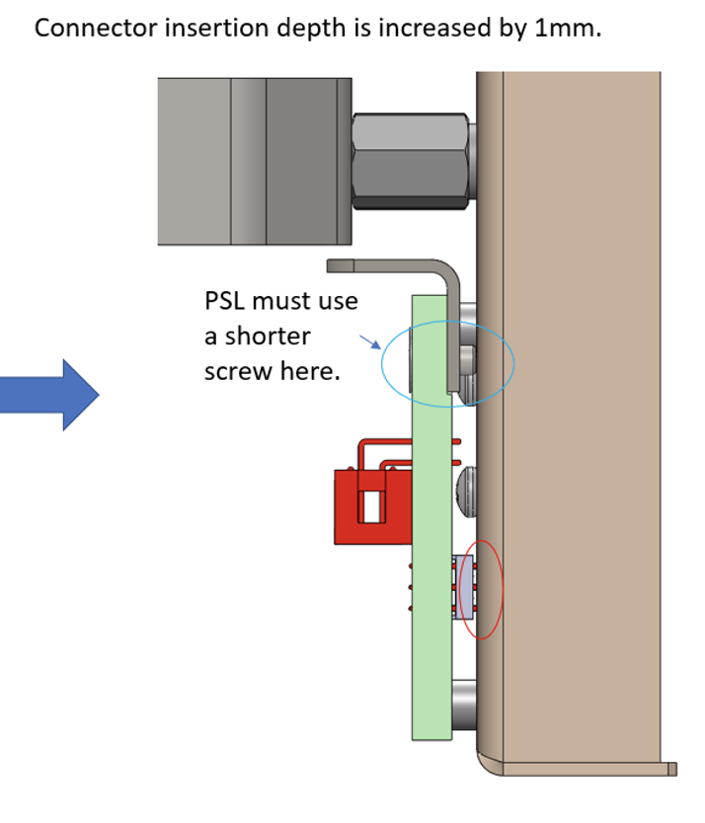
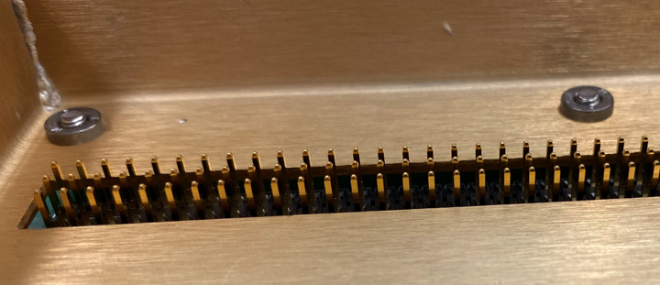
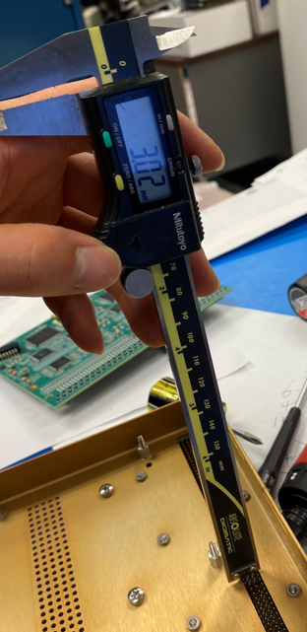
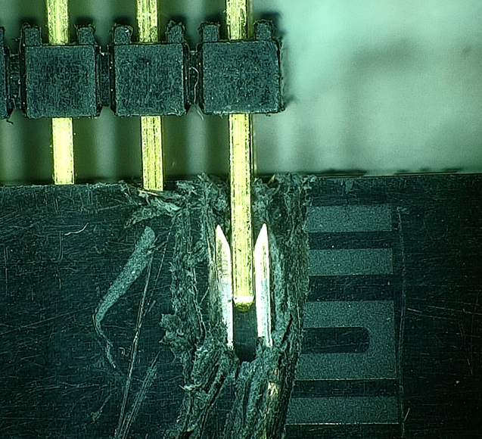
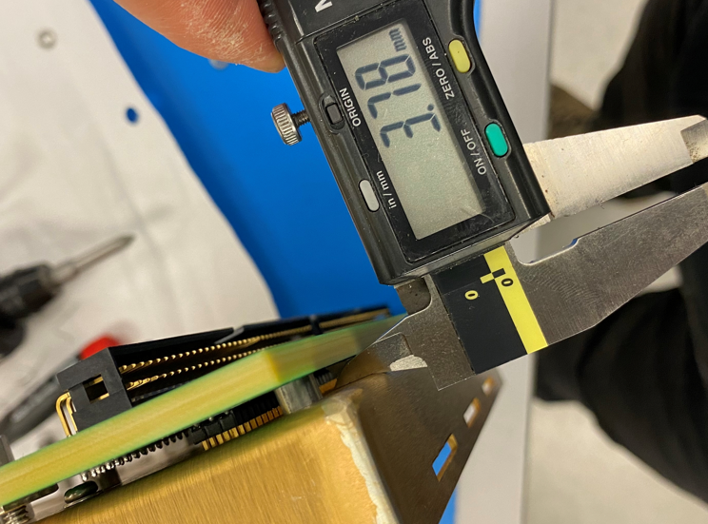
Not sufficient insertion depth between FEMB and CR adapter board
Issue exists since ProtoDUNE CE-box assembly
In order to increase insertion depth, standoffs between CR adapter board and the box of each CE box for ProtoDUNE APA2-4 were replaced with 3m standoffs

Slide 3
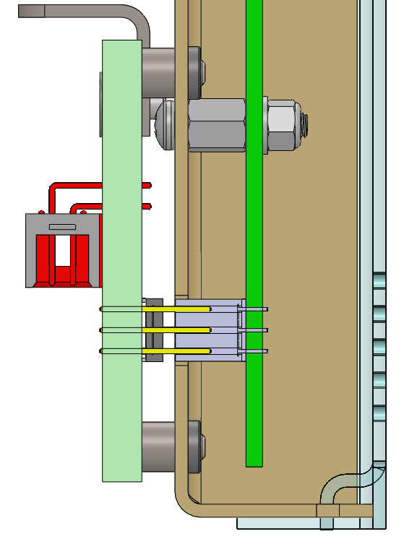
Tolerance analysis of pin insertion
o
The pin insertion depth can therefore be calculated as
D = p2 – p1 = (8.38mm) – (4.0658mm ± 0.3616mm)
= 4.3142mm ± 0.3616mm
Thus, the actual minimum pin insertion depth is
4.3142mm – 0.3616mm = 3.9526mm.
According to the Samtec datasheet, the required minimum pin insertion depth is 3.68mm.
3.9526mm – 3.68mm = 0.2726mm
So, the actual minimum pin insertion depth is only 0.2726mm more than the required minimum pin insertion depth.
Note that the omitted tolerances of connectors may make the situation worse. Also note that the FEMB deflects (in mm scale) due to the insertion force applied when the CE box is assembled. The extra 0.2726mm insertion depth can not guarantee a reliable connection.
p1
p2

Slide 4
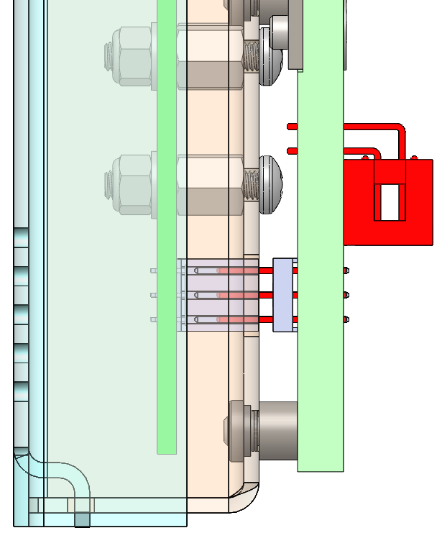
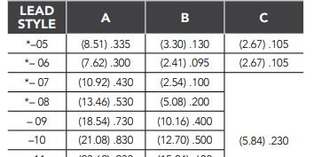
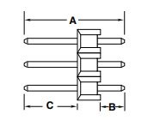
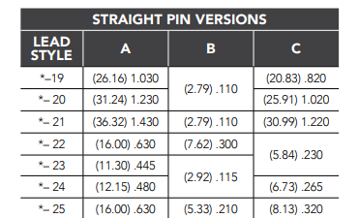
A solution
A solution to increase the pin insertion depth is to replace the current connector, TSW-132-08-G-T, with a long pin connector, TSW-132-25-G-T, which is readily available.
The pin of the new connector is 2.29mm (8.13mm – 5.84mm) longer than the pin of the current connector. With 2.29 mm extra length, the requirement of insertion length will be met, even with the mm scale of FEMB deflects.
long pin of new connector
short pin of current connector

Slide 5
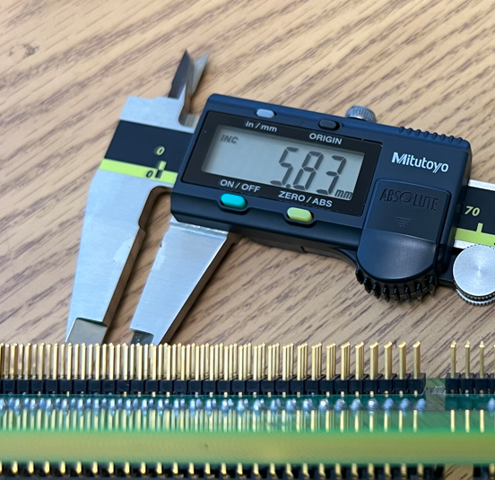
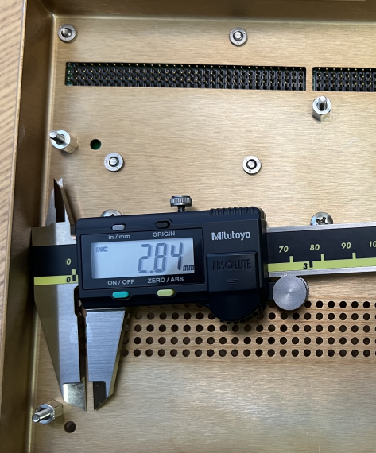
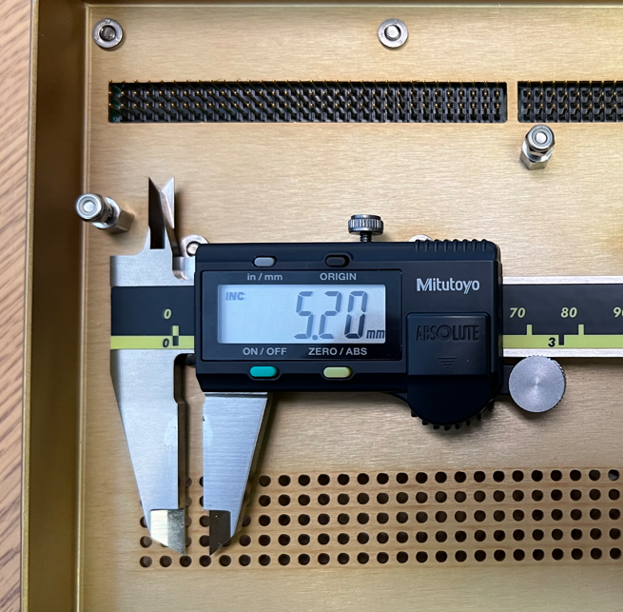
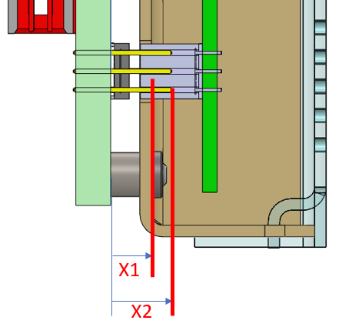
A Visual Inspection (03/22/2023)
C =
C =
X2-X1
X2-X1
TSW-132-08-G-T
TSW-132-25-G-T

Slide 6
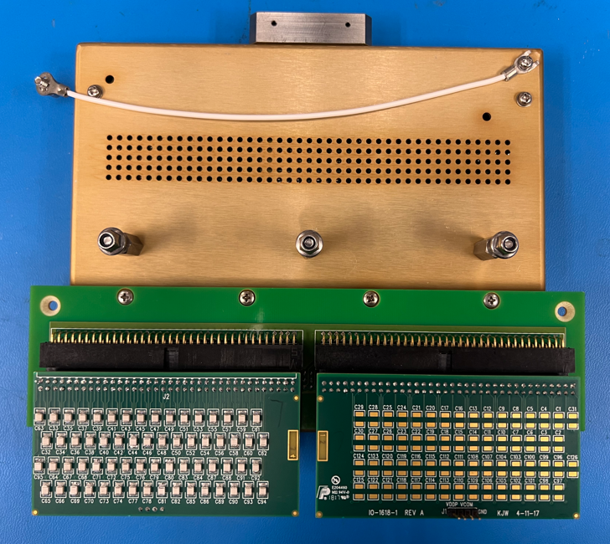
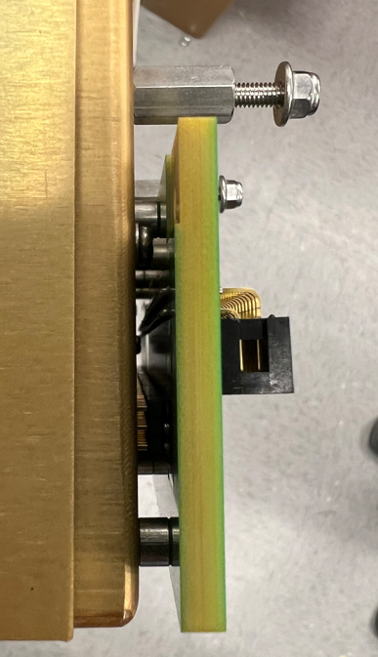
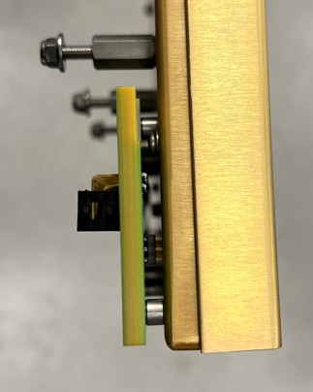
Assembly Trial (03/22/2023)
Comment from Augie
No difference or issue observed from the CE box assembly process
A cold test with the assembly was done

Slide 7
backups

Slide 8
Tolerance analysis of pin insertion
o
L2
L1
L3
Take the back surface of the adapter board as the origin ‘o’.
L1 = 4mm ± 0.13mm //height of the adapter board standoff
L2 = 0.062” ± 0.004” //thickness of the CE box case
L3 = 7mm ± 0.13mm //height of the FEMB standoff
L4 = 8.509mm * //height of the FEMB connector
The position of the top surface of the FEMB connector relative to the origin:
p1 = L1 + L2 + L3 – L4
= (4mm ± 0.13mm) + (0.062” ± 0.004”) + (7mm ± 0.13mm) – (8.509mm)
= 4.0658mm ± 0.3616mm
* Tolerance information of the connector is not available.
L4
p1

Slide 9
Tolerance analysis of pin insertion
o
Take the back surface of the adapter board as the origin ‘o’.
The position of the pin tip of the adapter board connector relative to the origin:
p2 = A - B = (13.46mm) - (5.08mm) = 8.38mm *
* Tolerance information of the connector is not available.
p2

Slide 10
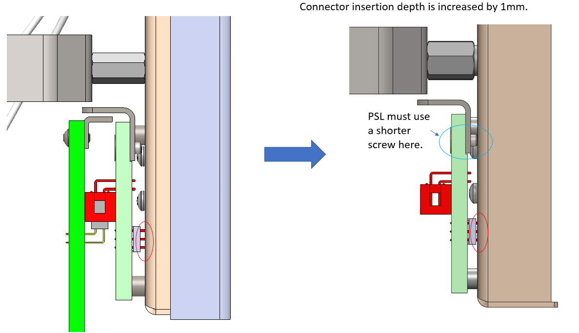
A solution to insufficient depth

