Slide 1
72 Hour Summary
Spencer Schiefelbein
April 3rd, 2023

Slide 2
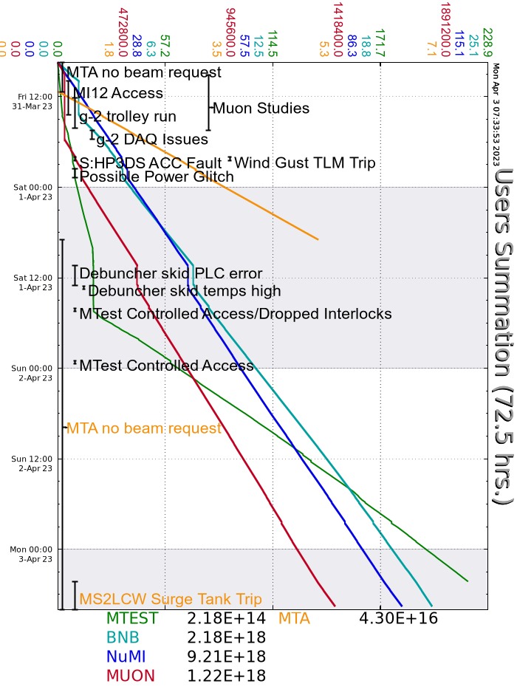
Summary
Friday
Mu2e Studies
MI12A/B prepared for Access for valve manipulations due to leak
MTA access followed by beam
Horn 1 RAW temperature fluctuations investigated
g-2 beam established in the evening
Fire alarm coded at D0 Assembly Building
Roof leak onto fire panel was cause – covering placed over panel
Wind gusts in evening tripped some TLMs off
GMPS trip in evening – experts came in and resolved
Saturday
Adjusted intensity to NuMI as needed based on Horn RAW temp alarms
MTA finished with beam
MIRF16 investigated by techs – no issues found
Debuncher tripped – PLC errors again
Linac MC replaced modules
Tripped again, so left off and are running without it
Sunday
Series of Recycler RF02 trips on Spark Tuner Fault
DM replaced broken belt on Booster Air handler unit
Accessed Source A HV Cabinet to reset Source A Heater
Monday
MS2LCW system tripped off at ~0400h
Experts filled system this morning
NuMI beam disabled at ~0800h for Horn 1 RAW temperatures investigation
Current Conditions:
BNB: 5.04 E16 p/hr
Muon 1.02E12 PoT
Establishing beam to MTest

