Slide 1
9 O’Clock Meeting
Nathan Ruffatti
MCR Crew Chief
Wednesday, April 4th, 2023

Slide 2
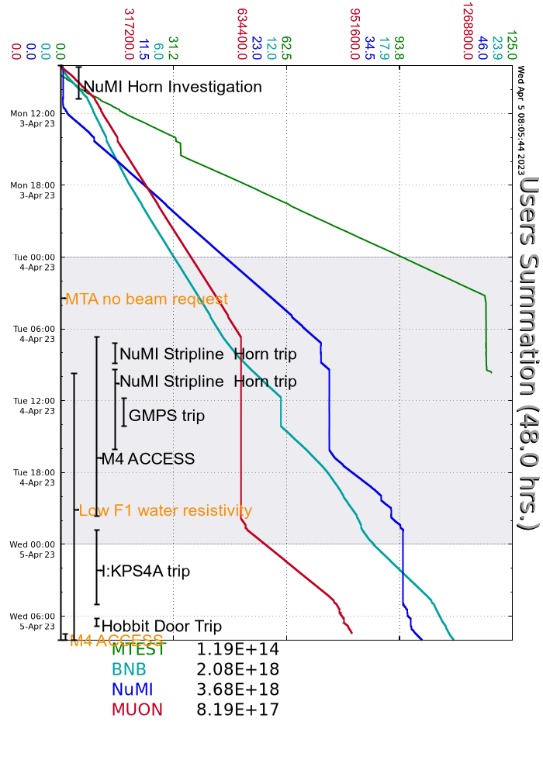
Since Monday…
Monday
Horn 1 RAW temp investigation
Adjusted PID loop
I:HP608N odd behavior again, held off NuMI permit for a bit
Tuesday
NuMI horn trip, Experts investigated
Replaced the Safety Relay Chassis
M4 Access all day
Remnant resistivity low, turned off Muon And SY power supplies
Flow was increased, was able to run to g-2 overnight
GMPS trip
GMPS racked out and investigated GMPS1
I:KPS4A tripped off
Replaced thyratron with spare and also replaced Fil/Res PS chassis
Continues to trip off occasionally on pre-fire, likely cause for a couple of NuMI RAD trips
Wednesday
M4 access

