Slide 1
2x2 ODH analysis
Sergey Koshelev
2x2 Installation meeting
10 April 2023

Slide 2
Agenda
Why?
What?
How?
2x2 results

Slide 3
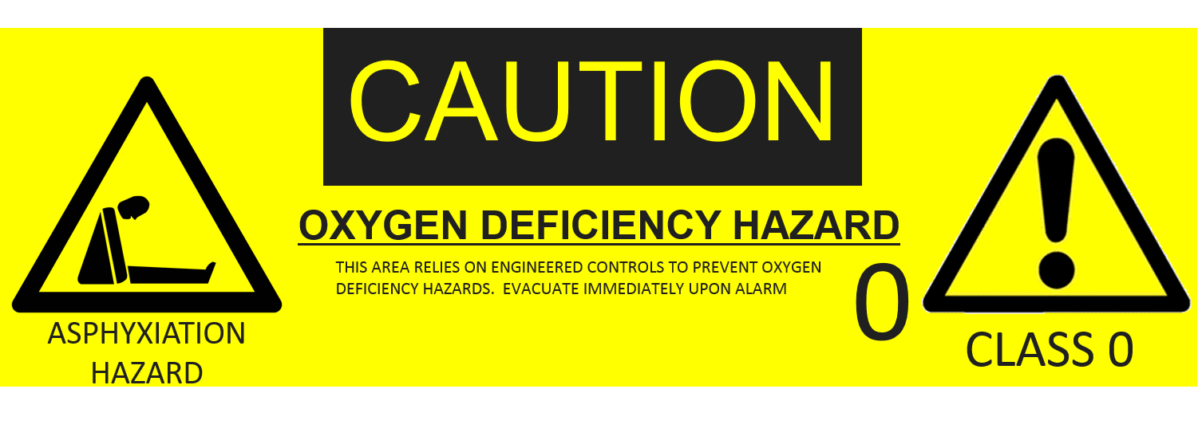
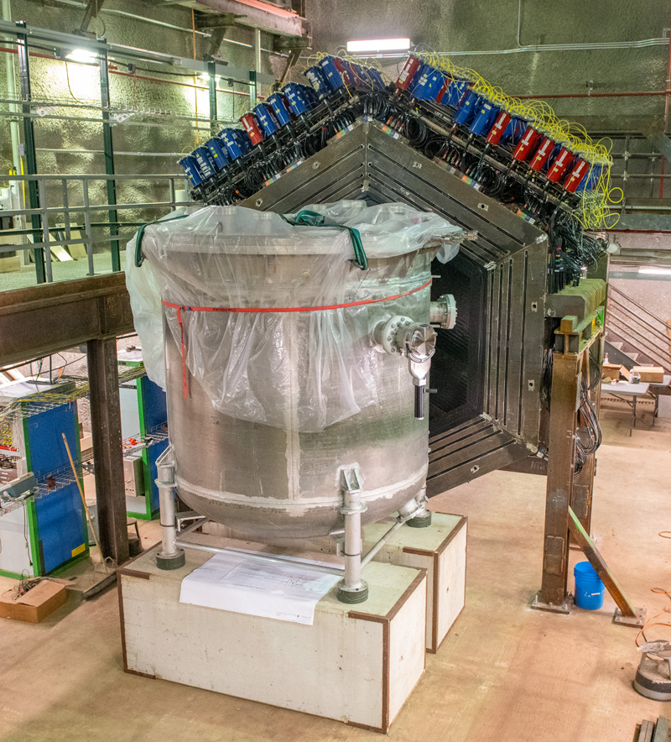
Why are ODH analyses?
Personnel safety
DOE requirements
Supporting science

Slide 4
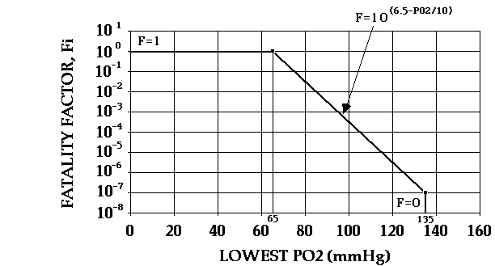
What are ODH analyses?
Quantify the risks caused by ODH
Prevention through the design
  Implement changes on the system level to reduce the risks.
Defense in depth
  Provide multiple layers of
  protection.
Conservative assumptions

Slide 5
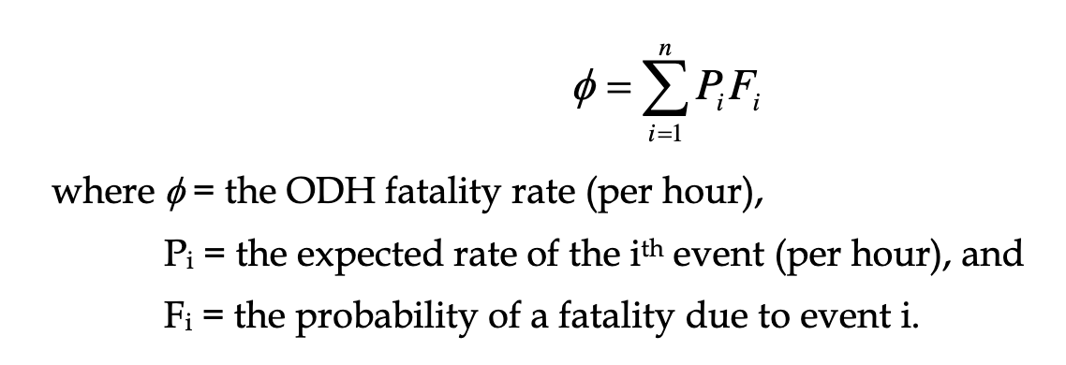
How are ODH analyses?
Failure modes
  Flanges
  Pipes and welds
  Bayonets
  Valves
  Flex hoses
  Common cause failure
Scenarios
  Power failure
  ODH chassis failure
  Fan failure

Slide 6
2x2 parameter sensitivity analysis
Transfer line failure
  Number and leak area for bayonets:
    Bayonets require to be protected from complete blowout,
    Direct measurement of leak areas.
  Number of CF flanges:
    Interlock on transfer line isolation valves.
  Inventory and air volume:
    Limit number of dewars during fill,
    Stratification and floor grade.
  Constant leaks and “medium” releases:
    Min fan capacity required.

Slide 7
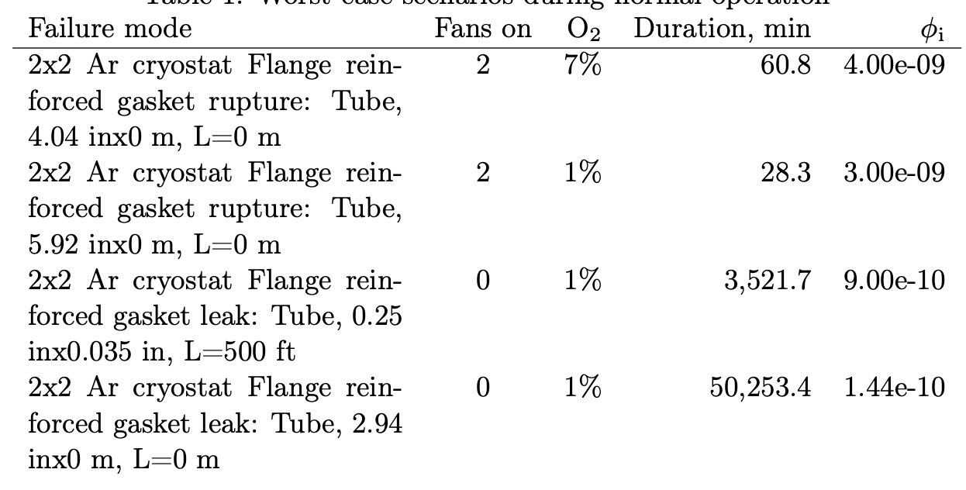
2x2 results
Normal operation: Engineered ODH 0
  For nominal fan capacity 7000 CFM
Fill: TBD

Slide 8

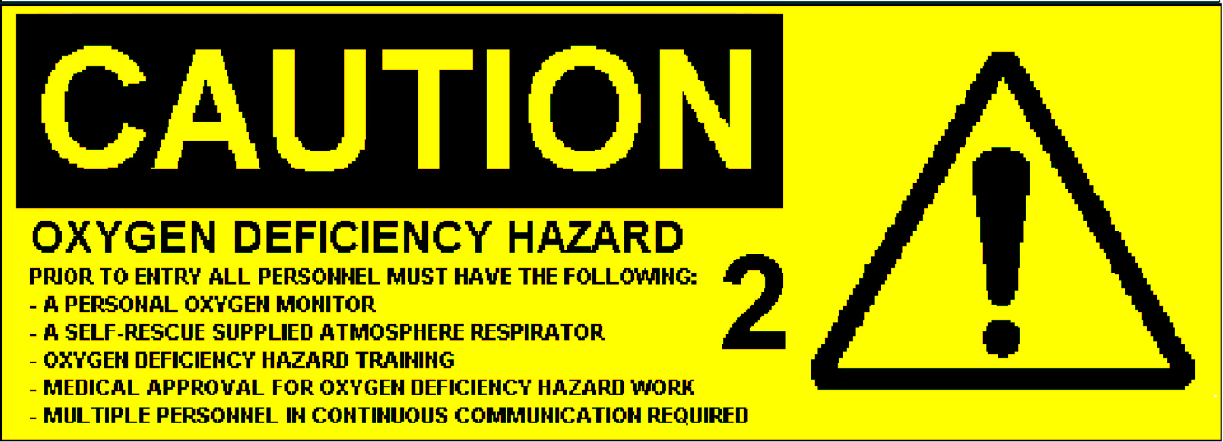
2x2 Out-of-service policies
Power outage
  Normal operation: ODH 1
  Fill: ODH 2
Fan unavailability
  Normal operation: ODH 1
  Fill: ODH 2

Slide 9
Summary
Why, what, and how ODH.
Most impactful factors for 2x2 ODH.
Results and protection to implement.

