Slide 1
GEANT Reconstructions *Orientation Fixed (Again…)
6/5/24

Slide 2
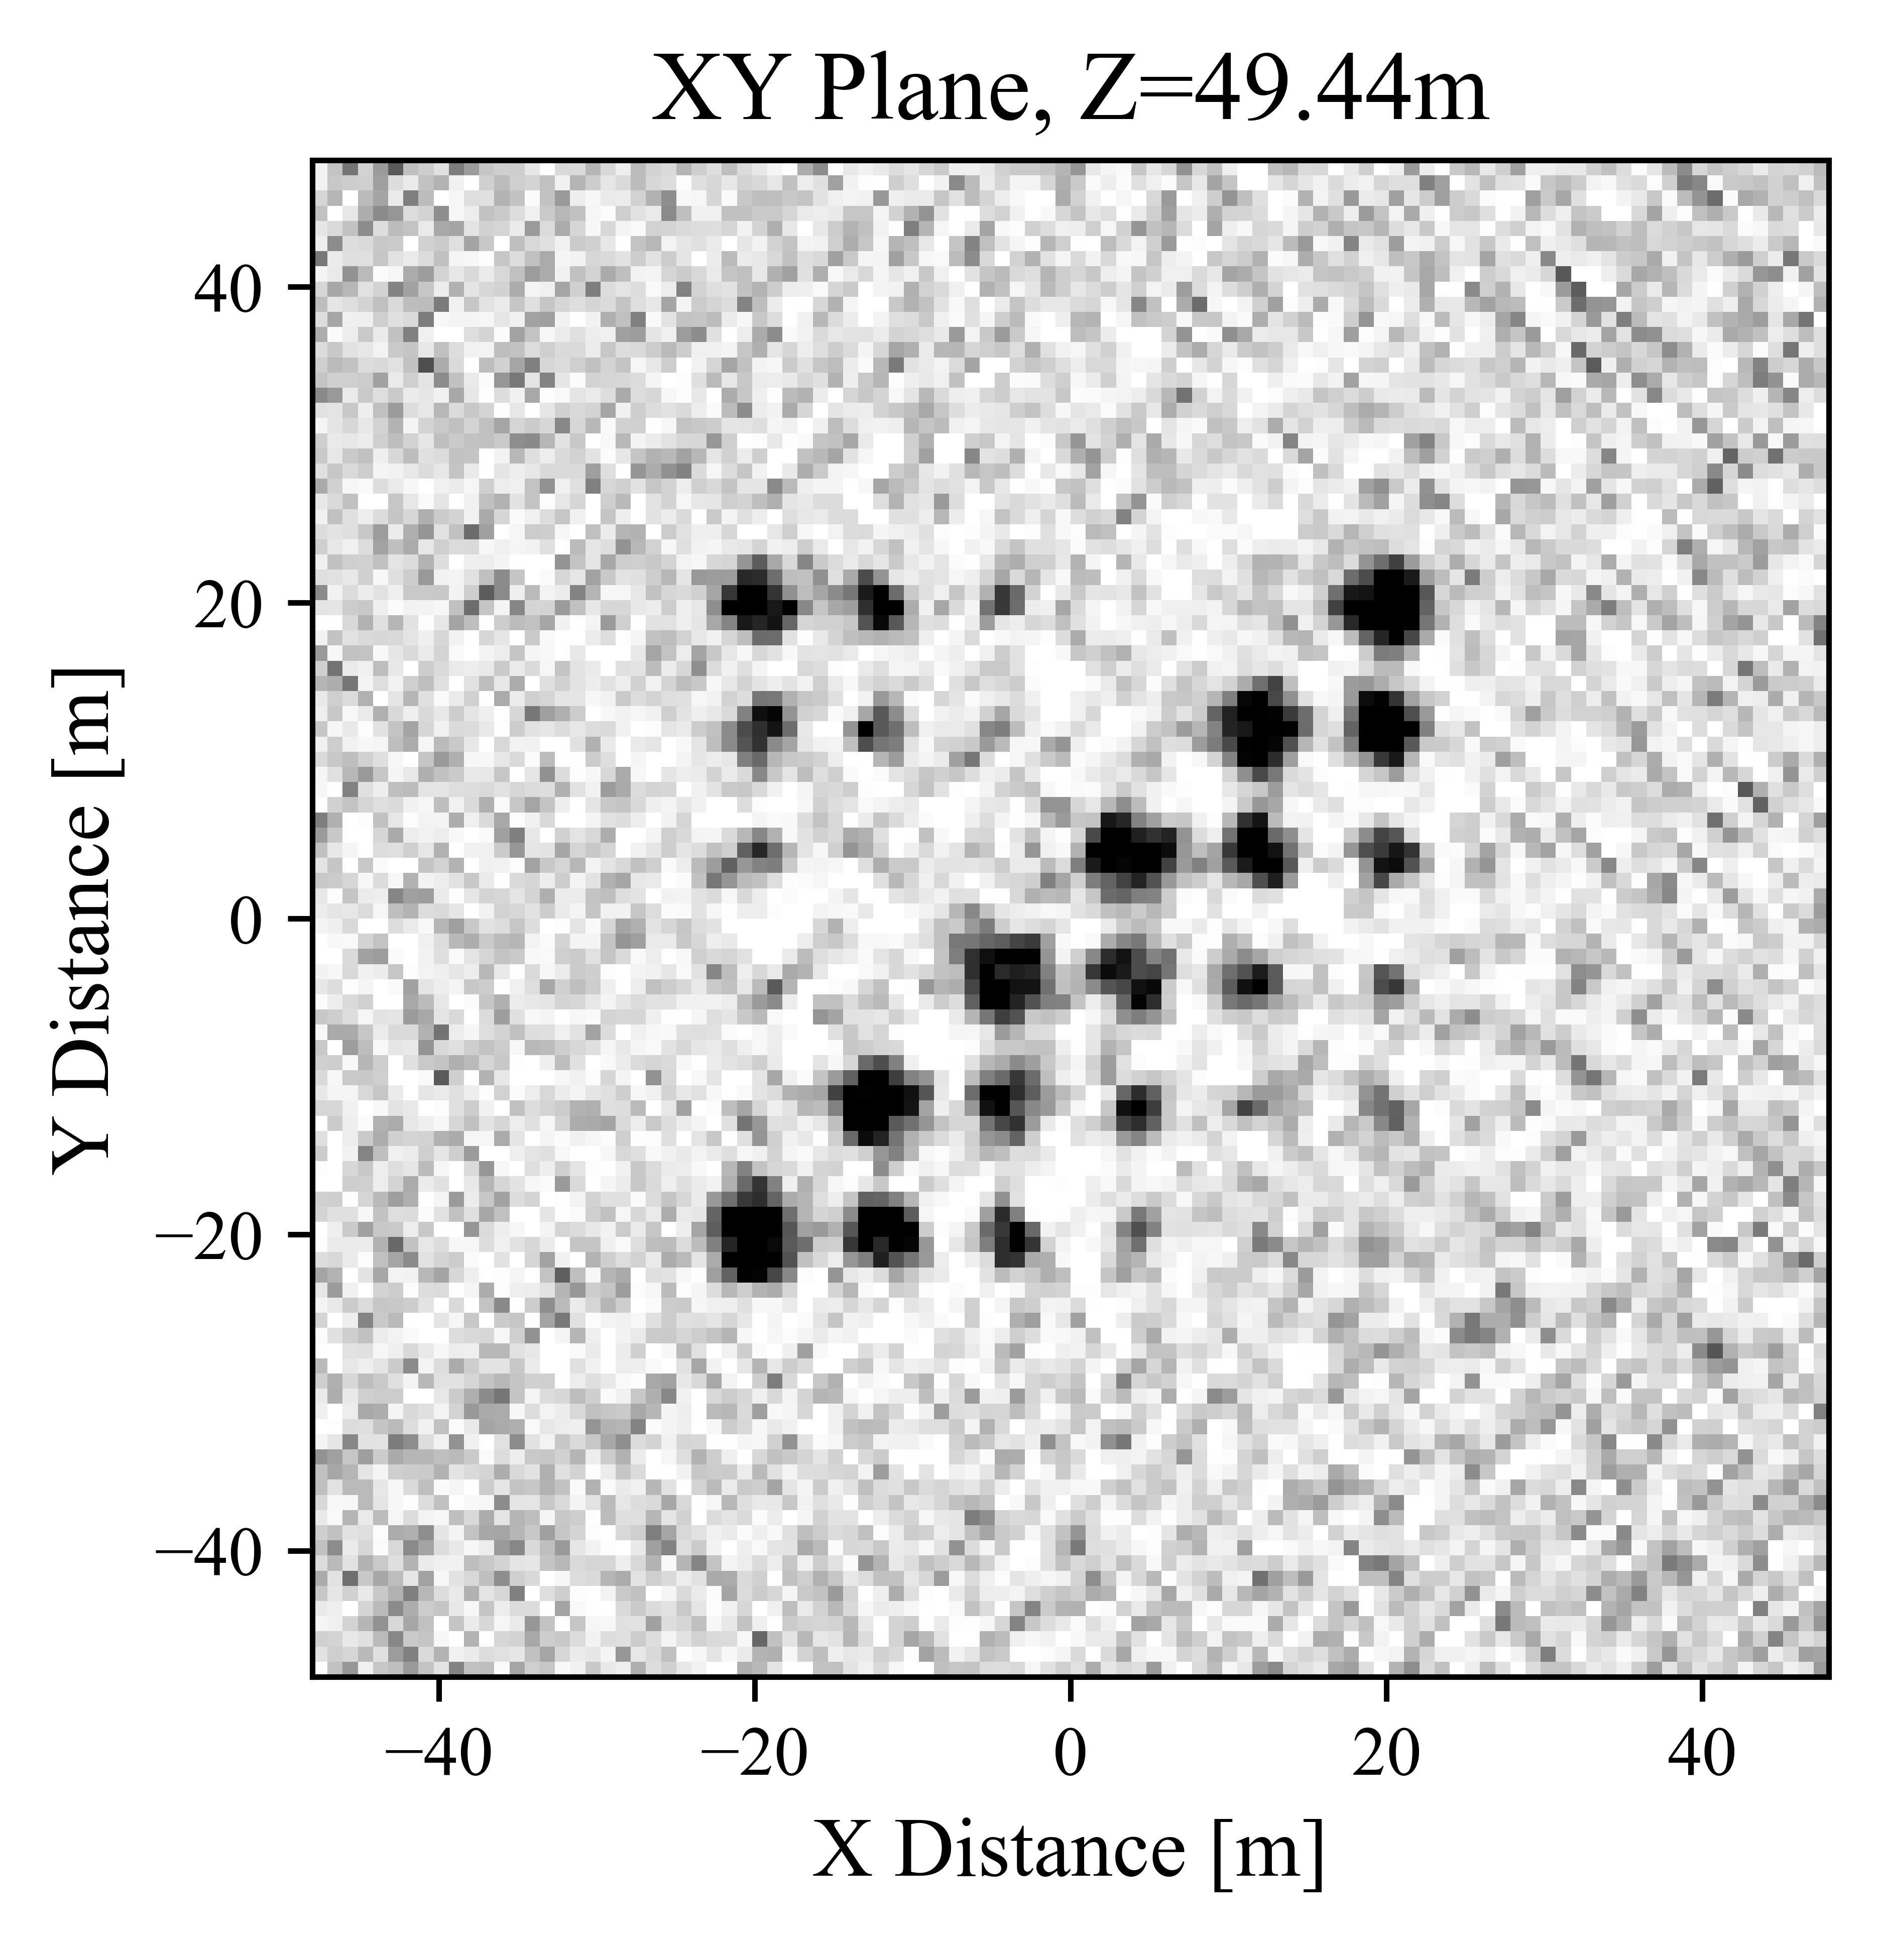
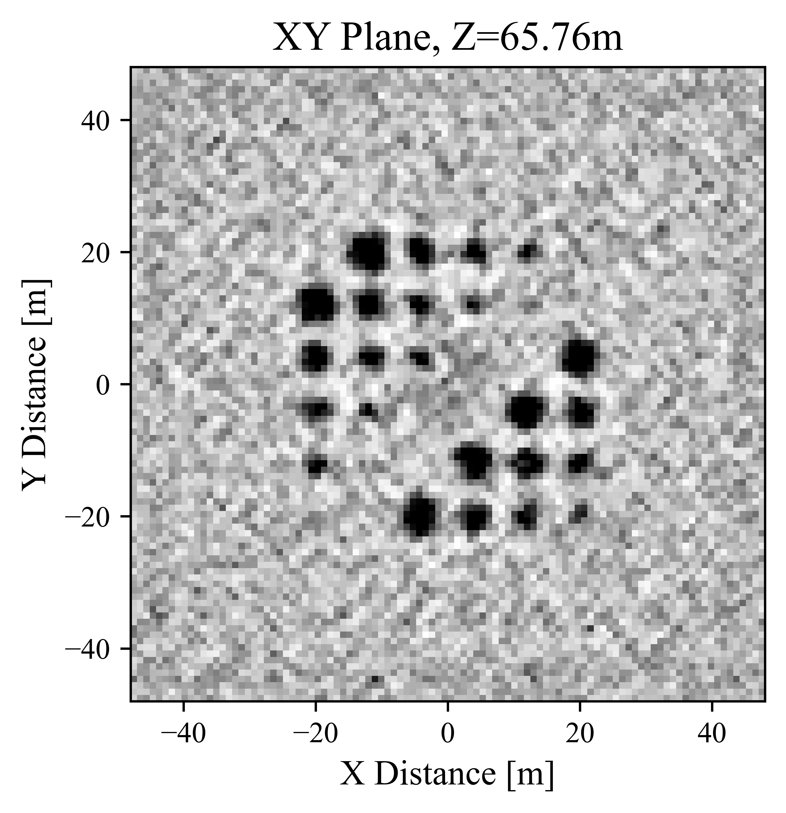
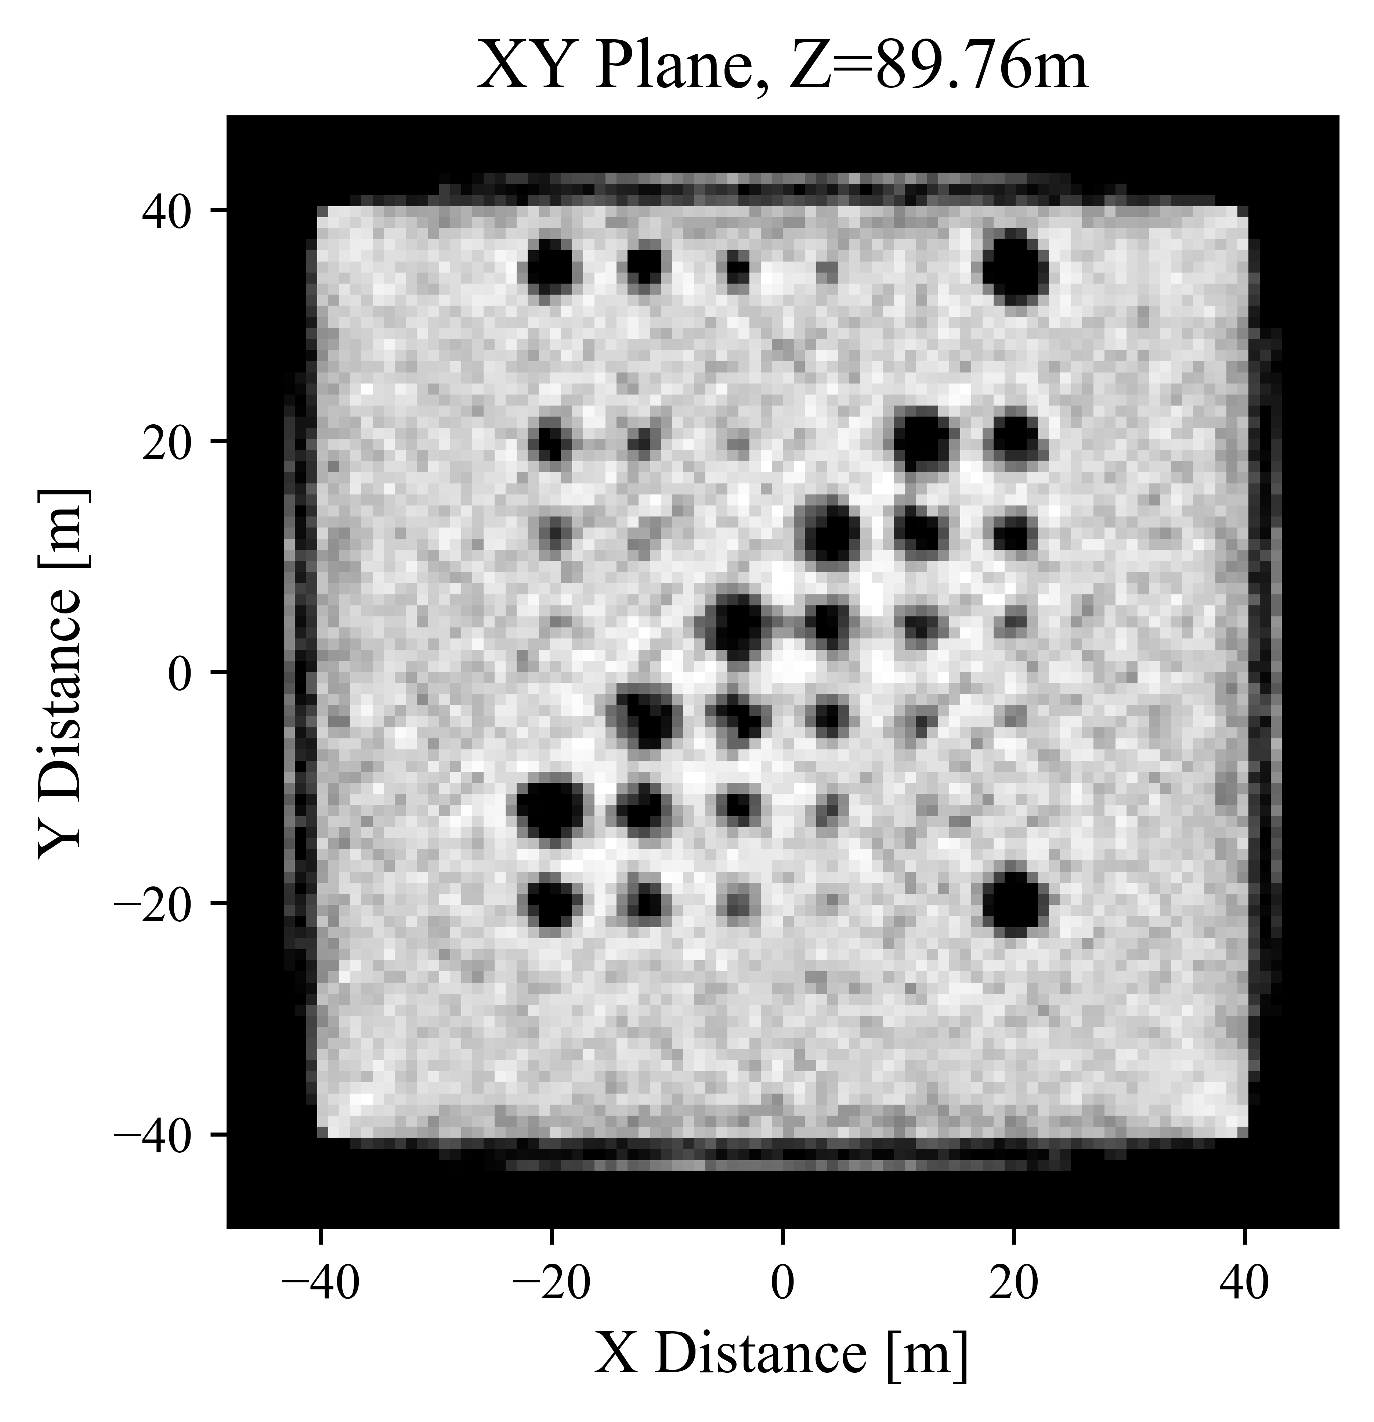
Final Reconstructions (XY Plane) – 500 Iterations

Slide 3
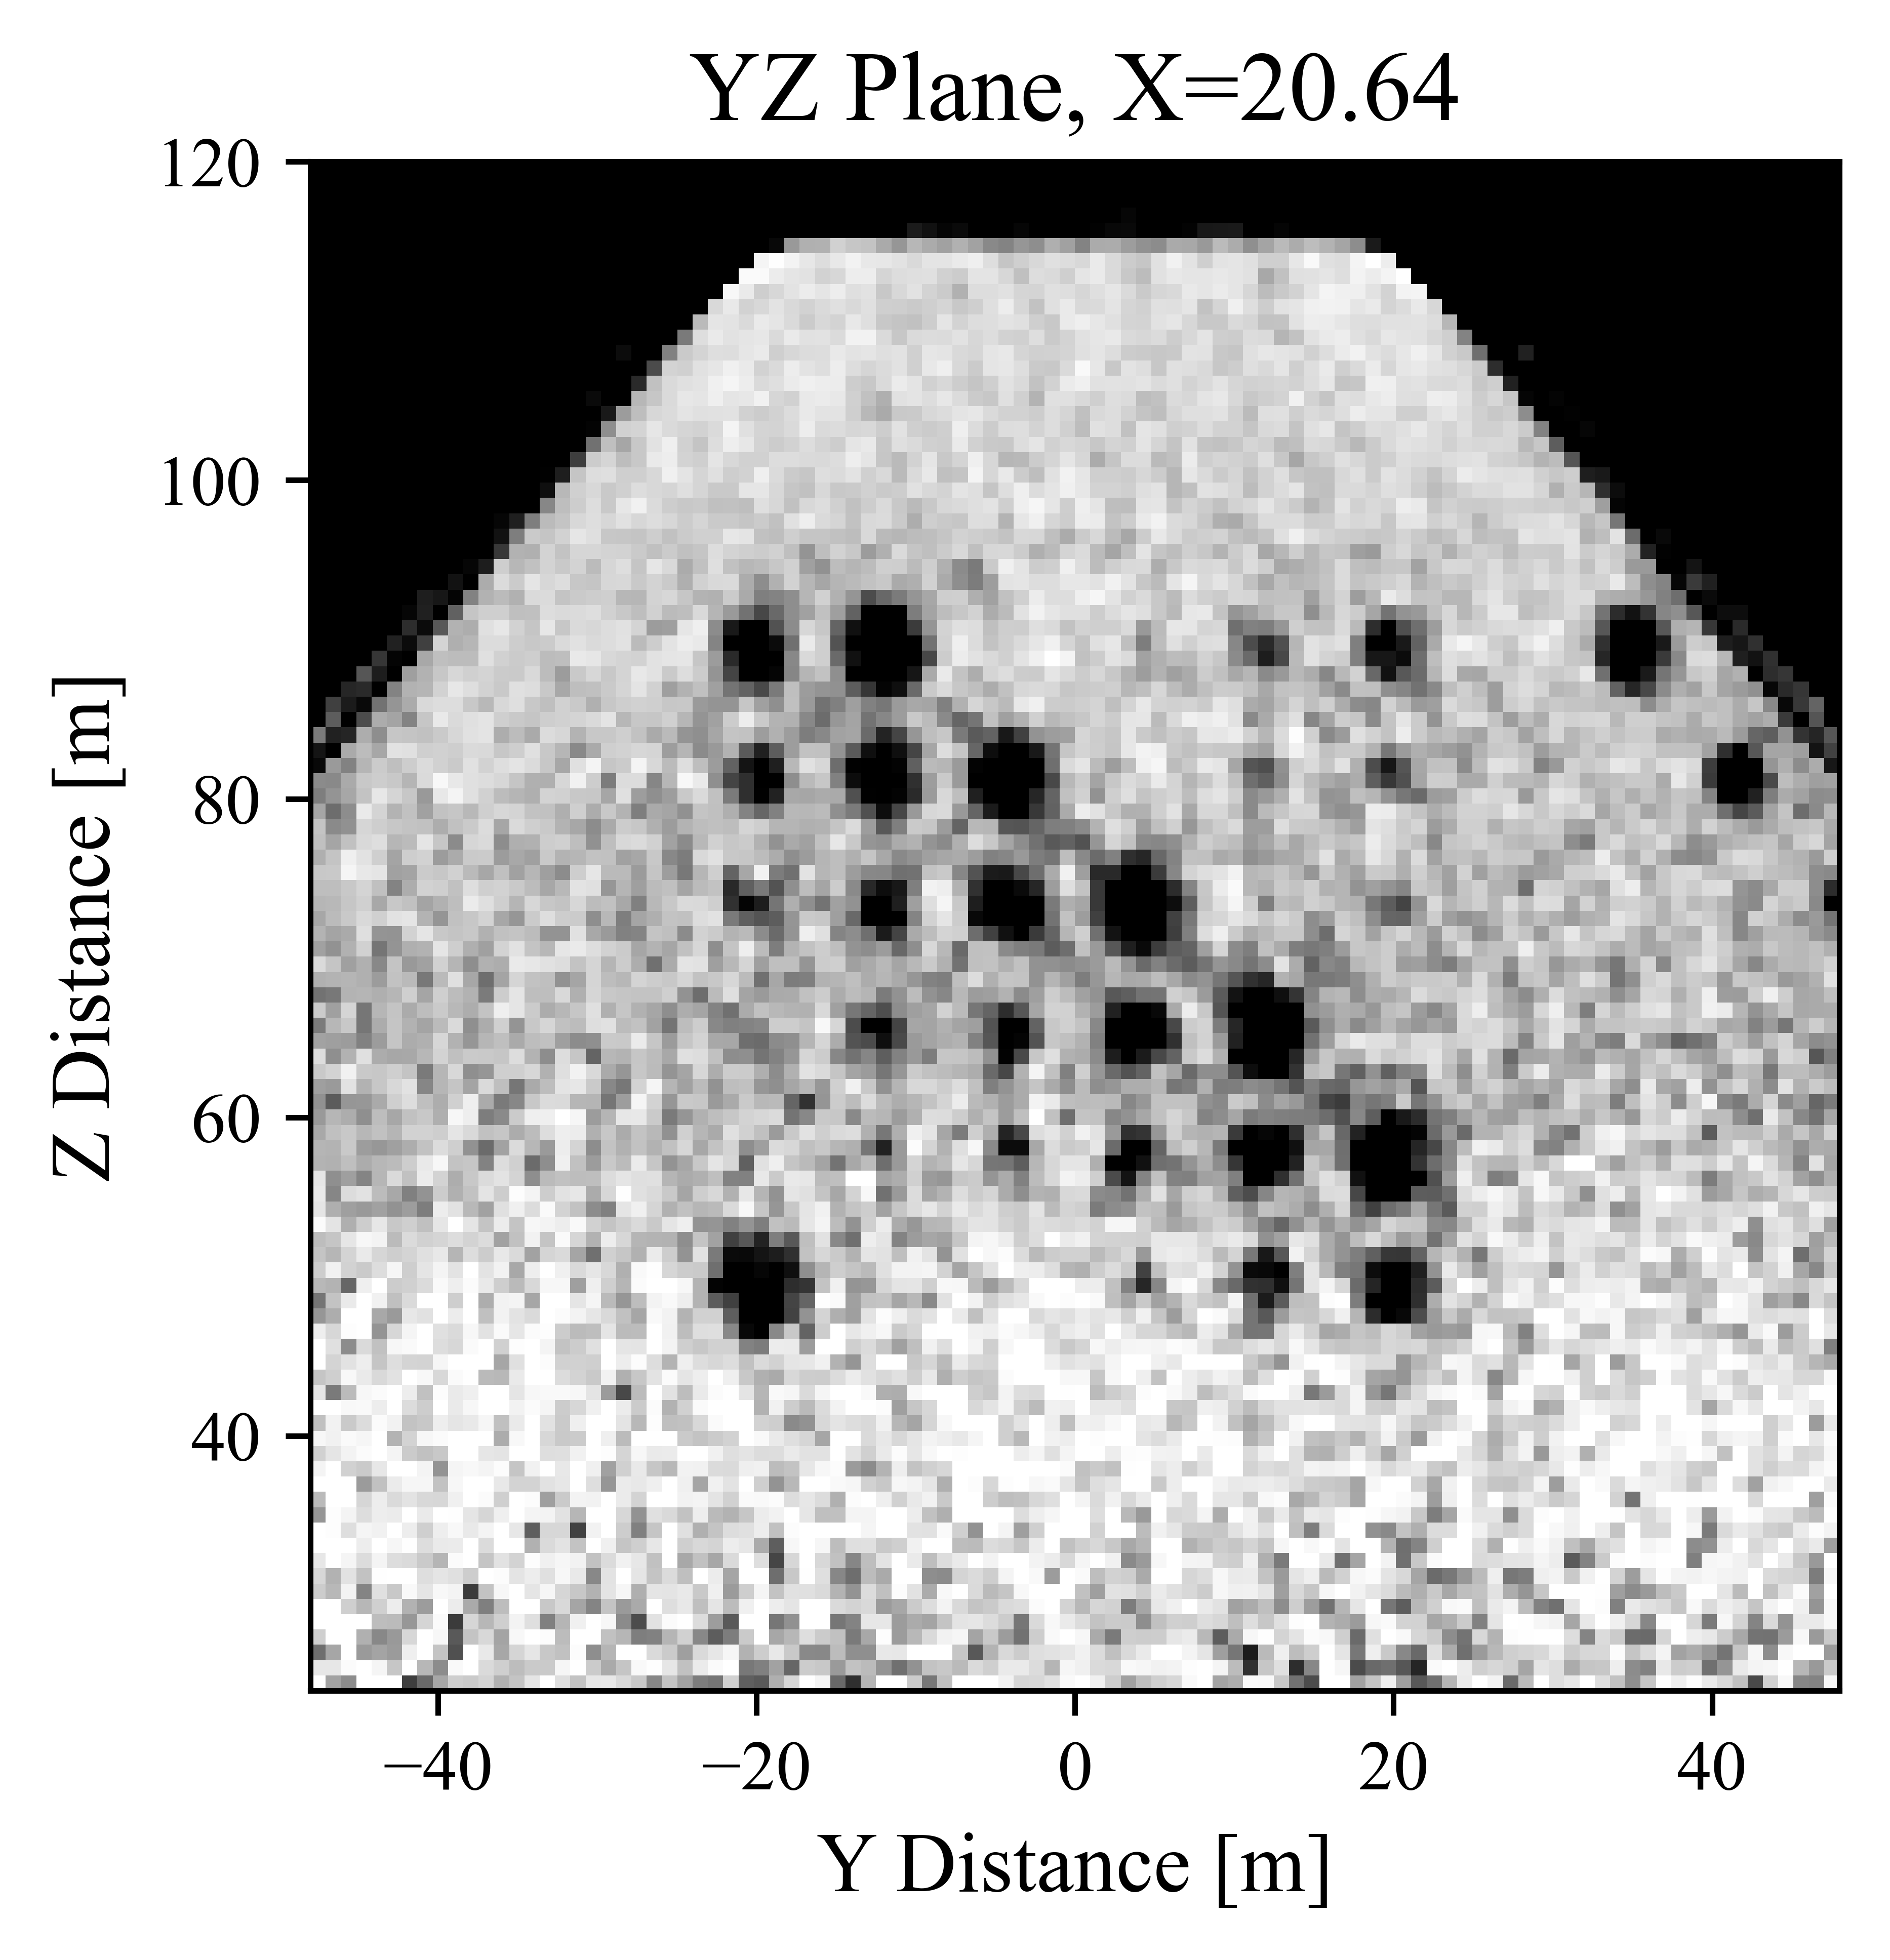
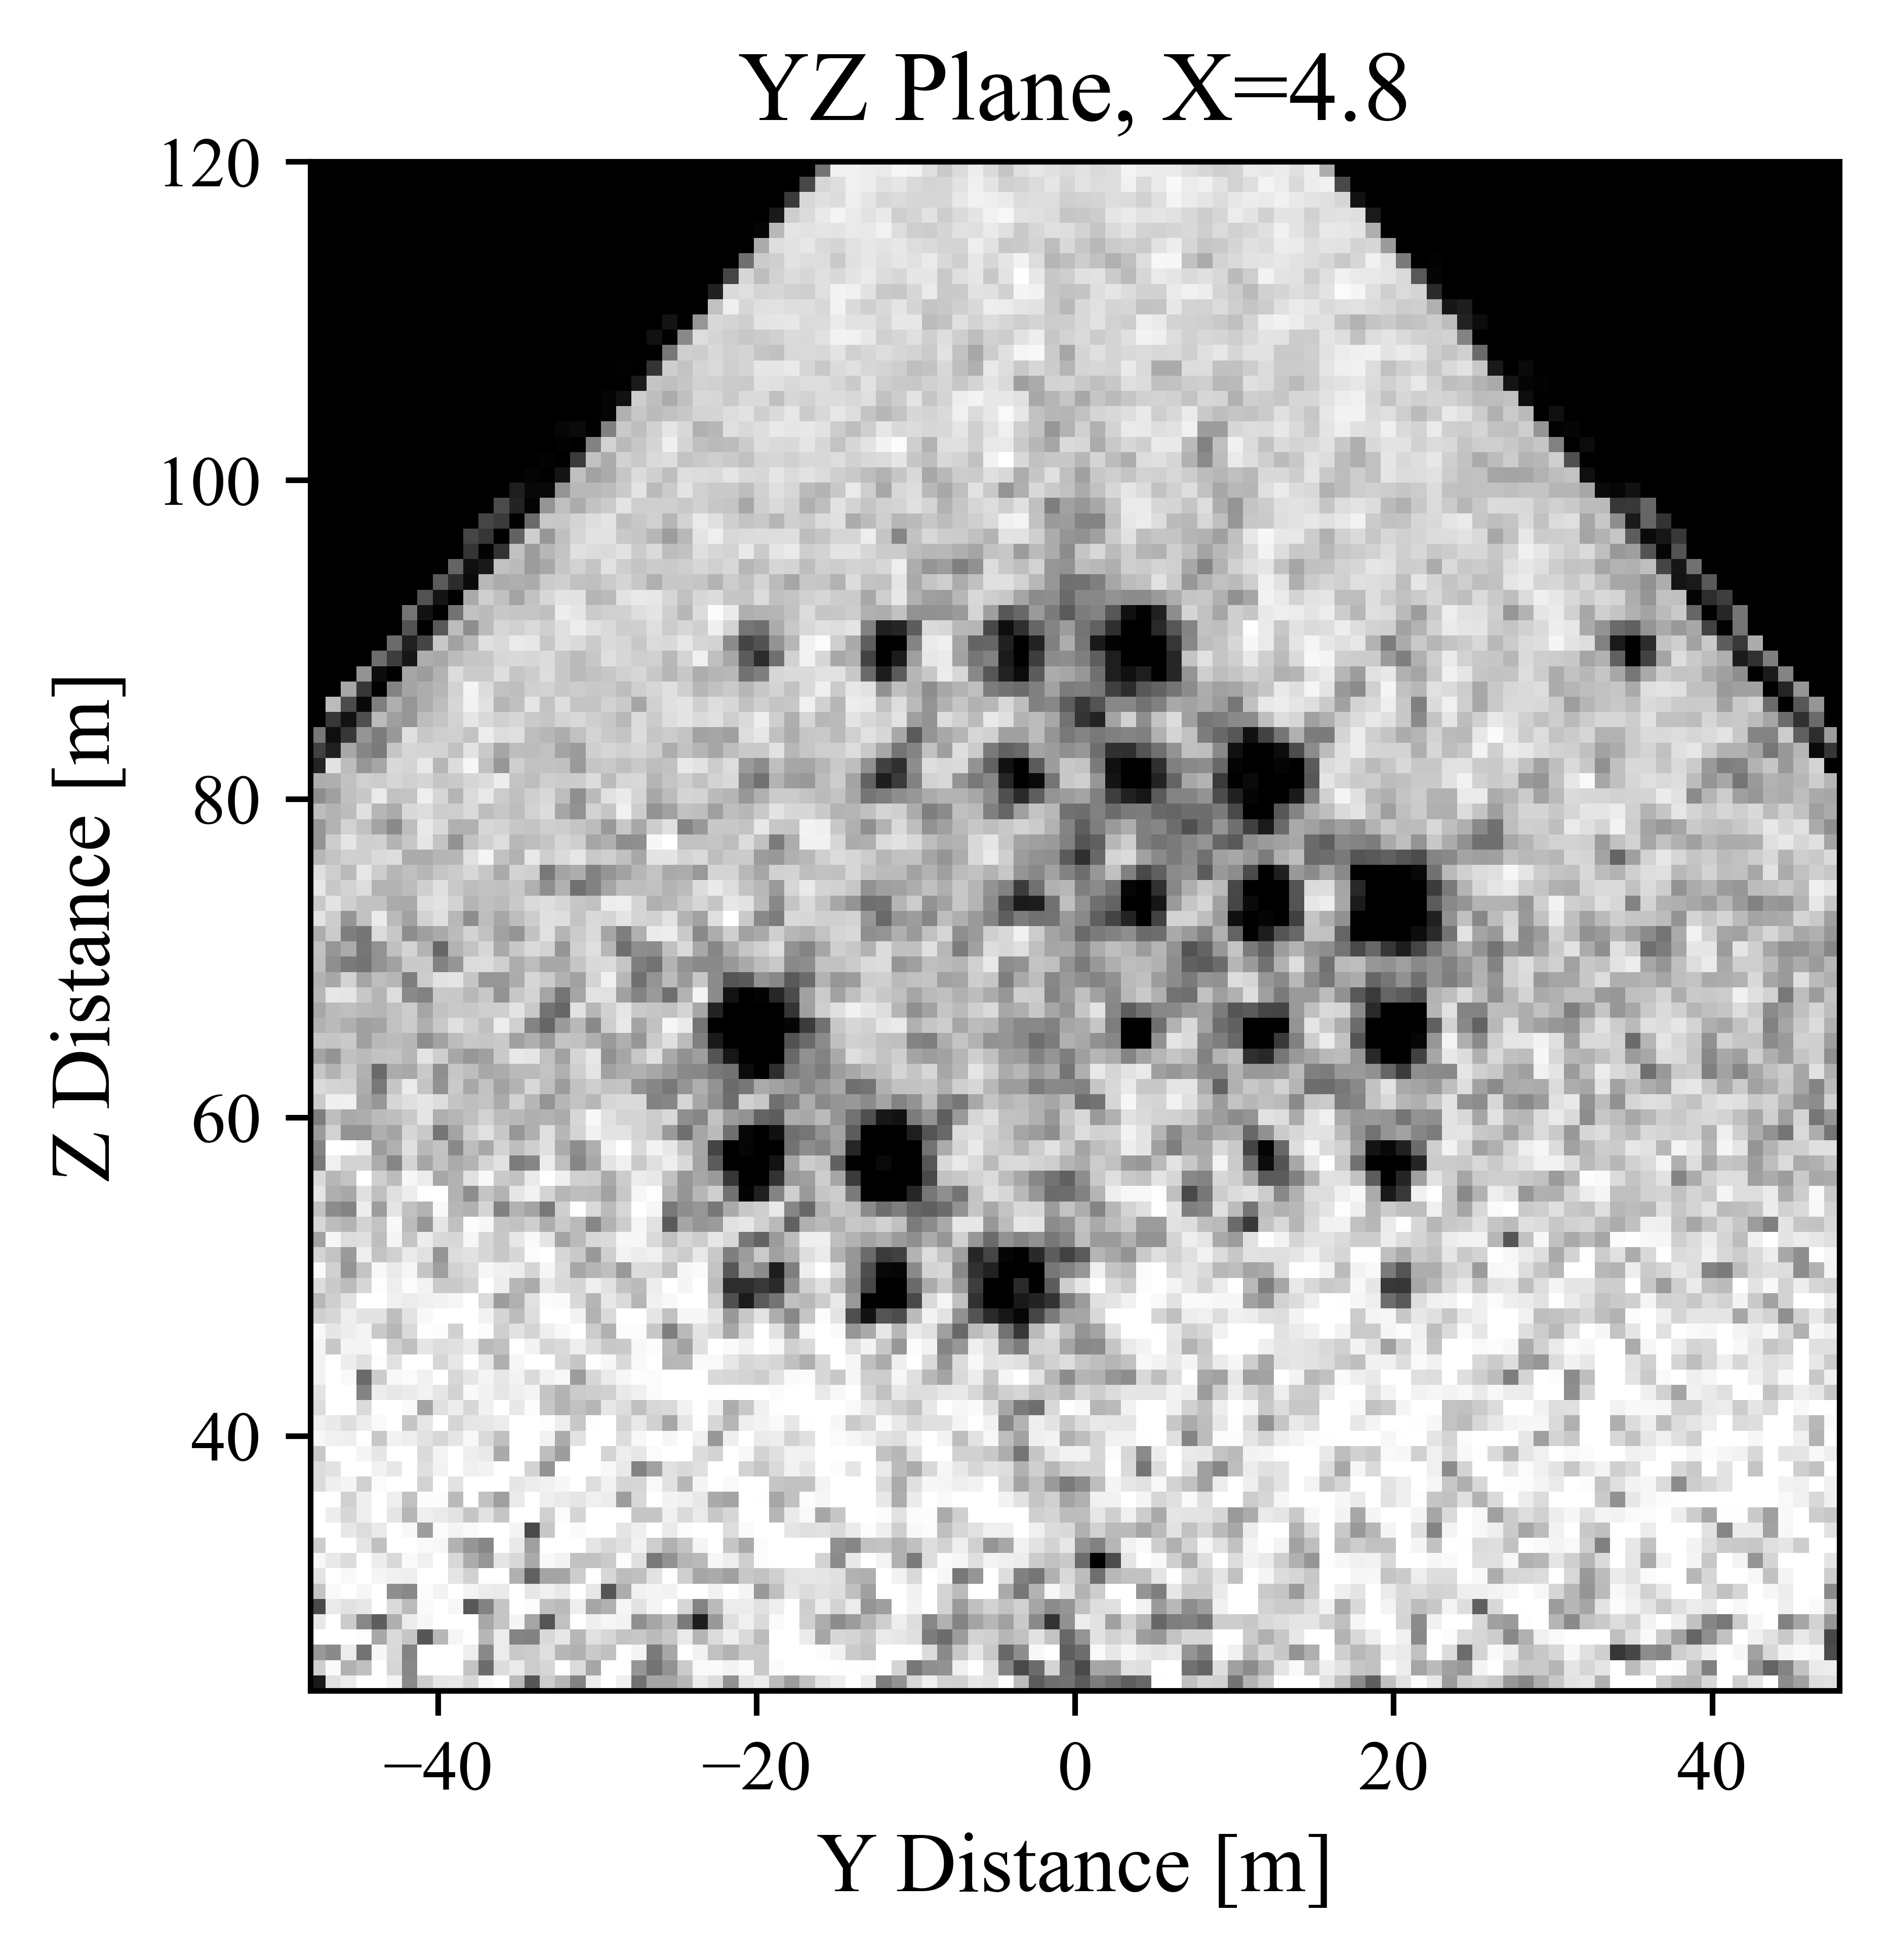
Final Reconstructions (YZ Plane) – 500 Iterations

Slide 4
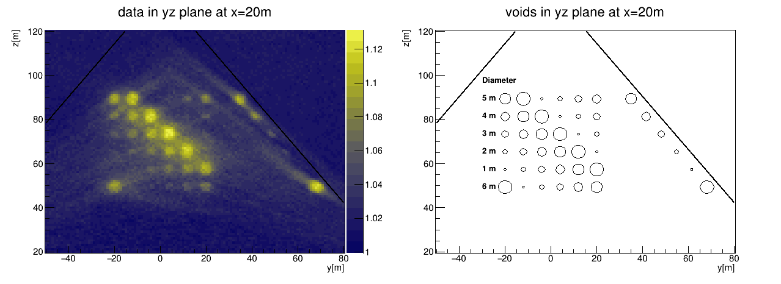
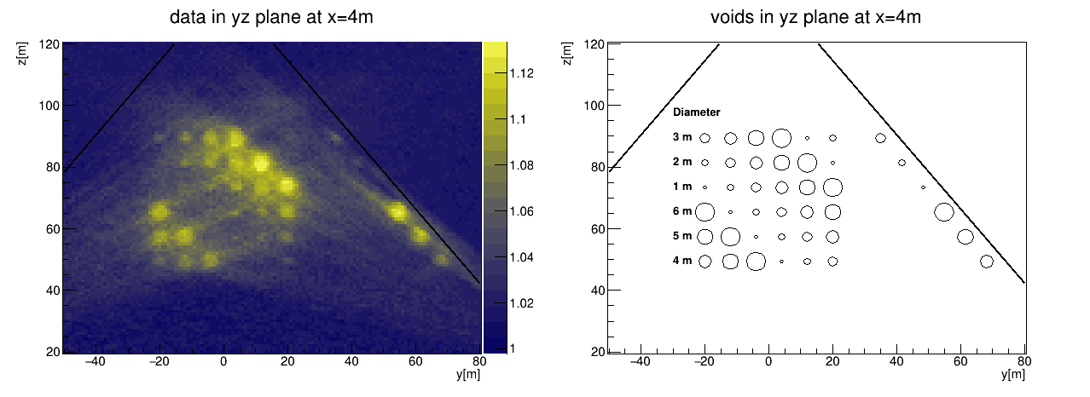
Final Reconstructions (YZ Plane) – 500 Iterations

Slide 5
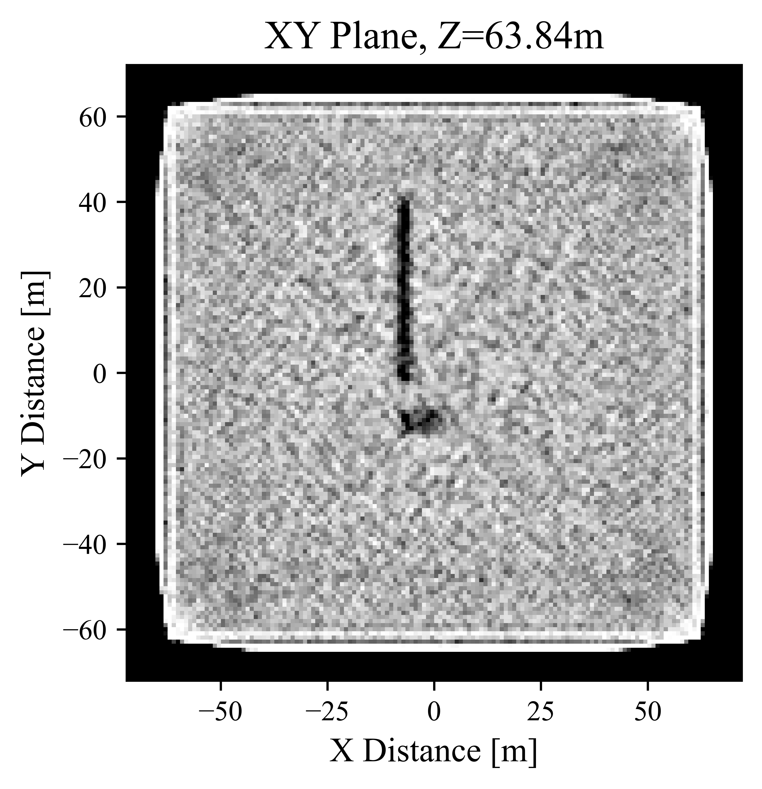
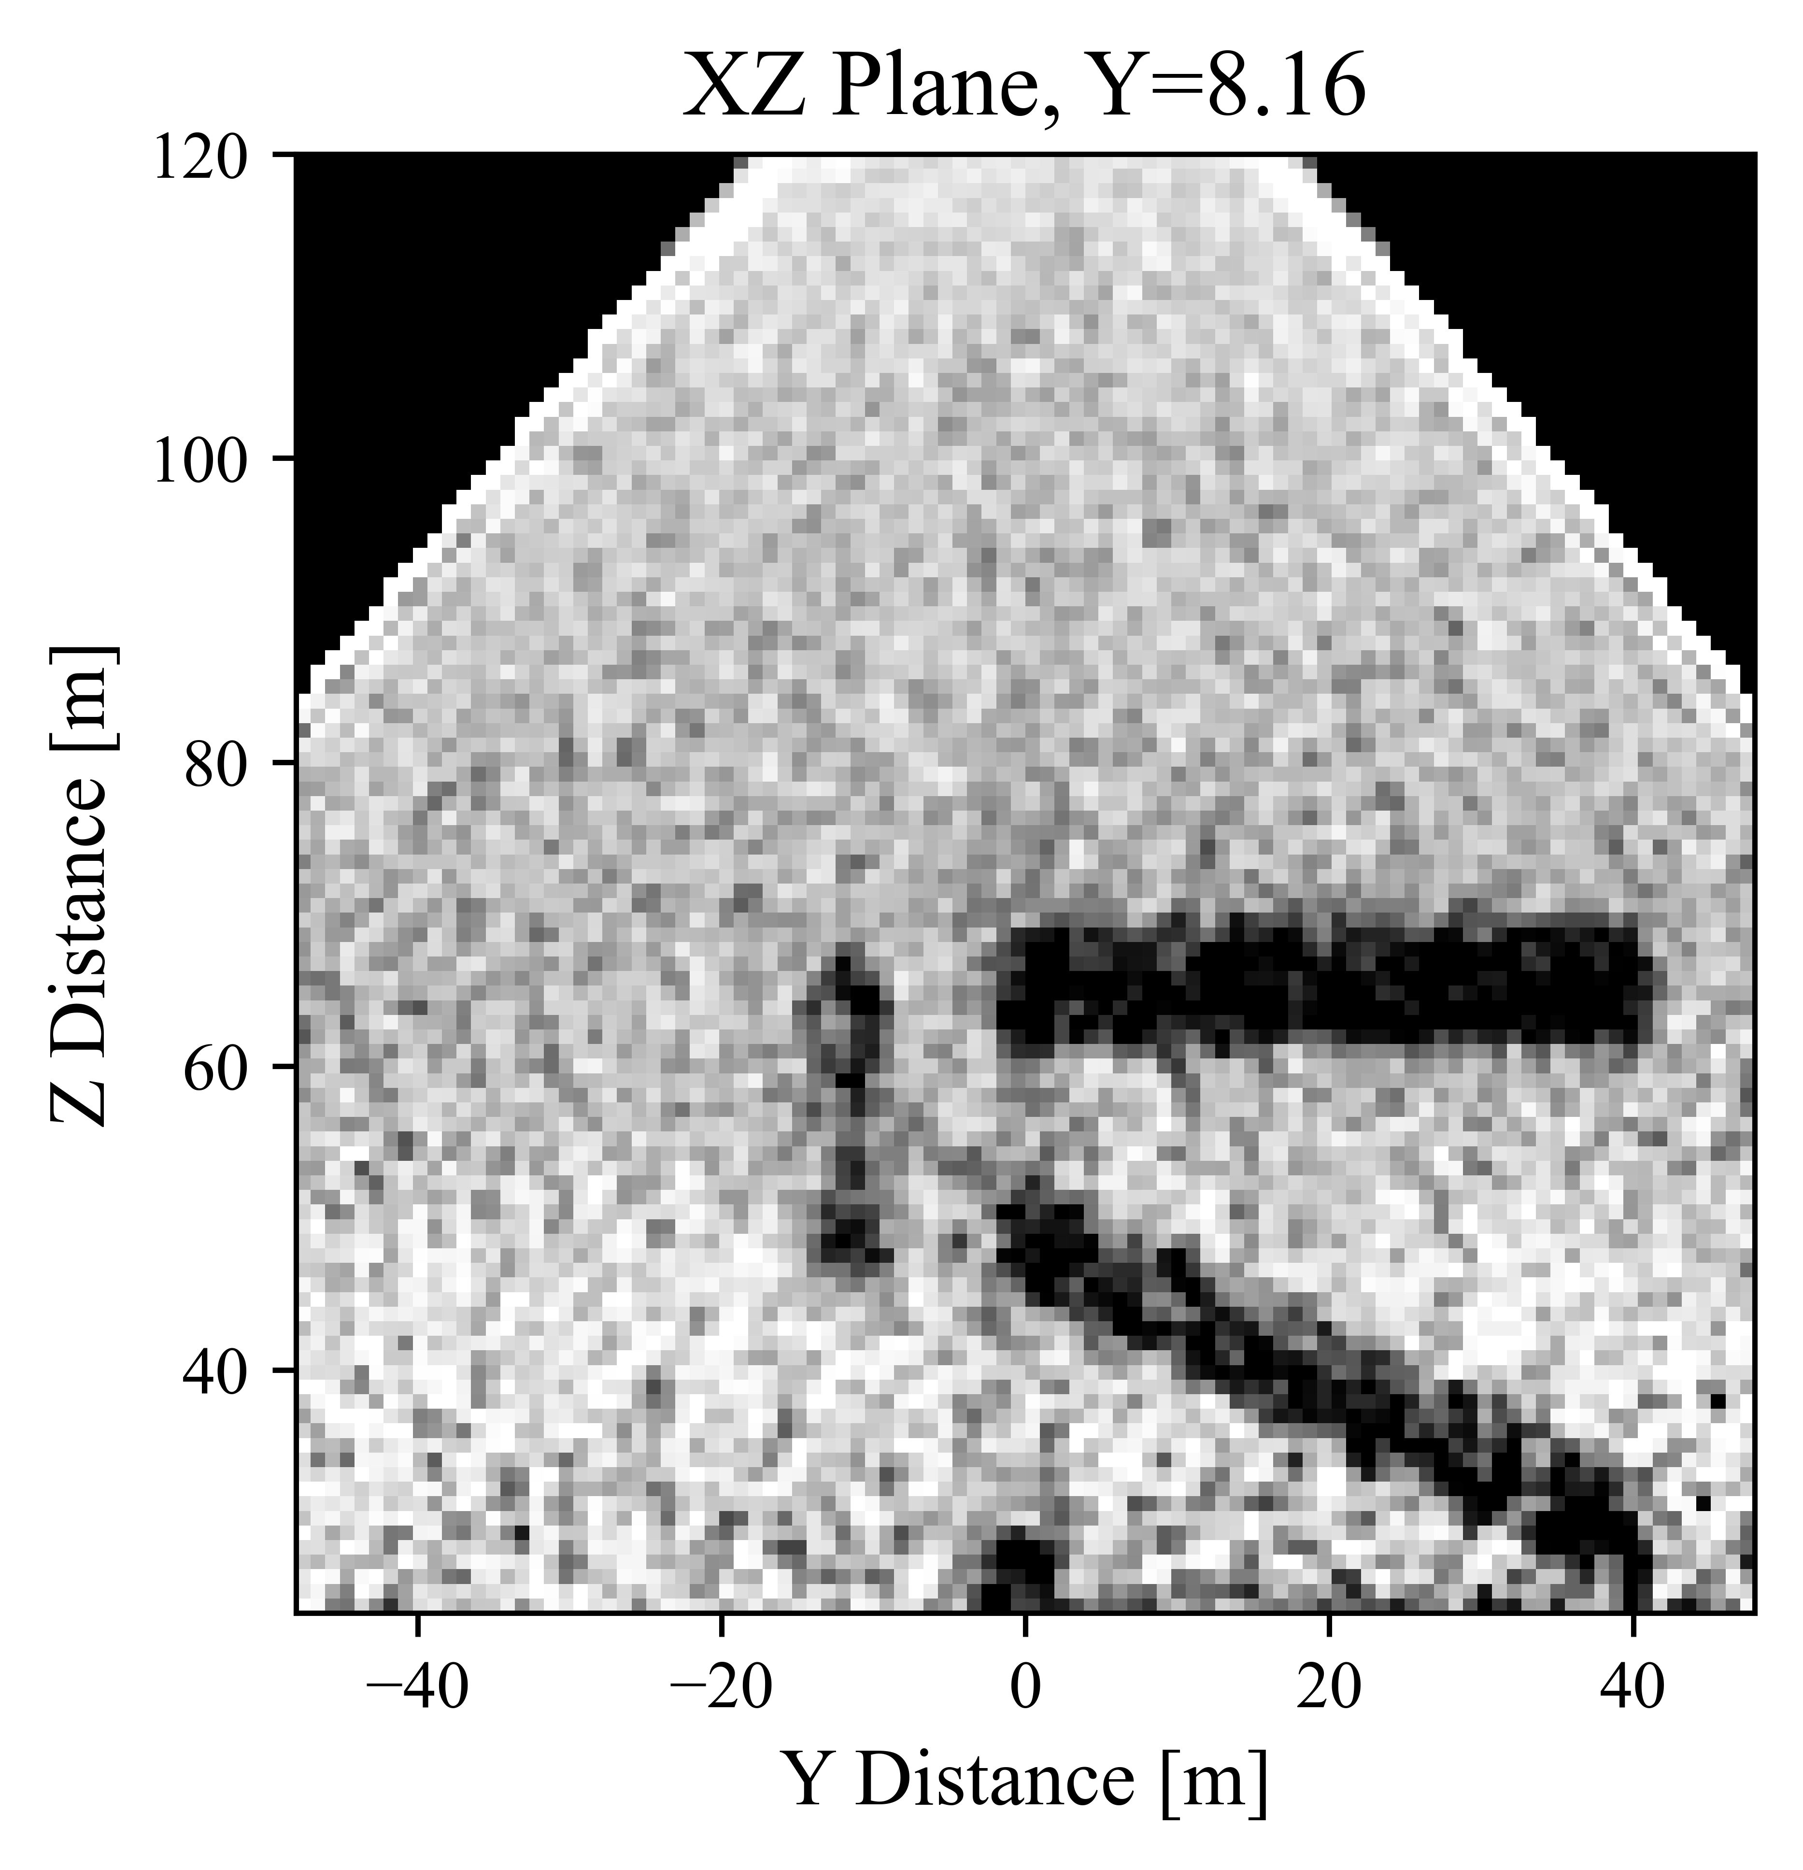
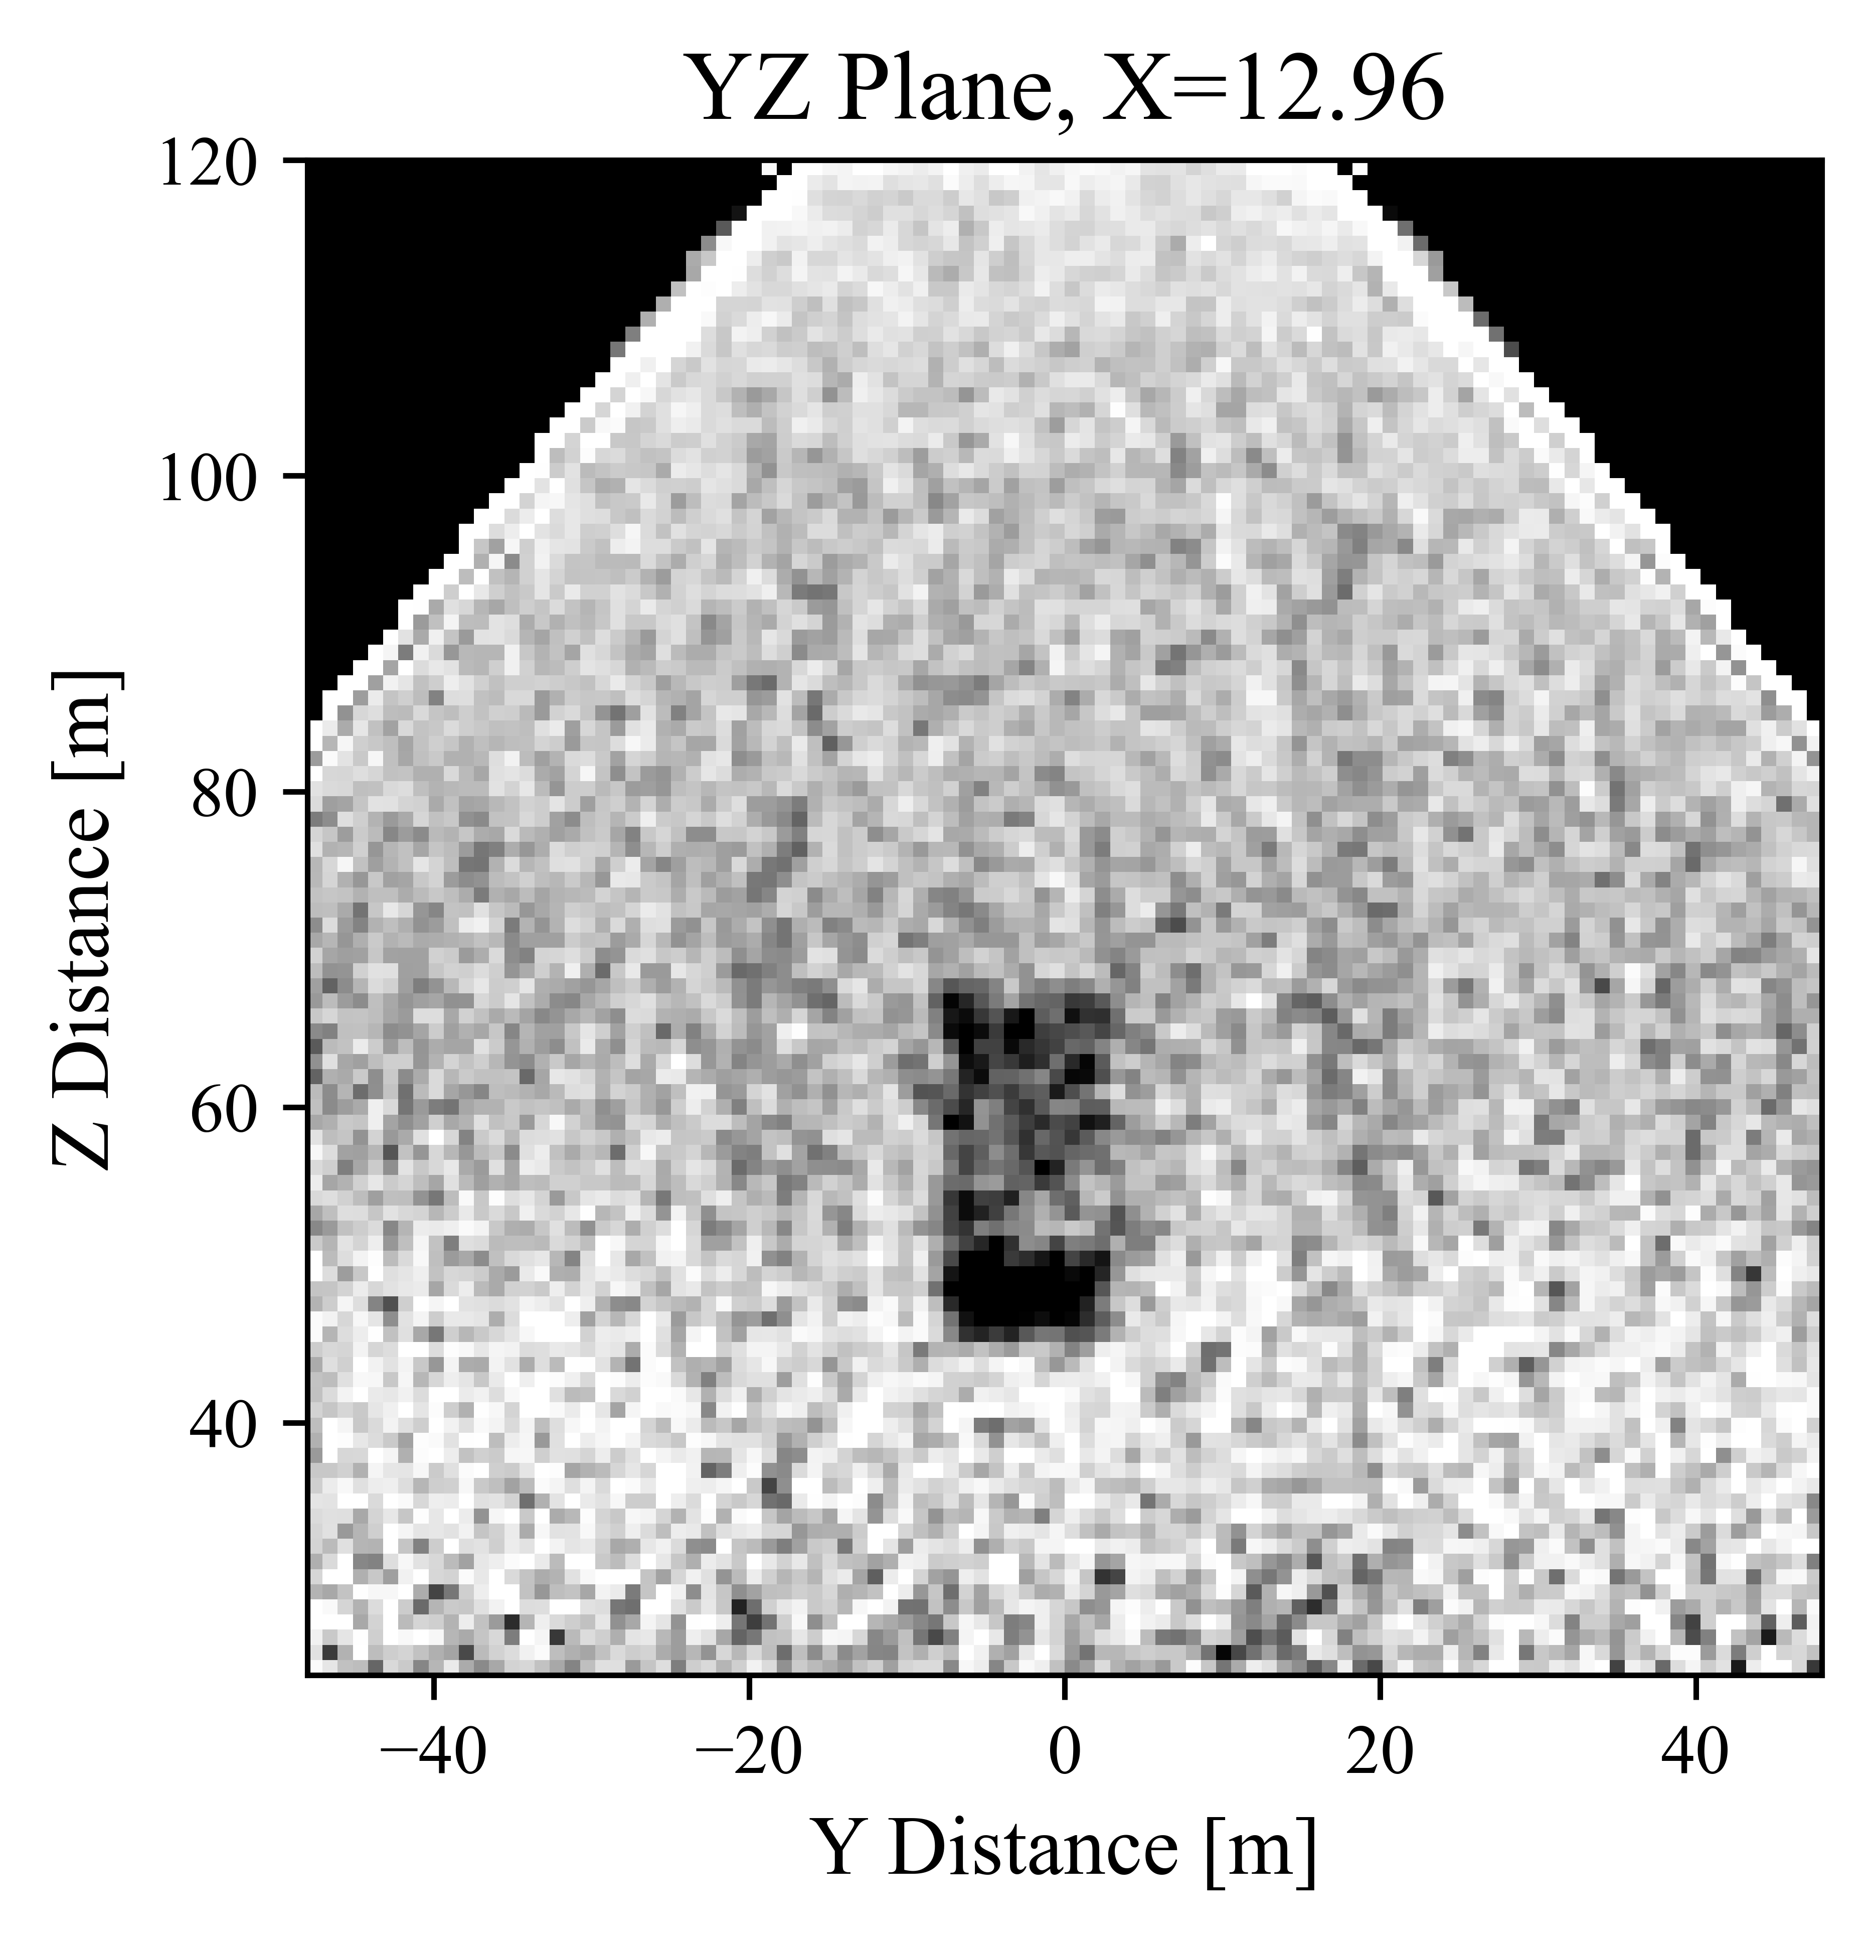
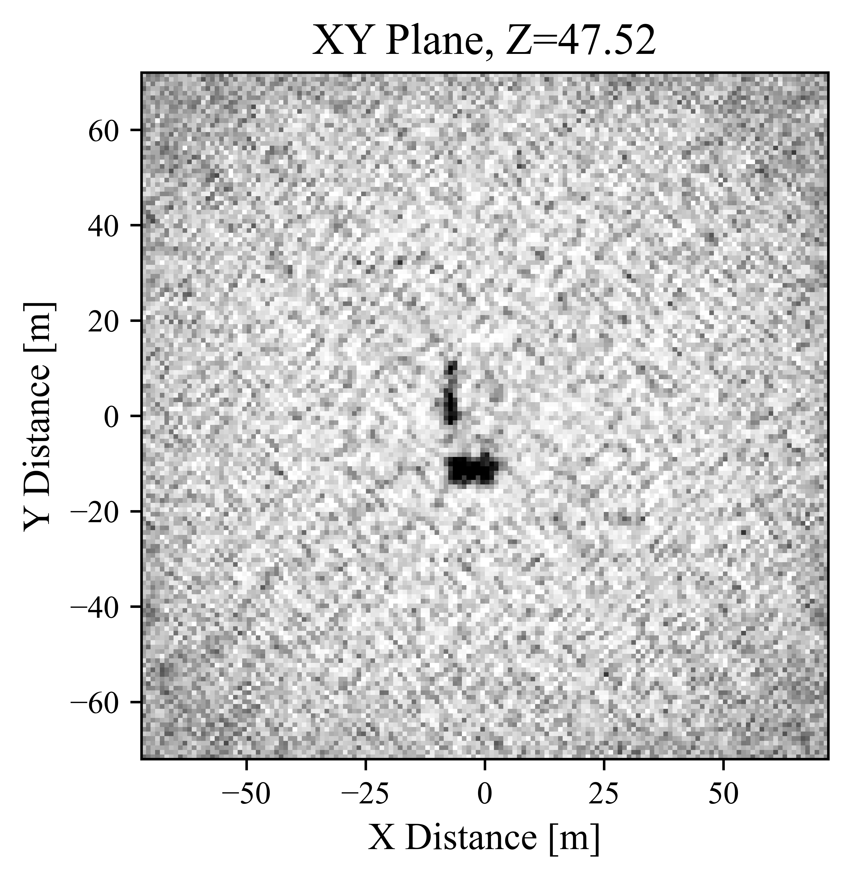
Pyramid Final Reconstructions (XY and YZ Plane)
500 Iterations

