Slide 1
9 O’Clock Meeting
Nathan Ruffatti
MCR Crew Chief
Friday, April 7th, 2023

Slide 2
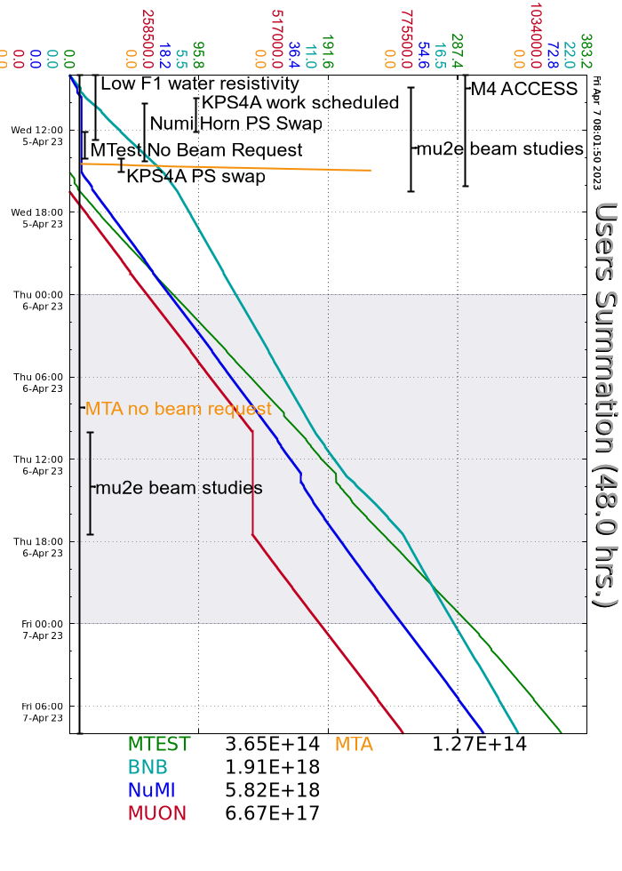
Since Wednesday…
Wednesday
Mu2e studies
I:KPS4A conditioning
Still having 1-2 pre-fire trips per shift
NuMI horn trip
Switched over to PEI-B, no trips since
Remnant resistivity recovered enough to resume beam to SY
M4 access finished, secured and racked in
Thursday
Mu2e studies
MTA in Supervised Access
MI/RR RF down while pond pump strainer cleaned at MI60
H1 Raw temp limiting intensity after resuming beam following downtime, slowly walked intensity back up
Temps are still elevated, but ok
BNB vertical positions jumping around last 2 nights
VP867 a little suspicious
NuMI permit drops on E:V118 PS in regulation, maybe ~1 per shift

