Slide 1
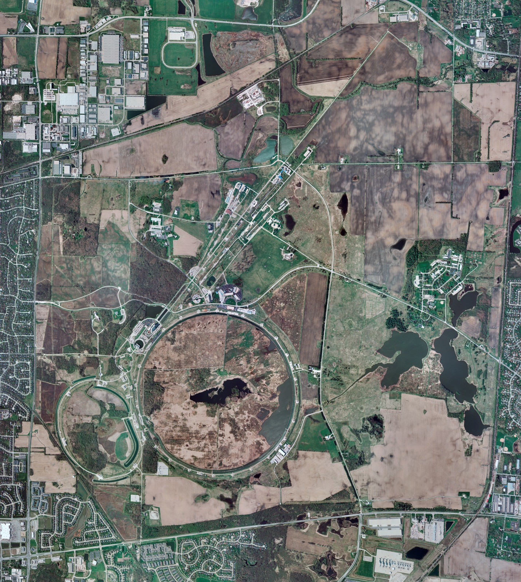
Helium Cryogenics
Status 4/7/2023 J.Makara
CMTF: SCP cold and operating fine
CMTS: HECM24 warmed up tp RT for electrical repairs
PIP2IT: SSR1 at RT
HB650 CM cold at 4 K after another Purifier contamination breakthru thus regenerated; continuing leak hunting
MCTF: cryo system is shut down at RT
MDB/HTS: at RT
MDB/STC: SSR2 cavity testing completed thus shut down at RT
MDB Magnet: at RT
NML/FAST: Cryo system cold and running fine
CC1: cold at 2 K
CC2: cold at 2 K
CM: cold at 2 K
IB1: cryo system running fine
Muon Campus: A0 comprs (3) online with MC-1 g-2 cryogenic system running fine at 5 K
Misc:.

