Slide 1
Muon Campus Operation Report
Dean Still
Friday 09:00 Operation Meeting
Week of April 3, 2023

Slide 2
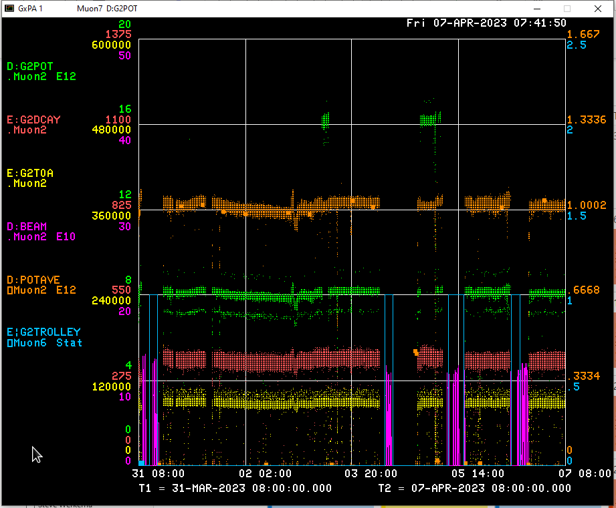
Performance for the Past Week
Protons On Target
Avg Protons on Target
Particles to Entrance of G-2 Ring
Decay Positrons in G-2 Ring
G-2 Trolley Run
8Gev Delivery Ring beam
< Linac Debuncher skid PLC error
← BPM Studies
M4 beamline Extraction Studies
← BPM Timing Studies
← BPM & Tune tracker Studies
← Stopped MC operation due to remnant LCW
<-------Weekend ------→
<------------Week Days -------------------→

Slide 3
Activities for the Past Week
G-2 Status:
Delivered beam to g-2
Work completed:
Accessed M4 enclosure to conduct Mu2e HRS hydrostatic testing. ( Overlapped work with 8ev studies)
Had to stop muon campus & switchyard operations due to remnant beamline LCW resistivity dipping below limit of 3 Mohm. MDS made changes to improve resistivity.
8Gev Studies: (4 days)
M4 beamline resonant extraction studies to get instrumentation working.
BPM 8Gev beam studies. New code to the digitizers & period to retime BPMs. (Patel +)
Worked on getting tune tracker data through the QX ramp.

Slide 4
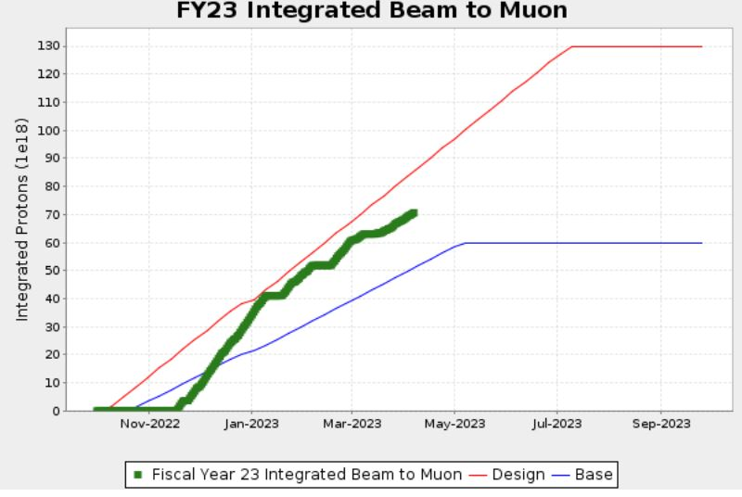
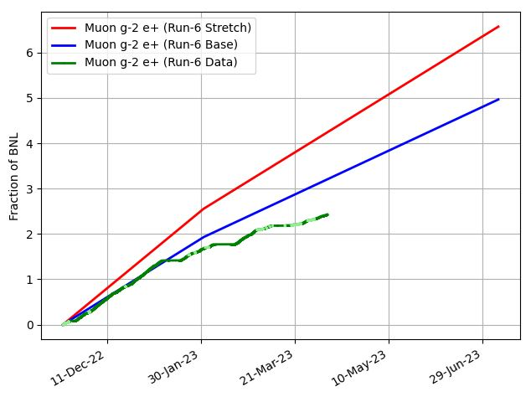
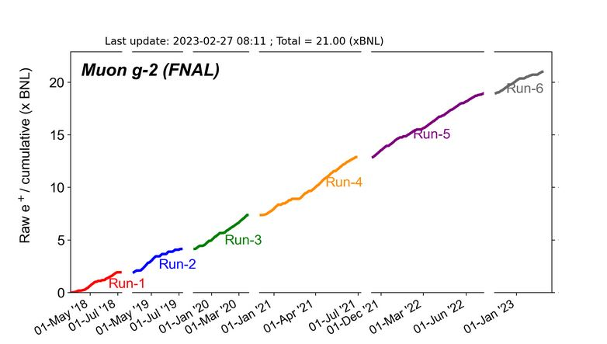
G-2 Performance – Integrated for Run 6
G-2 Experiment POT Run Goal
~4.2E20 POT
Run 6 period is Nov 2022 – June 2023
Run 6: Goal of ~x 6 BNL
Total Run: goal of x 21 BNL
Run 6 # POT Delivered ~ 7.1E20
Run 6 Integrated ~ x 2.43 BNL
0.1 for the week
Total Integrated ~ x 21.38 BNL
Start of
Summer
Shutdown
2023
Plots as of 4/7/2023

Slide 5
Plan for Next Week
g-2 operation:
Deliver Beam to g-2
Muon Campus Study Plans :
Friday – Deliver beam to g-2
Saturday – Deliver beam to g-2
Sunday – Deliver beam to g-2
Monday – Deliver beam to g-2
Tuesday - 8 Gev Studies. (Lines up with g-2 roof work)
Wednesday - 8 Gev Studies.
Thursday – Deliver beam to g-2
Friday – Deliver beam to g-2
Future Planning :
April 17 - Confirming work and schedule to start AP0 AC installation.
G-2 line
Mu2e M4
line

