Slide 1
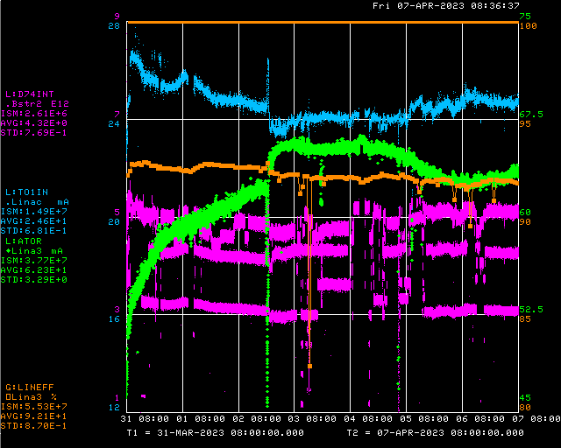
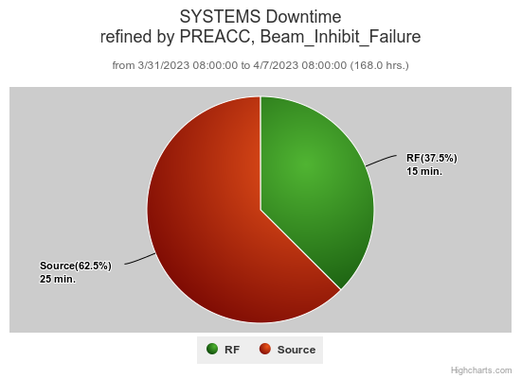
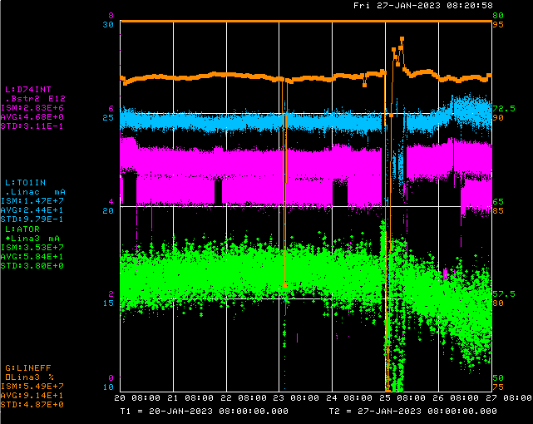
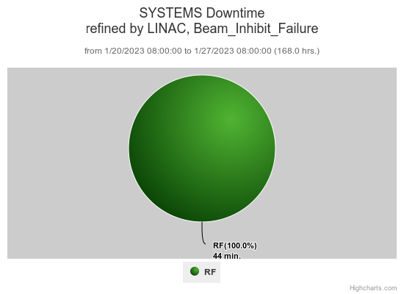
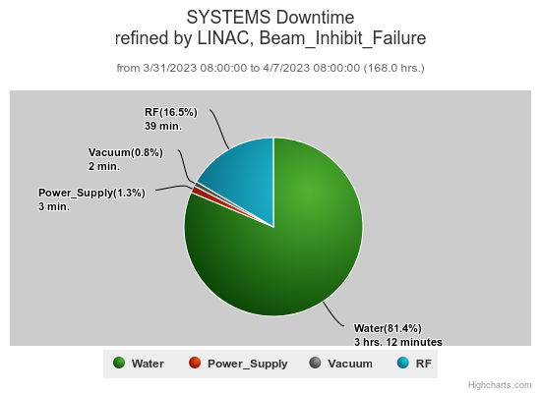
Preacc/Linac Weekly Performance
No Preacc
Downtime
Weekend KRFD water skid PLC backplane failure
Source A heater trip
Monday SCL vacuum valves closed erroneously
RFQ driver tuning/screen timing off
Source A sympathetic sparking/Source B short
Wednesday Source A extractor drop out
All week:
KRF2 CS faults
LRF5 spark trips

Slide 2
Current Conditions/Plans
Source A – 63 mA
Linac input – 25 mA
Linac output – 22 mA, 4.4E12 /pulse
Opportunistic downtime request
1 hour to replace KRF6 CS fan coil
1 hour to tune buncher loops
Need to run to 400 MeV, beam quality will be variable

