Slide 1
PIP-II Report
PIP-II Team
Project Management Group
17 May 2023

Slide 2
Project Management
We continue to work on rebuilding the management team:
  Project Director search continues
  Saravan Chandrasekaran was appointed IKC coordinator
New CAMs for AccS-Instrumentation needed – ongoing discussions with AD
P2PEB15 planned for June 7-8 at CEA/IJCLab.
ALaT Hardware contract: missed May 15 deadline, working with procurement to finalize discussions
IPR Highlights:
  Technical progress is strong in all areas
  Schedule variance is of concern and a recovery plan was requested by June 16
  IKC non delivery and delays should be monitiored and mitigations applied
  The step up in resources for FY24 and FY25 should be secured
  The risk register should be re evaluated and RMBs held on monthly basis
  Next IPR in ~6 months
2

Slide 3
Financials
SPI 0.92 0.00, CPI 0.98 0.00
It is all about schedule!
Current Period Red Variances:
SRF CV is related to SSR1 cavities milestone payment
AccS SV is related to HPRF, MagPS, and Controls
LIC SV is distribute amongst several accounts
CF SV is related to delay in Linac complex Subcontract
3

Slide 4
RLS Development Status
Contingency recovered to 27.0% (-0.3%)
Critical path still though SRF systems (SSR and 650)
4

Slide 5
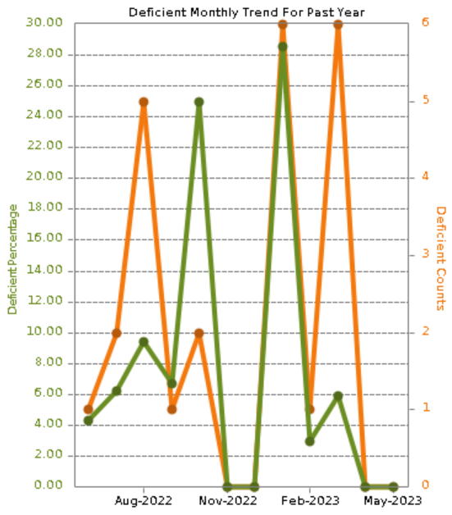
ESH
Cryo Plant - No deficiencies noted since last report (graph).
Linac Construction – (2) Housekeeping, material in pathway, (3) safety glasses not worn and hard hat not correct orientation, (1) Back up alarm on cement truck not operational, (1) guardrail not adequate
COVID level - Low​​
PHB650 module RF moves going well from the ESH perspective, involved in the traveler. ​​
Rad Safety completed the ConOps review and the EA OE reviews, much work to do, much of which was known. ​
DOE IPR review complete, recommendations entered into iTrack.
5

Slide 6
QA
Project Self-assessment on Training wrapped up and draft report has been shared.
  Report to be finalized and distributed next week.
QC Planning Efforts
  Revision made to the SSR2 CM CQ Plan and shared
  CDS and Cryo Plant QC Plans Reviewed
  Reviewed and provided feedback on a number of QC plans leading up to their associated FDR:
    HPRF Distribution
    Controls
    MEBT Quadrupoles
    Linac Installation
Conventional Facilities efforts
  Continue efforts with Barton Mallow on the outstanding Cryoplant Deficiencies/Nonconformances
  Reviewed and approved Quality Control Systems (QCS) QC Plan for the Isolated Cooling Loop project
  Linac Complex QC deliverables continue to come in on a times basis from Whittaker
Documenting and following up on Project Review Outcomes in iTrack (Directors Review and DOE IPR)
6

Slide 7
International
DAE short term visitors as part of technology transfer process
  Two BARC cavity visitors completed stay, having participated in or observed cavity cleanroom activities, STC installation & testing, and coupler room temperature testing. Third BARC visitor continues stay.
  One RRCAT RF hardware visitor is nearing completion of visit, having participated in the operation & maintenance of the 650 MHz 32 kW amplifier being used for PHB CM testing.
  A RRCAT RF controls visitor has arrived and will continue helping FNAL on the 650 MHz 32 kW amplifier.
TUL visitors with their RFPI System arrived at FNAL to test RFPI
UKRI Cryogenics Engineer integrated into APS-TD Cryogenics Division for 3 months
  Will gain experience operating the cryogenics system for PHB CM testing, & will assist in CM data analyses
DAE/BARC LLRF system has arrived at O’Hare airport. Will be at FNAL soon.
Partners (INFN & UKRI) supported PIP-II DOE IPR in-person, with rest on Zoom
P2PEB15 on 7—8 June, at CEA & IJCLab. Satellite meetings on 6 & 9 June.
DAE Production/Construction Phase expected to start in 2—3 months
INFN: Technical Coordinator Carlo Pagani retiring
7

Slide 8
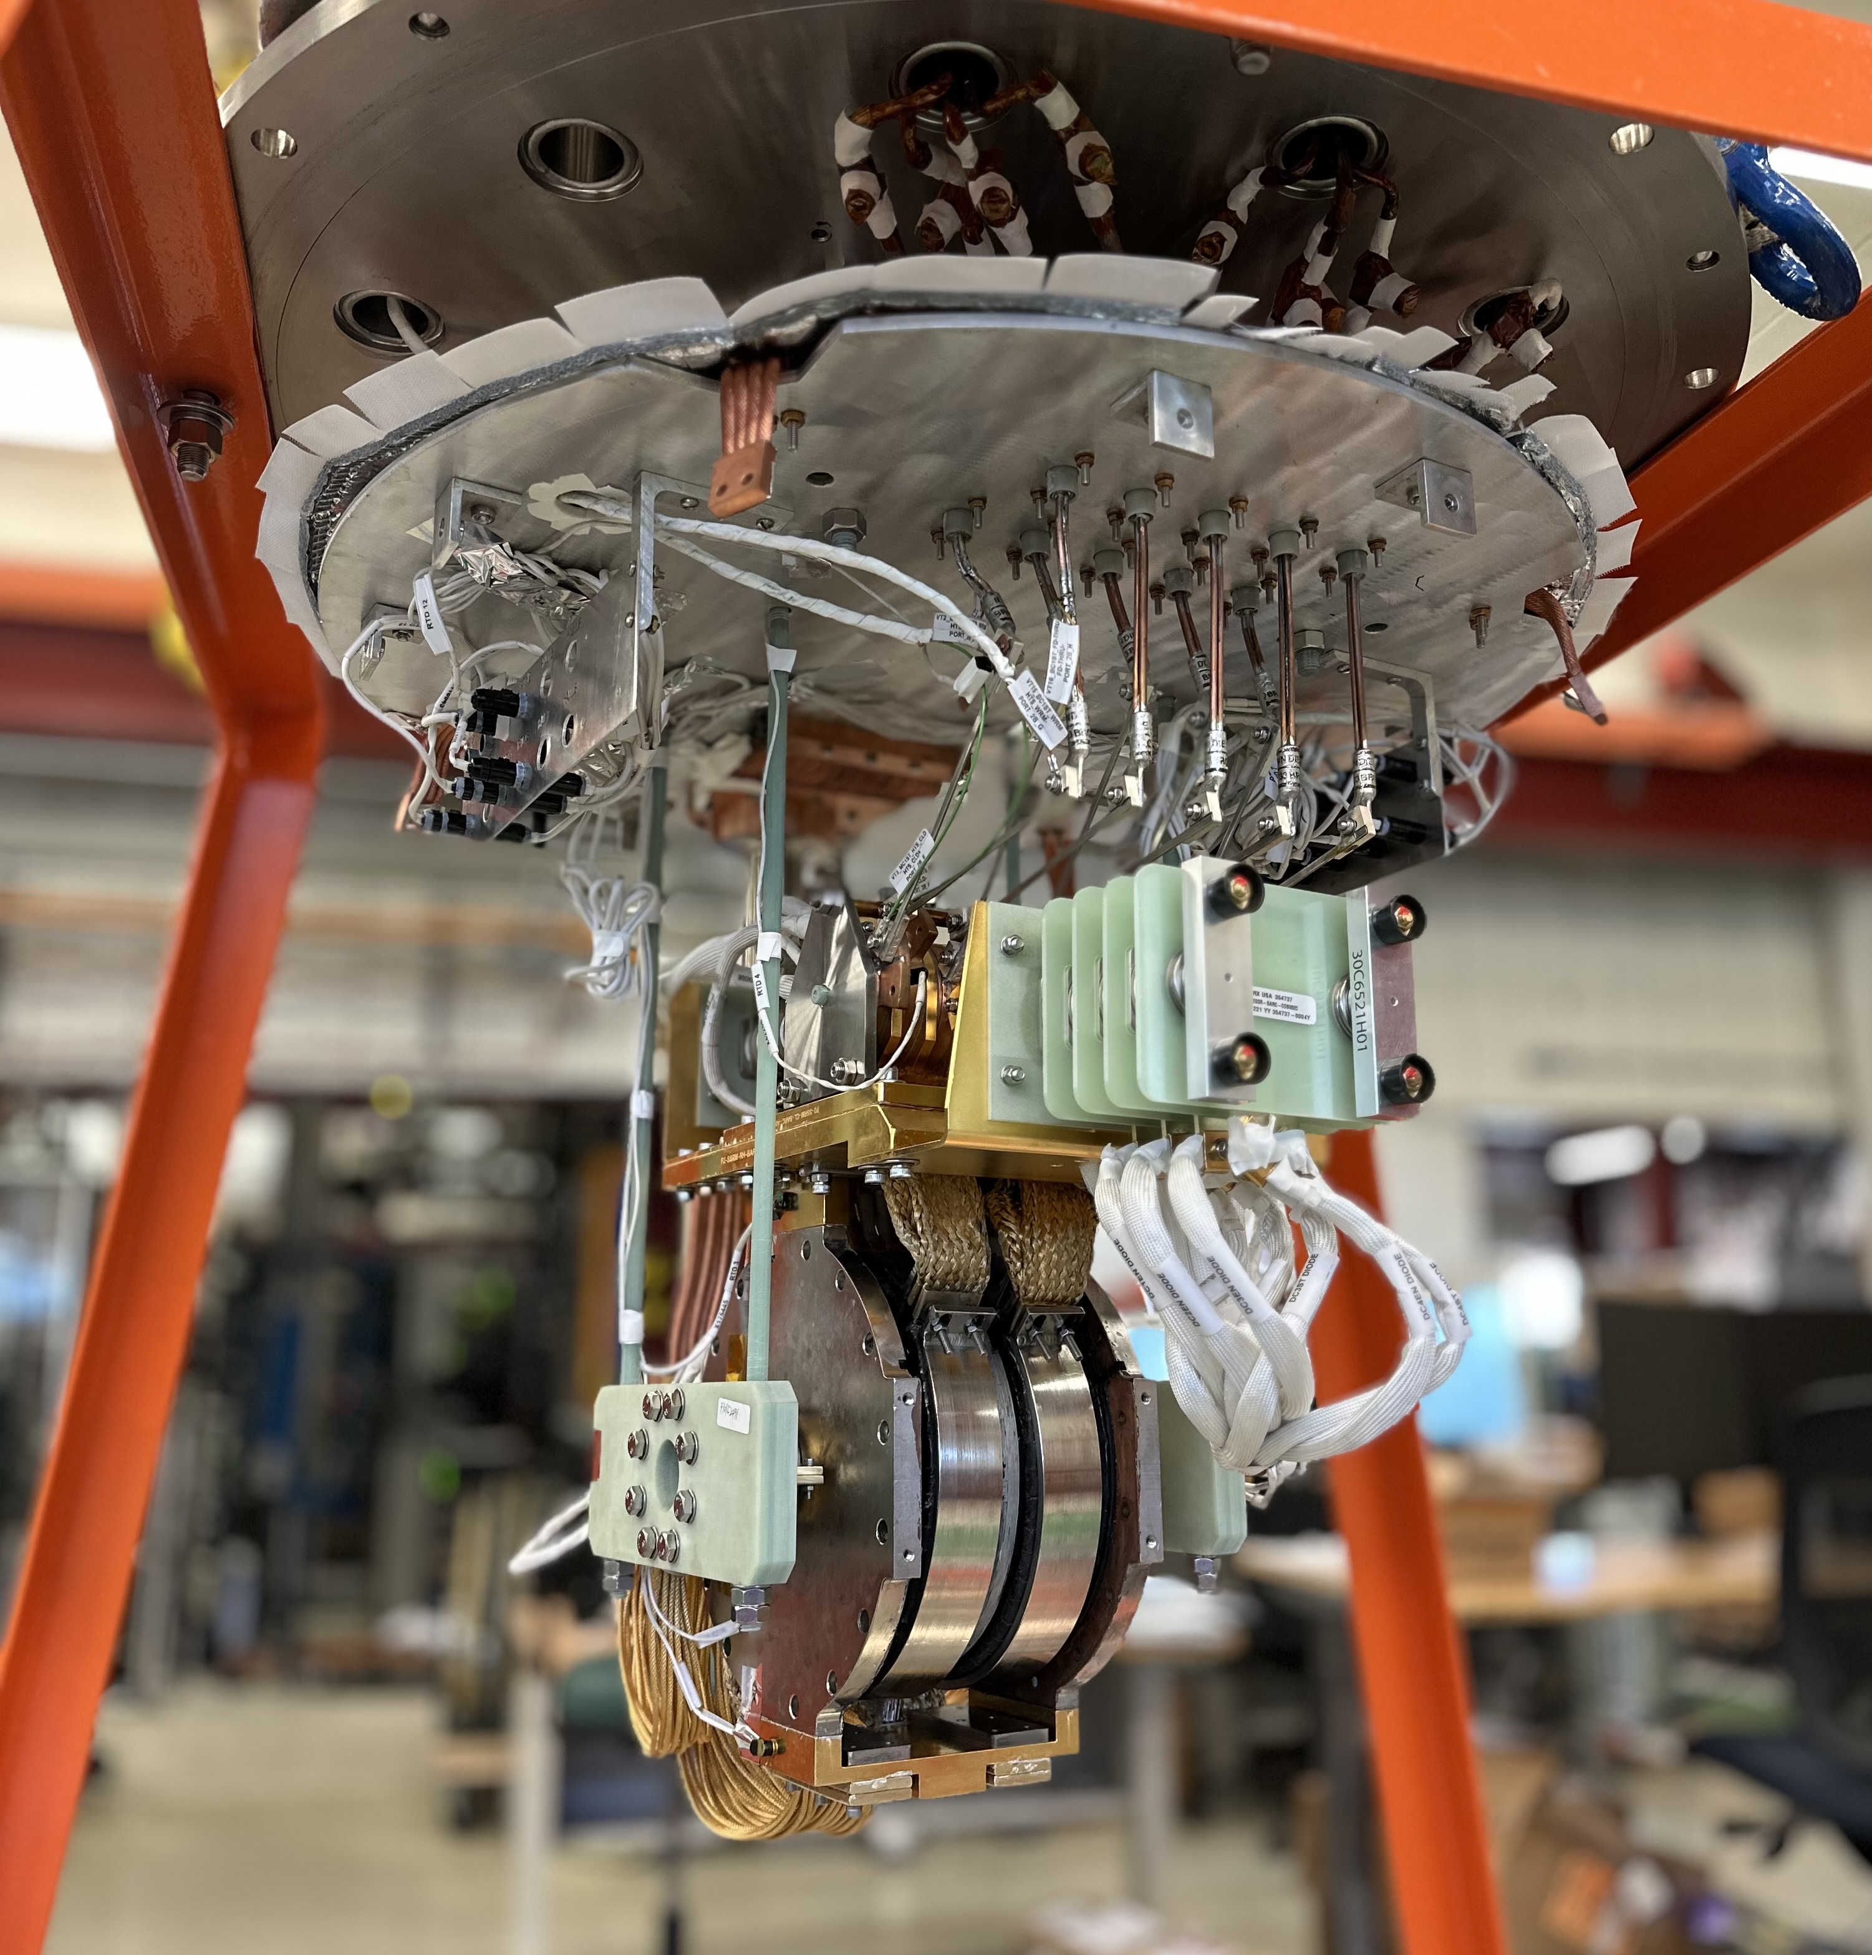
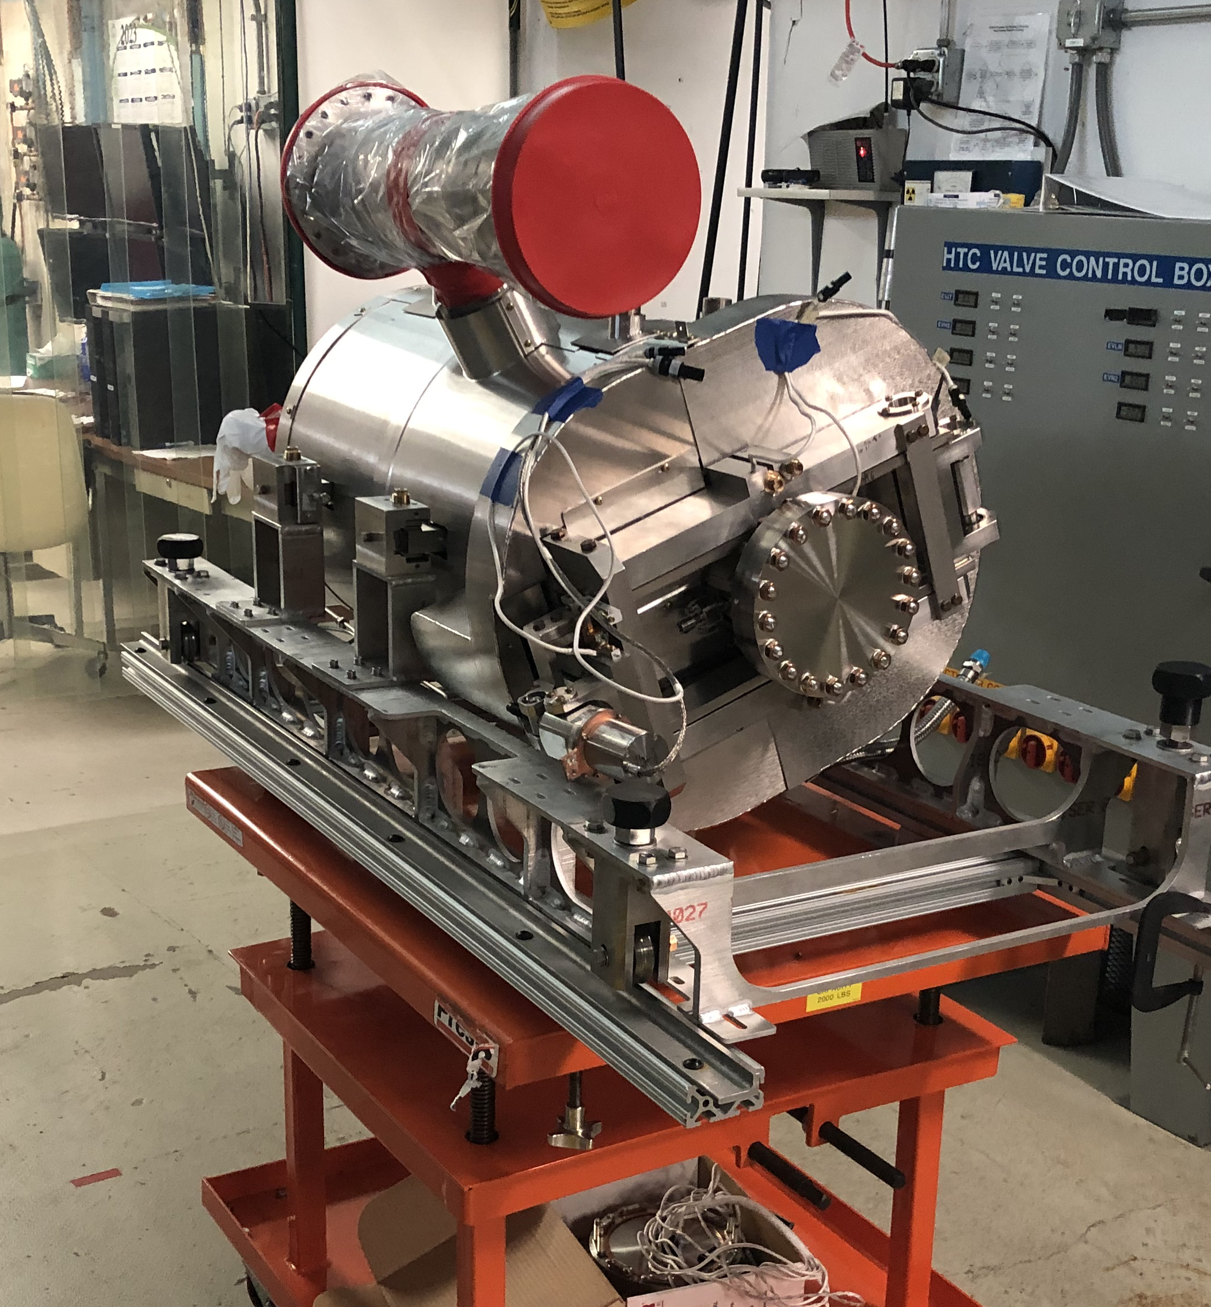
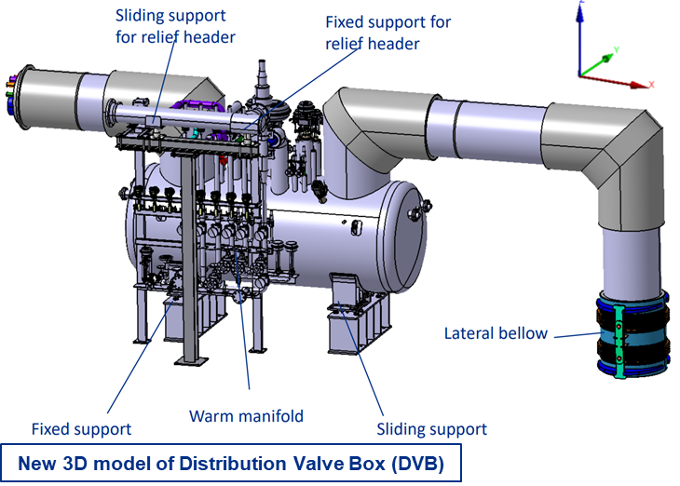
SRF Cryo
SSR cavities and cryomodules
  Still working on resolving the field emission limiting the performance of prod SSR2 cavities. Continuing to improve the internal rinsing (HPR). ​
  Performing technical and cost evaluation of Nb for 33 SSR2 cavities.
  Cooldown of the prototype solenoid in the CoCoLoCo test stand was attempted but it did not reach the desired working temperature (2K). Team is working on improving efficiency of the system and integrating thermal straps used in the CM configuration.
  Significant progresses in the fabrication of components for ppSSR2 CM.​
650 cavities and cryomodules​
  HB650 pCM is at 2K: performing RF cold testing and heat loads analysis. ​
  Continue preparing LB650 cavities for ppLB650 CM.​
  Performing technical evaluation of (6) LB650 couplers and all ceramic disks needed.
  Working with UKRI to define procurement specification for couplers.
Cryoplant ​
  Cryoplant FDR-2 Review (covering mainly the warm compressor system) to be held on the week of May 22nd at BARC​
  Cryoplant Transportation and Rigging Study underway. Final report presented.​
  Thermal cycling engineering scope awarded. Negotiations for thermal cycling hardware scope is underway and expected to be awarded in the next few weeks.​
Cryogenics Distribution System: ​
  CDS DVB-TTL PDR-2 with WUST completed.
  TTL 3D models and FEA are complete.​
  ITL RFP proposals received. Performing technical and cost evaluation.
SSR2 solenoid
LB650 cavity
8

Slide 9
Procurements
Red= Behind schedule; actively working major issues
Green= On-Schedule; No major issues identified
Yellow= On-Schedule; Potential issues identified
Item |  | Req # | Est SubK Value | Status | Expected Award/Delivery Date
SSR2 Resonator Cavities |  | 305165 | $960K | RI has passed Manufacturing Readiness Review and resumed progress. RI submitted a status report on the mfg. of the three prototypes of SSR2 jacketed cavities to PIP-II on 5/15/23. PIP-II is currently reviewing the status report submitted by RI. | November 2023 Estimated
SSR2 Production Cavities – 33 total |  | TBD | $6.270M | Acquisition Procurement Plan - in Development | TBD
SSR2 Resonator Cavities (second PO with Zanon) |  | 328365 | $567K | Second Subcontract No. 686389 was awarded to Zanon due to RI issues. Continued progress is being made from Zanon. Delivery on prior Subcontract No. 673794 has been completed. | March 2023 delivery is running late
Niobium for SSR1 Cavities |  | 328256 | $1.03M | With FRA Legal for resolution, questions remain regarding new Buy American Act Guidance from DOE. Subcontract No. 698536 will be awarded to Ningxia. Submitted for Proc Manager’s review on 3/8/23. Approved on 3/30/23. Submitted to Compliance on 3/30/23, approved by compliance on 4/26/23. PS submitted 698536 to Legal on 4/26/23. FSO approval was determined to not be required by Wagner/Underwood. Review meeting with legal held on 5/15/23. | May 2023 / TBD
SSR 2 Niobium Material for Production Cavities |  | 337264 | $7.06M | FRA has received back two proposals on RFP337264-SC Ningxia (Foreign) and Viridis Materials (Domestic). Evaluation scoring of proposals underway by Donato/Mattis. | July 2023 / TBD
HB 650 Vacuum Vessel |  | 316651 | $573K | PHPK responded that they have made the PIP-II upgrades referenced in PIP-II drawings and are requesting to be paid accordingly. Change order req being routed for approval to pay PHPK for upgrades referenced in PIP-II drawings. Alternate Paint spec was approved and notice sent to PHPK May 9th. PHPK to submit material specs to FRA for Approval as of 5/15. | PHPK late on their estimated delivery dates for the Vacuum Vessel
Helium Vessels |  | 309207 | $386K | On schedule to make delivery dates per the Cure Notice. Update: End of March delivery is expected, but Roark is late on their March 14, 2023 delivery. Olderr ??? | Final delivery was not made on March 14, 2023
Design for Cryoplant continuous operation |  | 339623 | $342K | Engineering design Subcontract No. 696597 was fully executed 3/10/23. | Awarded 3/10 / designs due in June (dual relief / ORS connections) & Aug (HP3)
Thermal Cycling Upgrade Hardware |  | 341977 | $4.18M | Negotiations with ALaT scheduled for 12/May. Advance Notification acknowledgement received by FSO on 10/May. Not questions asked | May 2023

Slide 10
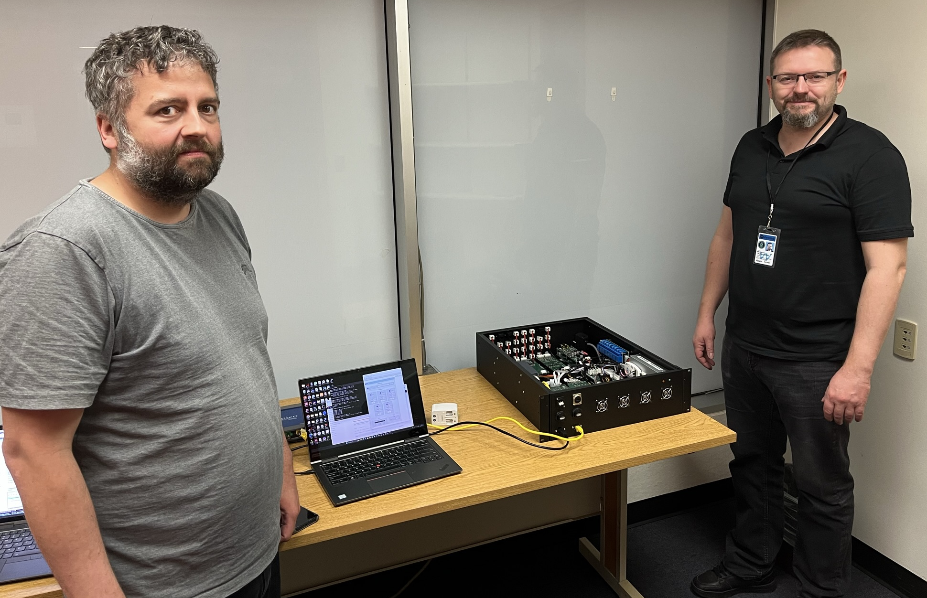
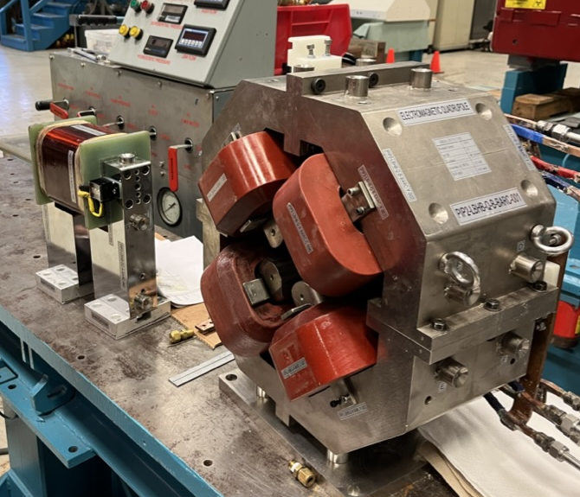
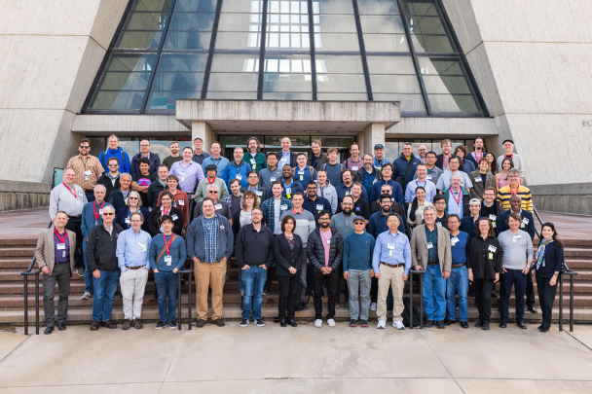
Accelerator Systems
HPRF
  RF distribution FDR conducted on 27 April
  Supporting pHB650 testing
LLRF
  TUL visitors on-site to install/checkout 'Proof of Concept' RFPI chassis
  WUT IKC funding request submitted to funding ministry
  Shipment of LLRF/RFPI from BARC arriving this week (now at O'Hare)
  Supporting pHB650 testing
Magnets/Power supplies
  2nd BARC quadrupole/corrector delivered and under acceptance testing: discrepancies being documented
Vacuum
  FDR conducted on warm front end & linac on 25-26 April
Controls
  Successful international EPICS collaboration meeting week of 24 April
  Supporting pHB650 testing
TUL colleagues with Proof of Concept chassis
2nd prototype warm corrector (left) & quadrupole (right) from BARC
EPICS Collaboration meeting
10

Slide 11
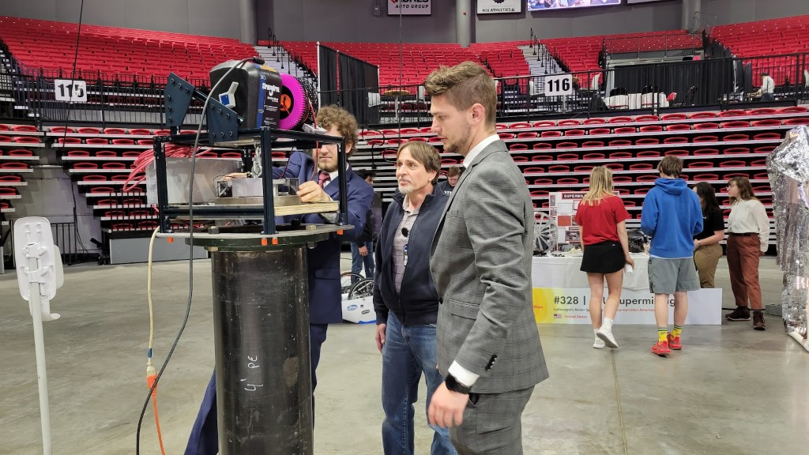
Installation and Commissioning
Project Management
  All areas spent significant effort preparing/participating in IPR
Warm Front End
  Ion Source Power Cabinet internal “mini-review” held – will feed into FDR planning
Building Infrastructure
  Preparing for Utility Plant Procurement Readiness Review (PRR)
Linac Installation
  Preparing for Cryomodule Stand Final Design Review (FDR) on May 23rd
  NIU design team completed site riser plug project
Commissioning & Accelerator Physics
  Booster/AP Studies
    Full Booster cycle simulated with gamma-t jump
    Electron Cloud simulations completed
NIU Senior Design Presentations
(PIP-II Site riser plug removal device)
11

Slide 12
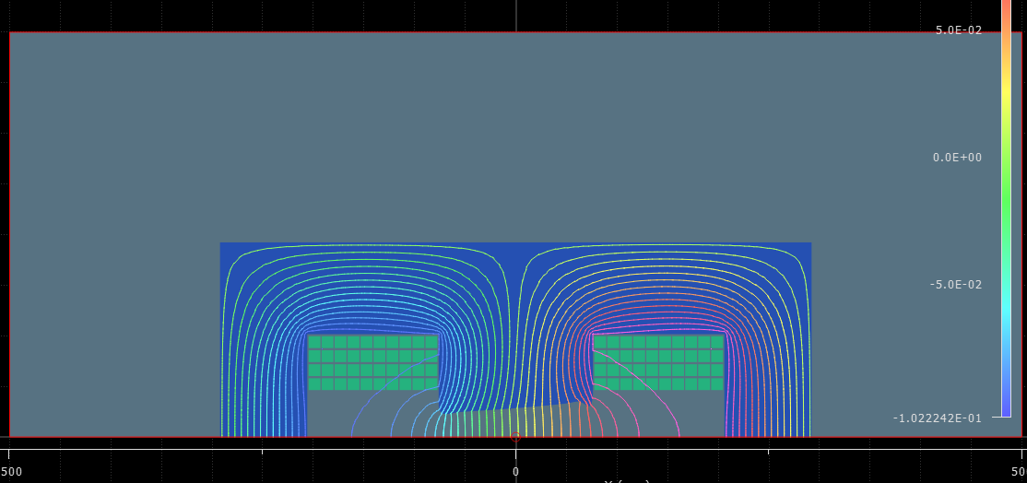
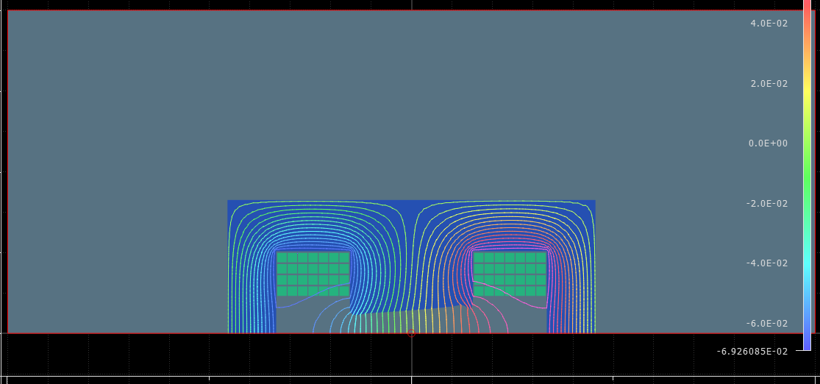
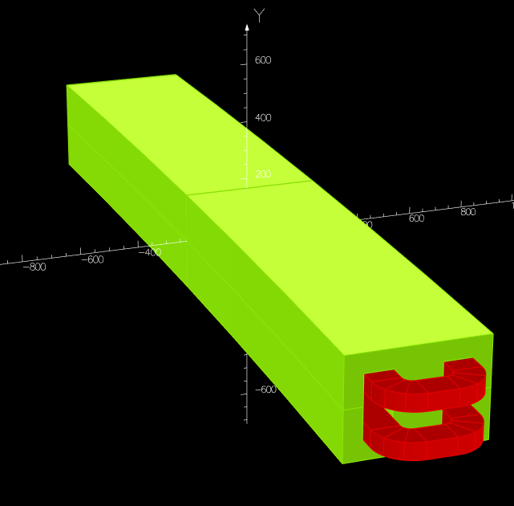
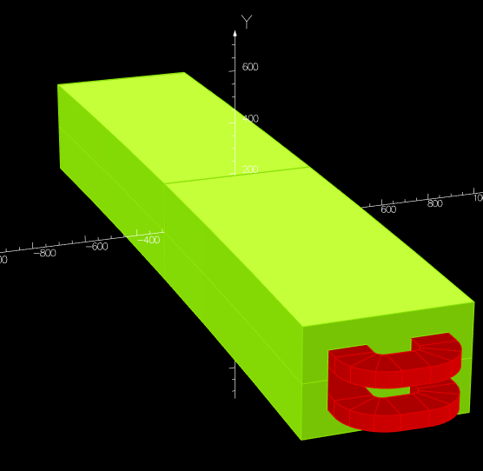
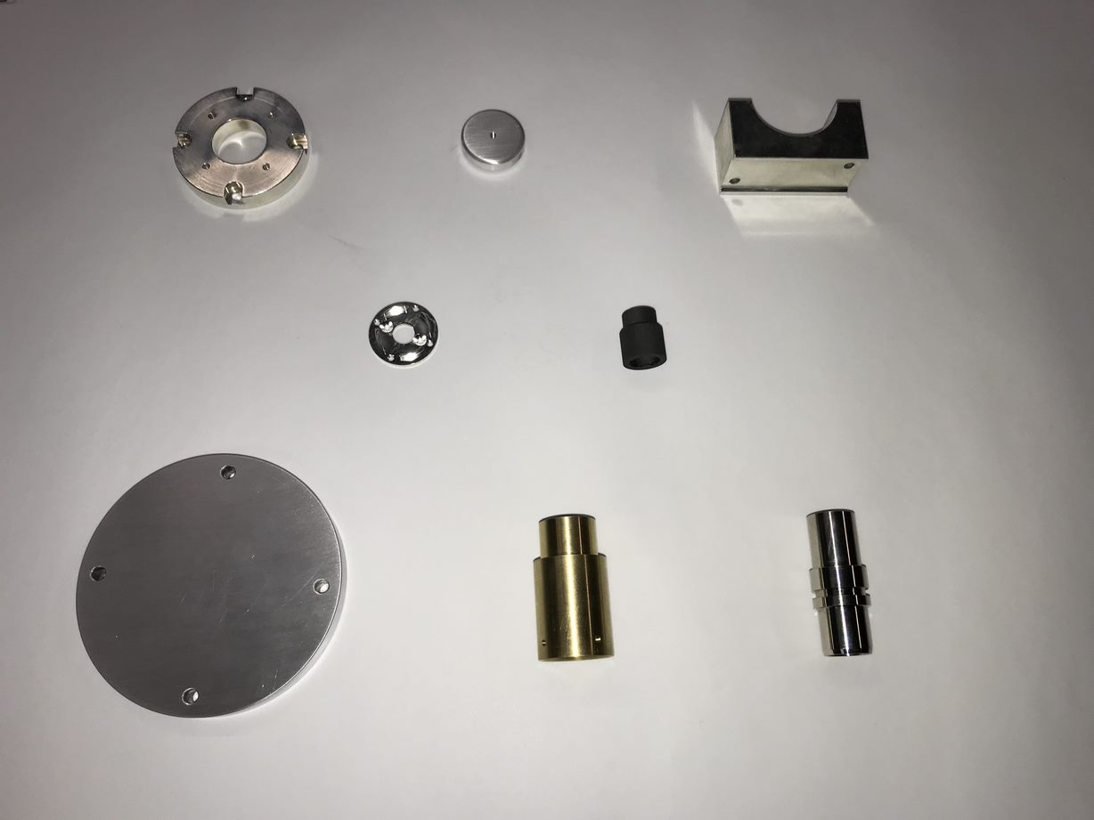
Accelerator Complex
Beam Transfer/Absorber Line
  Preparing for the PRR review of the BTL Collimators.
  Working on the 2KW portable absorber drawings and beam windows design.
  We have a new magnetic design for the Gamma-T MI quads. Developed the mechanical model. Working on the ceramic vacuum pipe.
Booster
  Working on finalizing the ORBUMP magnet and the injection girder design. Preparing for the PRR review.
  Ordered most of the Booster collimator parts. Started receiving parts.
  Preparing for Booster Gradient magnet testing (15 Hz) in E4R.We are resolving last issues and planning for ORCs in May.
  Magnetic simulations of the shorter Booster Gradient magnets continue. Started working on the mechanical model.
  The new Booster DCCT is being commissioned.
MI/RR/Booster RF
  Started modifying the spare modulators.
  Receiving 200 KW PA arts($800K/$1,100K). CPI is ahead of schedule for delivering power tubes (23/40).
  Making progress addressing the RR/RF PDR review recommendations.
  Started ordering parts for the Booster RF cavities.
Models of Booster gradient magnets. Current magnet (left), shorter magnet (right) (K. Badgley)
Various parts for the 200 KW PAs.
12

Slide 13
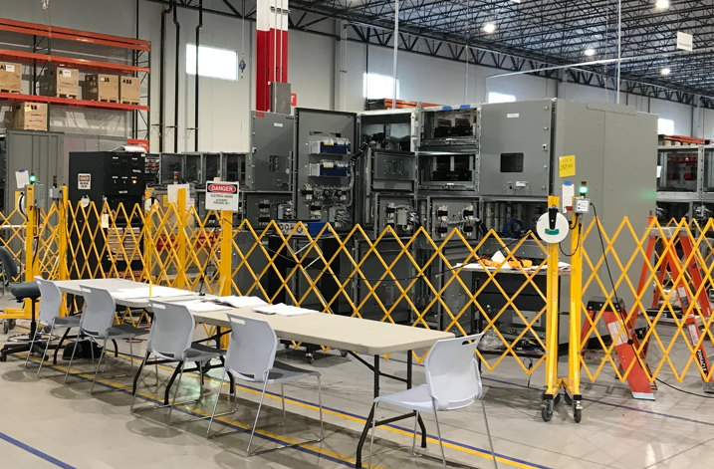
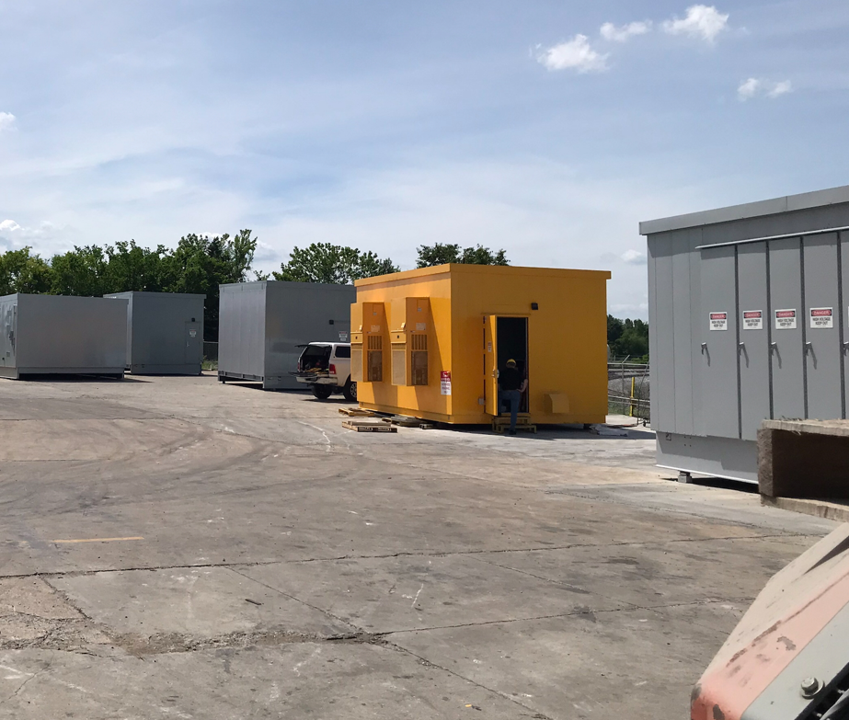
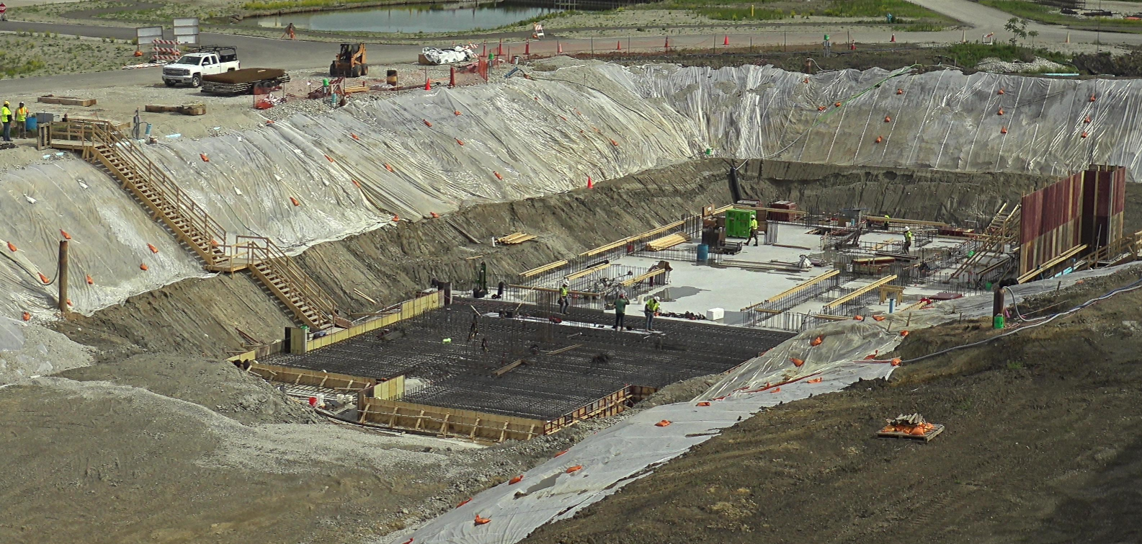
Conventional Facilities
WBS 121.06.07.02 - Cryogenic Plant Building ​(99% complete)
Authorization for Use and Possession (AUP) achieved January 5, 2023
Commissioning and punchlist items under way
Factory Acceptance Testing of 4160V switchgear hut held in May – ISD electrical engineers attended.
Installation scheduled for May/June 2023.
Project completion scheduled for late August 2023
WBS 121.06.07.03 - Isolated Cooling Loop​
Notice to Proceed issued on April 28, 2023
Scheduled for completion in December 2023
Electrical equipment are long lead time. Mitigation efforts underway (thank you Ryan Crawford)
WBS 121.06.05 - Linac Complex ​(8% complete)
Notice to Proceed issued on February 13, 2023
Last pour (3 of 3) for high bay building slab May 17, 2023
Wall forms installation underway
4160V Switchgear and Switchgear Hut
Looking northwest at high bay building construction
13

Slide 14
Technical Integration
Design Reviews:
  9 Design reviews completed in April
  5 PDRs & 47 FDRs remaining
Requirements, Interfaces, and Acceptance Criteria:
  Beam Instrumentation Requirements revised:
    ED0008303 Rev B – PIP-II Beam Instrumentation FRS
    ED0013713 Rev A – PIP-II TRS BI Invasive BProM
  ED0010433 Rev AF PIP-II Master ICD: Updated with updated interface information including:
    2695-005 Invasive Profile Monitor to Controls interface update
    BProM interfaces updated with current ISD references
    ED0016035 Rev A – BI Invasive BProM ISD updated
  Acceptance Criteria Documentation development continues as primary focus prior to IPR
    40+ Acceptance Criteria documents are currently actively being drafted by L3/L4 systems with IKC deliverables. (52% development progress)
    100+ Acceptance Criteria documents identified for other PIP-II Installation/Upgrade deliverables (18% development progress)
Design Change Requests (DCRs): No new DCR’s this reporting period
14

Slide 15
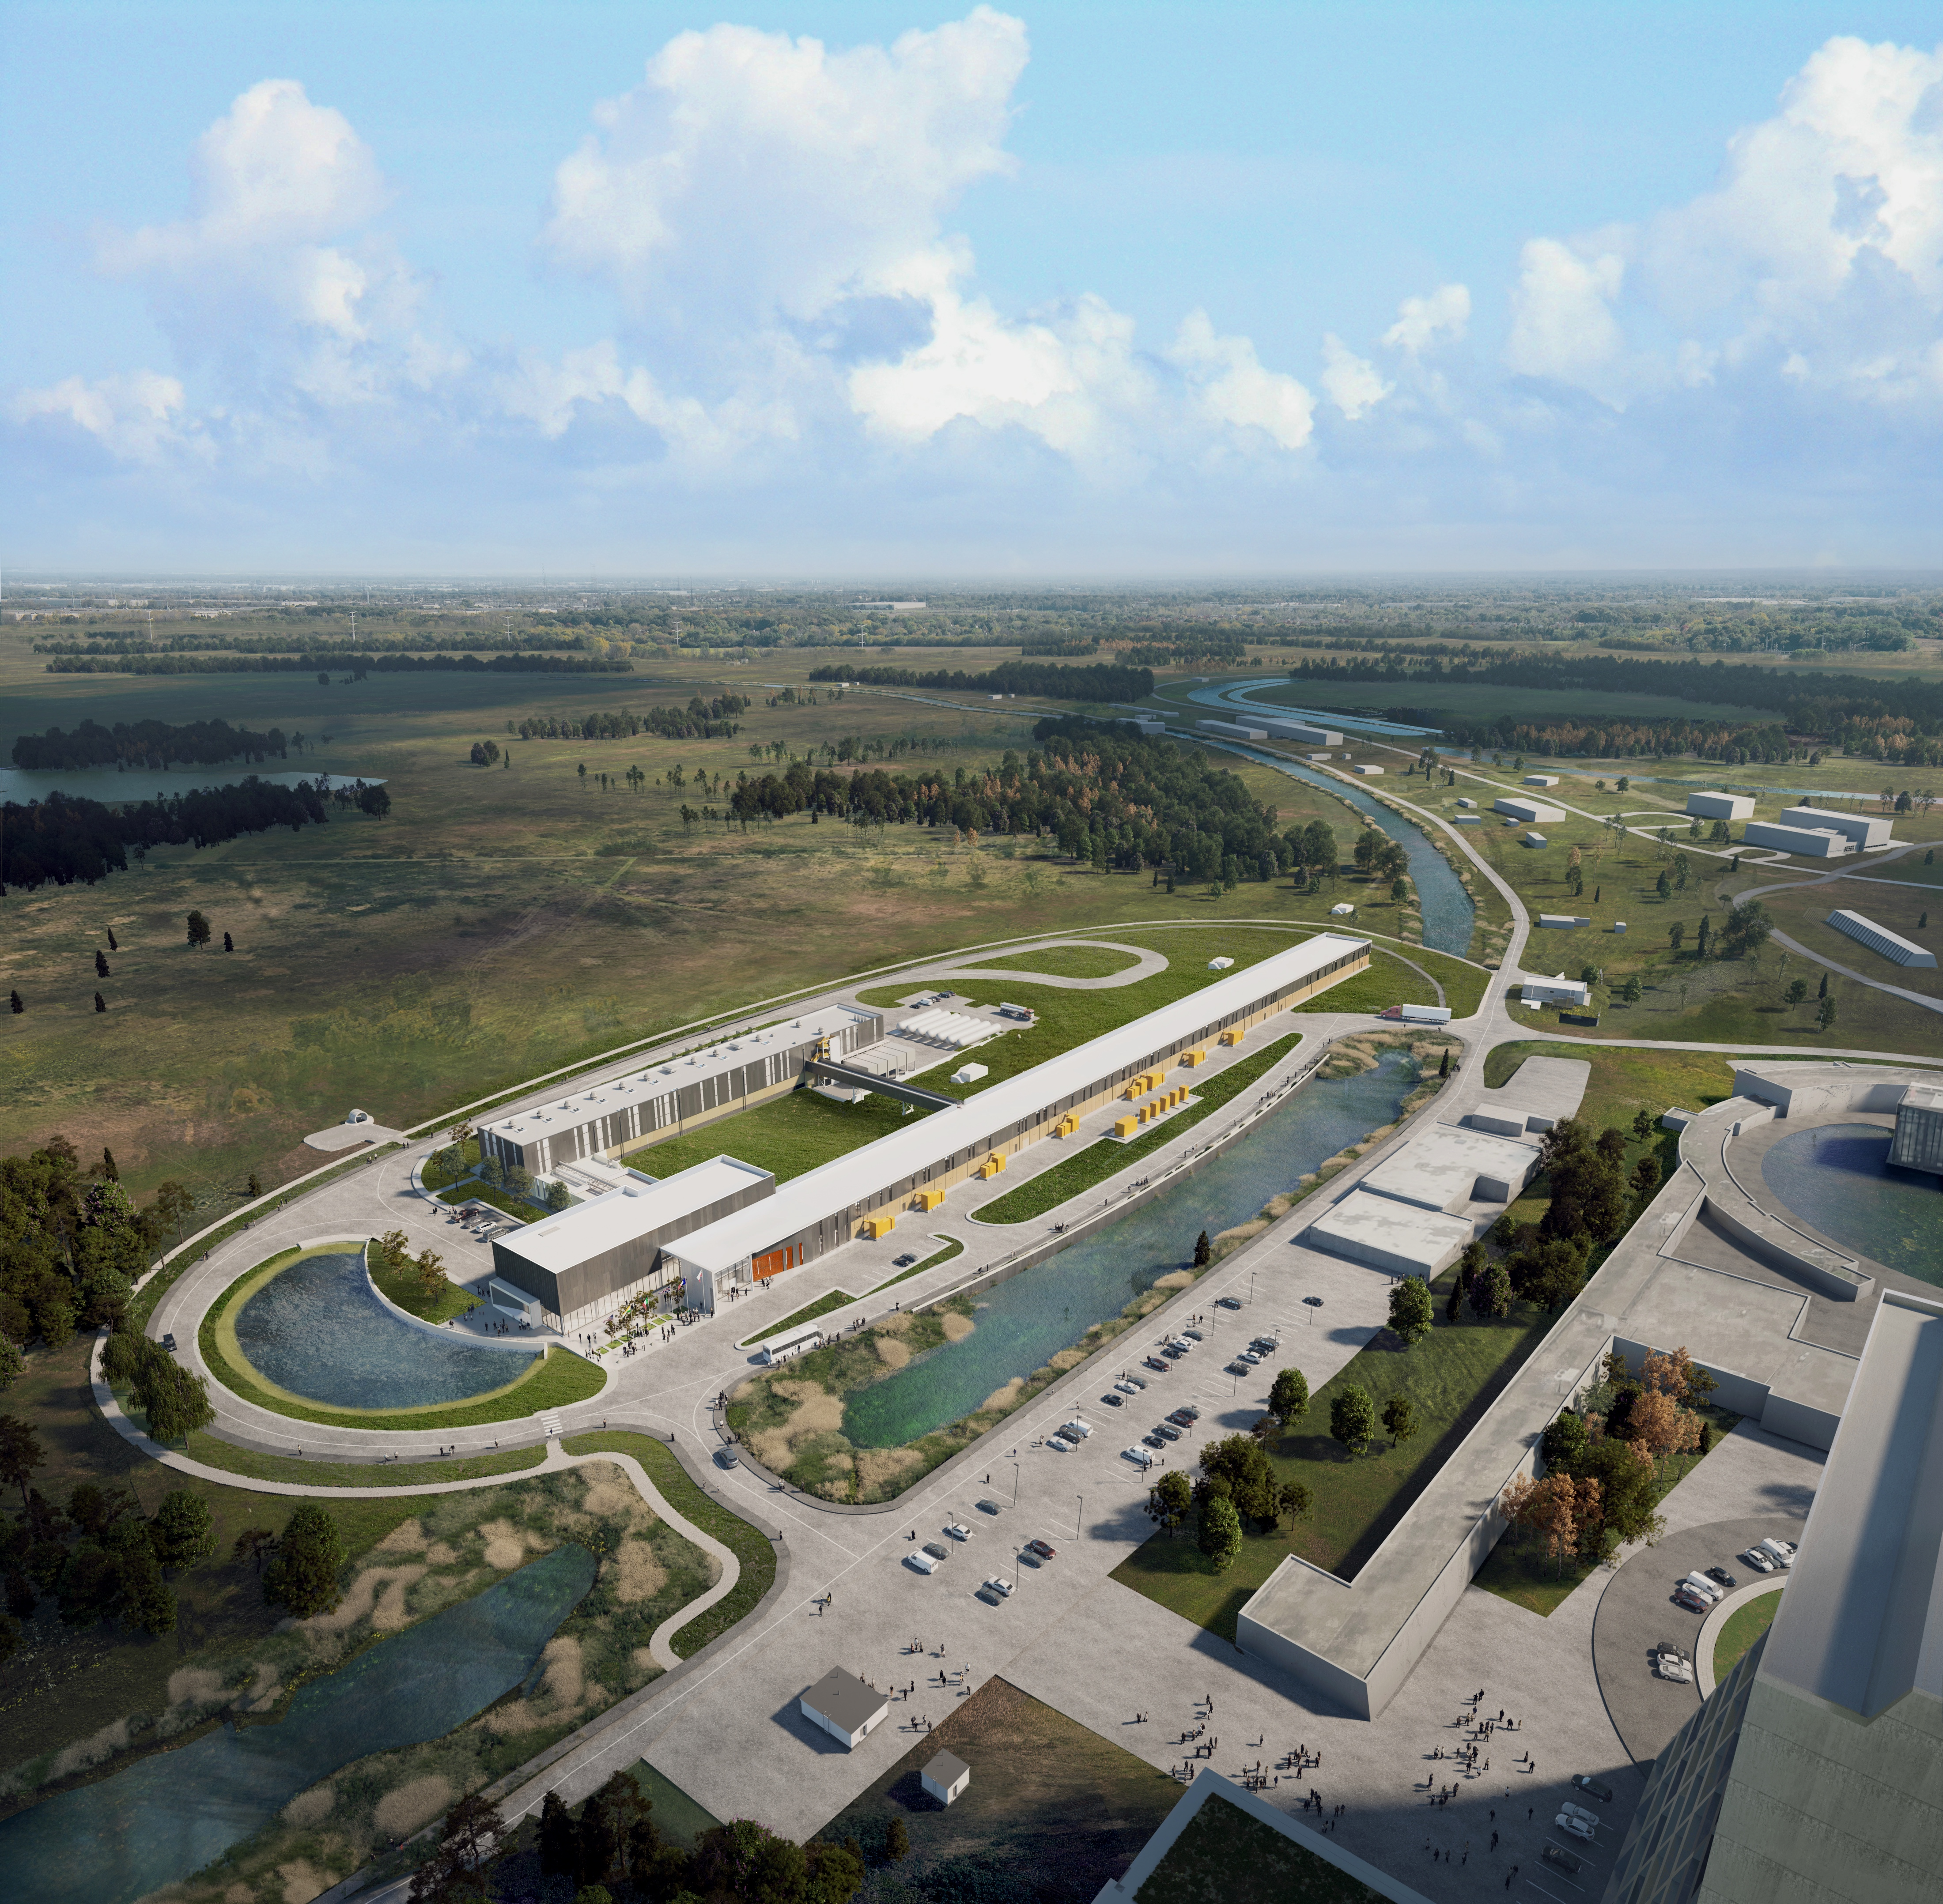



THE FUTURE OF FERMILAB
Follow us:
www.pip2.fnal.gov
@PIP2accelerator
/showcase/pip-ii/

