Slide 1
9 O’Clock Meeting
Keymonty Bullock
MCR Crew Chief
Wednesday, April 12, 2023

Slide 2
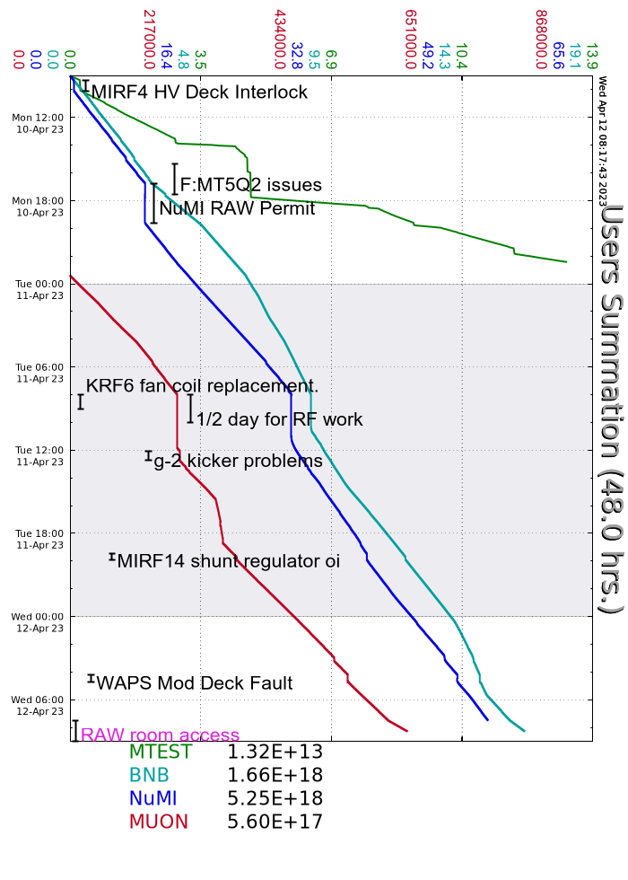
Since Monday…
MIRF04 Modulator Deck Fault from a dead fan
F:MT5Q2 trip on Reverse Switch over current fault
KRF6 Fan Coil was replaced on Tuesday
MIRF14 had multiple shunt regulator over current trips.
Bypassed it for the evening. Station is recovered now
NuMI raw room access to work on the horn 1 raw skid temperature control valve
Estimated 3-4 hours of downtime
Walkthroughs on off-shifts
Studies ran when requested
Beam to BNB, g-2

