Slide 1
ColdADC and COLDATA David Christian May 8, 2023

Slide 2
Outline
Choice of 65nm CMOS
ColdADC
Requirements
Design
Performance
COLDATA
Requirements
Design
Performance
QC testing for ColdADC and COLDATA
Preliminary yield measurements

Slide 3
Choice of 65nm CMOS
In 2014, the FNAL & SMU ASIC groups performed a study of TSMC 65nm & 130nm (standard oxide thickness) transistors to determine their suitability for cryogenic use.
Results were published in IEEE Trans Nucl Sci Vol 62, No. 3 (June 2015):
Both technologies were less sensitive to the hot carrier effect than larger feature size CMOS technologies.
65nm transistors were significantly less sensitive to the hot carrier effect than 130nm transistors were.
Minimum length 65nm transistors had a predicted lifetime of more than 20 years even if operated at 1.3V rather than the nominal 1.2V.
As a result, 65nm CMOS was chosen for COLDATA and ColdADC.
Logix Consulting was paid to make cryogenic measurements of a variety of 65nm transistors and extract SPICE models.
To be extra safe, the decision was taken not to use minimum length transistors in the design.
A set of custom standard cells was developed (initially at Penn), characterized using the SPICE models, and used for digital design.

Slide 4
ColdADC Requirements & Specifications
Requirements:
Sampling frequency ~2 MHz
Number of ADC bits: ≥ 12
Total power (of all ASICs): < 50 mW/channel
Noise contribution ≪ 1000 e- (negligible compared to LArASIC)
Specifications:
Crosstalk: < 1%
Differential Nonlinearity (DNL): Absolute value < 1
Integral Nonlinearity (INL): < 1(12-bit ADC unit)
Equivalent Number of Bits (ENOB) > 10.3
Overflow protection: When input signal exceeds the upper or lower ADC range, the output should be fixed at the maximum or minimum value.

Slide 5
ColdADC Design
LBL, FNAL, BNL collaboration led by Carl Grace (LBL)
Designed to digitize signals from 1 LArASIC:
16 channels; linear output range of ~1.6V
Analog blocks are implemented using thick oxide (2.5V) devices
Digital logic is mostly implemented using thin oxide (1.2V) devices.
Uses two 15-stage pipelined ADCs operating at ~16 MHz (1.5 bit/stage)
Digital calibration logic corrects for non-ideal stage gain and offsets
Calibration procedure is automatic (occurs on command)
Reference voltages and currents are produced on-chip

Slide 6
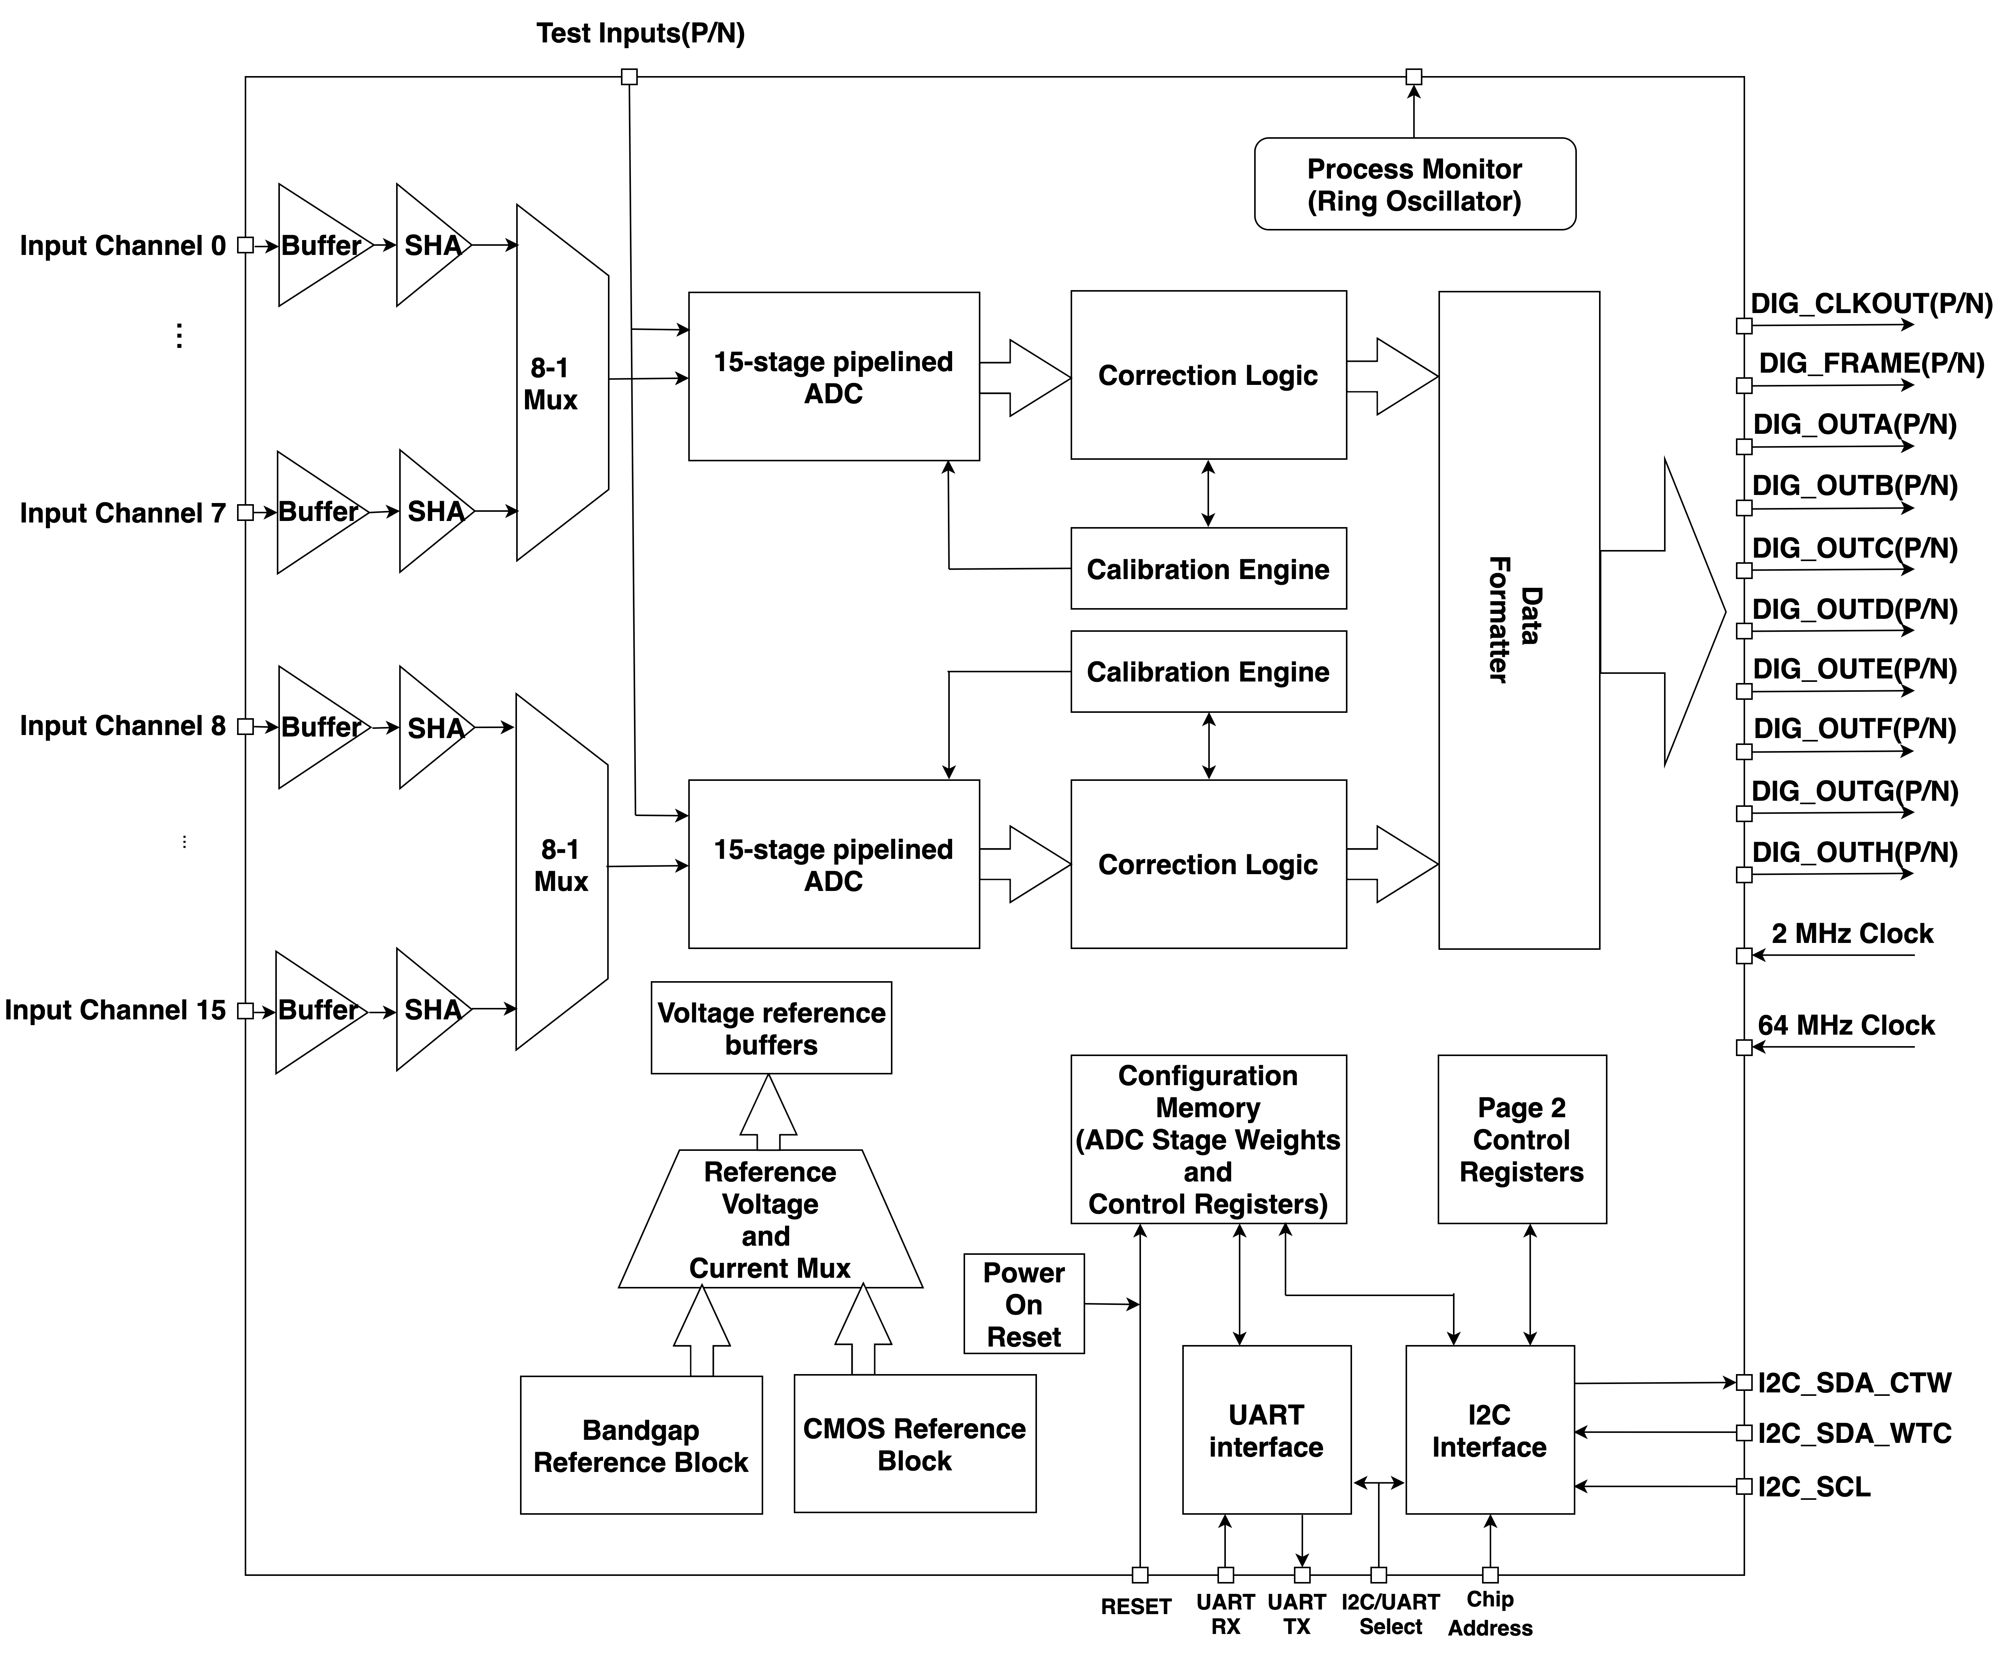
ColdADC Block Diagram

Slide 7
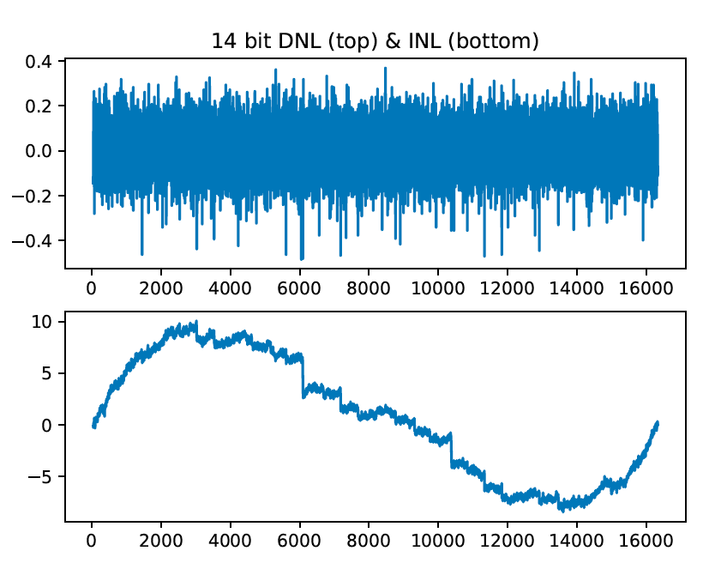
ColdADC Performance
Power consumption is within budget (< 21 mW/channel)
Noise is very low & uniform channel to channel & chip to chip:
Differential inputs: ~.75 (14-bit) ADC counts
Single ended inputs ~1.5 ADC counts
Differential nonlinearity (DNL) is good
No missing 14-bit codes
INL is larger than expected.
Typical DNL and INL (14-bit)

Slide 8
ColdADC Integral Nonlinearity
INL is larger than expected (especially for channels 0 and 8).
INL (defined as the integral of DNL) is well fit by a polynomial of odd order and can be improved offline.
Increasing bias currents in ADC stages does not reduce the nonlinearity--> not an MDAC settling problem
Linearity can be dramatically improved by decreasing the ADC clock rate → not a capacitor nonlinearity problem
Decreasing the settling time of the input buffer made no difference.
We believe the nonlinearity is consistent with the presence of dielectric absorption in the capacitors.
Dielectric absorption is a phenomenon by which charged caps only partially discharge after being charged for a long time.
Caps used are MIM structures (because they are reasonably small and accurate)… but MIM caps implemented with high-k dielectric are known to suffer from dielectric absorption.
We decided to live with the problem rather than redesign the chip using a different capacitor type (MOM).

Slide 9
ColdADC INL is stable in time
Fit to data taken on 10/27/20 together with a cubic fit to the data. Temp=77K
Data taken on 11/2/20 with the fit from the 10/27 data superimposed.

Slide 10
INL is very good after offline correction
12-bit INL for data corrected using the cubic fit to the 14-bit data on the right hand side of the previous slide.

Slide 11
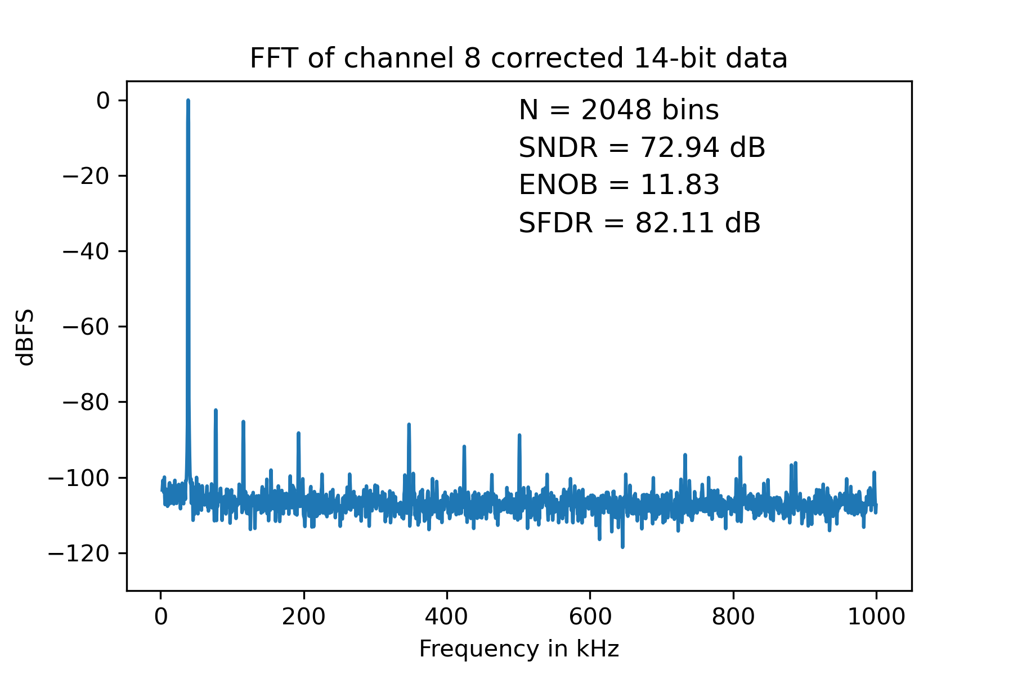
Dynamic Linearity is also good after offline correction
Typical frequency spectrum of ADC output codes (with differential inputs at 77K) after offline polynomial correction. The input frequency was 38.6 kHz.

Slide 12
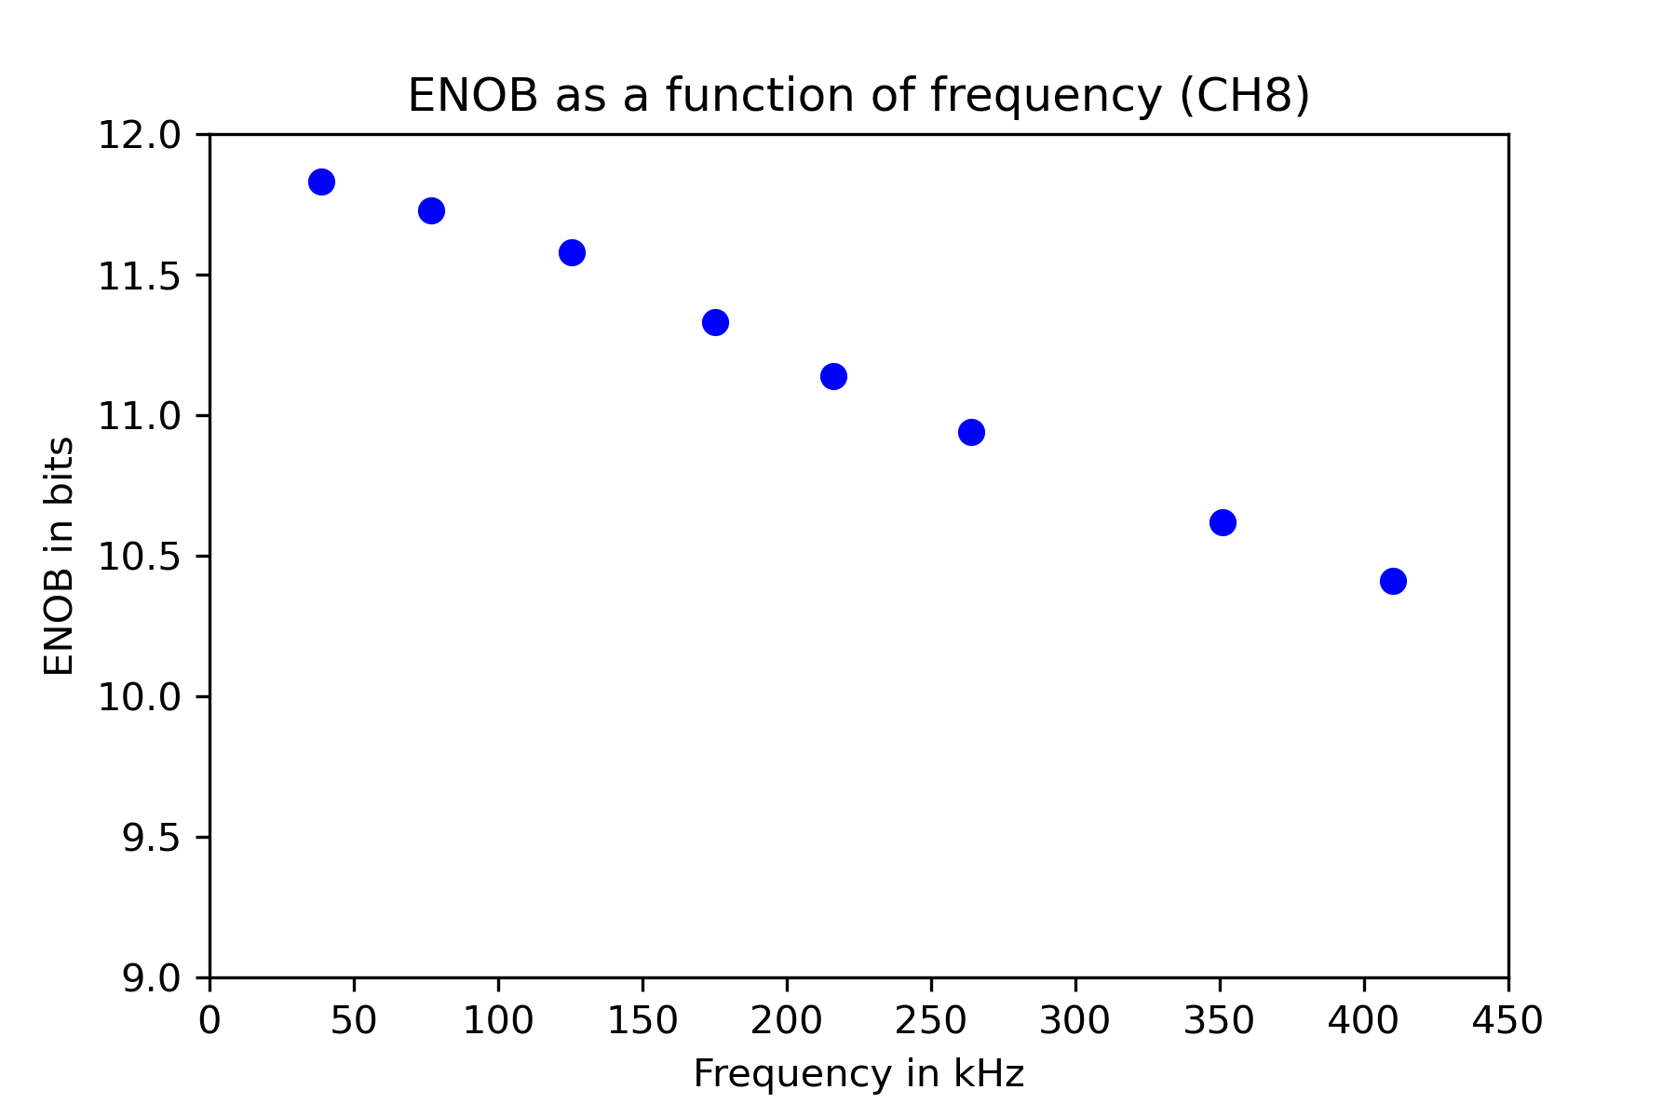
ENOB as a function of frequency
LArASIC -3dB bandwidth is ~205 kHz with 1 us shaping time

Slide 13
COLDATA Requirements & Specifications
Requirements:
Total power (of all ASICs): < 50 mW/channel
Specifications:
Number of links between FEMB & WIB: 4 at 1.25 Gbps
Clock jitter: < 180 ps [consistent with ADC ENOB of ~11 and signal bandwidth of 350 kHz]

Slide 14
COLDATA Design
FNAL, BNL, SMU collaboration led by Jim Hoff (FNAL)
Only thin-oxide (1.2V) devices are used
COLDATA controls 4 LArASICs and 4 ColdADCs
I2C-like control path for COLDATAs & ColdADCs
SPI control paths for LArASICs
All clocks are derived from the 62.5 MHz system clock
1.25 Gbps hybrid-mode line driver (current-mode transmitter equalization and voltage-mode pre-emphasis) designed to drive long twinax cables (up to ~35m)

Slide 15
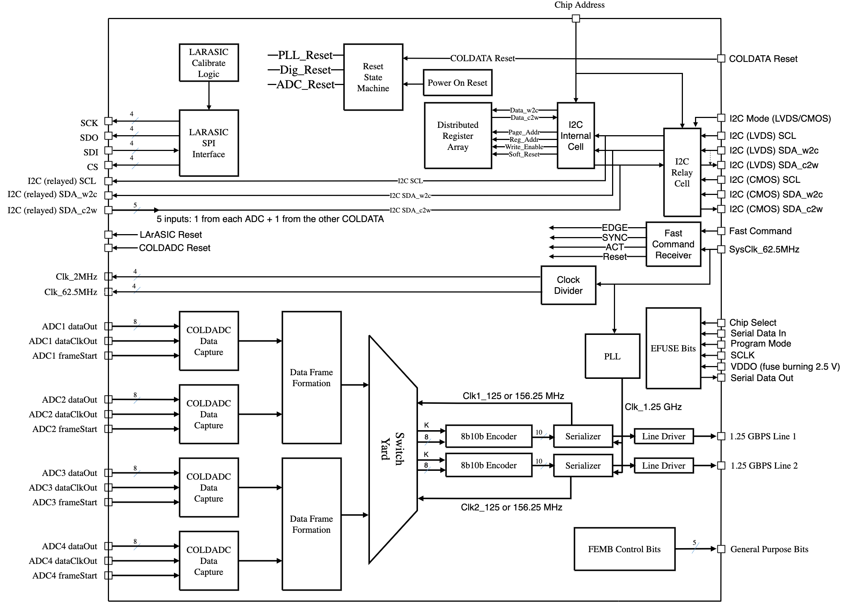
COLDATA Block Diagram

Slide 16
COLDATA Performance
All subcircuits operate as designed.
Total power consumption ~170 mW (2.7 mW/channel)
I2C Echo delay is ~4ns → cable delay can be accurately measured and compensated for (so all ADCs will sample simultaneously).
PLL locking range is large and changes only slightly with change in temperature (RT – LN2).

Slide 17
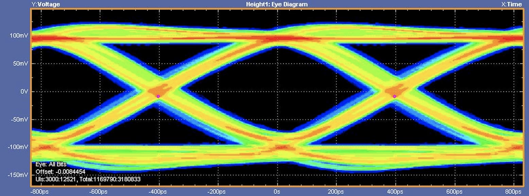
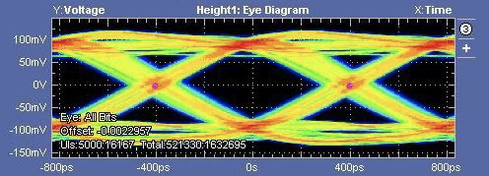
Line driver performance
~150 mV
~100 mV
PRBS7 eyes (RT): 25m Samtec twinax (top) & 35m (bottom)

Slide 18
ColdADC QC
Power cycle at least 5 times; measure currents
Test I2C communication
Check power-on reset (verify default register values)
Write/read registers
Measure reference voltages
Perform auto calibration; check weights
Measure open channel noise
Measure DNL/INL (slow ramp or sine wave input)
Check overflow protection
Measure ENOB
Repeat at LN2 temperature
For a fraction of devices:
Measure ring oscillator frequency
Measure cross talk

Slide 19
COLDATA QC (Not yet done; long lead time for sockets)
Power cycle at least 5 times; measure currents
Test I2C communication
Check power-on reset (verify default register values)
Write/read registers using both LVDS and CMOS paths
Verify I2C relay (read/write registers in ColdADCs)
Verify LArASIC SPI functionality
Burn EFUSE bits (assign chip identifier)
Measure PLL locking range
Verify Fast Commands (check I2C echo, reset commands, & status regs)
Verify output links using FRAME 14
Check FEMB control bits
Repeat at LN2 temperature
For at least a fraction of devices:
Verify all output formats
Measure output link eye (for PRBS7) with long (warm) cable

Slide 20
Yield
Statistics from ColdADC QC done at 3 sites (LBL, UC Irvine, & LSU) indicate a yield of >98%
Most failures are obvious (power shorted to gnd, for example)
Some failures may have been due to test equipment problems.
Very few failures are observed at LN2 temperature for chips that operate properly at room temperature.
COLDATA:
FEMB tests indicate COLDATA yield is also high (>97%)

