Slide 1
DUNE PRR: FD1 TPC Electronics (Cold ASICs+FPGA) ASIC QC Test Stand and ESD Discussion
S. Gao and D. Shooltz on behalf of DUNE-FD TPC electronics team
Brookhaven National Laboratory, Michigan State University
05/08/2023

Slide 2
Content
Charge Questions
DAT Design and Status
RTS Status
R&D is conducted by MSU
ESD Discussion
Summary

Slide 3
Charge Questions
7. Has the handling procedure of ASICs to minimize ESD been defined and documented?
Yes. Please refer to EDMS#2782612.
8. Have the designs and production of the ASICs QC stations been completed?
DAT and RTS status is presented.

Slide 4
Content
Charge Questions
DAT Design and Status
RTS Status
ESD Discussion
Summary

Slide 5
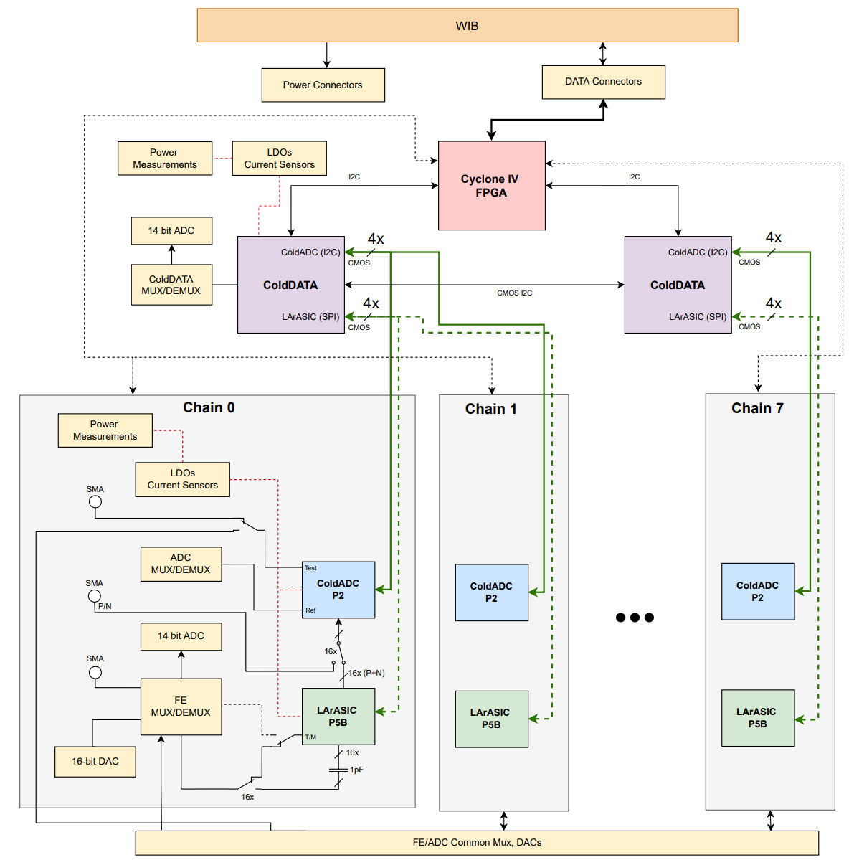
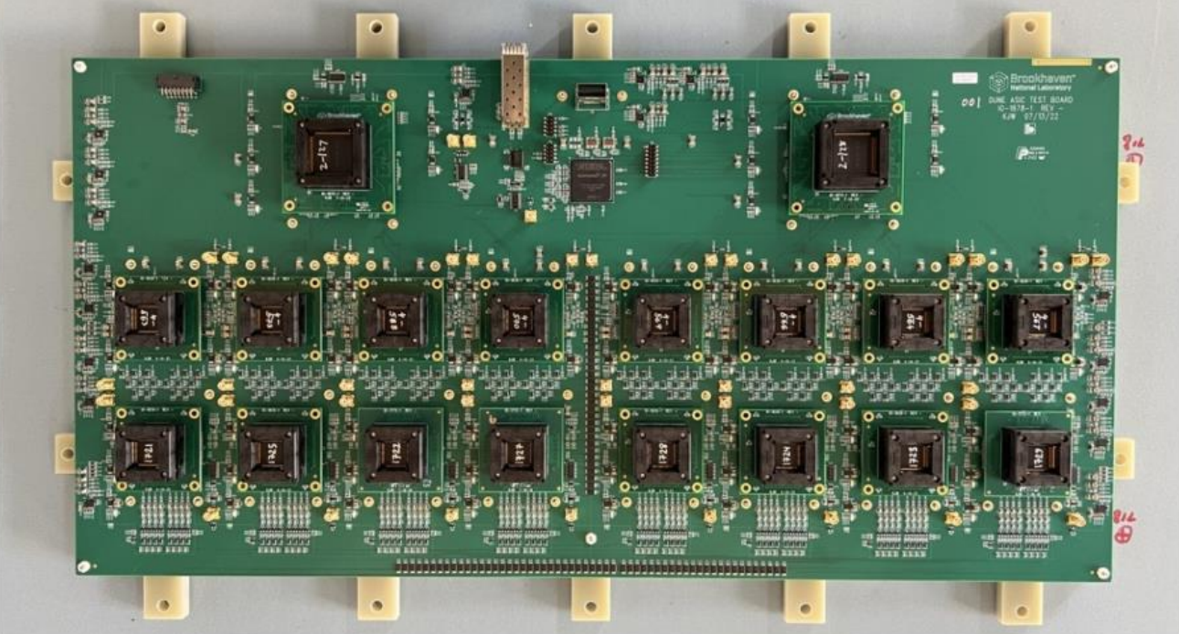
Hardware: DUNE ASIC Test Board (DAT)
DUNE ASIC Test (DAT) Board
Unified ASIC test board for LArASIC, ColdADC and COLDATA QC
Compatible power and data interface with WIB. It acts as exactly as a FEMB to WIB
Can perform QC testing for 8x LArASIC, 8x ColdADC and 2x COLDATA at both RT and LN2 with MSU new RTS
Aim for DUNE-FD1 & FD2 ASIC QC carried out in several test sites
A single big board solution with ASIC socket mezzanines
ASIC socket suffers mechanical degradation through thermal cycling
More commercial semiconductor devices have been identified for cryogenic operation
Such as Analog MUX: SN74LV4051, Power Monitoring Chip: INA226, I2C Bridge device: PCA9306, DAC: AD5675ARUZ
Unified ASICs and FEMB QC with the same software suite
Can benefit directly from the WIB, back-end DAQ, analysis software developments
Some extra software effort for ASIC QC can be implemented as a widget to the available software

Slide 6
Power Measurement
Power Rail | V /V | I /mA | V /V | I /mA | V /V | I /mA | V /V | I /mA | V /V | I /mA | V /V | I /mA | V /V | I /mA | V /V | I /mA
 | COLDATA#1 |  |  |  |  |  |  |  | COLDATA#2
VDDA | 1.193 | 9.3 |  |  |  |  |  |  | 1.193 | 9.1
VDD_LArASIC | 1.786 | 0.0 |  |  |  |  |  |  | 1.783 | 0.0
VDDCORE | 1.089 | 9.2 |  |  |  |  |  |  | 1.088 | 9.2
VDDD | 1.089 | 19.5 |  |  |  |  |  |  | 1.086 | 19.5
VDDIO | 2.234 | 66.9 |  |  |  |  |  |  | 2.228 | 67.6
 | ColdADC #1 |  | ColdADC #2 |  | ColdADC #3 |  | ColdADC #4 |  | ColdADC #5 |  | ColdADC #6 |  | ColdADC #7 |  | ColdADC #8
VDDA2P5 | 2.190 | 132.6 | 2.185 | 133.0 | 2.184 | 132.3 | 2.181 | 134.6 | 2.184 | 125.0 | 2.184 | 132.8 | 2.186 | 121.1 | 2.189 | 135.4
VDDD2P5 | 2.206 | 5.2 | 2.206 | 5.3 | 2.206 | 5.3 | 2.206 | 5.3 | 2.210 | 5.0 | 2.211 | 5.1 | 2.211 | 5.2 | 2.211 | 5.2
VDDIO | 2.205 | 17.2 | 2.206 | 17.7 | 2.205 | 17.5 | 2.205 | 15.6 | 2.210 | 17.5 | 2.209 | 16.4 | 2.209 | 17.1 | 2.210 | 14.7
VDDD1P2 | 1.095 | 1.5 | 1.095 | 1.4 | 1.094 | 1.5 | 1.094 | 1.5 | 1.094 | 1.4 | 1.098 | 1.4 | 1.099 | 1.4 | 1.099 | 1.5
 | LArASIC #1 |  | LArASIC #2 |  | LArASIC #3 |  | LArASIC #4 |  | LArASIC #5 |  | LArASIC #6 |  | LArASIC #7 |  | LArASIC #8
VDDA | 1.778 | 21.5 | 1.778 | 21.4 | 1.776 | 21.7 | 1.776 | 20.5 | 1.771 | 21.4 | 1.771 | 21.5 | 1.773 | 21.4 | 1.771 | 21.5
VDDO | 1.781 | 0.0 | 1.780 | 0.0 | 1.780 | 0.0 | 1.781 | 0.0 | 1.776 | 0.0 | 1.776 | 0.0 | 1.776 | 655.3 | 1.775 | 0.0
VDDP | 1.776 | 32.5 | 1.775 | 32.6 | 1.775 | 32.4 | 1.774 | 32.2 | 1.769 | 32.2 | 1.770 | 32.3 | 1.769 | 32.3 | 1.771 | 32.4
Total 66 power rails are measured independently by 66 INA226 chips
Each COLDATA: 5 power rails
Each ColdADC: 4 power rails
Each LArASIC: 3 power rails

Slide 7
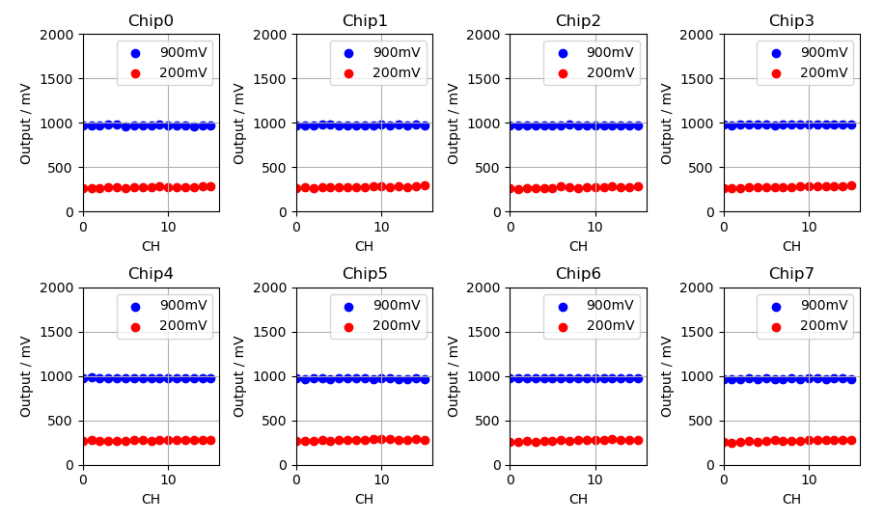
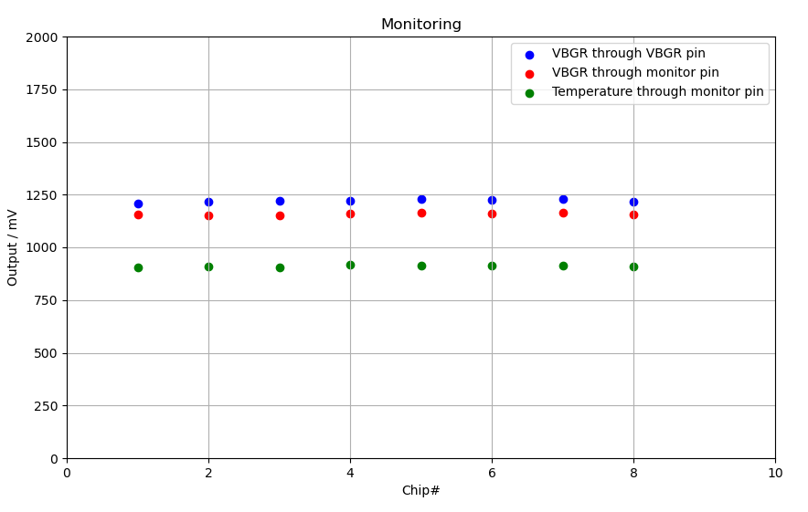
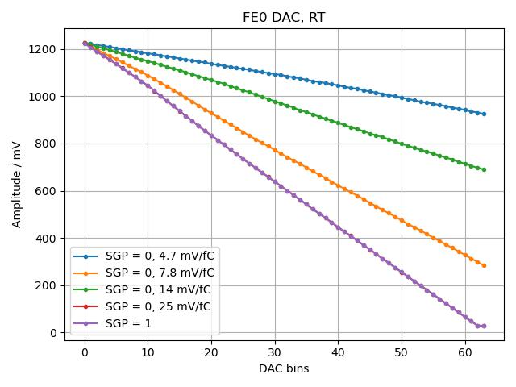
Monitoring through COTS ADC
COLDATA
VCEXT, VDDIO, VDDCORE, VDDD, ATO, LOCK
LArASIC
VBGR (1.18V), Temperature, inner-DAC, LArASIC output
ColdADC
VOLTAGE_MONITOR, CURRENT_MONITOR, AUX_VOLTAGE, VREFP, VREFN, VCMI, VCMO, AUX_ISINK, AUX_ISOURCE
FE Baseline through monitoring pin (note: monitor output waveform is available though not implemented yet)
Monitoring (FE Bandgap Reference & Temperature)
Each LArASIC 6-bit DAC will be measured independently

Slide 8
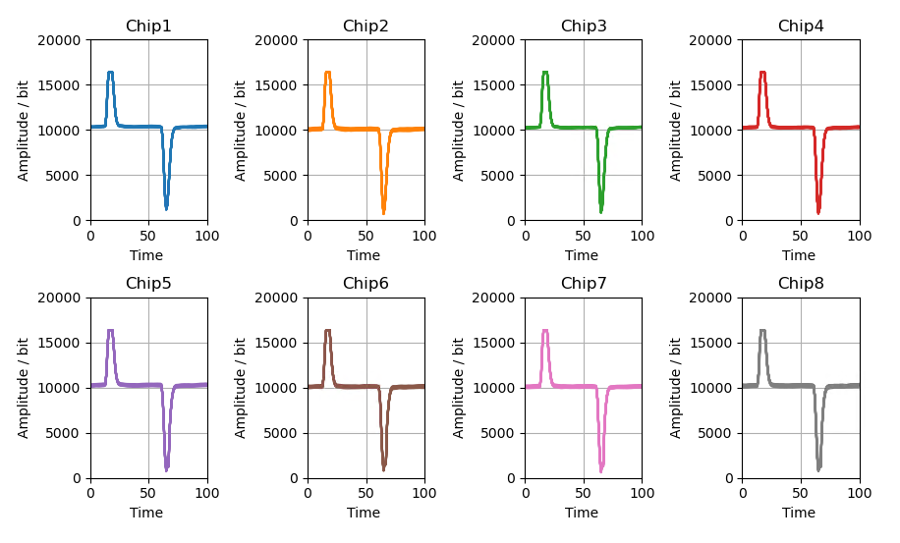
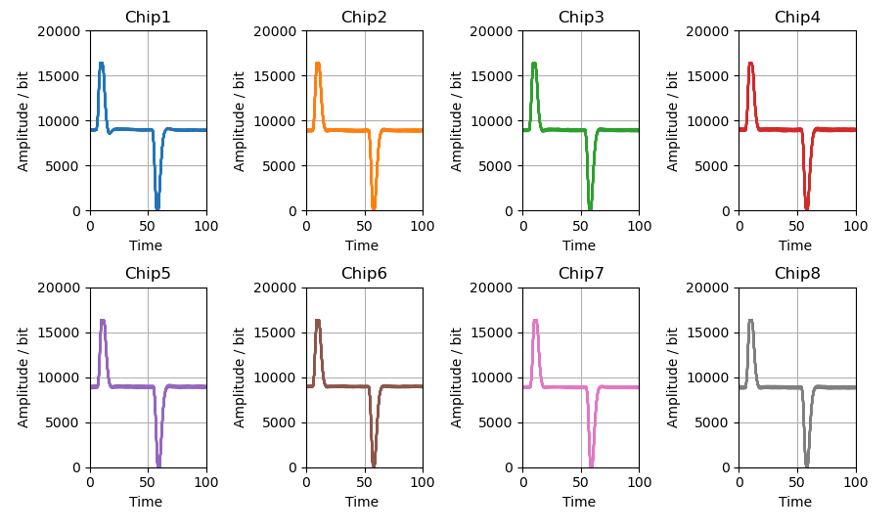
LArASIC Pulse Response
Single-ended Interface Between LArASIC & ColdADC
Differential Interface Between LArASIC & ColdADC
DAT is fully compatible with WIB firmware
Unify ASIC and FEMB QC test stand
Benefit directly from FEMB QC scripts development
Multiple onboard calibration can perform all LArASIC QC items
Onboard 16-bit DAC can characterize ColdADC static performance (INL/DNL)
ColdADC dynamic performance (ENOB) can be done with external signal generator (SMA interface)
All COLDATA QC items can be performed with DAT revision

Slide 9
LArASIC QC Items
Test Item | Description | Reference chips | Chips for QC | DAT doable
Power Consumption | Measure the power consumption on the three rails of LArASIC (VDDP, VDDA, VDDO), for each of six configurations (two baseline references: 200 mV and 900 mV; three configurations of the output buffer: bypassed, single ended, differential) | Required | Required | Yes
Power Cycling | a number (>5) power on/off cycles, measure the pulse response with a certain configuration (e.g., 14mV/fC, gain, 2.0us peak time, 200mV baseline, 500pA leakage current) | Required | Required | Yes
Register configuration | check through SPI interface for register configuration W/R | Required | Required | Yes
Bandgap | Measure the bandgap reference voltage | Required | Required | Yes
Temperature sensor | Measure the voltage of embedded temperature sensor | Required | Required | Yes
Channel response monitoring | Check response of each channel through the monitor pin | Required | Required | Yes
Internal DAC measurement | measure INL/DNL of 6-bit DAC (4 ranges for 4 gains) | Required | subset | Yes
baseline measurement through monitoring pin | Measure baseline through the monitoring pin (4 gains x 4 peak times x 2 baselines x 4 leakage currents) | Required | subset | Yes
baseline measurement | Measure baseline with ColdADC (4 gains x 4 peak times x 2 baselines x 4 leakage currents) | Required | subset | Yes
Noise measurement | Measure with ColdADC (4 gains x 4 peak times x 2 baselines x 4 leakage currents). A reference capacitive load of ~150 pF at the inputs. | Required | subset | Yes
Calibration with internal-DAC | Measure with ColdADC (4 gains x 4 peak times x 2 baselines x 4 leakage currents) for gain, linearity, range | Required | subset | Yes
Calibration with external precise source | Measure with ColdADC (4 gains x 4 peak times x 2 baselines x 4 leakage currents) for gain, linearity, range | Required | No | Yes
Crosstalk [1] | Measure with ColdADC (1 gains x 4 peak times ) | No | No | no
Internal calibration capacitor measurement | Measure the capacitance of the calibration capacitor | Required | No | Yes
[1] crosstalk test should be done on FEMB only

Slide 10
ColdADC QC Items Recommendation
Item | Description | FEMB doable | DAT doable
Power consumption and power cycling | Voltage and current of each power rails should be recorded | No | Yes
I2C Write/Read | Check all default register values | Yes | Yes
Chip reset |  | Yes | Yes
Reference voltages measurement | VCMI, VCMO, VREFN, VREFN | Yes | Yes
Pulse 16 channels | Either at once or individually automatically. Needs external signal generator to get INL/DNL, ENOB, DC noise | No | Yes for INL/DNL No for ENOB [1] Yes for DC noise
Overflow checkout | Needs external signal generator | No | Yes
Coupled with LArASIC | Full-chain test. Needs automatically switch sources (LArASIC or signal generator) for ADC inputs | Yes | Yes
16-bit mode | COLDATA doesn’t support 16-bit mode | No | No, 14-bit
Ring oscillator | Measure the frequency | No | Yes
UART | Not used in FEMB design | No | Yes
[1] It is doable with external ultra-low distortion function generator and extra coaxial cable connection

Slide 11
COLDATA QC Items Recommendation
Item | Description | FEMB doable | DAT doable
Power consumption and power cycling | Voltage and current of each power rails should be recorded | No | Yes
I2C Write/Read | Check all default register values | Yes | Yes
Fast commands | Verify all Fast Commands | Yes | Yes
PLL, 8b10b Encoder, Serializer, & Line Driver |  | Yes | Yes
Data Capture, Frame Formation, Switchyard |  | Yes | Yes
General Purpose I/O |  | Yes | Yes
Master/Slave operation | I2C LVDS, I2C CMOS and ADC I2C addressing | no | Yes
EFUSE | Add EFUSE programming into DAT revision | no | Yes

Slide 12
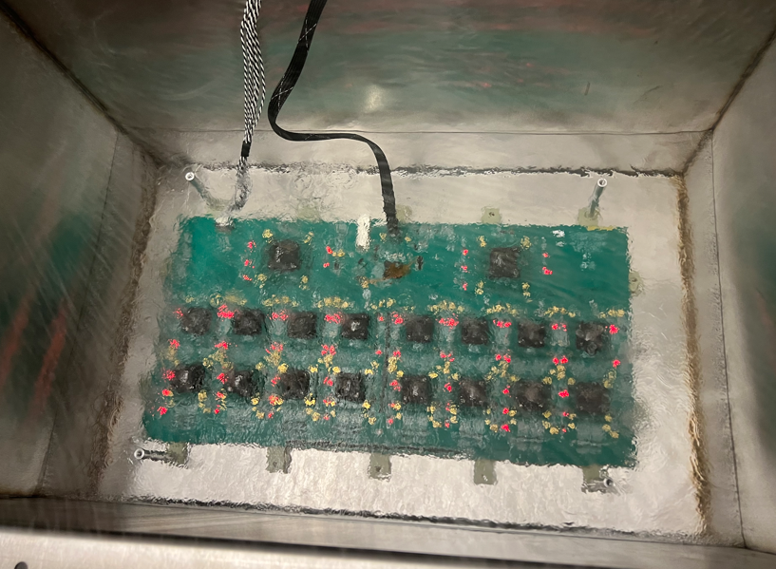
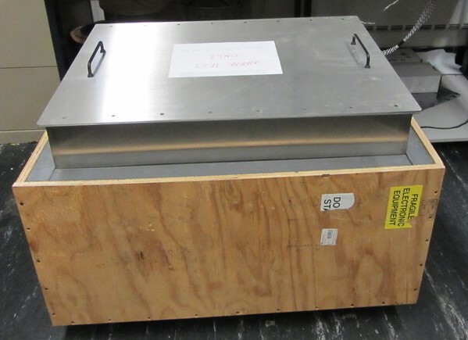
DAT Cold Testing
A stainless-steel box for EMI shielding and LN2 containment, with DAT board inside
The outer plywood box with foam provides thermal insulation
This box is intended for FEMB QC in future
It has the capability to hold multiple FEMBs (CE boxes)
Got ESR approval for the cold operation
DAT 1st run at cold
All commercial components survive (we did cold screening to choose cryogenic-eligible components)
Reliable communication between DAT and WIB
Unreliable connection between chips and sockets
Cooldown may cause misalignment between chip pins to socket pads (sometimes poking the chips slightly can fix it sometimes not)
Observed channel response
2nd cold run with chip mezzanines is scheduled

Slide 13
DAT Revision is Under Review
1st DAT satisfies 3-ASIC QC requirement, a minor revision is required for
Fix some FPGA IOs assignment issue
Add support of COLDATA EFUSE programming
Power measurement for COLDATA chips
SCL and SDA lines are going into the wrong pins on INA226s
V_{REF} of Two COTS ADCs for COLDATA monitoring should connect to Reference
Revision of schematics and layout are done, waiting for approval
PCB fabrication was hold until we fully characterize the current DAC capability for 3-ASIC QC testing.

Slide 14
Content
Charge Questions
DAT Design and Status
RTS Status
R&D is conducted by MSU
ESD Discussion
Summary

Slide 15
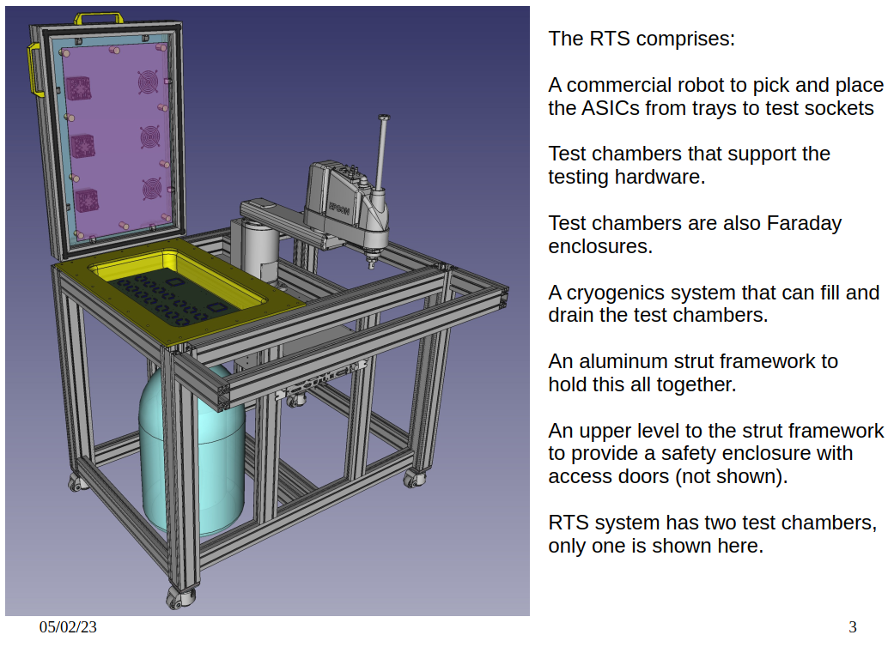
Hardware: DUNE Robotic Testing Station
RTS is designed by Dean Shooltz, Kendall Mahn, Carl Bromberg from Michigan State University

Slide 16
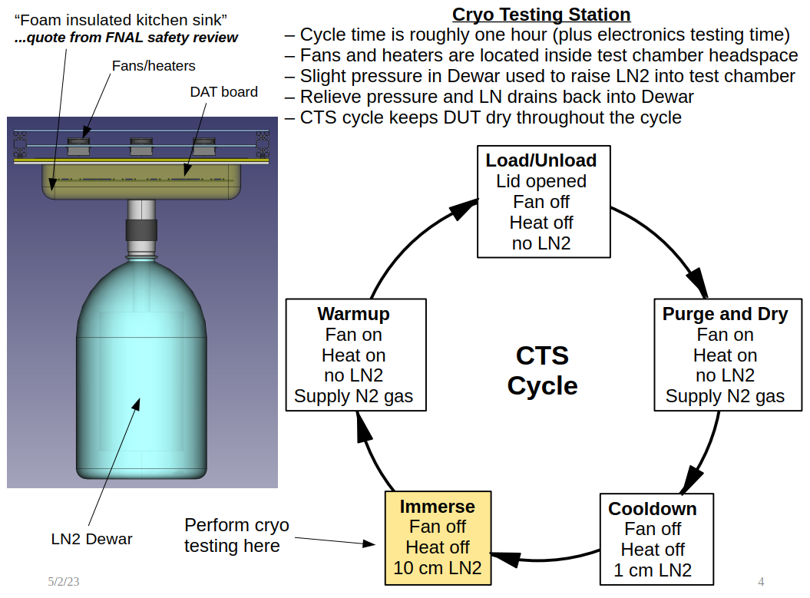

Slide 18
Video demos
A timelapse of the RTS swapping a batch of 8 chips in the sockets in the current prototype setup
The motions of the RTS robot when moving chips from tray to chamber and back

Slide 19
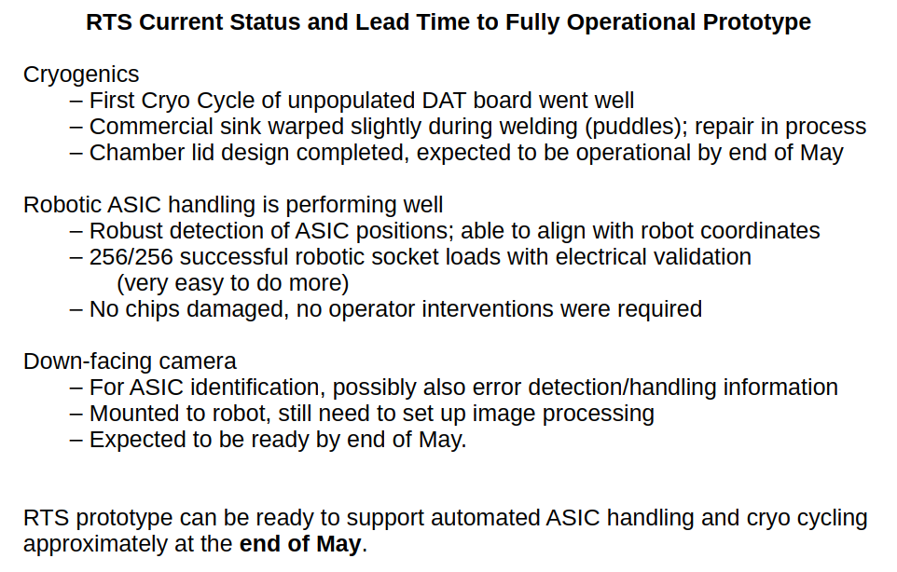

Slide 20
Content
Charge Questions
DAT Design and Status
RTS Status
ESD Discussion
Charge Question: Has the handling procedure of ASICs to minimize ESD been defined and documented?
Summary

Slide 21
LBNF/DUNE-US Electrostatic Discharge control for TPC electronics
Document number: EDMS#2782612
In DUNE, ESD can damage any of the electronics components mounted on the FEMBs, WIECs, the bias voltage supplies, or the power supplies.
To avoid this type of damage, devices must be given continuous ESD protection, as outlined in EDMS#2782612
Appropriate preventive measures must be taken during assembly, testing, installation, and shipping of all detector components provided by the TPC electronics consortium
These measures include using appropriate ESD-safe packing materials, appropriate clothing and gloves, wearing conducting wrist or foot straps to prevent charges from accumulating on workers’ bodies, anti-static mats to conduct harmful electric charges away from the work area, and humidity control. All laboratories with detector components provided by the TPC electronics consortium will implement these measures, including SURF.
All personnel must be trained to take the appropriate preventive measures.
ESD monitor is highly recommended
TPC electronics consortium comply with DUNE STANDARD

Slide 22
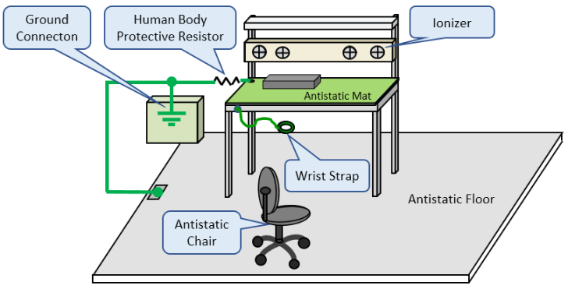
ESD protection for ASICs / CE boards
Keep ASICs / CE boards (FEMB, WIB, PTC, etc.) and everything that comes in close proximity to them at ESD ground potential.
Any person handling ASICs / CE boards must be grounded either with a wrist strap or ESD protective footwear, used in conjunction with a conductive or static dissipative floor or floor mat
The work surface where ASICs / CE boards are placed for handing, processing, testing, and so forth, must be made of static dissipative material and be grounded to ESD ground.
All insulator materials either must be removed from the work area or they must be neutralized with an ionizer.
Static generating clothes should be covered up with an ESD protective smock.
When ASICs / CE boards are being stored, transferred between operations or workstations, or shipped, they must be maintained in a Faraday shield container whose inside surface (touching the ASICs) is static dissipative.
Standard ANSI/ESD S6.1 recommends
Grounding all components of the workstation and personnel to the same electrical ground point
Connecting the common point ground to the equipment grounding conductor or the third wire electrical ground connection
Any work on DUNE ASICs (installation in sockets, inspection, testing, etc.) must be performed only at ESD-safe workstation designed according to the above guidelines. The work must be performed by trained personnel.

Slide 23
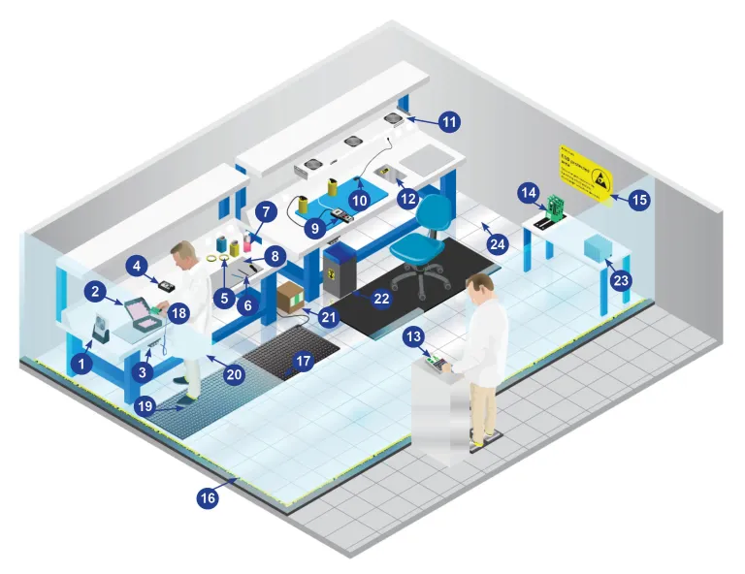
ESD Protected Area in Electronic circuit test
In the DUNE experiment, there are more than 100 k ASIC chips need to be tested. The ESD Monitors are used to constantly test the connection of the person, the wristband and the coiled cord to help ensure that people remain grounded.
To minimize the chance of damaging ESD sensitive devices, an ESD protected area, which is an area that is equipped with the ESD control items, is recommended to used as a standard test platform.
A protected area is also referred to a “static-safe” area, a permanent workstation within room or an entire factory. The main component include:
1 Bench Top Ionisers 13 Data Acquisition
2 ESD Packaging Containers 14 PCB Storage
3 Earth Bonding Point Bar 15 Signs and Labels
4 ESD Testers and Monitors 16 Floor Marking Tape
5 ESD tape 17 Floor Mats
6 Menda Probes 18 Wrist Straps
7 Menda Dispensing Bottles 19 Foot Grounders
8 Dissipative Worksurface Mats 20 Static Control Garments
9 Surface Resistance Meters 21 Floor Maintenance
10 Grounding Cords 22 Waste Bins and Liners
11 Overhead Ionisers 23 Document Handling
12 Shielding Bags 24 Floor Tiles
A fully ESD-safe workbench is being built and evaluated at BNL, which will help multiple test sites in future building the similar workbenches.

Slide 24
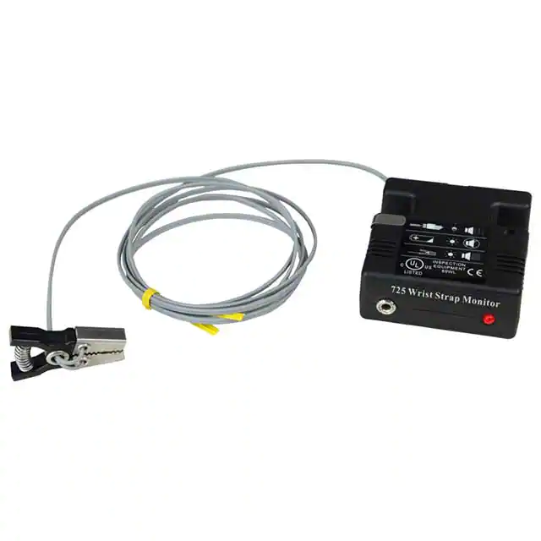
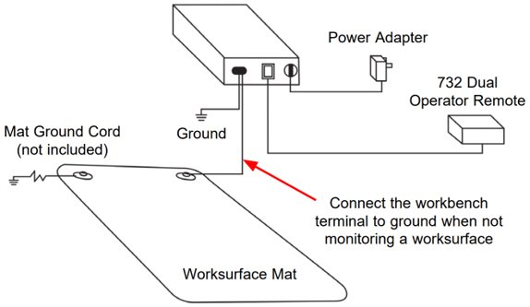
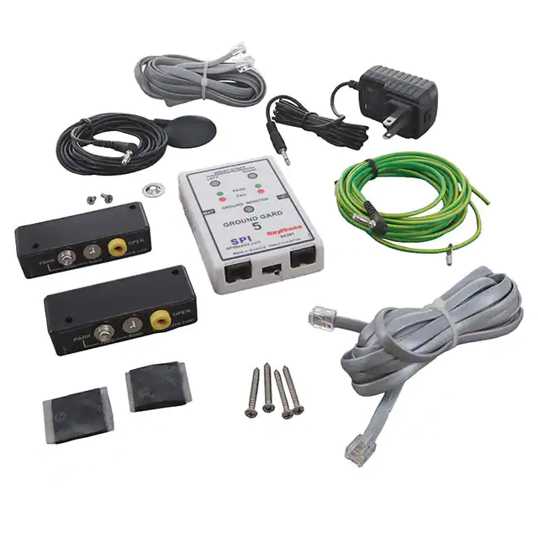
ESD monitor
A typical ESD monitor is set in protection architecture and mainly includes monitor, remotes, power supply, mat cord and mechanical fixed part. The monitor powered by AC adapter and all GND cable snap to the ground. When operators start working, the wrist strap should link with the monitor on itself or the remote part. Then, the voltage status are under an effective monitoring.
DESCO: 94391
SCS: 725
For fixed workstation
Carry on environment (e.g. installation )
SCS 725 was applied during Yale CRP4 CE installation. It is small, flexible, and sensitive.
It receives positive feedback from the BNL CE installation team at Yale.

Slide 25
Summary
DUNE ASIC Test Stand is being finalized
All 3 ASICs show high yield at both warm and cold
DAT can meet 3 ASICs QC requirements and a revision is ready
RTS prototype can support automated ASIC handing and cryo cycling by end of May
The current QC test stand built for ProtoDUNE will be kept in service for a while until DUNE ASIC test stand is deployed
TPC electronics consortium complies with DUNE STANDARD
Any work on DUNE ASICs (installation in sockets, inspection, testing, etc.) must be performed only at ESD-safe workstation designed according to the above guidelines. The work must be performed by trained personnel.
A fully ESD-safe workbench is being built and evaluated at BNL, which will help multiple test sites in future building the similar workbenches.
ESD monitor is recommended in future DUNE CE installation activities.

Slide 26
backups

Slide 27
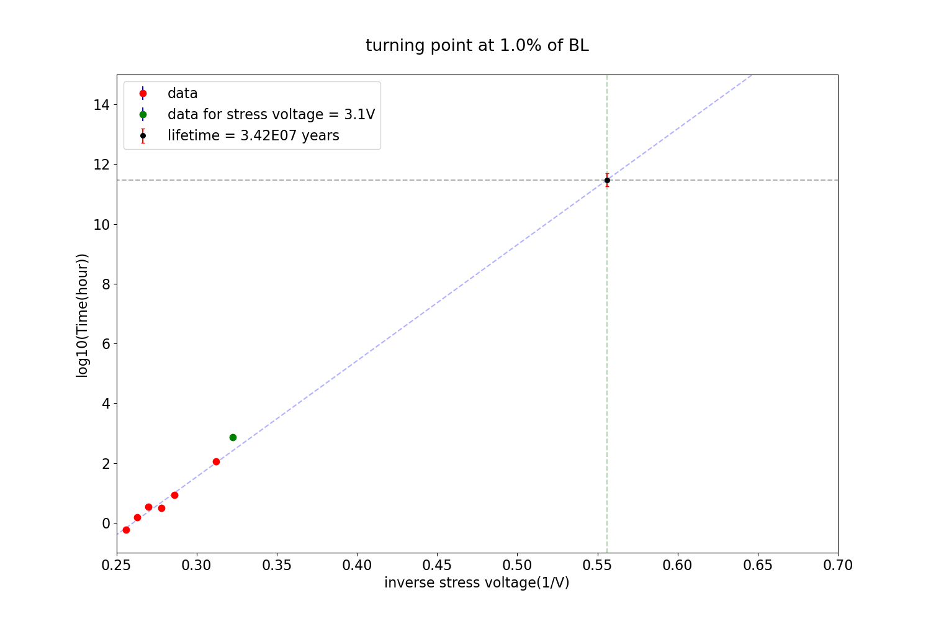
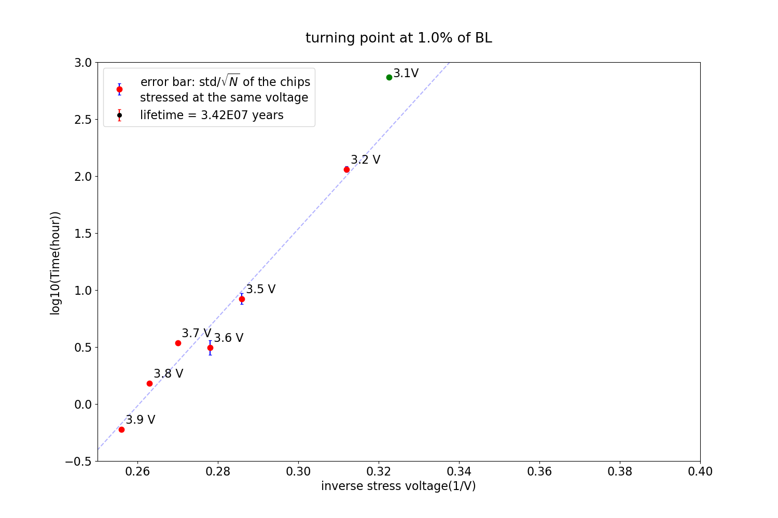
Charge Questions
2. Have life-time tests of all ASICs been done?
LArASIC PRR review on Mar 7-8, 2022 has responded to this question.
https://indico.fnal.gov/event/53072/timetable/#20220307
https://edms.cern.ch/document/2314428/2
LArASIC is designed with HCE tolerance
All transistors in LArASIC are well below nominal voltage of 1.8V and at low I_{sub}
All n-channel devices are either 270 nm or longer, at voltages 1.5 V or lower
Reduce V_{ds} by 6%, for each order of magnitude margin in the lifetime
Two chips stressed under 3.1 V for over 900 hours
No significant degradation observed so far (< 1%), still under stressed
3.1V down to 1.8V, there is over 8 orders of magnitude, predicted lifetime is ~1x10⁷ years
Oxide damage
>= 3.2V is much higher than the maximum voltage (~2V) allowed by TSMC 180 nm process, the degradation could be caused by oxide damage
If degradation is caused by oxide damage, LArASIC lifetime will be longer than the below projection plots.
Plotted by Rado Razakamiandra

Slide 28
Charge Questions
5. Have the ASICs QC procedures been defined and documented? Have sufficient resources been allocated to successfully execute the QA/QC plan?
LArASIC PRR review on Mar 7-8, 2022 has responded to this question.
https://indico.fnal.gov/event/53072/timetable/#20220307
https://edms.cern.ch/document/2314428/2

