Slide 1
MeV Scale Dark Sector Particle Detection
Workshop on Physics Opportunities at PIP-II
Fermilab
May 11, 2023
Jaehoon Yu
Department of Physics
University of Texas at Arlington

Slide 2
MeV Scale Physics at PIP-II
Fixed target experiments at PIP-II beam energy scales enable exploration of MeV scale physics which are difficult to access at the collider experiment environments
High intensity proton beams in a sufficiently long target or thick dump at the PIP-II generates a large number of mesons and photons that could couple to dark sector mediators and produce dark sector particles
In order to take full advantage of the capabilities of the facility, several experimental considerations must be reflected into designing an experiment

Slide 3
BSM and DSP Signature Categories at PIP-II
Direct Observation Signatures from the beams
High beam flux
Large mass, high density detectors for scattering signatures
Large volume, low density detectors for decay signatures
Capable near detector complex
Low threshold energy
Low background from cosmic sources
Can we consider inferred Observation Signatures from the beam?
Leverage oscillatory behaviors at low E?
Sterile neutrinos at the inaccessible range?
How about LEDs?
What do we need to know?
Signal flux and realistic behaviors in the detector
Neutrino flux and their interactions in the detector as backgrounds

Slide 4
Dark Matter Search Motivation
No DM
Opportunity

Slide 5
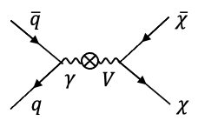
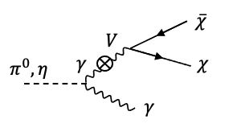
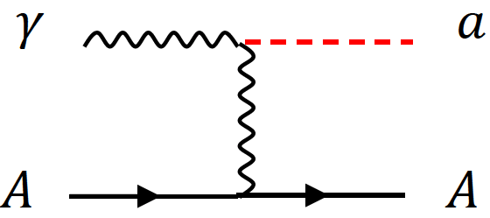
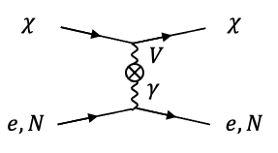
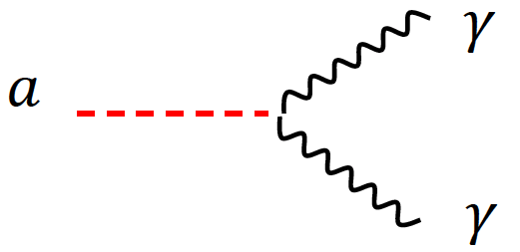
DSP’s? How are they made & seen?
Set of new particles which do not experience the known forces
DSPs can be weakly coupled to visible sector thru a mediator or “portal”
Photons from brem, DY and neutral mesons decays ➔ Make it possible to contemplate couplings of new U(1) gauge to SM γ
Detection through an electron scattering, N(n) recoil or 1, 2 γ final states

Slide 6
Selected BSM Topics @ DUNE
High beam power, large detector mass + highly capable, precision near and far detectors with low E threshold make DUNE a BSM machine
Recall the signal to background ratio grows by the sqrt of the beam power
Near Detector Searches ➔ Take advantage of high beam power
Axion-like Particles (ALP) - Dutta
Low mass Dark Matter (LDM) - Dutta
Heavy Neutral Leptons (HNL)
Dark Photon - Dutta
Neutrino Trident
Milli-charge Particles (mCP) - ZL
And many many more.. - RH
Far Detector Searches ➔ Take advantage of ND, large V_{A} FD & long baseline
Sterile neutrino searches
Non-standard Interactions, Non-Unitarity, CPT violation
Large Extra Dimensions (LED)
Boosted Dark Matter (BDM) & Inelastic Boosted Dark Matter (iBDM)
And many many more…

Slide 7
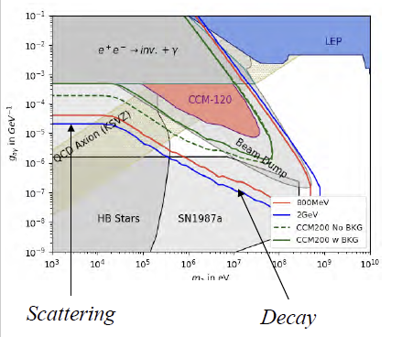
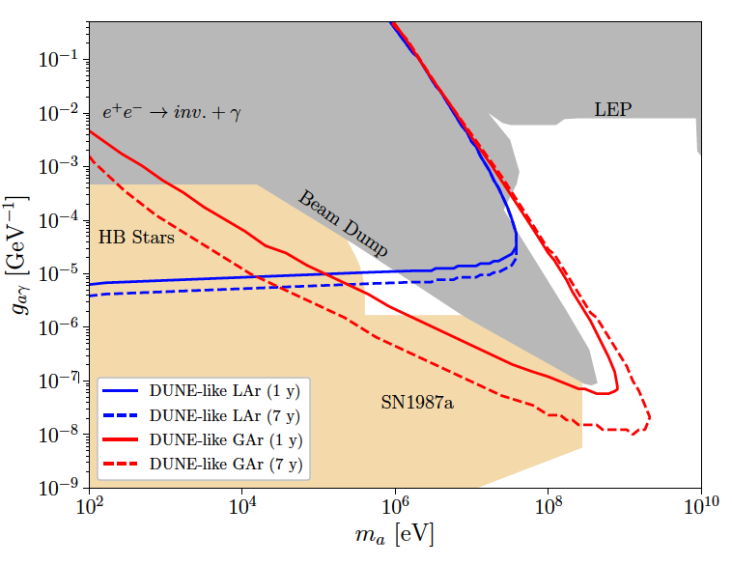
Opportunities on ALP Searches
Axion-like particles (ALP) can be produced via the Primakoff process in high intensity proton beams
Detection via the inverse Primakoff process either in a scattering with e/N + γ or decays of the ALP to two γ
A case study on DUNE ND shows a potential to fully close the cosmic triangle
Brdar et al., PRL126, 201801 (2021)
Production in ν target
Detection - scattering
This edge constrained by the distance from the source to the detector
BD
20m beam to det.
Oppo

Slide 8
Light Dark Matter (LDM) Search
LDM’s produced in the target via coupling of dark photon with a SM γ from brem, scalar meson decays or direct DY
Identify the signal using e⁻ or nucleon recoil by LDM via dark photon kinetic coupling with SM γ
Batell et al. [0906.5614],
deNiverville et al. [1205.3499]
Coloma et al. [1512.03852]
Ability to identify e⁻ recoil w/ low E threshold key
Expands the LDM mass coverage
Recoil E_{e} peaks at low E for low LDM mass
Significant background from ν_{μ} scattering off e⁻

Slide 9
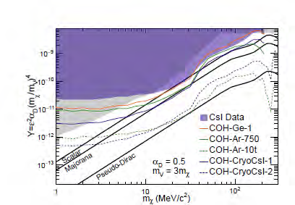
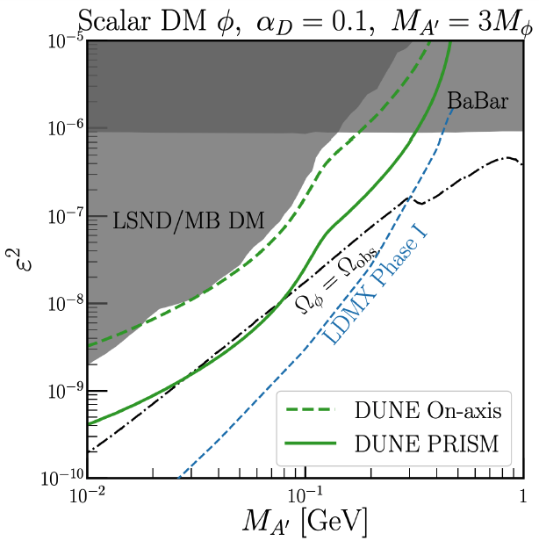
LDM Search Sensitivity
Search benefits from DUNE PRISM for neutral meson induced LDM
Leverage more rapid reduction of ν_{μ} flux than the signal off-axis (De Romeri et al., PRD100, 095010, 2019)
BD

Slide 10
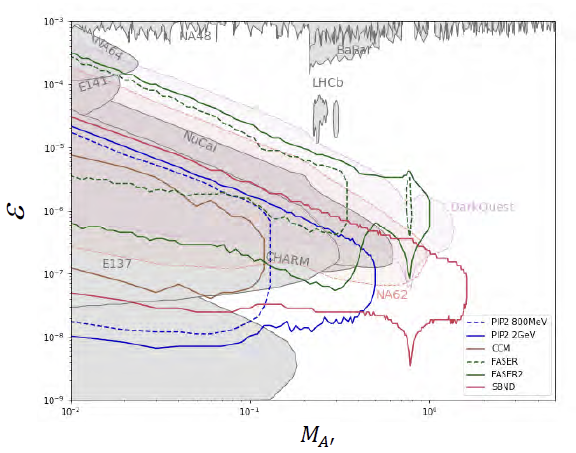
Dark Photon Searches
New U(1) could kinetically mix with a SM γ from scalar meson decays or direct DY
If these dark photons can live sufficiently long to reach the DUNE ND ➔ Look for their decays to a charged lepton pair
A’ → e⁺e⁻
Primary background from π⁰→ γγ
One of the γ mid-ID’s as e and one missed
Could a magnet help?
A’ → μ⁺μ⁻
Charged pion production from CC
Charged π decay product mixing with other low E hadronic activities
Low E threshold & precise understandings of ν CCQE and CCRES essential
BD

Slide 11
Signature & Backgrounds of BSM
BSM signal final states include charged leptons (e+/-, μ+/-), photons and nucleus (nucleon) recoil ➔ ν-N interactions the primary background
BSM Process | Selected signatures | Background
ALP | Scattering: γ+e, γ+N (n) Decay in flight : γγ | BRN, ν coherent, NC w/ π⁰, ν_{e} CC w/ π⁰, etc
LDM | χe⁻◊χe⁻, χN◊χ’N→χe⁻e⁻N, χN◊χ’N→χγN, | BRN, NC w/ π^{0,} ν_{e} CC, QE, RES,
mCP | Multiple e⁻ scatterings | BRN, ν_{e} CC w/ π⁰
Dark Photon | A→e⁻e⁺, μ⁻μ⁺, many more | BRN, ν CC + mis-ID π, Accidental overlap of CC
HNL | Ν → νe⁻e⁺, νμ⁻μ⁺, νγ, νeμ, νπ⁰, eπ, μπ | BRN, ν CC + mis-ID π, ν_{e} CC w/ π⁰

Slide 12
Theoretical Predictions
PIP-II energy regime difficult to compute accurately for both the DSP signatures and for the background processes
BSM production extremely rare and are in the tail ends of the SM processes ➔ can easily be masked by SM fluctuations
Interactions of neutrinos in the detector dominated by QE & RES ν-N interactions in the E_{ν} range ➔ critical to understanding ν backgrounds
The uncertainties at these low energies become important in background estimate
Generator tools begin to incorporate BSM processes but could take a long time to implement due to insufficient resources

Slide 13
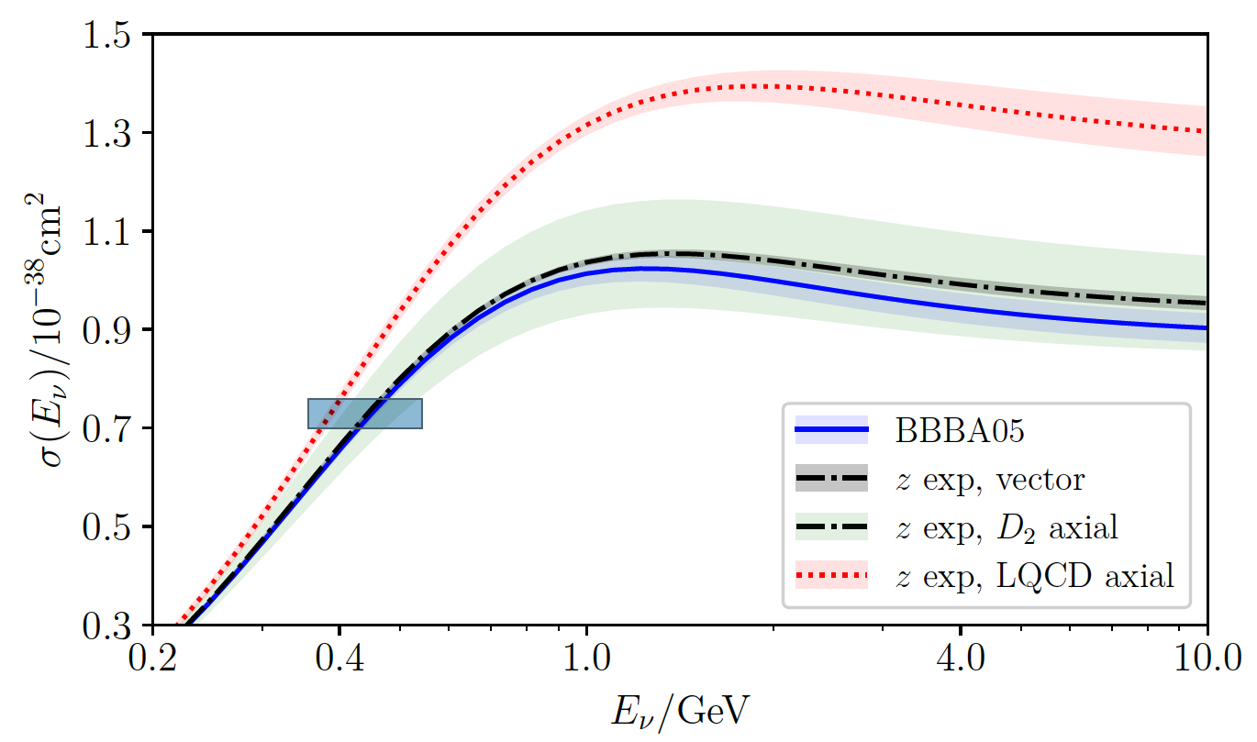
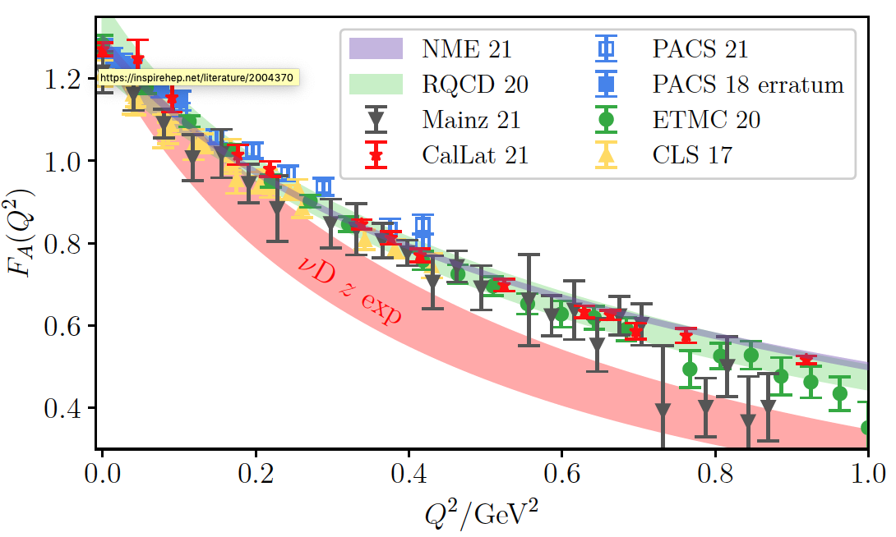
At the CERN ν-N Interactions workshop..
ν+n
A. Kronfeld
2GeV ν_{μ}+Ar
Resonant single γ production
C. Andreopoulos

Slide 14
Experimental Considerations
Signatures focus on lepton and photon final states
Discovery is the primary goal, start with the signatures most accessible and easy to reduce background
What are the primary backgrounds
What would be the strategy to mitigate them without compromising the efficiencies for signals?
What would be the beam characteristics and target to accomplish the above?
What is the necessary detector capabilities?

Slide 15
Physics Signatures and Backgrounds
The most optimal signatures involves photons and electrons in the final states
Two EM particle final states, such as ALP’s and dark photons, have a clear advantage over single EM particle final states
The impact of the ν-N interaction backgrounds less for more EM particle final states
The uncertainties in ν-N interaction modeling effect smaller
BRNs become primary backgrounds for PIP-II energy level, especially for the shorter distances between the beam source and the detector
These should factor into the selection of detector technologies and the experimental environments

Slide 16
Beam and Target Considerations
Goal: Create many source particles for signal production while enabling minimizing the source of backgrounds
Beams ➔ of course, we need as high an intensity protons as possible but
What would be the optimal E_{p}?
Should the beam be pulsed? Why and what intervals?
Should the beam transverse size braodened? Why and what would be the most optimal? Can the accelerators do this?
Target ➔ Ideally, we want to absorb 100% of the protons
We can almost accomplish this with a 3m long carbon target but is this the right material for the goal?
Would the dump be better? What would be the most optimal material and the dimensions to accomplish the goal?
If we find a good combination of these, it becomes a facility ➔ What other physics can we do with this?

Slide 17
Detector Considerations
Goal: Capture the signal at the high efficiency while enabling minimizing the backgrounds
The characteristics of detector depends on the signal and the kinematic phase space we want to search for
Decay signatures ➔ Low detector mass, large volume
What would be the most optimal dimensions of the detector?
Can we implement decay volume in the upstream of the detector?
What would be the thinnest wall thickness that can help minimizing background interactions, such as those from BRNs?
What are the capabilities of the detector for the above goals?
What is the position, momentum and energy resolutions to accomplish the above at MeV range signals? The final state particle energies are of the order few 100s of MeV..
Do we need good timing? How good do we need and why?
Low energy threshold definite be the most optimal material and the dimensions to accomplish the goal?

Slide 18
Background Mitigation Strategy
Need to have a clear idea what the significant backgrounds are
For low Ep beams, such as the 800MeV PIP-II LINAC onto beam dump, BRNs rather than the beam generated neutrinos would become the significant background
These determine what technological capabilities are required for detectors
EM particle identification ➔ LArTPC, fine granular total absorption calorimetry, magnetized detectors
High position and angular resolution ➔ LArTPC
Low energy threshold ➔ LArTPC, total absorption calorimetry
Fine energy, momentum and invariant mass resolution ➔ fine granular total absorption calorimetry, LArTPC, gas TPC
Vertex pointing capability ➔ Some combination of precision si layers sandwiched in longitudinal layers of fine granular total absorption calorimeter
Fast timing (sub-ns) with a well separated beam pulses helps a great deal in beating down the BRN backgrounds ➔ Crystal or Scintillator based photon detectors
The necessary timing depends heavily on the distance from the beam source to the detector
For 10m distance, it takes ~30ns for the speed of light ➔ Mass dependent parameter

Slide 19
The Time Projection Chamber (TPC)
Invented in 1974 by David Nygren at LBNL (now at UTA)
Provide a precise 3-dimensional image of a particle interaction
Can be made to reach sub-MeV level threshold
Working principle
Utilize ionization of an inert element, drifting the ionization electrons to the anode plane with 2D readout for position info on 2 of the 3 spatial coordinates
Determine the time of interaction (t₀) from the first flash of the scintillation light resulting from a neutrino-atom interaction
Measure the time of arrival of the drifting ionization electrons under the uniform electric field, providing the 3rd coordinate
First one built in 1981 using a gas medium
LAr medium proposed by Carlo Rubbia in 1977

Slide 20
Liquid Argon TPC
L_{D}=3.6m for DUNE HD

Slide 21
Potential Detectors at PIP-II
LArTPC with low E threshold capability
A 2x2 LAr-ND Prototype immediately available ➔ Utilizes pixelated readout, could self trigger
A version of LArTPC with similar configuration can be built rather quickly in time for 2029

Slide 22
DAMSA Exp. Concept
DAMSA (담사 (冥想) = 깊은생각 – Rumination or Reflection) consists of
1m diameter, 1m long Tungsten beam dump with some moderators to mitigate BRNs
10m diameter, 10m long decay volume with as thinnest possible walls
Fast timing, fine granularity, superb E resolution total absorption EM calorimeter ➔ potentially be augmented with some Si layers
Vacuum Decay Volume
L=10m
Detector
Proton beam
Moderator
W Dump
L=1m

Slide 23
Timeline Considerations
2029: PIP-II 800MeV LINAC ➔ Definitive
2034’ish: LINAC Extension, PAR, CAR and other higher energy AR options require additional time for development and construction
2031’ish: DUNE-LBNF turns on
The window of opportunity exists for quick measurements without distracting the DUNE efforts in 2029 – 2031
Even after this period, many experiments could subsequently happen, depending on the lab’s strategy
To fully take advantage of this opportunity, experiments must be ready in the next 5 – 6 years

Slide 24
Conclusions
High intensity PIP-II LINAC and other future accelerator facilities at Fermilab is a window to dark sector particle search and discovery
The kinematic space inaccessible by energy frontier experiments can be explored by these experiments at the MeV mass scale
Depending on the energy of the protons and the signal final states of interests at these facilities, different sources of backgrounds should be considered
Experimental configurations must reflect these factors, starting from the beams, target, dump to vacuum chamber and detector capabilities
Timing is of the essence, and a good demonstrator experiment that is ready and take data in 2029 would be essential
We need to be vigilant, help lab determine its strategic direction
Convince them to utilize the full capacity of the facility, making it become a dark matter discovery and beam power-house in the world

