Slide 1
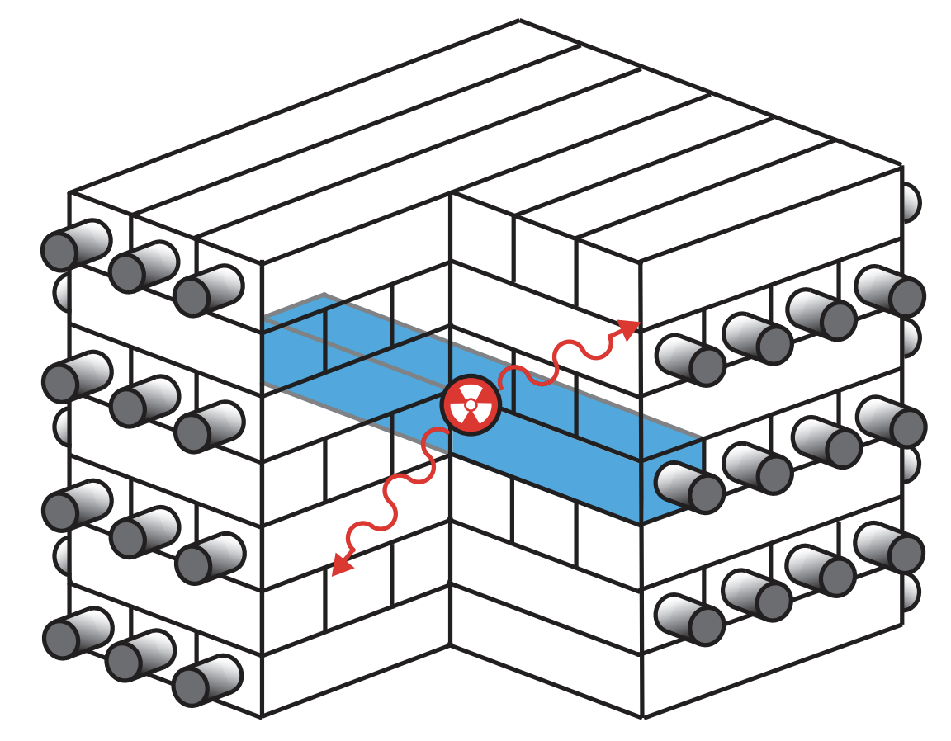
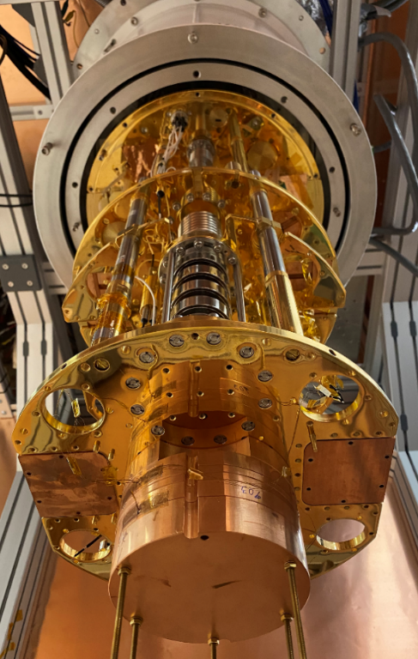
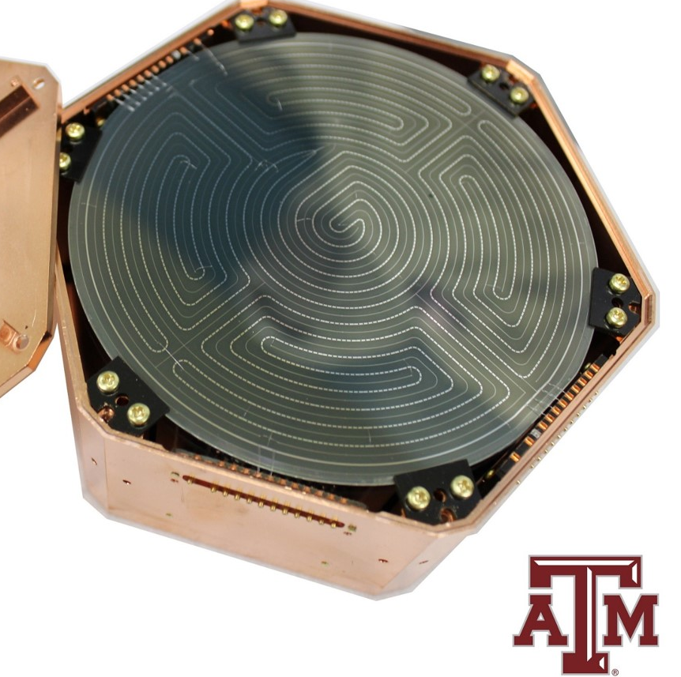
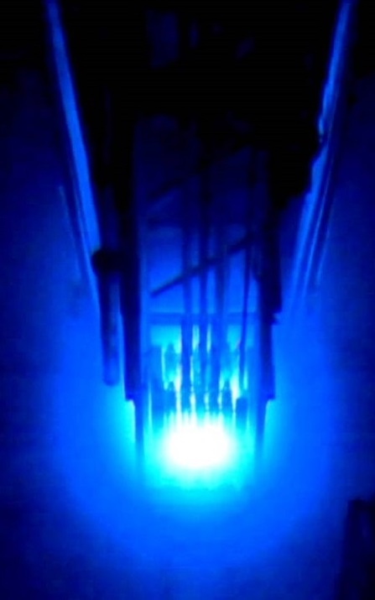
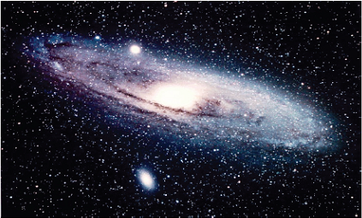
Cryogenic (and Other) Detectors for Dark Sector Searches
χ₀
Dr. Rupak Mahapatra
Texas A&M University
ν

Slide 2

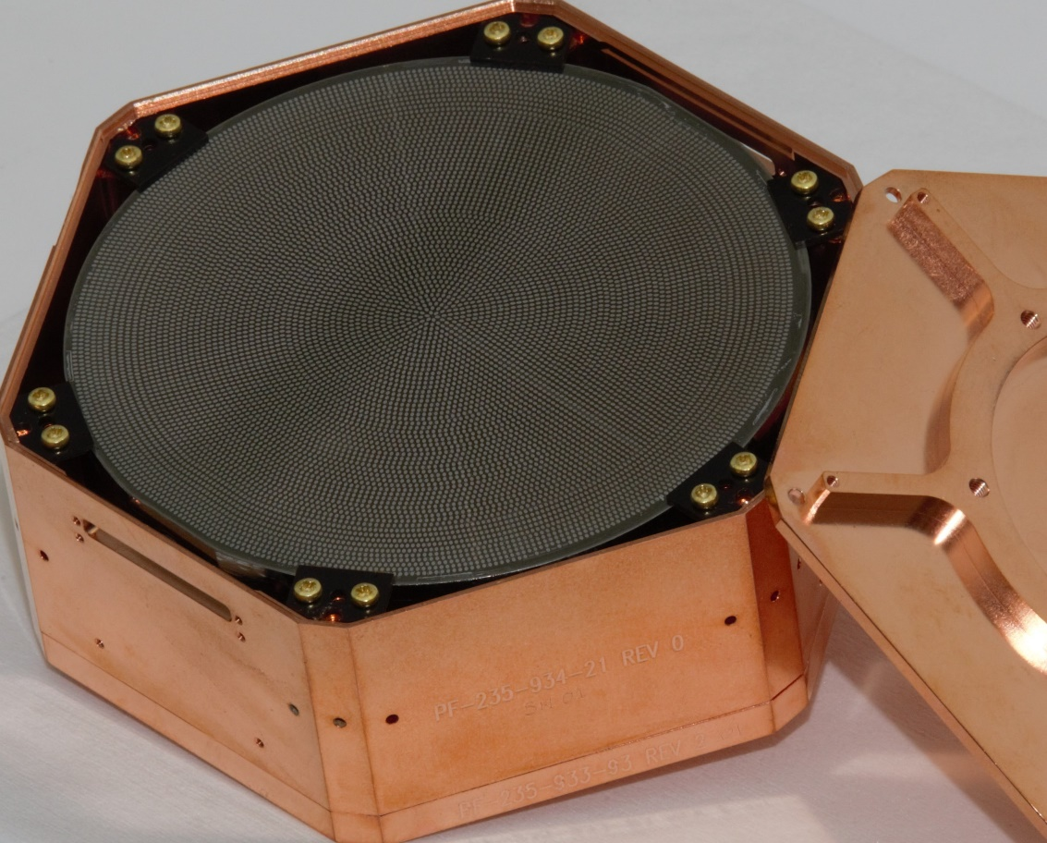
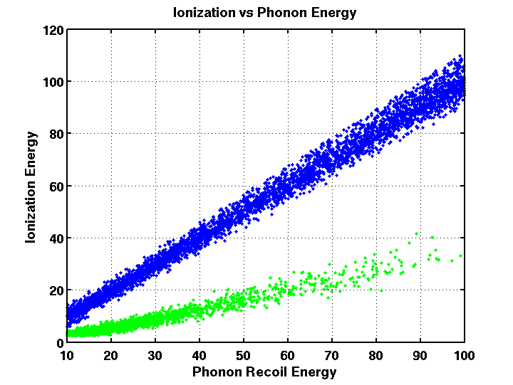
Cryogenic Detector Technology Developed for SuperCDMS
iZIP Detector with ionization and phonon sensors for ER/NR discrimination (>keV)
First SNOLAB Ge iZIP (fabricated at TAMU)
https://arxiv.org/pdf/1610.00006.pdf
7mK base temp
Phonon
Ionization
High Voltage Detector with NTL gain. Give up discrimination in favor of low threshold (~100eV).
First SNOLAB Si HV (fabricated at TAMU)

Slide 3
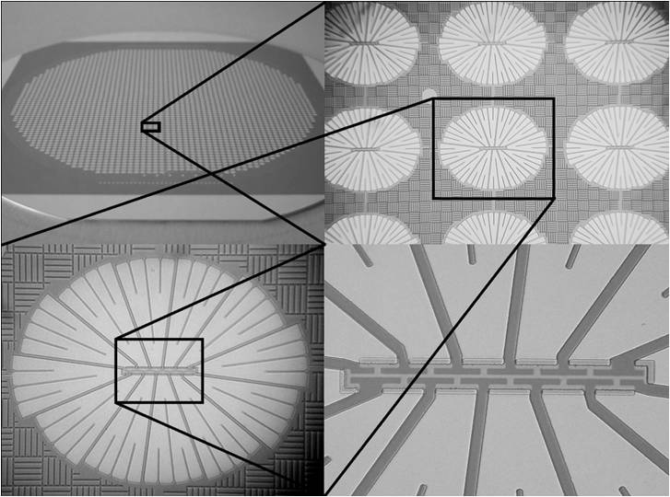
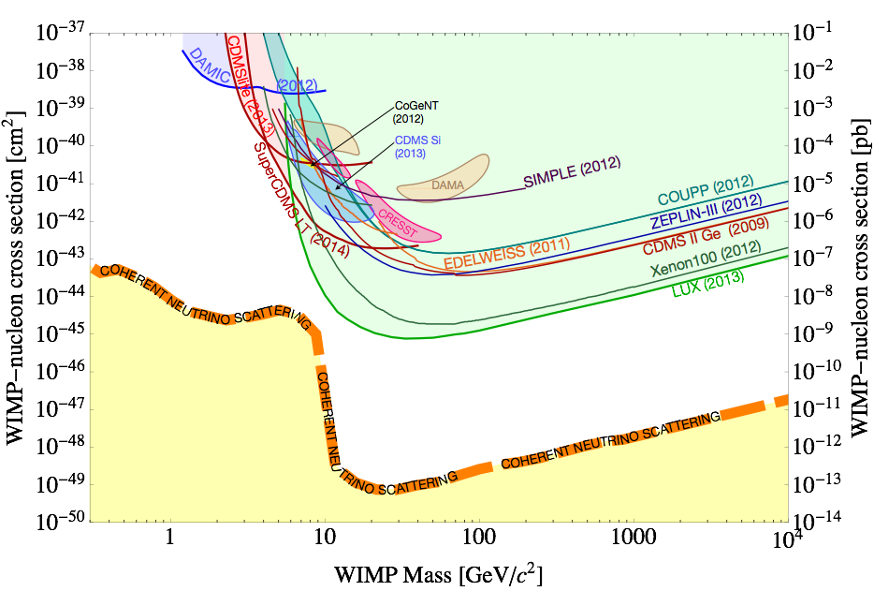
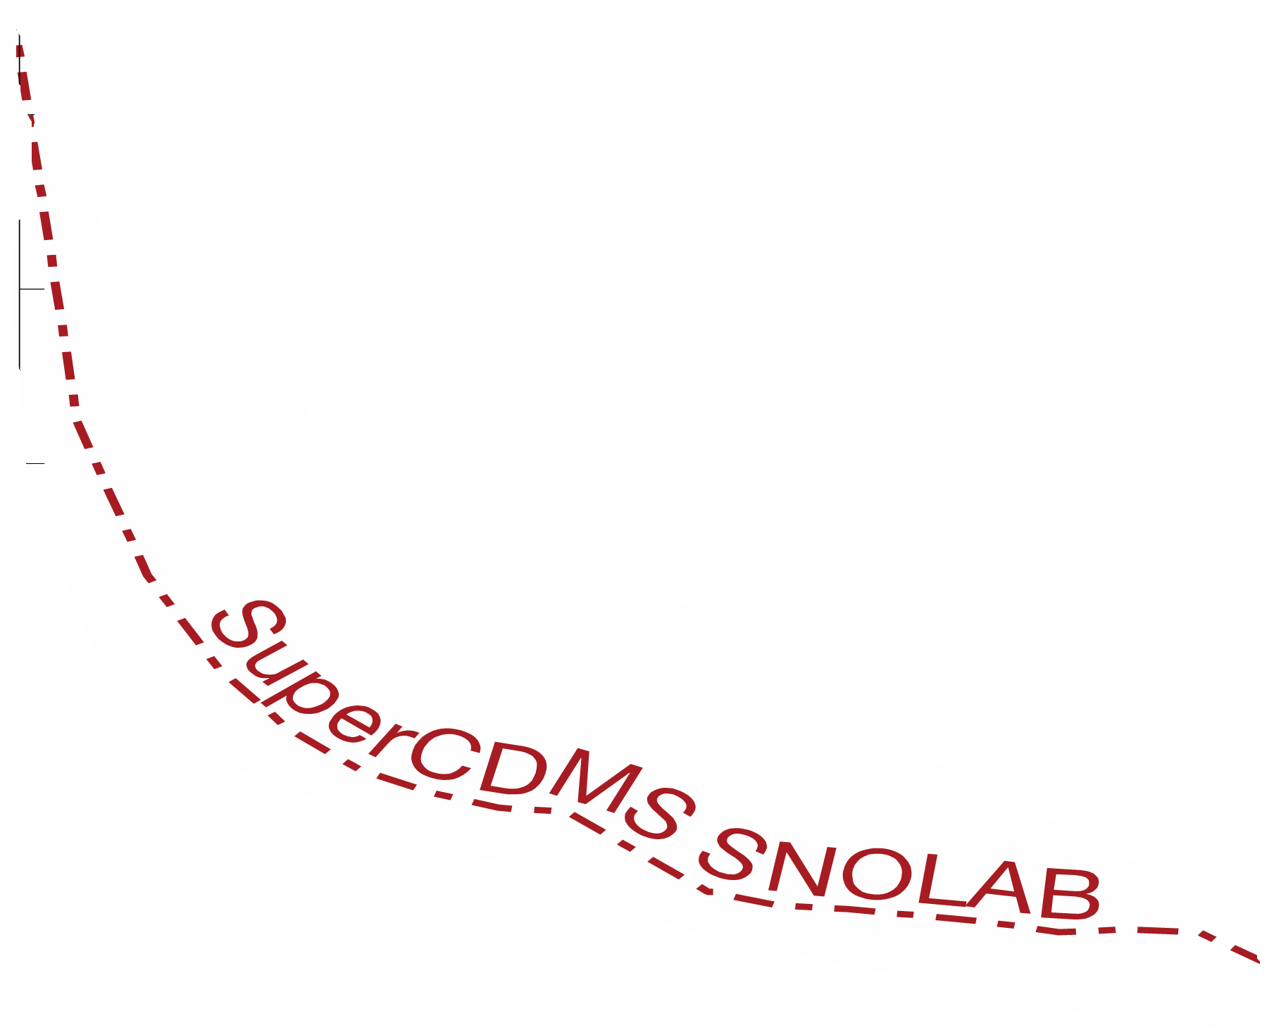
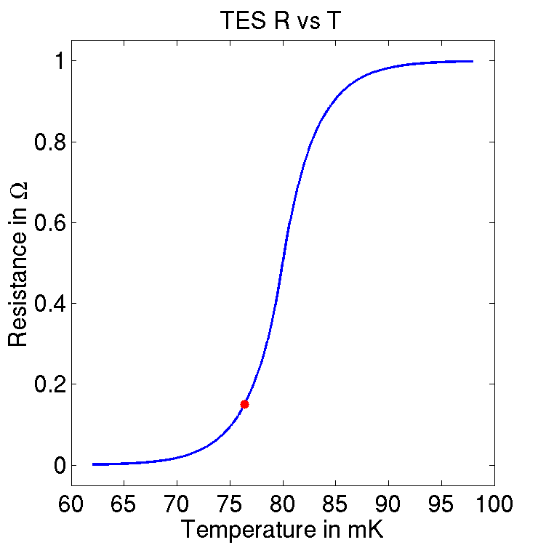
Phonon Sensors
1 μm TES
Al Collector
W Transition Edge Sensor (TES)
Cooper Pair
Al
ΔR
Ge or Si
R₀
ΔT
phonons
T₀
Phonons are collected by superconducting Al fins (Δ=~meV), creating quasi particles that are then trapped by the W Transition Edge Sensors (TES), held in equilibrium between Normal and Super Conducting temp. SQUIDs measure small change in current through sharp ΔR/ΔT

Slide 4
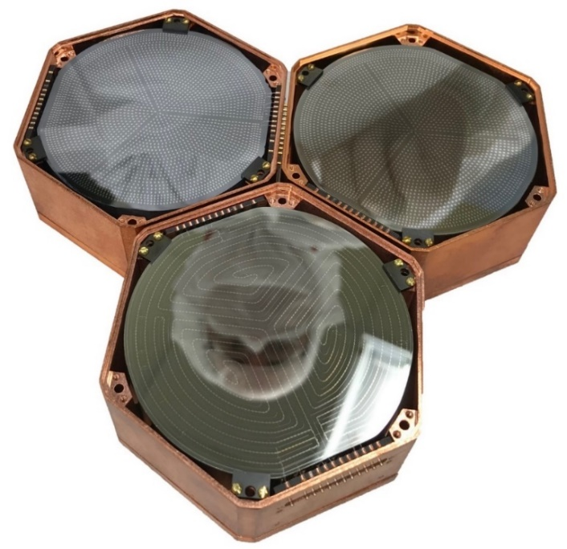
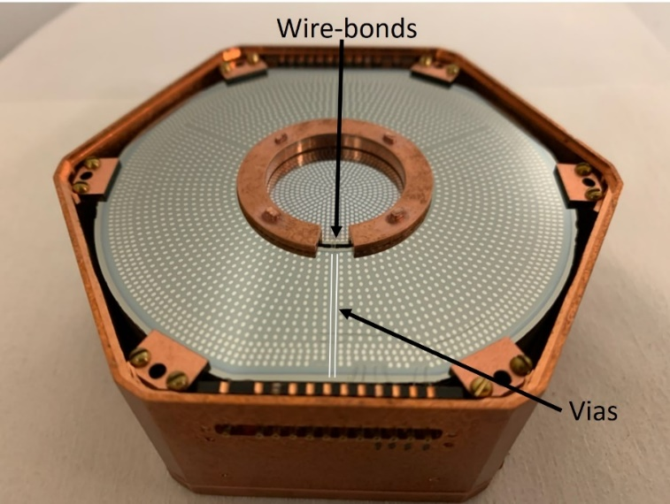
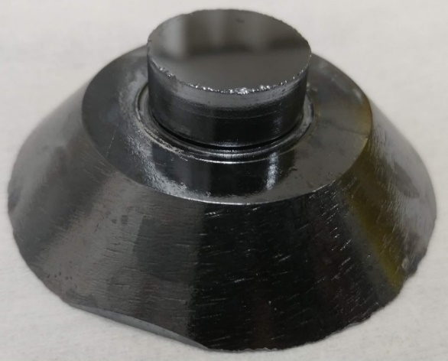
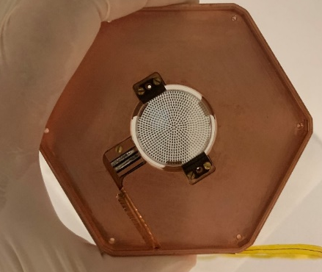
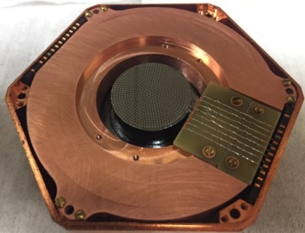
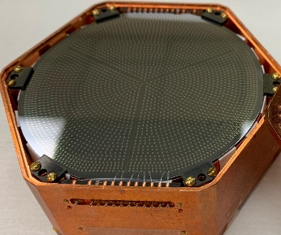
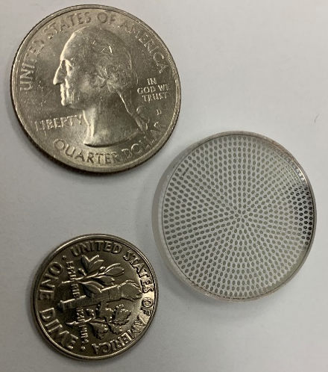
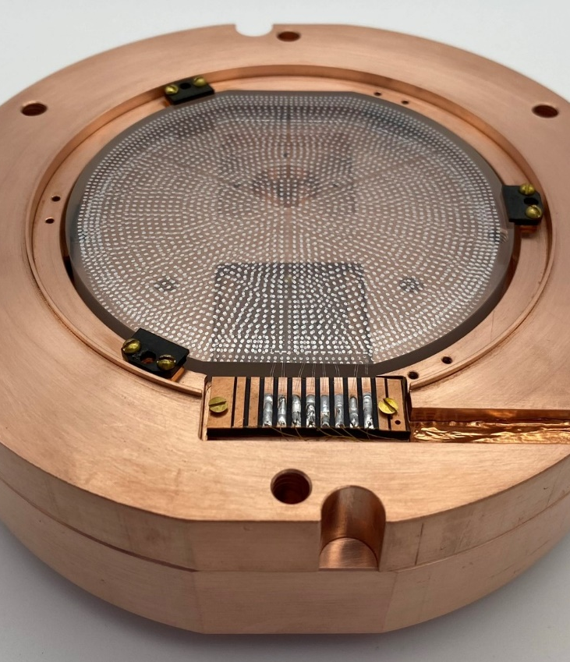
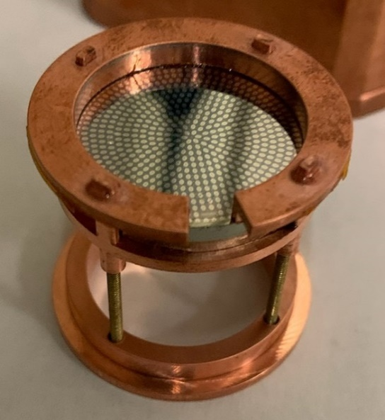
gm-kg scale Phonon Detectors for DM/ν
Ge, Si, Al2O3, SiO2, GaAs
0V, LV (few V), HV (400V)
Smallest – 10 gm Si
Largest – 1.5 kg Ge

Slide 5
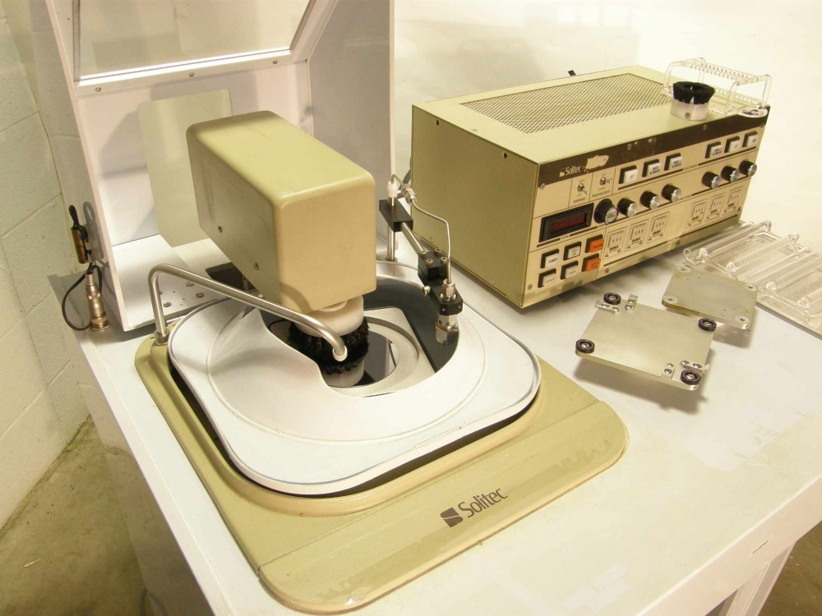
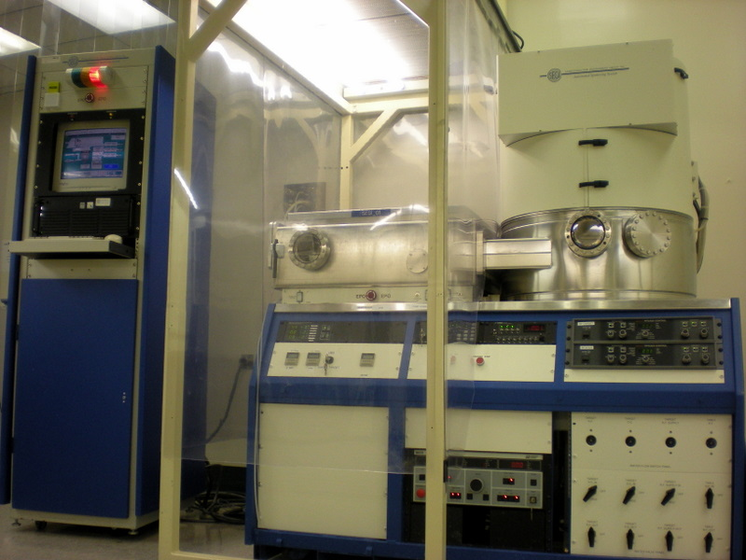
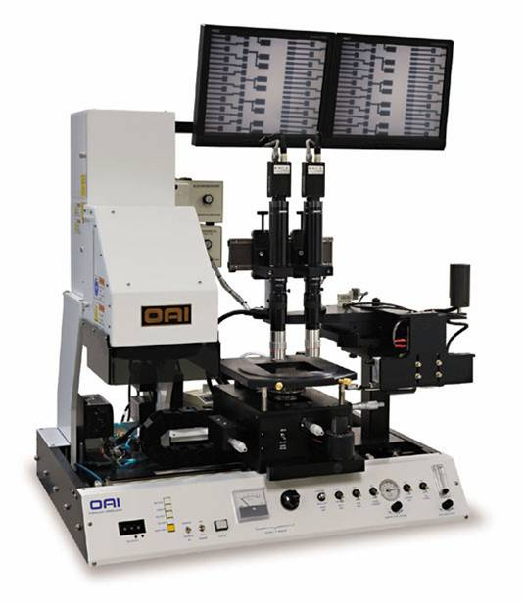
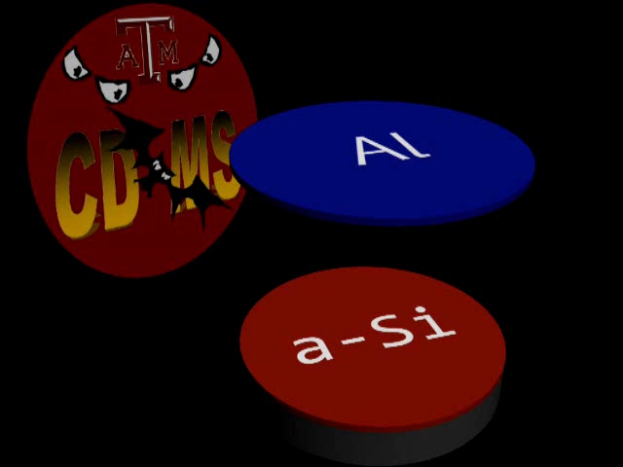
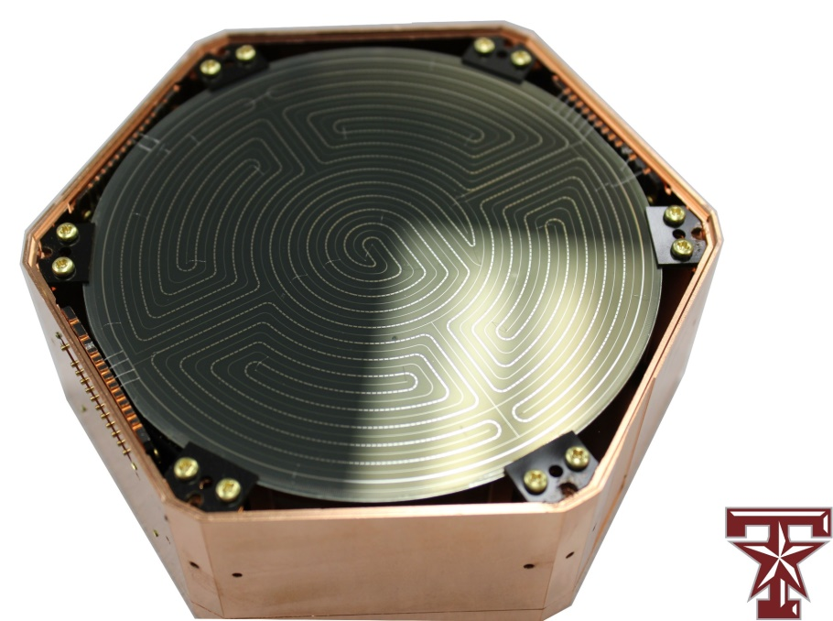
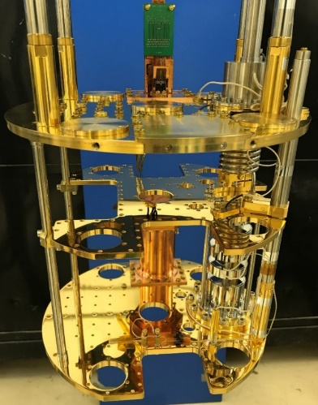
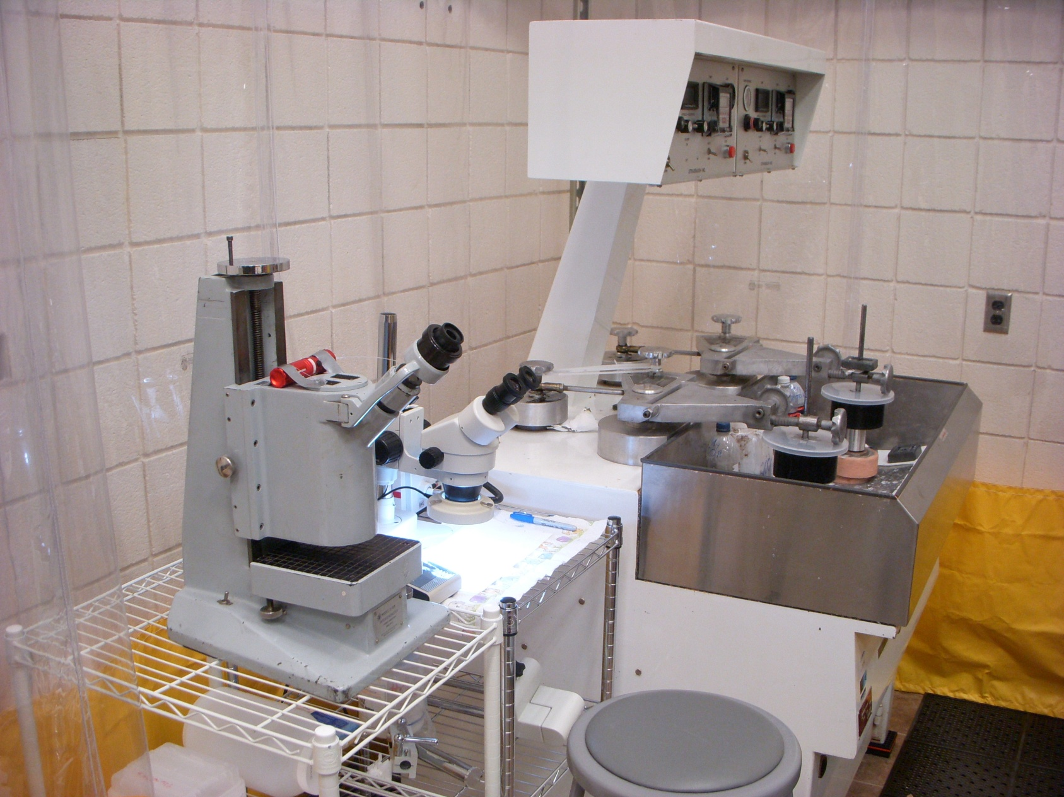
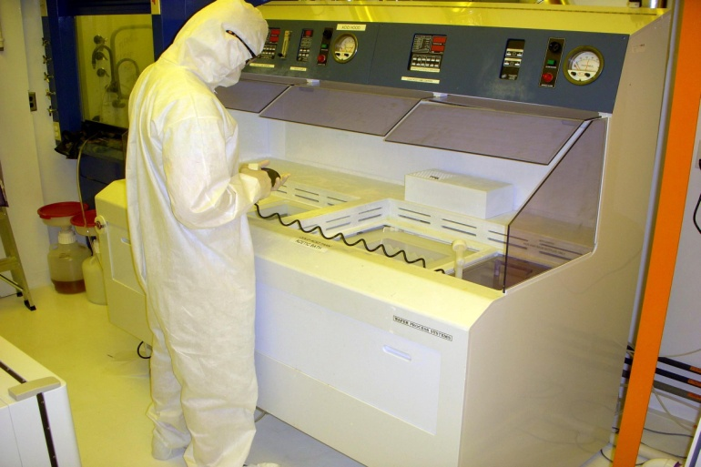
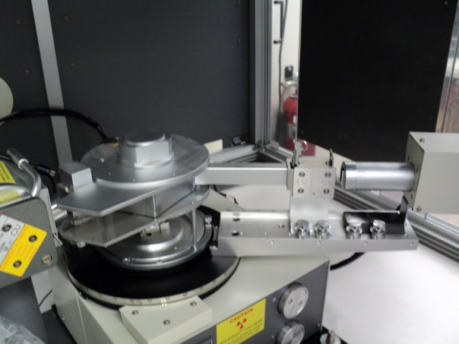
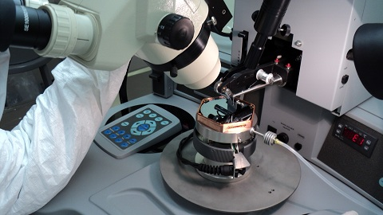

Dedicated Fab and Testing @ TAMU. 1st SNOLAB Tower Done
Multi-step process repeatable for high quality detectors
Photo Coat
Deposition
Circuit Mask Exposure
Polish
XRD
Inspect and Package
Chemical Etch

Slide 6
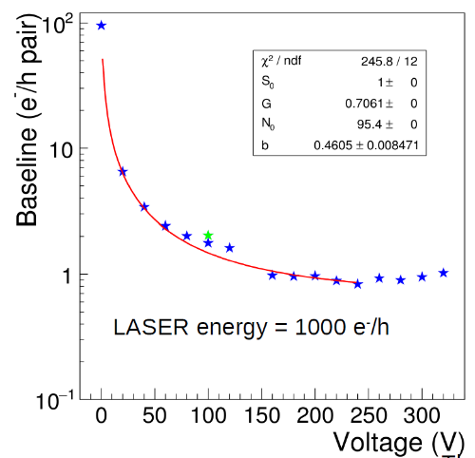
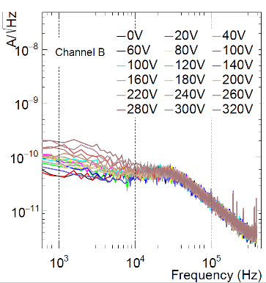
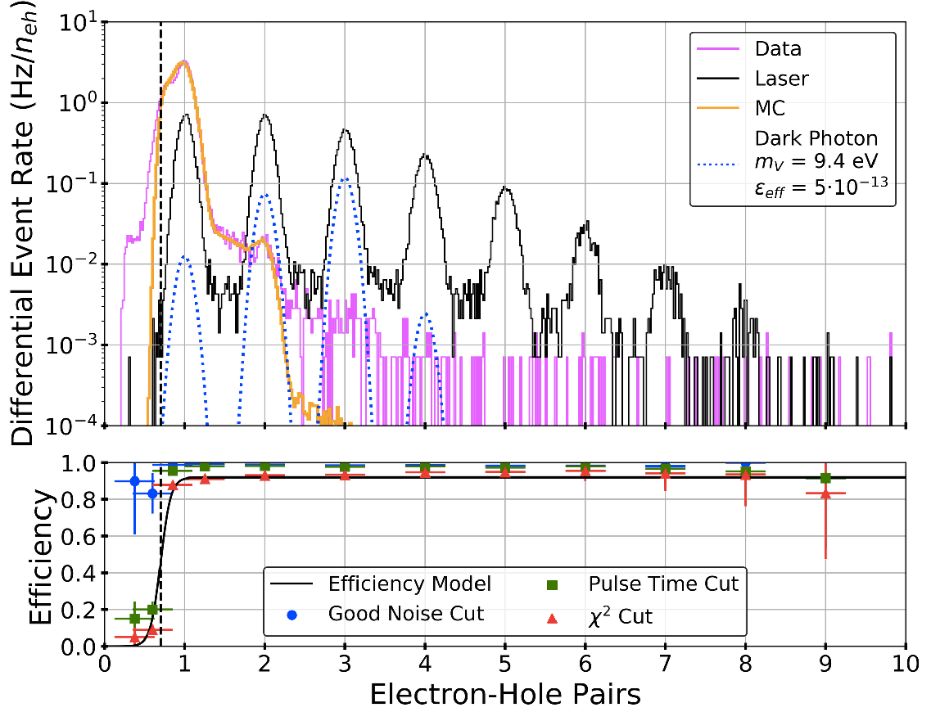
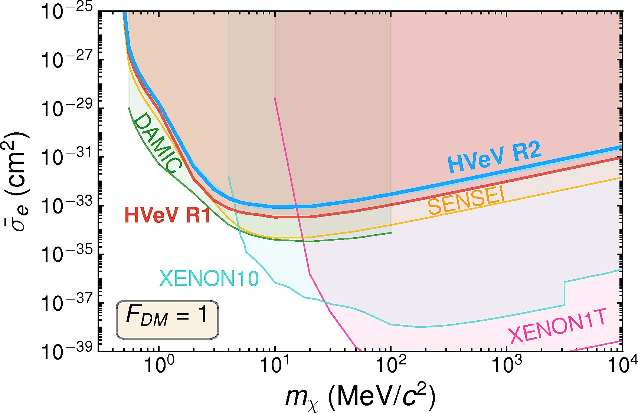
Single-e Sensitive HV Detectors
Initial demo with 250 gm Ge with σ=7 eV
https://doi.org/10.1016/j.nima.2017.02.032
Single-e/h pair 100 gm Si :
https://inspirehep.net/literature/1828158
100-gm single-e sensitive Contact Free Si HV Detector for MINER. Signal amplification observed without increase in leakage up to 300 V using laser
gm-scale Si HV @ 100V bias- resolves single e-h. Strong validation at NEXUS@FNAL
SuperCDMS Collaboration 10.1103/PhysRevLett.121.051301

Slide 7
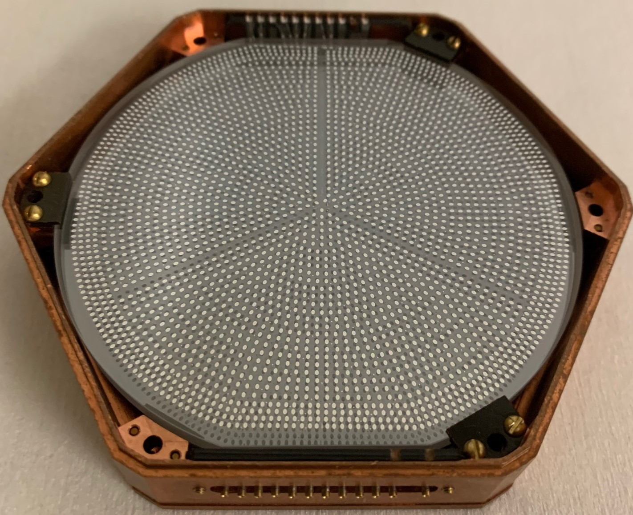
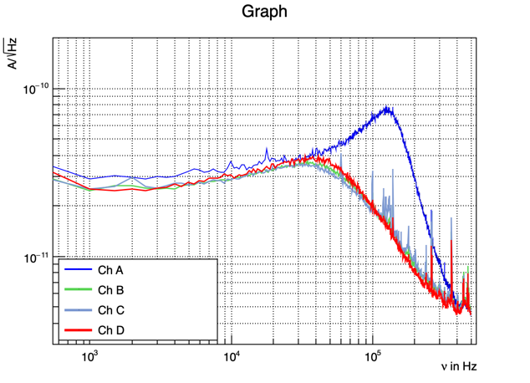
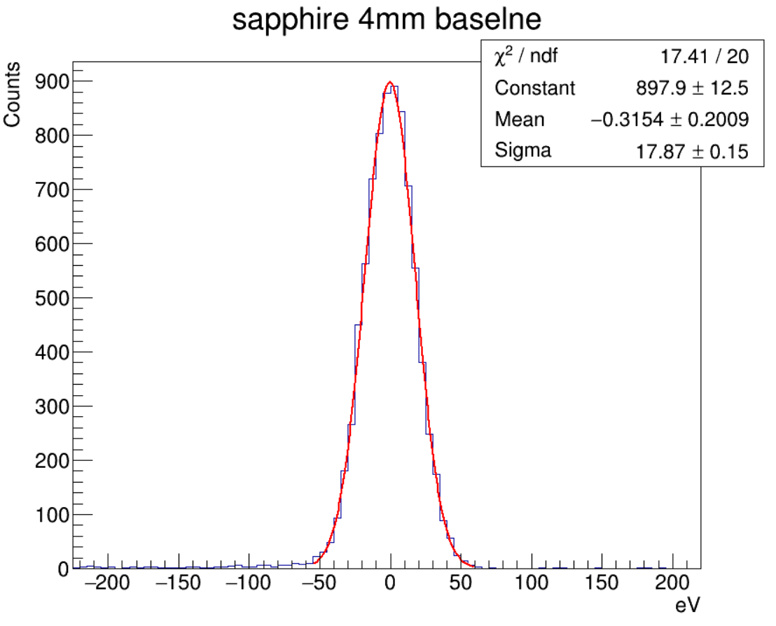
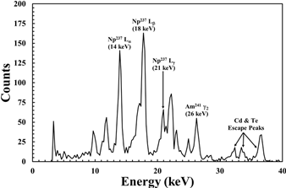
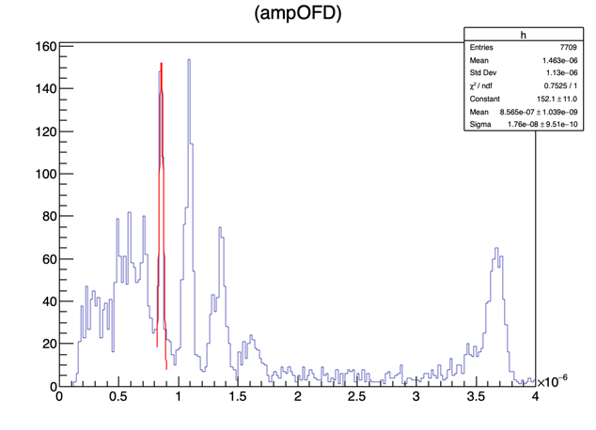
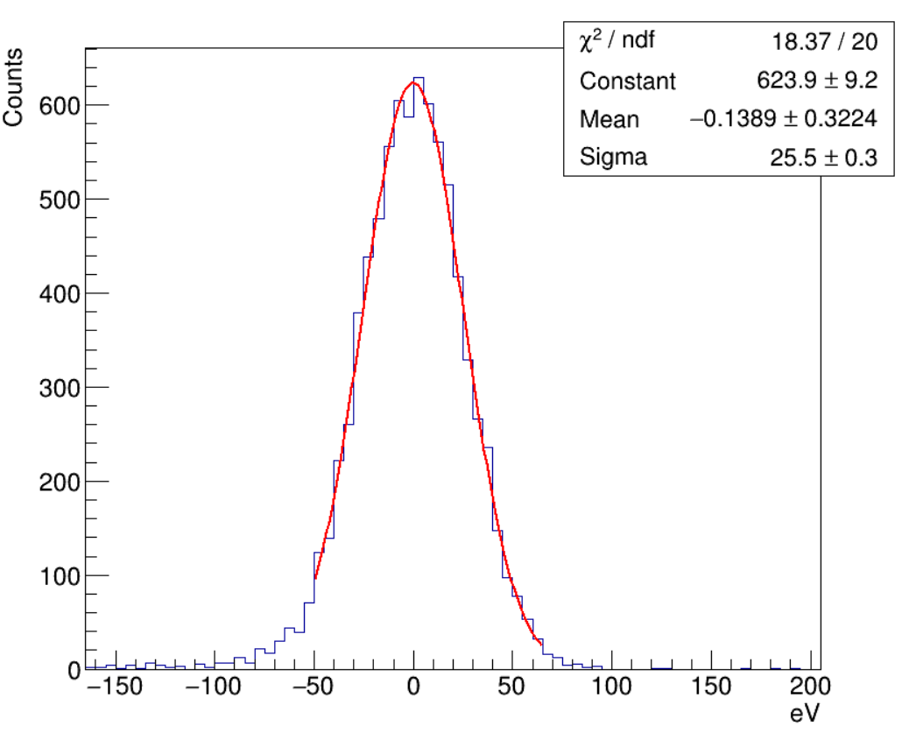
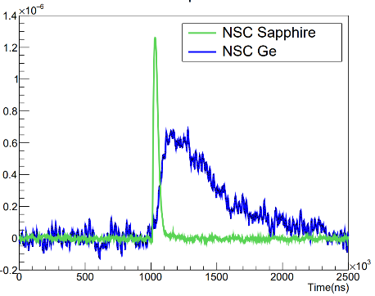
Low-Threshold Sapphire Detector with No Lindhard Suppression
Calibrated based on 13.9KeV line.
~100 gm 3”x 4mm sapphire detector shown
~200 gm 3”x1cm sapphire detector tested
Calibration: Internal ⁵⁵Fe, ²⁴¹Am and external ⁵⁷Co, ²⁵²Cf, AmBe.
TES sensors will be optimized for the faster timing
~5 times better (A+B+C+D) resolution than Si detector with same mask (~120eV in Si HV at 0V)
https://linkinghub.elsevier.com/retrieve/pii/S0168900222009263

Slide 8
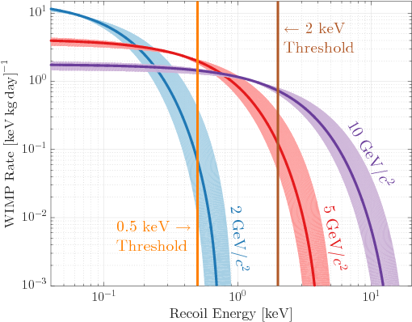
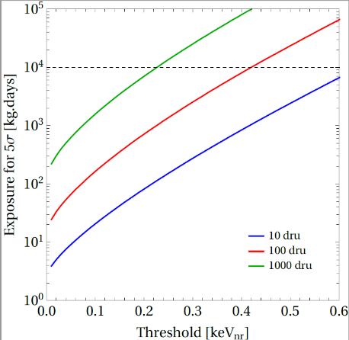
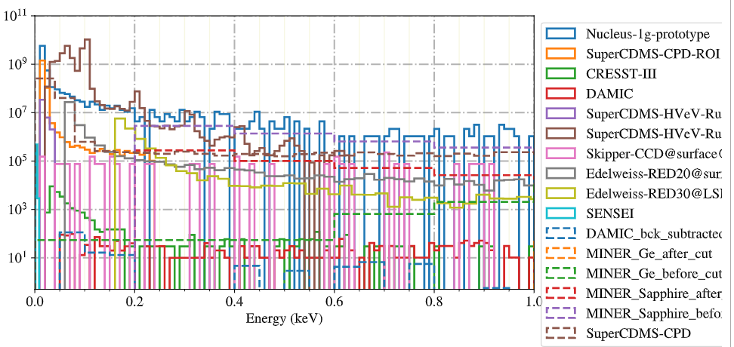
Dark Aspects of Dark Sector Searches
Integrated rate/kg-year
Background
Recoil energy in eV
Background-limited Discovery Potential? All detector technologies see similar exponential rise in “unknown” background at low energies. The DM/CEνNS community working to understand

Slide 9
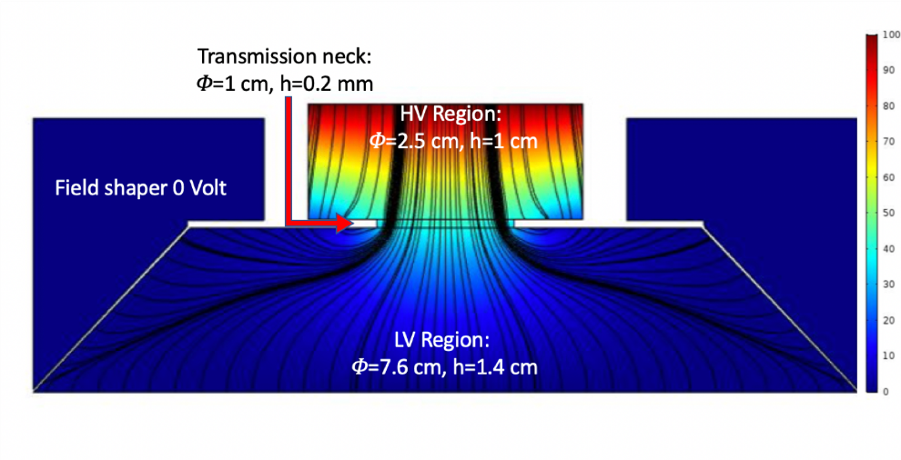
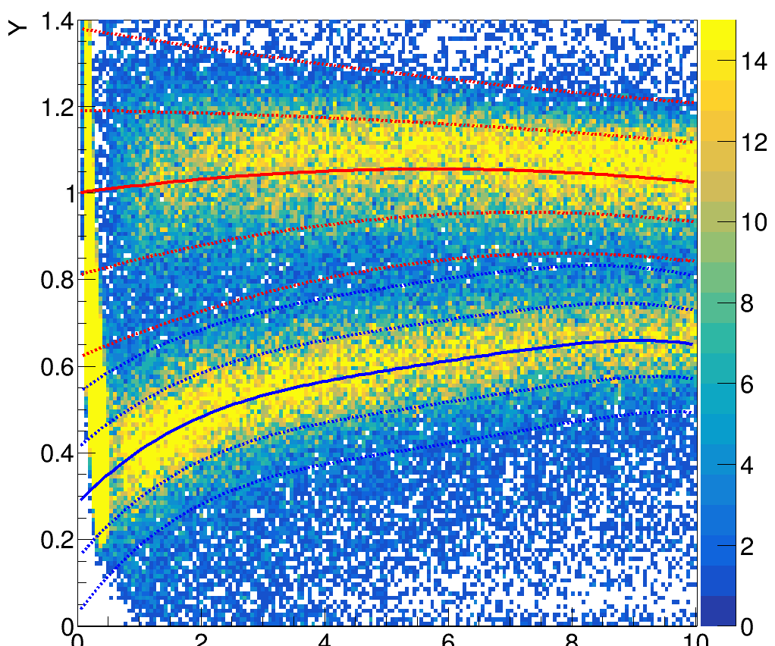
Hybrid HV Detector
Main idea: Monolithic detector with a LV and a HV side – LV to measure primary phonons like iZIP and HV to measure NTL phonons. Do it without significant NTL pollution from HV to LV. ~100gm
Discrimination improves at low energies due to Lindhard suppression of ionization
https://www.sciencedirect.com/science/article/abs/pii/S0168900222002467

Slide 10
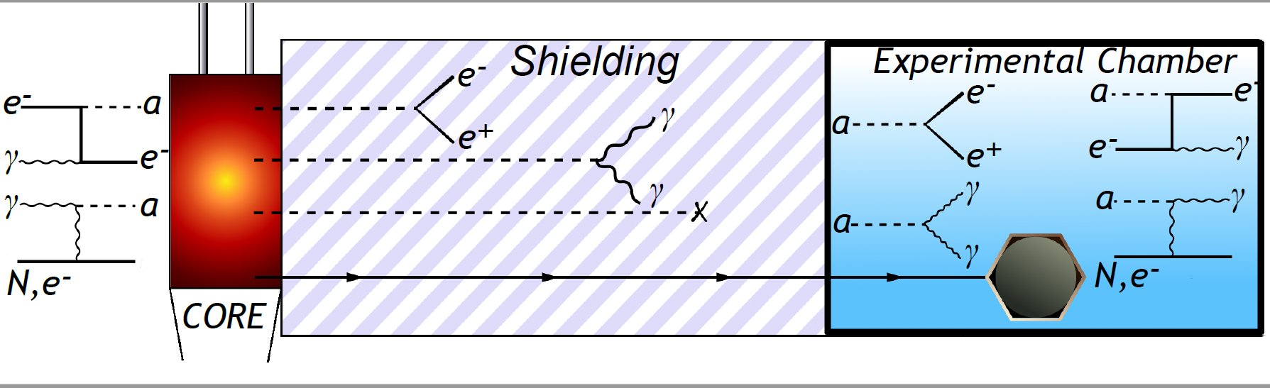
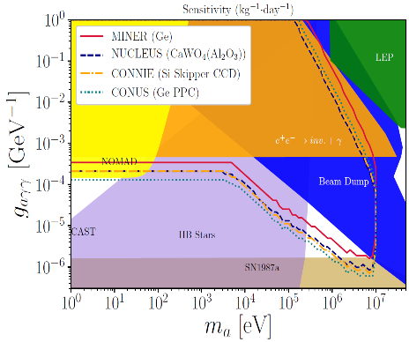
ALP Search @ Reactor/Beam
PRL: https://journals.aps.org/prl/abstract/10.1103/PhysRevLett.124.211804

Slide 11
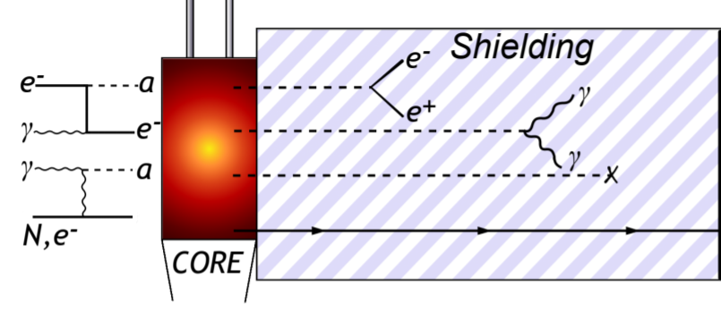

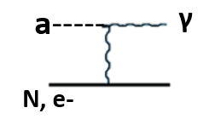




CsI(Tl) Single Scatter Event Selection (Active Veto)
CsI(Tl)
CsI(Tl)
CsI(Tl)
CsI(Tl)
CsI(Tl)
CsI(Tl)
Signal: Unvetoed Single-scatter event
CsI(Tl)
CsI(Tl)
CsI(Tl)
5x5 vs 3x3 Background

Slide 12


ALP Search Using Nuclear Gamma Cascades
Same MINER CsI setup is used for this experiment. Moving to LANL this summer for beam-based and source-based searches as a CCM sister experiment
Trigger on E1 and Search for missing E2
PRD:https://journals.aps.org/prd/abstract/10.1103/PhysRevD.105.015030

Slide 13

Sensitivity to Dark Sector
10eV-100 keV: Ge electron recoil
(100-kg scale G2 experiment, Can go to ton-scale for PIP2)
10 keV-100MeV: CsI Inelastic
(20-ton scale experiment)
10²³ POT
Credit: Wei-Chih, Dutta

Slide 14

Searches for Lightly Ionizing Particles
SuperCDMS: 10.1103/PhysRevLett.127.081802
Sensitivity to smallest charge directly related to E_{th}
  Low-threshold (10eV) detectors can search beyond μ-e
For modest (keV-scale threshold) charge sensitivity, large (20-ton) CsI-cube is ideal for PIP2 – ability to use tracking in segmented detector system to strongly reject background

Slide 15
Conclusion
Two strong detector technologies available for world-leading dark sector searches at PIP2
  Low-threshold phonon-mediated cryogenic Ge/Si/Sapphire detectors with sub-100 eV threshold (~10 eV for smaller dets.)
  Higher-threshold CsI(Tl) detectors that can be scaled to 20-ton scale with keV-MeV scale dynamic range
These detector technologies are already in use or soon to be used in SuperCDMS SNOLAB Dark Matter Search, MINER CEνNS search, CsI-Cube ALP search using reactor and missing-gamma experiments.

