Slide 1
DAMSA Concept and Meeting Goals
Workshop on Physics Opportunities at PIP-II
Fermilab
May 11, 2023
Jaehoon Yu
Department of Physics
University of Texas at Arlington

Slide 2
Meeting Goals
Introduce DAMSA in detail
Receive feedback and input to the concept
Form a team to perform further studies to transform the concept to an experiment and prepare a proposal for Fermilab PAC
Beams
Dump
Vacuum chamber
Detector ➔ Technological choices, design, cost estimate, etc
Set up an egroup and start regular follow up discussions

Slide 3
What is DAMSA?
Dark sector particle (DSP) search concept at low E, high intensity proton beam facility
Stands for Dump produced Aboriginal Matter Search at an Accelerator (DAMSA)
담사 (冥想) = 깊은생각 – Rumination or Reflection
Jang et al., PRD 107, L031901 (2023)
Search for DSP in the low mass regime, using low energy, high intensity beam capability ➔ ideally below the pion threshold
Originally developed for 600MeV rare nuclear isotope facility
3xpand the search beyond the ALP
The 800MeV PIP-II LINAC beams fit the bill

Slide 4
Who participated in DAMSA concept?
DAMSA study conducted by a healthy combination of theorists and experimentalists in Korea and in the U.S. for about 2 years
Theorists
Doojin Kim (Texas A&M)
Kyoungchul Kong (U. of Kansas)
Jong-Chul Park (Chungnam National Univ.)
Seodong Shin (Jeonbuk National Univ.)
Experimentalists
Wooyoung Jang and Jaehoon Yu (U. of Texas at Arlington)
Richard van de Water (LANL)
Un-Ki Yang (Seoul National University)
Youngjoon Kwon (Yonsei University)
Inkyu Park (Univ. of Seoul)
Min Sang Ryu (Kyungpook National Univ. & U. of Seoul)

Slide 5
DAMSA Experiment Requirements
Focus on Axion-like particles (ALP) search through their two- photon final states via the Primakoff process
Produce as many photons as possible in the beam source, namely the dump

Slide 6
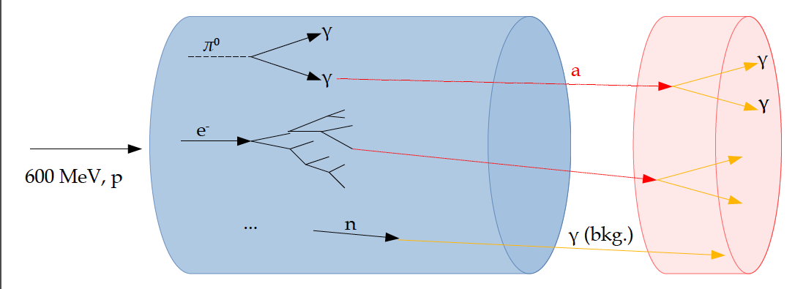
DAMSA Experiment Signature
Beam

Slide 7
DAMSA Experiment Requirements
Focus on Axion-like particles (ALP) search through their two- photon final state via the Primakoff process
Produce as many photons as possible in the beam source, namely the dump
Capture as many ALPs as possible in as wide a mass range as possible

Slide 8
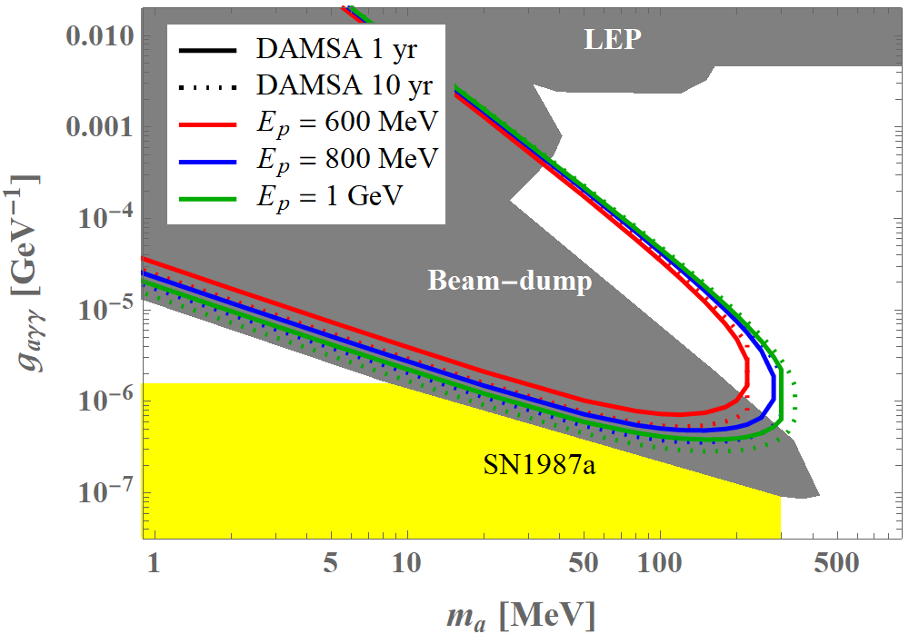
Expected DAMSA Sensitivity
Short lived! ➔ Capture decay products b4 det.
Long lived! ➔ Capture decays in the detector
DJK’s talk

Slide 9
DAMSA Experiment Requirements
Focus on Axion-like particles (ALP) search through their two- photon final state via the Primakoff process
Produce as many photons as possible in the beam source, namely the dump
Capture as many ALPs as possible in as wide a mass range as possible
Shorten the distance from the source to the detector
Increase the detector angular coverage
Minimize the background from neutral particles
Neutron spallation → accidental photon overlaps
Neutrino NC and CCQE interactions ➔ produce π⁰→ 2γ

Slide 10
DAMSA Exp. Concept – II
Inject and absorb as many low-E (1GeV or less) proton beam particles in the dump as possible
Allow higher mass ALP’s to decay with as small number of neutrons which produce spurious photons as possible
Place the detector as close to the dump as possible on axis to expand the mass reach to higher mass region
Vacuum Decay Volume
L=10m
Detector
Proton beam
Moderator
W Dump
L=1m

Slide 11
DAMSA Requirements – The Beam
PIP-II LINAC’s 800MeV beam energy enables access to the tangible ALP mass range
Need to have as much beam as possible after the use of beams at all upstream experiments
~1x10²³ POT/yr was assumed in 600MeV physics study
~3x10²³ POT/yr for PIP-II 800MeV and 1GeV physics study
PIP-II CW beam characteristics
Bunch length: 1ns 8x10⁷ p/bunch
N_{p}/bunch : 8x10⁷ p/bunch
Bunch spacing: 6.2ns
PIP-II CW Chopping possibility?
μ−pulses w/ two 14x10⁷ p-bunches separated by 6.2ns and the next pair separated by 16.2ns, repeating every 22.4ns
Each μ−pulse lasts for 0.6ms spaced every 50ms ➔ I=2mA/μ−pulse

Slide 12
DAMSA Requirements – The Dump
What material on what depth would be most optimal?
Produce most photons per unit length
Produce least number of neutrons out the dump
Absorb most particles per unit length
GEANT4 based study shows 1m diameter, 1m long cylindrical shape tungsten dump (~10 nuclear interaction lengths) produce most photons and absorb ~99.995% 600MeV protons ➔ See WYJ’s talk
Neutrons produce additional photons in the dump, providing additional source for ALP

Slide 13
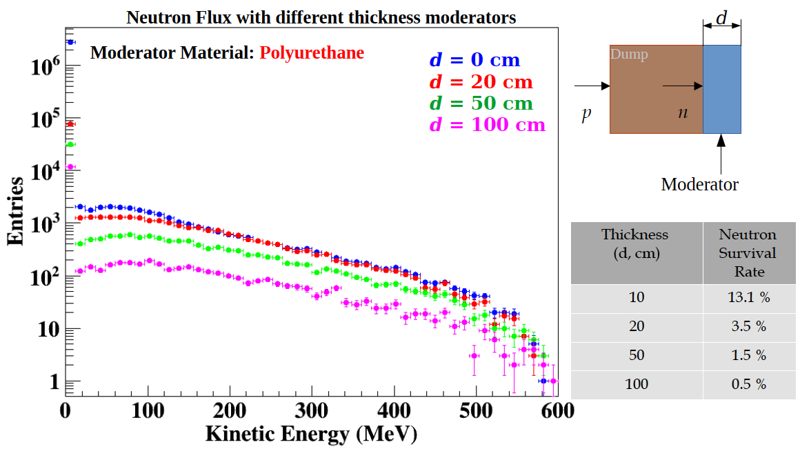
DAMSA Requirements – The moderator
Need to further reduce the number of neutron background
What material at what depth for an optimal neutron moderation?
GEANT4 based study shows the polyurethane provide most cost-effective solution for neutron moderation

Slide 14
DAMSA Requirements – The Detector 1
What detector capabilities are needed to
Capture as many ALP’s as possible in as wide a mass range as possible
High mass ALP’s have shorter lifetime ➔ Need to be able to capture two photons from the ALP decays before arriving the detector
Low mass ALP’s live longer ➔ Allow them to decay and interact in the detector and capture decay products upstream of the detector as much as possible
Reject accidental backgrounds from neutron spallation in the detector
Reduce the materials upstream of the detector for neutron to interact
Place a large decay volume in vacuum to fill the gap between the dump and the detector
Vacuum decay chamber w/ 0.6cm SS wall thickness assumed ➔ this may have to be thicker
Allows high mass ALPs to decay ➔ giving clear vertices where the two final state photons originate from
Neutron interactions confined to the decay chamber walls

Slide 15
DAMSA Requirements – The Detector 2
What are other possible ways to further reduce the background from neutron spallation? ➔ Aim to reduce by order >=10¹⁰
Leverage the speed of the neutron ➔ Neutrons are 10 – 1000 times heavier than the ALPs, thus for the given momentum, the arrival time of the neutron induced photon accidentals would be slower than that of the ALP’s
Leverage the distance of the closest approach of the two photon traces
Requiring the traceback of the overlapping two photon momentum sum be inside the dump
Invariant mass of the two photon momenta be within the interested mass range
Arrival time difference between two photons
A large number of neutrons have low kinetic energy ➔ Require the photon energy to be greater than 5 MeV

Slide 16
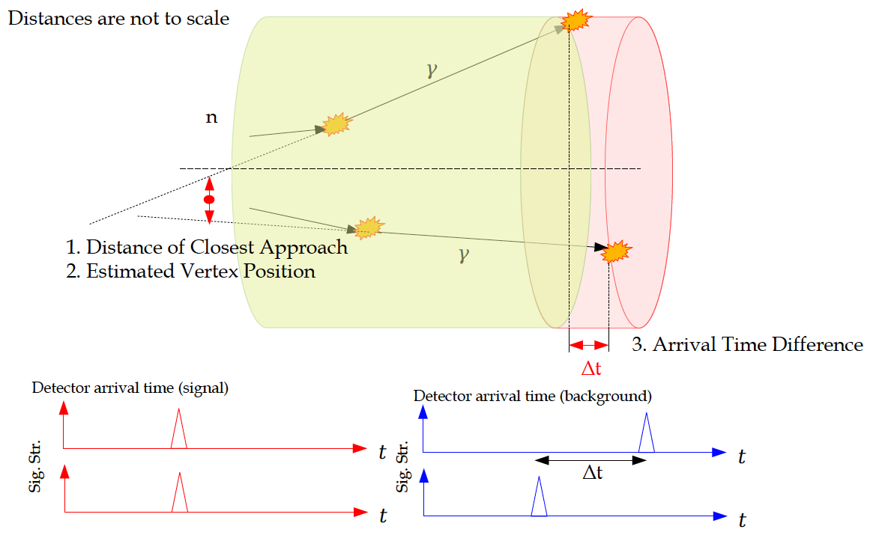
DAMSA Requirements – The Detector 2

Slide 17
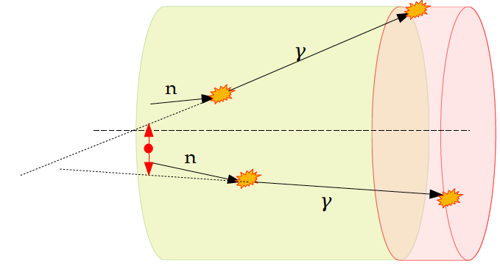
DAMSA Detector – The γ pair traceback
Require two photon track trace back position be inside the dump perimeter
2x10⁻² of γ pairs remain
Before cut
in unit of m
After cut
in unit of cm
100 cm

Slide 18
DAMSA Detector – Invariant Mass
Optimize the selection based on the interested mass range
Could obtain an additional reduction factor of 10⁻³ depending on mass range
ΔM_{Inv} (MeV/c²)

Slide 19
DAMSA Detector Requirements
Based on the concept studies using GEANT4 and neutron background rejection studies ➔ The detector must be
Capable of measuring up to 500 MeV photons with a MeV or better mass resolution
Fine granularity for superb shower position (1cm or better) and angular resolution
Fast timing capability, ideally at the sub-ns (100ps or better) level resolution

Slide 20
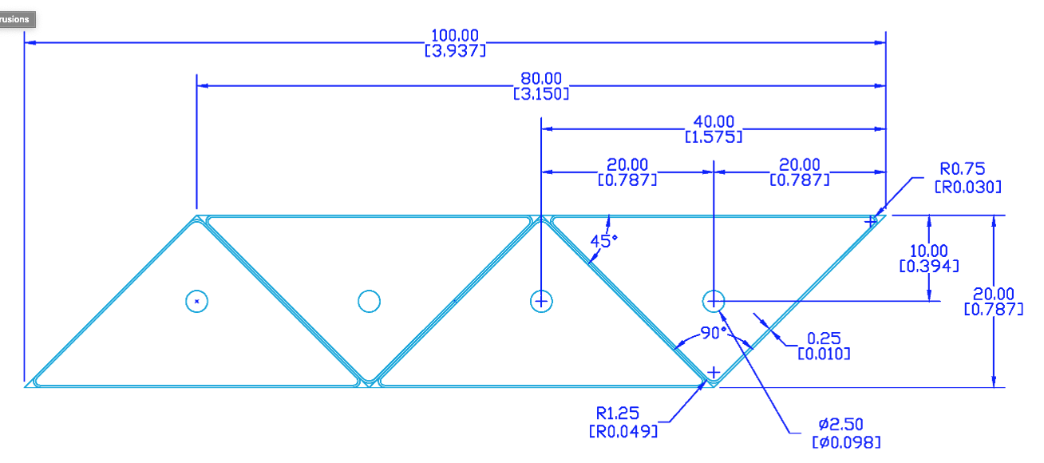
Potential DAMSA Detector Technology
A total absorption EM calorimeter
Sufficient depth to absorb photons up to 500MeV
Need further optimization for low mass ALP decays
Crystal or scintillation counter with fine lateral and longitudinal granularity
A thin (<5cm) triangular pixels with a fast photon detector attached to the pixel
Lateral and longitudinal granularity
SPAD, MCP, Hybrid SiPM, etc
Requires detailed study to develop the most optimal detector for the physics

Slide 21
Potential DAMSA Experiment Timeline
2029: Complete the detector construction and start commissioning for data taking
Request 1 – 3x10²³ POT total
2025/2026 – 2028: experiment construction
2024 – 2025/2026: experiment approval and project establishment
Jan. 2024: Submit the DAMSA proposal to PAC
Form a team (proto-collaboration?) to prepare a proposal
Physics goals and sensitivity reach
Detector design and rough cost estimates
Internationality would be important – Korean colleagues

Slide 22
Conclusions
DAMSA searches for dark sector particles in the unexplored mass regime
DAMSA can take fully advantage of the PIP-II facility
A significant level of detailed studies have been performed
Many experimental parameters and requirements rather well understood but still real R&D needs to be carried out
Need to put together a team to transform a concept into an experiment

