Slide 1
IOTA Proton Injector Update
Dean (Chip) Edstrom
04/14/2023

Slide 2
Source HV Enclosure Update
HV Enclosure components connected to Aux Chassis
✔ Ready to connect to the PLC and begin checkout (Extractor HVPS loaned out…)
Remaining Items
✔ Replace patch fiber in Aux Chassis (Greg Brown & Chip)
✔ Route Fiber for patching into the HV Enclosure in/around Source Test Cage (Chip)
✔ Replace eyebolt with routing ring for AC & fiber (Daniel)
✔ Verify routes to HV Common & install fixtures for grounding (Chip)
✔ Install Arc Modulator Toroid (Daniel)
🕑 Install 24V relay switch for VAT Valve Control (backordered)
🕑 Install new fire detector (order canceled)
✔ Finish installation of HV Enclosure door interlocks & lighting
Once these are taken care of…
Move HV Enclosure into Source Test Cage
Make Source Stand adjustments:
Turn off the source vacuum
Measure and cut the HV Bridge
Connect HV Enclosure door interlocks / lighting through the Source Stand Interlocks box.
Run / measure / cut / connect source connection cables
Extractor / Magnet (incl. Fluorinert flow & klixon) / Filament / Arc Modulator / VAT Valve

Slide 3
Latest Developments
Installed Extractor Monitoring Toroid
Installed HV Enclosure Interface Panel
Loaned Extractor HV Power Supply to Jeff Simmons
Checking out spare Extractor Electronics
Wired HV Enclosure Door Interlocks
Still needed:
Fan to encourage air flow in HV Shell
HV Enclosure paneling for Source-side
Asking around for potential long-term 4-channel scope solution
4 channel, 100 MHz…

Slide 5
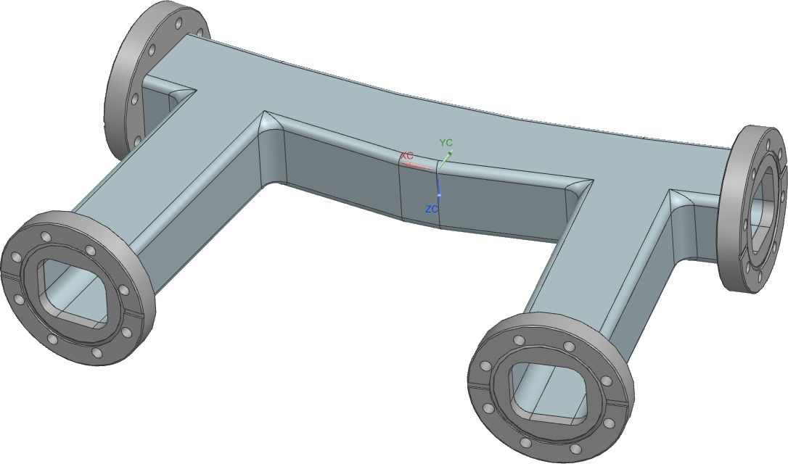
IPI Big Ticket Items
Electrical Contract / Cable Pull: $95k (T&M, not IDIQ…)
IPI LLRF Control Upgrade: $24.7k
Bend Dipole Vacuum Chambers: $25.6k
$12.8k each for D330 / D340
MEBT Girders / Stands: ~$25k?
Anything else?
Scanning Wire Replacement?
LEBT Scraper Replacement?
Scraper?
Wires?
Einzel Lens?
RFQ Repair (~$100k)?
Misc (Vacuum crosses, Welding, etc…)

Slide 6
Support
Safety
Source Commissioning
PPD
T&M Contract
Mechanical Support
Numerous engineering notes
Controls
EPICS Integration
IRM Installation
RF / EE Support / Instrumentation
RF Controls / Interlocks

